Slide 1
PIA 2528
Governance, Local Government and
Civil Society:
INSTITUTION BUILDING, CONFLICT AND GOVERNANCE

Slide 2
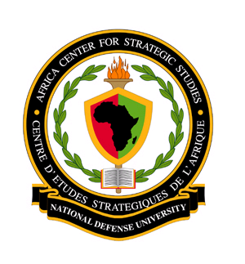
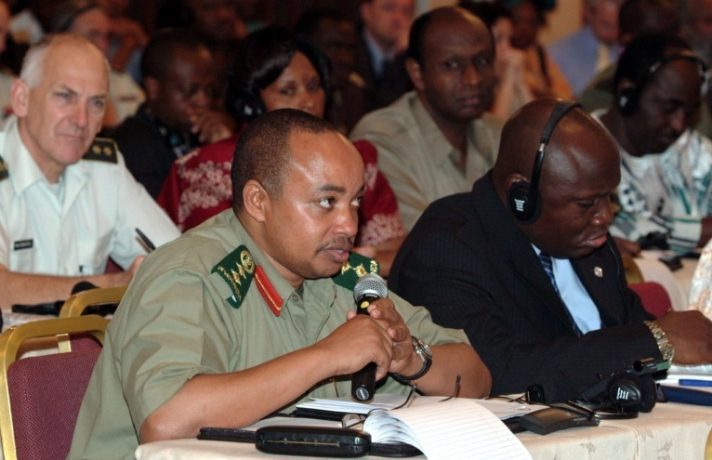
Governance and Security
Bilateral Aid, Governance and the Three D’s:
Defense, Diplomacy and Development

Slide 3
National Defense University
Note: This Presentation was originally made on July 10, 2007 at National Defense University, Fort McNair, Washington D.C. but has been modified over the years.
Focus of Original Presentation: The Creation of the African Command (AFRICOM)
The Views Presented here do not reflect those of the National Defense University, the Department of Defense or the United States Government

Slide 4
Overview: Seven Themes in Governance, Foreign and Security Policy
I. Conflict Prevention and Management
II. Conflict and Peace Making
III. Peacekeeping and international organizations

Slide 5
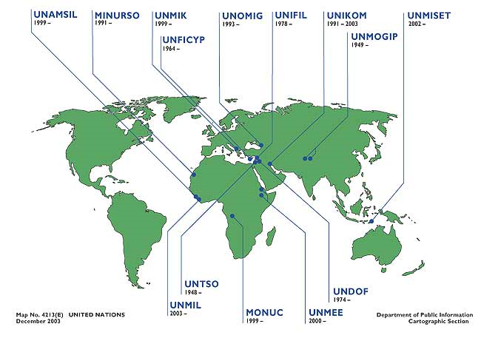

Slide 6
Themes- Continued
IV. Terrorism and Counter-terrorism
V. Post-Conflict Governance
Foreign Aid and Foreign and Security Policy
Theme: On the Ground Governance

Slide 7
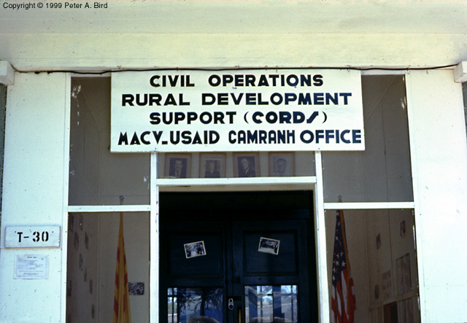
CORDS—Civil Operations and Revolutionary Development Support in Vietnam
MACV-CORDS Office in Ba Ngoi
Military
Assistance
Command
Vietnam.

Slide 8
Three D’s on the Ground
Provincial Reconstruction Teams Teams in Iraq and Afghanistan

Slide 9
I. Conflict Prevention and Management
Community based conflict mitigation
      Role of indigenous leadership and traditional
      conflict mediation
      Land, social rights and behavior
      Joint Traditional and Local Government Mechanisms
      Leadership (cadre) modalities (The Mandela Model)
Traditional Justice vs. Political institutions
Governance and Development- The Institutions Issue and Elites

Slide 10
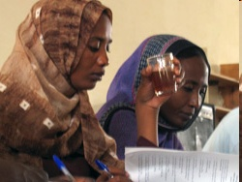
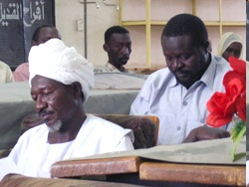
Conflict Resolution in the Sudan
Conflict Resolution
"We drew upon traditional conflict resolution techniques”
Research by Germaine Basita
GSPIA PhD Student

Slide 11
Indigenous Methods of Conflict Mediation
      Small Scale: Problem of ratcheting up and reconstructing institutions
      Problem of collapsed and failed states
      National Identity Challenges- Leadership Modalities
      Survival of Traditional Institutions

Slide 12

Traditional Ceremony REAL DE
CATORCE, Mexico

Slide 13
II. Conflict and Peace Making- Different Modes
Wars of Liberation- South Africa, Algeria, Lusophone Africa (Victory or Stalemate and Negotiations)
Civil Wars- Ethnic and Religious “Cultural Pluralism”- Sierra Leone, Liberia, Sudan. Burundi and Rwanda (Mediation and Peacemaking)
State Collapse- Somalia and DRC
International Conflict- Now rare- Proxy Wars YEMEN and
SYRIA
II. Conflict and Peace Making- Different Modes

Slide 14

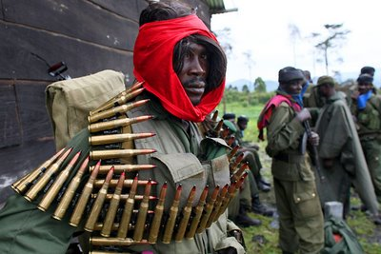

Slide 15
Other Conflicts: Role of Mediation
Congo (DRC & Ethiopia)
Eastern Europe and Caucasus- Yugoslavia, Georgia, Chechnya, Azerbaijan
Asia- East Temor, Kashmir, (India and Pakistan) Afghanistan
Middle East- Iraq, Palestine
UKRAINE?

Slide 16
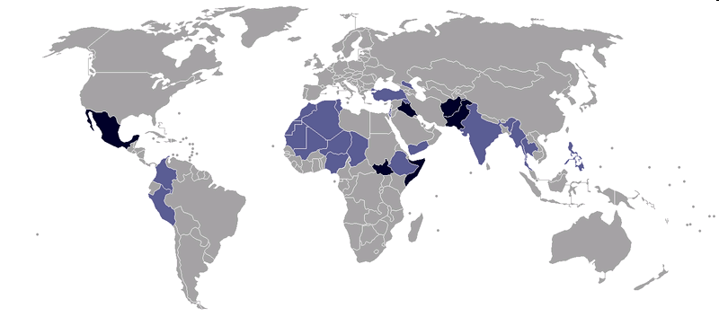
Conflicts: 2009

Slide 17
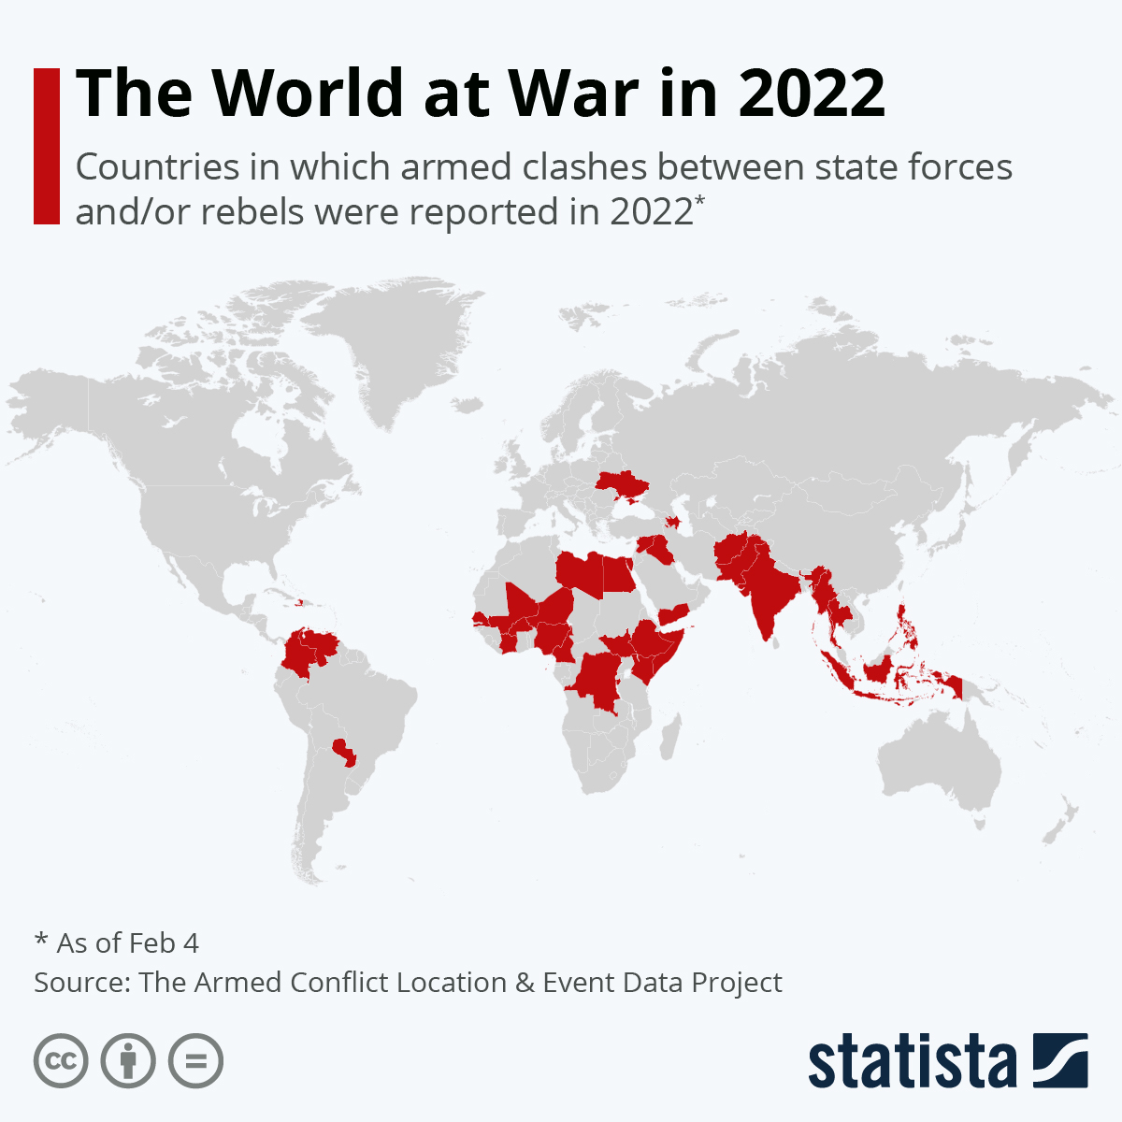
CONFLICTS 2022

Slide 18
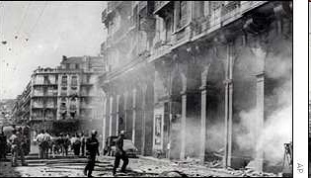
Image: Algerian Civil War 1954
THE FIRST MODERN WAR

Slide 19
Different Modes of Conflict
Economic Conflict- poverty and organized crime (Post-Apartheid South Africa, Kenya, Somalia)
Regional conflicts- DRC, Namibia/Angola and Liberia/Sierra Leone (International Negotiations and Peace Making), Syria and Ukraine

Slide 20
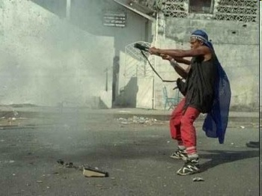
Liberian Civil War

Slide 21
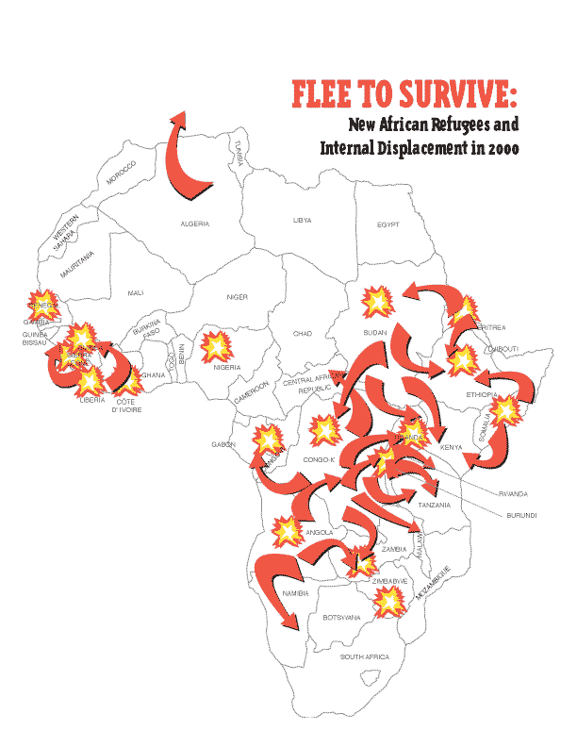
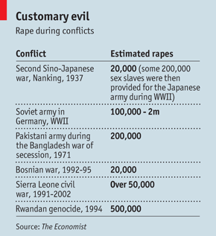
War and Refugees

Slide 22
III. Peacekeeping and international organizations- Issues
  Northern State mechanisms: NATO and EU
  Regional: African mediators (ECOWAS,SADC)
  Unilateral vs. Multilateral (U.S., France and U.K.)
  Quartet: U.S., Russia, UN, EU

Slide 23
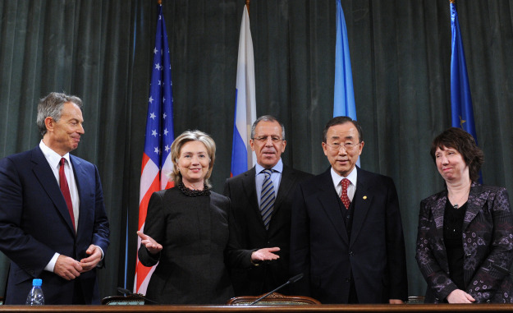
The Middle East Quartet: Russia, US, UN and EU
From left, former British Prime Minister Tony Blair (special envoy for the "quartet" on Middle East peace), Secretary Clinton, Russian Foreign Minister Sergei Lavrov, U.N. Secretary-General Ban Ki-moon, and EU foreign-policy chief Catherine Ashton

Slide 24
Peacekeeping and international organizations- Issues
  Multi-lateral and bi-lateral- Continental vs. International
  Regional Groups: ECOWAS, Africa Union, ASIAN, Mercasor, EU
  United Nations Peacekeeping vs. Monitoring vs. Conflict control (Rules of Engagement)

Slide 25
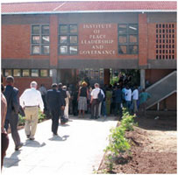
Peacekeeping and international organizations- Issues
  Role of “proxy” states/armies (Ethiopia)
  Impact of Foreign and Military assistance Programs (Ukraine, Horn, Sahel and War on Terror)
  Special Role: Mediation Centers (Institute of Peace, Leadership and Governance at Africa University, Zimbabwe

Slide 26
IV. Terrorism and Counter Terrorism. Is it an Issue?
Terrorism and Counter-terrorism (Includes regional, sub-regional, national and sub-national levels of activity) – U.S. and Europe
Global vs. non-global (eg. Lords Resistance Army?)
How Relevant to LDCs and the North South Debate?

Slide 27
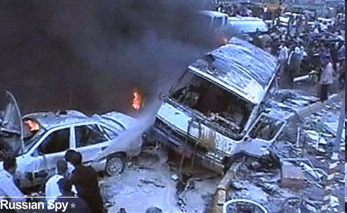
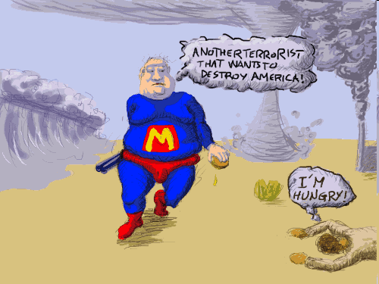
North vs. South?

Slide 28
Sector Reforms and Counter-Terrorism
Legislation, Finance, Border Security (including passports and travel documents Control)
Police, military and security, combating ideological Support for Terrorism
Strengthening Traditional Leadership
Information and Intelligence and International Cooperation

Slide 29
Sector Reforms and Counter-Terrorism
Evolution of U.S. CT Policy in Africa Since September 11
Impact of ethnic and religious identification on Terrorist threats
Challenges of parallel governance: The “Arab Spring” (Egypt, Levant, North Africa)

Slide 30
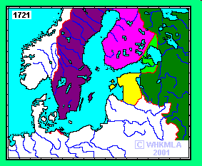
Ethnic Conflict is not new: Northern Europe in 1721

Slide 31
Regional Threats (Africa)
The threat of Collapsed States and crime- Diamonds, Drugs, guns (Guinea Conakry)
Paramilitary Violence (Great Lakes/Congo)
Organized Crime, and Piracy (Air, Land and Sea)- Indian Ocean and Gulf of Guinea (Naval Pods)

Slide 32
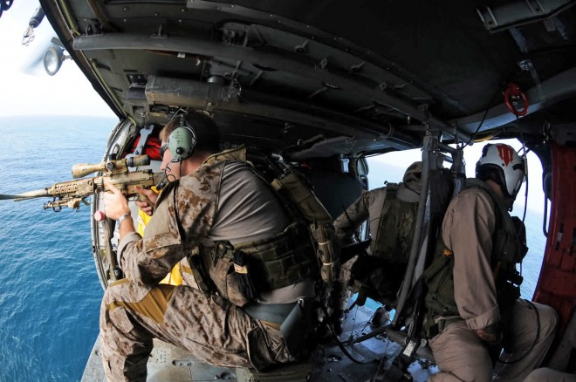

Slide 33
V. Post-Conflict Governance
      The Role of Negotiated Pacts
      Truth and Reconciliation vs. Justice
      International Courts Issues

Slide 34

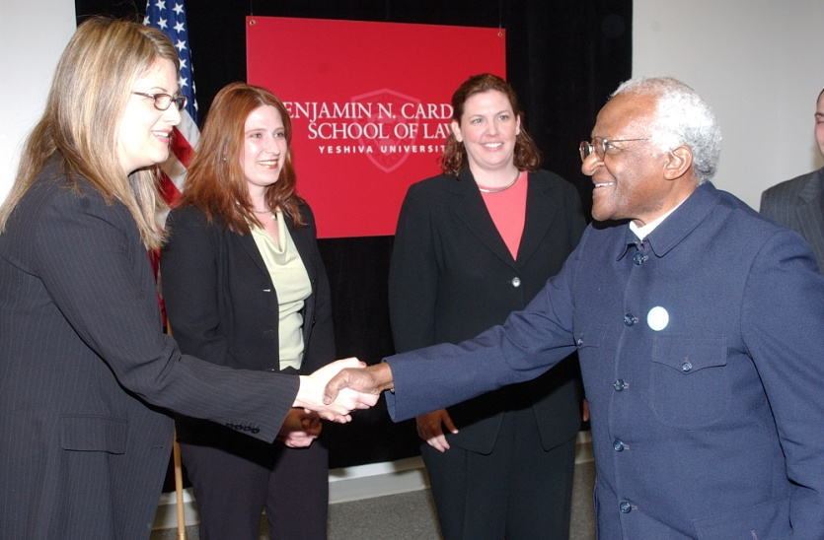
Liberian Truth and Reconciliation Commission
Conflict Resolution
vs.
Justice
Bishop Desmond Tutu

Slide 35
Post-Conflict Governance
      Demilitarizing societies
      State Rebuilding and Institutional Development
      Democracy and Governance
      From Failed States to Fragile States and Beyond
      Ending Marginalization and Hiddenness

Slide 36
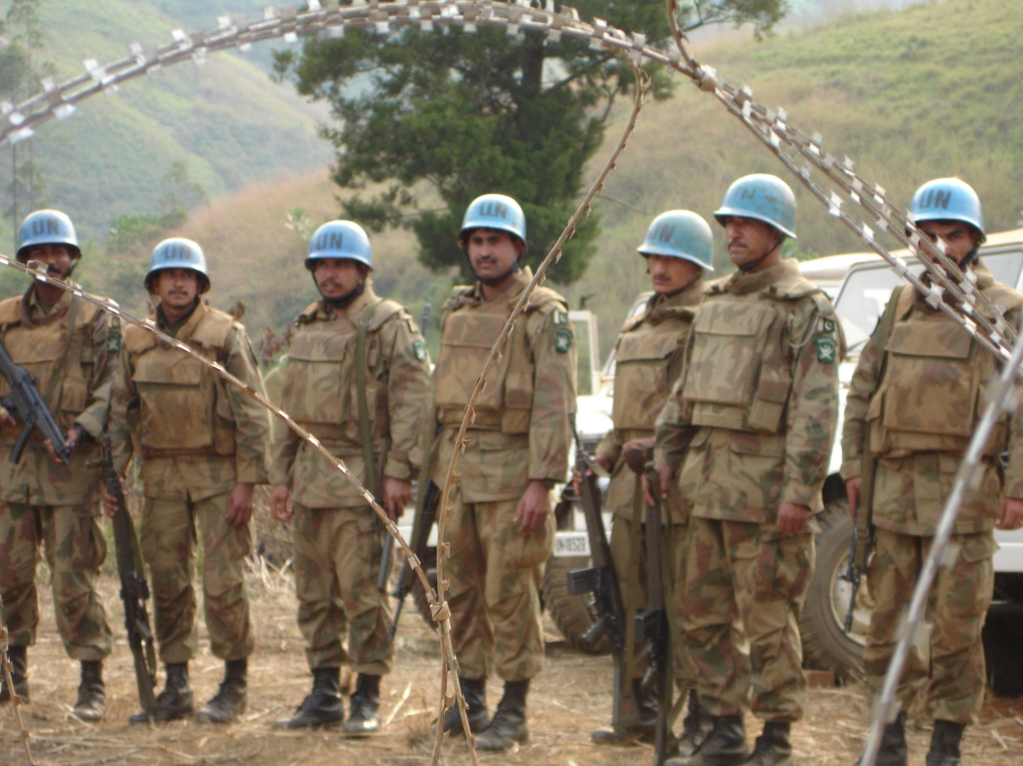
Nation-Building, United Nations Style

Slide 37
VI. Foreign Aid and Foreign and Security Policy- Two Views
1. So Called “Whole of Government” Approach- The Method
2. Historical Debate about “Hearts and Minds”- The Problem (Russia vs. Ukraine is the newest example)

Slide 38
“Whole of Government”
      3. Focus: Diplomacy, Development and Defense
      4. Usually Add Information/ Intelligence, Trade and Finance, Environmental, etc.

Slide 39
Whole of Government Countries:
Extent of Integration
Scandinavia
Canada
U.K.
Australia
France
U.S.

Slide 40
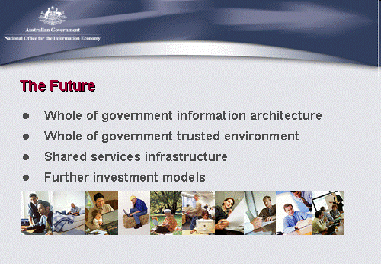
Australia

Slide 41
“Whole of Government”
        Definition:
        Integrated Approach to Conflict and Post-Conflict Situations in Fragile States

Slide 42
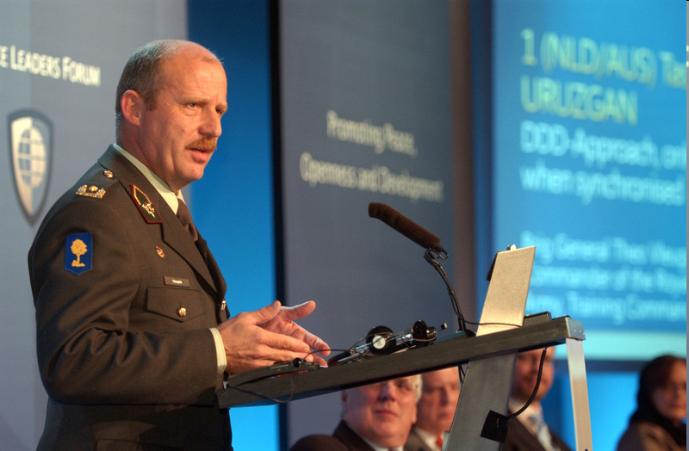
Netherlands
“Development, Defense and Diplomacy should be the three legs of any stabilization operation, says the recently returned commander of the first Netherlands-Australian Task Force in southern Afghanistan.”
Brigadier General Theo Vleugels, of the Royal Netherlands Army

Slide 43
“Hearts and Minds Debate”
“Hearts and Minds”
Phrase Widely Used re. AFRICOM-
Development Linked to Ideological Change- Rural Development, Collective Villages, Militias
Five “Classic” Variations

Slide 44
“Hearts and Minds” Five Examples
a. Origins- Malayan Emergency- (But Not Kenya)- Malaya Only clearly agreed upon Success re. “Hearts and Minds.” Next three failed to meet “goals”
b. French Military Theory- Best Represented in debates about Indo-China not Algeria
c. U.S. Goal: Vietnam- “Third Force” (Quiet vs. “Ugly” American literary image)

Slide 45
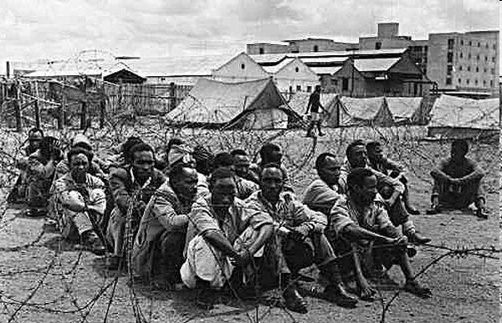
Kenya

Slide 46
“Hearts and Minds” Examples
WHAM- “Winning Hearts and Minds” P.W. Botha- So-Called “Total Strategy”
Not a Happy Memory
Cold War- Successfully ended (1948-1989).
Iraq and Afghanistan
Ukraine

Slide 47
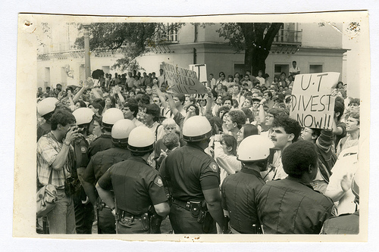
South Africa; Battle for Hearts and Minds

Slide 48
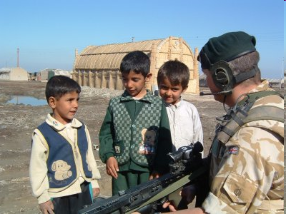
Iraq

Slide 49
Whole Government vs. Hearts and Minds in AFRICOM
Issues: Geographic Command
a. Original Cold War- Focus re. Hearts and Minds was on States. Key- Political Leadership was Coordinating
b. Now since 2001, there is a perception “World Wide” re. U.S. that there is military and security which is driving Reginal Groups- Focus: Non-State Actors (Terrorist Groups) and Community Loyalty

Slide 50
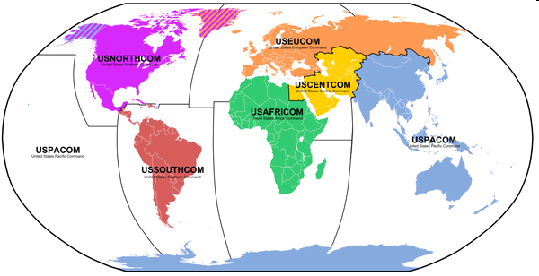
Issues: Geographic Command

Slide 51
Whole Government Clearer: Focus on Implementation Problems:
a. Blending the Three Ds- People and Finance (Stovepipes and Staying in your own lane)
Non Defense Budgeting Limitations
Budget imbalance- State/USAID vs. Defense
Joint Activities- Controversial eg.
Provincial Reconstruction Teams (PRTs)

Slide 52
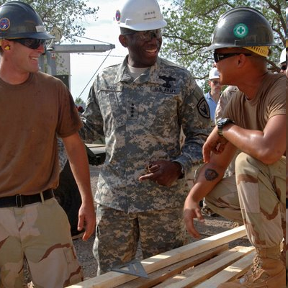
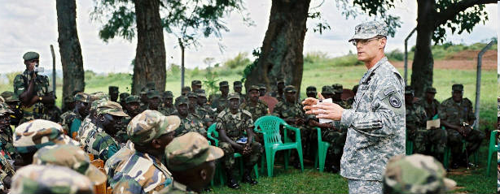
AFRICOM
Winning Hearts and
Minds

Slide 53
Implementation Problems
b. DFID vs. USAID in terms of resources (Development vs. Security)
c. Role of “Conflict/Post-Conflict Financial Pool” –Jointly Managed, so called “Inter-Agency Doctrine”
d. Role of Contractors and NGOs

Slide 54
The Current Debate Re. AFRICOM
1. Location of Leadership- subordination of civilian leadership to military command
2. New Targets- Direct linkup between security system and non-state actors. How this will work?
3. Issue: Is Primary Concern “fragile” states or “international terrorism”
4. Is definition of Fragile States important?

Slide 55
The Current Debate Re. AFRICOM-2
5. Physical location- Organizational location: Europe vs. Africa (Symbolic)
6. Military- no single big base possibly an Office (change from current situation only incrementally) –pods and mobile forces
7. Military Policy- Non-issue in the sense that it changes a name and integrates the horn and Indian Ocean islands into the rest of Africa and breaks Africa off from Europe organizationally, a legacy of the colonial paradigm
8. Symbolism- “Re-colonialization of Africa”
9. Africa and the G-20

Slide 56
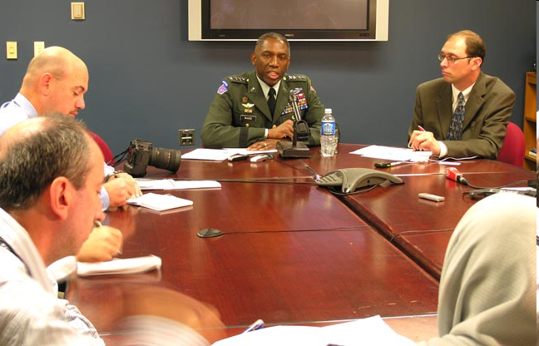
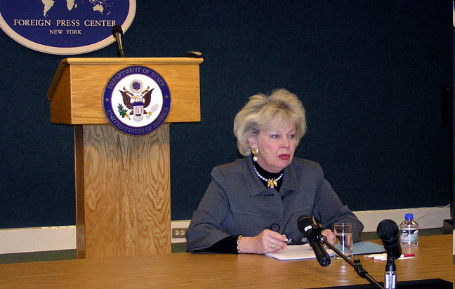
2007 AFRICOM Commander General William E. Ward and Ambassador Mary Carlin Yates, Deputy to the Commander for Civil-Military Activities, U.S. Africa Command

Slide 57
Conflict and Post-Conflict Governance
Key Role: National Level- Coordinating & the Responsibility of Chief of Mission- The Ambassador and DCM
This Coordinating Role may need to be addressed within the context of:
1. Relationship with Regional Association
2. Regional Economic Commissions
3. Addressing issues of Governance

Slide 58
The Current Debate Re. AFRICOM-3
8. Diplomacy and Development- Already linked State/USAID
  The Non-Security vs. Security Components: Not well articulated at this point
  Perception of Subordination at regional and sub-regional level to military commands
  Foreign Policy and Foreign Aid First

Slide 59
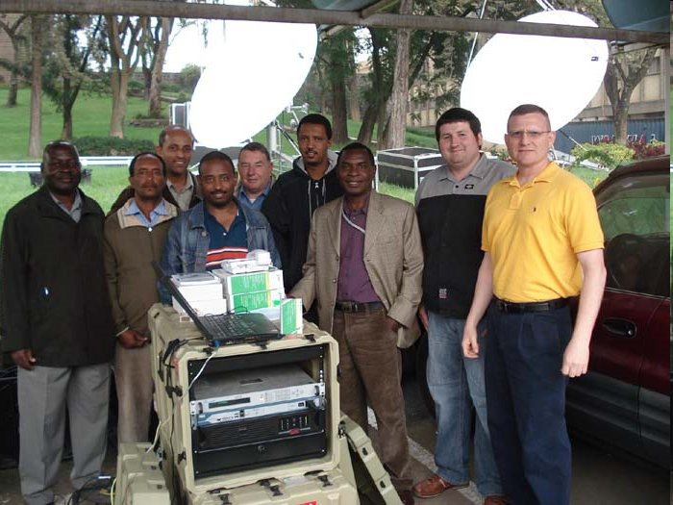
Technicians with African Union AFRICOM Trainers
AFRICOM: “Life after Iraq and Afghanistan for Dyncorp, Triple Canopy and Blackwater.”

Slide 60
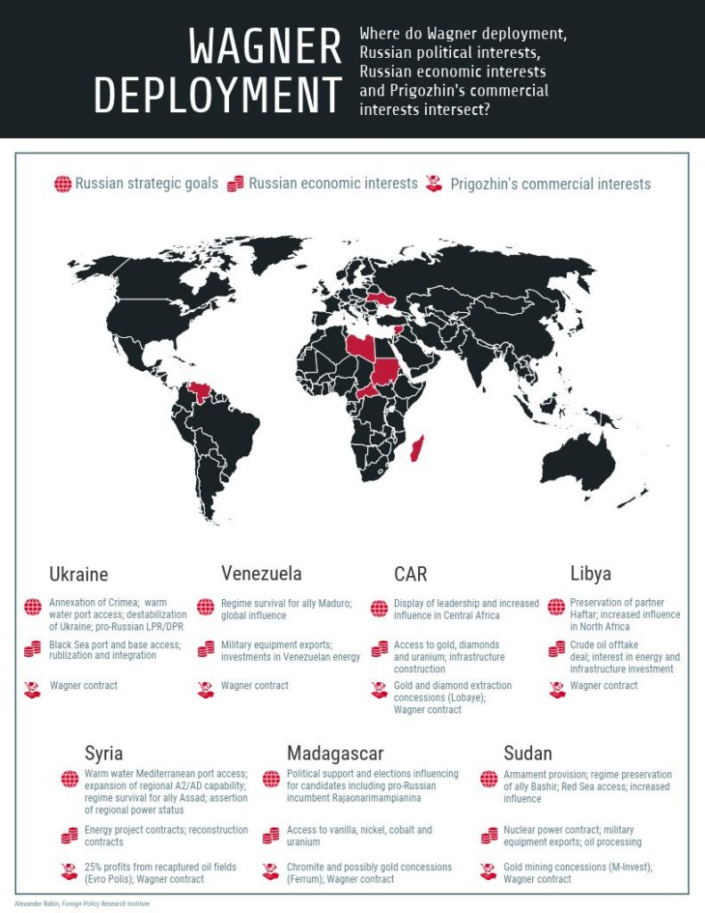
The Wagner Group

Slide 61
AFRICOM Picard Research Focus
Series of Studies of African Perceptions of AFRICOM and the Three Ds- (Triangulation Study)- Book with Kumarian Press
Research Interests: AFRICOM Book
  Coordinating Mechanisms
  Common Pool Resources
  Community Based Solutions (Elective and Traditional)
  Balance Development vs. Security Focus

Slide 62
DICUSSIONS/QUESTIONS/
CRITIQUE?

Slide 63
Newsreel Coverage of Mau Mau
British Pathe Report
VIDEO

Slide 64
Special Forces
The Three D’s Theory Defense, Diplomacy and Development
VIDEO

