Slide 1
PIA 2528
Governance, Local Government and Civil Society

Slide 2
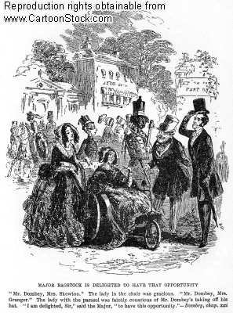
Introduction: (Please Introduce yourself)
Background
Interests
Future Goals
Why is Governance
important to you?

Slide 3
Overview-1: The Importance of Governance for Policy and Management
Basic Theme: Governance and Economic Development
Development management theorists and practitioners need to be careful that their formulas for social and economic change do not to do more harm than good.
Key: Balances

Slide 4
Overview-2 The Need for Balance
A balance exists between the extremes of the command economy and centralized planning on the one hand and the libertarian approach advocated by radical public choice theorists on the other.
Throughout, it is not possible to divorce economic and development issues from issues of governance and civil society. Nor can the debate and selection of policy choices be detached from the capacity of institutions to implement policy.

Slide 5

Command vs. Libertarianism:
The Need for Balance

Slide 6
The Course: Governance and Society: Private Sector, Ethics and Human Secuity
1. This course will attempt to define this balance by looking at issues of governance, local government, and civil society
2. In Latin America, Eastern Europe, the Middle East, South and Southeast Asia and Africa.
3. Compare it with North America, Western Europe and East Asia.

Slide 7
OVERVIEW DISCUSSION AND QUESTIONS ABOUT CLASS
PLEASE ASK QUESTIONS

Slide 8

We Work
Together

Slide 9

Course Materials
There are assigned readings. Each individual will have to decide how much and which readings are most important for him or her in any given week.
However, participants are expected to do additional reading each week especially targeting their second paper.
It will be assumed that if you have committed to DISCUSS something in your “plan” you are able to discuss it in class.
Clearly, mastery of the literature will be a major measure of how I assess your class performance

Slide 10
ASSIGNMENT
Two-Three Page Biography- Third Person and prepare a brief study plan based on this syllabus (Essay stating concerns, issues, questions).
Due: Next Week

Slide 11

Third Person Bio: Next Week
Background
Goals
Future

Slide 12
Course Materials: Discussion
The basic source of our understanding about micro-politics will be the reading list assigned below. It is lengthy and various.
The categories under which it is assigned are somewhat arbitrary and as we go along the re-examination of earlier readings will be essential when we get further into the course.
Because of the length of each week's reading assignment, it is essential that students keep up with the reading from week to week.
Failure to do so will result in academic "overload" as the course draws to an end.

Slide 13
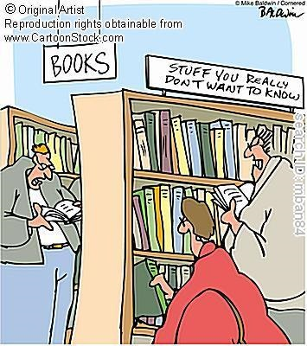
The Overload Problem

Slide 14
Course Requirements
DETAILED DISCUSSION OF SYLLABUS
Open Syllabus to Assignments section

Slide 15
Note: Syllabus
Detailed look at the semester.
1. Syllabus
2. Reserve Reading
3. Substitute Reading for class and
4. second paper

Slide 16
Key Dates:
1. January 19- One Page Bio
2. April 13- Oral Presentation and Presentation of Research Paper
3. April 20. Final Exam Due

Slide 17
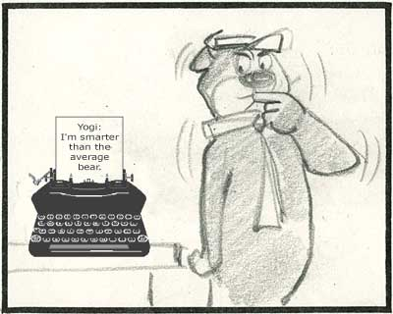
Course Requirements
Discussion
Questions
Clarification

Slide 18
Questions and Discussion
Note: Read Back
Next Week- Read materials listed in the syllabus for today.
?????

