Slide 1
JANUARY 28 PIA 2574 AFRICAN DEVELOPMENT SEMINAR: Conflict, Governance and Development
Introduction and Pre-Colonial History

Slide 2
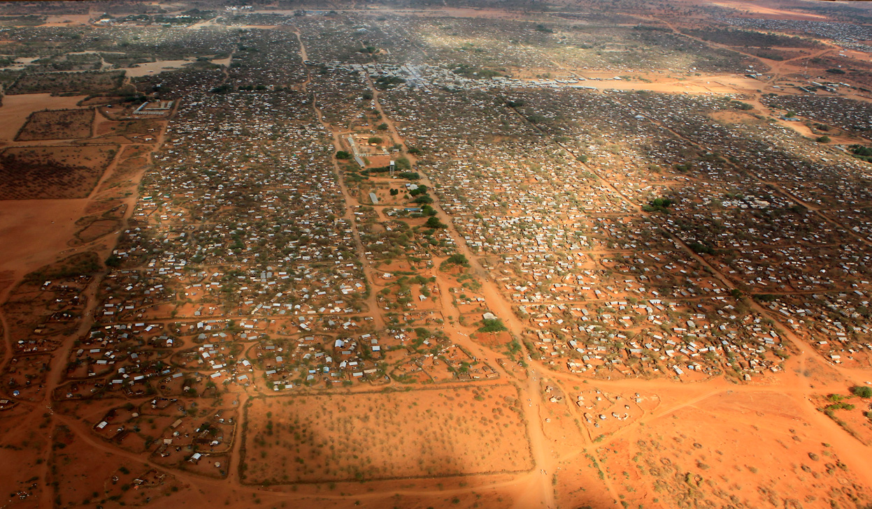
World’s Largest Refugee Camp, Dadaab, Kenya (500,000 people). Northern Uganda (1million) may now exceed it.

Slide 3
Part I: The Bottom Line
Poverty, Human Security and Conflict are a Key to the Issues facing Africa.
Art, Social Cohesion, and Creativity are also important.
Most People in Africa’s 54 states work, love, play and communicate (the continent of the ubiquitous cell phone). Africa “works”
The Important role of “Hybridity.”

Slide 4
The Goal? An African Middle Class Family in Lusaka, Zambia

Slide 5
Introduction and Overview of Discussion: Theories and Themes
An Overview of the Problem
Regional Failures
Geography and Natural Resources
Identity: People, History and Culture
Hiddenness and Marginalization
Political Systems and Institutional Collapse
Donor Fatigue and Dependence

Slide 6
DISCUSSION POINTS: History
Did Things Fall Apart?
Did Europe Under-develop Africa?
Should the Settlers Go Home?
Was Colonialism in Africa Different?

Slide 7
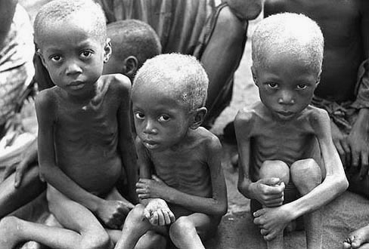
Hiddenness: The Key to Debate?

Slide 8
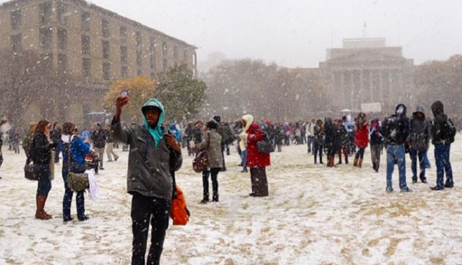
Stereotypes Johannesburg, August 7, 2012

Slide 9
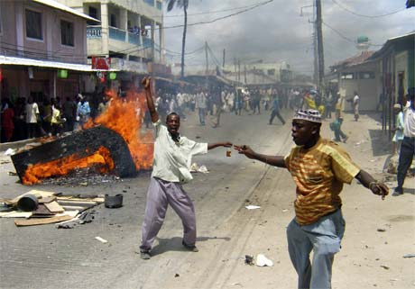
Stereotypes: The Image

Slide 10
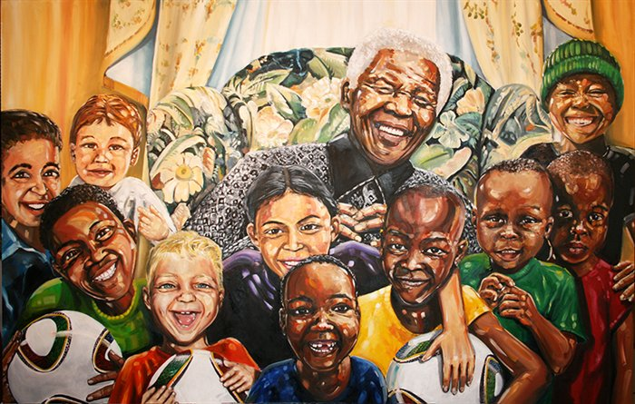
People, History and Culture
The Rainbow Nation Myth

Slide 11
Africa and Poverty
The Question is Why?

Slide 12
HISTORY: Fragmentation, Dependence and Conflict
HISTORY AND POLITICAL DEVELOPMENT
THE NATURE OF THE PAST
THE IMPACT OF COLONIALISM AND NATIONALISM

Slide 13
Pre-Colonial Africa

Slide 14
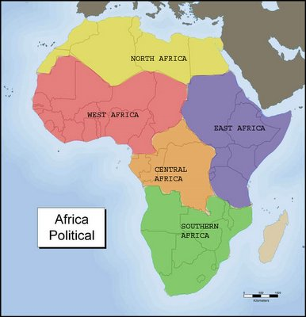
Fifty Four Countries?

Slide 15
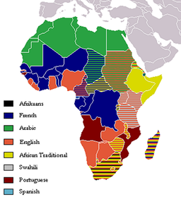
European and Trade Languages

Slide 16
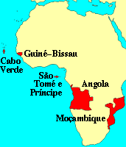
African Regions: The Language Issue
Francophone
Lusophone*
Horn of Africa
North Africa
Anglophone Africa
Southern Africa
South Africa

Slide 17
Regions and Integration: A brief Overview
An alternative future-Interlocking Regions-Combines Languages and Culture/History
Culture and Politics: Role of Language
1. North Africa- Arabic (Plus French and English)
2. Horn- Somali, Amharic, Tigrinya (Italian Legacy, inc. Libya)
3. Francophone and ECOWAS (The Problem of Anglophone West)

Slide 18
Regions and Integration:
4. SADC and Southern Africa: 15 countries. Alternative Free Trade Association of Eastern and Southern Africa. Lusophone vs. Anglophone (Special role: South Africa and Settlers)
5. The Great Lakes: Eastern and Central Africa as a style of governance: Uganda, Kenya, Tanzania, the Horn (Swahili)
6. Central Africa: Anarchy Zone? Former Zaire, Rwanda and Burundi

Slide 19
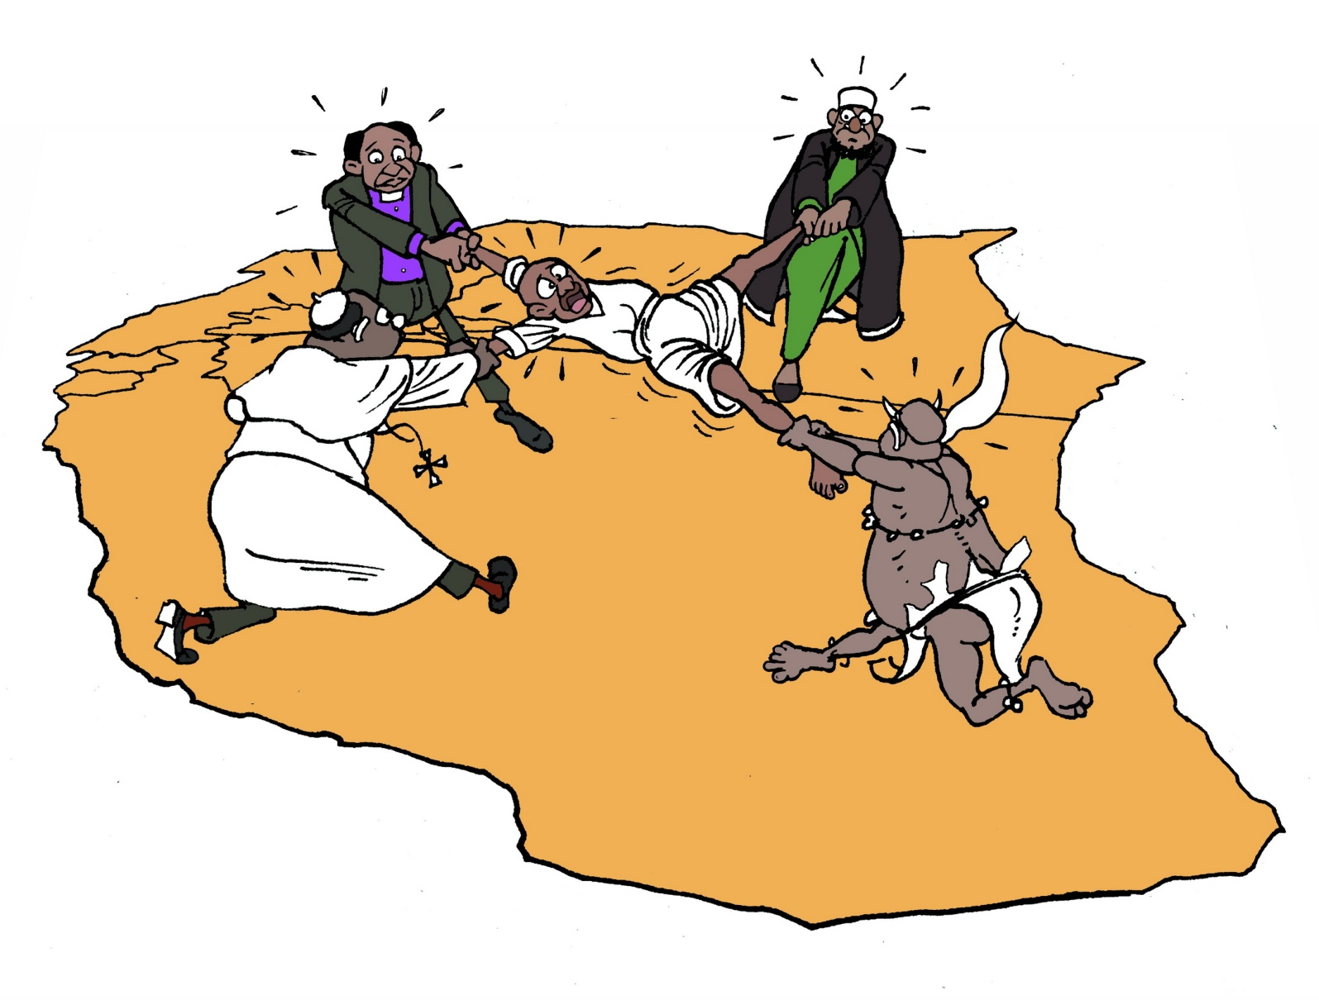
East African Regional Scenarios from Society for International Development (SID)

Slide 20
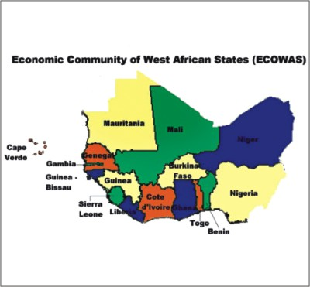
A Military Scenario sans Economics

Slide 21
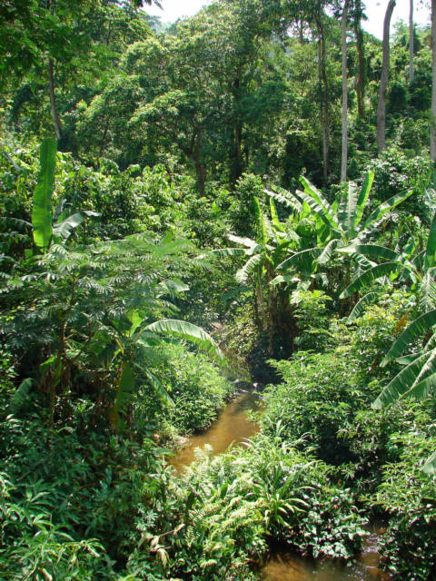
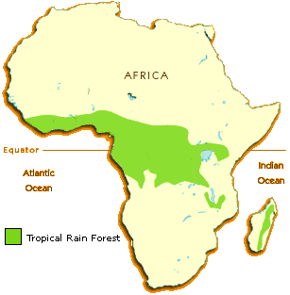
Environmental Issues: Most of Africa is not rainforest

Slide 22
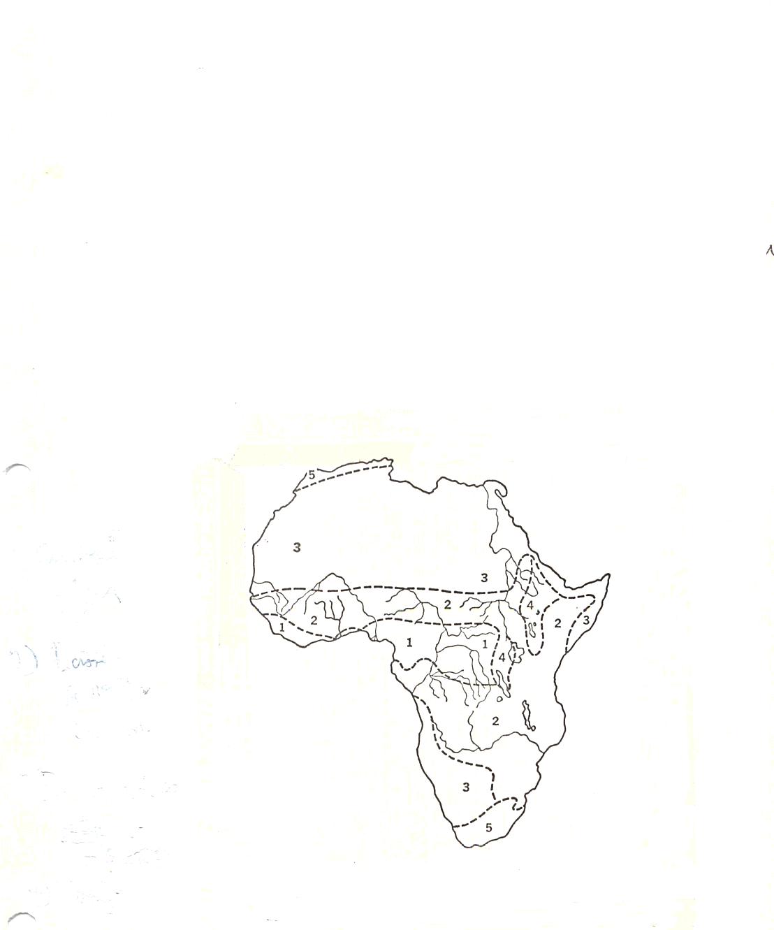
The African Continent

Slide 23
Africa: Climatic Regions
Tropical Rain Forest
Tropical Savanna and Summer Rain
Low Latitude Dry Climates
Undifferentiated Highlands
Mediterranean

Slide 24
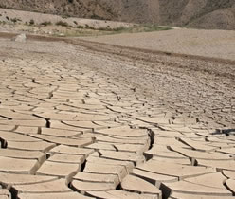
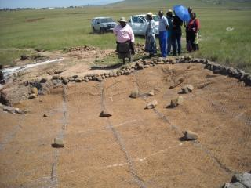
Geography
Tropical Soils
Desertification
Deforestation
Water Loss
Land Uses
Savannah vs. Rain Forrest

Slide 25
Regional Features
Rift Valley and Lake Systems
Deserts: Sahara and Kalahari/Namib
River Systems:
Nile
Niger
Congo
Zambezi
Volta

Slide 26
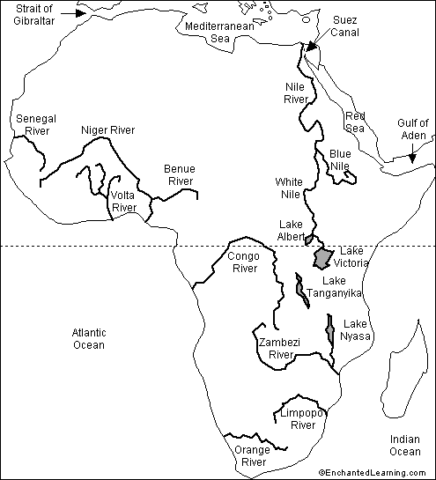
Big Rivers

Slide 27
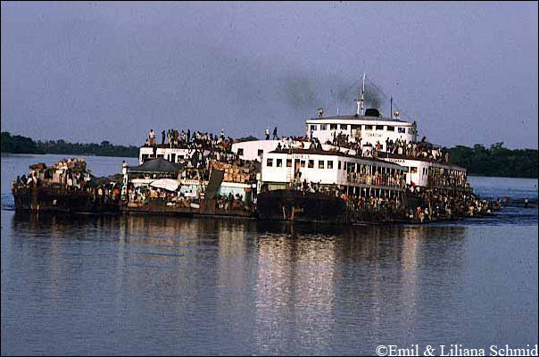
Congo River

Slide 28
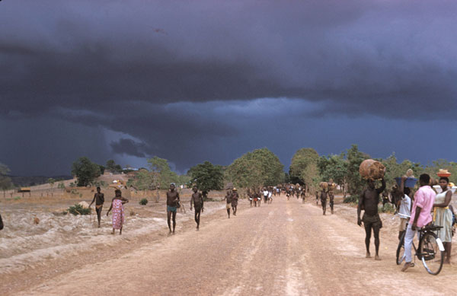

Slide 29
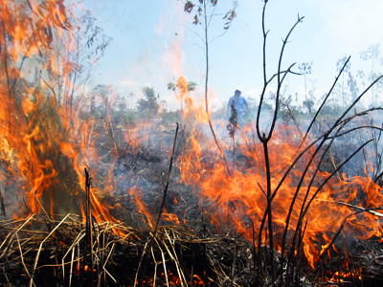
Patterns of Rain and Agriculture
Monsoon Tropical Rain
Alternating Wet and Dry
Deserts- Sahara, Namib, Kalahari
Shifting Agriculture
Slash and Burn
No Humus/regeneration of soil
Leaching: Nutrients and Minerals

Slide 30
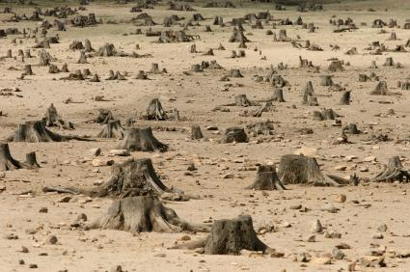
Deforestation

Slide 31
Natural Resource Curse: Elite Extraction and Corruption
Oil- Extraction and Short Term Benefits
Diamonds- Conflict and Blood Diamonds
Gold- Basis of Settler Wealth
Specialized metals: technology, phone and computers
Forests and natural resources
Wildlife

Slide 32
Natural Resources: The PROBLEM: Desertification
Overgrazing
The destruction of forests
Loss of Top Soil
Patterns of Cyclical Drought
Major Declines in Food Production

Slide 33
ISSUE: THE NATURE OF TROPICAL AGRICULTURE
Hunters and Gatherers (none or few)
Pastoralists
Subsistence Farming- roots, grain, Bananas
Cattle and Small Stock
Commercialization of Animal Husbandry and Agriculture
Land Use and Property Rights Issues

Slide 34
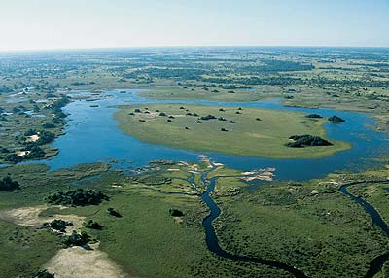
Okavango Delta

Slide 35
The Peoples of Africa

Slide 36
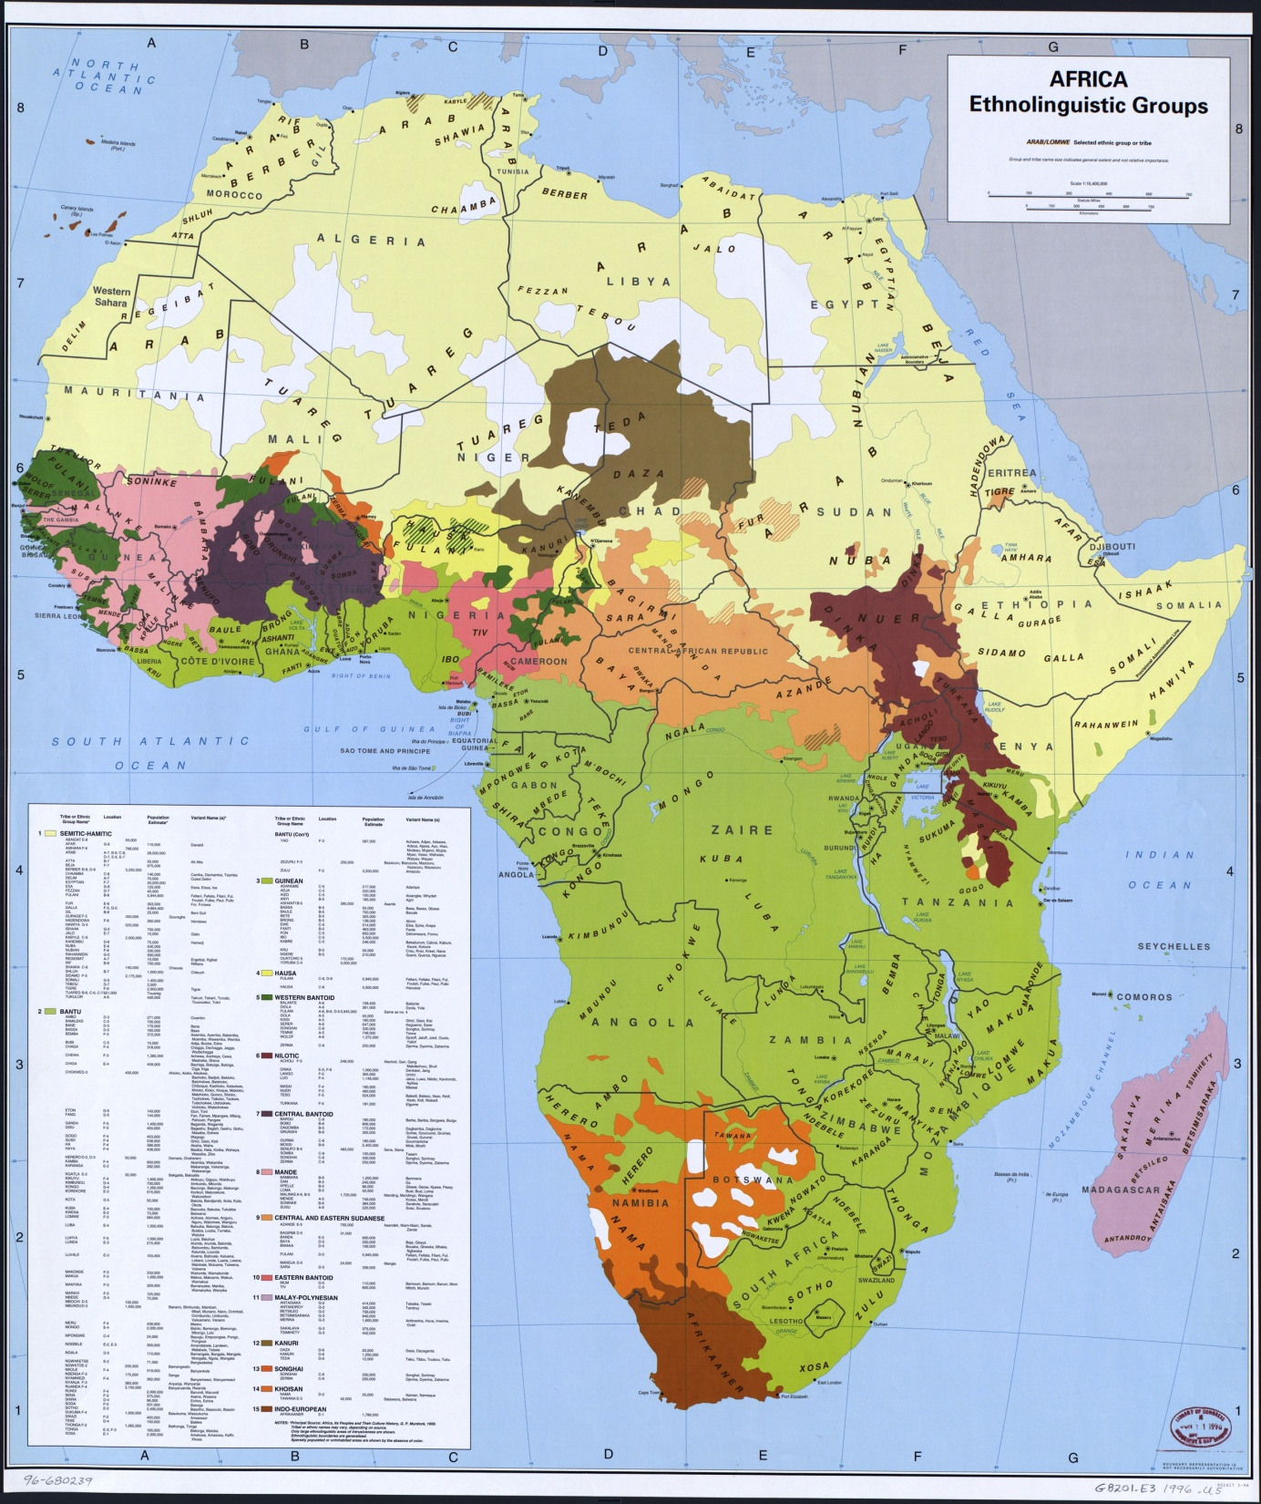

Slide 37
Eastern and Southern Africa
Khoisian 200 BC-1600
Bunyoro from 1300
Buganda from 1500-1800
Mwonomotopa1500-1800
Luba/Lunda 1500-1800
Zulu Empire and Dissolusion 1700-1850
Portugal 1600-1975
Afrikaners 1652-1994

Slide 38
San in Southern Africa

Slide 39
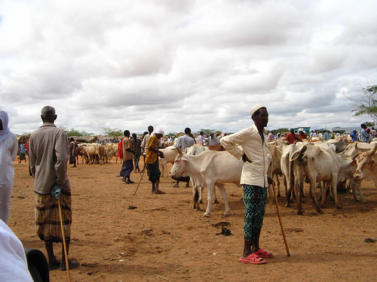
Somali Pastoralists in Northern Kenya

Slide 40
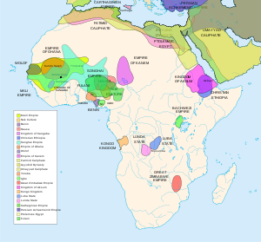
Iron Age Kingdoms

Slide 41
Pre-Colonial History: The Issue of Iron
Iron Age Sites
Meroe: 550 BC
Egypt: 600 BC
Carthage: 840 BC
Nok Culture (Nigeria): 200 B.C.
Axum and Ethiopia: 25 AD
Zimbabwe: 200 AD
Tzaneen (South Africa): 500 AD

Slide 42
History and Political Development The Nature of The Past
Role of oral history
Isolation from North Africa/Europe
African Historical Migration
Nature of Political Organization- "state vs. Stateless" systems
Impact of Slavery
Oral tradition vs. Written Language
Lack of Political Organization?

Slide 43
African Political Systems: The Problem of Institutional Collapse
Extended Family and Clan Systems: Hunter-Gatherers in Southern Africa and Somalia
Age Grade Systems- Ibo in Nigeria, Luo in East Africa and Kikuyu in Kenya
Kingdoms (State Systems)- Ethiopia, Yoruba, Buganda, Zululand and Swaziland

Slide 44
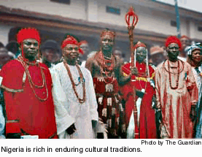
Age Grade Systems: circa seven years apart (A Generic Example)
Children
Youths
Circumcised Young Men
Warriors
Governors
Elders
Governing Age Grade

Slide 45
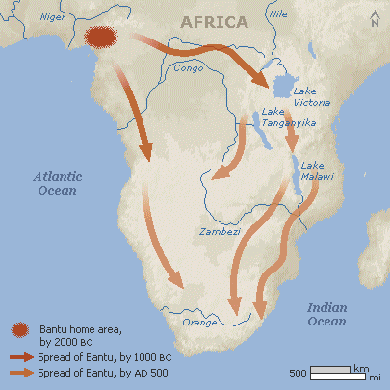
African Migration

Slide 46
African Migration-Theories
Movement From Northeast to South West
The Bantu Heartland idea
Indigenous Occupants: Pygmy, San, Khoisian, Nama
The Issue of so called “Mixed Race People”
Issue of Arrival in West and South Africa -1600 and 1653
Myth of Arrival: 1653
The importance of Carbon Dating

Slide 47
Pre-Colonial Polities- Principles
State vs. Stateless Systems
Not a dichotomy but a Continuum
Age Grade
Kinship
Lineage
Hierarchy/Bureaucratic (Weberian)
Hybrid Legacy

Slide 48
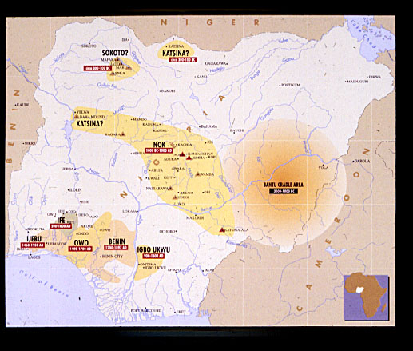
Nigerian Kingdoms

Slide 49
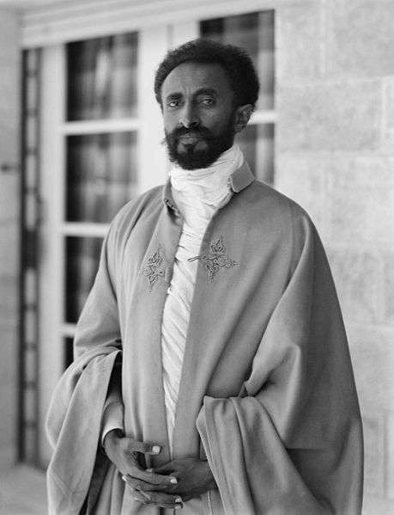
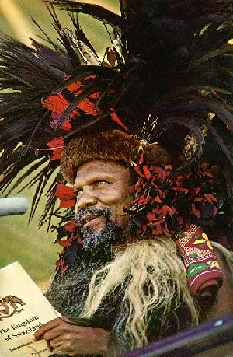
Haile Selassie of Ethiopia and Sobuza II of Swaziland

Slide 50
State Survival: Moshoeshoe I, King of the Basotho, 1796-1870

Slide 51
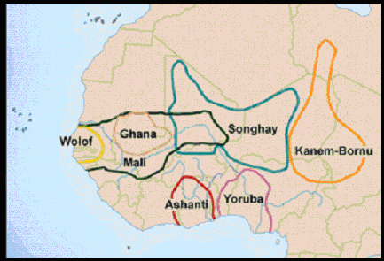
West African Kingdoms

Slide 52
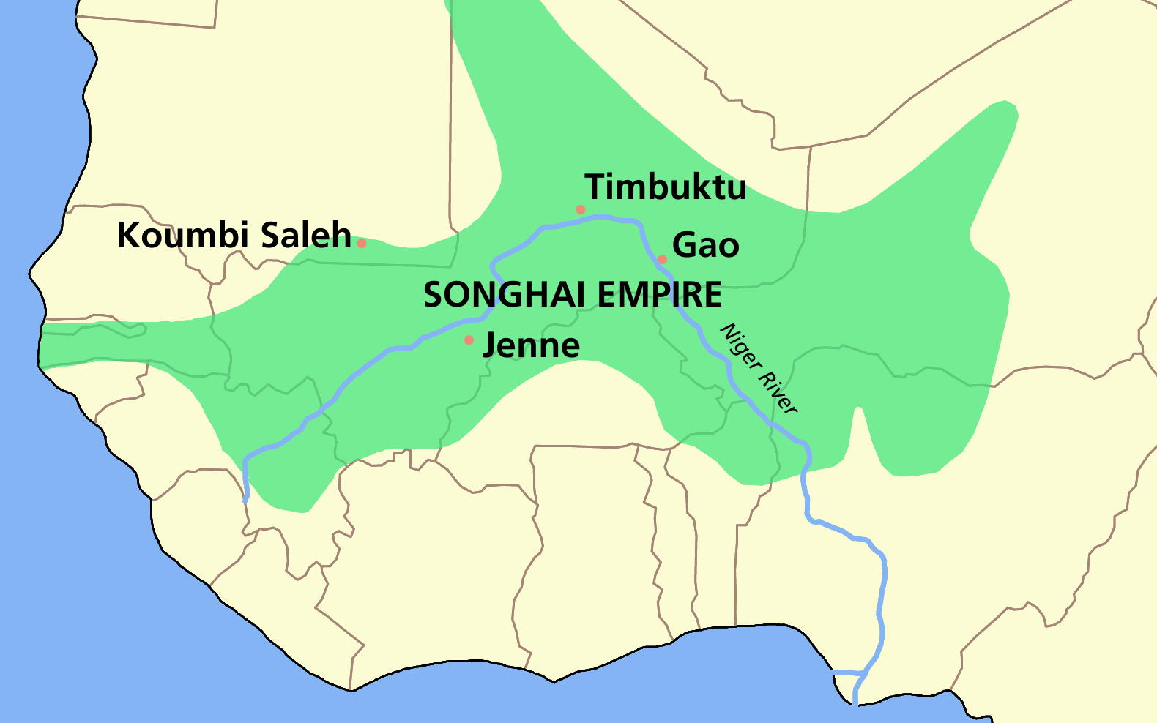

Slide 53
Western Africa
Hausa, Mossi, Borno
Islamic Empires: Invasion, Establishment and Puritanism
Futa Jalon and Usman dan Fodio, 1804
Identity of Arab, Berber and African

Slide 54
Western Africa Pre-Colonial Systems: Images and Myths?
Ghana- 300-1100 AD:
Trans-Saharan Trade (Gold For Salt)
Feudal Structures
Slave Trade to Middle East
Mali- 1200-1400 (Timbuktu)
Islamic Invasion
Hierarchical
Part of Middle East and Islamic Cultural Patterns

Slide 55
Western Africa: Historical Kingdoms
Songrai/Songhay- 1400-1700
Money: Gold and Cowries
Laws and Hierarchical Administration
Islamic Education
Shift to Coastal Trade and Slavery 1600

Slide 56
The Institution of Slavery
Roman, Middle Eastern and African Slavery
African Kingdoms, trade and slavery
Chattel Slavery and the Overseas Trade

Slide 57
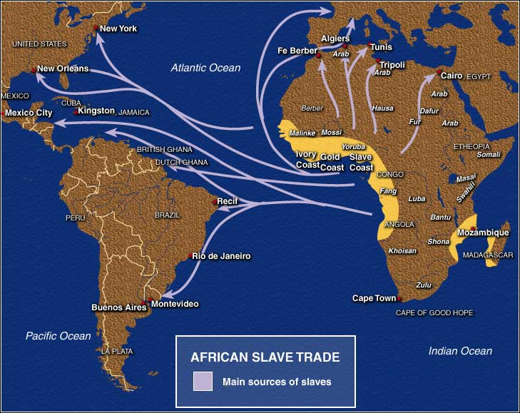
Pre-Colonial History: Atlantic and Sahara Slave Trade

Slide 58
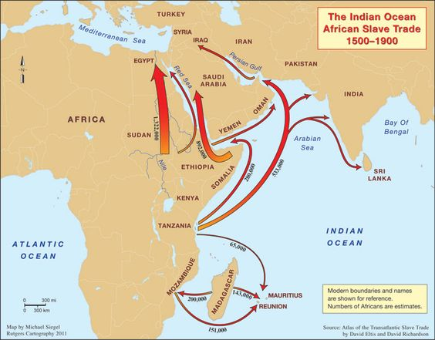
Indian Ocean and Red Sea Slave Trade

Slide 59
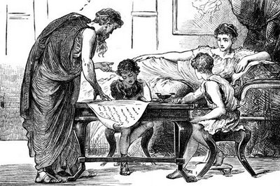
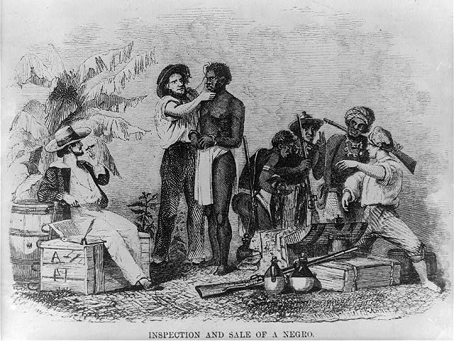
Slavery: Teacher vs. Chattel

Slide 60
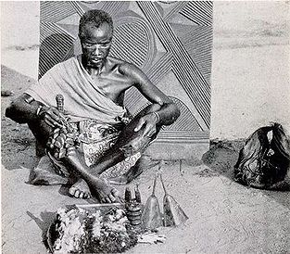
The Issue of religion
Indigenous
Christianity
Syncretistic
Islam

Slide 61
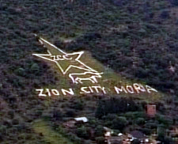
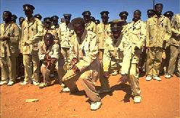
Syncretistic Religion
Zion Christian Church

Slide 62
The Influence of Islam
Middle Eastern and Asian influences:
Indians and Syrians
Land based trade- Still little understood
Puritanism and Revival in the nineteenth century
Extremism: Boko Haram and Al-Qaeida (AKIM) 20th century
Competition with Christianity: (Catholic, Protestant and Pentecostalism

Slide 63
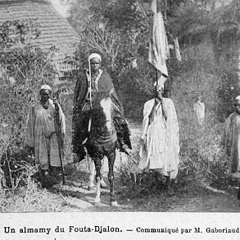
Futa Jalon: 19th Century: Links to 20th Century Fundamentalism

Slide 64
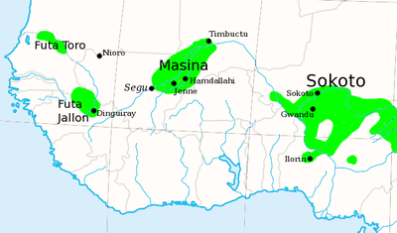
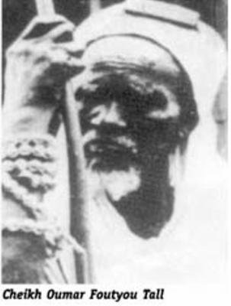
Kingdom of Fouta Djallon , 1776-1896, Islamic Empire
Cheikh Oumar Foutou Tall,1796-1864

Slide 65
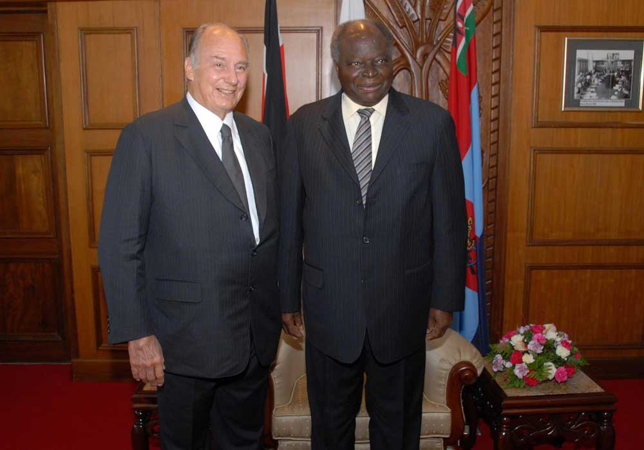
Aga Khan Visits Kenya (with President Mwai Kibaki)

Slide 66
Reminder: Overview of Discussion: Theories and Themes
An Overview of the Problem
Regional Failures
Geography
Natural Resources
People, History and Culture
Institutional Collapse
Donor Fatigue and Dependence

Slide 67
Come Back Africa (1956)
VIDEO
http://www.youtube.com/watch?v=Buod66bq0cg

