Slide 1
PIA 2096 Foreign Aid Capstone Seminar Week Seven
From Multilateralism to
Bilateral Aid:
Structural Adjustment
NGOs and Civil Society

Slide 2
Status of Paper Proposal
A Thirty Second Update

Slide 3
PIA 2096
ORGANIZATIONS, INSTITUTIONS AND
DEVELOPMENT: THE ROLE OF NGOs

Slide 4
NGOs and Civil Society
THE NATURE OF THE BEAST

Slide 5
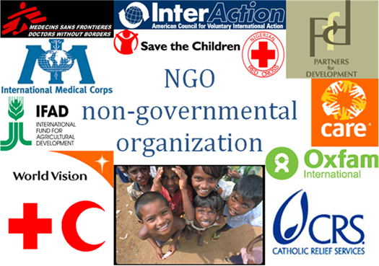

Slide 6
Grassroots, NGOs and Civil Society
Governance /
Democracy
NGOs
Women’s Focused
Groups
Communication
and
Support
Target Group
Rural
Credit
Rural
Industries
Land
Civic
Education
Grassroots
Organizations

Slide 7
State Societal Linkages
Central State - Macro
Weak
Strong
SOFT STATE…………………………….PREDATORY STATE
Mezzo-Intermediate
State-Weak
Strong
Mono-State…...INTERGOVERNMENTAL Systems in place.…..Local State
Civil Society - Micro
Weak
Strong
Local - SOFT STATE….………………LOCAL GOVERNMENT

Slide 8
Civil Society
"Human Rights, Basic Needs and the Stuff of Citizenship" (Anonymous)
Issue: First vs. Second and Third generation Human Rights and Civil Society

Slide 9
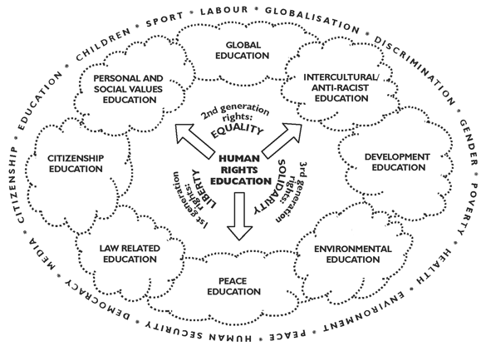

Slide 10
Civil Society
Networks of organizations, groups and individuals pursuing socio-economic interests
"Beyond the family but short of the state" (Hegal)
Formal vs. Informal Institutions

Slide 11
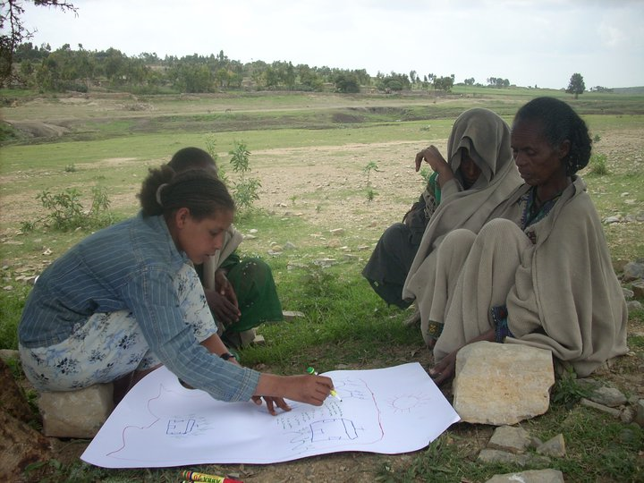
Beyond the Family

Slide 12
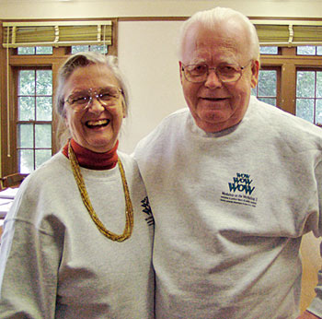
Civil Society
Privatization as an issue (“Left wing vs. Right wing?”)
Corporatism vs. Clientelism
Organic VS. Individualist
nature of society
(Vincent Ostrom)
Establishing the rule of law
Roman vs. Common Law
What is the role of the individual

Slide 13
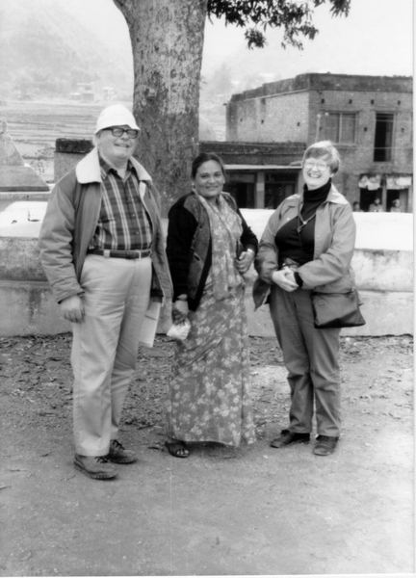
Vincent and Elinor Ostrom (Nobel Prize in Economics)

Slide 14
Civil Society
NGOs, CBOs, PVOs: Who do they represent?
Grassroots, interests, not for profits (neutrality)
Groups
Role of ethnicity, religion and class, vs. individual rights

Slide 15
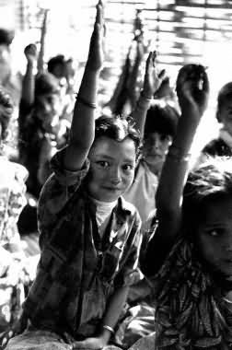
Bhutanese refugee children in a camp in the south-east of Nepal, 1997

Slide 16
NGOs--The Nature of the Beast
Non-Profits vs. For Profits
Not for Profits- More value directed
Private Voluntary Organizations(PVOs)
Community Based Organizations (CBOs)
Foundations
Economic Associations

Slide 17
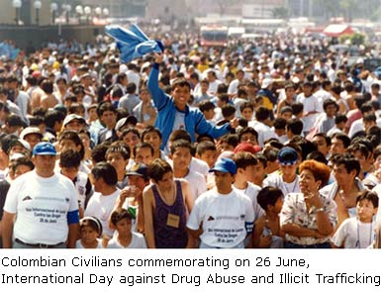
Civil Society or a Mob

Slide 18
“Winners” in Civil Society
Grameen Bank
Nobel Prize for Peace (2006)
Micro-credit
The Concept and the Controversy
Links to Traditional Savings Banks

Slide 19
Professor Muhammad Younis, Gramen Bank founder and 2006 Nobel Peace Prize winner

Slide 20
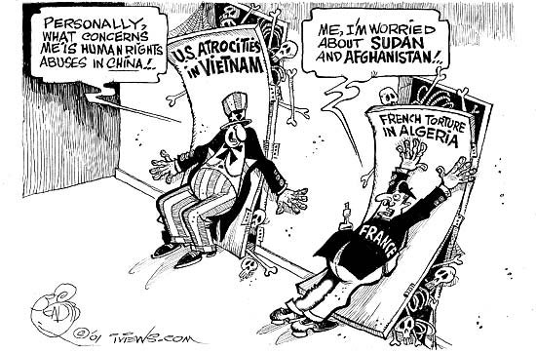
The Human Rights Agenda

Slide 21
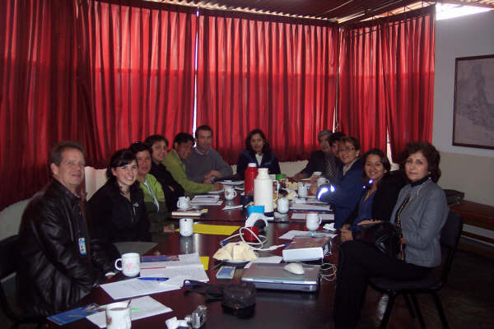
Is There an NGO Type?

Slide 22
NGOs- The Nature of the Beast
Civic Associations
Interest Groups
Quangos
Trade Unions
Religious Organizations
Large Corporate Like Structures

Slide 23
Just another NGO

Slide 24
Five Caveats
Usually excludes “for profits”
Issue of contractors- both for profits and non-profits
Includes both International and Local
Internationals are not universally loved

Slide 25
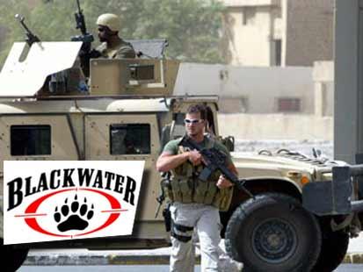
The Role of Security Contractors

Slide 26
Caveats
Very often internationals are religious or charity based
Focus has been primarily on relief rather than development or civil society goals

Slide 27
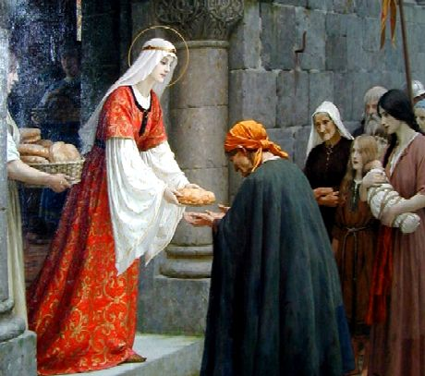
The Model?

Slide 28
Types of “Development” NGOs
Philanthropy
Relief and Welfare Societies
Public Service Contractors
Populist based development agencies (national)

Slide 29
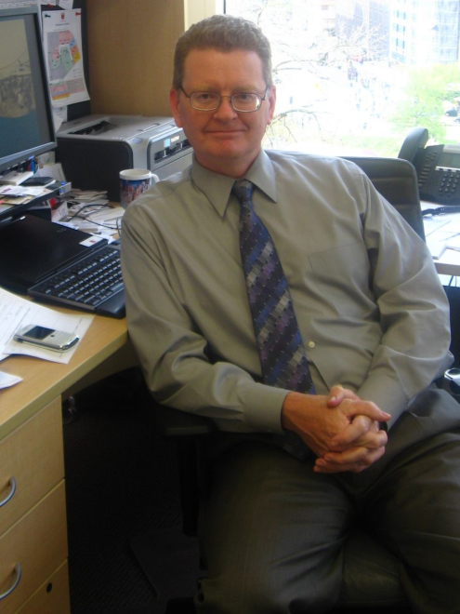
International Stability Operations Association
Doug Brooks, GSPIA Alum, President

Slide 30
Types of “Development” NGOs
Grassroots associations (local or village based)
Advocacy groups
Public Service Contractors

Slide 31
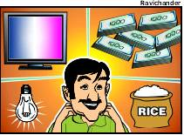
Origins- Natural Disaster: Humanitarian Assistance and Human-Made Disaster
Human Security
War, Drought, Agricultural Failure
Focus on Rural Development
Human Rights
Focus on Governance

Slide 32
Natural Disaster: Humanitarian Assistance and Human-Made Disaster
NGOs--Areas of Perceived Advantage
Cost-effective
Small but efficient
Innovative
Staff loyalty and commitment

Slide 33
Natural Disaster: Humanitarian Assistance and Human-Made Disaster
NGOs--Perceived Advantage
Ideologically compatible with Development values
Links with poor
Image of populism

Slide 34
Natural Disaster: Humanitarian Assistance and Human-Made Disaster
International NGOs—Weaknesses
Lack of local legitimacy
Donor driven
Inefficiency
Corruption?

Slide 35
Academy for Educational Development
AED to Shut Down After Corruption Charges
(March 04, 2011)

Slide 36
Natural Disaster: Humanitarian Assistance and Human-Made Disaster
International NGOs—Weaknesses
Amateurism
Leadership and continuity problems
Staffing problems
Self-serving-own objectives
Faith Based

Slide 37
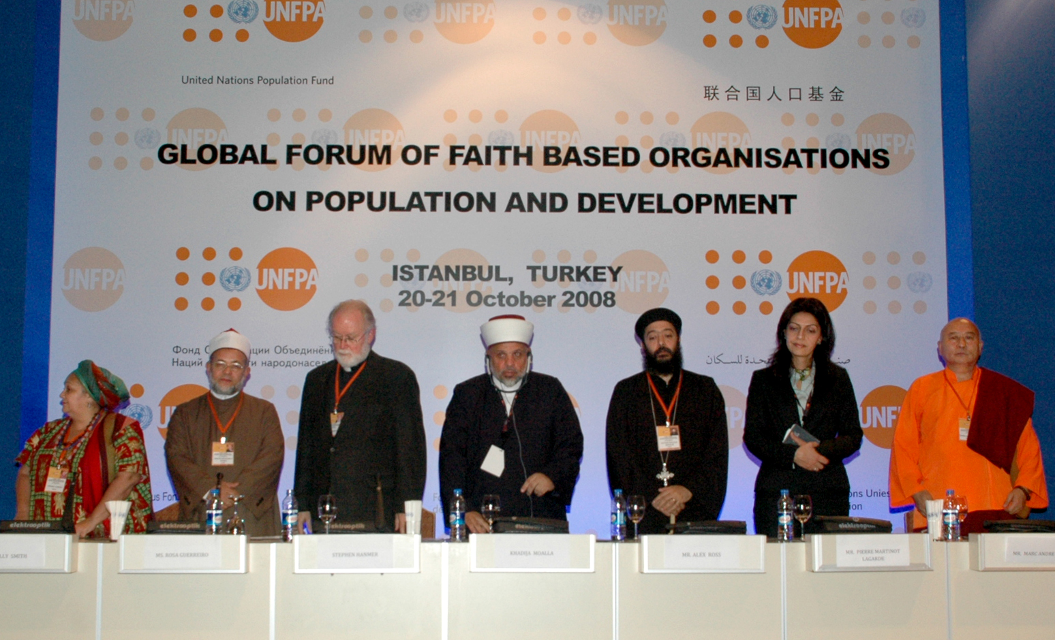

Slide 38
Natural Disaster: Humanitarian Assistance and Human-Made Disaster
International NGOs—Weaknesses
Fixation on projects
Problems of replication
Lack of perceived accountability
Learning problems/lack of institutional memory

Slide 40
Natural Disaster: Humanitarian Assistance and Human-Made Disaster
International NGOs—Weaknesses
Tensions with government institutions
Politically threatening
Ties with existing local elites
Inability of humanitarian organizations to transfer to new development orientation
Failure to support Human Security

Slide 41
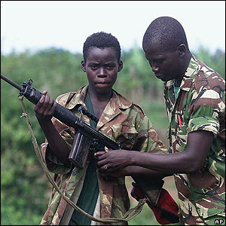
Civil War

Slide 42
Postscript- World Bank Mission (Picard)
Local Governance and Civil Society in Guinea Conakry (2006)
Creation of a Poverty Alleviation Fund- includes Micro-Credit
Design Capacity for Service Delivery
Role For Civil Society as Stakeholders for Political Change

Slide 43
Thirty Five Years Waiting for Change- 1987-2022 (Guinea Conakry)

Slide 44
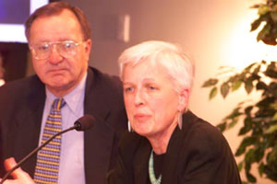
Discussion: Do No Harm?
Mary Anderson, Do no Harm
President Collaborative for Development Action

Slide 45
Final Glimpse of Foreign Aid
How to Give Help

Slide 46
Discussion of Readings

