Slide 1
PIA 2528
Governance, Local Government and Civil Society
Grants and Contracts: The Privatization Debate

Slide 2
The Original Model

Slide 3
Overview: Governance and Outsourcing
The Knowledge and Skills Base for Service Delivery, International Assistance and Security

Slide 4
Overview
Concepts: New Public Management Principles
Social Services- Delivery
The Importance of Grants
Re-inventing Government- Customer vs. Citizen
Subsidiarity- Decentralization
Privatization: Private or Non-Profit Sector
Contracting Out- Extending Governance out of Government

Slide 5
Privatization: Grants and Contracts
The Key to Understanding Contracting Out
Prior to 1979: Focus of Contracts was Purchases and construction
Before 1979- Social Services: “Block Grants”
Now Social Services: Contracted Out or Categorical Grants (Tied Grants)
Cooperative Agreements: Shared Management

Slide 6
Block Grants vs. Categorial Grants
Community Development Block Grants
Categorial Grants

Slide 7
From Policy to Project
Grants vs. Contracts: Assessing Sub-Grants
Request for Application (RFA)’s and Implementation
Project is the Common Denominator for the Domestic Grant and the International Donor
Cooperative Agreements vs. IQCs

Slide 8
Public Private Partnerships
The underlying rationale for Public Private Partnerships is the belief that
1. The nonprofit/nongovernmental sector is closer to the community and has a better sense of the needs of the community and thus can more cost-effectively apply resources and
2) The private sector is more efficient at responding to market forces because of private investment and than large public bureaucracies.

Slide 9
Public Private Partnerships
Building PPPs brings the public, the nonprofit and non-governmental and the private sector together for a common purpose.
PPPs involve a set of elements of political good will management:

Slide 10
Sub-Grant Administration

Slide 11
Public Private Partnerships (PPPs)
PPP Supporting Factors in the Domestic and International Context
1. Democratic Governance- private sector and NGOs seen as legitimate actors; transparency, accountability and responsiveness
2. Rational Government- Merit Principles, anti-corruption environment, acceptance of non-state actors as service deliverers.
3. Use of Contracting Out and Controlled Sub-Grants

Slide 12
Public Private Partnerships
4. Building a climate of tolerance, active support or ongoing operational assistance for
5. A policy or overall strategy to achieve specific objectives among those outside the scope of those who have direct authority over the domain
6. But whose operational assistance is necessary to achieve the objective. Not Competitive at this stage

Slide 13
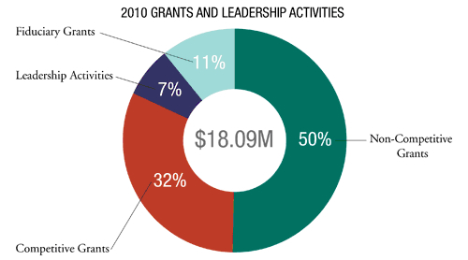
Many PP Grants are Non-Competitive

Slide 14
Public Private Partnerships
7. Cooperative Agreements: Comes out of Domestic Non-Profits and Block Grants
8. Internationally Moving Beyond Structural Adjustment and Policy Reform?
9. Grants are seen by some as an alternative to Contracting Out- Others as part of it
10. Critics see it as detrimental to a market approach to economic change

Slide 15
Public Private Partnerships
Characteristics-
a. Targeted at the expansion of Social Capital and Synergy in the promotion of Economic and Social Development
b. Seeks a holistic or Integrated Approach to Economic and Social Development
c. Involves informal processes, cultural sensitivities as well as legal norms and contracting principles.

Slide 16
Integrated Approaches: Integrated Rural Development (IRD)

Slide 17
Public Private Partnerships: The Use of Grants
The idea is that by drawing upon the non-politicized interests of the nonprofit/ nongovernmental sector and the expertise and acumen of the private sector, public services can be provided more cost-effectively and efficiently and thus create better public value for taxpayers.
Thus the desire to create better public value is the primary objective behind the PPP movement. The PPP movement joins together public management, the political neutrality of nonprofit or non-governmental organizations and the ingenuity of free market forces.

Slide 18
Public Private Partnerships
Public Private Relationships is a concept that grew out of efforts to “downsize” the role of government.
They refer to relationships between the public sector, nonprofit and nongovernmental sector, and the private sector.
PPPs have also be referred to as: Privatizing Government, Outsourcing, and Devolving Government. The most obvious outcome of PPP movement has the growth in the number of nonprofit/nongovernmental organizations that provide a wide range of public services.

Slide 19
Contracting Out
The Assumptions

Slide 20
Relationship Between Contracts and Projects
Key: Not a Grant
Contract
Legally enforceable document
The Project has become the vehicle

Slide 21
Valuation Problem: The Key to Privatization (Best Value Procuremenrt)

Slide 22
Service Delivery Systems and Categories of Service Delivery
Private Provision
Use of conventional Markets
Contracts with public agencies
Monopoly Franchises
Management Contracts
Vouchers
Consumer Cooperatives

Slide 23
Tendering
Tendering is the procurement of acquisition of goods and/or services at the best possible total cost of ownership, in the correct quantity and quality, at the right time, in the right place for the direct benefit or use of governments, corporations, or local authorities, generally by a contract (Request for Proposal or RFP)

Slide 24
THE TENDERING PROCESS: From End of Input (EOI) to Expiration of Terms of Service

Slide 26
In the Development Context
Parties to the Donor Contract:
Developing Country/Host Country
Sponsoring or donor agency
USAID, the World Bank, UNDP
Contractor
NGO, For-profit private firm, University

Slide 28
Purpose
Judicial review in event of a disagreement between the parties
A good contract is able to be understood by a member of the judiciary
Projects: define obligation by time and money. Limited time and limited money

Slide 30
Judicial Review of Contracts
Judge may be assumed to be a lay-person in terms of the technical aspects of the contract
For judicial review the contract should strive to make the technical issues as clear as possible
Understandable not just to project teams but to lay individuals as well

Slide 32
Judicial Review of Contracts
Few contracts are in fact brought before the judiciary for determination
Nonetheless, it is this ultimate test--against judicial criteria--that sets the pattern for contract administration

Slide 33
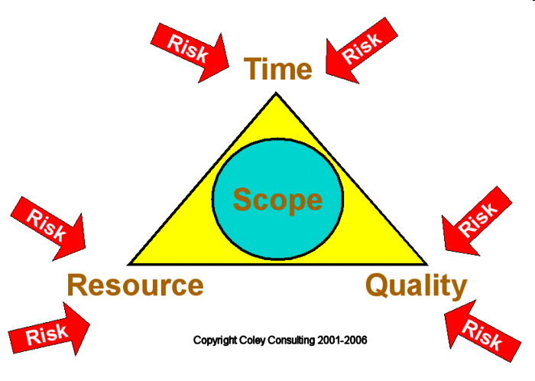

Slide 34
Key: A Meeting of the Minds
“Intent” of a contract
Establishes for judicial review "why" the contract was entered into
Includes knowing why the two parties have entered into a contract; their long-term objectives
Actions consistent with the meeting of the minds are consistent with the contract
Actions inconsistent may constitute breach of contract or non-performance [Next Slide]

Slide 35
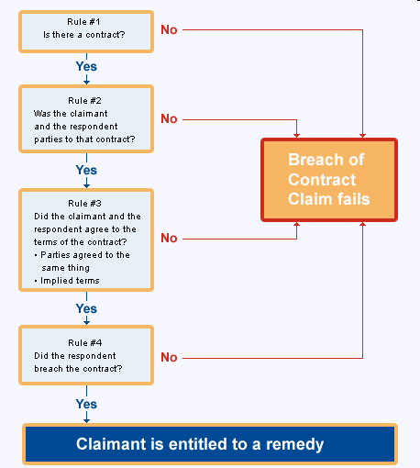

Slide 36
A Meeting of the Minds
Relates directly to the purpose and goals identified in the project’s planning document
Project document always indicates “outputs” in the hope that it will result in an agreement that the task is completed

Slide 37
A Meeting of the Minds
Contractor is expected to obey “reasonable person” rule
contractor is expected to do all the things that any reasonable person would do given the resources available, and
add to the list of outputs in order to reach the agreed upon purpose
contracting agent agrees to modify or add to the inputs in order to reach a modified “meeting of the mind”

Slide 39
The Meeting of the Minds
Contracting agent has a reasonable right to expect that the contractor will obey the “reasonable person” rule
However, contractor expects that the contracting agent will attempt to take all reasonable actions necessary to realize the overall goal of the activities

Slide 40
A Meeting of the Minds
“Purpose” of Contract
Most important project focus
Or project activities within the context of a program
Facilitates "meeting of the minds" by clarifying long-term objectives

Slide 42
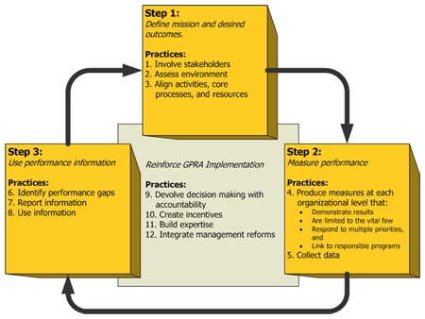
U.S. Government Performance and Results Act of 1993

Slide 43
Management of Deliverables

Slide 44
3. Deliverables of Contract
Essentially the “outputs”
Things the contractor has agreed to produce
Important to note that deliverables under a contract should be results, not activities (or inputs)
Further, objectively verifiable indicators must be provided for each output with qualitative, quantitative, and time targets

Slide 45
Project Planning Documents
Help clarify contract elements
Consists of the following:
A meeting of the minds
Specific deliverables
Consideration
Force Majeure
Objectively Verifiable Indictors

Slide 46
In the Development Context
Developing (host) country is usually considered ultimate “client” of the contractor, although this is not legally binding if the contract is made with the donor agency

Slide 47
Consideration
Essence of a contract, particularly in terms of its equity provisions
What do a contractor and contracting agent each promise to provide each other?

Slide 48
Consideration
Minimum guarantee is the inputs
Contractor agrees to provide technical personnel, commodities and undertake activities, etc.
Sponsor agrees to pay contractor certain fees, and may provide on-site support, etc. as agreed upon in the contract

Slide 49
5. Force Majeure
The project framework documents and the contract clarify force majeure by:
Identifying factors that require re-analysis of the ability to perform
Setting levels at which those factors become important

Slide 51
Force Majeure
At input level, contractor identifies assumptions that must be made in order to guarantee ability to produce outputs
Example: If the contractor assumes that host government will provide ten vehicles and drivers in order produce the project outputs, but in fact only five are provided, then we expect a corresponding reduction in the quantity or quality of outputs produced

Slide 52
Objectively Verifiable Indicators
Indicators that determine if the terms of a contract have been met
To avoid a misunderstanding and provide an objective means for recognizing successful achievement of the project objectives, the contract and associated planning documents must establish “objectively verifiable indicators”

Slide 53
Quantitative Indicators

Slide 54
Objectively Verifiable Indicators
Indicators show the results of an activity
Not the conditions necessary to achieve those results
Indicators clarify exactly what we mean by our statement of the objectives at each level in the project planning document

Slide 55
Objectively Verifiable Indicators
At input level:
only concerned with consumption of project resources
At the purpose level:
These are of particular importance and are given a special name:
End of Project Status (EOPS)

Slide 56
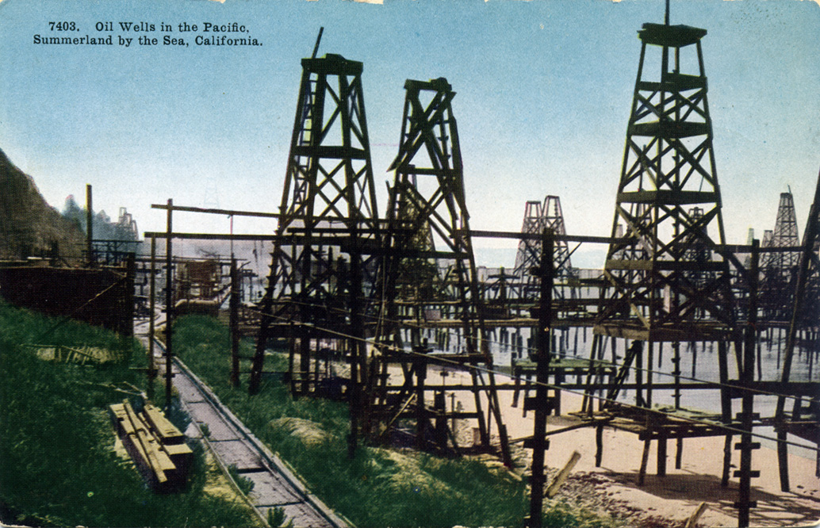

Slide 57
Resourcing Projects

Slide 58
Contract Analysis
Assessment vs. Evaluation
Process Evaluations
Impact Assessment
The Need for Quantitative Data
The Reason for Blueprints

Slide 59
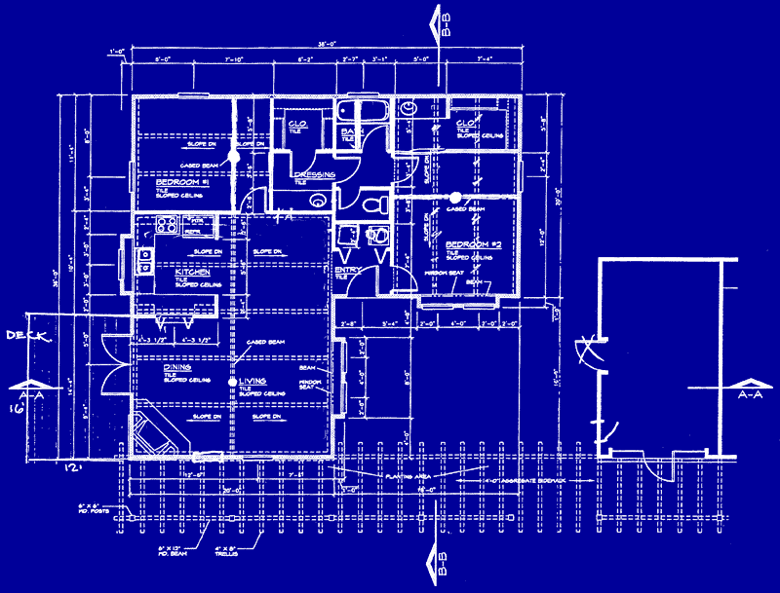
The Blueprint

Slide 60
Blueprint Approach to Development Planning
Tested Models
Pilot Project
Researchers
Planner
Project
Blueprints
Actual Change
Versus
Targeted Change
Administrators
Evaluation
Researchers
Actions
Before-After
Surveys
Target
Population

Slide 61
Project Identification, Formulation, Preparation & Design
Problems in project identification
In developing countries:
Lack effective procedures for project identification within national planning agencies and operating ministries
Weak conceptual and operational links exist between various national, regional, local, and special interest constituencies
National plans often fail to provide a strategy for development
Allocation of resource issues
Issues of priority

Slide 62
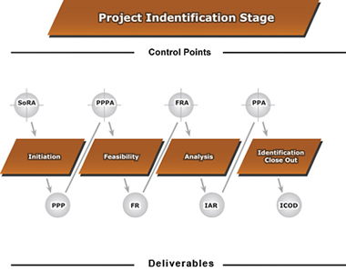
Project Identification

Slide 63
This image describes the Project Identification Stage, its phases, control points and deliverables:
Phases
Initiation
Feasibility
Analysis
Identification Close Out
Control Points
Preliminary Project Plan Approval (PPPA)
Feasibility Report Approval (FRA)
Preliminary Project Approval (PPA)
Deliverables
Preliminary Project Plan (PPP)
Feasibility Report (FR)
Investment Analysis Report (IAR)
Identification Close Out Document (ICOD)

Slide 64
Project Identification, Formulation, Preparation & Design
Problems in project identification
In developing countries, cont.:
Influence of interest groups
Limited international assistance agency staff time to help government planners
Excessive turnover and rotation of field representatives of assistance agencies
Weaknesses in the overall planning system
Design Primarily focuses on Contracting Process

Slide 65
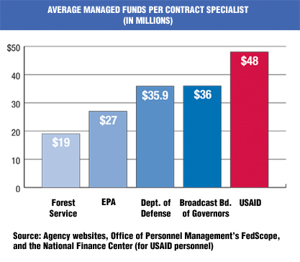
The Name of the Game

Slide 66
Project Plan
1. Scope: defines what will be covered in a project
2. Resource: what can be used to meet the scope
3. Time: what tasks are to be undertaken and when.
4. Quality: the spread or deviation allowed from a desired standard.
5. Risk: defines in advance what may happen to drive the plan off course, and what will be done to recover the situation

Slide 67
The Project Cycle & Contracts
Design
Identifying nature of problem and possible solutions--specific needs and desired changes
Appraisal
(Mandatory) data needed to prepare project plan and measure completion

Slide 68
Community Project Design

Slide 69
The Project Cycle
Analysis--collection of information
Prediction
Selection of preferred alternatives
Measurement of Impact to determine contract fulfillment

Slide 70
The Project Cycle
1. Design
Project
Objectives
Achieved
3. Evaluation
2. Execution
Source: Project Management System, Practical Concepts, Inc., Washington, DC 1979.

Slide 71
The Project Cycle and the Contract
Analysis--collection of:
Social Analysis targeted groups: women, minorities, indigenous peoples
Economic Analysis--Cost Benefit
Institutional Analysis
Sustainability
Organizational Requirements
Recurrent Cost Implications
Human Skills Needed
Social Acceptance

Slide 72
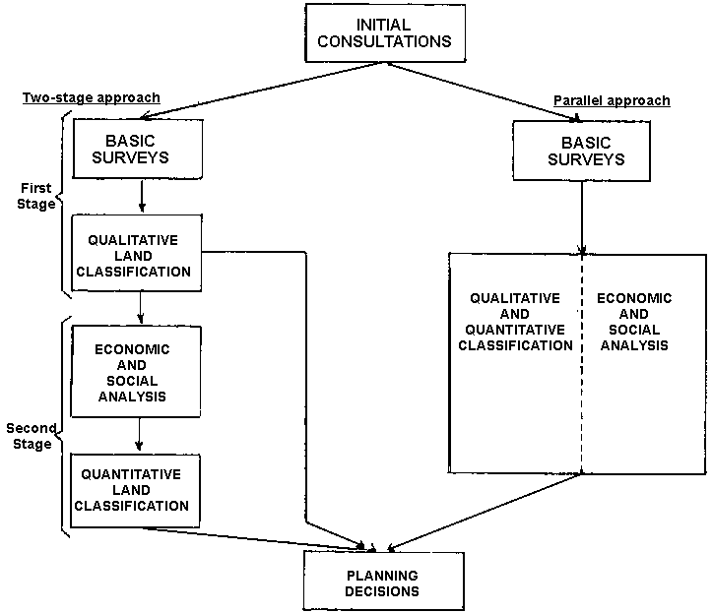

Slide 73
The Project Cycle Analysis
The Logical Framework: (LOGFRAME)
If-then conditions
Some donors have moved away from original Log-frame
Was replaced by a system based on identifying Strategic Objectives, Intermediate Results, Impacts, Measurable Indicators, etc.
That system was recently "de-emphasized."
AID mission requests for funds were tied to promises of specific results
Results Framework system is "under review."

Slide 74
The Log Frame

Slide 75
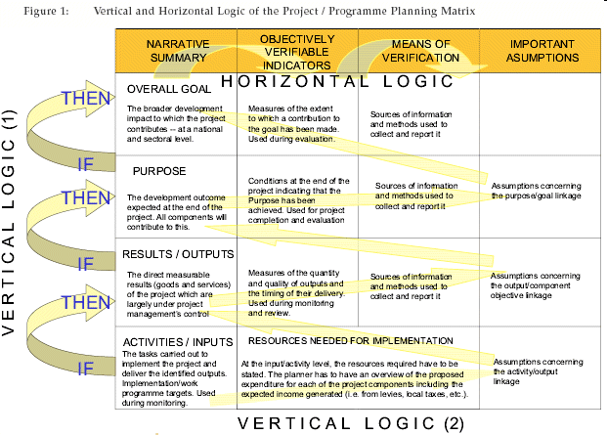
Logical Framework

Slide 76
Project Management System Provides Management Tools to Support all Stages of the Project Cycle
Logical Framework
Performance Networks
1. Design
Networks display performance plans over time
Project
Objectives
Achieved
3. Evaluation
2. Execution
Evaluation System
Reporting System
ACHIEVEMENT
EXCEPTION
Evaluations assess performance against plans and analyze causal linkages
Progress indicators and formats for communicating project information
Practical Concepts, Incorporated

Slide 77
Message of the Day: Governance focuses on (requires?) skills
Project Assessment (Design, Monitoring and Evaluation
The Project Cycle
Tendering: Contracts vs. Grants
IQCs and Cooperative Agreements

Slide 78
Questions
Discussion?

Slide 79
Films for the Week
The Logical Framework VIDEO

Slide 80
Break A Lesson from History
The Theory of the Contract

Slide 81
An Early Morning View of Privatization
The Privatization of the Police

