Slide 1
PIA 2528 Governance, Local Government and Civil Society
Land, Traditional Society and Economic Interests.

Slide 2
Governance Theme Clusters
Human Security- Illiberalism, Dirty Wars, Cronyism, Dysfunctional Systems
Human Rights- Social, Economic and Political liberalism and Self-Governance
Institutions- Gate Keepers, Legitimacy, Decision-Making, Rational Choice

Slide 3
Historical Patterns of Governance
Paternalism- Empires
Monarchy, Theocracy and Authoritarianism
Authority Linked to the Control of Land (and Water)- Feudalism
Capitalism, Cattle and Property Rights

Slide 4
Historical Patterns of Governance and Control
Land, Rural Development and Human Resource Development
Debates about Property Rights: Access to Water, Livestock and arable land
Issue: Effect of climate change on conflict

Slide 5
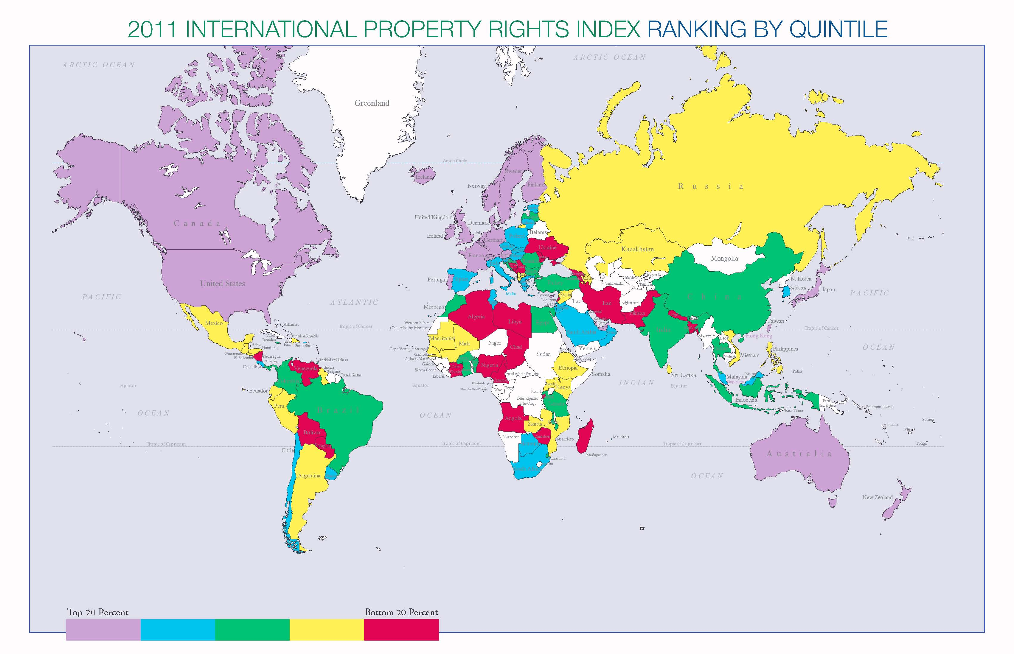

Slide 6
Three Sub-Themes
Rural Governance:
Authoritarianism and Land and Water Use
Rural Change
Human Skills Development and Arable Agriculture

Slide 7
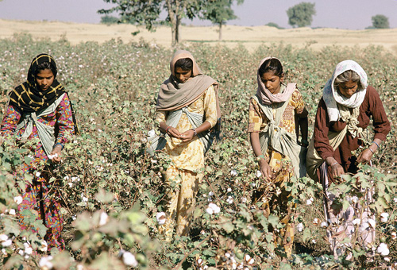
Gender, Land and Agriculture

Slide 8
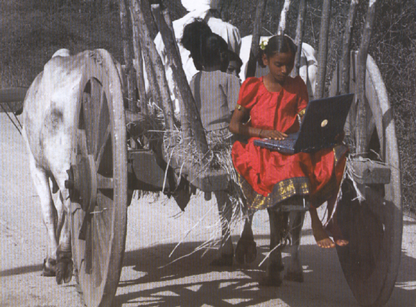

Slide 9
Governance and Sovereignty
"[T]ransformation (and globalization) has led to a reinvention of government and what it does"
- Anonymous

Slide 10
Origins of Executive Governance

Slide 11
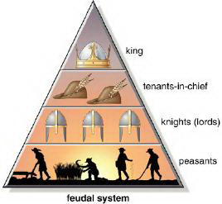
LAND

Slide 12
The Evolution of the Rural Community
1. Hunter-gatherers: Age-grade societies
2. Settled Subsistence Agriculturalists

Slide 13
San or Basarwa of Southern Africa (Indigenous Peoples)

Slide 14
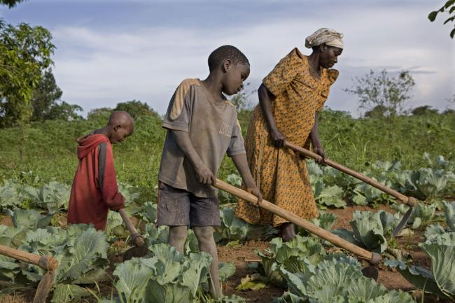
Subsistence Agriculture

Slide 15
The Evolution of the Rural Community-2
3. Cattle Keeping
4. Plantations, Commercial Farms and Agri-Business
5. So-Called Communal Tenure

Slide 16
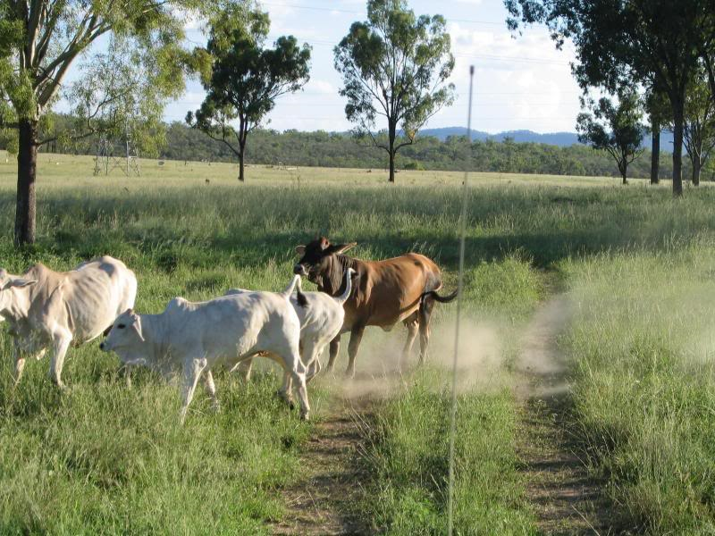
Indian Cattle Keeping

Slide 17
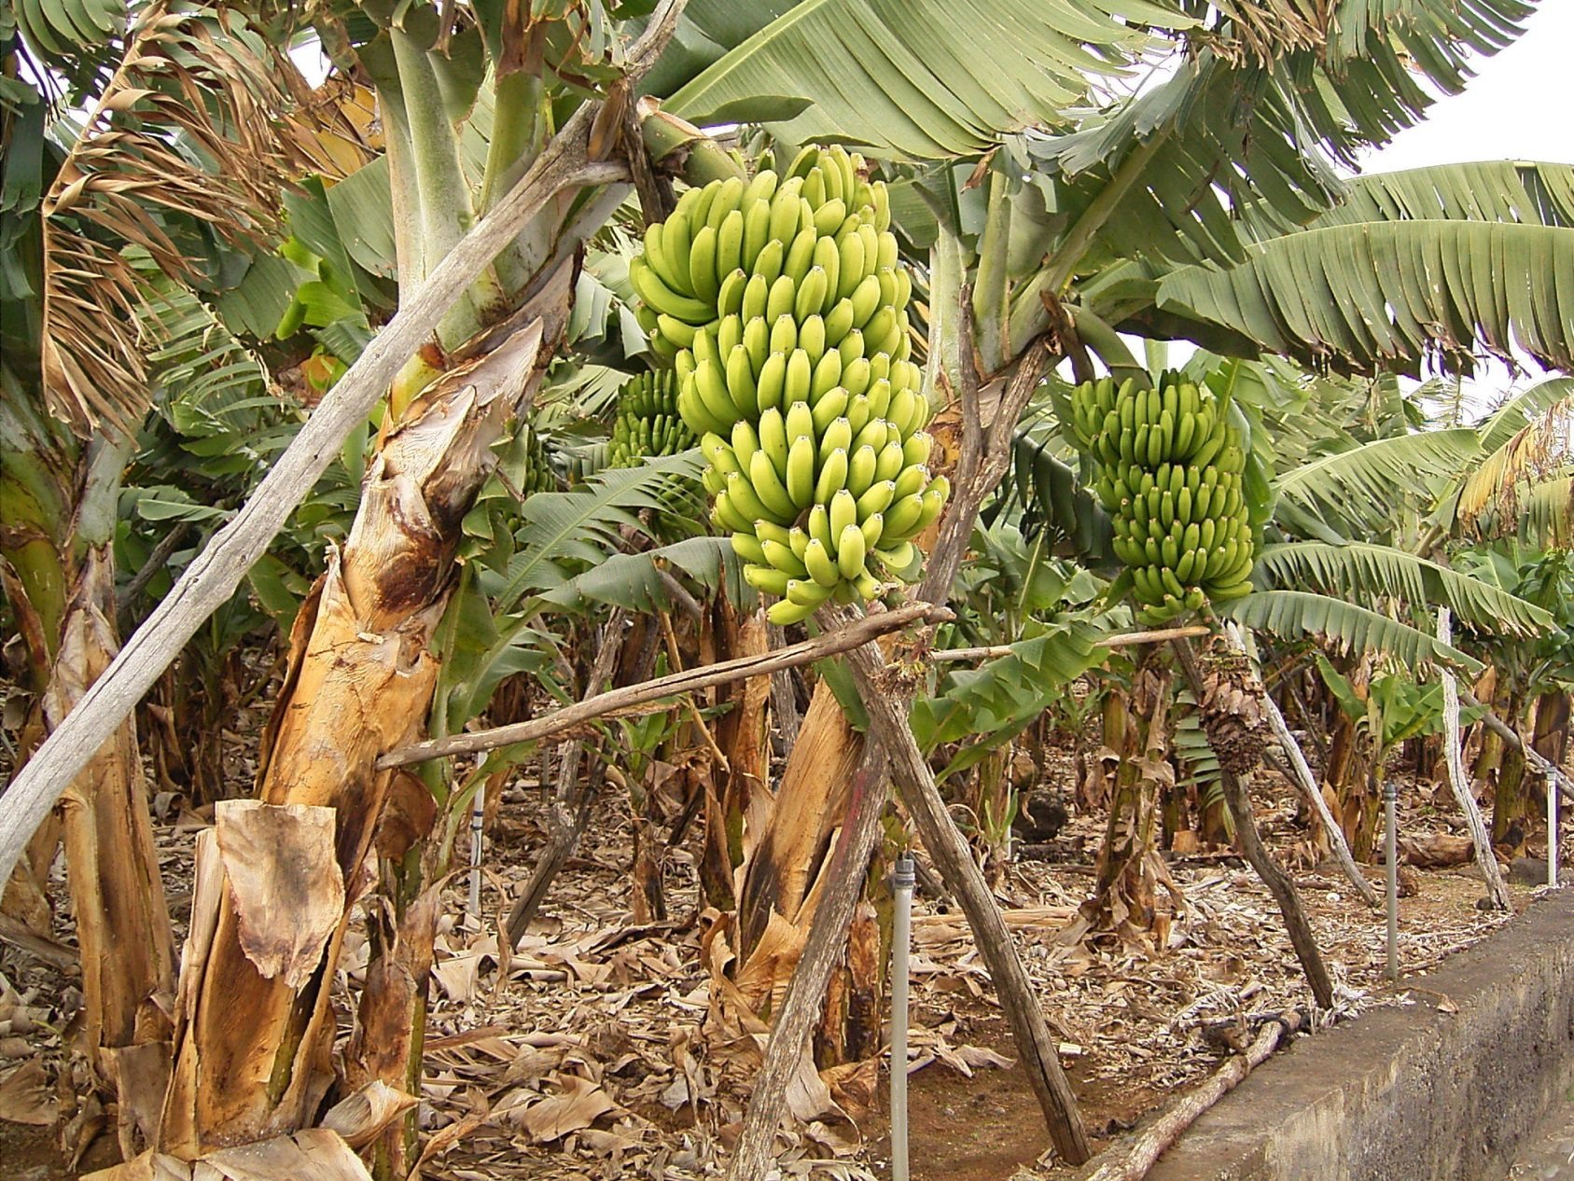
Plantation Systems: Labor Intensive

Slide 18
Traditional: Communal Land
The term is misleading- there are an infinite number of land relationships- Note Three
1. Use same land for individual benefit (cattle rearing)

Slide 19
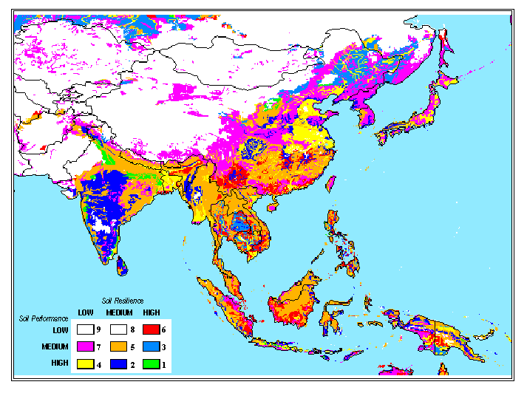
Land Quality and Soil Resilience

Slide 20
Communal Land
2. People use same land and pool proceeds- aspiration in socialist countries. (Communalism):
Little evidence in traditional society
COLLECTIVE FARMS AND FARM FACTORIES

Slide 21
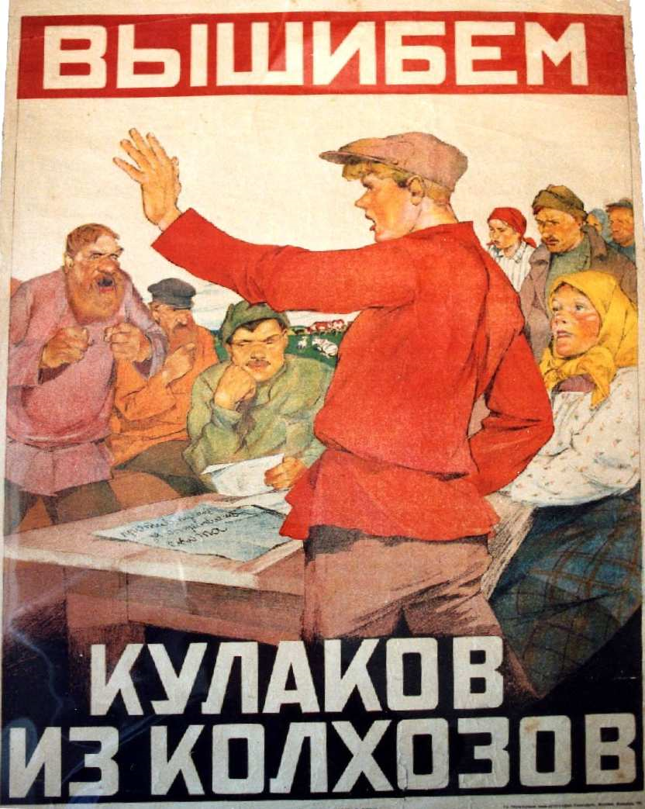
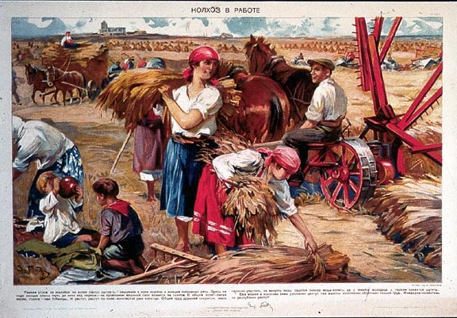
Soviet Collectives

Slide 22
Rural Socialism as an ideology in the 1960s
1. Peasant collectives and Communal state farms- Soviet Union
2. Voluntary collectives- Ujamaa villages in Tanzania
3. Move the peasant away from individualized production (China)
4. Ideal: village level economies of scale
5. Reality: Failure- Collectives, prefectoralism and state enterprises (State Agri-Collectives)

Slide 23
Tanzania Socialism

Slide 24
Communal Land
3. Individual use of land for individual gain
a. without legal tenure
b. no sale or disposal of land
c. no collateral for Loans

Slide 25
Overgrazing in Latin America

Slide 26
Property Rights

Slide 27
Issue of Usufruct
Usufruct is the legal right to use and derive profit or benefit from property that belongs to another person
Share Cropping: “Farming on the Halves”
The problem- No property, no security and no collateral for loans

Slide 28
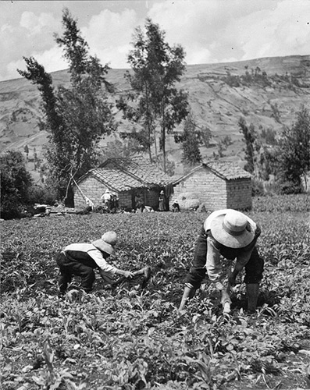
Usufruct- “On the halves”

Slide 29
The Problem of Landlordism
Tenancy relationship to large hacienda, plantation or commercial agricultural enterprise
In much of the world, Land is traditional controlled by land-lords
Vast majority of rural peasants in some form of tenancy relationships

Slide 30
Landlordism
Serfdom: legal linkage to land and ownership
Small scale subsistence agriculturalist- produce for food
Reality: Peasants- dependency relationship to land

Slide 31
Ecuador Hacienda

Slide 32
Serfs vs. Slaves?
Russian Serfs
Alexander I Freeing the Serfs

Slide 33
Modernization- Western (and to some Post- Colonial) Land Divisions
Individual ownership and control of land and water with rights of transfer, collateral, inheritance and sale. ISSUES:
Usufruct: Leasing of Land
Landed elites- landed aristocracy
MNCs as plantation farmers- Firestone, Dole and Unilever
Individual Title, access to capital (loans)- Urban and Modern Farming

Slide 34
Urban Planning

Slide 35
The Complexity of Planning

Slide 36
Land Reform - Action and Research in Scotland (Emotive Issue)

Slide 37
Individual Land Tenure: Results
Landless Rural Workers- Sell their labor in cities, to plantations, to small farmers or as a labor export (regionally or internationally)
The realities and limits of collective finance: From Burial Societies to micro-credit schemes
How to define individual relationship to land: FAILURE OF LAND TENURE REFORM

Slide 38
Zimbabwe

Slide 39
Rural Development and civil society: Focus of Tenure
Induced Rural Transformation-Approaches
1. Radical Transformation- urbanization
a. Primacy of Industrialization
b. Emphasis on infrastructure and mechanization of farming

Slide 40
Cuba: Debate about Property

Slide 41
Rural Development
2. Green Revolution: Variant of above. Capital intensive and export oriented. (Landlordism?)
a. Focus is primarily on Technical (seeds, equipment- focus is on extension and technical)
b. Economies of scale mean large farms

Slide 42
Green Revolution: Two Views

Slide 43
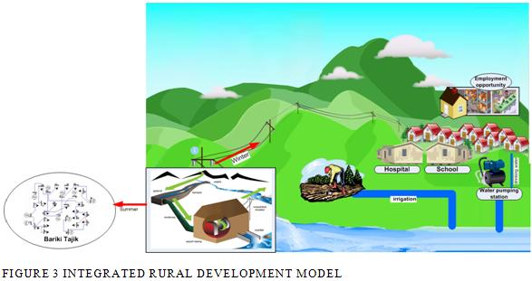
Rural Development: Small Urban?
3. Small holder approach- Primacy is on rural sector
INTEGRATED
RURAL
DEVELOPMENT

Slide 44
Rural Development and Governance: Summary
1. Primacy of social development, health, education, community development
2. Small holder peasant sector/single person occupancy
3. Stresses the importance of individual land tenure and producer cooperatives in marketing
4. Links with local government structures: Village Development Committees
5. Role for Civil Society Groups

Slide 45
Rural Cooperatives

Slide 46
Post-Industrial Cooperative

Slide 47
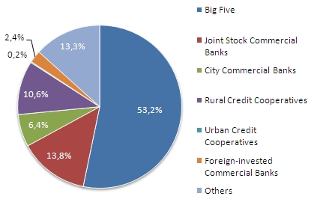
China: From State to Cooperative (and back?)

Slide 48
Problem: Critics of “Capitalist” Commercial Farming- LDCs
Have no Alternative system and Failure of Collective Agriculture
Failure of and agricultural transformation except for parts of Southeast Asia (plus war and weather)
Lead to the decline of the state and the intervention of NGOs - Relief and Humanitarian activities. Human Survival at risk

Slide 49
The Image Projected

Slide 50
Discussion

Slide 51
Films for the Week: South Africa
Bantustans and the Importance of Land

Slide 52
An International Development Perspective
A Theory of Human Security

Slide 53
Historical Patterns of Governance and Conflict
South Sudan: Land, Cattle and Water VIDEO

