Slide 1
Development Policy
And Management
Civil Society: A Conceptual Framework- development

Slide 2
This week’s Themes

Slide 3
Origins of Modernization
LDCs MODERNIZATION, Nationalism and Independence: Major Theme

Slide 4
Overview of Themes: Management of Economic Growth in LDCs
1. From Nationalism to Decolonization
2. Links with (and Legacy of) Colonialism
3. Theories of Modernization
4. Critiques of Modernization
5. Underdevelopment and Dependency

Slide 5
Managing the Economy
The Legacy of Colonialism: The Anthropologists?

Slide 6
Asia and Africa: From Middle Class Nationalism to Mass Movements
World War II led to the collapse of over
seas empires
Begins Japanese imperialism and Asian
nationalism
The Atlantic Treaty and self-determinism
Two patterns:
Gandhi and non-violence and
Sukarno, Ho Chi Minh and violent resistance or
revolution

Slide 7
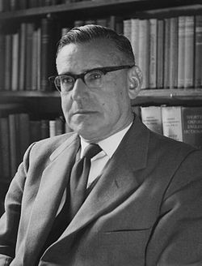
Development Theory Review
In 1950, There existed…
Colonial Anthropological Theories
Modernization
Rhetoric of Nationalism throughout world
Political change and independence
The Rhetoric contrasts with public sector continuity and debate about its role in economic development
Beginnings of Cold War
Picture Above: Isaac Schapera (23 June 1905 born in Garies, South Africa – 26 June 2003 London, England), was a social anthropologist at the London School of Economics

Slide 8
The “Development Era” 1948-1989
In the 1940s and 1950s there was a rhetoric of Nationalism through out the World
Political Change (Nationalism in the Middle East, and Latin America) and Independence (Caribbean, Africa, and Asia (1960s-1970s)
Transformation in Eastern Europe and the CIS (1980s)

Slide 9
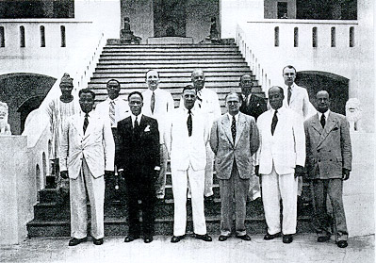
The New Colonials and End of Sea Based Colonialism (Sir Charles Arden-Clarke of Gold Coast in the Center)
Egypt- 1922
Dutch East Indies- 1944 (Indonesia)
Philippines (1946)
India- 1947
Israel-1948
Sudan-1965
Ghana-1957
The Deluge-1960

Slide 10
Independence
Between 1945 and 1985 more than one hundred new states came into existence (Another 20 or so by the end of the century)
Kwame Nkrumah “Seek ye first the Political Kingdom”
Implication was that economic
development would follow

Slide 11
(L to R) PM Pandit Jawaharlal Nehru of India, Pres. Kwame Nkrumah of Ghana, Pres. Gamal Abdel Nasser of United Arab Rep., Pres. Sukarno of Indonesia, & Pres. Tito of Yugoslavia.

Slide 12
Mixed vs. Command Economies
Nationalism, Independence and Theories of Development
Socialism as a“Model?”
LDC Development part of European Social Democracy Movement?

Slide 13
Social Democracy

Slide 14
Vs. Communist Theory and Development
State Control
Social Engineering
Command Economy
Industrialization vs. Rural Transformation
State Managed Development

Slide 15
The Great Helmsman

Slide 16
1950-1982
Keynesianism and the“Western” Development Model

Slide 17
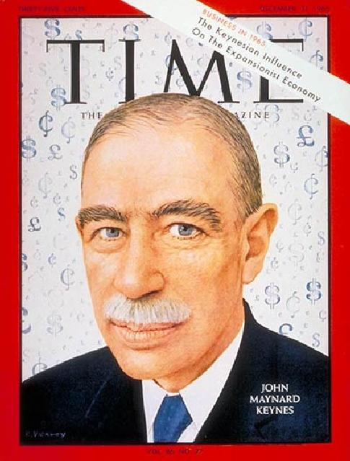
Historical Character?
John Maynard Keynes: “We are all Keynesians Now.”

Slide 18
John Maynard Keynes, 1883-1946
British Economist who worked several years in the British India Office
John Rapley:“Keynes had no problem with the market economy. He liked the machine but judged it to be in need of improvement if it was to operate well.”

Slide 19
John Maynard Keynes
His goal was to influence the market and not replace it
Influenced the U.S. New Deal and the thinking of the Labour Party in England
He had an important influence on the social democratic parties in Western Europe
His ideas suggested that European mixed economies could be replicated in LDCs

Slide 20
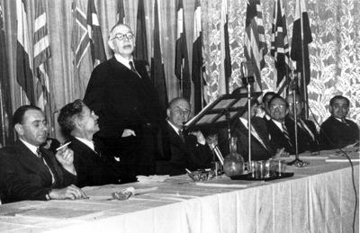
British economist Lord John Maynard Keynes (3rd l.) addresses the Bretton Woods Conference in July 1944

Slide 21
Keynesianism as Economic Principle
Government had a role in the management of the economy
KEY: Faith in the State

Slide 22
More Keynes: Programs
Physical development (roads and dams) and Economic Growth
Physical and Mental Change or Social Development
Human Resource Development vs. Social and Economic Change
Proposed a Mixed Economy—public and private

Slide 23
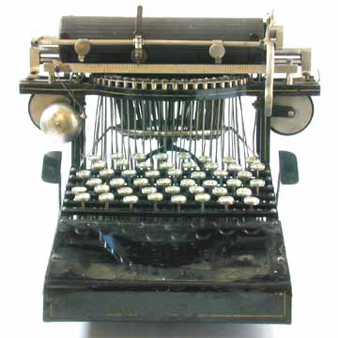
Modernization: Time sensitive

Slide 24
Modernization, Development Theory, and its Critics
A. Agraria vs. Industria

Slide 25
Development: The Modernization Definition
Agraria
Attitudes: parochial – fixed rules
Customs: particularistic / inherited
Status: ascriptive
Functionally: diffuse
Holistic Change
Lack of Specialized Roles
Result
Agricultural, rural, poor
Oral / illiterate
Authoritarian instability
Subsistence – non-monetary
Revolution and violence
Occupation fixed
Industria
Universalistic
Legal / Rational
Achievement Oriented
Roles Functionally Specific
High Degree of Technology
Manufacturing and Production
Oriented
Result
Commercial
Democratic / Peaceful
Occupational mobility
Literate
Urban, Rich
Incrementalism, Stability and Gradual Change

Slide 26
Beginnings of Development Theory- 1950s and 1960s
There existed…Many terms
Division of the world in the 1950s and after
Non-Western Colonial Dichotomy
Third World—West, East and "Non-West"
Developing States and Modernization
North vs. South states
More Developed vs. Lesser Developed Countries—LDCs
Keynesianism

Slide 27
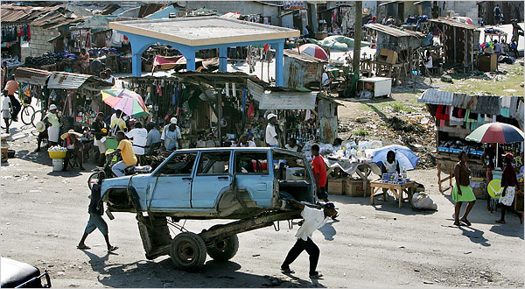
C. Concept of Modernization, Continued
Haiti: City Image
Dual Society / Dual Economy: Characteristics:
Tradition is source of poverty and underdevelopment
Modernization assumes dual economy with an enclave modern sector

Slide 28
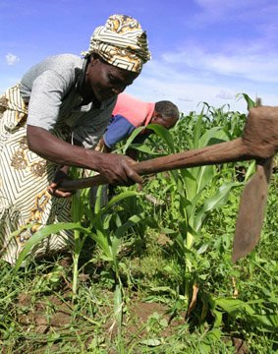
Concept of Modernization, Continued
Characteristics:
Concept of Empathy
putting oneself in the position of others, according to Daniel Lerner in The Passing of Traditional Society
Mobile personality or acceptance of new ideas
Series of individual changes affect society, including secularism, literacy, and urbanization
Society changed by mass based communications

Slide 29
Empathy?

Slide 30
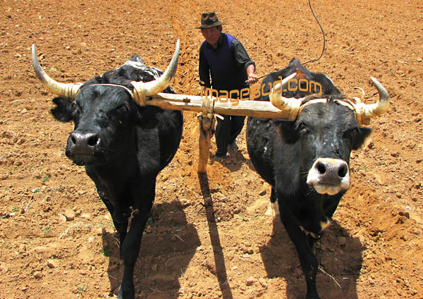
Modernization, Continued
Movement from traditional to modern (and rural to urban) in all societies
The “West” has distinguishing characteristics which distinguish it from Third World
Result is an assumption of Dichotomy
(references include writing by Talcott Parsons, Marian Levy, Frank Sutton and in modified form Fred Riggs)

Slide 31
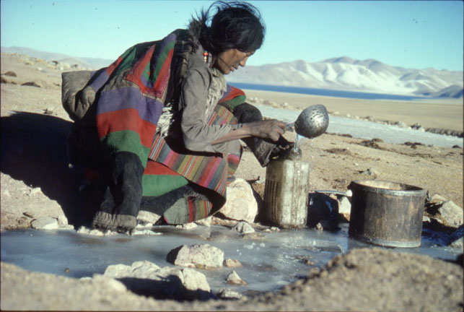
Concept of Modernization
Characteristics:
Social Mobilization (focus on value change)
Defined the process in which old social, economic and psychological commitments are “shaken off”
Social mobilization, and for some, forced value change was the key to modernization
Social Engineering

Slide 32
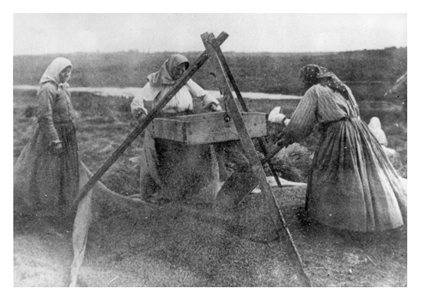
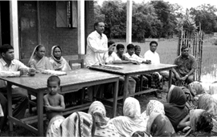
Social Mobilization- Continued
Advocates call for use of the mobilizing party for social engineering purposes (Sometimes Forced)
Goal became the use of the state to break down personal (organic) values and integrate modern values into a common political and socio-economic change system

Slide 33
Scholar OF THE DAY- Represents a Generation of Scholar Practitioners
Kathleen Staudt: Author, Professor of Political Science, University of Texas at El Paso
Peace Corps Volunteer in the Philippines (1966-1968) Researcher in Kenya- 1970s. Current focus, Mexico and U.S. Border issues
Helped found the Women and Development Sector of USAID
Raised Questions- Is there a grass-roots perspective? Role of Gender and Development?
Why or Why not?

Slide 34
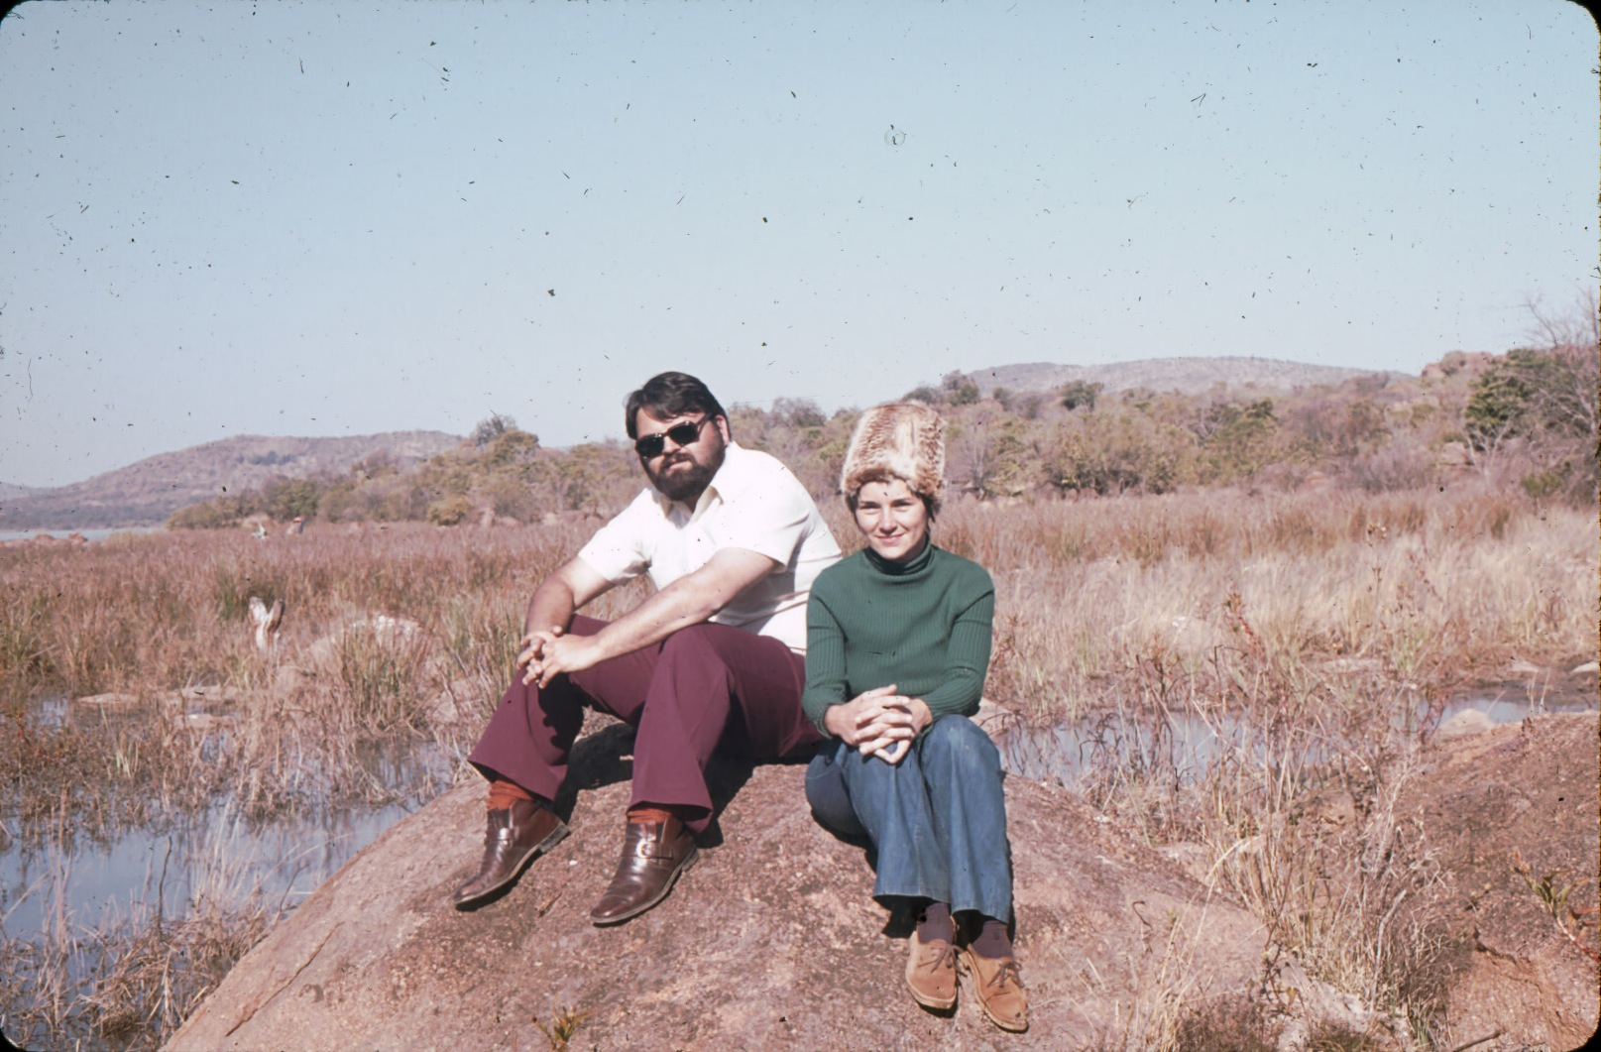
Staudt in Botswana, 1975

Slide 35
Gender and Development: Modernization vs. Traditionalism
Sue Ellen M. Charlton
Is gender discrimination a product of colonialism or
traditionalism?
Is Gender different in developing societies?
How are women under counted?
Is it a gender issue or a women’s issue?

Slide 36
Sue Ellen M. Charlton

Slide 37
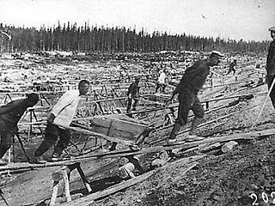
The Impact and End of the the Cold War
Dates: 1948-1991
Impact of Soviet Union on the Development Debate
Heavy Industrialization
Collectivization and State Farms

Slide 38
There Existed…The World Between 1950 and 1989
North America, Antipodes, Western Europe and Japan (First World)
The self-described socialist states—Eastern Europe, Soviet Union, China, most of South East Asia and Cuba (Second World)
Africa, most of Asia, Latin America, Middle East and Caribbean (Third World)

Slide 39
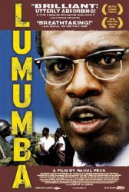
The Cold War
Proxy Wars
New and Old

Slide 40
The Arms Race

Slide 41
The End of the Cold War: 1991-2001
An expansion of the “concept” of developing and transitional states
Were also called “Newly Industrializing” or “Newly Emerging” or Transitional States
Impact of End of Socialism
Eastern Europe, Balkans, Turkic and Asian States, Russia, Ukraine and Belarus
Impact on “third world socialism” in Latin America, Africa and Asia

Slide 42
Ethiopia, 1991

Slide 43
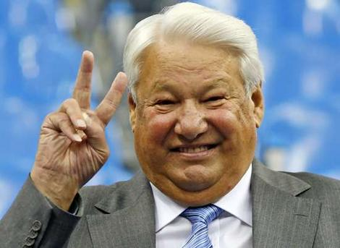
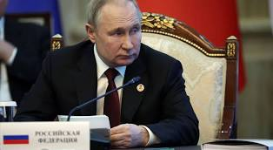
The Development Period: End of the Cold War: From Yeltsin to Putin
Begins with Arms Race of 1950s and ends with civil society and the collapse of the Soviet Union (1991)
Out of this comes the Transitional states as part of the developing world.
Ten Year Interregnum to September 11.
Putin’s World- Down to 2022

Slide 44
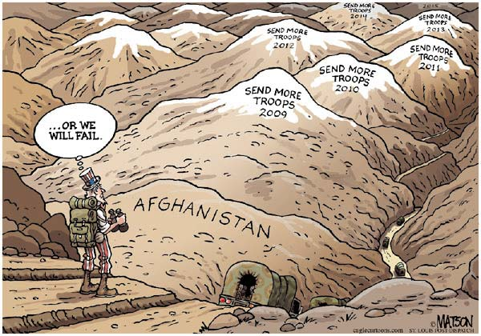
War in Afghanistan?

Slide 45
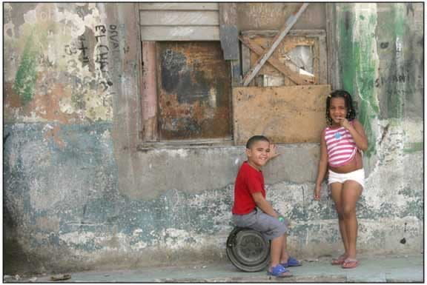
Poverty in Cuba A Future in Tourism?

Slide 46
Part of Concept of Modernization
Political Development
Two Themes-
Grassroots Perspective
Ignore Government- Focus on civil society and income generation
The Governance Perspective
Political Development is a prerequisite to social and economic development
Traditional society and modern society is a dichotomy

Slide 47
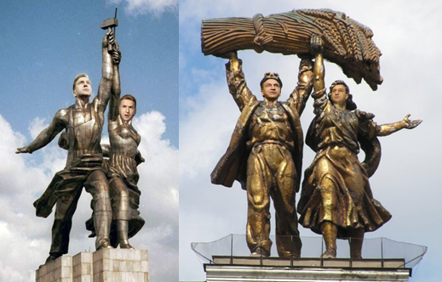
Concept of Modernization- Political Development
Governance Argument (political development as key)
Characteristics: Democracy and Governance vs. Bureaucracy
Bureaucratic Class (according to Manfred Halpern) are “modernizers” since only bureaucracy can penetrate rural areas
What is needed is a coalition between government leaders, the bureaucracy and industry (John Kautsky)
Russian State Heroes- 2007

Slide 48
The Problems of Development Management
Quote of the Week:
"...political systems in the developing areas must bear increasing responsibility for mobilizing the state's human and material resources in support of the objectives of economic and social mobilization."
Monte Palmer

Slide 49
Critiques of Modernization Theory- 1
Interpretations of Pre-Colonial Society
The heart of the matter: Pre-colonial and pre-modern society is characterized by violence, poverty and "Primitivism”
Modernization theory is based on this assumption (Joseph Conrad, Heart of Darkness Image)
The ecological approach and dependency theorists reject this
At issue is the idea of “balance”
Individuals and social groups were in balance with their physical environment

Slide 50
Critiques of Modernization- 2
Ecological View: Characteristics
People lived in "Primitive" communism and were hunter/gatherers
Subsistence farmers, grew grains and forged metals- They were in balance with environment
“Praxis” allowed individuals to control their interaction with nature

Slide 51
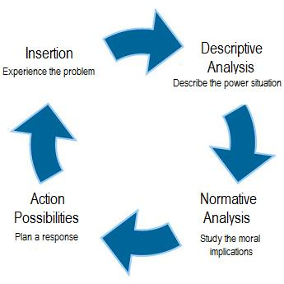
System in Balance

Slide 52
Ecological View
-Direct creative activity was used to procure food and shelter, through the use of own tools. Natural Life
-This was the Rousseauian Natural “Man.”
Jean-Jacques Rousseau (28 June 1712- July 1778)

Slide 53
The Ideal?

Slide 54
Ecological View
Change came with the development of excessive surplus, imbalanced trade, the creation of elites, domestic rule and then international empires.
Rome, China, and the land based Empires in Europe ending with Sea-Based Empires

Slide 55
A Natural Balance?

Slide 56
Critiques of Modernization Theory-3
Colonial Underdevelopment Argument: The Psychological Dimension
Focus of the debate—resistance vs. collaboration and its impact upon post-colonial society
Colonizer has an inferiority complex (Minnoni)
Colonial vs. colonized: (Memmi) colonized peoples have a dependency relationship with the West. It is based on the colonizer’s search for economic gain
Revolution as a cleansing process (Franz Fanon)

Slide 57
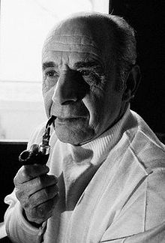
Octave Mannoni and Albert Memmi

Slide 58
Prospero vs. Caliban: Dependent Relationship
Prospero—In exile, isolated and inferior
Caliban—Dependence and the Fear of Abandonment
Further Reading:
Franz Fanon, Wretched of the Earth (New York: Grove Press, 1963).
O. Mannoni, Prospero and Caliban: The Psychology of Colonization (New York: Praeger, 1964)
Albert Memmi, The Colonizer and the Colonized (New York: Orion Press, 1965)

Slide 59
CALIBAN- Myth of Imperialism: 1500-1960
The Half Human Offspring of the Devil and a Witch who is a Servant of Prospero
in “The Tempest”

Slide 60
Critiques of Modernization Theory-Four
Colonial Underdevelopment Argument
Seeds of Violence and
Cognitive Dissonance
Role conflict (Robert Merton)
Indirect rule vs. assimilation
Role set (conflict between
colonial officials and Religious
or traditional leaders)

Slide 61
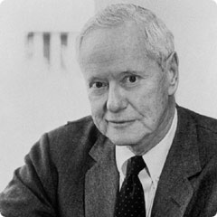
Robert Merton and Cognitive Dissonance: Fear of Social Division 21th Century World

Slide 62
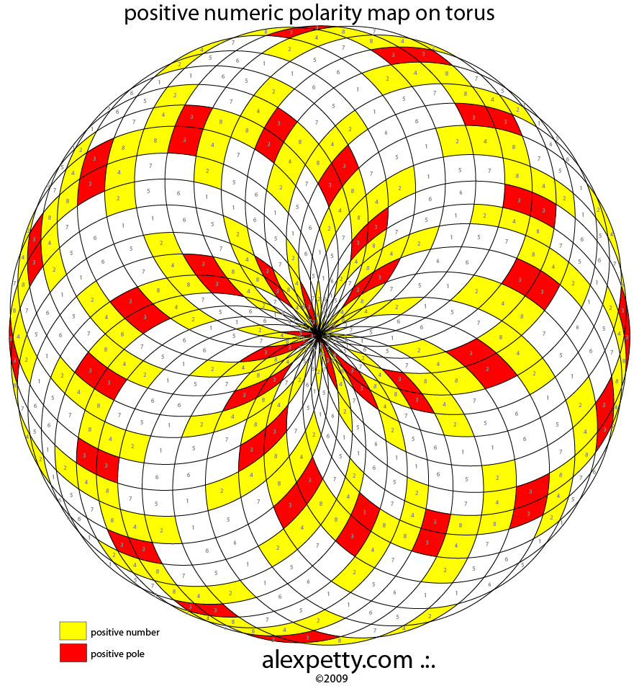
Critiques of Modernization Theory-5
Colonial Underdevelopment Argument
Traditionalism: Dichotomy or misplaced polarity (Gusfield)
Co-existence in Saudi Arabia and Japan
Modernization of Tradition in Swaziland
Secularization of tradition in Mexico

Slide 63
Critiques of Modernization Theory- Six
Interpretations of Underdevelopment and “Third Worldism”
Dependency Theory
Underdevelopment theorists critiqued Modernization Theory:
Modernization theory had its origins in Colonial ideology and the anthropological ideas that supported it.

Slide 64
Dependency Theory
During 500 Years of colonialism Northern Tier states used colonialism to extract from LDCs
Result often was the destruction of local production, agriculture and food production
The colonial government supported export import trade and where possible, SETTLERS
Europe became dependent on extraction from the “third world”

Slide 65
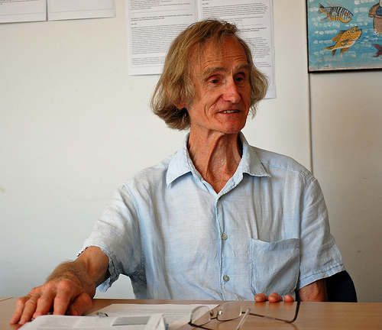
Interview Robert Chambers Research Associate at the Institute of Development Studies, University of Sussex, United Kingdom
He was born in 1932 and is an academic and development practitioner
Equity not Growth
Advocate of the
“participatory“
approach to
development

Slide 66
Underdevelopment and Dependency
Structuralism
Biology in the Tropics
Inelasticity of Tropical Products
Rigidity of Extractive goods

Slide 67
“Underdevelopment in History”
Rejects Dualism and “stage theories” of development (Keith Griffin)
Africa, Asia, Latin America not historically under-developed
European nations took slaves, metals and raw materials to build industrialization and grow their economies between 1500 and 1900
Empty Bucket- Full Bucket

Slide 68
Dependency Theory
and the beginnings of Dependency theory
Structuralism and
Interpretations of Underdevelopment and “Third Worldism”
In the beginning (1500) LDCs were self-sufficient at low level
Argument: Europe used its empire to market surplus goods and pay sub-economic costs for raw materials, agricultural products and minerals
Issue: Inelasticity (tropicalism vs. “underdevelopment”)

Slide 69
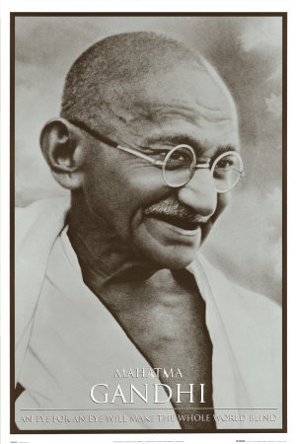
The Beginning of the Development Era
The End of Colonialism- Decolonization after World War Two

Slide 70
Keynesianism- Keynes on the End of the Gold Standard VIDEO
The Keynes Message

Slide 71
Interview Robert Chambers Research Associate at the Institute of Development Studies, University of Sussex, United Kingdom
Equity not Growth
Advocate of the
“participatory“
approach to
development

Slide 72
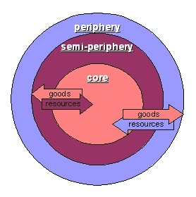
Dependency Theory VIDEO
Debates
About Chile
Dependency
Theory and Neo-
Orthodoxy
“The Chicago
Boys”

