Slide 1
Marginalization: Dehumanization- The Uganda Project
PIA 2528
Governance, Local Government and Civil Society
Historical Patterns of Local Control

Slide 2
The Nature of Political Control

Slide 3
The Nature of Political Violence

Slide 4
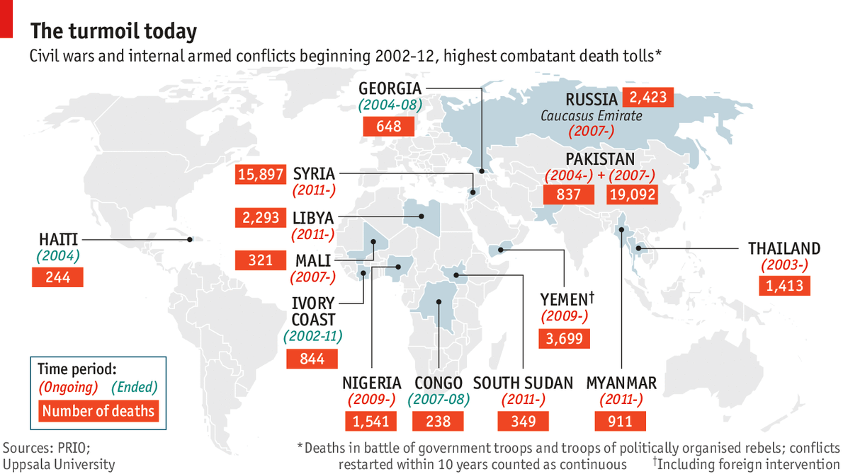
Conflict 21st Century: Civil Wars

Slide 5
Dehumanization: Impact on People
Abandonment of Children (Street Kids, Kidnapping and Child Soldiers)
Brutality (Rape, Gender Violence, Acid Attacks, Burns)
Atomization (Shunning, Exploitation and Death)
Marginalization (Subordination and Exclusion from the Social System
Violence and Genocide

Slide 6
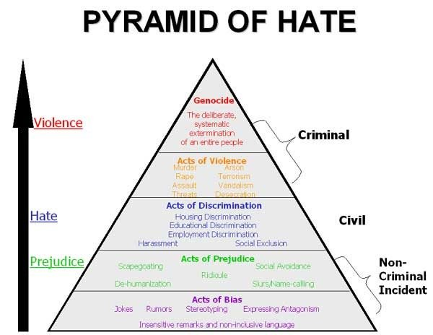
Marginalization: The Creation of Hidden People

Slide 7
Types of Hidden Peoples: World-Wide
Indigenous People- First People who lived in a place
Threatened People- Race, Gender, Ethnicity, Religion and Language
Endangered- At risk of Extinction
Marginalized- Shunned in War and Peace- Children, Women, People with Special Needs (Social, Physical and Mental)

Slide 8
Gypsies (Roma), Untouchables (Dalit) and Bushmen (San)

Slide 9
The Uganda Case Study: Language and Ethnicity
Internal vs. External Refugees- Anger and Resentment
Three “nations” (Bantu Speakers, Luo Speakers and Central Sudanic)
Marginalization in War and Peace
From Victim to Survivor: Goal
Focus on Governance in a Divided Society

Slide 10
A Formula for Disaster

Slide 11
Katwe Uganda 2018

Slide 12
500,000 Killed--1,000,000+ Displaced LRA War Joseph Kony & Friends “Lords Resistance Army” Gulu Uganda 1986- Present

Slide 13
Hidden Peoples Projects
University of Pittsburgh
ASA SOCIAL FUND FOR HIDDEN PEOPLES

Slide 14
ASA Social Fund for Hidden Peoples
Our Vision:
Combining social entrepreneurialism with philanthropy, in order to provide support for income generation (Micro-Loans)
Ensure people have the right to access work
Provide access to health and education​
Ensure all have reclaimed basic human rights and are entitled to human security
www.asasocialfundforhiddenpeoples.org

Slide 15
Our partners Victoria Nalongo Namusisi Founder Director Bright Kids Uganda Children’s Home and Bright Kids Enterprises 2000-2020 Speaking at University of Pittsburgh 2013

Slide 16
Medi Bugembe- Great Kings and Queens Centre
Katwe Uganda

Slide 17
Noah’s Ark Special needs school Entebbe

Slide 18
MULTI-MEDIA APPROACH From Victim to Survivor: Information and Advocacy
BOOK PROJECT
UNIVERSITY OF PITTSBURGH
FILM PROJECT
ASA SOCIAL FUND FOR HIDDEN PEOPLES
PAIGE ALDERSON NOAH,
ASHLEY SAXE
AND
LOUIS A. PICARD
PAULINE GREENLICK
AND
WILL ZAVALLA

Slide 19
Individual Stories of Hidden People Marginalized by War
Interviews: Abducted Children, Rape Victims, Child Soldiers and “War Brides” plus LRA and Uganda Military
Stories of Struggle, Survival: Orphaned, Maimed and Rejected
Some Look for Hope and Become Survivors
but Others Do Not- The Young Boys and the Next War (Kony Is Still Alive- and Around)

Slide 20
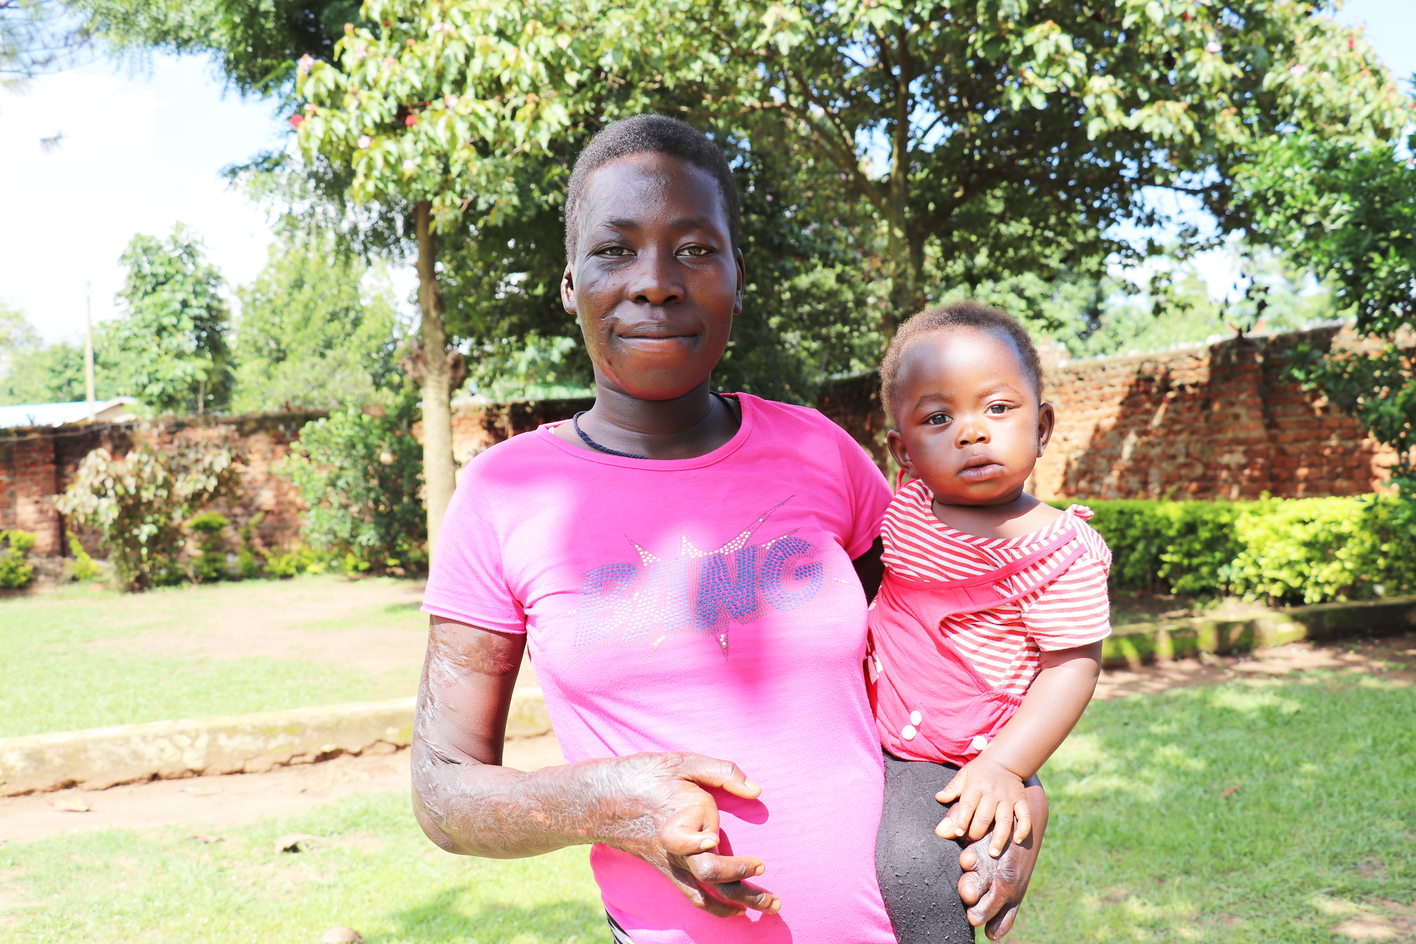
Micro-Enterprises
Land Mine And burn Survivor
GULU

Slide 21
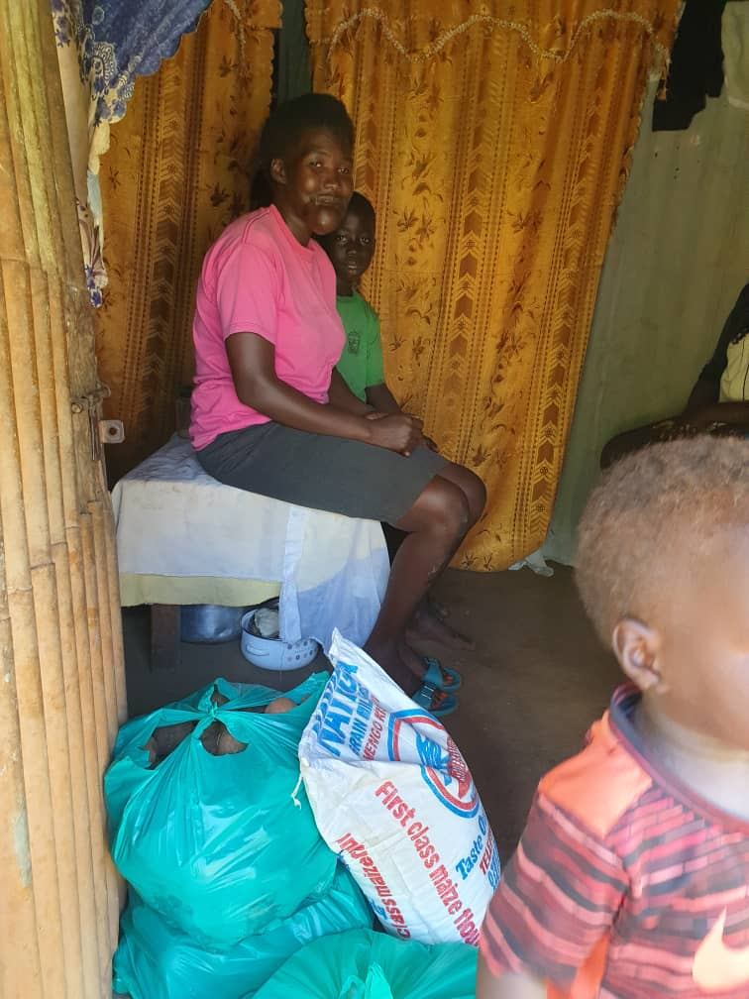
Civilian Casualty of War: Gunshot wound through the mouth Emergency Grant and And Micro-Loan

Slide 22
Acid Attack Survivors Skills Development

Slide 23
Barlonyo Uganda ASA/BKU Projects

Slide 24
ASA Social Fund for Hidden People: Documentary Film Project
Background and Scouting of Film- June 2019
Focus on Gulu Uganda
War Victims and Survivors
January 2020- Filming and Interviews

Slide 25
ASA Social Fund for Hidden People film Working Title: Kony 2021
THREE THEMES
Kony 2012: Viral YouTube Video: Simplistic Solution:
Catch Kony Ends The War
2. Complexity: Religious and Political Element
3. War Ended 2006. For the Victims the War has Not Ended
4. Impact on Individuals: People Want Their Voices Heard

Slide 26
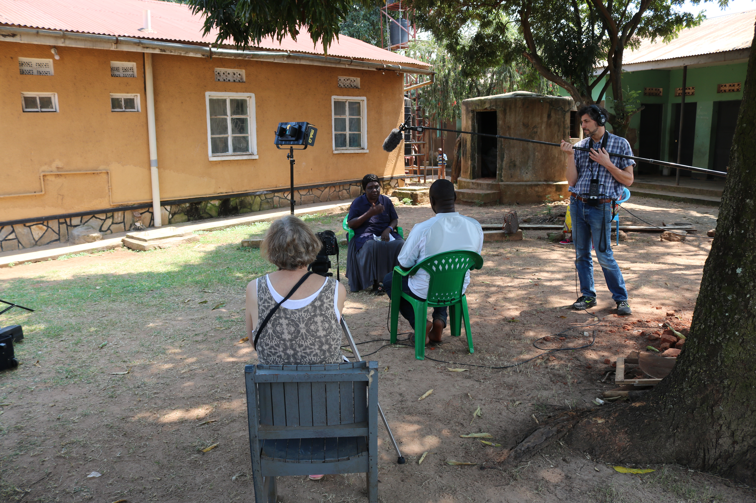
Post-War Gender violence Activist

Slide 27
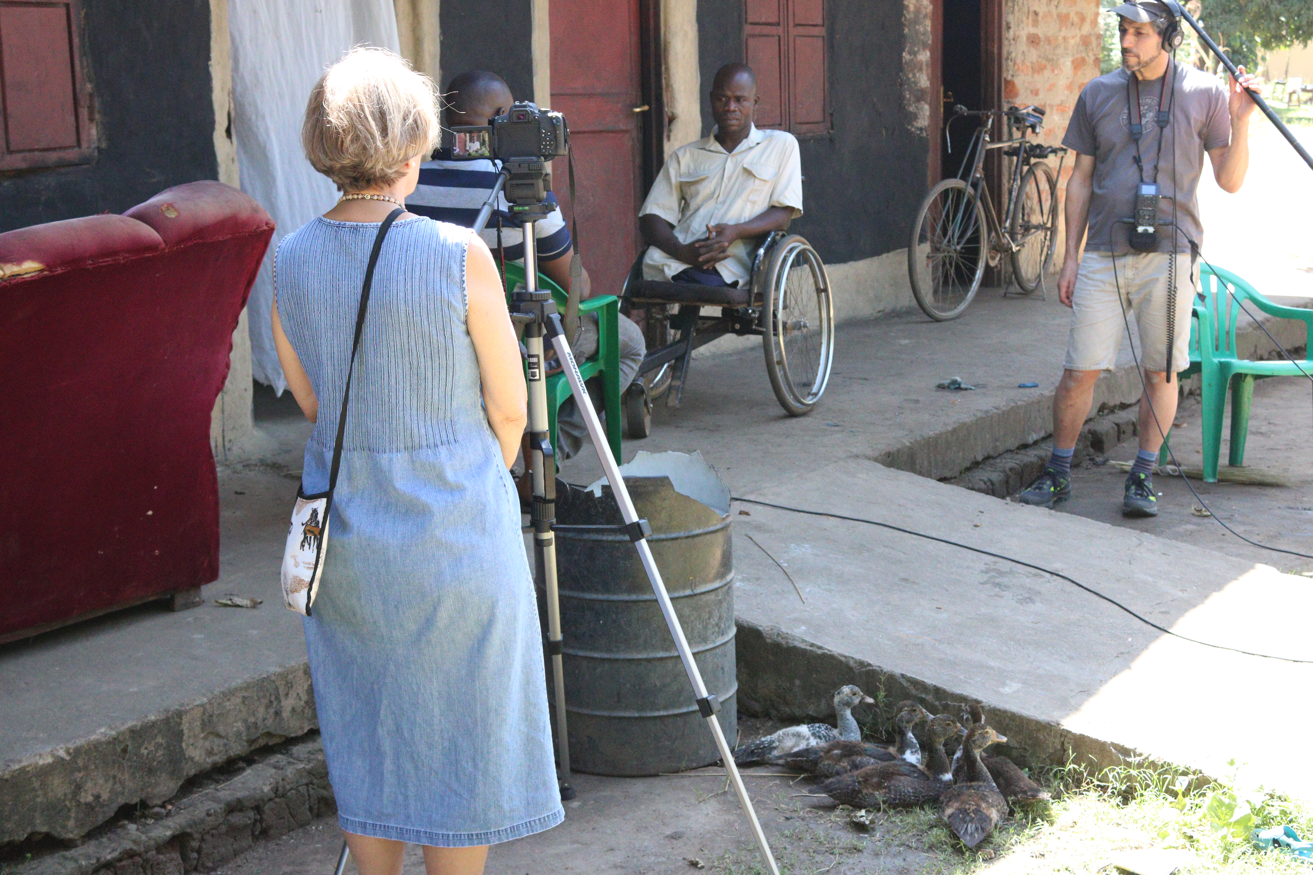

Slide 28
Interviewing Uganda Army Officer

Slide 29
Future Activities
November 2021- Focus on the Young Generation - Street Children
Focus in on the Day to Day, on Realities of Life in Gulu
Draw a Rich Personalized Picture of Gulu- Once the Epicenter of this Horrific War
How They Are Coping

Slide 30
And now for a Bit of Advertising
ASA Social Fund for Hidden Peoples
https://asasocialfundforhiddenpeoples.org/

Slide 31
QUESTIONS AND DISCUSSION

Slide 32
THE MOST IMPORTANT NUMBER IS ONE Produced by Pauline Greenlick
Streaming: Amazon Prime, VIMEO, Lady Film Makers Film Festival Awards:
Best Documentary Lady Filmmakers Film Festival
Gold Movie Award Competition
Film Festival Selection: WRPN TV Short
Award of Recognition Accolade Global Film Festival

Slide 33
Geographical Patterns: The Institutional Legacy: Groups
Regional Interests?
Try to DIAGRAM the colonial structure (de jure or de facto) for your part of the world and Discuss “Colonialism” and “illiberalism” in aa country you are interested in?
Identify patterns of Institutionalized Governance, Local Governance and Civil Society in your country- Identify the (reading) source of pattern.

Slide 34
The Most Important Number is One
FILM

