Slide 1
PIA 2528
Governance, Local Government and Civil Society
The Local State, Local Government and Democracy:
Historical Patterns of Conflict and Governance

Slide 2
What’s Ahead
Our task: look at how authority is dispersed to understand why governments act the way they do
  Vertical
  Horizontal

Slide 3
Authority
This leads to the core issue for this course
It’s not just the U.S.: it all has to do with the intergovernmental structure, specifically how authority is dispersed in different parts of the world

Slide 4
Types of Government
Confederations
Federal Systems
Unitary systems

Slide 5
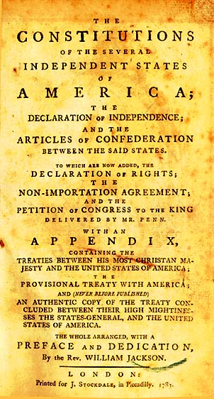
Articles of Confederation

Slide 6
Confederation and loose confederal relationships
Power lies with the sub-units
U.S. Articles of Confederation-BREXIT
NAFTA
European Union
Mercesor
ASEAN
Southern African Development Council (SADC)
Economic Council of West African States (ECOWAS)

Slide 7
Federal Relationship
Some power lies with the National Unit
Some power lies with lower units Federalism
Can transfer additional authority back to the sub-units but not take power away from the federated governments

Slide 8
Federal Relationships
FEDERAL SYSTEMS
This is the key Distinction:
1. Lower units cannot break away from the National
Unit
2. National Unit cannot take power away from the lower units

Slide 9
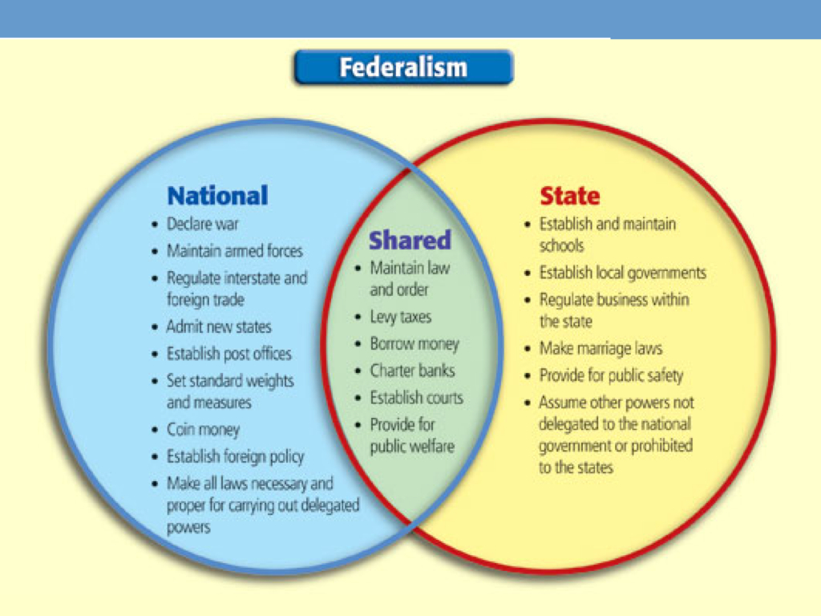
Federalism
Second-order subdivisions (e.g. states) hold some inviolable powers, for example, in the U.S.:

Slide 10
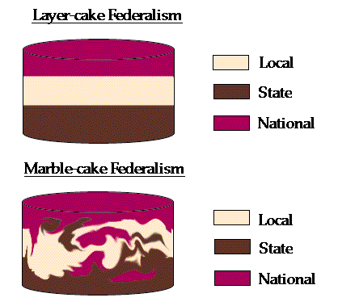

Layer Cake vs. Marble Cake (Reality)
Iraq?

Slide 11

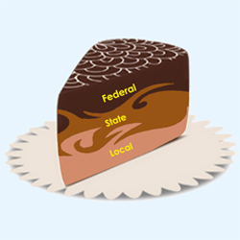
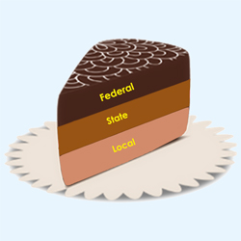
Evolution of Systems: the U.S.
Evolution: from layer to marble cake
Why the shift to mixed marble? What effect do you think the shift has had on governance?

Slide 12
Federal Relationships
Examples:
USA
Mexico
Canada
Germany - Federal Republic
Nigeria
Brazil
India
Russian Federation
Austria
Switzerland

Slide 13
Unitary Systems
All power ultimately lies at the national level
What power the local level has, is given to it by the national level
The power that the national unit has given to the local level can also be taken away from it

Slide 14
Unitary Systems
Examples:
United Kingdom
France
Denmark
Costa Rica
Thailand
Kenya
Ivory Coast
South Africa? (Unitary or Quasi-Federal)
Hungary

Slide 15
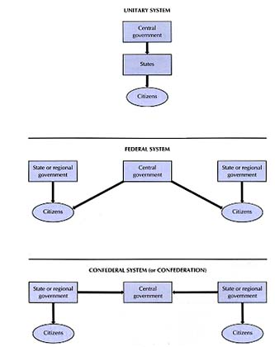
A Comparison of Systems

Slide 16
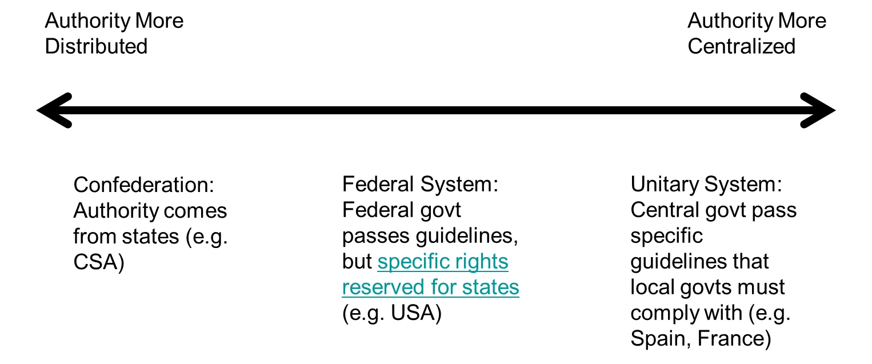
Continuum of Vertical Dispersion- Complexity
We can arrange states on a continuum depending on how centralized power is in the main government

Slide 17
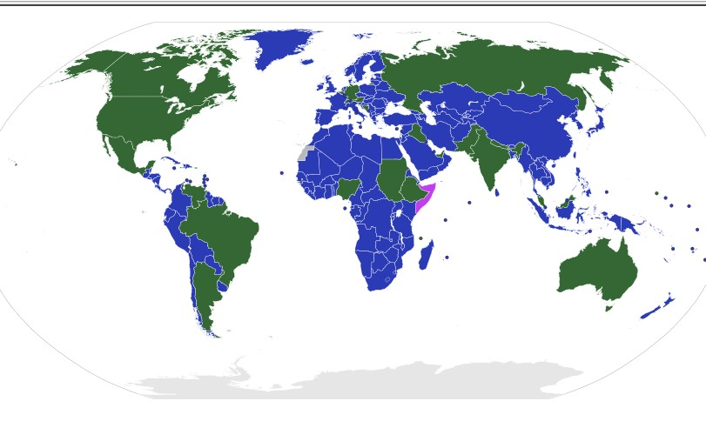
Unitary & Federal Systems

Slide 18
United Kingdom: a Unitary Government
Unitary state: centralization of power in nation’s capital, little autonomy for sub-divisions
First-order government
Local government
Since 1999- devolution of power to more local levels: new Scottish parliament can now raise taxes, run Scotland’s medical services

Slide 19
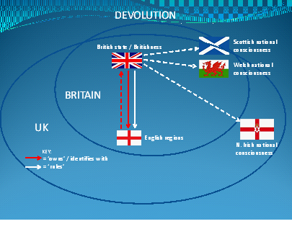
Evolving Devolution

Slide 20
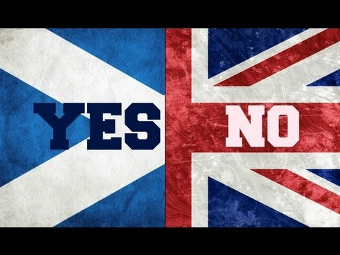
United Kingdom: a Unitary Government
Since 1999- devolution of power to more local levels: Question: Will the U.K. Survive?
Issue of Brexit

Slide 21
Returning to a Strange Policy- Unitary Systems in Federal Systems (U.S. Example)
Decentralized decision making in policies (but feds supreme)
“Power struggles” & tension
Battle: tailoring policies to specific locales v. creating uniform policies (e.g. civil rights leg.)

Slide 22
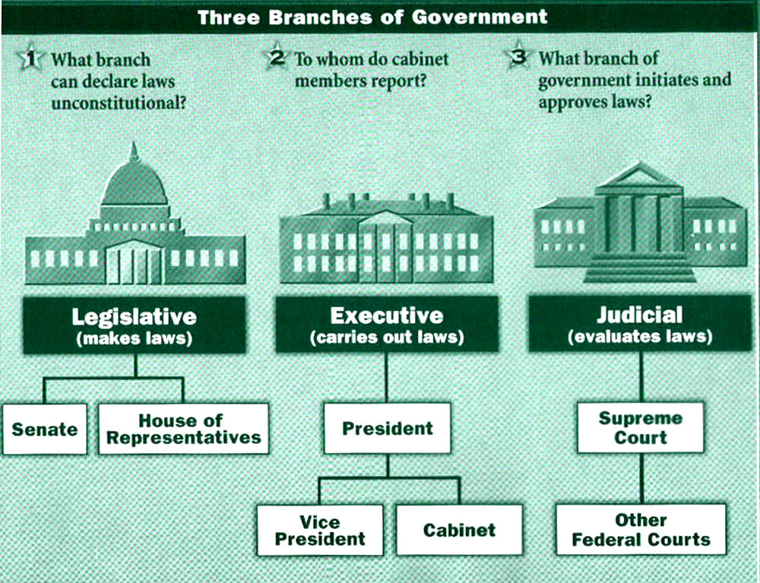
Separation of Powers vs. Parliamentary Systems
Greater horizontal dispersion of power, requires coordination to enact policy, slows process

Slide 23
Separation of Powers
Each particular branch has special powers and can weigh in on an issue
  For example: budget policy

Slide 24
United Kingdom- A Fusion of Powers: Review
The executive branch is an offshoot of the legislation branch
How? The prime minister is from the winning party in the legislative branch, assembles a cabinet from legislature
  Examples: Germany, U.K., Japan
  Cabinet selected by legislature which is elected by voters

Slide 25
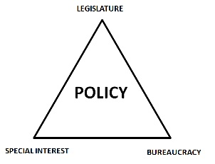
Other Forms of Horizontal Dispersion: Iron Triangles
Separation of powers explain some, but not all of horizontal dispersion
Division by functional policy area (e.g. heath, agriculture)
Each actor gets “something” in return, overlapping interests
Key “fuels”: logrolling, pork barrel

Slide 26
Summing Up
Dispersion of authority in a government both vertical and horizontal can affect policy outcomes
Vertical dispersion: unitary, federal, and confederal
Horizontal dispersion: separation of powers & fusion powers

Slide 27
Decentralization and Local Government: Models
Devolution- Political
Deconcentration- Administrative
Delegation- Public Organizations
Privatization- Contracting Out

Slide 28
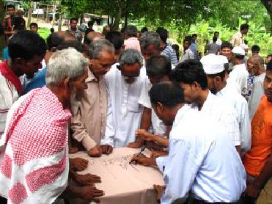
Decentralization: An Overview
The Local Governance Debate
Devolution of Authority

Slide 29
The Primary Unit of Government
Municipality: Lowest level with Bureaucrats
English/American
  Town vs. county (Rural vs. Urban)- Counties in U.S.
Continental European
  Commune (no distinction between rural and urban)

Slide 30
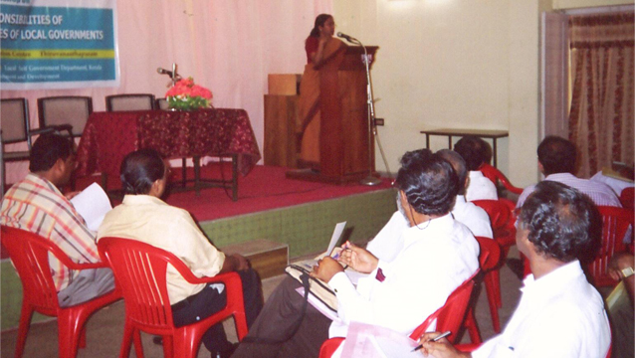
The Local Meeting

Slide 31

European Union Poster- The Importance of Local

Slide 32
Decentralized Governance:
Subsidiarity- higher units of Government should not do what can be done by lower units
Principle used by European Union
Not necessarily Based on the separation of powers

Slide 33
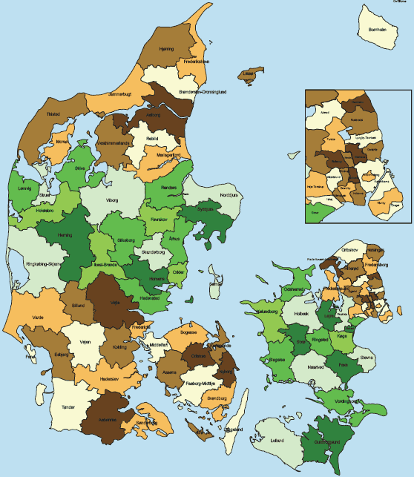
Denmark Communes

Slide 34
What Local Government Does
Services- Depend Upon:
  Fiscal/budget allocation
    Taxes and transfers
  Planning
    Strategic priorities
  Managing
    Implementing (water, sanitation, roads, etc)

Slide 35
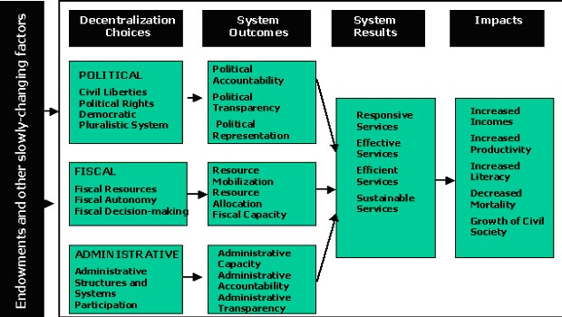

Slide 36
The Incoherence of U.S. Policy
From “night watchman state” to behemoth
  89,500 separate governments
  Why do you think government has changed in the U.S. so much in the last 150 years?
Intentional & unintentional: “whole system lacks coordination, coherence, and control”

Slide 37
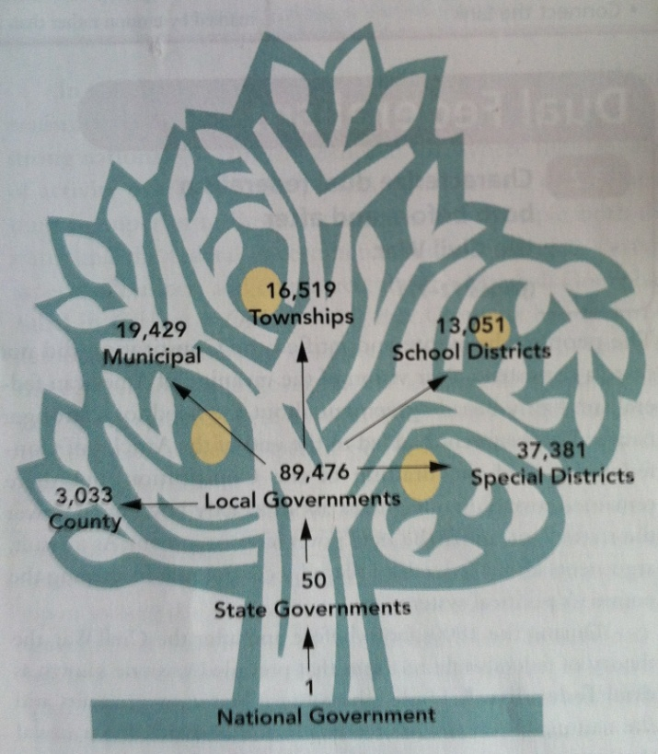

The Size of U.S. Government: Unitary below the state

Slide 38

The Development vs. Governance Debate
States will necessarily remain central actors in development policy and development management."
Milton Esman (born
in 1917 (Cornell)

Slide 39
Local Government and the
Local State
Local State – Local administration Offices
Functional vs. Territorial Control
Devolution- Key to Local Government
  Urban vs. Rural
  Urban linked with Rural

Slide 40
State Societal Linkages
Central State - Macro
Weak
Strong
SOFT STATE…………………………….PREDATORY STATE
State-mezzo Weak
Strong
Mono-State…...INTERGOVERNMENTAL Systems in place.…..Local State
Civil Society - Micro
Weak
Strong
Local - SOFT STATE….………………LOCAL GOVERNMENT

Slide 41
Deconcentration- Local State: World Comparison
Functional vs. Prefectoral
Prefectoral integrated
Prefectoral unintegrated

Slide 42
Control Systems
Functional
Home Affairs
Local Govt.
Public Works
Agriculture
Education
Labor
Council
Public Works
Office
District Ag.
Office
District Ed.
Office
District
Labor
Office

Slide 43
Control Systems
Prefectoral - Integrated
Interior
Local Govt.
Public Works
Agriculture
Education
Labor
District
Office
Council/Chief
Public Works
Office
District Ag.
Office
District Ed.
Office
District
Labor
Office

Slide 44
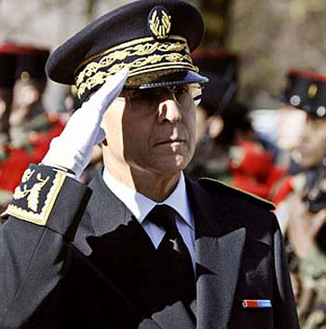
French Prefect Jura Region
Aissa Dermouche. FRance

Slide 45
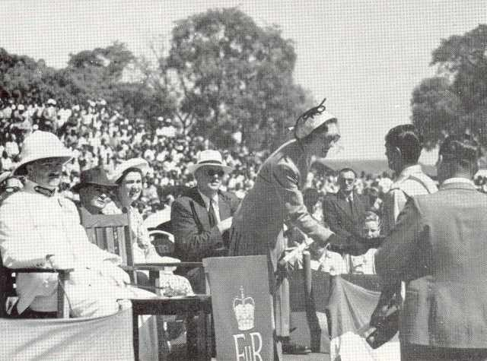
Colonial District Commissioner (Prefect)

Slide 46
Control Systems
Prefectoral - Unintegrated
Interior
Local Govt.
Public Works
Agriculture
Education
Labor
Police
District
Office
Police
Council/
Chief
Public Works
Office
District Ag.
Office
District Ed.
Office
District
Labor
Office

Slide 47
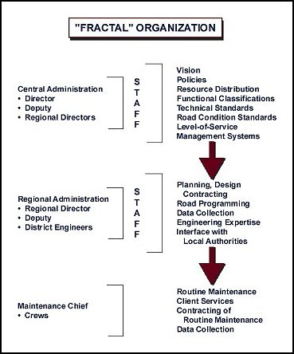
Deconcentration

Slide 48
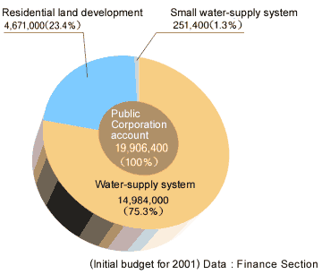
Delegation
City Water Supply System

Slide 49
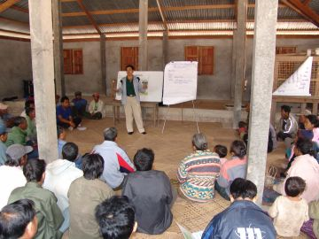
Agricultural Extension-Laos

Slide 50
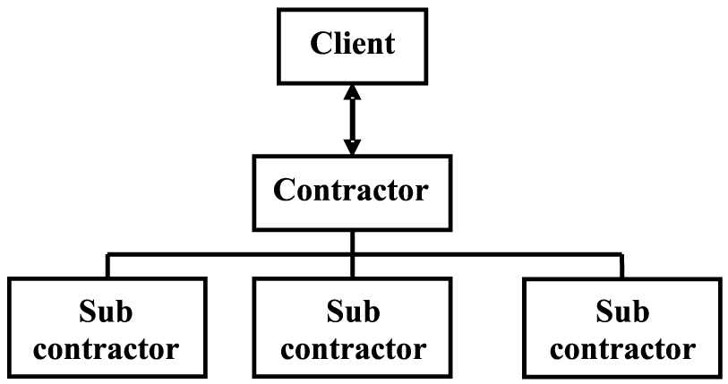
PRIVATIZATION- Government as Client

Slide 51

On the topic of giving up poweR. The FinAL Step
Privatization: Transfer function out of government sector to the For Profit or Non-Profit Sector
  For example, private prisons

Slide 52
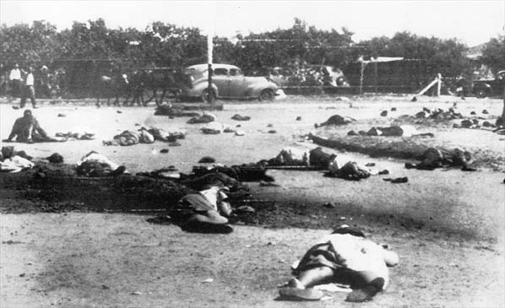
Sharpeville Massacre- Predatory State (21 March, 1961). Back to the Uncivil state later in the course.

Slide 53
Discussion Session
Governance and Democracy

Slide 54
Robert Dahl, A Preface to Democratic Society
What is at the Crux of “Madisonianism?”
How would you critique Madisonianism?
What is the difference between “republicanism” and “democratism” (small d and small r).
What is the unique problem of power, according to Dahl? How does one deal with power?

Slide 55
Steven Levitsky and Daniel Ziblatt, How Democracies Die
What are two ways that Authoritarians Can Come to Power?
What are the Characteristics of an Authoritarian?
What Does Gatekeeping mean from the perspective of Protecting Democracy?
How relevant is the History of Authoritarianism to America in 2018?

Slide 56
Nadine Gordimer, “Town and Country Lovers”
What do these stories say about South Africa?
What do they say about the legal and moral landscape of the Country?
Do these stories describe what is at the Heart of Racism? [Money, Violence or Sex?]
How do the stories relate to Democracy and Governance?

Slide 57
Background Discussion
Discussion One: What is unique about Governance in different parts of the world?
Discussion Two: Limited Government-
What is it?
Why do States Fail?
Discussion Three: Command Economy? Is it Dead?

Slide 58
Videos to watch- Separation of Powers
Example of separation of powers in action: the “Debt Ceiling”

Slide 59
The Difference Between Policy and Management
The Difference between policy and management

Slide 60
The Importance of satire in Politics
VIDEO:
On ”Xenophobia”

Slide 61
Political Satire: A View from India
VIDEO

