Slide 1
PIA 2528
Governance, Local Government and Civil Society

Slide 2
Today: Governance an Overview

Slide 3
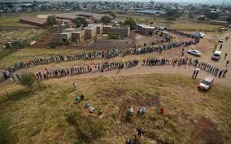
Background to Democracy
Soweto South Africa: June 7, 1994

Slide 4
The Course: Governance Local Government and Civil Society
This course will attempt to define this balanced relationship by looking at issues of:
Governance, local government, and civil society
In North America, Latin America, East and West Europe, the Middle East, Asia and Africa.
LDCs vs. MDCs

Slide 5
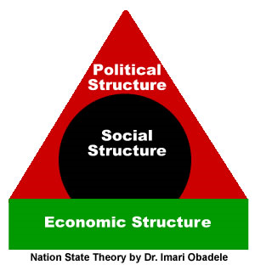
Core Terms: Look for in Reading
Governance
State
Sovereignty
Nation
Government
Democracy
Local State/Local Government
Civil Society

Slide 6
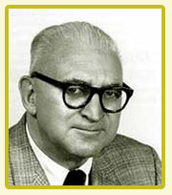
Government: Two Definitions: Both Important
Who Gets What, When, Where and How
Harold D. Lasswell
1902-1978
The Authoritative Allocation
of Values
David Easton 1917-2014

Slide 7
Governance: Standard Definition
Governance comprises all of the processes of Authoritative Decision-Making:
– whether undertaken by the government, by a market, or by a network
– over a social system (family, ”tribe,” formal or informal organization, over a territory, or across territories) –
and whether through the laws, norms, power, or declarations of an organized society. Key: MANDATORY

Slide 8
Good vs. Bad (Weak) Governance

Slide 9
Theme: The Importance of Governance for Policy and Management
Basic Theme: Governance and Economic Development
Economic Development and management theorists and practitioners need to be careful that their formulas for social and economic change do not to do more harm than good.
Key: Balances- Public-Private-Non-Profit
Problem-Weak Governance vs. Bad Governance

Slide 10
Terms: The State
The state as an analytical concept refers to an idea or set of ideas as to how government relates to society;
National level Government structures (Not as in American or Indian states)
The state system, by the nineteenth century, had acquired its modern form (in Europe) as a steering mechanism over societal forces and an institutional apparatus with human and structural characteristics;

Slide 11
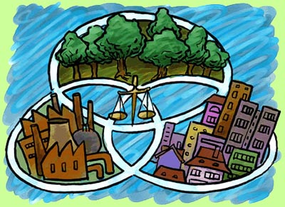
Command vs. Libertarianism: The Need for Balance

Slide 12
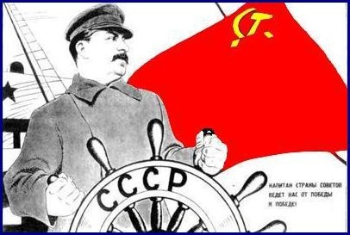
The State: Collectivist vs Libertarian

Slide 13
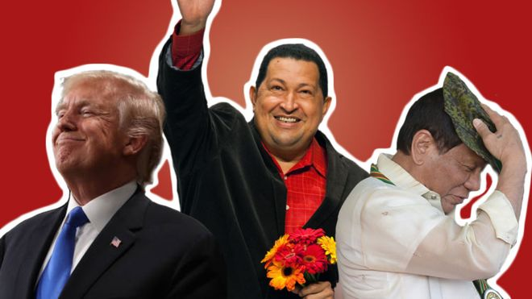
Populism vs. Mob Rule? Roberto Duterte, Hugo Chavez plus one
"the pure people" and "the corrupt elite” (Bad Governance?)

Slide 14
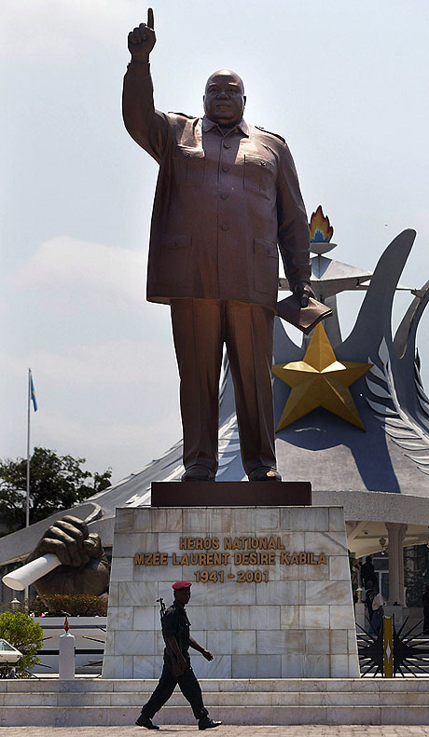
Critique:
Populism
Leads to
“The
Leader”

Slide 15
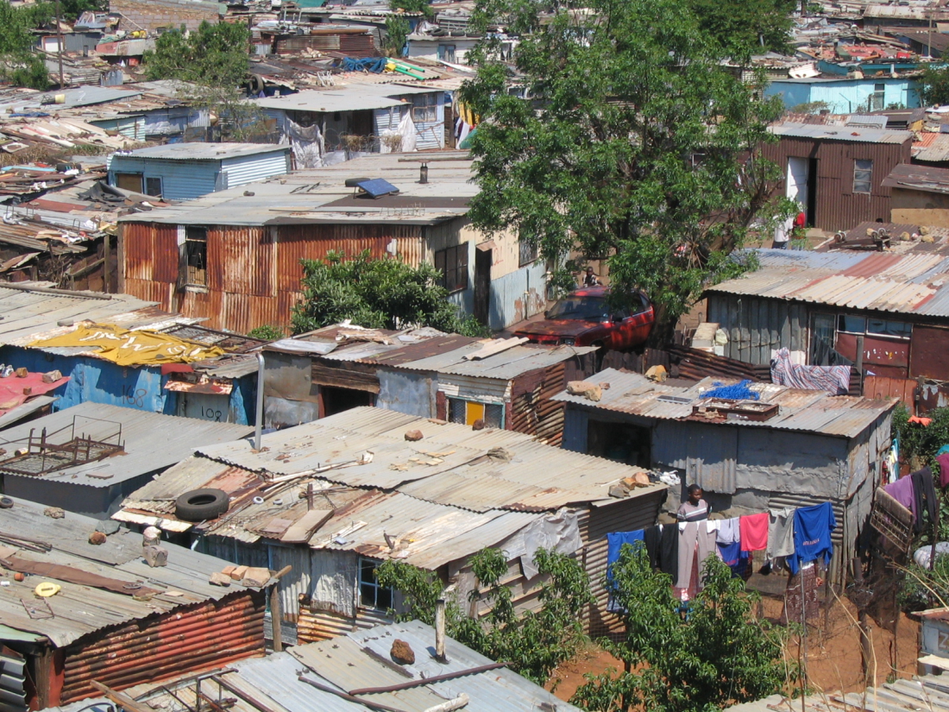
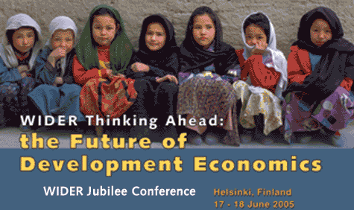
The Problem with libertarianism: Poverty and Inequity

Slide 16
Principles of the International State System
Sovereignty
Principles crucial to modern international relations
The inviolability of borders and
Non-interference in the domestic affairs of sovereign states

Slide 17
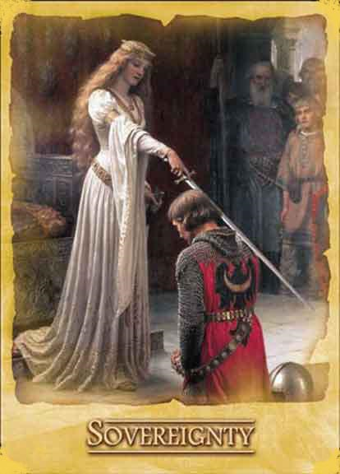
Undividable Authority
Sovereignty
(Term)

Slide 18
Treaty of Westphalia: 1648
Established the idea of co-existing Economic Entities SOVEREIGNTY

Slide 19
Terms: The Nation
A large body of people united by common descent, history, culture, or language, inhabiting a particular country or territory
Vs. Sub-national Groups
Mono-National vs. Multinational (Norway vs. India)
Issue of Ethnic Groups (Language, Culture, Common History)
So Called “Settler States”

Slide 20
Ethnicity in Latin America

Slide 21
Term: Rule of Law

Slide 22
Reality: South Asia State, Ethnicity and Corruption (Fragile or Collapsed State)

Slide 23
The Institutional State-1
The institutional state can be defined as the set of structures and processes;
including the public service, the nature of social relationships, networks and internal (formal and informal) organizational dynamics;
which—though it evolves over time—is a permanent part of the dynamics of government.

Slide 24
U.K. Government Institutions

Slide 25
Focus on The Institutional State
The contemporary capitalist state makes and influences investment decisions and it is often the mission of the state to sustain conditions in its economic management and coordination conducive to investment;
It does so, while simultaneously pursuing revenue-consuming distribution policies indispensable to its legitimacy.
And addressing demands for staying out of private sector social and economic activity.
Current debates question the contemporary Mixed Economies of Governments

Slide 26
Problem: State Failure

Slide 27
The Institutional State-2
Formal institutions are organizationally based units which have effective authority over aspects of policy and implementation and
are based on formal rules, common values, and standard modes of behavior and regulations that are widely accepted
For the state to serve society, the bureaucracy must see themselves as parts of the institutional system.

Slide 28
Instability and Political Risk

Slide 29
The Institutional State-3
Distorted institutional relationships occur when groups and individuals identify only with their own immediate interests;
This disjointed institutionalism, sometimes resulting in corruption, is difficult to change once it is installed. A state, once institutionalized, has a formidable capacity for its own reproduction across time;

Slide 30
U.S. Institutional Processes

Slide 31
The Institutional State 4
National Identity, ethnic, racial, religious loyalties often distort the Institutional State
Differences between politics and administration do not exist in disjointed systems
Often systematic efforts by new regimes to uproot prior forms and build new blueprints over state and society can fail.

Slide 32
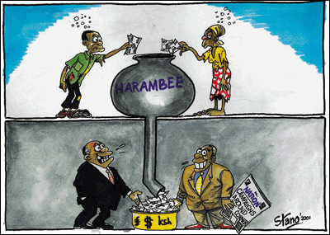
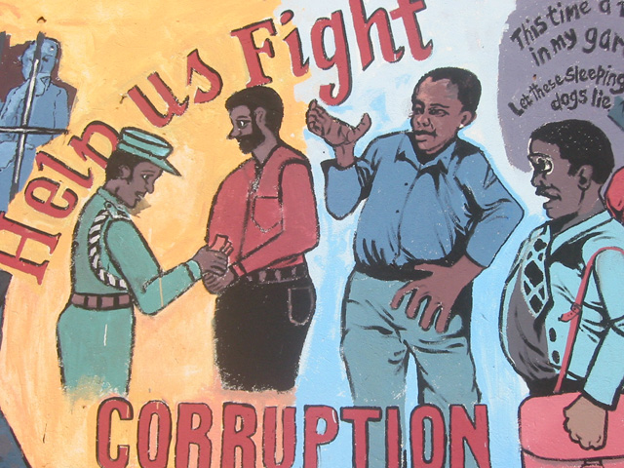
Key to Governance Failure: Corruption

Slide 33
Two Final Concepts
1.Local Government:
Sub-national
Intermediate vs. Primary Government
2. Civil Society
Not Government
Not Private Sector

Slide 34
The Local State vs. Local Government
Democratic stability requires both a strong state and societal strength based upon the values of civil society and democratic institutions imbedded in a wider network of state and social organizations.
The "local state" is not synonymous with local government. The former reflects the local control mechanisms of the central authority.
The latter reflects a bottom up process of political influence and control based on principles of democratic government.

Slide 35
The Problem

Slide 36
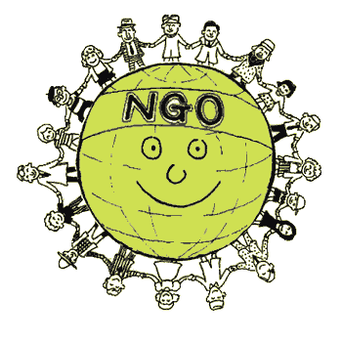
More Basic Terms
Happy NGOS?

Slide 37
Institution Building vs. Nation Building: Summary
Stable democracies require social strength to maintain a civil society and a bureaucracy that sees itself as part of an institution, as having interests wider than its own organizational or class interests.
It is important that "institution building" rather than "nation building" take precedence, particularly in an ideologically divided or a multi-ethnic (multi-cultural) country.

Slide 38
Governance Redeux
Danger: Reification of the State. Leads to AUTHORITARIANISM
The state is not a unitary actor but is made up of human and organizational components which cooperate and compete and which link up with and influence civil society;
To repeat: the state is no unitary instrument. Rather, it is a complex system shaped by the integration of political officials, civil servants, external actors, and social, ethnic and racial divisions.

Slide 39
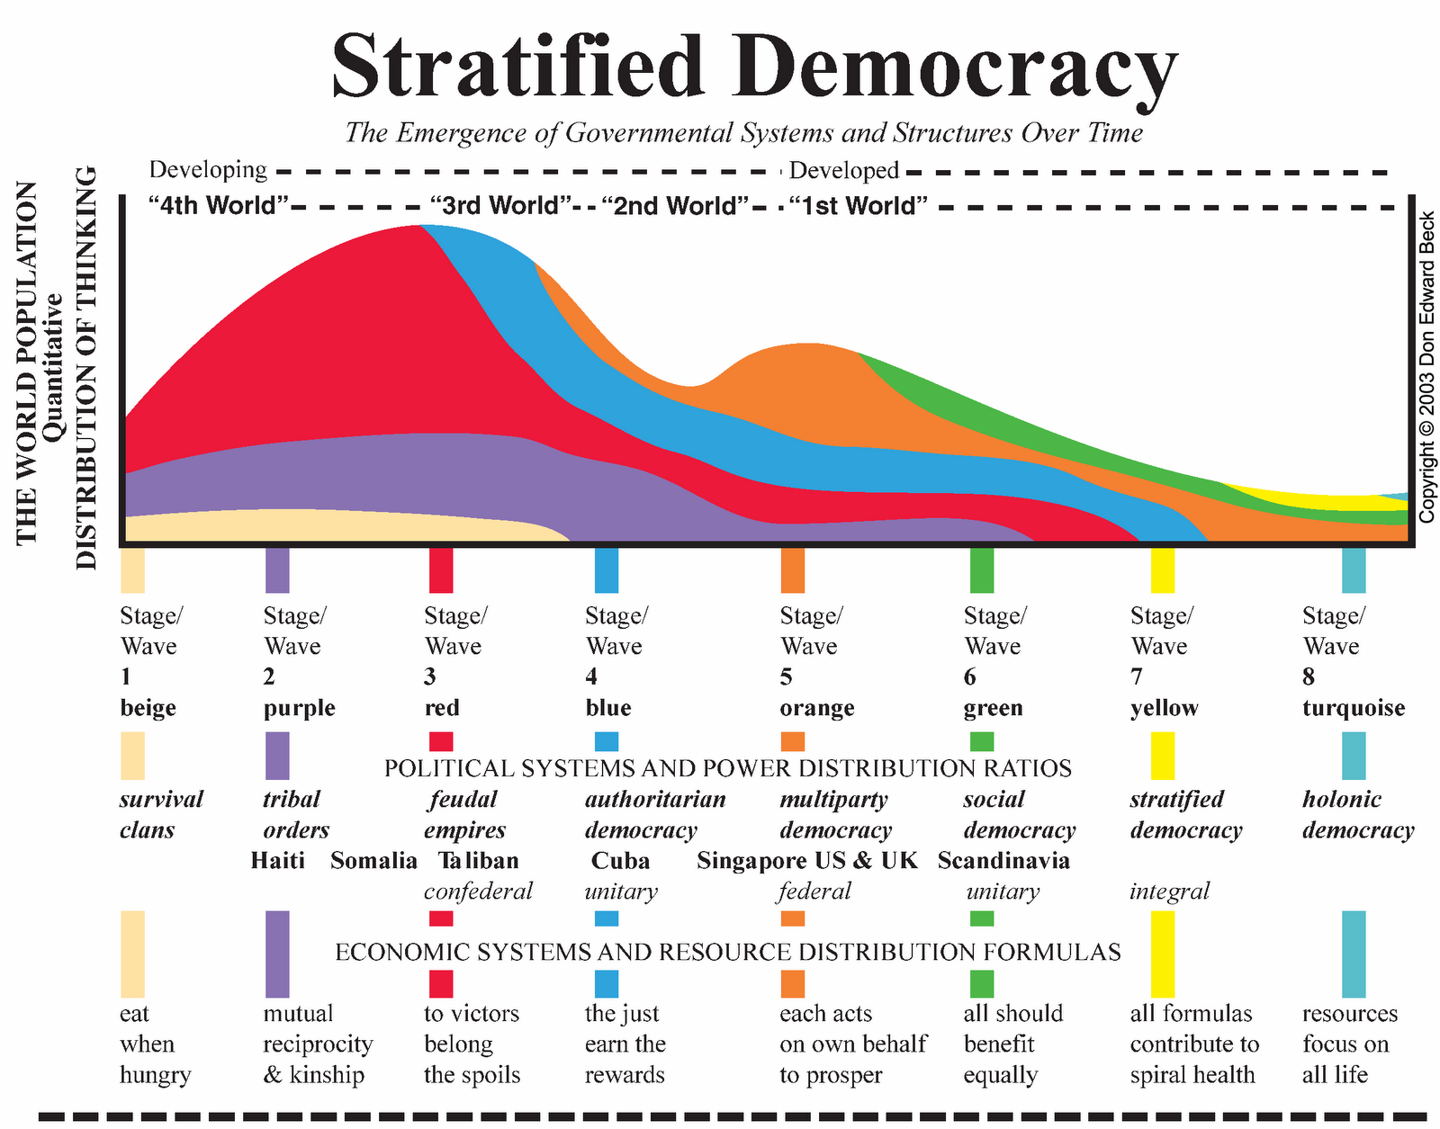

Slide 40
REVIEW OF GOVERNANCE Systems Theory: The basis of discussion of Governance

Slide 41
The Black Box Problem
Critics of state analysis complain of the "black box”
problem.
Rather than reifying the state as a single actor, the
argument here is that the state is characterized by
both a structural complexity and an institutional
fragmentation of the government of the day;
Institutional approaches have suggested that it is
important to analyze issues of personnel, culture and
the psychological influences that circulate within the
state, between society and the government and its
bureaucracy;
Difficulty: “Getting inside” the Black Box
(of Government- What happens inside).

Slide 42
The Black Box

Slide 43
Review
Development theorists and practitioners need to be careful that their formulas for social and economic change do not do more harm than good.
A balance exists between the extremes of the command economy and centralized planning on the one hand and the libertarian approach advocated by radical public choice theorists on the other.
Throughout, it is not possible to divorce development issues from issues of governance and civil society. Nor can the debate and selection of policy choices be detached from the capacity of institutions to implement policy.

Slide 44
Overview-2 The Need for Balance
A balance exists between the extremes of the command economy and centralized planning on the one hand and the libertarian approach advocated by radical public choice theorists on the other.
Throughout, it is not possible to divorce economic and development issues from issues of governance and civil society.
Nor can the debate and selection of policy choices be detached from the capacity of institutions to implement policy.

Slide 45
Quote of the Week
"The policy makers have rational interests- to develop their countries, to improve the condition of their people, to acquire or stay in power, or to steal as much as possible.”
Peter Berger, Pyramids of Sacrifice

Slide 46
Questions and Discussion
?????

Slide 47
Political Satire: A View from India
VIDEO

Slide 48
The Difference between policy and management
VIDEO

Slide 49
The Origins of the Debate about Governance Outside Europe
VIDEO

Slide 50
The Importance of satire in Politics
VIDEO:
On ”Xenophobia”

