Slide 1
PIA 2528
International Donors, Governance and Civil Society

Slide 2
PIA 2528
Governance, Local Government and Civil Society
Debates about Rural Development

Slide 3
Overview Themes
Modernization (Review)
Patron-Client Issues
Role of Agriculture in development
Service Delivery
People Centered Development
Public Choice

Slide 4
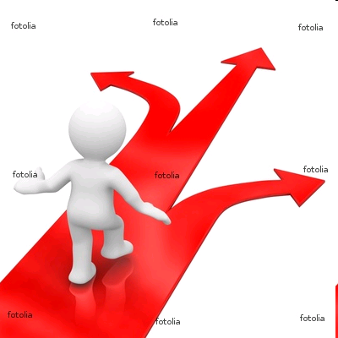
Choices?

Slide 5
I. Theories of Modernizaton
MODERNIZATION: Major Theme

Slide 6
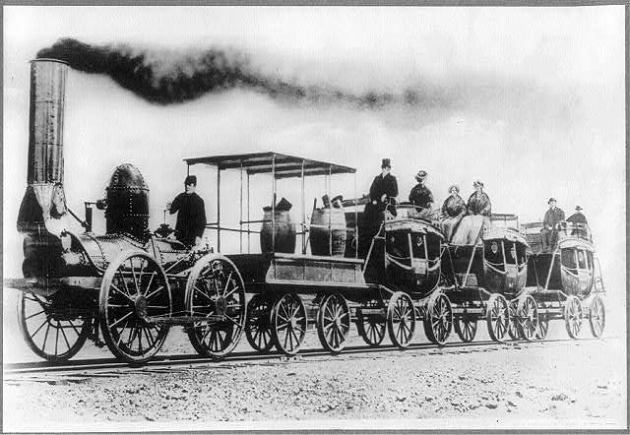
Modernization?

Slide 7
Modernization, Continued
    Movement from traditional to modern (and rural to urban) in all societies
    The “West” has distinguishing characteristics which distinguish it from Third World
    Result is an assumption of Dichotomy
    (references include writing by Talcott Parsons, Marian Levy, Frank Sutton and in modified form Fred Riggs)

Slide 8
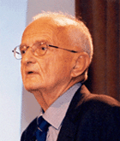
Modernization, Development Theory, and its Critics
Agraria vs. Industria
(Popularized by Prof. George Modelski-Born in Poznan, Poland)
University of Washington

Slide 9
Development: The Modernization Definition
      Agraria
Attitudes: parochial – fixed rules
Customs: particularistic / inherited
Status: ascriptive
Functionally: diffuse
Holistic Change
Lack of Specialized Roles
Result
Agricultural, rural, poor
Oral / illiterate
Authoritarian instability
Subsistence – non-monetary
Revolution and violence
Occupation fixed
  Industria
Universalistic
Legal / Rational
Achievement Oriented
Roles Functionally Specific
High Degree of Technology
Manufacturing and Production
Oriented
Result
Commercial
Democratic / Peaceful
Occupational mobility
Literate
Urban, Rich
Incrementalism, Stability and Gradual Change

Slide 10
II. Patron-Client Issues
"The patron-client relationship [is] an exchange relationship between roles."
James C. Scott

Slide 11
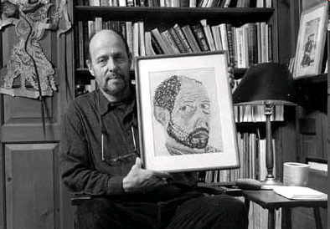
James C. Scott (born 2 December 1936) is Professor of Political Science at Yale University

Slide 12
Theories of agricultural development: Issue: Peasant farmer as decision-maker
1. Moral Economy- social and family obligations predominate
2. Rational Economy- peasants are economically rational- self serving
3. Patronage and Exchange Theory-rural dwellers seek protection in Zero Sum political Games (James Scott)

Slide 13
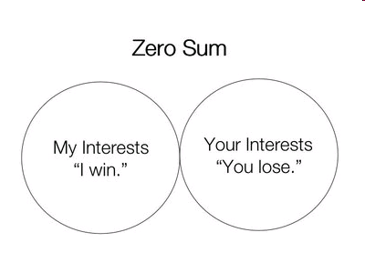

Slide 14
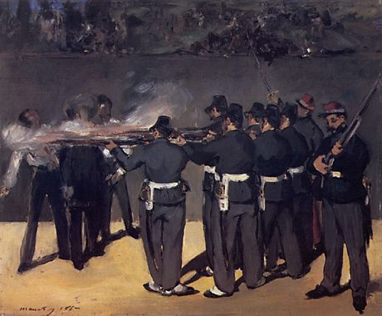

Slide 15
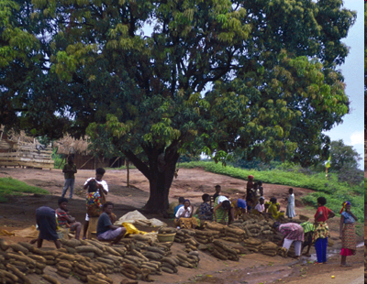
Review: Land Tenure
Usufruct
Legal
Individual Access but no ownership
Common Access
Issue of Credit
Debate about Property Rights

Slide 16
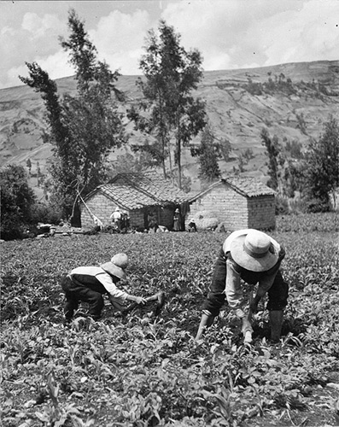
Usufruct Debates
Usufruct is the right of a person to derive profit or benefit from property that either is titled to another person or which is held in common ownership

Slide 17
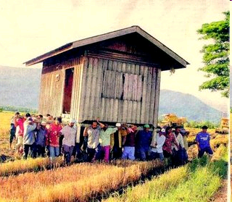
Moral Economy
The need to
work collectively
to meet common
needs

Slide 18
III. Role of Agriculture in development: Seven Views
Source of economic surplus
Obstacle to growth
Necessary pre-requisite to modernization
Key to development but suffers from urban bias

Slide 19
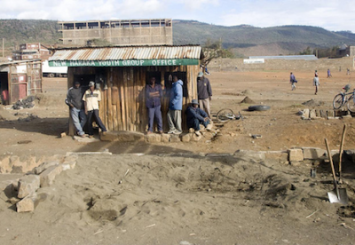
Lack of Economic Surplus

Slide 20
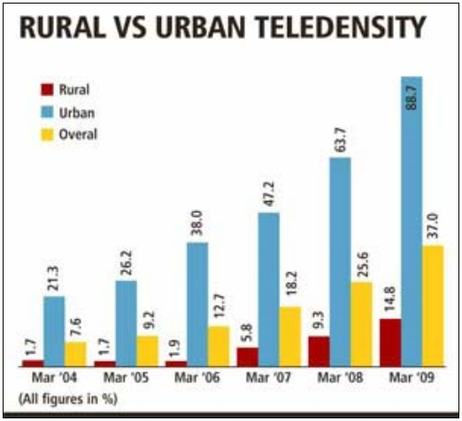
Urban Bias

Slide 21
Role of Agriculture in development-
Potentially leading sector- eg. France and Denmark
Related to environmental degradation- problems of resource consumption -re. population
Controversy sustainable development and "ecological
balance

Slide 22
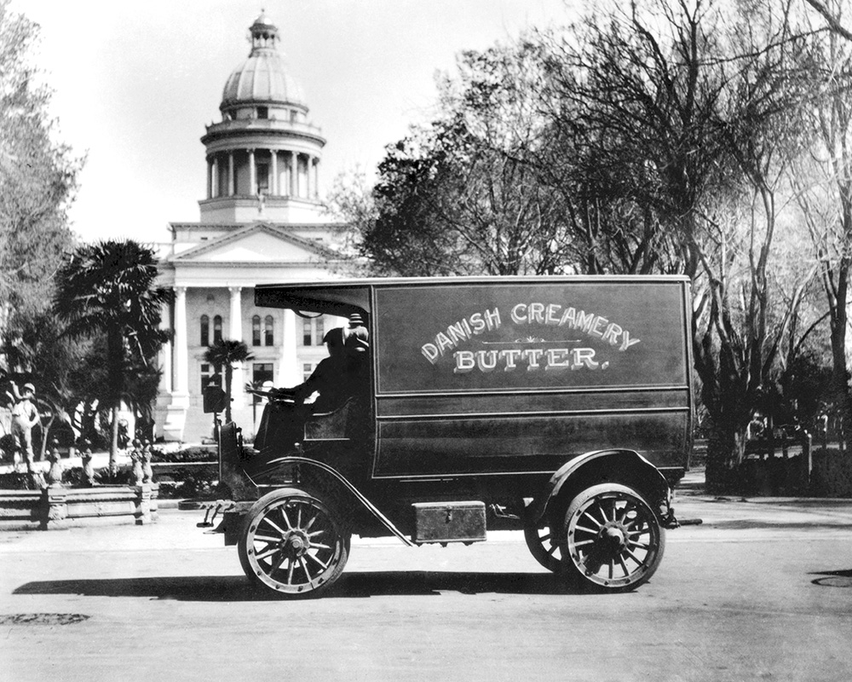
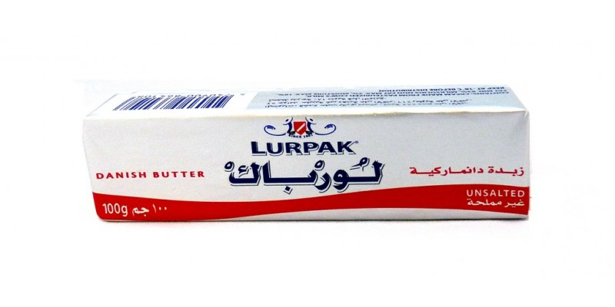
Lurpak- Danish Dairy Production
1880-2021

Slide 23
IV. Service Delivery: NGOs, agriculture and the Private Sector
a. The role of government vs. the role of private sector, cooperatives and NGOs
b. Agriculture the cornerstone of rural areas
C. Development external to the country (Agribusiness)

Slide 24
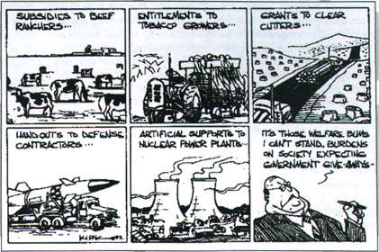
A Biased View?

Slide 25
Service Delivery-2
d. Controversy over export based agriculture. Add on value
e. Issue: subsistence agriculture, little income generation or job creation vs. Commercial Agriculture

Slide 26
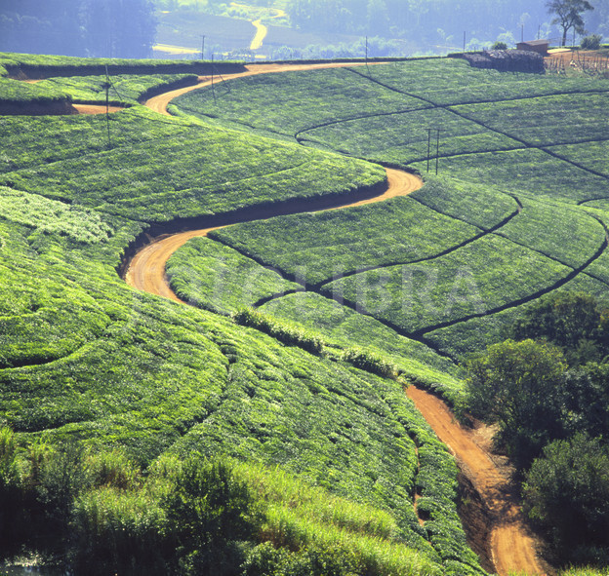
Tea Plantation

Slide 27
Service Delivery-3
f. Women and the effect of subsistence vs. cash crops
g. Land reform, land tenure and usufruct- The failure of Land Tenure Changes
h. Government: (Bates) Marketing Boards, prices and urban bias and the exploitation of Farmers
i. The faded glory of integrated rural development. From Social Development to Social Funds

Slide 28
Models: Agriculture and private and non-profit sector
1. Public-Private partnerships (collaboration)
2. Associations as local appointed agents of peasants- not directly representative in a self- governance sense (Cooperatives)

Slide 29
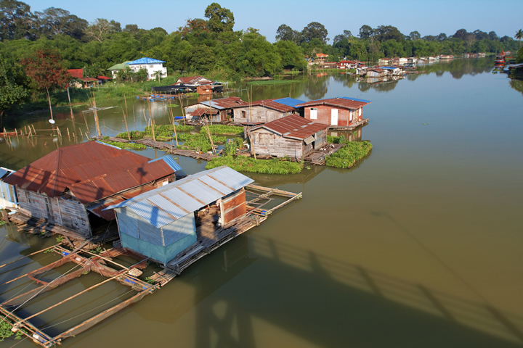
Community Based Rural Association

Slide 30
Models-2: Continued
3. Direct involvement
(eg. water groups, producers cooperatives)
Issue: Representation and problems of scale (eg. Elinor Ostrom)

Slide 31
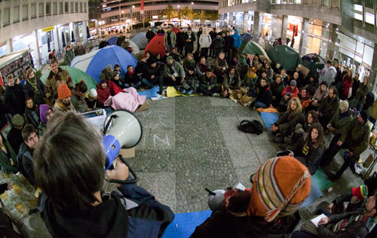
Direct Self Governance?

Slide 32
Models-3
4. Issue of service delivery which is non-hierarchical
i. Need to adapt to the field (manual water pumps)
ii. The Farms systems research and training and visit (T & V) techniques

Slide 33
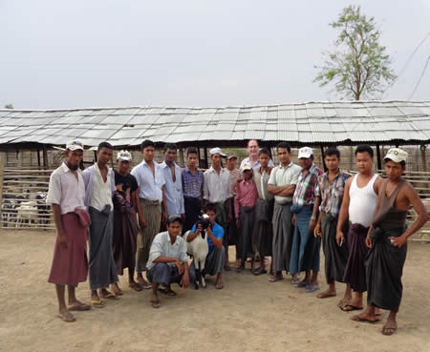
Training and Visit System (T&V)
Southest Asia

Slide 34
Models-4
5. The role of incentives for farmers: self-organization, self-management, and its alternatives
6. NGOs as Foreign Aid contractors (Beltway Bandits)

Slide 35

National Endowment for Democracy

Slide 36
V. People Centered Development
a. Bottom Up
b. Community Development
c. Micro-enterprises and micro-credit
d. Rapid Rural Appraisal
Notes:
36

Slide 37
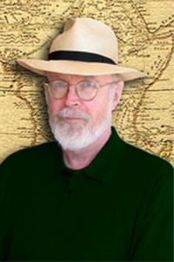
VI. Debates: Public Choice
“Agriculture is about ‘getting the prices right’“
A Public Choice
Mantra-
Robert H. Bates

Slide 38
Robert Bates
The state distorts agricultural marketing structures to divert gains to be had from commercial agriculture to other interest groups (the organizational bourgeoisie) employed in the state and in state controlled industries.

Slide 39
Author of the Week- Robert Bates
Markets and States in Tropical Africa
Important influence on rational choice theory
THESIS-
Need to consider markets and how they can be distorted by state decisions in terms of producers and prices, consumer goods and factors of production

Slide 40
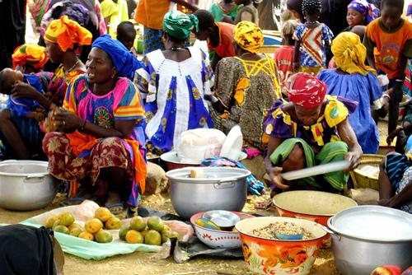
Supply and Demand Principles

Slide 41
Robert Bates
Government policy subsidizes urban dwellers
Agricultural production used (or misused) to fund urban capital accumulation and/or capital flight
The state, in effect taxes farmers for state sponsored “crony capitalism” and excessive access “rents”

Slide 42
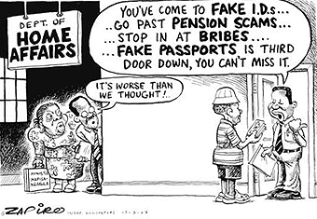
Recent South African Cartoon

Slide 43
Robert Bates
The result is the depression of prices for cash crops
The key to understanding the economic system in Africa is in historical patterns of prices depression that goes back to the colonial period.
Monsopsonies- use of state agencies (often called marketing boards) to control marketing and sales of agricultural products.

Slide 44
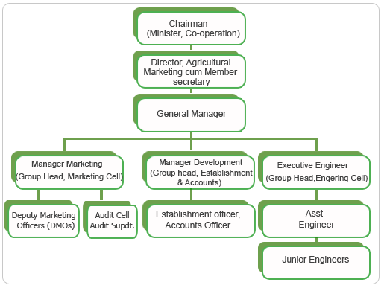
Odisha Agricultural Marketing Board (India)

Slide 45
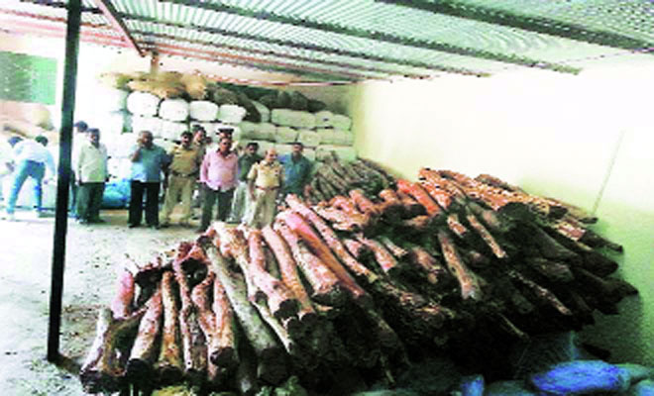
Exit Option: India
Result: the “Exit Option” for rural dwellers. Red Sandlewood Smuggling
Result- Structural Adjustment

Slide 46
The Debate
"Collective self-management of the resources is a socially and culturally embedded institutional arrangement..."
Martinussen on Ostrom

Slide 47
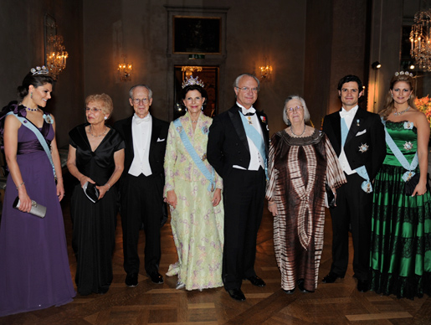
Example: Elinor Ostrom
Essentialist- Ostrom: commons vs. individuals. Inability to manage public goods without individual direct interest involvement.
Notes:
47

Slide 48
Public Choice and Rationalism
Public Choice: Peasant Organizations, Popkin and The Free Rider Problem
=The overall issue is that of Collective Action vs. individual choice
=Question: What is there between collectivization and privatization
Notes:
48

Slide 49
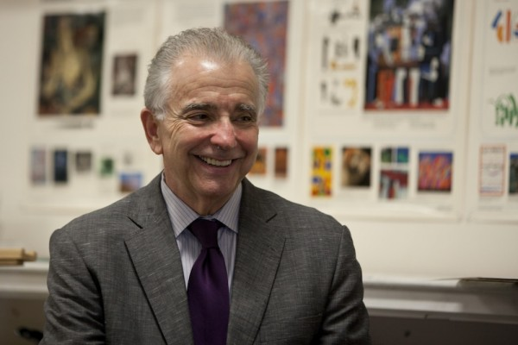
Samuel L. Popkin University of California- San Diego

Slide 50
The Motivation of Conservative Discourse “Debates”
Tendency is to avoid collective responsibility or collective action
1. Common Pool Resources Problem
2. Prisoners dilemma- can never get to optimal
3. Change the rules of the game” and “getting the institutions right”
4. Key: getting direct involvement (Ostrom)
Notes:
50

Slide 51
More Motivations
5. Designing their own contract with your neighbors in Mass Society
6. Critique: How does one ratchet up from local communities (and direct democracy) to cities, intermediate governments and nations and (lesson) avoid collective responsibility?
Notes:
51

Slide 52
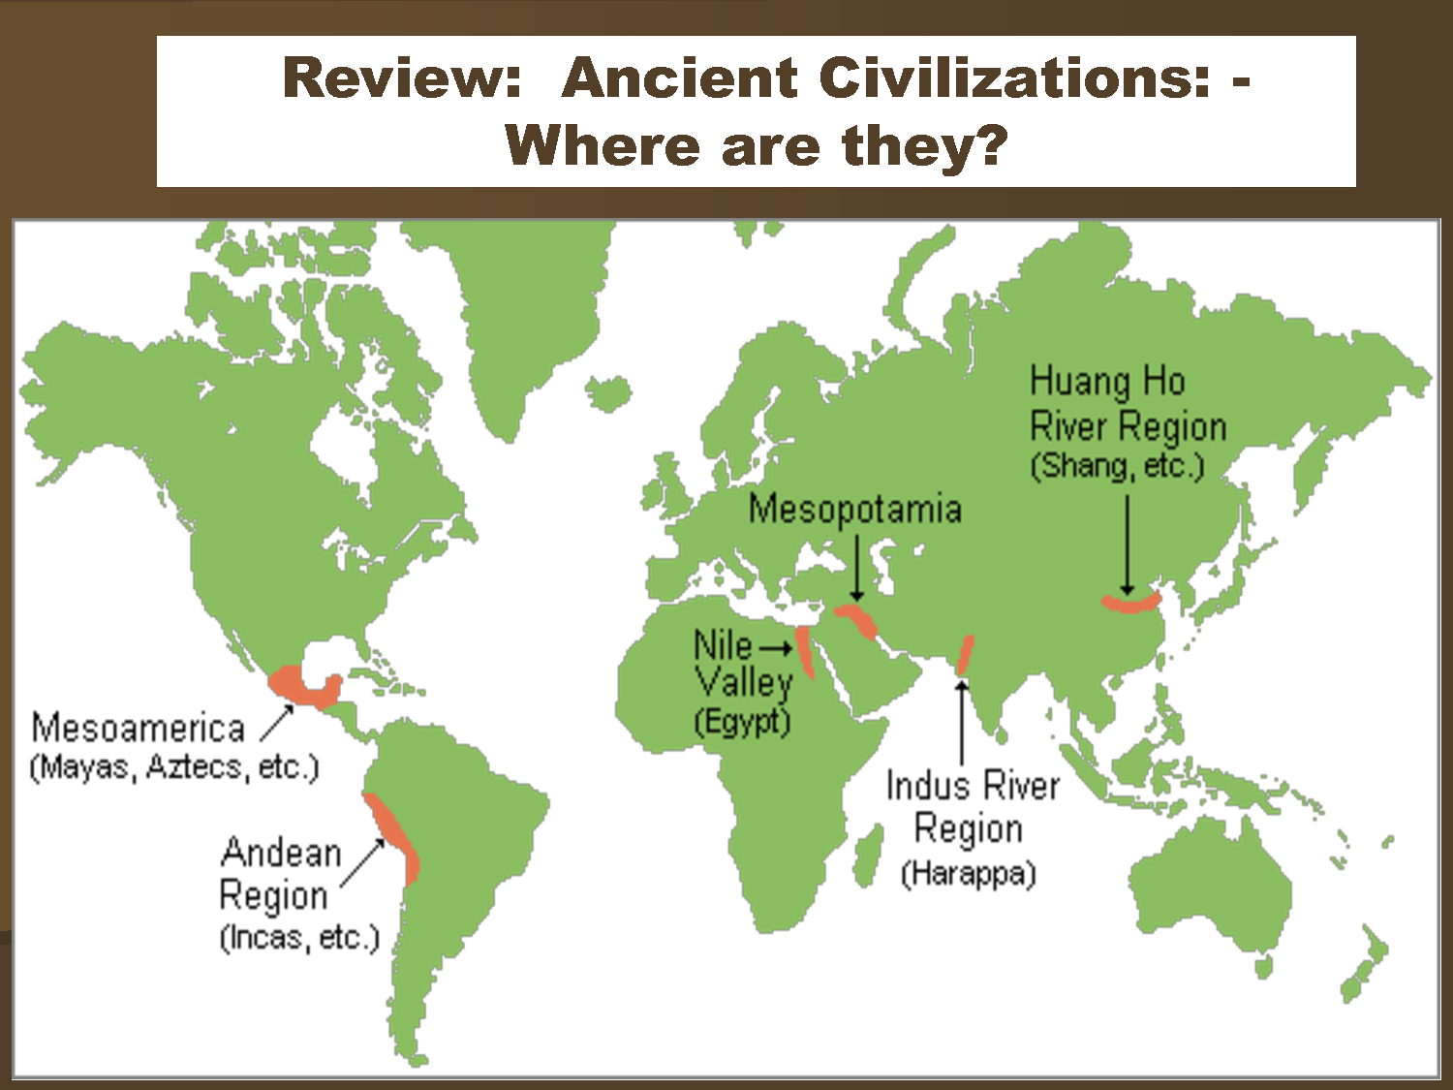
Motivations and an Issue
Historical Antecedents for Collective Action:
Max Weber and complex bureaucratic systems
Maintain power and control through exclusive control over access to water
Water the Key to local development
Notes:
52

Slide 53
Pre-Keynesian State Planning
a. "Hydraulic Societies" and centralized bureaucratic empires (China, Egypt and Rome)
b. Classic administrative systems elitist, hierarchical and rational vs. state roles in industrialization (Late developers- Germany and Japan)
c. Public Choice says public organizations require collective responsibility that is almost impossible, yet history shows bureaucracies can be collective (New Deal)

Slide 54
Public Choice vs. Common Pool Resources
Interview with Elinor Ostrom
VIDEO

Slide 55
The Foreign Aid Fix
Saving Africa

Slide 56
An Afterthought: Politics, 1964 and the Tom Lehrer “Theory of Governance”
The Theory

