Slide 1
Governance, Local Government and Civil Society
PIA 2528
Week Five: Historical Patterns of Conflict and Control

Slide 2
I. Overall Theme for the Week
Institutions and The Nature of Civil Conflict

Slide 3
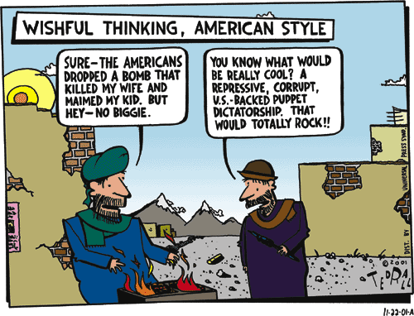

Slide 4
Sub-Themes
Institutionalization
Violence and Expectations
Role of Civil Society
Economics and Politics
Systems Theory/Structural Functionalism
Corporatism as a problem or a solution

Slide 5
SUMMARY

Slide 6
The Political Development Argument- Three Quotes Re. the Issue
"...there is a close link between respect for human rights and democracy, on the one hand, and the ability to sustain economic and social development on the other."
John Martinussen
"...states will necessarily remain central actors in development policy."
Milton Esman
“There was never a good war; only a bad peace”
Benjamin Franklin

Slide 7
Causes of Violence
1 Culture and Religion
2. Crises
3. Social Change
4. Class
5. Ultra-Nationalism

Slide 8
The Charles Chaplin Theory
Global Theory

Slide 9
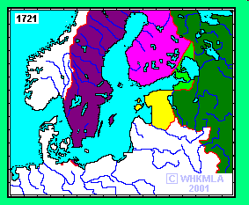
Nothing New: Ethnic Conflict in Northern Europe

Slide 10
CULTURE AND RELIGION
Debates about Political Institutions Samuel P. Huntington
The Huntington Model: Political Instititutionalization vs. Violence
Huntington’s Theory of Institutional Development Suggests stability over participation
Fear ethnic, ideological and religious based conflicts

Slide 11

Huntington: Summary
Key: Loss of Equilibrium and Violence (David Apter with Huntington)
Political Order is Culture Bound:
Clash of Civilization Theory?
Samuel P. Huntington

Slide 12
The Huntington Matrix
GOAL: STABILITY OVER PARTICIPATION
Institutionalization
Participation
High Low
High INDIA Egypt
Low SAUDI ARABIA SWAZILAND

Slide 13
Huntington’s Formula
Order and Civilization
Institutionalization should equal Mobilization
or
Institutionalization should be greater than mobilization
but not
Institutionalization should be lower than mobilization

Slide 14
The Clash of Civilizations Map

Slide 15
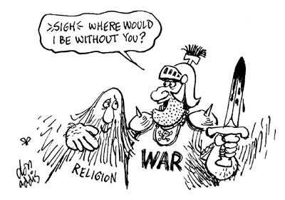
Huntington’s Fear: Political Instability as a Result of the Clash of Civilization. Remembering the Cartoon

Slide 16
CRISES
Political Development and Governance: Alternative Models
Identity
Legitimacy
Participation
Penetration
Distribution
Conflict: The Effect of Cumulative Crises
Leonard Binder: Sequential Crises
Universal Rule?

Slide 17

Leonard Binder, UCLA
Political Crises and Sequences:
Sequential vs. Cumulative
200 years U.S./U.K. vs.
20 years for Uganda

Slide 18
Systems Theory and Structural Functionalism- Classic Political Science Theories: Balance as the Solution to Conflict. ”GRADUALISM AND CRISIS”
Systems Theory (David Easton) and Structural Functionalism (Almond and Verba, The Civic Culture (1957)
Origins of contemporary Civil Society Model:
“There is a ‘civic culture’ which is the most developed political form.”
Gabriel Almond and Sidney Verba

Slide 19
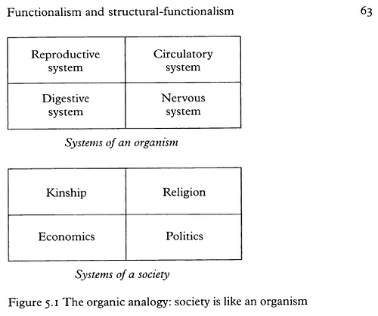
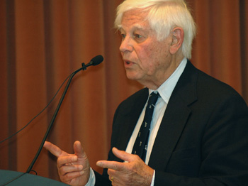
Systems Theory

Slide 20
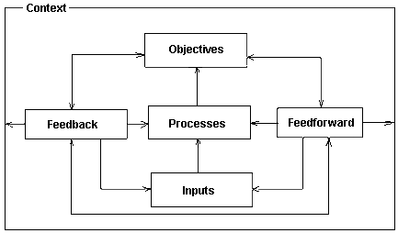
General Systems Theory

Slide 21
Structural Functionalism: Gabriel Almond
Inputs:
interest articulation
Interest aggregation
The Black Box (With-inputs)
Outputs- Policies
Feedback

Slide 22
SYSTEMS THEORY IN GOVERNANCE

Slide 23
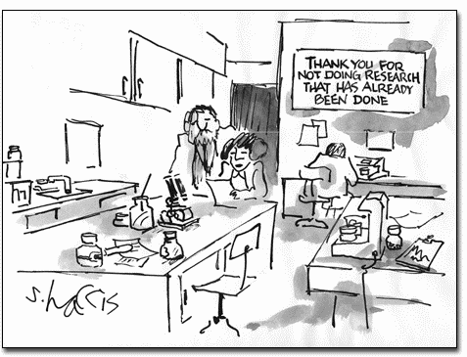

Slide 24

SOCIAL CHANGE
Cultural Debates, Conflict and the Political Institutions: A Reminder
Disjointed Modernization (Gusfield and Susan Rudolph)
Misplaced Polarities Theory
Japan, Saudi Arabia and Nazi
Germany?

Slide 25
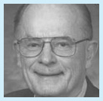

Problems with a Destabilized or Passive Bureaucracy
Civil Society Collapse and the Impact of Colonialism (Crawford Young)
The Administrative State (Picard) as consumer
And the Organizational Bourgeoisie (Leonard Markovitz)
Crawford Young
Markovitz Book

Slide 26
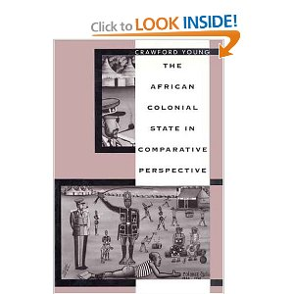
M. Crawford Young, Born 1931- University of Wisconsin
Worked on the Colonial state and on the politics of cultural identity in the third world, and presaged the contemporary "instrumentalist" and "constructivist" approaches to political identity.
CULTURAL IDENTITY ISSUES.

Slide 27
Class Analysis
Debates About Social Class
Class Analysis: (Marx and his Successors)
Rural vs. Urban
Agricultural vs. Industrial collectivization
Conservative Critique of Class War

Slide 28
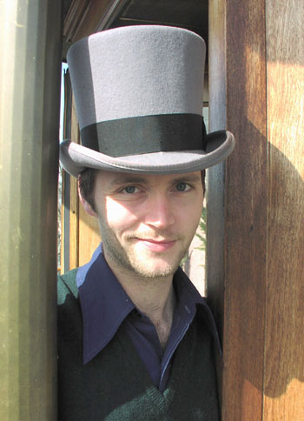
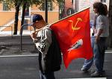
Class Analysis
Marx and Class
Is Class Important?
How does it impact SOCIAL CHANGE?

Slide 30
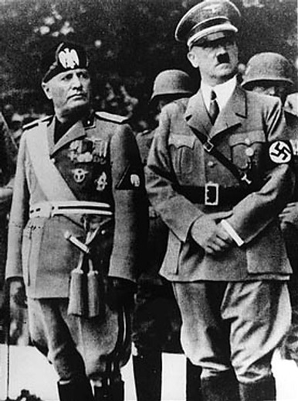
What is Fascism?
By 1935, Jews were not able to travel freely from Germany
Who are these men?

Slide 31
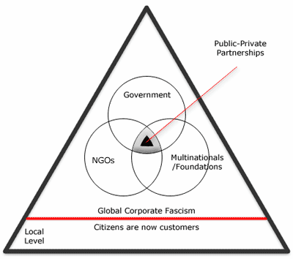
Critique of Corporatism AS ULTRA-NATIONALISM

Slide 32
Fear of Immigration

Slide 33
Overview: FIVE Themes in Conflict and Security Policy
I. Conflict Prevention and Management
II. Conflict and Peace Making
III. Peacekeeping and international organizations
IV. Terrorism and Counter-terrorism
V. Post-Conflict Governance

Slide 34
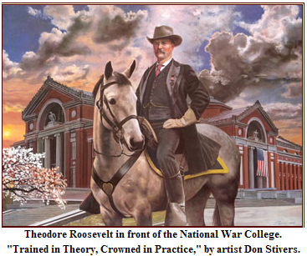

Slide 35
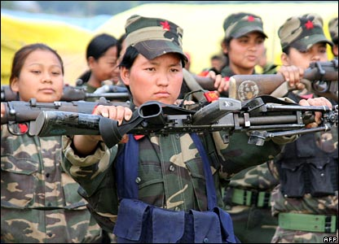
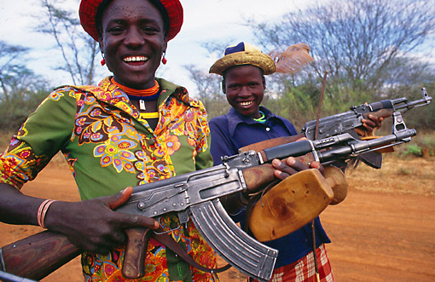
Twenty First Century Armies

Slide 36
Conflict Prevention andManagement
Community based conflict mitigation
      Role of indigenous leadership and traditional conflict mediation
      Land, social rights and behavior
      Joint Traditional and Local Government Mechanisms
      Leadership modalities (The Mandela Model)
Traditional Justice vs. Political institutions
Governance and Development

Slide 37
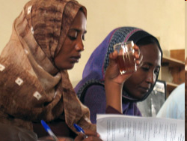
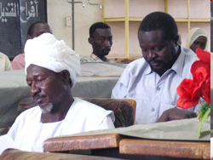
Conflict Resoluton in the Sudan
Conflict Resolution
"We drew upon traditional conflict resolution techniques”
Research by Germaine Basita
GSPIA PhD Student

Slide 38
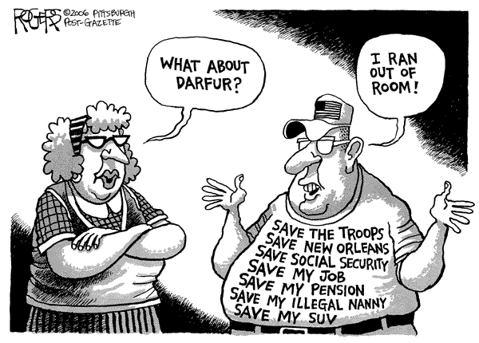

Slide 39
Indigenous Methods of Conflict Mediation
      Problem of ratcheting up and reconstructing institutions
      Problem of collapsed and failed states
      National Identity Challenges- Leadership Modalities
      Survival of Traditional Institutions

Slide 40
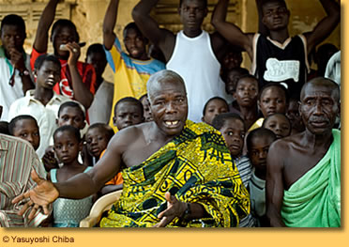
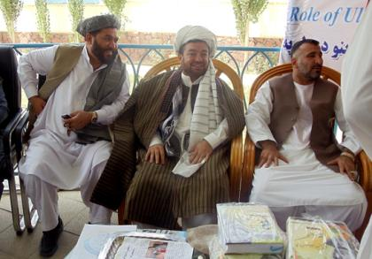
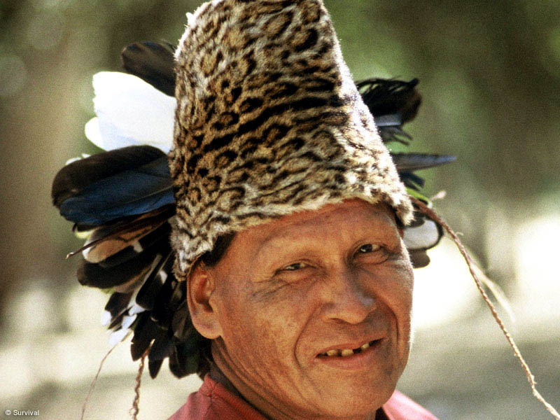
Traditional Leaders

Slide 41
Conflict and Peace Making- Different Modes
Wars of Liberation- East Timor, South Africa, Algeria, Lusophone Africa (Victory or Stalemate and Negotiations)
Civil Wars- Ethnic and Religious “Cultural Pluralism”- Bangladesh, Somalia, South Sudan and Rwanda (Intervention, Mediation and Peacemaking)
Interstate Conflicts: World War II, Korea, Iraq, Afganistan and Congo (Often both or all three)

Slide 42
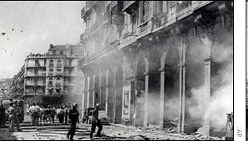
Algerian Civil War: An Important Event

Slide 43
Algeria
Video
The Beginning of the Modern World
From the Battle of Algiers, 1966

Slide 44
Different Modes of Conflict
Economic Conflict- poverty and organized crime (Post-Apartheid South Africa)
Cold War- Ethiopia/Eritrea and Namibia/Angola
Ethnic Regional conflicts- DRC, Rwanda and Liberia/Sierra Leone (International Negotiations and Peace Making)
Post-September 11: CVE

Slide 45
Peacekeeping and international organizations- Issues
  Northern State mechanisms: NATO and EU
  Mediators
  Unilateral vs. Multilateral (U.S., France and U.K.)

Slide 46
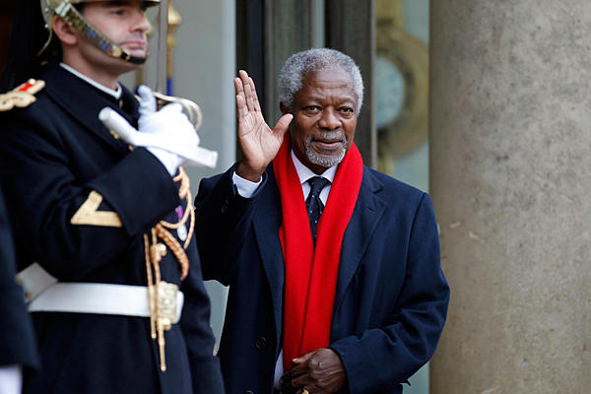
Former UN Secretary General Kofi Annan

Slide 47
National or Transnational Groups?
Al Qaeda in the Arabian Peninsula
Al Qaeda in Iraq
Al Qaeda in the Islamic Maghreb
Boko Haram
Al Shabaab

Slide 48
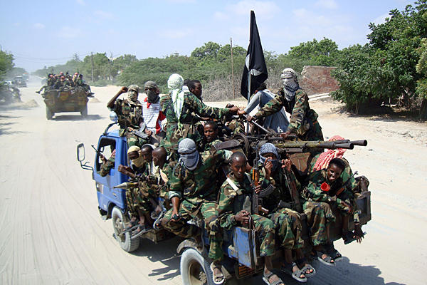

Slide 49
Peacekeeping and international organizations- Issues
  Multi-lateral and bi-lateral- Continental vs. International
  Regional Groups: ECOWAS, Africa Union, SADC
  What is NATO?
  United Nations Peacekeeping vs. Monitoring vs. Conflict control (Rules of Engagement)

Slide 50
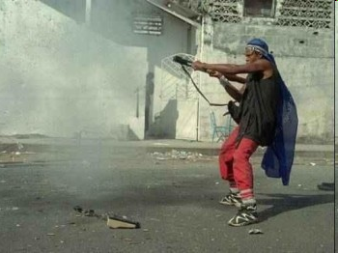
Liberian Civil War

Slide 51
Peacekeeping and international organizations- Issues
  Role of “proxy” states/armies (Ethiopia)
  Impact of Foreign and Military assistance Programs (Horn, Sahel and War on Terror)
  Special Role: Mediation Centers (Institute of Peace, Leadership and Governance at Africa University, Zimbabwe)

Slide 52
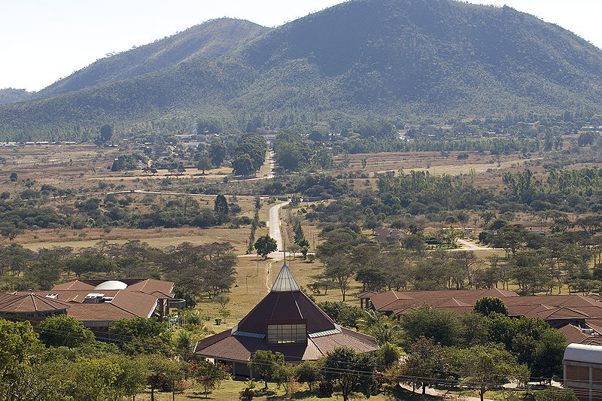
Africa University
Mutare, Zimbabwe

Slide 53
Terrorism and Counter Terrorism. Is it an Issue?
Terrorism and Counter-terrorism (Includes regional, sub-regional, national and sub-national levels of activity) – U.S. and Europe
Global vs. non-global
How Relevant to LDCs?

Slide 54
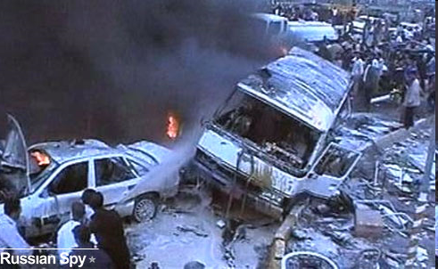
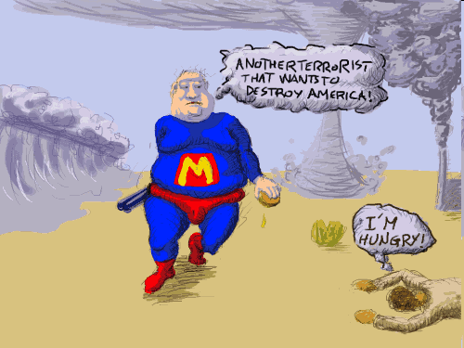
North vs. South?

Slide 55
Counter-Terrorism Strategies
Legislation, Finance, Border Security (including passports and travel documents Control)
Police, military and security, combating ideological Support for Terrorism
Strengthening Traditional Leadership
Information and Intelligence and International Cooperation
Offensive Combat

Slide 56
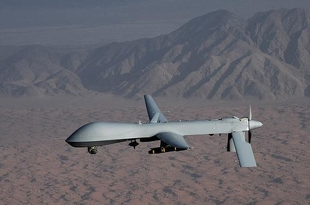

Slide 57
Sector Reforms and Counter-Terrorism
Evolution of U.S. CT Policy in Africa Since September 11
Impact of ethnic and religious identification on Terrorist threats
Challenges of parallel governance and the Arab Spring (Egypt, Tunisia, and Libya)

Slide 58
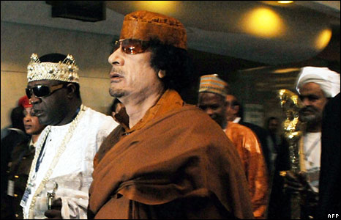
Popular Appeals

Slide 59
Regional Threats
The threat of Collapsed States and crime- Diamonds, Drugs, guns (Columbia, Guinea Conakry)
Paramilitary Violence (Philippines, Great Lakes)
Organized Crime, and Piracy (Air, Land and Sea)- Indian Ocean and gulf of Guinea

Slide 60
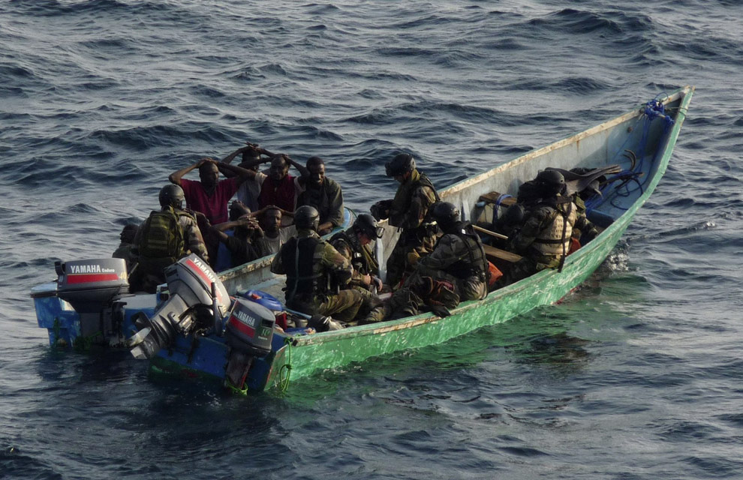

Slide 61
V. Post-Conflict Governance
      The Role of Negotiated Pacts
      Truth and Reconciliation vs. Justice
      International Courts Issues

Slide 62

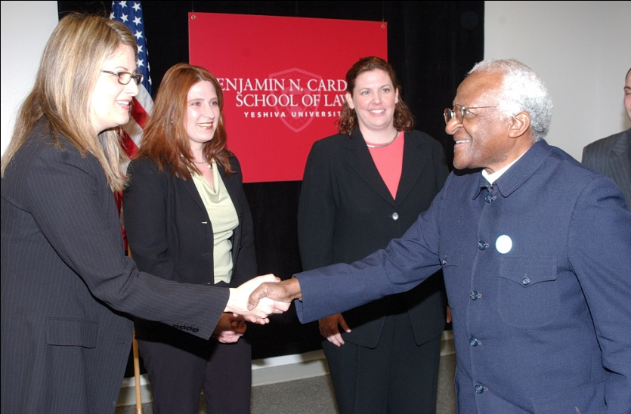
Liberian Truth and Reconciliation Commission
Conflict Resolution
vs.
Justice
Bishop Desmond Tutu

Slide 63
Post-Conflict Governance
      Demilitarizing societies
      State Rebuilding and Institutional Development
      Democracy and Governance
      TO BE CONTINUED….

