Slide 1
PIA 2574 African Development Seminar:
One Party Rule, Patrimonialism and the Military State

Slide 2
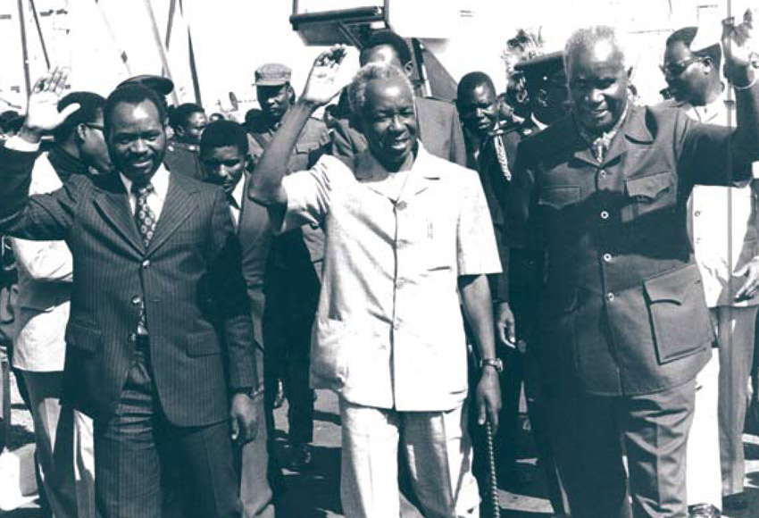
“One Party” One Party Rule and the Administrative State (Machel, Nyerere, Kaunda)

Slide 3
I. The Institutional State
Civil Society
Institutionalized Norms
Stable Government Structures
Decentralized Governance
Economic Rules of the Game

Slide 5
The Institutional State
Stable and Merit Based Permanent Government: The Administrative Apparatus
Muted Cultural Differences
Problem of Organizational Bourgeoisie

Slide 6
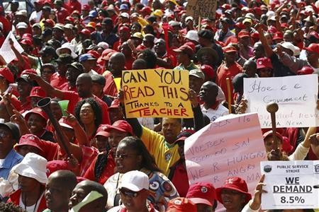
South African Public Service on Strike

Slide 7
The Civic Culture Theory
Parochial Political Culture
Subject Political Culture
Participatory- citizen based

Slide 8
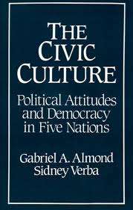
Civic Culture

Slide 9
Definitions of Democracy
Issue: Opposition vs. Consensus:
Presidential Systems- Separation of Powers
Parliamentary systems- Representation and Fusion
Direct vs. Representative

Slide 10
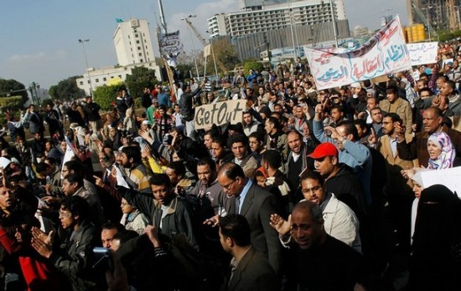
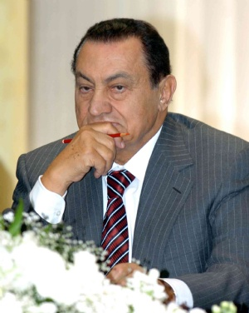
Egypt: The Arab Spring and Today
Do Institutions work in Africa?

Slide 11
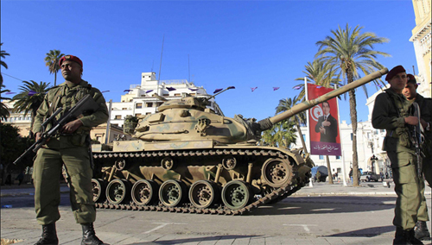
Tunisia January, 2011

Slide 12
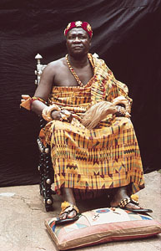
Traditional Democracy
“A Chief is a Chief by the People”

Slide 13
Traditional Democracy
Traditional Africa- Consensus and hierarchy
Village democracy and talking things out
Ubuntu, Ujamaa and Humanism

Slide 14
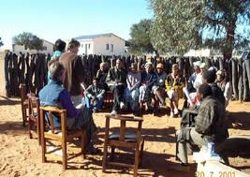
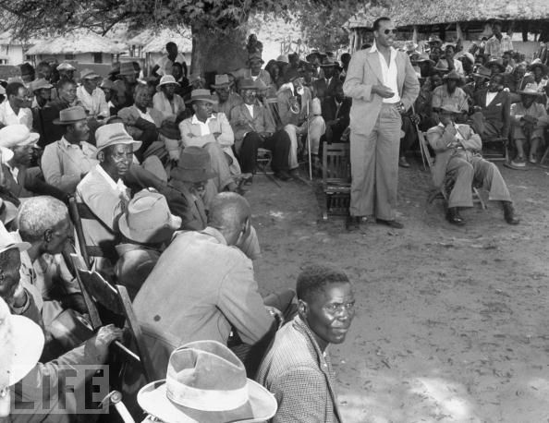
Village Meetings Southern Botswana
Kgotla

Slide 15
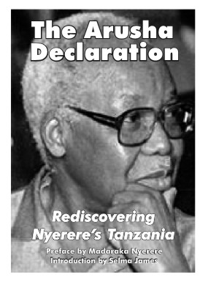
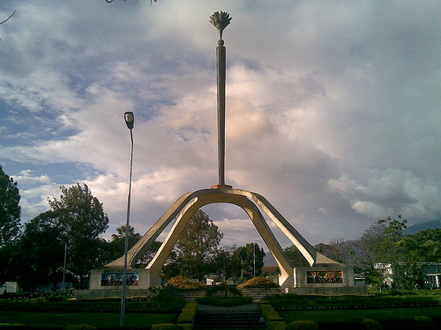
Arusha Declaration Monument and Julius Nyerere
Traditionalism Modernized: Umoja na Ujamaa

Slide 16
Differing Forms of Democracy
Traditional Communitarianism
Search for Consensus not Competition
The Kgotla, the Stool and the Baraza
Julius Nyerere- Village Democracy and Talking Things Out: ONE PARTY DEMOCRACY

Slide 17
The Problem of Crises: Redux
Identity
Legitimacy
Participation
Distribution
Penetration

Slide 18
Build Up of Demands
Relative Deprivation
Underdevelopment
Elitist Political Systems
Promises Not Kept

Slide 19
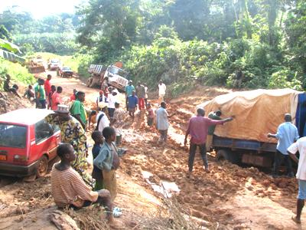
Does this lead to war?
Underdevelopment?

Slide 20
Why Inherited Governments Disappeared
Failure to Deal with Traditional Political Elites
The Imposition of Political Structures
Loss of Legitimacy- Patronage and Clientelism
Ethnicity- Opposition labeled ethnic

Slide 21
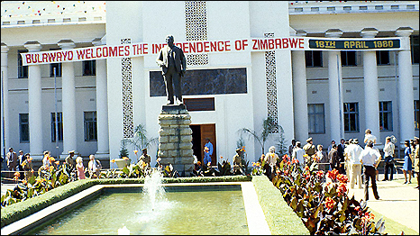
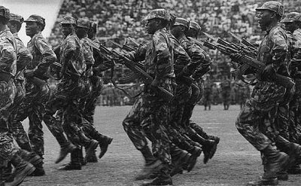
10,000 Killed in 1980s
Korean Trained Fifth Brigade in Western Zimbabwe

Slide 22
Why Inherited Government Disappeared
Military Interventions
Corruption
Self-Serving Bureaucratic Elites
Violence, Interstate Conflict and African Underdevelopment
Absence of Rules of the Game
Illusions of Unity
Zero Sum Game

Slide 23
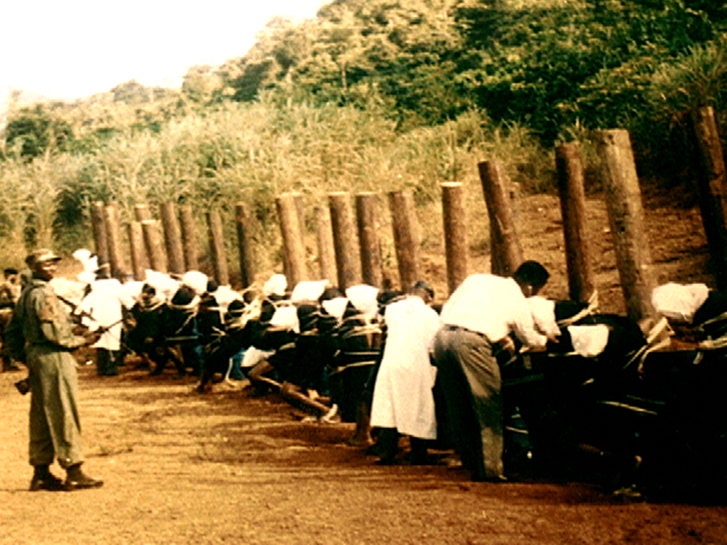

Slide 24
Why Inherited Government Disappeared
“Loyalty, Disloyalty and the Nationalist Movement”
Issue: Why One Party State had to be de jure
Question: How Democratic?

Slide 25
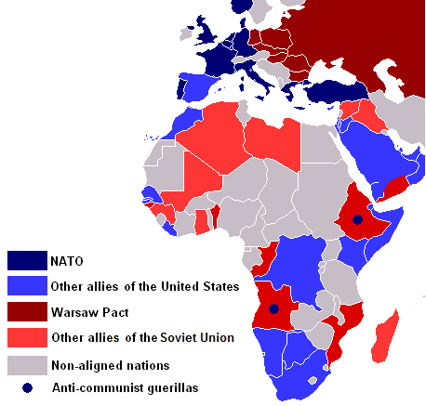
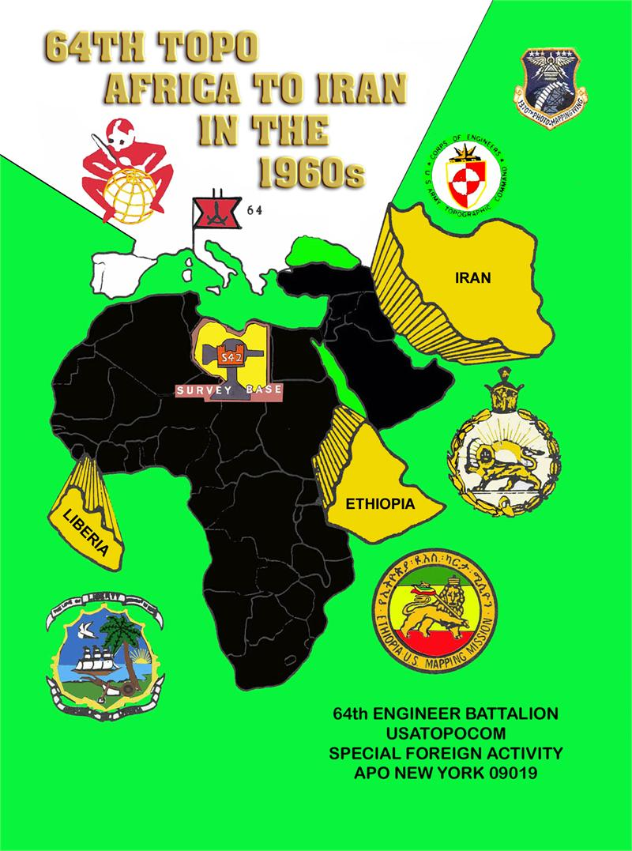
The Cold War

Slide 26
Why Inherited Governments Disappeared
External Intrusions
The Cold War as Proxy War
U.S. vs. Russia
Cuba and the African proxies
Examples:
Congo
Angola, Namibia and Southern Africa
Ethiopia and Somalia

Slide 27
The Disappearing Opposition
Movement Gains Power of the State and the Mantle of Independence
No Spoils Available
Opposition in Frustration Crosses the Floor to Join Government Party

Slide 28
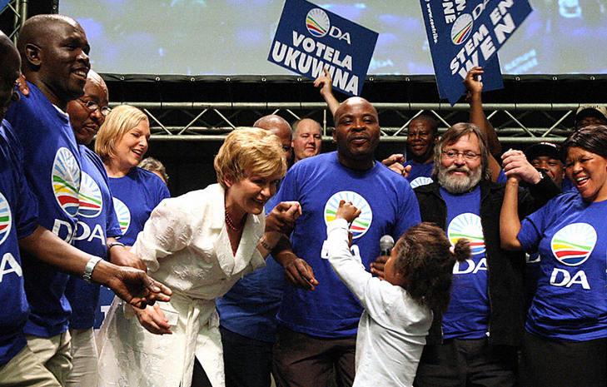
Democratic Alliance South Africa
Helen Zille, Premier of Western Cape Some exceptions.

Slide 29
African Governance Patterns
Review of Regime Types

Slide 30
V. Patterns of Government
Traditional Remnants
Ethiopia- 1960s
Swaziland
Somalia

Slide 31
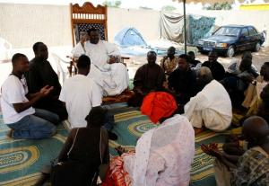
Neo-Traditional
Botswana
Senegal
Buganda
Kwa-Zulu

Slide 32
One Party States
Quote: “One Zambia, One Nation, One Party”
Radio Zambia, 1975
Quote: “One Man, One Vote, One Time”
Rhodesian White Tobacco Farmer, 1980

Slide 33
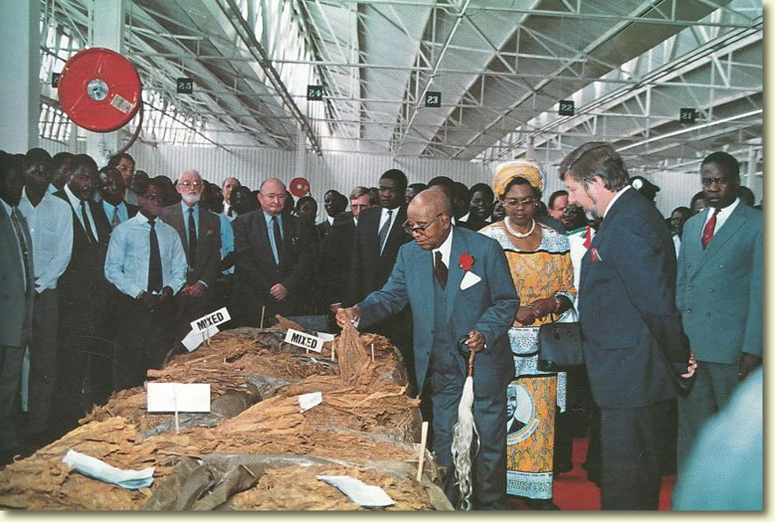
Tobacco Farming in Central Africa

Slide 34
Attempts at Intra-Party Democracy
Ghana, 1960s, Tanzania and Zambia, 1970s
Grass Roots Participation and Mobilization
Elections (primary) within the Party
Goal: Contained Political Systems
Socialist Goals.

Slide 35
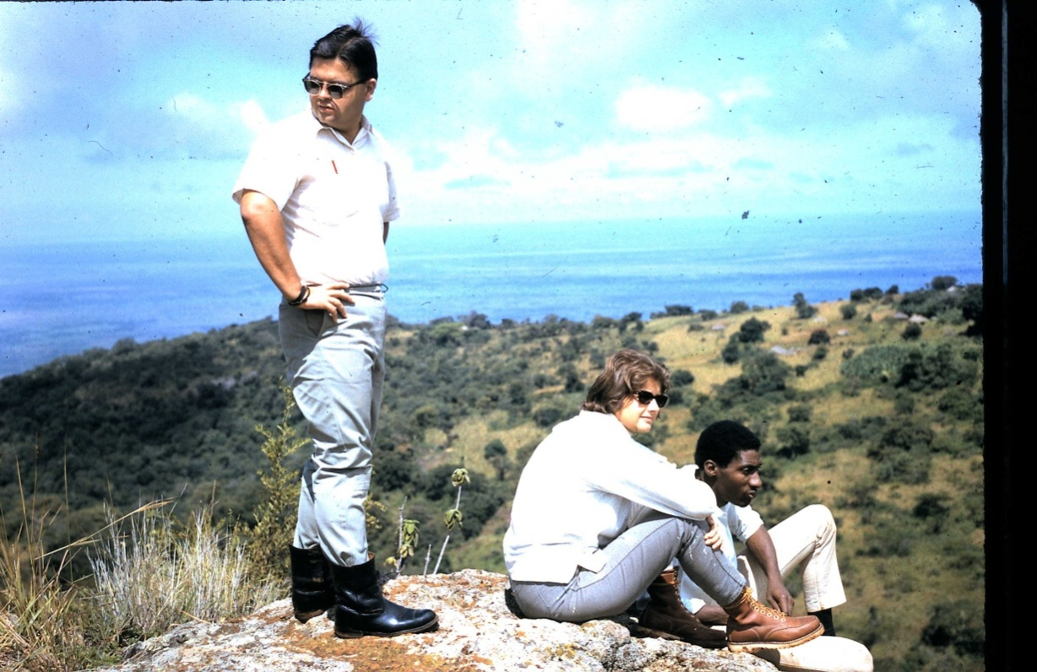
Louis A. Picard, “Socialism and the Field Administrator: Decentralization in Tanzania,” Comparative Politics, July, 1980, Louis A. Picard, pp. 439-457
The Guy Standing thought Tanzania socialism was great!

Slide 36
Vanguard and Leninist Parties
Angola and Mozambique 1980s (Revolution)
Ethiopia- 1980 (Leninist State under the Dergue)
Congo Brazzaville and Benin- Marxism and Croissants
Guinea Conakry (Syndicalism)
Zimbabwe- (Rhetoric)

Slide 37
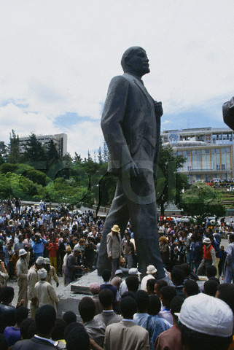
Revolutionary Square, Addis
The Derge
Ethiopia,
1964-1991

Slide 38
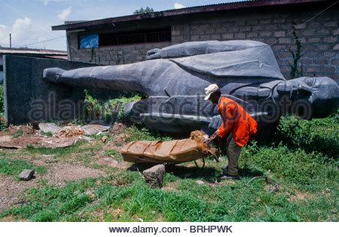
Lenin in Addis, 1994

Slide 39
“No Party” Administrative States
One Party States where the Party is a Shell (Afro-Capitalist)
Kenya, Ivory Coast, 1970s
Uganda in the 1990s
Eritrea, Rwanda, Ethiopia Now

Slide 40
The Nature of the Bureaucratic State
KEY:
The Bureaucracy evolves over time but political institutions tacked on a few years after independence
Beyond Elections: The Need to develop political institutions
Bureaucrats as an institutional elite

Slide 41
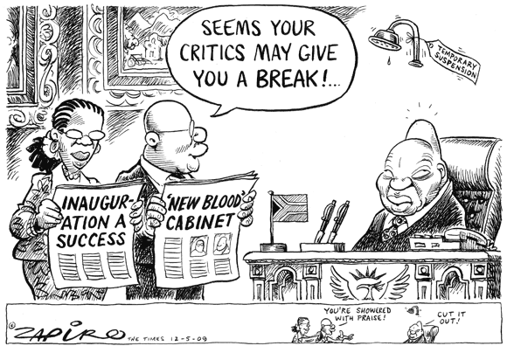
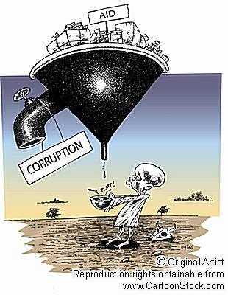
African Cronyism
Corruption

Slide 43
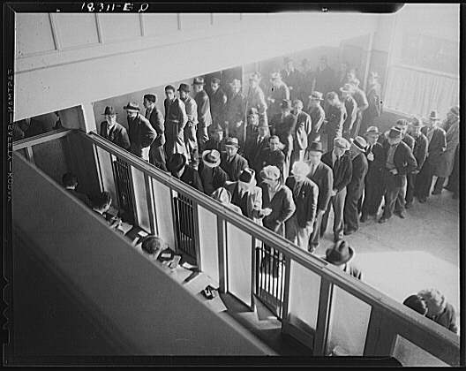
Lining up for the state bureaucracy

Slide 44
The Nature of the Bureaucratic State
Causes of Institutional Weakness
Too Strong a Bureaucracy weakens Institutions and causes decline of political parties
NOTE: Institutional Analysis studies how institutions—i.e., structures and mechanisms of social order and cooperation governing the behavior of two or more individuals—behave and function according to both empirical rules (informal rules-in-use and norms) and also theoretical rules (formal rules and law)

Slide 45
Bureaucratic Dominance
No Private Sector, Few Private Interest Groups
Public Sector Dominates Economy
Bureaucratic Interests dominated by an “organizational Bourgeoisie”
Absence of Civil Society

Slide 46
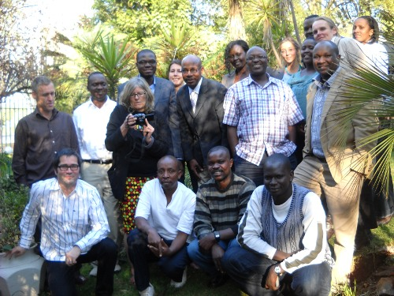
African Transitional Justice Research Network (ATJRN) Workship 2010
Civil Society?

Slide 47
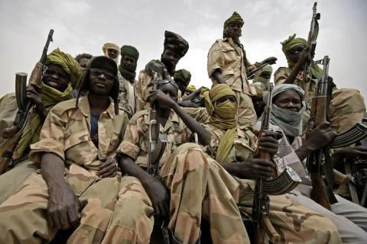
Military Government in Africa

Slide 48
Patriarchy and Power and African Governance
From One Party Rule to the Military Regime
Patronage and Clientelism
Patrimonial Leadership and the Presidential Model
From the Patriarchy to the Military.
Reference: Jackson and Rosberg, Personal Rule in Black Africa

Slide 49
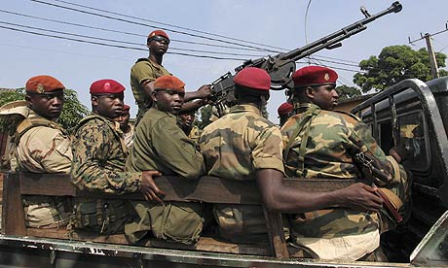
Direct Military Rule
Direct Rule: Uganda, Nigeria, Ghana examples (1970s)
Francophone states prone to military government in the 1980s (Togo, Benin, Guinea Conakry)

Slide 50
Sanitized Military: “Soldiers in Mufti”
Ghana under Rawlings
Egypt- for the moment
Nigeria Now?
Uganda since 1987
Soldiers form a political movement not a Political Party

Slide 51
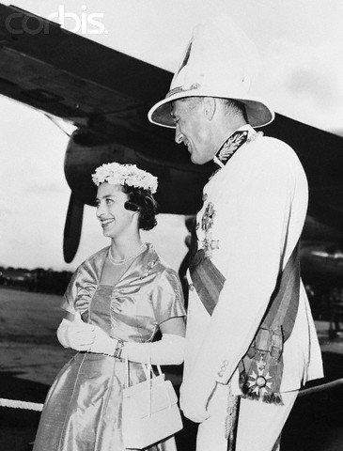
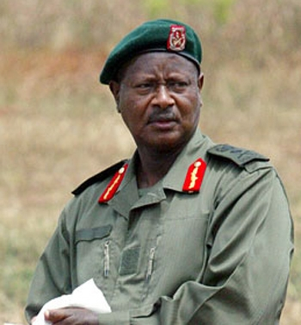
Military “Ornamentalism”
President Yoweri Museveni of Uganda and Sir Evelyn Baring, Colonial Governor of Kenya

Slide 52
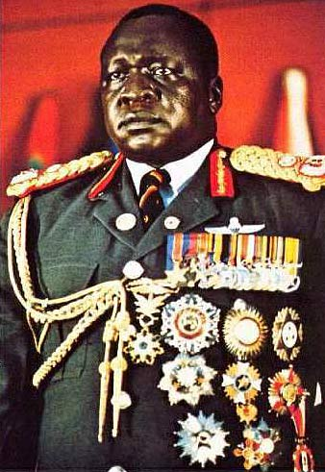
Military “Ornamentalism”

Slide 53
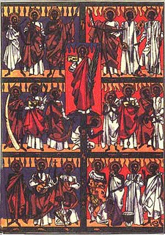
Uganda Martyrs and LRA

Slide 54
Why the Military Intervenes?
Political vacuum theory- military modern
Military as Interest group- Corporatist
Military as "puritanizing" politics- target corruption- anti-corruption as interest group politics
Coups as result of "fragmented" or disreputable politics

Slide 55
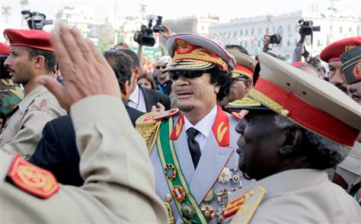
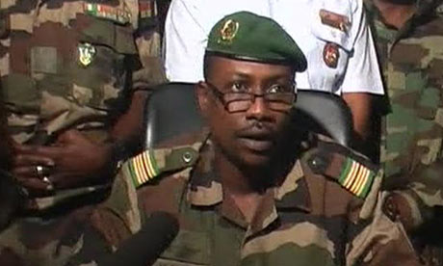
Military Coup Leaders

Slide 56
Why the Military Intervenes
Heavy handed civilian repression
Decline of legitimacy of civilian movements
Schism of Military leaders
Generals
Colonels
lieutenants
Sergeants
Left wing military- coups and class conflict

Slide 57
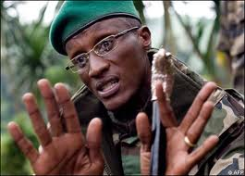
Why the Military Intervenes
Ethnic coups
Economic malaise and collapsed states
Laurent Nkunda,
“Ethnic Tutsi”
in DRC

Slide 58
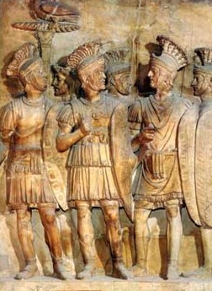
Military Regimes
Two Roman Concepts
Praetorianism
“Cincinatus in Africa”
Praetorian Guard

Slide 59
Debates About Multi-Party Governance
How to Get the Military back into the Barracks
How to Get Back to Civilian Government

Slide 60
Return to Multiparty Government
Forums (1990s)
Human Rights Movements
Movements Towards Democracy
Religious Nationalism- Algeria and Islamic regimes
Civil Society Movements
Reforming Elites?

Slide 61
Return to Multi-Party Government
Multi-Party Challenges
Structural Adjustment Pressures
Collapse of Military Regimes
What is the Future of Politics in Africa?

Slide 62
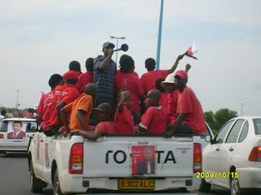
Lingering Multiparty Regimes- Are They Models?
Botswana- “African Success?”
Senegal- Islam and Civic Culture
South Africa- From Caste Democracy to non-racialism
Mali- How
institutionalized?

Slide 63
Ghana

Slide 64
Multiparty Regimes
Benin
Zambia
Kenya
Zimbabwe (still)

Slide 65
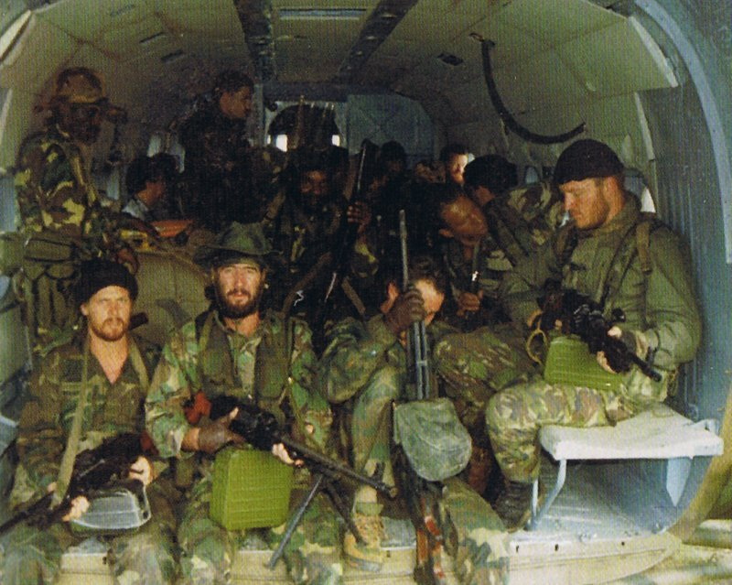
Collapsed States (To be Continued)
Economics, Politics, regional wars and “Executive Outcomes”

Slide 66
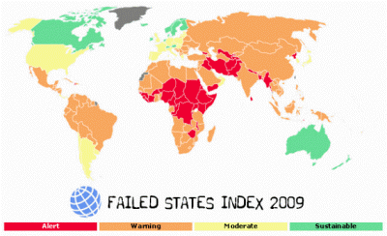
Collapsed States
Somalia
Rwanda
Congo
(Zaire)
Liberia
Angola
Sierra
Leone

Slide 67
Collapsing States
Who’s next (the case of Northern Ghana?)
Who’s next (the future of Zimbabwe)
Whither Liberia and Mali?
Questions and Discussion

Slide 68
The Power of the Cartoon
How to fight authoritarianism and Corruption?

Slide 69
Saving Africa
One Party Rule, Authoritarianism and the Administrative State.

Slide 70
Paper Proposal Presentations
Governance and Development

