Slide 1
PIA 2096
Capstone Seminar on Foreign Aid
A War on Terror: Defense, Diplomacy and Development
(DDD)

Slide 2
National Defense University
Note: This Presentation in a different form was originally made in July 10, 2007.
Focus of Original Presentation: The Creation of the African Command (AFRICOM)
The Views Presented here do not reflect those of the National Defense University, the Department of Defense or the United States Government
Here: AFRICOM as Whole of Government
Here we use The African Command as an example of DDD.

Slide 3

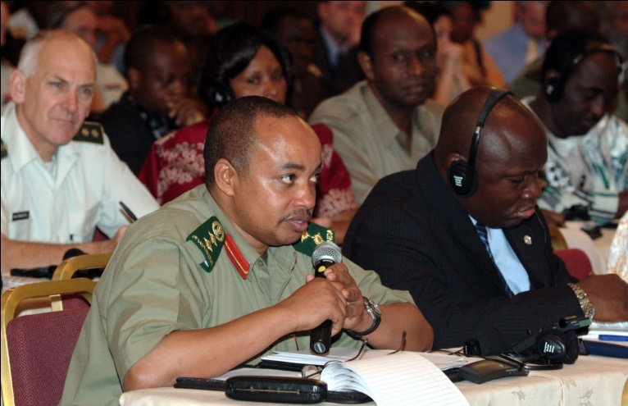
Africa Center for Strategic Studies
The Three D’s:
Defense, Diplomacy and Development
Dr. Louis A. Picard Then
Senior Research Fellow
National Defense University
Washington D.C.

Slide 4



Slide 5
Overview: Six Themes in Foreign and Security Policy
I. Conflict Prevention and Management
II. Conflict and Peace Making
III. Peacekeeping and international organizations

Slide 6
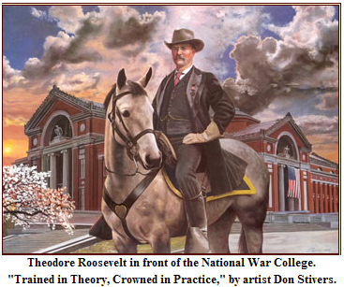

Slide 7
Themes- Continued
Terrorism and Counter-terrorism
Post-Conflict Governance
Foreign Aid and Foreign and Security Policy

Slide 8
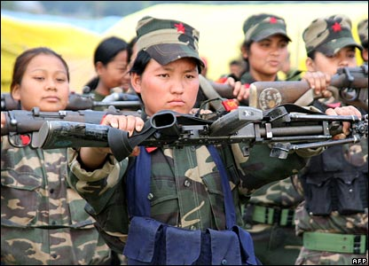
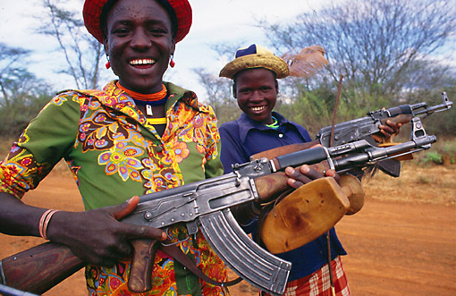
Twenty First Century Armies

Slide 9
I. Conflict Prevention and Management
Community based conflict mitigation
      Role of indigenous leadership and traditional conflict mediation
      Land, social rights and behavior
      Joint Traditional and Local Government Mechanisms
      Leadership modalities (The Mandela Model)
Traditional Justice vs. Political institutions
Governance and Development

Slide 10
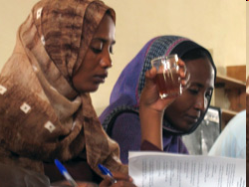
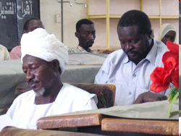
Conflict Resoluton in the Sudan
Conflict Resolution
"We drew upon traditional conflict resolution techniques”
Research by Germaine Basita
GSPIA PhD Student

Slide 11
Indigenous Methods of Conflict Mediation
      Problem of ratcheting up and reconstructing institutions
      Problem of collapsed and failed states
      National Identity Challenges- Leadership Modalities
      Survival of Traditional Institutions

Slide 12
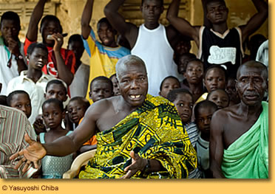
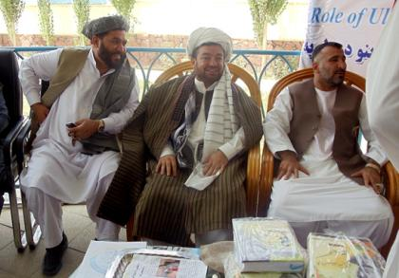
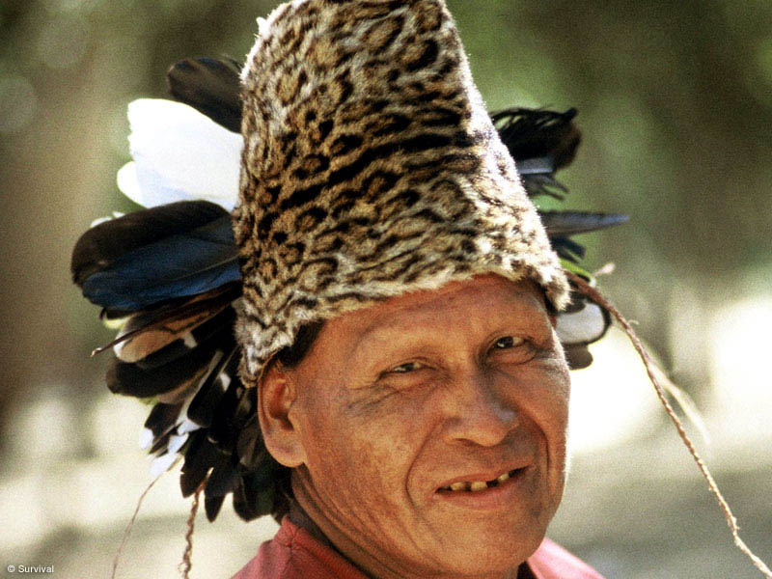
Traditional Leaders

Slide 13
II. Conflict and Peace Making- Different Modes
Wars of Liberation- East Timor, South Africa, Algeria, Lusophone Africa (Victory or Stalemate and Negotiations)
Civil Wars- Ethnic and Religious “Cultural Pluralism”- Bangladesh, Somalia, South Sudan and Rwanda (Intervention, Mediation and Peacemaking)

Slide 14
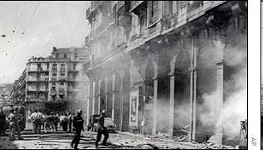
Algerian Civil War: An Important Event

Slide 15
Algeria
Video
The Beginning of the Modern World
From the Battle of Algiers, 1966

Slide 16
Different Modes of Conflict
Economic Conflict- poverty and organized crime (Post-Apartheid South Africa)
Cold War- Ethiopia/Eritrea and Namibia/Angola
Ethnic Regional conflicts- DRC, Rwanda and Liberia/Sierra Leone
(International Negotiations and Peace Making)
Afghanistan, Iraq and Ukraine

Slide 17
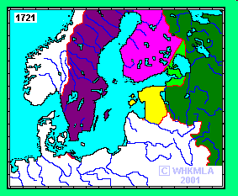
Are we Different Now? Ethnic Conflict in Northern Europe

Slide 18
III. Peacekeeping and international organizations- Issues
  Northern State mechanisms: NATO and EU
  Mediators
  Unilateral vs. Multilateral (U.S., France and U.K.)

Slide 19
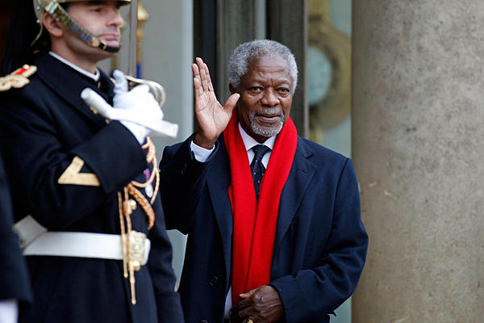
Former UN Secretary General Kofi Annan

Slide 20
National or Transnational Groups?
Al Qaeda in the Arabian Peninsula
Al Qaeda in Iraq
Al Qaeda in the Islamic Maghreb
Boko Haram
Al Shabaab
Allied Democratic Forces (ADF)
Islamic State (IS)

Slide 21
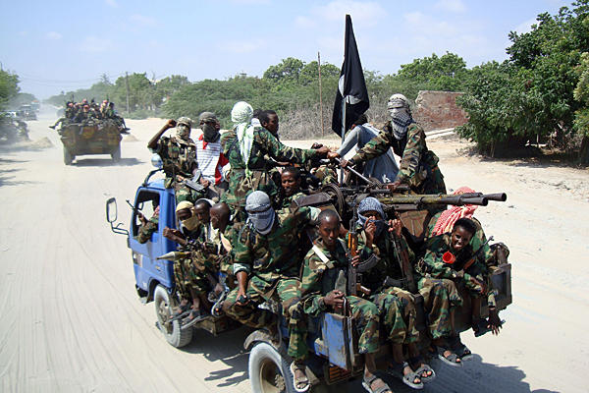

Slide 22
Peacekeeping and international organizations- Issues
  Multi-lateral and bi-lateral- Continental vs. International
  Regional Groups: ECOWAS, Africa Union, SADC
  What is NATO?
  United Nations Peacekeeping vs. Monitoring vs. Conflict control (Rules of Engagement)

Slide 23
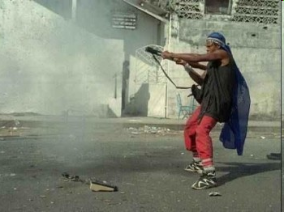
Liberian Civil War

Slide 24
Peacekeeping and international organizations- Issues
  Role of “proxy” states/armies (Uganda)
  Impact of Foreign and Military assistance Programs (Horn, Sahel and War on Terror)
  Special Role: Mediation Centers (Institute of Peace, Leadership and Governance at Africa University, Zimbabwe)

Slide 25
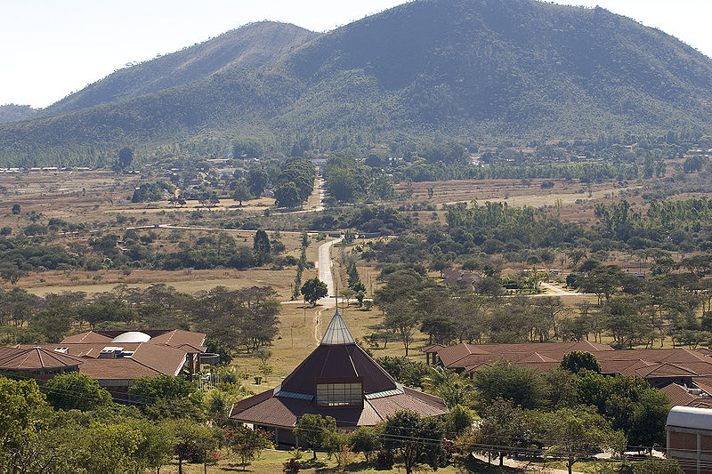
Africa University- Mutare, Zimbabwe

Slide 26
IV. Terrorism and Counter Terrorism. Is it an Issue?
Terrorism and Counter-terrorism (Includes regional, sub-regional, national and sub-national levels of activity) – U.S. and Europe
Global vs. non-global
How Relevant to LDCs?

Slide 27
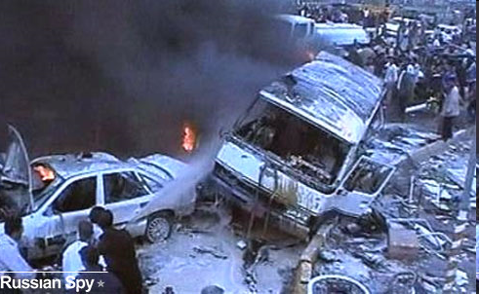
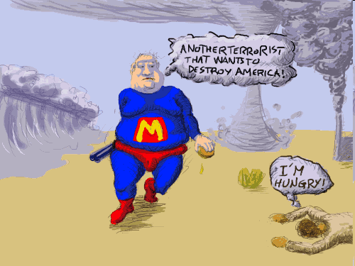
North vs. South?

Slide 28
Counter-Terrorism Strategies
Legislation, Finance, Border Security (including passports and travel documents Control)
Police, military and security, combating ideological Support for Terrorism
Strengthening Traditional Leadership
Information and Intelligence and International Cooperation
Offensive Combat

Slide 29
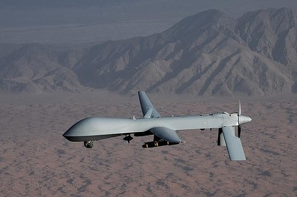
The New War?

Slide 30
Sector Reforms and Counter-Terrorism
Evolution of U.S. CT Policy in Africa Since September 11
Impact of ethnic and religious identification on Terrorist threats
Challenges of parallel governance and the Arab Spring (Egypt, Tunisia, and Libya)

Slide 31
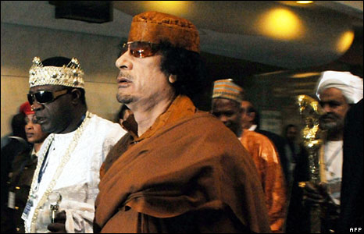
Popular Appeals

Slide 32
Regional Threats
The threat of Collapsed States and crime- Diamonds, Drugs, guns (Columbia, Guinea Conakry)
Paramilitary Violence (Philippines, Great Lakes)
Organized Crime, and Piracy (Air, Land and Sea)- Indian Ocean and gulf of Guinea

Slide 33
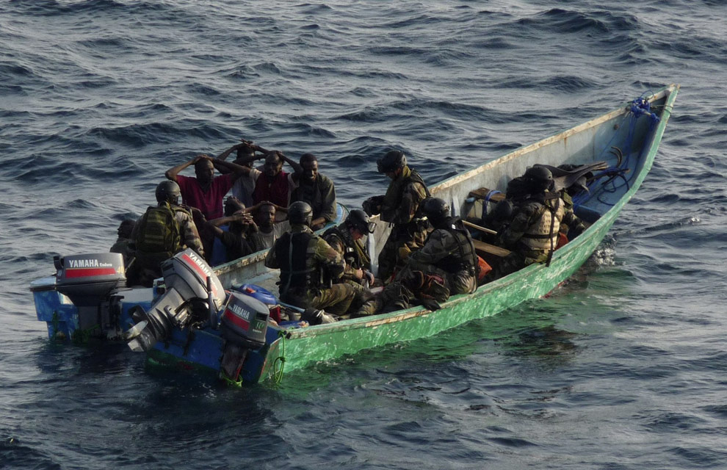

Slide 34
V. Post-Conflict Governance
      The Role of Negotiated Pacts
      Truth and Reconciliation vs. Justice
      International Courts Issues

Slide 35

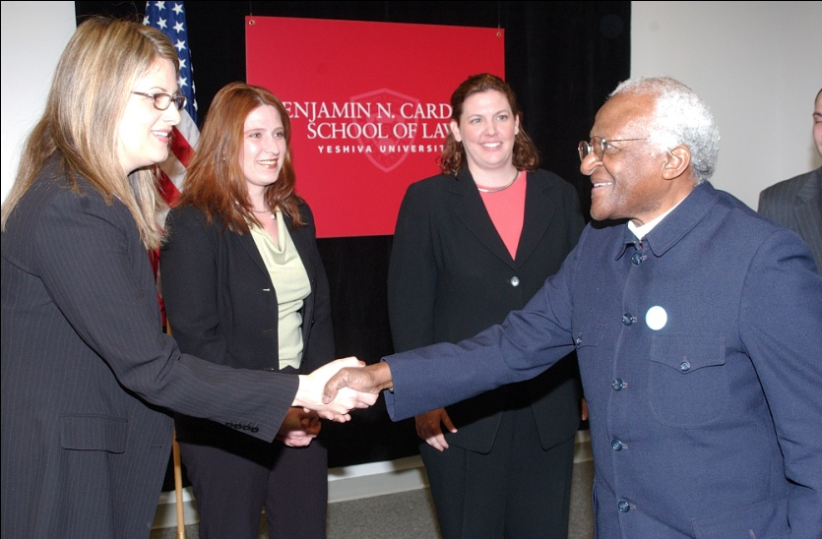
Liberian Truth and Reconciliation Commission
Conflict Resolution
vs.
Justice
Bishop Desmond Tutu

Slide 36
Post-Conflict Governance
      Demilitarizing societies
      State Rebuilding and Institutional Development
      Democracy and Governance

Slide 37
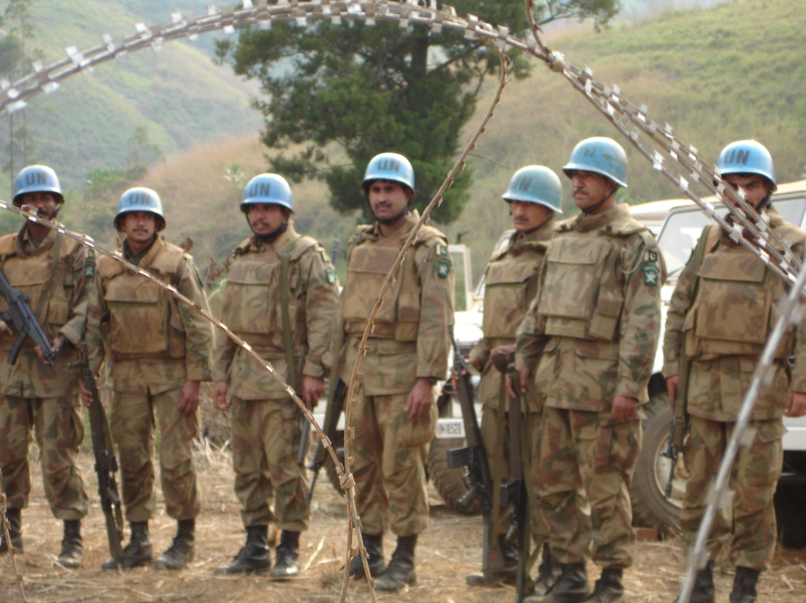
Nation-Building, United Nations Style

Slide 38
National Security Strategy
Presentation by Secretary of State, May 27, 2010
Video
Presentation by Secretary of State
May 27, 2010 (4:00)

Slide 39
VI. Foreign Aid and Foreign and Security Policy- Two Views
1. So Called “Whole of Government” Approach- The Method
2. Historical Debate about “Hearts and Minds”- The Problem

Slide 40
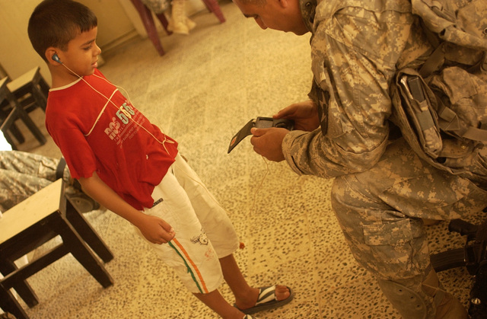

Slide 41
“Whole of Government”
      3. Focus: Diplomacy, Development and Defense
      4. Usually Add Information/ Intelligence, Trade and Finance, Environmental, etc.

Slide 42


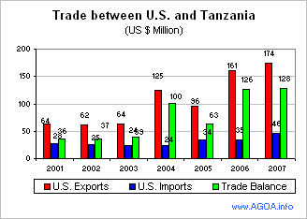
The Trade Issue

Slide 43
“Whole of Government”
        Definition:
        Integrated Approach to Conflict and Post-Conflict Situations in Fragile States

Slide 44
Whole of Government Countries:
Extent of Integration
Scandinavia
Canada
U.K.
Australia
France
U.S.

Slide 45
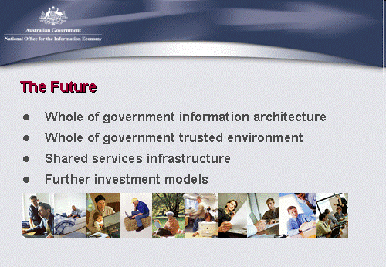
Australia

Slide 46
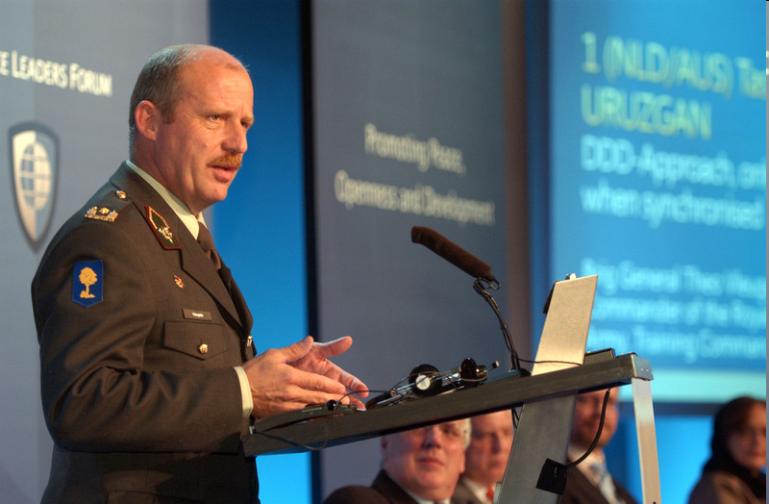
Netherlands
“Development, Defense and Diplomacy should be the three legs of any stabilization operation, says the recently returned commander of the first Netherlands-Australian Task Force in southern Afghanistan.”
Brigadier General Theo Vleugels, of the Royal Netherlands Army

Slide 47
“Hearts and Minds Debate”
“Hearts and Minds”
Phrase Widely Used re. AFRICOM-
Development Linked to Ideological Change- Rural Development, Collective Villages, Militias
Five “Classic” Variations

Slide 48
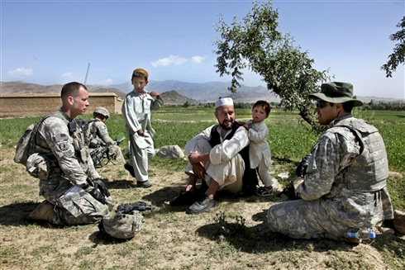
Counter Insurgency in Afghanistan- COIN

Slide 49
“Hearts and Minds” Five Examples
a. Origins- Malayan Emergency- (But Not Kenya)- Malaya Only clearly agreed upon Success re. “Hearts and Minds.” Next three failed to meet “goals”
b. French Military Theory- Best Represented in debates about Indo-China not Algeria
c. U.S. Goal: Vietnam- “Third Force” (Quiet vs. “Ugly” American literary image)

Slide 50
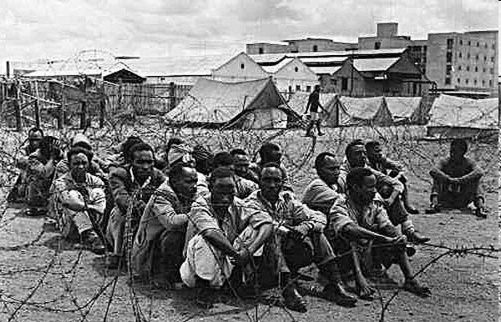
Kenya

Slide 51
“Hearts and Minds” Examples
Cold War- Successfully ended (1948-1989).
WHAM- “Winning Hearts and Minds”(South Africa) P.W. Botha- So-Called “Total Strategy”
Video: Not Such a Happy Memory
Not a Happy Memory

Slide 52
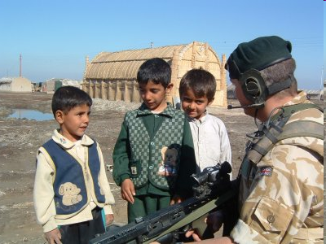
Iraq and Afghanistan

Slide 53
Whole Government vs. Hearts and Minds in AFRICOM
Issues:
a. Cold War- Focus re. Hearts and Minds was on States. Key- Political Leadership was Coordinating
b. Now since 2001, there is a perception “World Wide” re. U.S. that there is military and security which is driving AFRICOM- Focus: Non-State Actors (Terrorist Groups) and Community Loyalty

Slide 54
Whole Government Clearer: Focus on Implementation Problems:
a. Blending the Three Ds- People and Finance (Stovepipes and Staying in your own lane)
Non Defense Budgeting Limitations
Budget imbalance- State/USAID vs. Defense
Joint Activities- Controversial eg.
Provincial Reconstruction Teams (PRTs)

Slide 55
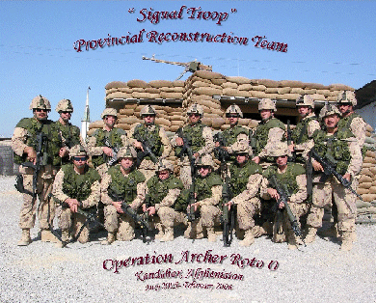
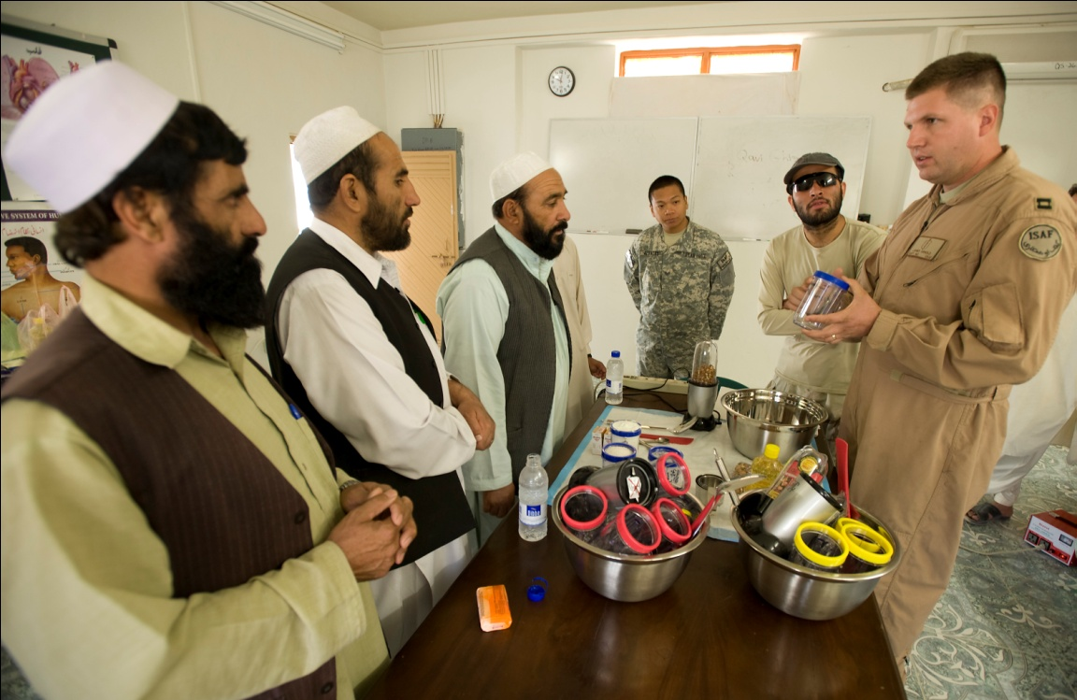
PRTs- Canadian Group on Right

Slide 56
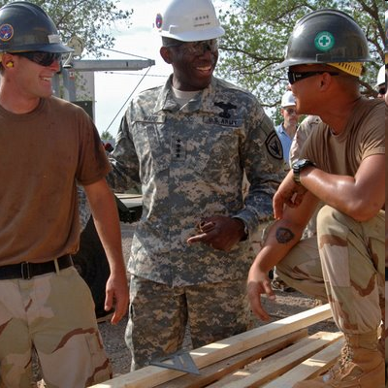
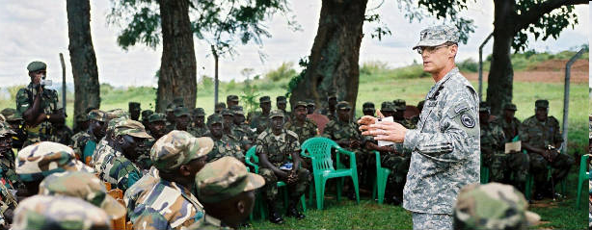
AFRICOM
Winning Hearts and
Minds

Slide 57
Implementation Problems
b. DFID vs. USAID in terms of resources (Development vs. Security)
c. Role of “Conflict/Post-Conflict Financial Pool” –Jointly Managed, so called “Inter-Agency Doctrine”
d. Role of Contractors and NGOs

Slide 58
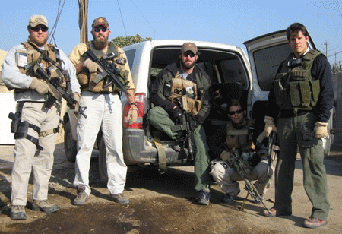


Slide 59
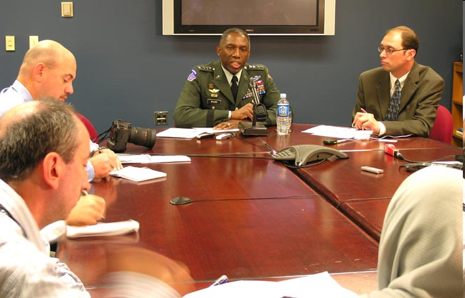
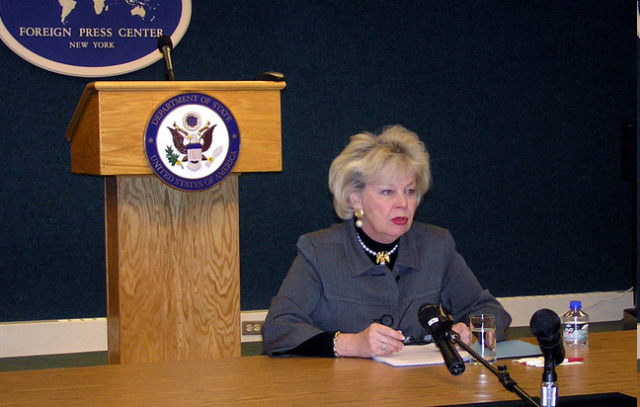
Former AFRICOM Commander General William E. Ward and Ambassador Mary Carlin Yates, Deputy to the Commander for Civil-Military Activities, U.S. Africa Command

Slide 60
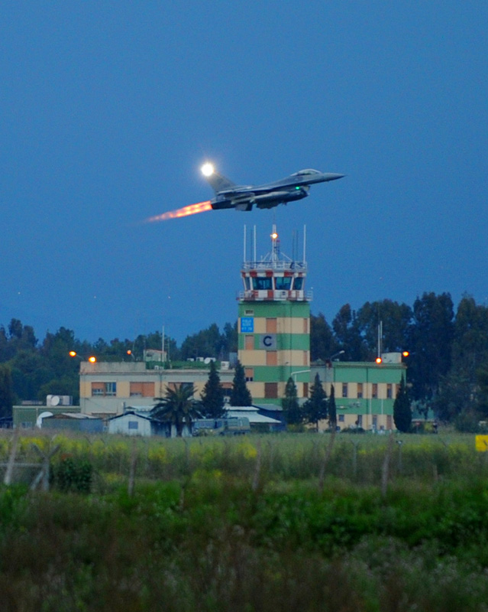
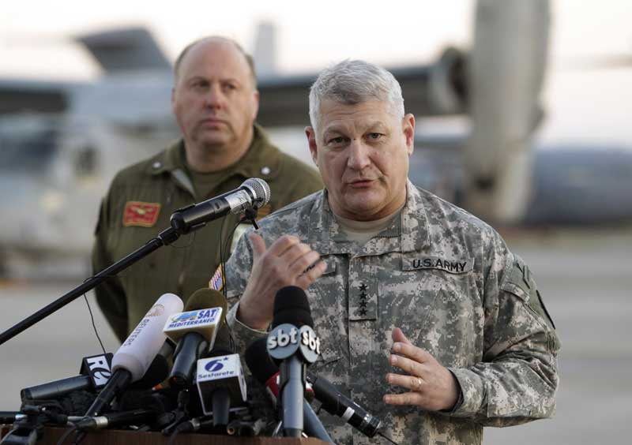
AFICOM: The Folks Who Brought you Libya General Carter Ham

Slide 61
The Current Debate Re. AFRICOM
1. Location of Leadership- subordination of civilian leadership to military command
2. New Targets- Direct linkup between security system and non-state actors. How this will work?
3. Issue: Is Primary Concern “fragile” states or “international terrorism”
4. Is definition of Fragile States important?

Slide 62
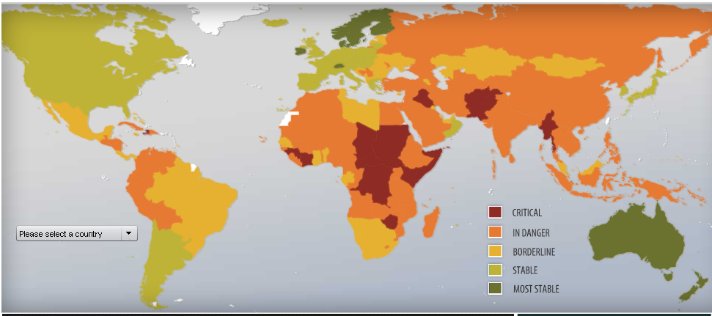

Slide 63
The Current Debate Re. AFRICOM-2
5. Physical location- Organizational location: Europe vs. Africa (Symbolic)
6. Military- no single big base possibly an Office (change from current situation only incrementally) –pods and mobile forces
7. Military Policy- Non-issue in the sense that it changes a name and integrates the horn and Indian Ocean islands into the rest of Africa and breaks Africa off from Europe organizationally, a legacy of the colonial paradigm
8. Future Libyas? Future Ukraines?

Slide 64
The Current Debate Re. AFRICOM-3
9. Diplomacy and Development- Already linked State/USAID
  The Non-Security vs. Security Components: Not well articulated at this point
  Perception of Subordination at regional and sub-regional level to military commands
  Debate about Democracy and Governance

Slide 65
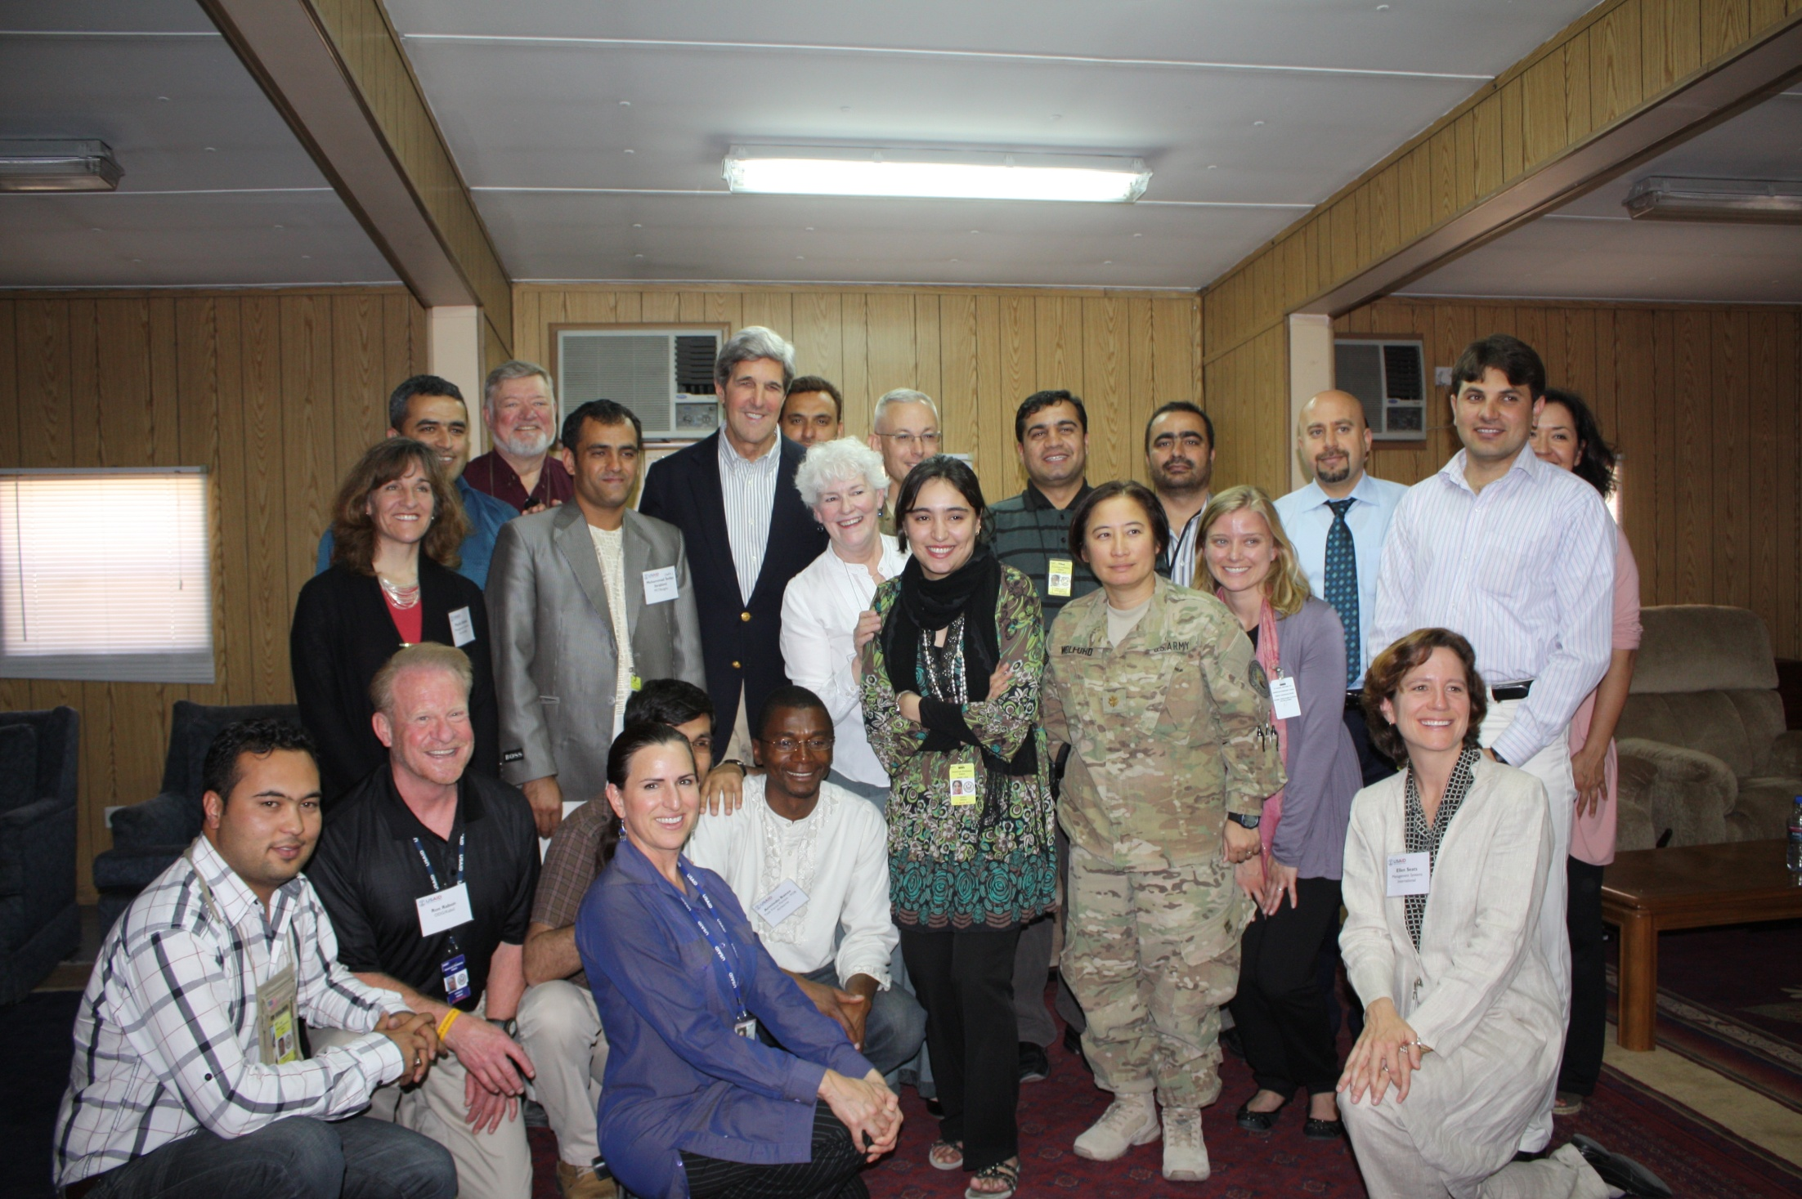
Senator John Kerry Opens USAID’s Democracy and Governance Fundamentals course in Kabul

Slide 66
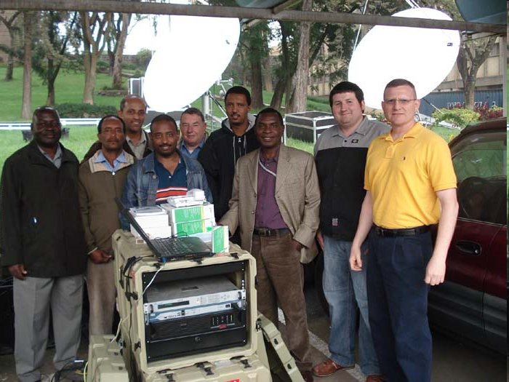
African Union Technicians with AFRICOM Trainers
AFRICOM: “Life after Iraq and Afghanistan for Dyncorp, Triple Canopy and Blackwater.”

Slide 67
Conflict and Post-Conflict Governance
Key Role: National Level- Coordinating & the Responsibility of Chief of Mission- The Ambassador and DCM
This Coordinating Role may need to be addressed within the context of:
1. Relationship with African Union
2. Regional Economic Commissions

Slide 68
AFRICOM Research Focus
Series of Studies of African Perceptions of AFRICOM and the Three Ds- (Triangulation Study)
Research Interests: Human Security Debates
  Coordinating Mechanisms
  Common Pool Resources
  Community Based Solutions (Elective and Traditional)
  Balanced Development vs. Security Focus

Slide 69
“Where is the Beef”
USAID Funding Redeux
When asked why he robbed banks, infamous criminal Willie Sutton said, “Because that’s where the money is.”
Looking for Jobs where the money is.
Where the Money is?

Slide 71
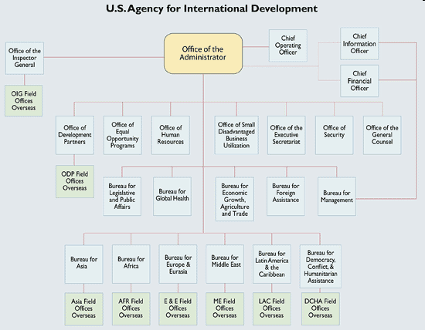
Organization Chart

Slide 72
USAID Hiring Policy
USAID Foreign Service Junior Officer Vacancies
USAID Junior Officer (JO) Foreign Service (FS) announcements for career candidate positions are planned for Fiscal Year (FY) 2007 for intended entry into the FS in FY 2008. USAID plans to recruit JOs in several employment categories, including the following:
    Financial Management
    Economic Growth (Agriculture, Private Enterprise, Economics, and Environment)
    Crisis, Stabilization and Governance
  http://www.usaid.gov/careers/nepanno2.html

Slide 73
Next Meeting
Presentation of Paper Proposal
Two Weeks

Slide 74
COMMENTS/QUESTIONS/
CRITIQUE?

