Slide 1
PIA 2096
Foreign Aid Capstone

Slide 2
Foreign Aid
Dealing with Donors:
(and Coping with Donor Complexity)

Slide 3
Overview Issues The Current Period 2002 - 2022
The Donor System and Their Clients
The Federal Government and its Vendors
Contracts vs. Grants
Cooperative Agreements
Intra-governmental Transfers

Slide 4
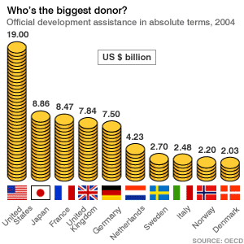
I. The Donor System and Their Clients- Review: Who Gives Absolutely?

Slide 5
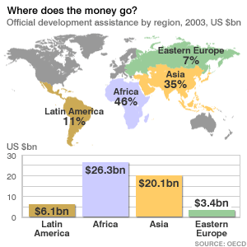
Where does the Money go?

Slide 6
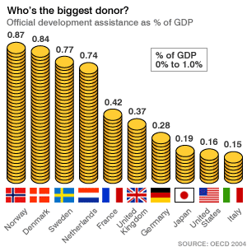
Who Gives Per capita

Slide 7
The Foreign Aid Apparatus
Foreign aid created two new kinds of professionals, a donor official and a recipient program manager
The Program Manager’s Plea
Video

Slide 8
The Problem
Host County Program Managers have to work with the international Donor system
The Rodney Dangerfield syndrome

Slide 9
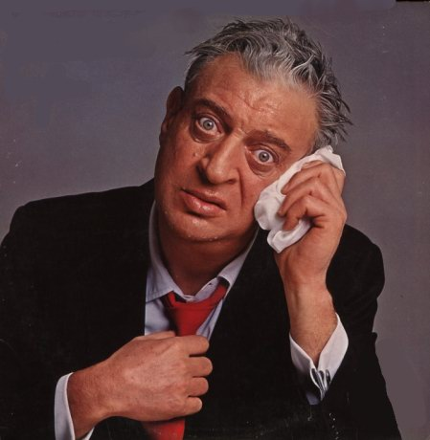
Like Rodney, Foreign aid “gets no respect”

Slide 10
Donors and program management
A weak and unstable LDC bureaucracy time and time again would come up against the donor community’s massive pool of well qualified people and complicated bureaucratic process

Slide 11
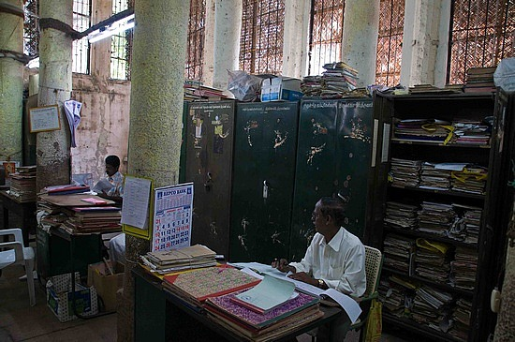
Stereotype: Indian Bureaucracy

Slide 12
Donor Priorities
Particularly during the cold war, corrupt countries often seem to receive the lion’s share of foreign aid.
Donor Client relationships part of Dependency patterns
Now: Move the Money

Slide 13
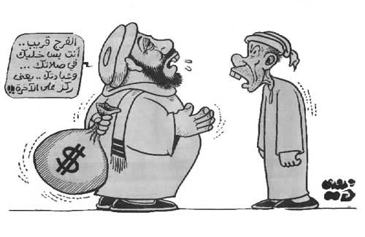
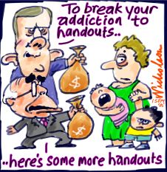
The Problem

Slide 14
Program Managers
Recipients often cannot say no to aid even when the recurrent maintenance revenue requirements cannot be met.
Foreign aid failure rates are disturbing.
Recipients sometimes need to “just say no.”

Slide 15
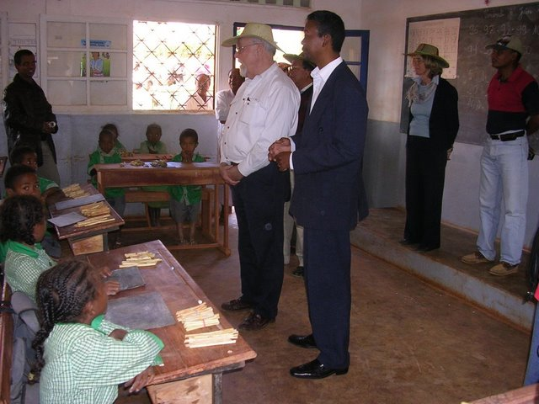
USAID official Jerry Cashion (wearing hat) speaks to the class

Slide 16
Dealing with Donors
Understand the Donor Language
Understand the Donor’s Documents
Understand the Donor’s Rules
Understand soft as well as hard donors
Understand the Sustainability Problem

Slide 17
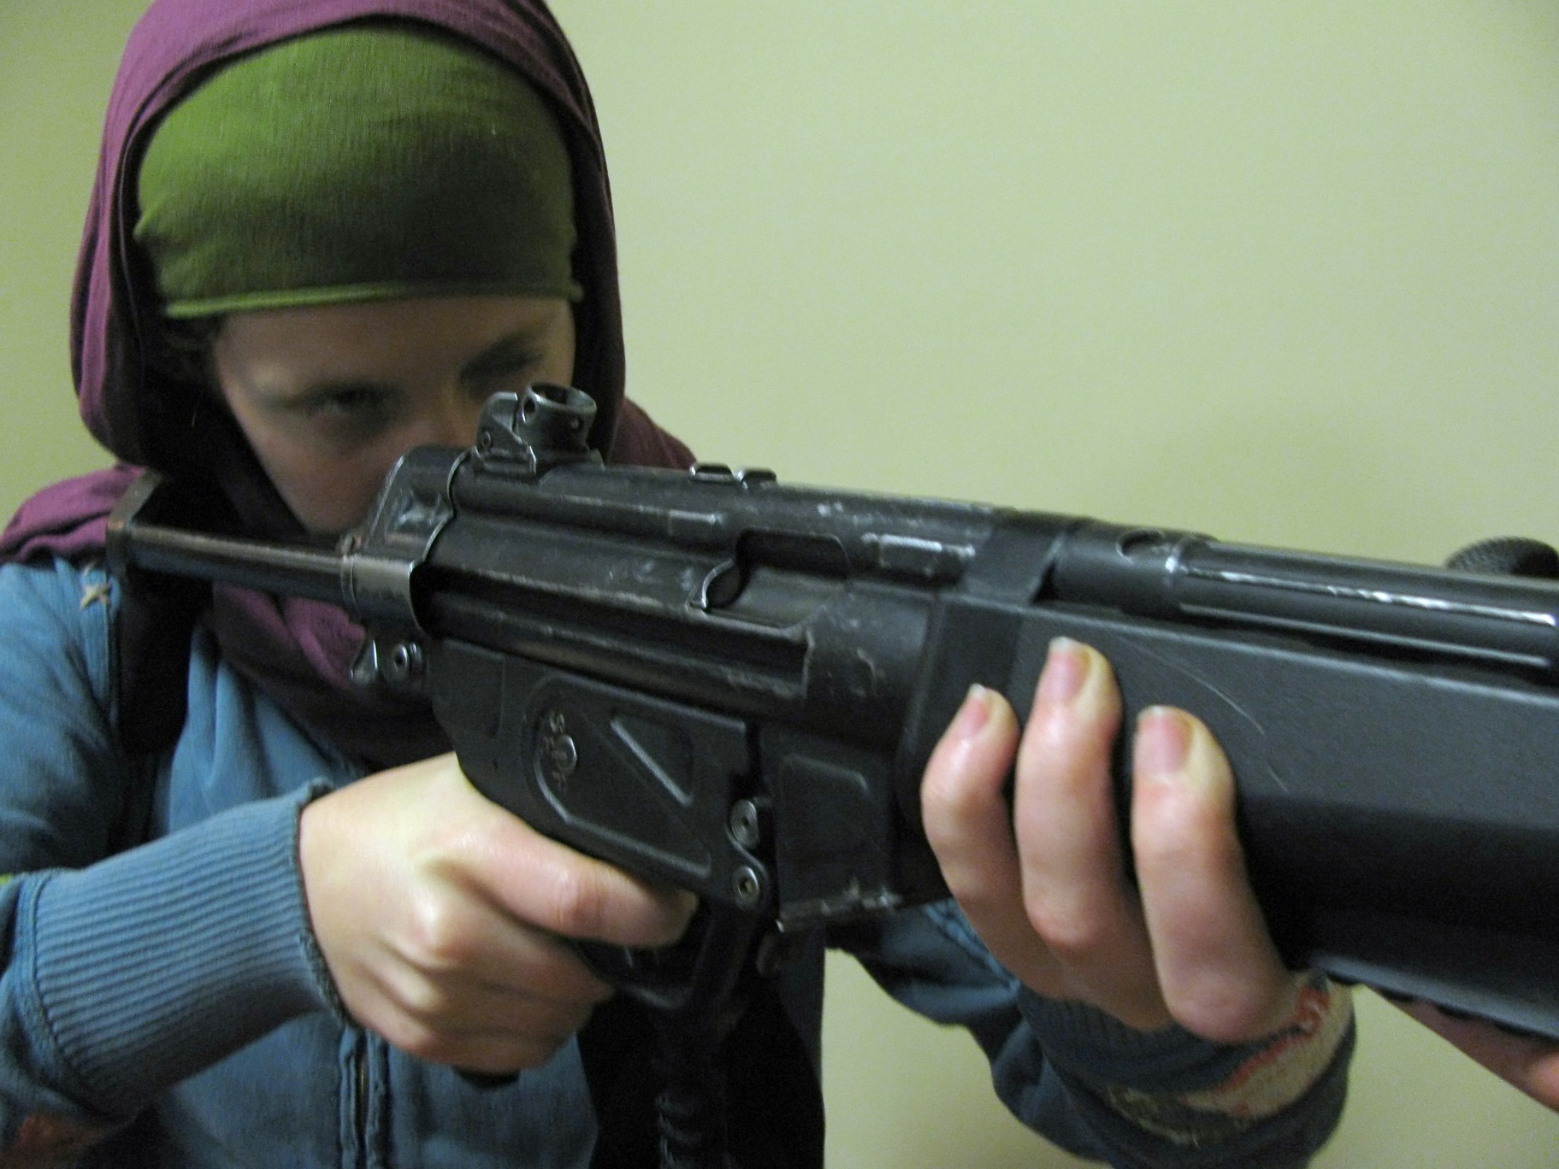
For their own safety foreign aid workers in Afghanistan became familiar with weapons

Slide 18
LDC Program Managers: Coping with Expatriates
Understand the internal Organizational Imperative
Be Aggressive and a “Hard” Recipient
Understand hidden agendas, Italian Computers, Danish Bacon

Slide 19
Products and Foreign Aid

Slide 20
Qualifications in Mali
The project was designed to assist poor villages excluded most of the villages in Mali. When he asked how many micro-credit loans were available in one Mali village, the response was “None, the village does not qualify.”
In order to qualify for the credit, villages had to have village associations. Only the better off villages, he added, had village associations.
The lesson to be learned from this is that foreign aid often does not assist the poorest of the poor and sometimes makes matters worse for them.

Slide 21
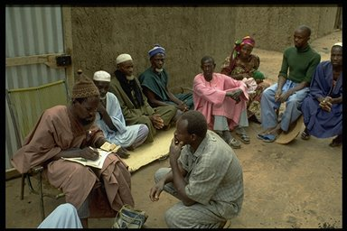
Mali Village

Slide 22
Reference
John Madeley, When Aid is No Help: How Projects Fail and How They Could Succeed (London: Intermediate Technology Publications, 1991).

Slide 23
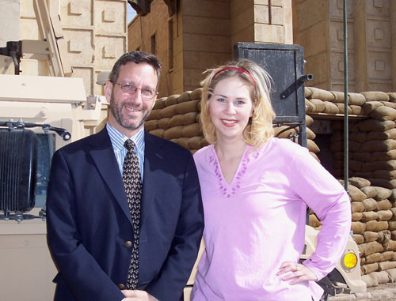
2. Foreign Aid-The Federal Government and Its Vendors
The People: 3,700
In Government
Foreign Service Officer
Civil Service Officer
Personal Services Contract
Contractor/grant officer in Private or Non-profit Sector
PRT volunteers, Foreign Service Officers Glenn Guimond and Angela Gemza, outside the entrance of the U.S. Embassy in Baghdad, formerly the Republican Palace.
Provincial Reconstruction Team

Slide 24
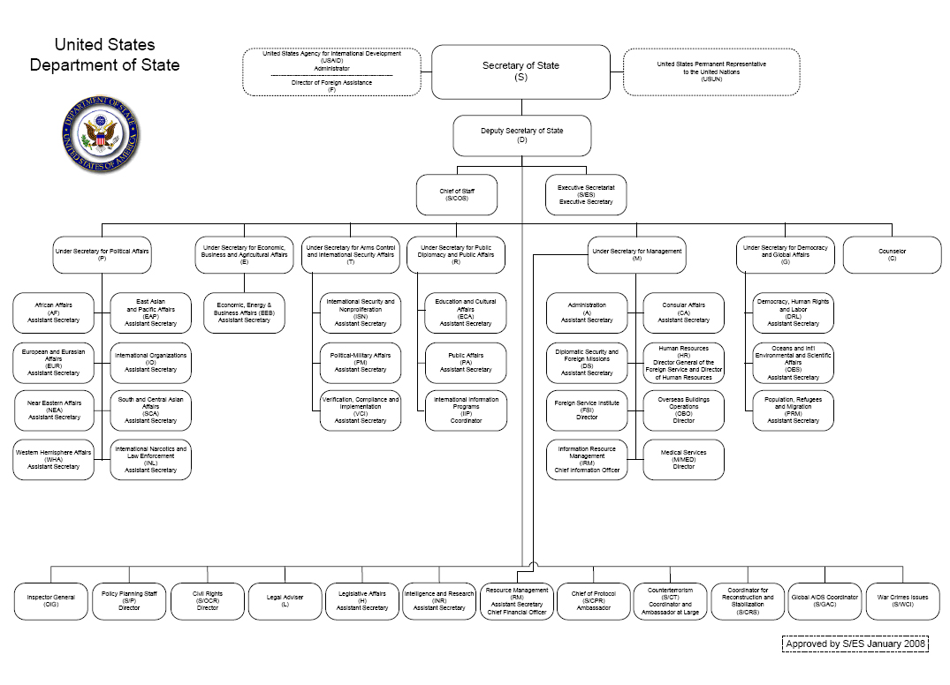

Slide 25
Other Foreign Aid Agencies
Millennium Challenge Corporation (MCC)
Presidents Emergency Plan for AIDS Relief (PEPFAR)
Department of Defense
Department of State
Department of Agriculture

Slide 26
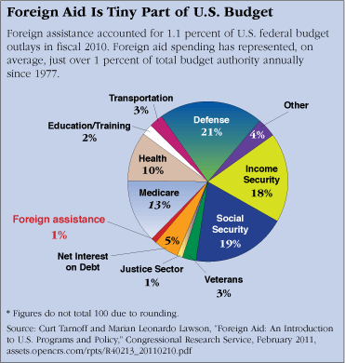
How the Pie is Split
Defense Department Foreign Aid about 22% of Total

Slide 27
The People: Tens of Thousands
Operational Expert or Advisor
Project Coordinator
Team Leader or Chief of Party
Contractor
Grantee/Sub-Grantee
Home Office Backup
TDY- in the Field

Slide 28
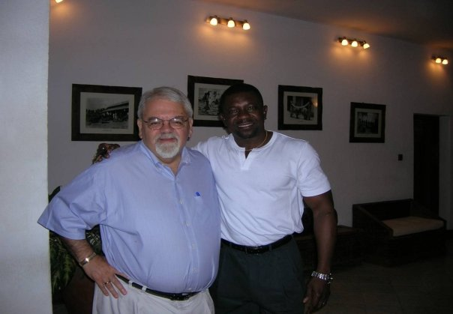
The Foreign Aid Worker
Dr. Matthias Zana Naab Lobilo is Program Coordinator for the Democracy and Governance Program of the United Nations Development Program in Dar es Salaam, Tanzania. He holds the MID and PhD in Public and International Affairs from the University of Pittsburgh.

Slide 29
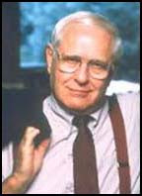
The Complicated World of the Federal Government
Goal: Hide or avoid restrictions on Personnel Ceilings
Jack Anderson and the “Washington Merry Go Round” (Reagan Administration)
Examine Interagency transfer/
Cooperative Agreement as an example

Slide 30
The Contract vs. Grant
Contracts- Requests for Proposals (RFPs). For profits vs. Non-profits
Principal- Legally enforceable delivery of services
Often through Indefinite Quantity Contracts (IQCs)
We Return to Contracts Next Week

Slide 31
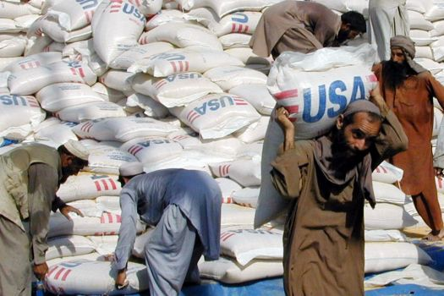

Slide 32
The Nature of Grants
Grants normally available to Non-Profits
Purpose of Grants is often Sub-Grants
Can be “Grants in Contracts”
Grant: Gift, with conditions but not legally enforceable
Can only refuse to give additional Money

Slide 33
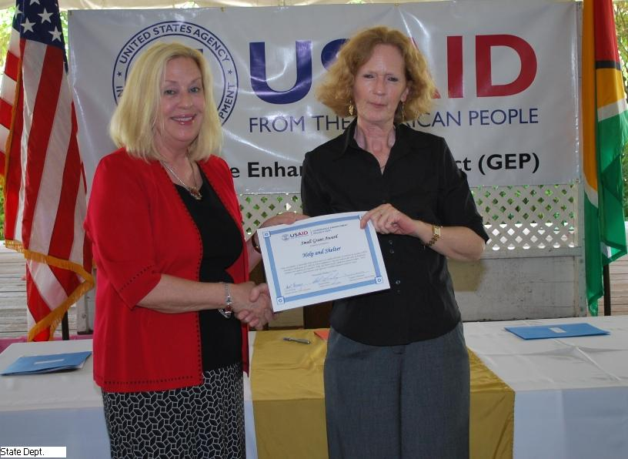
On Wednesday, October 27, 2010, the United States Agency for International Development (USAID/Guyana) through its Governance Enhancement Project (GEP) awarded grants in the amount of US$58,600 to three Civil Society Organizations (CSOs),

Slide 34
Contract vs. Grant
Grants- Based on Cooperative Agreements
Request for Applications (RFAs)
Grants have no legal enforcement mechanism but can be withdrawn
“Those intending to join the course should process their requests for grants in their own countries through the appropriate institutions” Government of Tanzania

Slide 35
Performance Management Cooperative Agreement 1979-1991
United States Agency for International Development
National Association of Schools of Public Affairs and Administration (Louis A. Picard, Director, 1984-1987)
DPMC- Development Planning Management Center- University of Maryland)
IDMI- International Development Management Institute U.S. Department of Agriculture

Slide 36
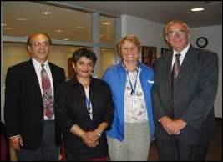
Higher Education and Development for Archaeology and Environmental Health Research SUNY at Stony Brook
Cooperative Agreement, September 30, 2003

Slide 37
Higher Education for Development: University of Pittsburgh Governance Group
“Pitt Political Science Professor Awarded $685,000 Grant to Evaluate USAID's Political Party Program”
“Scott Morgenstern and his research team will update and evaluate USAID's work in supporting political party development worldwide”

Slide 38
Sub-Contract: University of Pittsburgh and the Mitchell Group
Nature of Project: Combating Extreme Violence
West Africa- Based in Ghana
Louis A. Picard, Team Leader
Activities:
-Five Year Impact Evaluation- Mali, - Niger and Burkina Faso Evaluation Training (ECOWAS in Ghana)
-Research Support

Slide 39
Intra-Governmental Vending: A Case Study
Interagency Cooperation with each other and with for Profit and Non-Profit Sectors
The agreement is not like a contract (more like grant)
establishes operational guidelines and a spirit of cooperation to link the institutional resources of two government agencies in accomplishing U.S. foreign assistance goals
RSSA/PASA System
Participating Agency Service Agreements (PASAs)
Resources Support Services Agreements (RSSAs)

Slide 40
Historical Perspective
USDA and President Truman’s “Point Four” Program
administered the agricultural training and technical assistance programs
1950, Technical Cooperation Administration (TCA) created
Predecessor to USAID

Slide 41
The Spirit and Intent of RSSAs and PASAs
Within a USDA/USAID Partnership
Transfers can exist throughout the Federal Government
And between Agencies and Cooperants

Slide 42
USAID RSSA/PASA Partners
United States Department of Agriculture
U.S. Department of Labor
Environmental Protection Agency
U.S. Department of
Health and Human
Services

Slide 43
Historical Perspective (1950s)
USAID recognized "…the unique personnel resources, capabilities and experience of the Department”
sought to use this expertise through cooperation
USDA recognized "...its responsibility, within its authority, to contribute toward U.S. foreign policy by participation in foreign assistance programs"

Slide 44
Possible Foreign Aid RSSA Cooperants

Slide 45
Historical Perspective
1955, International Cooperation Administration (ICA)
All foreign economic development efforts were consolidated
USDA expertise and institutional resources were still critically needed
As a result, ICA and USDA drew up a major agreement to facilitate cooperation in technical assistance, training, and information dissemination

Slide 46
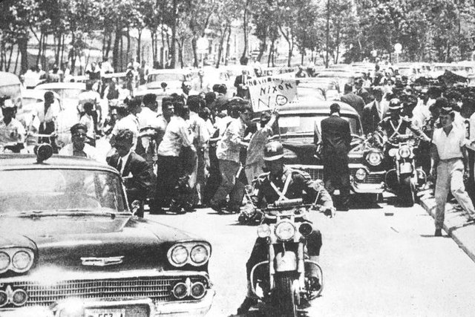
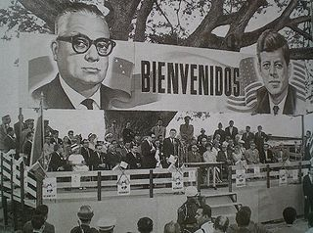
U.S. Stormy Relationship with Latin America in 1960s-2022
Nixon and Kennedy Trips to Latin America, 1956 and 1961

Slide 47
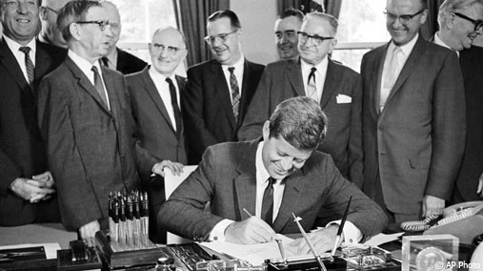
Historical Perspective
Passage of the Foreign Assistance Act of 1961 and the creation of USAID
A new General Agreement in 1966 laid the framework for cooperative relationships

Slide 48
Historical Perspective
General Agreement between USDA and USAID
Based on the premise of a partnership between USDA and USAID
emphasis on joint planning, coordination and consultation

Slide 49
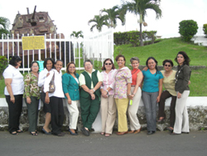
Historical Perspective-2
General Agreement between USDA and USAID
Agreement affirmed new partnership mechanisms to access USDA expertise:
Participating Agency Service Agreements (PASAs)
Resources Support Services Agreements (RSSAs)
Foreign Agricultural Service

Slide 50
“Spirit and Intent” & Responsibilities in Implementing PASAs and RSSAs
PASAs: Overseas Assignments (PSCs- Personal Services Contracts)
Normally issued by Missions for support outside the U.S., but can be used to carry out a specific goal or goals of an AID/W project
Effectively the two terms have become interchangeable

Slide 51
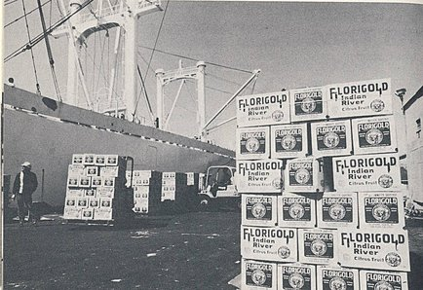
“Spirit and Intent” & Responsibilities in Implementing PASAs and RSSAs
RSSAs
Agreements funded in AID/W for continuing general support assistance, usually provided in an AID/W office, and have no specific, readily measurable goals to be accomplished within a set time period
In the 1990's, most USDA/USAID agreements have been RSSAs

Slide 52
A View of Foreign Policy from the Other Side of the Pond
Video

Slide 53
Discussion
The Issues and the
READING

