Slide 1
PIA 2096
Foreign Aid, Foreign and Security Policy
And Development Management
The Legacy of Vietnam and the Cold War
Week 6

Slide 2
Paper Proposals
Two Minute Overview

Slide 3
Technical Assistance and Structural Adjustment

Slide 4
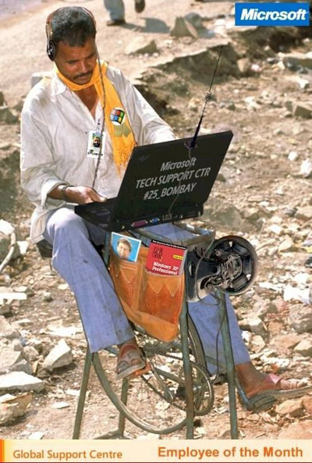

Slide 5
Overview of the Issues
Defining Development and Underdevelopment
The Problem of Debt, 1983-2011
Stabilization vs. Conditionality
Public Sector Reform and Policy Reform
Foreign Aid vs. Technical Assistance

Slide 6
I. Defining Development and Underdevelopment
Changing Terms
Non-Western World
Developing areas or nations
Third World

Slide 7
Foreign Aid: The Third Decade
The First Decade: (Baker’s Dozen) 1948-1960 “From Point Four to The Missile Gap”
The Second Decade (and a half) 1960-1975 (From USAID to Vietnam’s Collapse)
The Third Decade: 1975-1991 (Unlucky in Aid and War-Iran and Nicaragua)

Slide 8
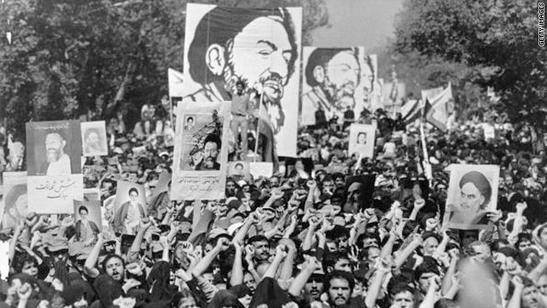

Slide 9
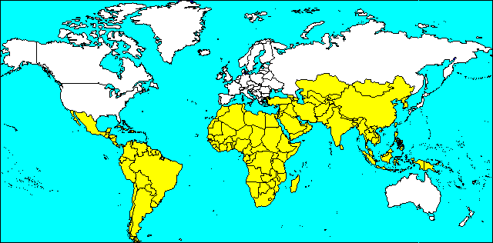
Changing Terms
Southern Tier States
LDCs
UDCs
Transitional States?
Emerging Markets

Slide 10
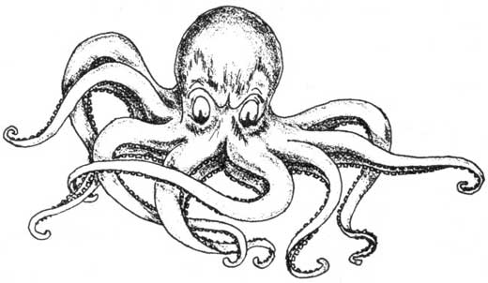
Divisions Within the World: Late 20th Century
North: Industrialist/ Developed Agriculture
Regime Type Democratic or not
Socialist vs. Capitalist
agric. Vs. Industry
South: Underdeveloped Socialist or primitive capitalist LDC
Capacity to Influence- limited Before 1985
Crony capitalism
Patron-client
Image: Crony Capitalism
In the Phillipines

Slide 11
Divisions Within the World
2001?
Capitalist Developed States, North America, Parts of East Asia, Western Europe including settler states
Emerging Markets
vs. “Everybody else”
Robert Kaplan, “The Ends of the Earth”

Slide 12
Robert Kaplan’s Definition- Isolation of Poor Countries

Slide 13
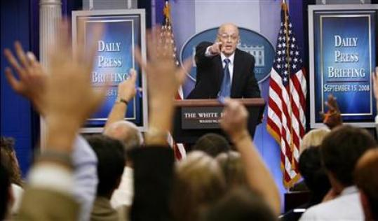
II. The Problem of Debt: 1983-2001
Treasury Secretary Henry Paulson fields questions from reporters on 700 Billion Debt Payout

Slide 14
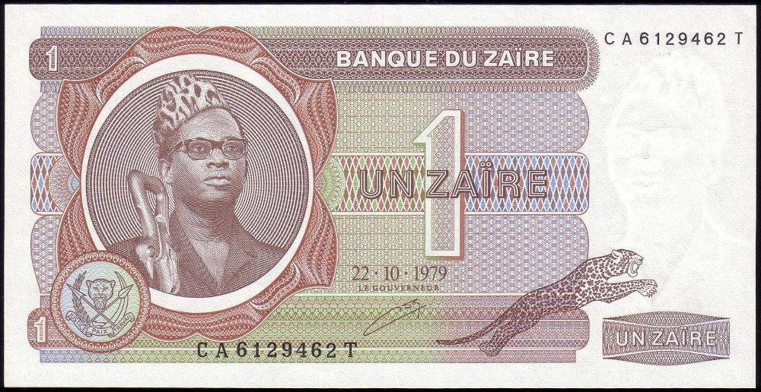
The Big Man’s Big Money

Slide 15
Video
He Let the Good Times Roll…

Slide 16
After 1991- Second World as New Debtors
Chad vs. Russia
Transitional States
Rise of Asia and blocks
Crisis in Asia and the return to debt management
First World and Threatened Collapse of Capital Markets
Chad vs. Russia
First World States: USA vs. Greece?

Slide 17
The Counter-Thesis- What about the Children

Slide 18
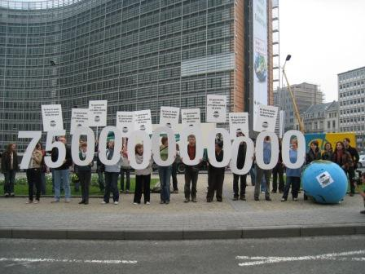
III. Stabilization vs. Conditionality
Conditionality: the use of conditions attached to a loan, debt relief, bilateral aid or for or membership of international organisations.
It is used typically by international financial institutions, regional organizations or donor countries.
Demonstration against conditionality

Slide 19
Current State of Financial Management
IMF stabilization and trade liberalization
Currency reform, auctions and end of subsidies (urban privileges)
Market prices for agriculture
Deregulate the economy

Slide 20
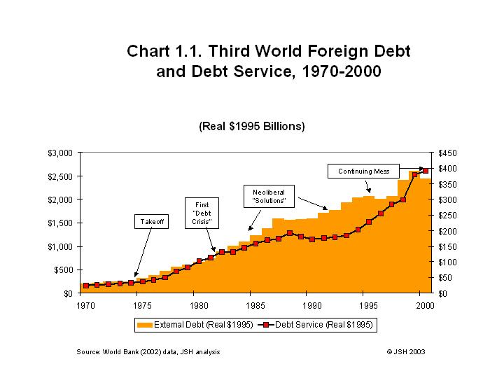
Stabilization
the search for equilibrium between costs, labor and currency value
Goal: the retirement of government debt, and lower inflation through decreased public spending
Currency Auction and Market Prices

Slide 21
Multilateral Institutions
IMF vs. World Bank vs. Bilateral Donors vs. UNDP
Bridging Loans
Sectoral Loans and Grants
Project Grants
International Requirements vs. domestic political response

Slide 22
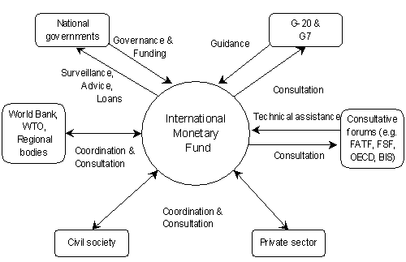
IMF Director Christine LaGarde 2011-2019

Slide 23
Domestic Management Systems and International Influences
Historical periods of budgetary and fiscal management (Continued)
1980s
Structural Adjustment—"non-budgetary" allocations vs. incremental budgeting
Problem of debt
Donor monies drive the system in the degenerated state

Slide 24
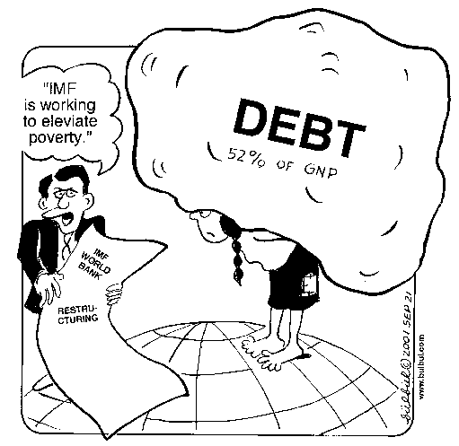
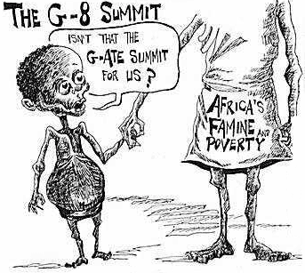

Slide 25
United Nations System vs. the Group of Twenty
The role of international regimes- UN, World Bank, IMP, etc. New International Order (NIO)
Opposing views of many UNDP Representatives (Pro-LDC)
The Debate and the Role of the Resident and Country Plans

Slide 26
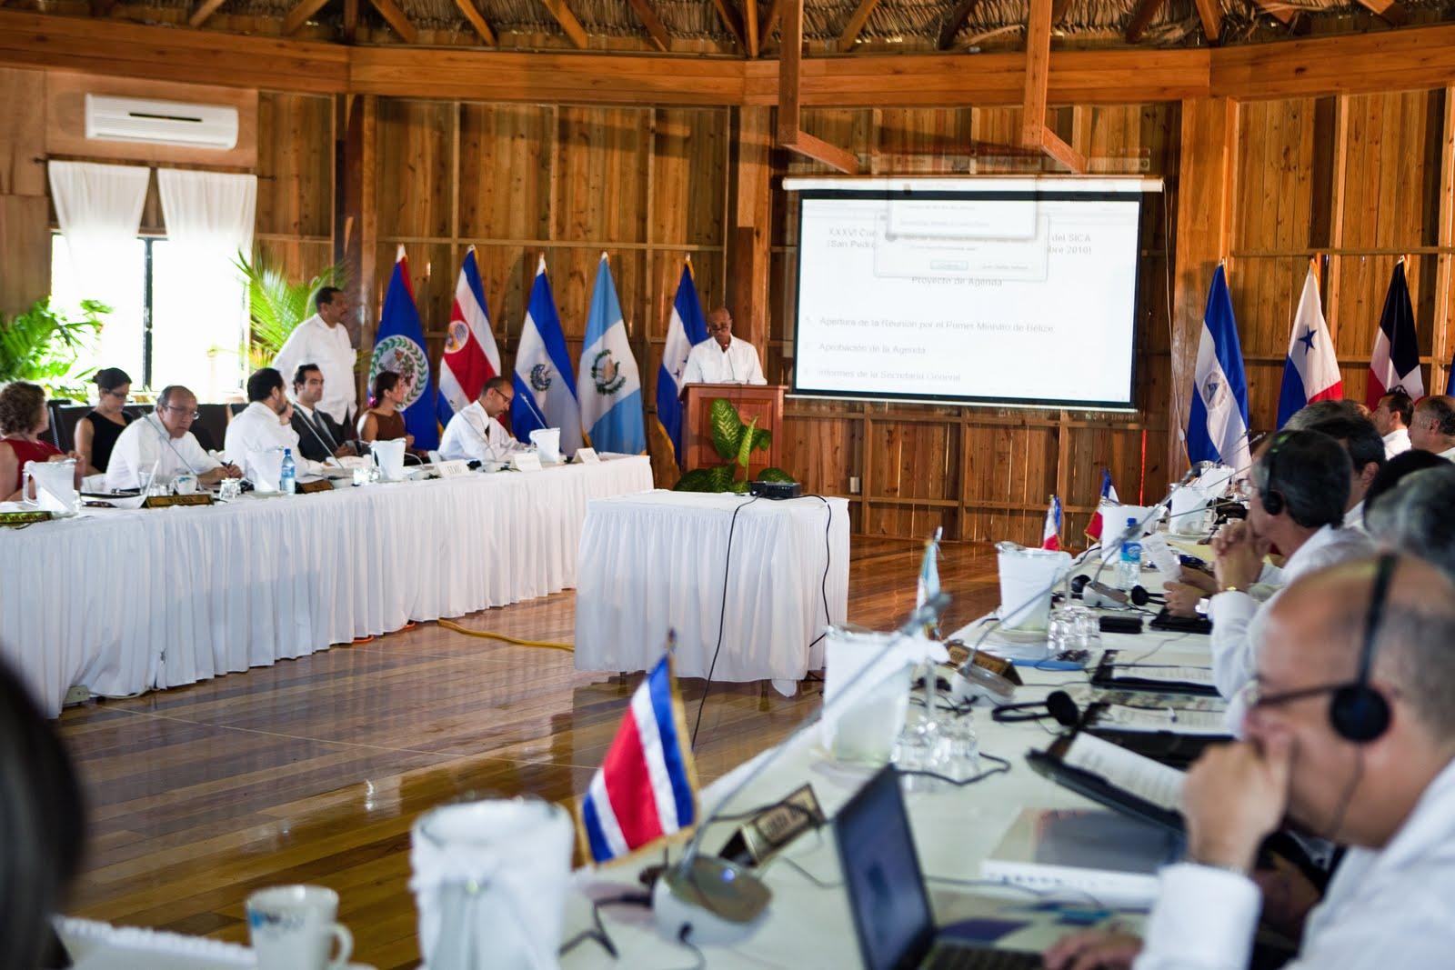
UN Resident Coordinator and UNDP Resident Representative Speak at Regional Meeting in Centdral America

Slide 27
State of Financial Management under SAPs
Conditionality—World Bank, UNDP and the "Management" SAPs
The receivership committee Resident Rep., World Bank Representative and the IMF delegate resident ambassadors
Stabilization and Conditionality Requirements
Public Sector Reform
Privatization

Slide 28
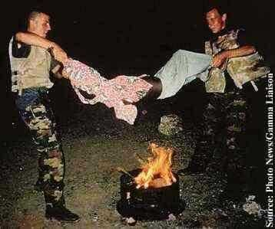
Not the New International Order in Somalia

Slide 29
How to Relieve Third World Debt?
The Celebrity Factor

Slide 30
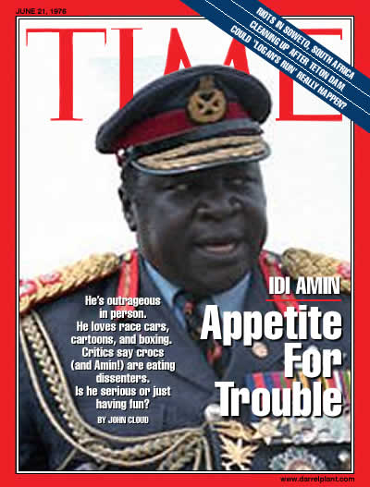
IV. Public Sector Reform and Policy Reform
Bad Governance.
LDC Poverty?

Slide 31
Domestic Management Systems and International Influences
Historical periods of budgetary and fiscal management
1990s
Collapse of the Soviet Union
“Clash of civilizations”

Slide 32
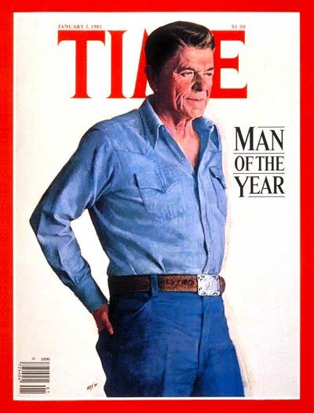
The End of the Command Economy?

Slide 33
“Happy Days”

Slide 34
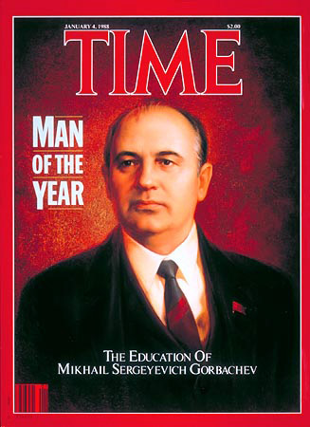
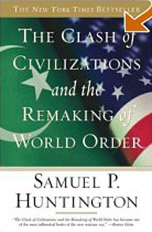
1989-1993

Slide 35
Current State of Financial Management
Reality—the absence of recurrent budgets. No Development Money
Military or Mobilization Regimes Collapse
Activity (economy) driven by technical assistance projects the only game in town
Bridging and sectoral loans and grants major source of international involvement

Slide 36
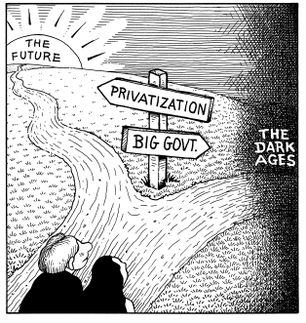
Current State of Financial Management
Key Conditionality—Privatization of the economy
Divestiture
Contracting out
Liquidation
Sell off public private partnership shares

Slide 37
State of Financial Management: 2001
Problem—Privatization of the bureaucracy
Cutback the civil service
Infamous 19% first cut
Departments sell their services
Statistics in Zaire/Congo

Slide 38
Current State of Financial Management Problem—Bad Governance and Privatization of the bureaucracy
Sub-economic salaries
Offices, houses and telephones
buying soap and selling chickens
Rent Seeking and Corruption

Slide 39
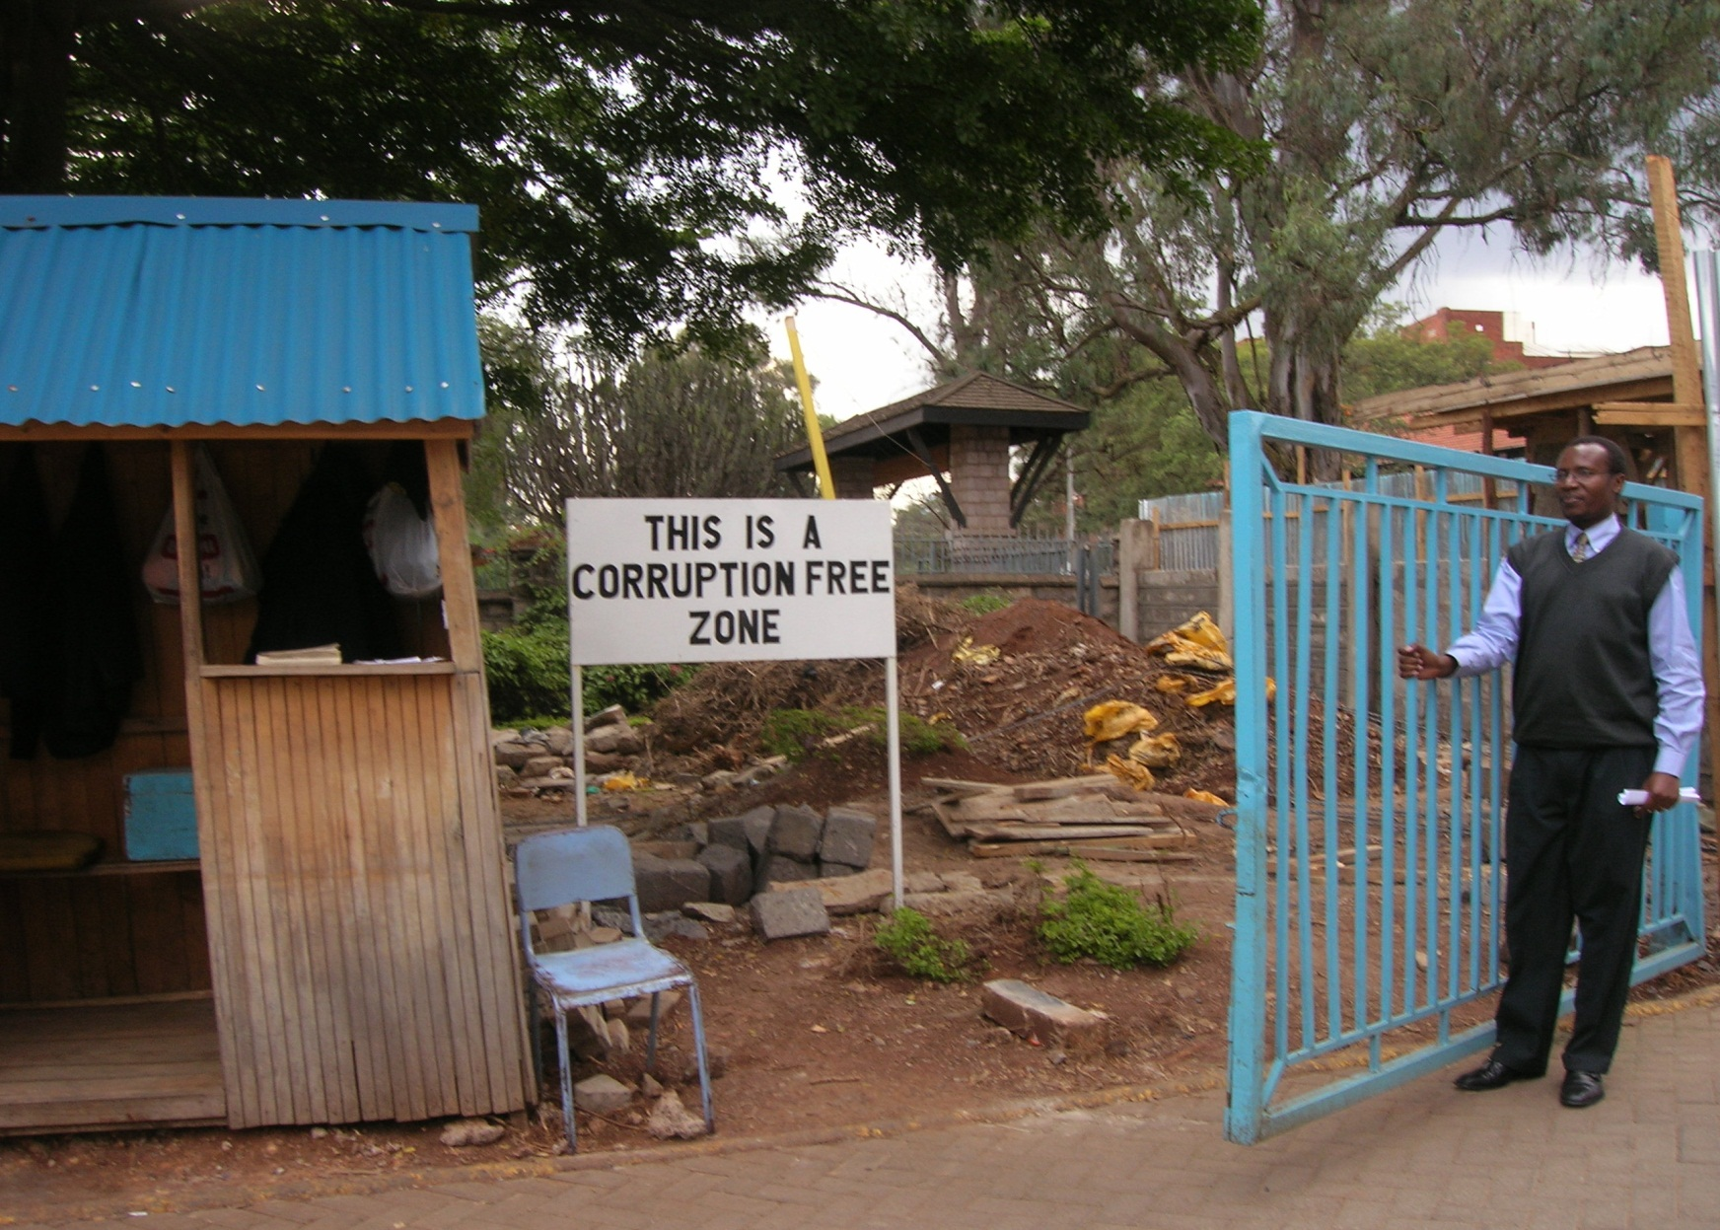
Dr. Joshua Kivuva at Entrence to University of Nairobi

Slide 40
Current State of Financial Management
International conditions for "good" bureaucrats
World Bank in Uganda special salaries for those on contract with the project
Individuals work with investments and the service/commercial sector
Goal: Return to the recurrent budgeting process of 1950s

Slide 41
The Debate
The primacy of the Nation-State: How sovereign?
Impact of trans-national actors
Issue of micro-states
Rational Actor model- public or social choice theory
Collective choice is non-rational

Slide 42
Policy Reforms Concepts and Terms: Review
Neo-Orthodoxy
Heterodoxy
Stabilization
Conditionality
Public Sector Reform

Slide 43
The Debate
The Importance of the Market and Debates about the Command Economy? The concepts of market and productivity
International systemic hegemony and competition within international markets
Complementarity problem and origins of capital
Market failure? Update: September, 2011

Slide 44
The Debate
The World Economic Regime
World Market: Only game in Town?
Questions of conflict: pluralist vs. hegemonic models in the post-war world
Economic change vs. political development
Governance (democracy) a pre-requisite?
Impact of world economy on Domestic Economies

Slide 45
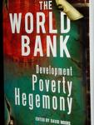
“No when to hold them, no when to fold them no when to walk away, and no when to run”
The Only Game in Town?
The IMF and the World Bank (The Bottom Billion)

Slide 46
V. Foreign Aid vs. Technical Assistance (TA)
Current bias to international trade
Dependent development and TA
Is it dependent and is it development
Governance and Nation Building
Back to the future
Get the LDC economy back to the 1950s
TA linked to Vietnam and CORDS

Slide 47
Foreign Aid vs. Technical Assistance
The utility of the rational actor model for foreign aid
Impact of culture
Corruption, clan and ethnicity
Clans in Somalia and taxi drivers in Washington
Impact of Intellectual systems and ideologies influences and beliefs
Impact of Standard Operating Procedures

Slide 48
Retrospective: Foreign Aid and Security Debates
Are Iraq, Yemen, Afghanistan, Somalia and Libya different from Vietnam? Still the same War? Review:
VIDEO: Jeanne Kirkpatrick said of Mobutu: “He may be a son of a bitch but he is our son of a bitch.”
The End of the Cold War: Down Memory Lane (3:30)

Slide 49
The Counter-Narrative
‘AID!’ the farmer cried. Look at you.... He pointed, sweeping his finger from one charred remembrance of a home to another. ‘Here is your American AID!’ The farmer spat on the ground and walked away. [i]
[i] Neil Sheehan, A Bright Shining Lie: John Paul Vann and America in Vietnam (New York: Random House, 1988), p. 562.

Slide 50
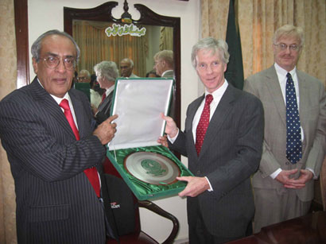
“USAID to Provide Technical Assistance to Strengthen Sindh (Pakistan) Assembly”

Slide 51
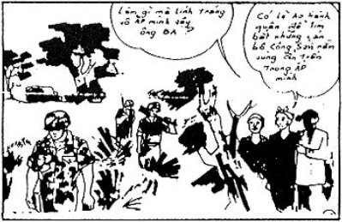
"Why are so many soldiers entering our village?" "Perhaps they are conducting a military operation against the Communists in hiding." This is part of a comic book prepared and disseminated by U.S. forces in South Vietnam as part of the Phoenix Program

Slide 52
CORDS: Overview and USAID
CORDS (Civil Operations and Revolutionary Development Support) was an integrated group that consisted of USAID , the U.S. Information Service, the CIA, and the State Department. along with U.S. Army personnel to provide needed manpower. Among other undertakings, CORDS was responsible for the Phoenix Program, which involved neutralization of the Viet Cong infrastructure.
John Paul Vann served as Deputy for CORDS III (i.e., commander of all civilian and military advisers in the Third Corps Tactical Zone in Vietnam) until November of 1968 when he was assigned to the same position in Four Corps, which consisted of the provinces south of Saigon in the Mekong Delta.

Slide 53
Neil Sheehan and John Paul Vann

Slide 54
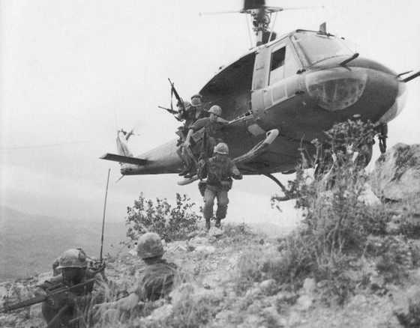
How Could We Have Won in Vietnam? Afghanistan?

Slide 55
The New Orthodoxy
“Today, three and a half decades after our withdrawal from Vietnam, it may be constructive to look back and ask if the U.S. military ever discovered the elements of a strategy in South Vietnam that, given the proper circumstances, might have achieved American objectives. Had those elements and circumstances existed how could they have been combined into a strategy that could have served American objectives at an acceptable cost? In retrospect, that is, how could we have won?”
May, 2008
Still Asking the same question?

Slide 56
“Are you part of this USAID Program?
VIDEO
John Paul Vann

Slide 57
The Legacy of Vietnam
Are Iraq, Afghanistan, Somalia, Columbia, Chad and Niger Different from Vietnam?
Syria and Ukraine?

Slide 58
And A Warning

Slide 59
Comments and Question
Discussion

