Slide 1
FOREIGN AID, FOREIGN POLICY AND DEVELOPMENT MANAGEMENT
Louis A. Picard
PIA 2096: Week Five

Slide 2
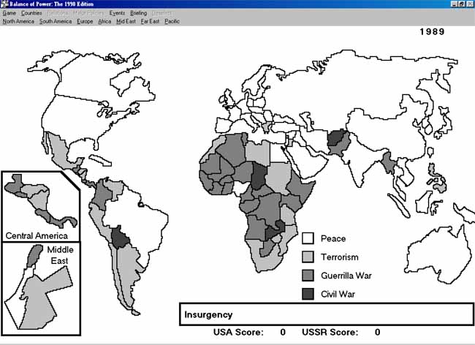
Concept of the Week- The Proxy Wars and End of Cold War
Balance of Power Thesis-1989

Slide 3
Unfinished Business: The Real Hans Morgenthau?
“Hans J Morgenthau (1904-1980) was a great intellectual in this tradition in America. He founded the National Committee on American Foreign Policy in 1974 and served as its first chairman.”

Slide 4
From Point Four to Kennedy Administration- Review
Organization for Economic Cooperation and Development 1948
1951 Economic Cooperation (Act) Administration (Truman)
Mutual Security Administration (1952)
Technical Cooperation Administration (1953)

Slide 5
Multi-lateral organizations: 1960
United Nations Organizations (UNDP)- Country Voting
IMF- Structural Loans
World Bank- Development Loans- Problem: Weighted Voting

Slide 7
Why Foreign Aid? The Reality?
U.N. Ambassador Jeanne Kirkpatrick’s alleged comment about out why we provided foreign aid to Zaire’s Mobutu in 1975:
“He may be a Son-of-a-Bitch but he’s Our Son-of-a-Bitch.”

Slide 8
President of Zaire, Mobutu Sese Seko (32 Years in Office)

Slide 9
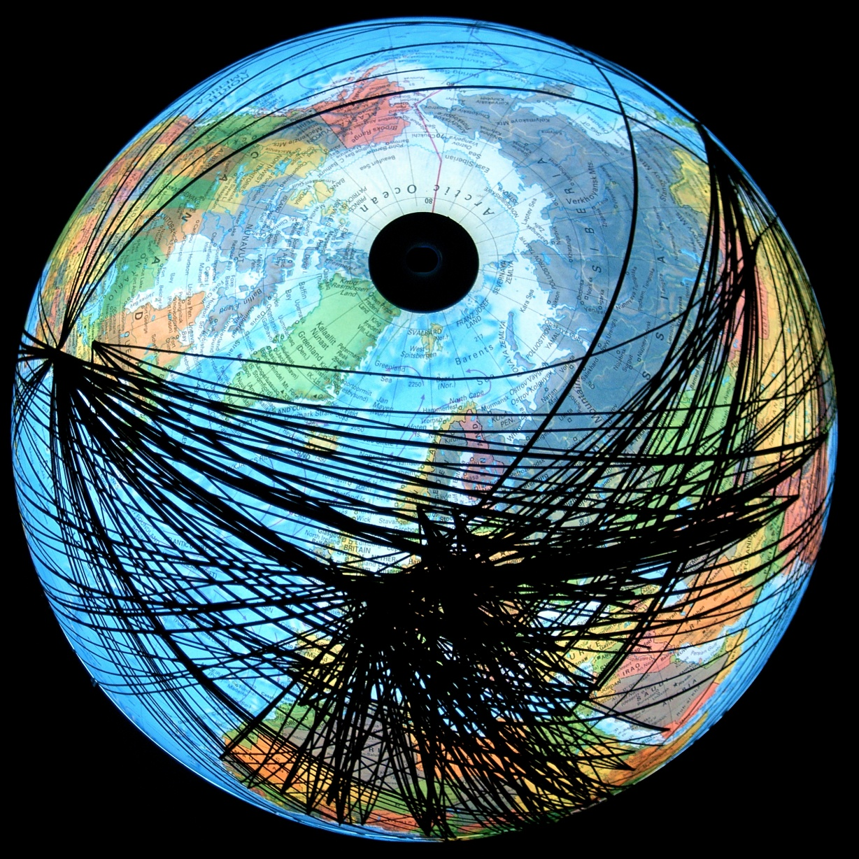
Foreign Aid: A European Perspective

Slide 10
Explanation-Foreign Aid Patterns
Thicker lines drawn from capital to capital indicate aid flow in excess of $66 million per year. Thinner lines represent the $20 million to $66 million bracket. Smaller amounts have generally been ignored unless they represent a significant portion of the donor country’s budget (OECD November 2004).

Slide 11
Foreign Aid and Technical Assistance
Foreign Aid Policy: 1955-1975
Review of
The Second Decade

Slide 12
Focus This Week
Motivations
Vietnam Again
Non-Profits and Contracting
Basic Needs and the Logic of Projects

Slide 13
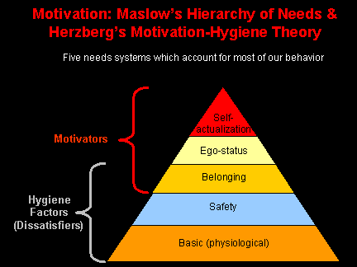

Slide 14
Motives: Colonizers and Aid Workers:
Idealism?
Adventure and freedom
Anger and Hurt?
Mission
National Loyalty
Money and Life Style

Slide 15
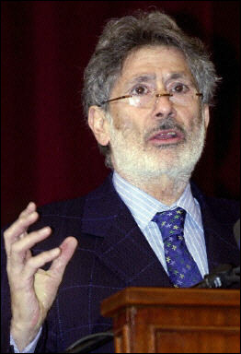
Franz Fanon (July 20, 1925- December 6, 1961) Anger and Hurt and Edward Said, (November 1, 1935- September 25, 2003), Culture and prejudice.

Slide 16
Motivations: The Expatriate Life Style (Redeux)
Read James Fox, White Mischief (Harmondsworth: Penguin, 1982). Also Feature Film
The Happy Valley Set, Central Kenya during the 1930s. Expatriate self centered values
Reference point for Emma’s Kenya Friends?
Outside of Social Convention and Personal Morality
Is this International Development?

Slide 17
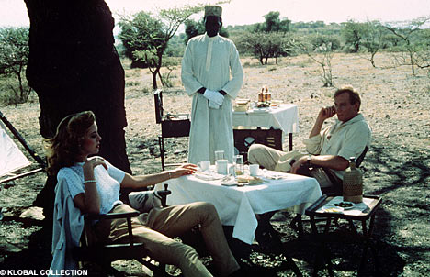
International Development?

Slide 18
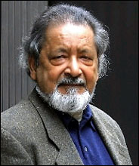
Albert Memmi and V. S. Naipaul Both Write about Moral Ambiguities

Slide 19
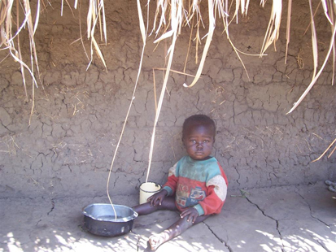
Mini-Discussion
The Motives of those in International Development

Slide 20
Vietnam: The Early Years
Beginnings-1951. Economic and Military Assistance Program in Indo-China
Then Part of the French Empire
1954. U.S. subsidizing French Rule and fight against Communism in Vietnam
Foreign Aid at the Core- “The Third Force” (The Quiet American)

Slide 21
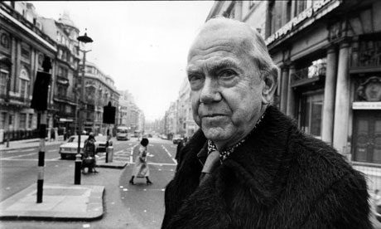
Graham Greene, (2 October 1904 – 3 April 1991)

Slide 22
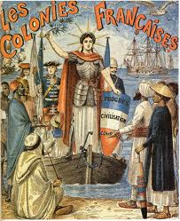
Vietnam: Why?
Fall of China- Threat to Indo-China
French Civilizing Mission
Part of Marshall Plan
March of Folly?
(Barbara Tuchman)

Slide 23
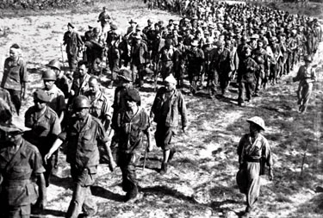
French soldiers march to a prisoner of war camp after they surrendered to the Viet Minh forces after the Battle of Dien Bien Phu, May 8, 1954

Slide 24
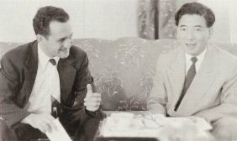
US Involvement: Michigan State University Vietnam Advisory Group
Wesley R. Fishel, Michigan State University (left) meets with Ngo Dinh Diem in major Technical Assistance Mission in Vietnam.
Mission later linked (in part unfairly) with CIA

Slide 25
Ramparts cover of April 1966, depicting Madame Nhu (Madame Ngo Dinh Nhu) as a Michigan State cheerleader.
Madame Nhu was the wife of Ngo Dinh Nhu, brother to and chief adviser (Head of Secret Police) under President Ngo Dinh Diem

Slide 26
Ralph Smucker, Vietnam Technical Assistance

Slide 27
Why we were in Vietnam? Review
We aid other countries with whom our relationships may be more nearly correct than cordial, because we believe that it is in our interests to maintain friendly contacts with their governments and their people and to keep them from going behind the Iron Curtain.[i]
[i] Speech by Arthur Z. Gardiner, Director United States Operations Mission in Viet-nam, address given to the Saigon Rotary Club on September 22, 1960 (Washington, D.C.: Department of State and U.S. Government Printer, 1961).

Slide 28
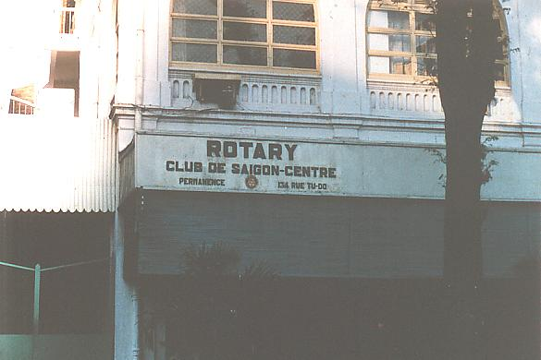

Slide 29
Picard’s View: Vietnam: The View From 2022
Represents the Best and Worst of Foreign Aid Policy
“We had to destroy the village in order to save it”
Strategies of Community Development and capacity building have their origins in 1950s Vietnam

Slide 30
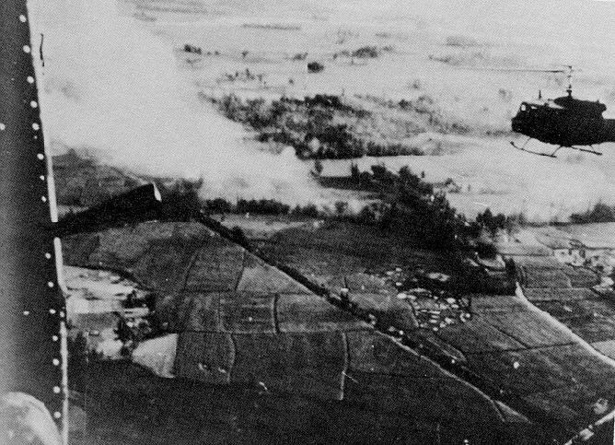

Slide 31
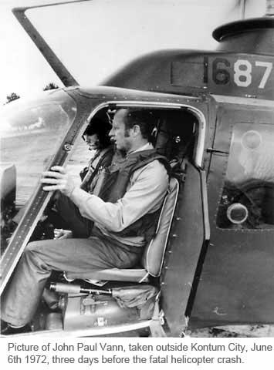
John Paul Vann, Senior Advisor, USAID, 1965-1972

Slide 32
The Best of Vietnam from Foreign Aid Perspective
Focus on Community Development
Rural Industrialization and (later) micro-credit
Foreign Aid Field Officers- on the ground
Basic Needs and Rural Development Focus

Slide 33
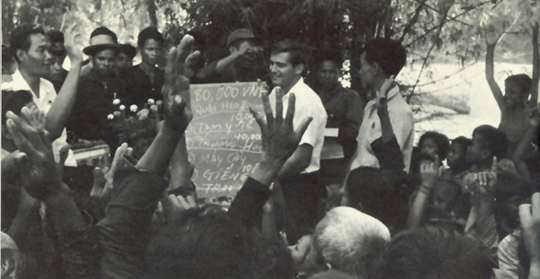
South Vietnamese villagers vote on the use of the community development budget of 80,000 piasters allocated by the provincial administration. An AID field representative holds a blackboard listing the items voted on. They include pig raising, health station, schoolhouses, tractors, wells, and buffaloes

Slide 34
Technical Assistance Profile: Groups in the Early Years
Summary of Contracting Agencies With the
Technical Cooperation Administration in 1952[i]
Educational Institutions 58
Consulting Firms 42
Research Foundations 5
Religious Organizations 3
TOTAL 108
[i] Walter R. Sharp, “The Institutional Framework for Technical Assistance,” International Organization, vol. 7, no. 3 (August 1953), p 364.

Slide 35
From the Beginning-Experiments: With Non-Profits and Contractors
The Role of the University- Hundreds of Contracts in the 1950s-1960s Capacity Building
The Operational Expert (OPEX)
Technical Assistance- Advisor
Food Aid, Contracts and NGOs
Peace Corps (1961) and PVO groups

Slide 36
An Operational Expert? (Truth in Advertising)
Palestine, 2005
Guinea- Conakry 2007
The Consultant
USAID
An Operational Expert in Botswanaand Swaziland, 1980-1984
South Africa, 1993-1994
Ghana, 2004-2005 (Intermittent)
South Sudan and Morocco, 2009-10
ECOWAS, 2012-2018
Jordan, 2020
World Bank/UNDP
Ethiopia and Eritrea, 1991-1994

Slide 37
BASIC NEEDS
1968- Robert McNamara appointed President of the World Bank
Announces a shift from Growth strategy to Basic Needs
Part of Debate about Equity
Goal: Integrated Rural Development

Slide 38
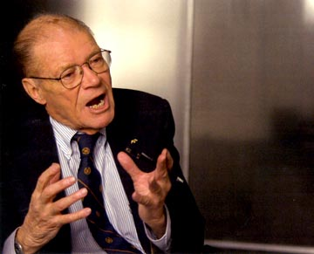
Robert McNamara: War and Foreign Aid
2003 “The Fog of War” (Film)

Slide 39
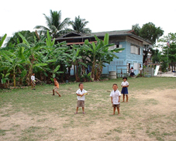
1975-1983: End of Vietnam and Shift to Basic Needs

Slide 40
Public Law 480- Since the mid-1950s
Title One- Cheap food which is sold to the private sector
Title Two- Emergency food
Title Three- Food for Development (Distributed as part of
Development projects)

Slide 41
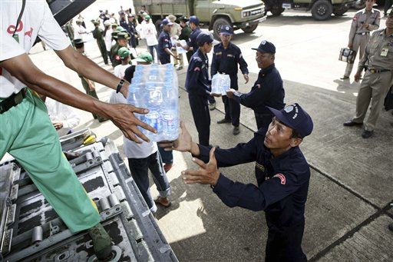
Food 2008 in Burma

Slide 42
Rural Development: The Models
Winning Hearts and Minds
Villagization- Rural Community Development
Strategies of Community Development and capacity building have their origins in 1950s Vietnam

Slide 43
Rural Development

Slide 44
Basic Needs Argument

Slide 45
Integrated Rural Development: The Project of the 1970s
Combines growth and production with social services:
Area wide Approach providing seeds, fertilizer and equipment
With social services: schools, water, health service and community development at village level

Slide 46
Integrated Rural Development Map

Slide 47
The Problem: Basic Needs
The Problem: Presages Economic Collapse
Overview Of Financial and Budgetary Management Systems in LDCs
Structural Adjustment
Accountability and Project Model

Slide 48
Domestic Management Systems and International Influences
Historical periods of budgetary and fiscal management in Foreign Aid
Until the 1950s
Recurrent budgets
Law and order
Colonial models
Recurrent vs. Development budgets
1950-1960 Development Budgets- Focus on Growth

Slide 49
Domestic Management Systems and International Influences
Six historical periods of budgetary and fiscal management
Mid 1960s – 1970s
Distribution and basic needs
World Bank and poorest of the poor
Heavy debts and deficit spending

Slide 50
Domestic Management Systems and International Influences
Historical periods of budgetary and fiscal management
Mid 1970s – 1985 (Planning vs. Budgets)
Planning demanded by technical assistance
Technical assistance both grants and loans (no private loans to Africa)
Project planning "wins" over national planning and budgeting systems

Slide 51
Domestic Management Systems and International Influences
Six historical periods of budgetary and fiscal management- Continued
Structural Adjustment and Policy Reform- 1982-?
Focus on Non-Profit Management
Logical Framework and Projects

Slide 52
Movement Towards Projects: 1970s
System of Logic
The Syllogism

Slide 53
The Cycle: After 1980

Slide 54
Quote
“[T]he syllogism is a reliable form of logic.”[i]
[i] Roland Egger, University of Virginia quoted in Harlan Cleveland, Gerard J. Mangone, John Clarke Adams, The Overseas Americans (New York: McGraw-Hill, 1960), p. 41.

Slide 55
The Logic Model

Slide 56
Planning and Finishing

Slide 57
The Counter Narrative
GOAL:
To conceive of a rival hypothesis that could reverse perceived reality and provides a possible policy option for future attention because of its very plausibility.

Slide 58
Four Views of Foreign Aid- A Reminder
1. Part of Balance of Power- Carrot and Stick Approach (based on exchange Theory
2. Commercial Promotion: Focus on International Trade
3. Humanitarian Theory: Moral Imperative
4. Missionary Pressures

Slide 59
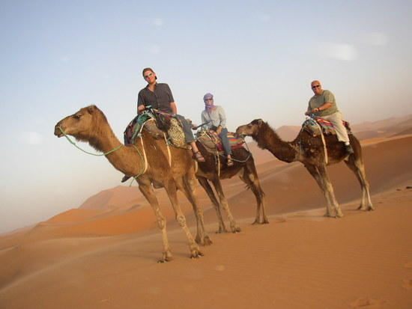
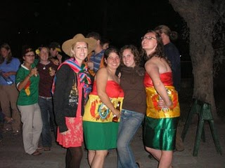
Also Part of Reality?

Slide 60
Happy Valley in Kenya: Just like Foreign Aid Workers? Enjoying Life without Rules
The Expatriate Life Style (Redeux)- Part II

Slide 61
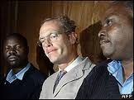
Thomas Patrick Gilbert Cholmondeley, Lord Delamere
In April 2005, he shot a Kenya Wildlife Service game ranger on his ranch under the claim of self-defense. The murder case against Cholmondeley was dropped before going to trial.^{[1]} In May 2006, he was taken into custody and held at Kamiti Maximum Security Prison for shooting a poacher on his Soysambu estate near Lake Naivasha. He was sentenced to serve 8 months in prison and was released on 23 October 2009

Slide 62
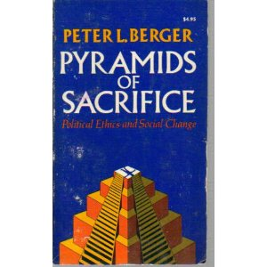
The International Development Myth Peter L. Berger, Born March 23,1929

Slide 63
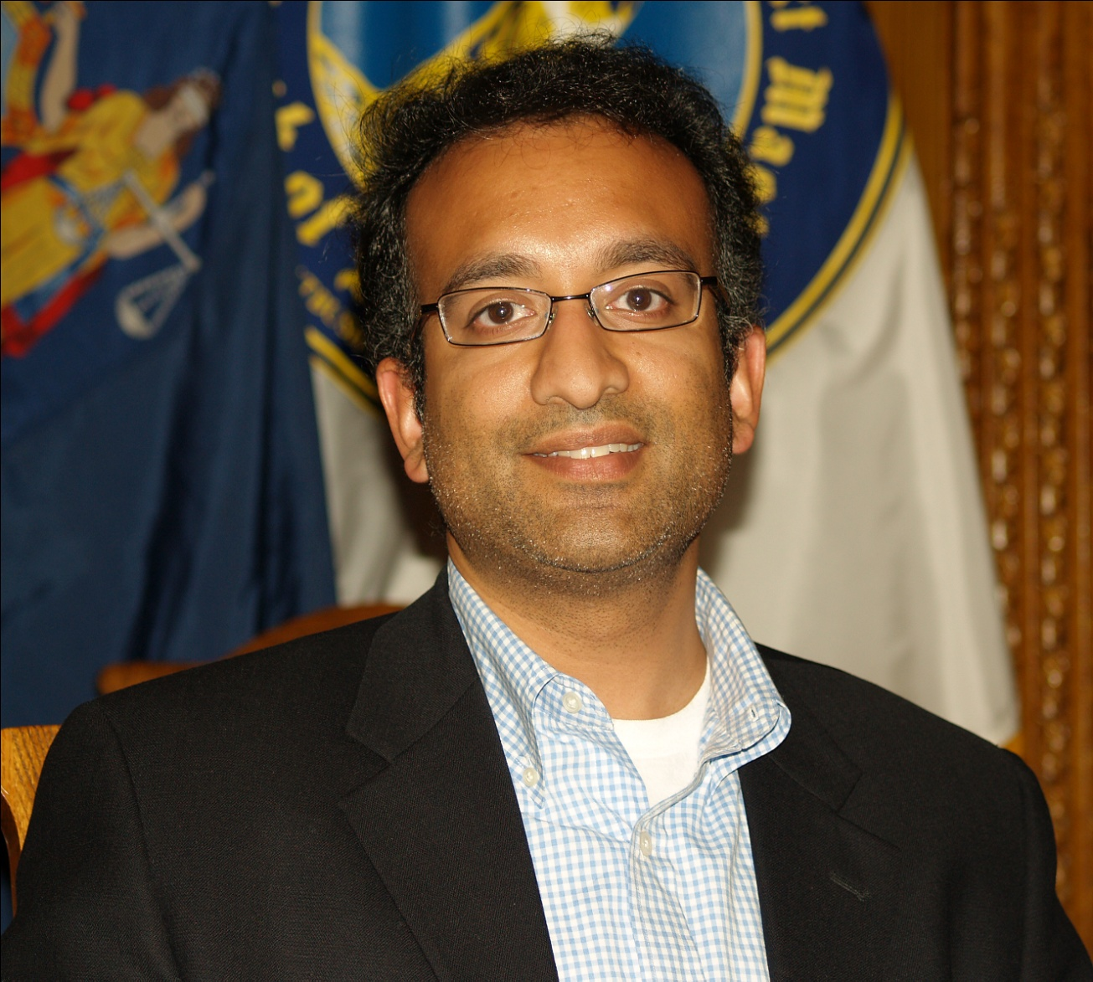
Rajiv Chandrasekara National Editor, Washington Post

Slide 64
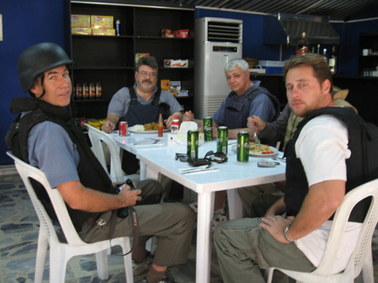
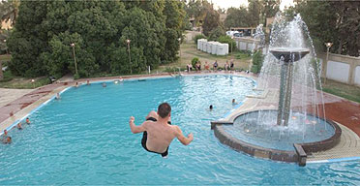
Fun in the Green Zone- Iraq

Slide 65
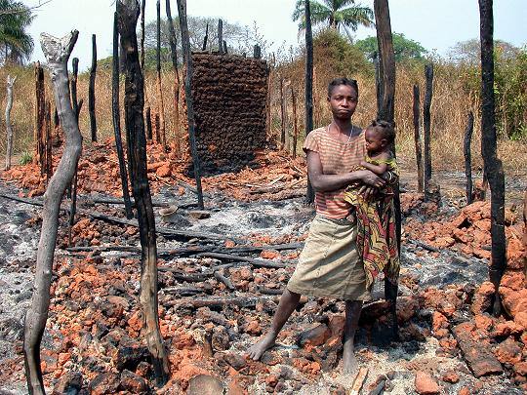
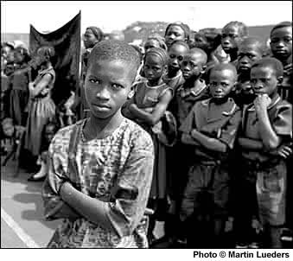
Sierra Leone, c. 1999

Slide 66
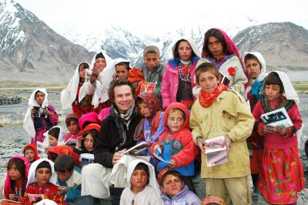
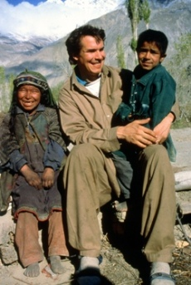
Discussion Images: Greg Mortenson: Happy Development Days?

Slide 67
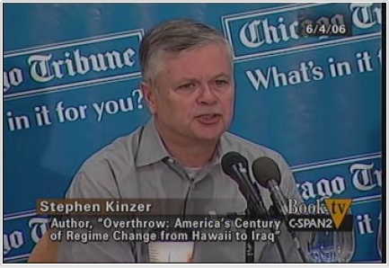
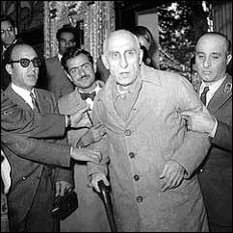
Happy for Some, Not for Others: Iran, 1953
Iran’s deposed prime minister, Mohammed Mossadeq, at his trial

Slide 68
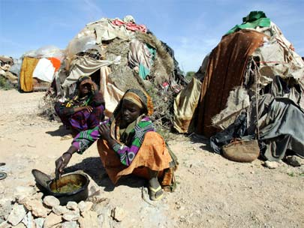
Not So Happy Days- Somalia 1999

Slide 69
Next Week
Paper Pre-Proposal
One Page and Two Minute Presentation

Slide 70
Discussion

