Slide 1
FOREIGN AID, FOREIGN POLICY AND DEVELOPMENT MANAGEMENT
Louis A. Picard
PIA 2096- Week Four

Slide 2
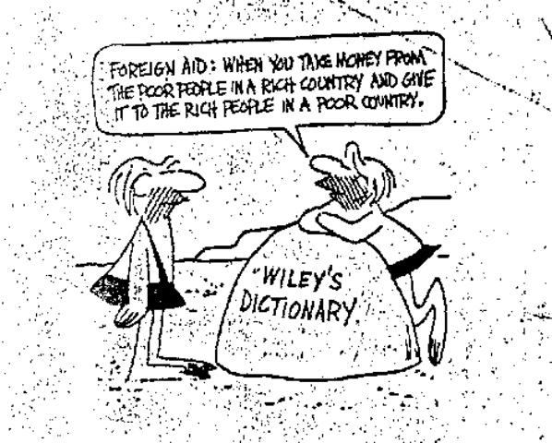

Slide 3
The Problem Review
Ostensibly, the goals of foreign aid in 2020 remain what they were more than half a century ago.

Slide 4
The Goals
They were the reduction of material poverty through economic growth and the delivery of social services, the promotion of good governance through democratically selected, accountable institutions, and reversing negative environmental trends through strategies of sustainable development.

Slide 5
The Problem
Ultimately, however, as a number of economists have noted, “universal models of growth [did] not work well.”
Quote David Sogge, Give and Take: What’s the Matter with Foreign Aid? (London: Zed Books, 2002), p. 8.

Slide 6
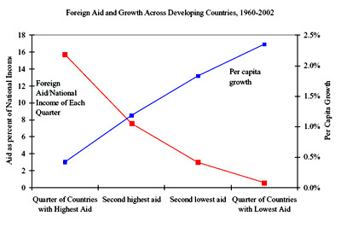
According to William Easterly

Slide 7
Foreign Aid Course
Foreign Aid Policy and the Cold War:
The First Decade

Slide 8
The Counter Narrative
GOAL:
To conceive of a rival hypothesis that could reverse perceived reality and provides a possible policy option for future attention because of its very plausibility.

Slide 9
Foreign Aid After World War II
Components This Week: Review
Europe at War
The Marshall Plan
Point Four and
The First Decade: 1948-1960

Slide 10
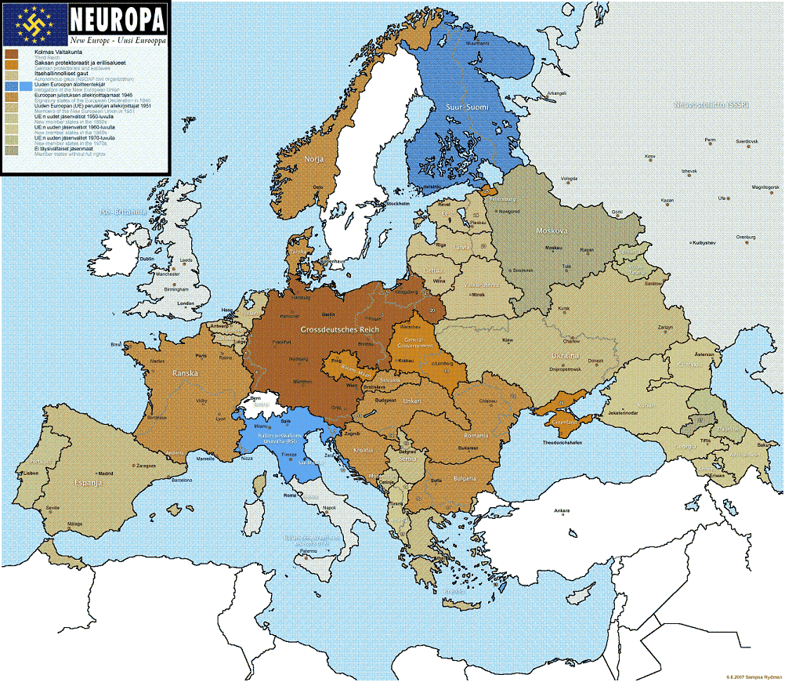

Slide 11
Quote: North Africa, 1943
“Behold, we the American holy warriors have arrived….we have come to set you free.”[i]
[i] U.S. script of radio broadcast from the U.S.S. Texas, October, 1943 on the beginning of the North African War
Quoted in Rick Atkinson, An Army at Dawn: The War in Africa, 1942-1943 (New York: Henry Holt & Company, 2002), p. 34.

Slide 12
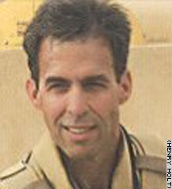
Rick Atkinson- Author of the Day

Slide 13
Foreign Aid
The Reality Nazi Europe, Destruction and
The Cold War

Slide 14
Foreign Aid as an Ideal
George Catlett Marshall, Jr. of Uniontown PA.
(December 31, 1880 – October 16, 1959) was an American military leader, Chief of Staff of the Army, Secretary of State, and the third Secretary of Defense.

Slide 15
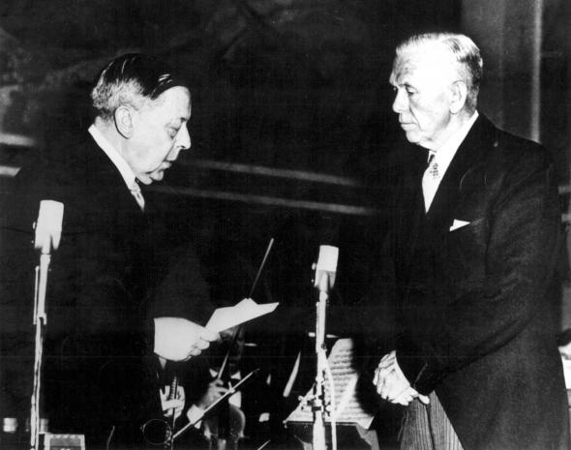
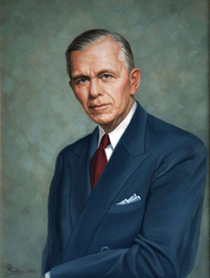
George C. Marshall- Nobel Prize 1953

Slide 16
Time Frame
Lend Lease, 1941
Foreign Economic Administration, 1942
Global Leadership and Unconditional Surrender, 1943

Slide 17
Post-War Planning: 1943-1945
Based on Unconditional Surrender
Planning Targets: Europe, including Germany, Japan, Korea and China (Taiwan)
Temporary Infusion of Cash: Massive but limited (five years)
Focus on Infrastructure- Human Skills Existed

Slide 18
Lend Lease
Russia 1941(top) and Australia 1942 (bottom)

Slide 19
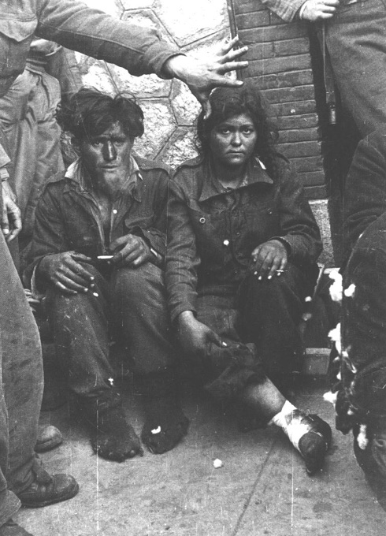
The Greek Civil War, 1944-1949

Slide 20
Time Frame: Defining Foreign Aid
Ad Hoc Assistance: 1944-1946
Greece and Turkish Assistance, 1947
Marshall Plan, 1948
Point Four Program, 1950

Slide 21
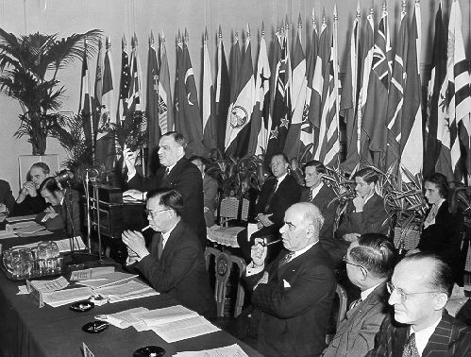
United Nations Reconstruction and Rehabilitation Administration 1943-1949
China, Czechoslovakia, Greece, Italy, Poland, the Ukrainian SSR, and Yugoslavia were the chief beneficiaries. UNRRA returned some 7 million displaced persons to their countries of origin and provided camps for about 1 million refugees.

Slide 22
The United Nations Role
United Nations Reconstruction and Rehabilitation Administration
Beginnings of Post-War Multi-Lateral organizations

Slide 23
Post-War Crises
Assistance to Greece and Turkey, 1946-47
Czechoslovakian Coup, 1948
Communists States withdraw from Foreign Assistance

Slide 24
Point Four Program: Focus Sustained Development

Slide 25
Truman Signing Point Four Legislation.

Slide 26
Point Four
Truman’s State of the Union Speech, 1950
Expansion of Marshall Plan to Developing World
Expanded Role for Economic Cooperation Administration (ECA)
Include long range Health and Education Goals

Slide 27
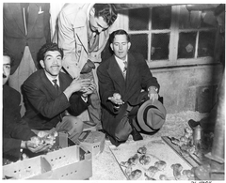
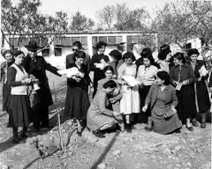
Point Four Program- Images

Slide 28
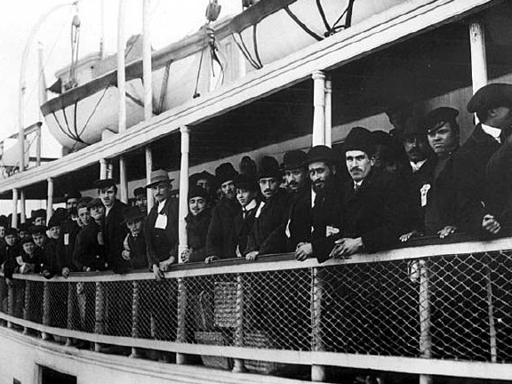
In Our Image?

Slide 29
Stated Goals of Point Four
Goal One: Development of Economic and Human Resources Worldwide
Goal Two: Stop the spread of Communism

Slide 30
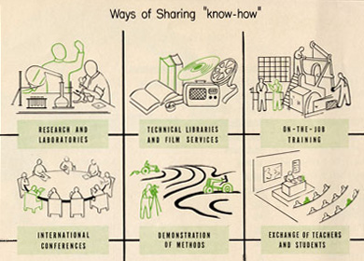
From a Department of State publication entitled The Point Four Program released in December, 1949.

Slide 31
Domestic Management Systems and International Influences
Keynes and Financial management during 1950s – 1960s
Growth—domestic development funds with bilateral technical assistance
Relationship between Command economy and the market
Keynesianism and the controversial models Soviet Union, India

Slide 32
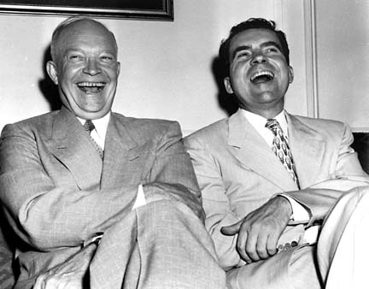
Eisenhower: A Closet Keynesian

Slide 33
U.S. Foreign Policy Goal:
Enlightened Self Interest
Take Off Point Optimism
Support for Asian and African Dependent Territories

Slide 34
The Price Tag in 1960
U.S. Dollars: $8 Billion in 195Os Dollars

Slide 35
The Cold War and Vietnam
We aid other countries with whom our relationships may be more nearly correct than cordial, because we believe that it is in our interests to maintain friendly contacts with their governments and their people and to keep them from going behind the Iron Curtain.[i]
[i] Speech by Arthur Z. Gardiner, Director United States Operations Mission in Viet-nam, address given to the Saigon Rotary Club on September 22, 1960 (Washington, D.C.: Department of State and U.S. Government Printer, 1961).

Slide 36
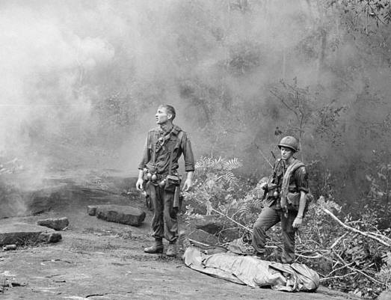
Another Time

Slide 37
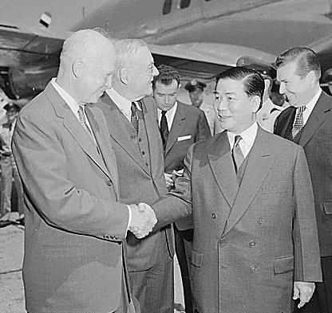
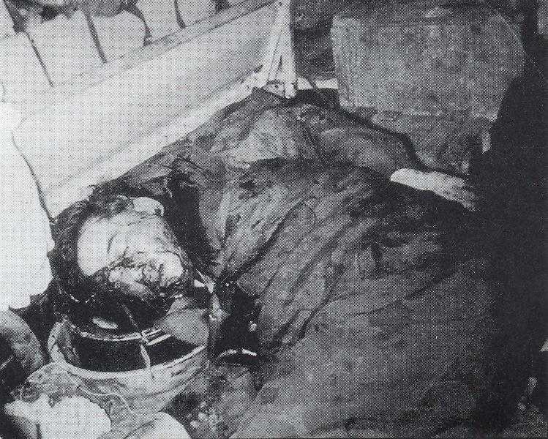
“Overthrow” Ngo Dinh Diem-First President of South Vietnam

Slide 38
Major International Relations Terms
International Conflict During the Cold War
Structural realism;
Realpolitik
Balance of power vs. Transnationalism
Bipolarity vs. Multi-polarity

Slide 39
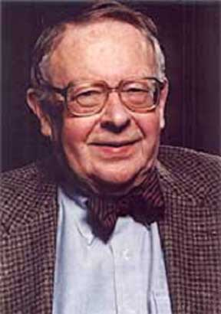
Hans Morgenthau, 1904-1980

Slide 40
First Decade: Assumptions Still with us
1. Development was based on a model of self-help and individual initiative. It was the absence of individual initiative that caused under-development. Humanitarian aid had to be changed to developmental principles in order for it to be successful. Wise guidance to indigenous peoples on the part of the change agent was built into this principle.

Slide 41
First Decade- 2
2. Education and training (and the technical assistance that went with it) were the key to development. Human resource development and training were thus pre-defined components of development efforts. Through targeting semi-skilled workers, through a kind of bridging training, a void could be filled in human resource terms.

Slide 42
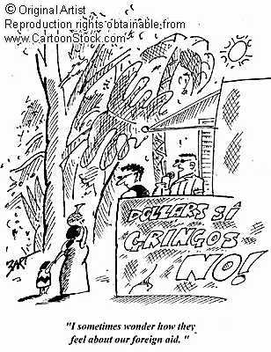

Slide 43
First Decade-3
3.There was a need to change values. This in part went back to the faith based organizations that dominated technical assistance in the first half of the 20th century. This required a minimum technical assistance commitment for 3-5 years.

Slide 44
First Decade-4
4. Crucial to development was the need to reduce tensions and foster understanding between groups. Conflict resolution was at the center of discussions about political development and later governance components of the development effort.

Slide 45
The Problem:
As early as the 1950s, observers identified the self-sustaining growth of institutions as a primary goal of foreign aid. However, U.S. foreign aid policy was often characterized by fragmentation and contradictory goals based on cold war needs.

Slide 46
Results: 1960
Skepticism
Unfulfilled Goals
No Take Off Point
Foreign Aid Permanent not Temporary

Slide 47
First Decade-5
5. It was possible to distinguish between elite projects that allowed only an indirect impact on development and grassroots activities which, though limited would impact directly on disadvantaged peoples.

Slide 48
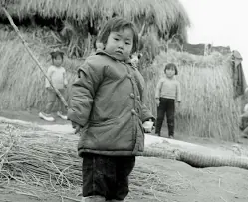
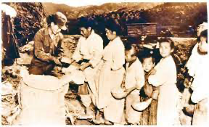
Foreign Aid to Korea and Korea 2022

Slide 49
Issues:
Keynesian Assumptions for LDCs
Macro-Economic Planning
Shortcomings of Program Planning
Planning Issues- 1975

Slide 50
The Problem with Planning-1
The allocation of agency or contractor roles was not always clearly defined in program terms;
2. Within the Point Four program proper, responsibility for project formulation and supervision sometimes seemed unnecessarily diffuse; (See cartoon)

Slide 51
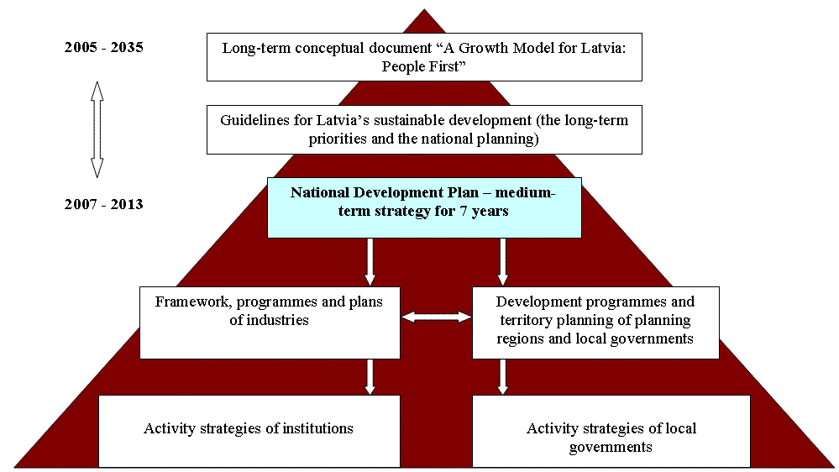
Planning Constants: The Latvian Development Plan- Legacy Issue

Slide 52
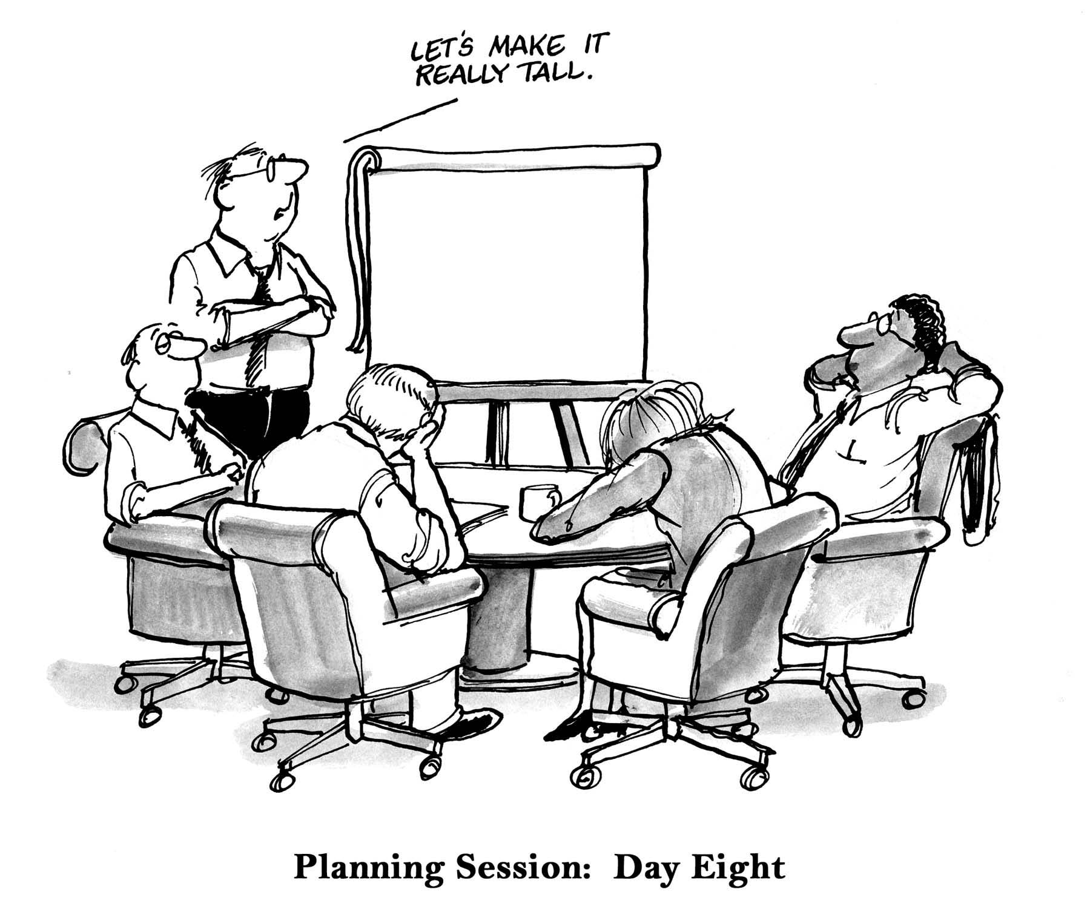

Slide 53
The Problem with Planning-2
3. In the management of foreign aid, there was too little provision for basic program planning and assessment particularly in terms of the entirety of the government’s technical assistance activities;
4. Relations of oversea field missions to the staffs of the U.S. diplomatic missions in countries, where economic and technical aid programs were in progress, were sometimes unclear;

Slide 54
The Problem with Planning-3
5. Finally, officials had not given sufficient attention to ways and means of correlating U.S. government lending policies with the probable financing and maintenance requirements of developmental technical assistance projects when completed.
6. Planning led to capital spending and debt. The White Elephant Problem

Slide 55
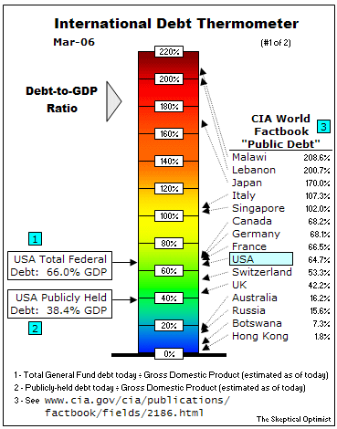
Debt Temperature

Slide 56
Three Views of Foreign Aid- A Reminder
1. Part of Balance of Power- Carrot and Stick Approach (based on exchange Theory
2. Commercial Promotion: Focus on International Trade
3. Humanitarian Theory: Moral Imperative

Slide 57
Two Books :
Michal Maren, The Road to Hell: The Ravaging Effects of Foreign Aid and International Charity (New York: The Free Press, 1997). Not Assigned- Focus Somalia
Stephen Kinzer, Overthrow: America’s Century of Regime Change from Hawaii to Iraq (New York: Times Books, 2006).

Slide 58
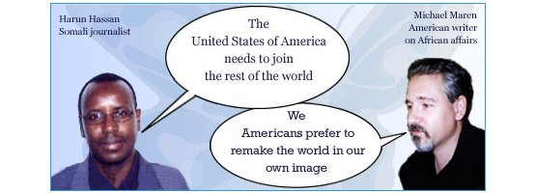
Michael Maren

Slide 59
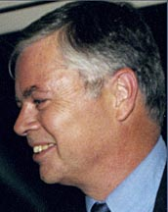
Stephen Kinzer

Slide 60
Issues: Kinzer and Maren
1. Coming out of the Road to War (Cold War and beyond) and Overthrow, what does one need to think about as one approaches the “Profession” of International Development within the context of U.S. Foreign and Security Policy?
2. What do you think of Kinzer? To what extent do our authors have something to say about Asia, the Middle East, Eastern Europe, and Caribbean?

Slide 61
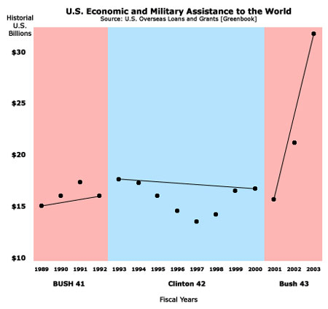
Overview: The Soft Power View of George W. Bush: The New Take Off Point?

Slide 62
Discussion of Kinzer
3. What does Kinzer purport to warn you about working in about foreign policy and aid international assistance?
4. How typical are the aid workers portrayed in are reading?

Slide 63
Discussion: Continued
5. How do you think the behavior of “Aid Workers” differ from that of colonial officials in the pre-independence periods?
6. What criticism would you make of the Book?

Slide 64
From the First Decade to 2022: Religious or ethnic war?

Slide 65
Focus Next Week and Beyond
Motivations
Multilateral Beginnings
Contracts and Non-Governmental Organizations
Vietnam: The Early Years

Slide 66
Quote:
America is what everyone here wants to be like….[i]
[i] Mark Hertsgaard, The Eagle’s Shadow: Why America Fascinates and Infuriates the World (New York: Picador Books, 2003), p. 4.

