Slide 1
Louis A. Picard CAPSTONE AND READING SEMINAR: FOREIGN AID, FOREIGN POLICY AND DEVELOPMENT MANAGEMENT
PIA 2096- Week Three

Slide 2
Concepts and Context
U.S. Foreign Aid
Policy:The Debate

Slide 3
Quote:
Americans are barely aware of our history, much less anyone else’s.[i]
[i] Mark Hertsgaard, The Eagle’s Shadow: Why America Fascinates and Infuriates the World (New York: Picador Books, 2003), p. p. 12.

Slide 4
Impact of Colonialism: Reprise
Colonialism defined authority in most of what we call the developing world until well after the middle of the twentieth century and foreign aid and technical assistance grew out of that heritage.
Understanding that legacy is important in any attempt to define the mixed legacy and the moral ambiguities that frame international assistance after 1960.

Slide 5
Four Views of Foreign Aid
1. Part of Balance of Power- Carrot and Stick Approach (based on exchange Theory)
2. Commercial Promotion: Focus on International Trade
3. Missionary Imperitives
4. Humanitarian Theory: Moral Arguments

Slide 6
The Counter Narrative
GOAL:
To conceive of a rival hypothesis that could reverse perceived reality and provides a possible policy option for future attention because of its very plausibility.

Slide 7
This Week
U.S. History of Foreign Aid Prior to 1948
Focus on inherited processes and values
Case Study: The Inter-American Highway

Slide 8
Influences on U.S. Foreign Aid Policy
Manifest Destiny
Isolationism
Missionary Influences
Exceptionalism

Slide 9
Manifest Destiny
Nineteenth Century Origins

Slide 10
Manifest Destiny
U.S. imperial expansion was part of the country’s perceived manifest destiny almost from the founding of the nation and would have a singular impact upon its foreign aid policy after 1948.

Slide 11
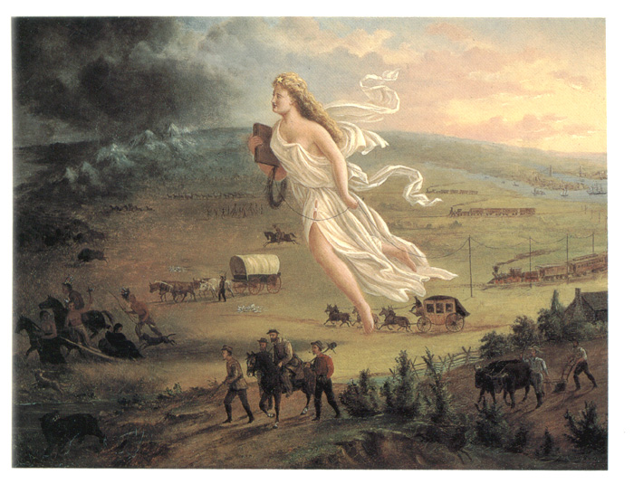

Slide 12
Historical Legacy: Four Assumptions
Monroe Doctrine- 1823
Continental Empire
Indigenous Peoples
Mexico

Slide 13
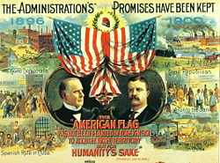
Thesis
U.S. Patterns (History) of Foreign Aid and Foreign Policy are similar to those of Britain, France and the other nineteenth century colonial powers

Slide 14
Historical Legacy: U.S. Not Isolationist
Latin America and the Pacific
Spanish-American War
An American Empire after 1900
From Good Neighbors (Roosevelt) to the Alliance for Progress

Slide 15
Isolationism
Primarily an Anti-European Sentiment
Did not apply to trade and missionary work
Nor Latin America, Asia or Africa

Slide 16
Selective Isolationism
Teddy Roosevelt and the Big Stick
Isolationism and World War I
Woodrow Wilson and Making the World Safe
Charles Augustus Lindbergh and “America First”

Slide 17
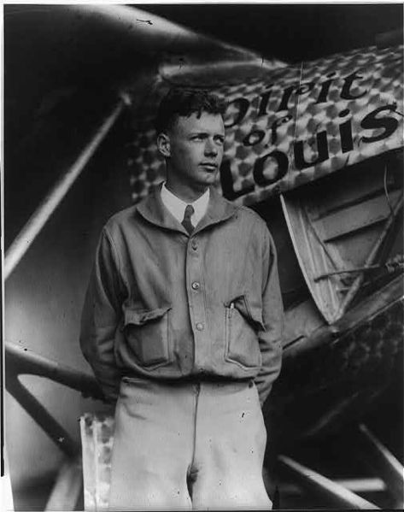

Slide 18
Isolationism After WWI
Foreign Policy swung between international interventionism and isolationism between 1900-1940

Slide 19
Counter Narrative
WWII

Slide 20
U.S. Missionary Values
Protestant Faith
Religious Platitudes
Racism: Domestic and International
Henry L. Luce and fear of “Losing China”

Slide 21
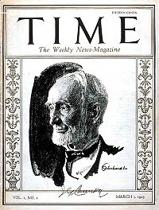
Founder of Time Magazine Birthplace: Tengchow, China

Slide 22
Missionary Influences

Slide 23
Imperial/Missionary Values Influenced U.S.
Social Darwinism
Subject Peoples
Imperialism- “Cuba and the Platt Amendment”
Ethno-centralism

Slide 24
Exceptionalism
Uniqueness of the American Experiment
Manifest Destiny

Slide 25
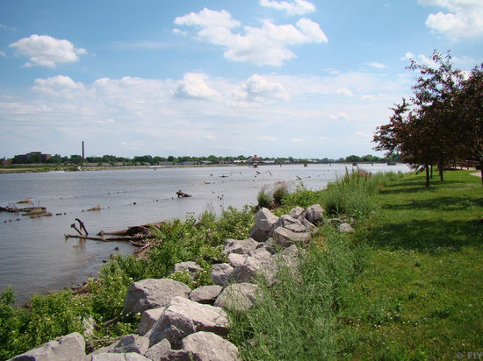
Alexis-Charles-Henri Clérel de Tocqueville (July 29, 1805 – April 16, 1859) Exploring the Saginaw Michigan River, July 1831

Slide 26
Democracy in America
Tocqueville's sought to understand the peculiar nature of American political life and its burgeoning democratic order

Slide 27
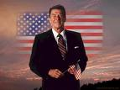
Exceptionalism: Ronald Reagan
“America is a shining city upon a hill whose beacon light guides freedom- loving people everywhere”

Slide 28
Exceptionalism
Basis of U.S. De Jure, but more importantly de facto economic, political and cultural impact on the world
Globalism and Foreign Assistance

Slide 29
The De Jure Empire
Strategic Interests

Slide 30
The American Protectorates
Republic of Palau Associated State 19,129 (2000)
Federated States of Micronesia Associated States107,000 (2000)
Republic of the Marshall Islands Associated State 50,840 (1999)

Slide 31
The American Protectorates
Commonwealth of the Mariana Islands Associated State (Commonwealth) 60,000 (2000)
U.S. Virgin Islands Territory 120,000 (1999)
Guam Territory 151,968 (1997)
American Samoa Territory 59,000 (1995)

Slide 32
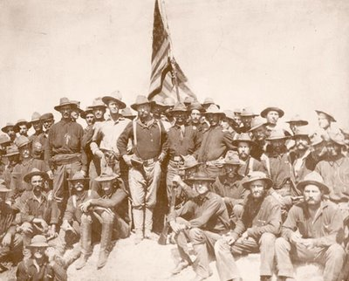

Slide 33
The American Protectorates
Commonwealth of Puerto Rico Commonwealth Associated with U.S.3,897,960 (2004)
District of Columbia Federal District 575,000 (2000)

Slide 34
The American Protectorates
Republic of Philippines Independent 86,241,697 (2004)
Panama Canal Zone Incorporated into Republic of Panama 62,000 (1979)
Cuba Independent 11,308,764 (2004)

Slide 35
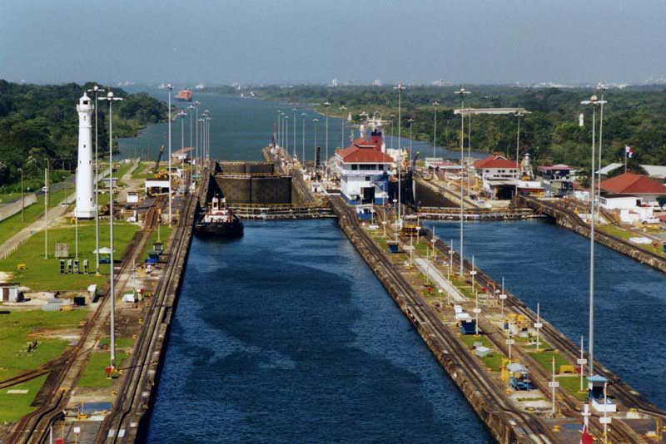

Slide 36
De Facto Privileges
U.S. Part of European Norm Prior to World War II

Slide 37
Rights of Intervention
Haiti
Nicaragua
Honduras
Dominican Republic
Liberia.

Slide 38
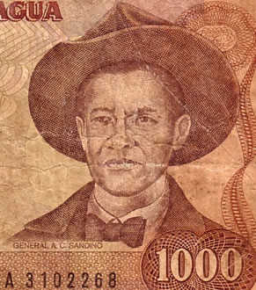
Resistance to U.S. Involvement- Augusto Nicolás Calderón Sandino (May 18, 1895 – February 21, 1934

Slide 39
Advisors, Military Intervention and Technical Assistence: Before 1939
El Salvador
Costa Rica
Bolivia
Ethiopia
Paraguay
Peru
Turkey
Persia
Siam
China

Slide 40
Historical Assumptions
Foreign Aid Prior to 1948

Slide 41
Early International Assistance
U.S. until 1870s- recipient in terms of concessions and loans.
In 1812, a program of relief and assistance to victims of an earthquake (The 1812 Act for Relief of the Citizens of Venezuela) passed the U.S. Congress.

Slide 42
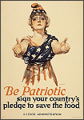
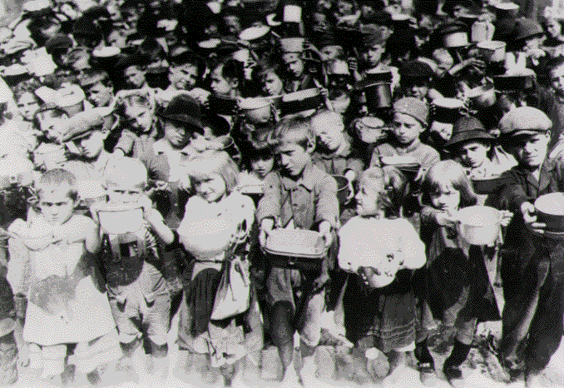
U.S. Food Aid- WWI: Herbert Hoover's European Children's Fund– Forerunner of CARE

Slide 43
International Assistance Before World War II
“Explorers”
Technicians
Missionaries
“Advisors” in Latin America
Educators

Slide 44
Private Foundations
Charity vs. Philanthropy
Ford, Rockefeller and Carnegie
Education, health and Agriculture

Slide 45
Early Foreign Aid- Before 1939
Elements of foreign aid and technical assistance were implemented in China, Persia, Abyssinia, Liberia and the Philippines.
Small but Full Blown Program in Latin America

Slide 46
Nelson Rockefeller

Slide 47
Director: Office of Inter-American Affairs 1940-1944

Slide 48
Early Foreign Aid
Franklin D. Roosevelt and the Good Neighbor Policy
The Foreign Aid program in Latin America was administered principally by the State Department and two federal instrumentalities

Slide 49
Foreign Aid Case Studies
Herbert Hoover and War Relief Commission
Nelson Rockefeller during Good Neighbor Policy
Pearl Buck, Governance and China
Inter-American Highway

Slide 50
Foreign Aid Structures
(1) the Interdepartmental Committee on Scientific and Cultural Cooperation (SCC), established by law in 1938; and
(2) the Institute of Inter-American Affairs (IIAA) and its predecessor bodies, dating from 1940-41.

Slide 51
Pan American Highway as Early Foreign Aid
Origins of Project- Department of Commerce, 1922. Secretary of Commerce Herbert Hoover.
At the governmental level, by 1940, the United States had a fully developed technical cooperation program in Latin America in the areas of agriculture, education and health.

Slide 52
THE INTER-AMERICAN HIGHWAY
Responsibility for the project was located in the Central American Accounts section of the Division of the American Republics, located in the Department of State.
Construction was managed by the Army Corps of Engineers and oversight was provided by the Department of Commerce.

Slide 53
PAH Project: 1922-1955
Essentially Completed in 1954
Except for an 87 kilometre (54 mi) rainforest gap, called the Darien Gap, the road links the mainland nations of the Americas in a connected highway system.

Slide 54
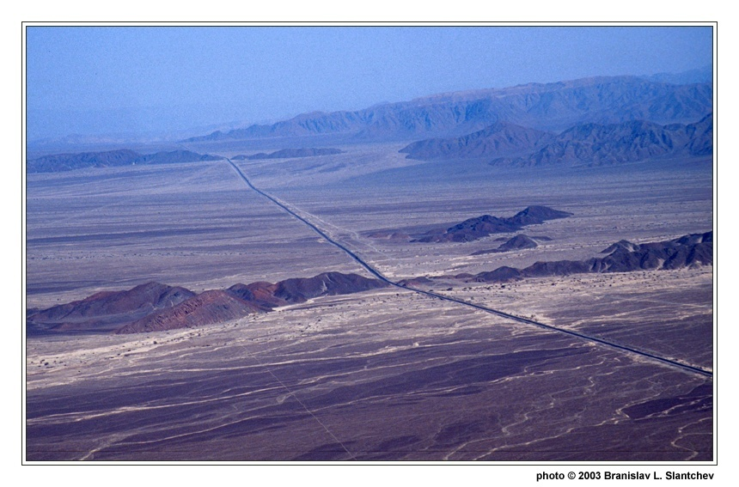

Slide 55
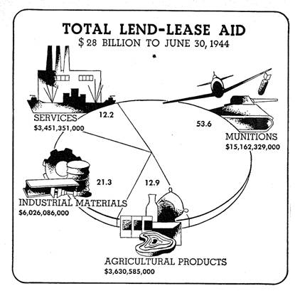
Review: Foreign Aid During World War II- Lend Lease

Slide 56
The Marshall Plan and Point Four
Rebuild Europe- Physical Structure
Replicate the process in Asia
Expand Around the world

Slide 57
A Book to Note
Emma’s War

Slide 58
Dr. Riek Machar, Vice President South Sudan and & John Marks (of USAID) Discussing Development in Southern Sudan

Slide 59
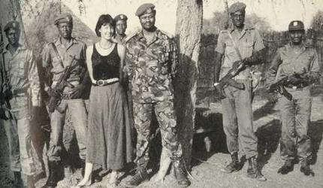
Emma McCune

Slide 60
Deborah Scroggins

Slide 61
Discussion of Reading and Thinking About Capstone.

