Slide 1
CAPSTONE SEMINAR: FOREIGN AID, FOREIGN POLICY AND DEVELOPMENT MANAGEMENT
PIA 2096
Week Two
The Context and
The Issues

Slide 2
ASK QUESTIONS AND TALK!

Slide 3
Goal: Reminder
This course examines several related themes:
1. First, we will examine the origins of foreign aid in the nineteenth and early twentieth century.
2. Following this, we look at the origins of foreign aid policy in the post-World War II period. Particular attention is given to the legacy of Vietnam as it impacted foreign aid and the impact of September 11.
Notes:
3

Slide 4
Goals-2
3. The discussion goes on to examine bilateral aid, multilateral organizations and the role of NGOs.
4. Finally, we will examines the counter-role relationships between donors and LDC program managers and concludes with a discussion of the moral ambiguities of foreign aid.
5. Focus will be on the twin issues of Unilateralism and the “Three Ds” of contemporary foreign aid.
Notes:
4

Slide 5
Three Views of Foreign Aid
1. Part of Balance of Power- Carrot and Stick Approach (based on exchange Theory)
2. Commercial Promotion: Focus on International Trade
3. Humanitarian Theory: Moral Imperative

Slide 6
Reminder: The Issue and the Goal Here
The issue of sustainable International development should be examined from both a policy and an ethical dimension.
The thesis is that ultimately there have both been policy problems and moral ambiguities that have plagued technical assistance and foreign aid.

Slide 7
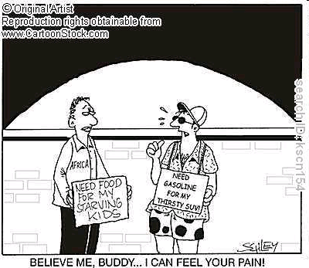

Slide 8
The Problem A Review
Ostensibly, the goals of foreign aid in 2022 remain what they were more than half a century ago.

Slide 9
The Goals
They were the reduction of material poverty through economic growth and the delivery of social services;
the promotion of good governance through democratically selected, accountable institutions;
and reversing negative environmental trends through strategies of sustainable development.

Slide 10
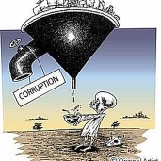
The Problem: Ethics and Corruption

Slide 11
The Problem-2 (Reminder)
Ultimately, however, as a number of economists have noted, “universal models of growth [did] not work well.”
Quote David Sogge, Give and Take: What’s the Matter with Foreign Aid? (London: Zed Books, 2002), p. 8.

Slide 12
Foreign Aid
Historical Values
And Debates

Slide 13
Focus This Week: Overview of Sub-Themes
Cultural Chauvinism
Impact of Colonialism and Imperialism
Foreign Policy and Exchange Theory: Economic Motives

Slide 14
Cultural Chauvinism

Slide 15
Impact of Colonialism
First, understanding that legacy is important in any attempt to define the mixed legacy and the moral ambiguities that frame international assistance after 1960.
Secondly, historical values remain an important factor in influencing foreign aid in the twenty-first century.
Colonialism, the Crusher and Foreign Aid

Slide 16
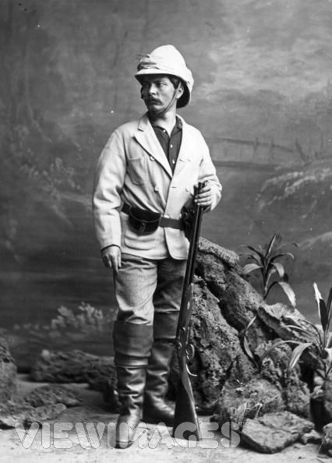
Henry Morton Stanley (Bula Matari- The Crusher) January 28, 1841- May 10, 1904 (The Congo)

Slide 17
North-South Relationships: Three Themes
Dependent Development
Modernization Theory
Technical Assistance

Slide 18
Historical Legacy: Christian Missionaries
Thirdly, non-governmental actors had a major historical impact upon foreign aid policy.
Fourthly, The role of Christian missionaries in the 19th and century is an important component of this influence.
Note: The Role of Protestant Evangelical Groups in Southern Sudan

Slide 19
Historical Quote
With God’s help, we will lift Shanghai up and up, ever up, until it is just like Kansas City.[i]
[i] American Missionary quoted by John Franklin Campbell, The Foreign Affairs Fudge Factory (New York: Basic Books, 1971), p. 178.

Slide 20
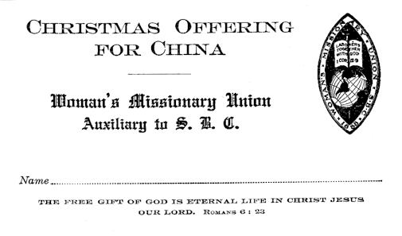

Slide 21
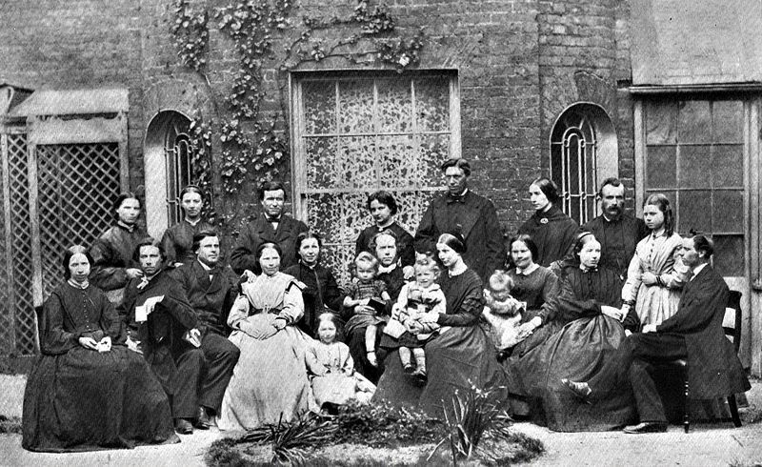

Slide 22
Southern Sudan

Slide 23
Impact of Colonialism
Religion and Humanitarianism justified Colonialism
Humanitarian intervention also linked to war
Two Images of Missionaries

Slide 24
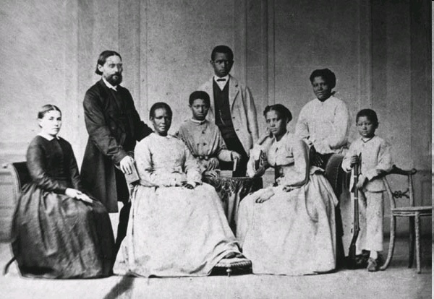

Slide 25
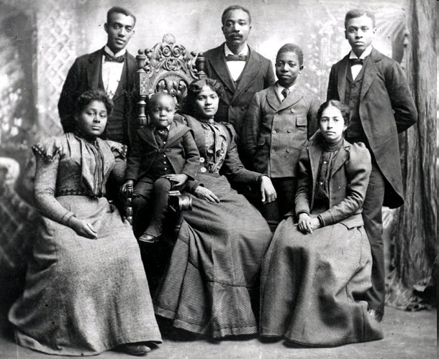

Slide 26
Impact of Colonialism, Continued
Anthropology and Concept of Folk Societies
Twentieth Century: Beginning of Grants and Loans

Slide 27
Cargo Cults and Folk Societies

Slide 28
Foreign Aid Historical and Imperial Models
Aborigines Protection Society, the Society for the Extinction of the Slave Trade and for the Civilization of Africa
Colonial Development Act of 1929
Colombo Plan - 1955

Slide 29
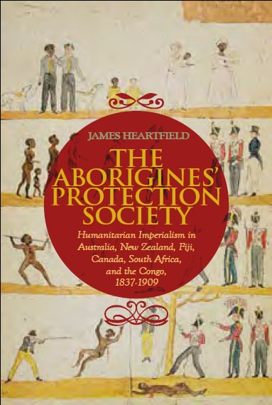

Slide 30
Western Images
Cultural Chauvinism
Race, Culture and Religion
And the Cynic

Slide 31
Author of the Week: Charles Dickens

Slide 32
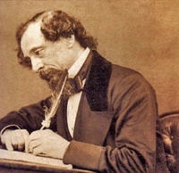
Charles Dickens- February 7, 1812- June 9, 1870
Dickens was a fierce critic of the poverty, hypocrisy and social stratification of Victorian society

Slide 33
Historical Quote
Mrs. Jellyby...is a lady of very remarkable strength of character [who] is at present…devoted to the subject of Africa, with a view to the general cultivation of the coffee berry-and the natives-and the happy settlement, on the banks of the African Rivers, of our superabundant population…educating the natives….[i]
[i] Charles Dickens, Bleak House (New York: Signet, 1964), pp. 49-50. The book was first published in 1853.

Slide 34
The West Has Long Operated in a World of Values.
Movie Quote:
I was born backwards. That is why I work in Africa as missionary teaching little brown babies more backward than myself.[i]
[i] The film version of Agatha Chistie’s “Murder on the Orient Express” (1974). Transcribed by the author.

Slide 35
Gender and Race

Slide 36
Legacy of Colonialism
Cultural Chauvinism or Moral Behavior?

Slide 37
Legacy of Colonialism-Two
Anti-Slavery Movements
Assimilation and Modernization
Cultural Comfort and Trusteeship-Protection
Development Theory

Slide 38
Imperial Values-Reviewed
Social Darwinism
Subject Peoples
Imperialism
Ethnocentralism

Slide 39
According to Social Darwinism, humans were going through an evolutionary process in which the fittest would survive, and the weakest would perish.

Slide 41
Dependency Complex
Colonized: culturally dependent
Colonizer: culturally insecure
Negative Dependent Relationship
Extent to which this applies to U.S. foreign aid and technical assistance?

Slide 42
The Shakespeare Play: Prospero and Caliban

Slide 43
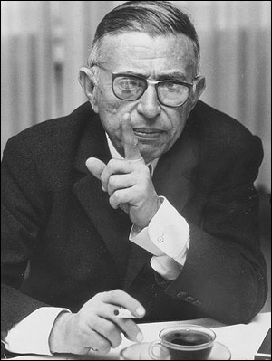
Quote
According to Jean-Paul Sartre, colonialism denied “the title of humanity to the natives, and defining them as simply [absent] of qualities, and defining them as animals, not humans.”

Slide 44
North-South Relationships: A Reminder
Dependent Development
Modernization Theory
Technical Assistance

Slide 45
Commercial and Economic Motives
Foreign Policy and International Exchange

Slide 46
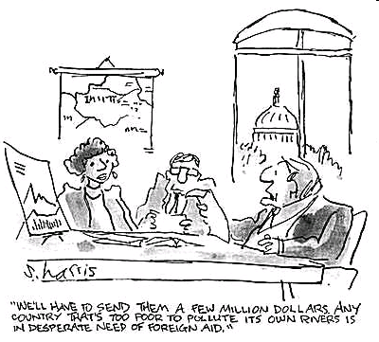

Slide 47
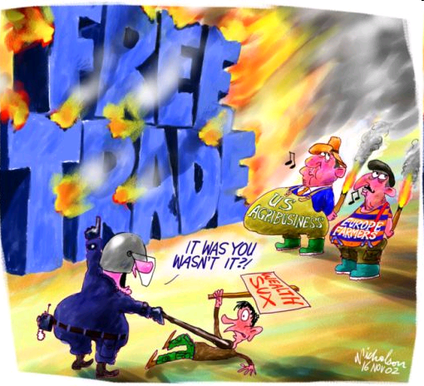

Slide 48
Foreign Exchange
Subsidies (either as grants or loans at sub-market rates) historically have been a very reliable means of inducing desirable behavior inter-nationally
Such subsidies go back to Ancient Greece

Slide 49
Niccolò di Bernardo dei Machiavelli (May 3, 1469 – June 21, 1527) A Reminder
Exchange Theory
Machiavelli emphasized the need for the exercise of brute power where necessary and rewards, patron-clientelism to preserve the status quo.

Slide 50
Exchange Theory
Social change and stability as a process of negotiated exchanges between parties (Individuals and Groups.
Social exchange theory posits that all human relationships are formed by the use of a subjective (Human) cost-benefit analysis and the comparison of best alternatives.

Slide 51
Exchange Theory: Leader Member Exchange (LMX)

Slide 52
Historical Legacy
First, there is a long history of financial transfer and exchange that in part defined international diplomacy.
Secondly, between 1500 and 1960, colonial empires defined a system of international economic (trade preference) governance that impacted on international assistance in the twentieth century.

Slide 53
Exchange as Patron-Clientism

Slide 54
Foreign Exchange
During the Renaissance (1400-1600) the Medicis created an alliance based on the use of financial support as an instrument of diplomacy
Financially, by the Nineteenth Century, Concessional Loans came to Dominate
State to State relationships (esp. Latin America)

Slide 55
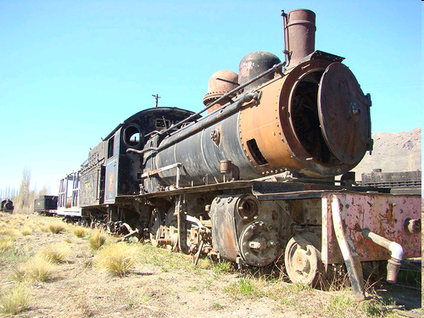
British Financing Railways
Serie La Trochita

Slide 56
The Crux of the Matter- The Counter-Narrative

Slide 57
Economic Theories- Discussion
Mercentilism
Neo-Classical Economics (Adam Smith)
Keynesianism

Slide 58
British economist John Maynard Keynes

Slide 59
Keynesianism and Colonies: Basis of Foreign Aid
Fiscal Policy- Grants in Aid
Monetary Policy- Control Trade
Labor Controls- Low Costs

Slide 60
Global Power
From Empires to UN (UNDP)
Multi-Lateral Institutions- IMF and World Bank, and Regional Banks
Cold War Competition
The Super-power and unilateralism

Slide 61
Modernization: Basis of Economic Change Assumptions
Thus an understanding development should occur at two levels, the relationship between the individual, a socialization process;
The extent to which national ethical and moral values impact upon the individual.
The result is said to be an urban, modern secular person. (Western)

Slide 62
Impact of History- Review
Colonialism defined authority in most of what we call the developing world until well after the middle of the twentieth century;
Economic Relationships are embedded in that history (modernizarion)
Foreign aid and technical assistance grew out of that heritage.

Slide 63
South Africa, 1900

Slide 64
Kenya, 1952 (“Mau Mau”)

Slide 65
The Counter Narrative: A Reminder of Goal of Course
What Emory Roe calls the development of the counter narrative is
to conceive of a rival hypothesis or set of hypotheses that could plausibly reverse what appears to be the case, where the reversal in question, even it proves factually not to be the case, nonetheless provides a possible policy option for future attention because of its very plausibility.
Quote from Emery Roe, Except- Africa: Remaking Development, Rethinking Power (New Brunswick, NJ: Transaction Publishers, 1999), p. 9.

Slide 66
Discussion
QUESTIONS?

