Slide 1
PIA 2501 Development Policy and Management
Week 10
Governance, Democracy and the Community:
Decentralization, NGOs and Civil Society

Slide 2
Local Government-
Focus on Links between Local Institutions and Development

Slide 3
Governance from the Grassroots
Myths and Realities

Slide 4
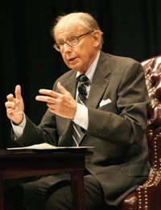
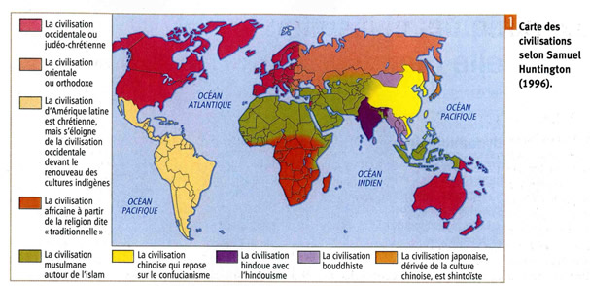
Local Governance As part of the Governance Debate Samuel P. Huntington, (April 18, 1927 – December 24, 2008) Harvard University.

Slide 5
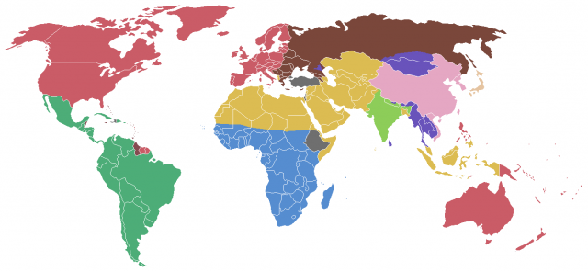
Governance Themes
Cultural Issues: Clash of Civilizations and Chaos
Theories- Measured against Civil Society
Samuel Huntington
Monte Palmer
Jorge Luis Borges
V.S. Naipaul
Michela Wrong

Slide 6
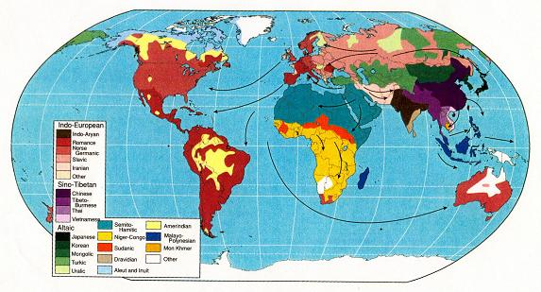
World Ethnic Divisions: Is Civil Society Cultural

Slide 7
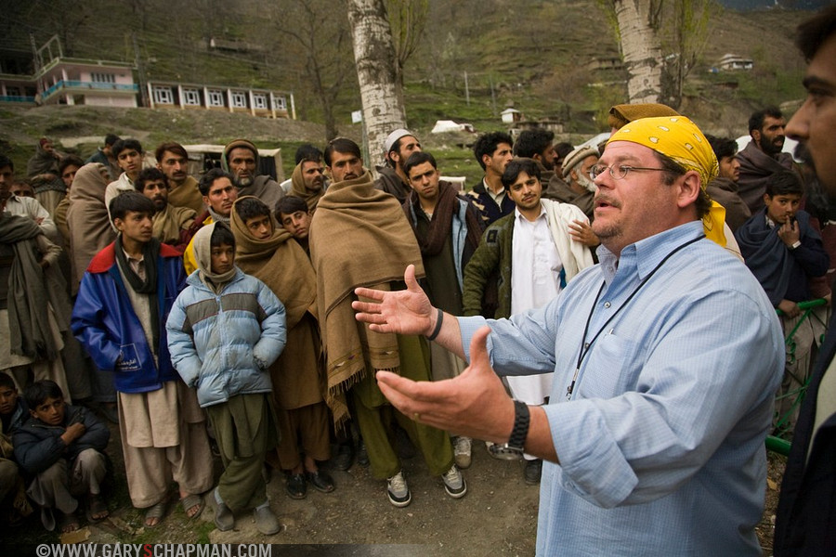
Northern Pakistan

Slide 8
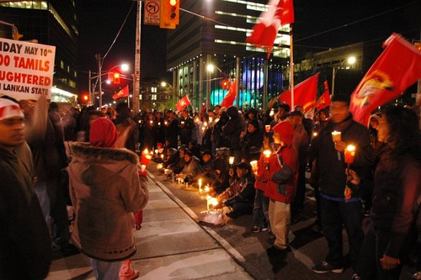
Tamil Protests and Sri Lanka’s Political Future ;

Slide 9
Tie Ins: NGOs, Civil Society and Governance
1. The Failed State
2. Decentralized Governance
3. Reconceptualization of Governance as Local Governance
4. Human Rights and Civil Society

Slide 10
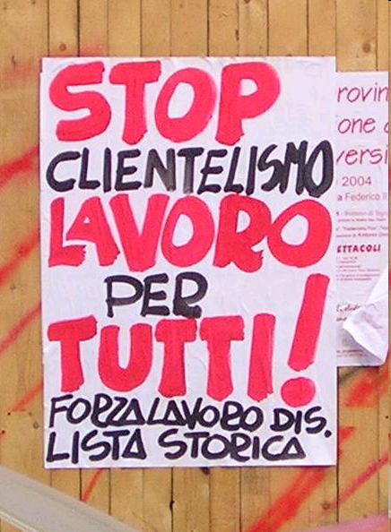
Stop Cronyism to Stop Poverty

Slide 11
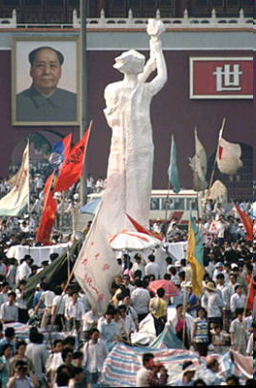
The Hard State

Slide 12
Political Cartoon Remembering the 1960s (Hard vs. Soft States)

Slide 13
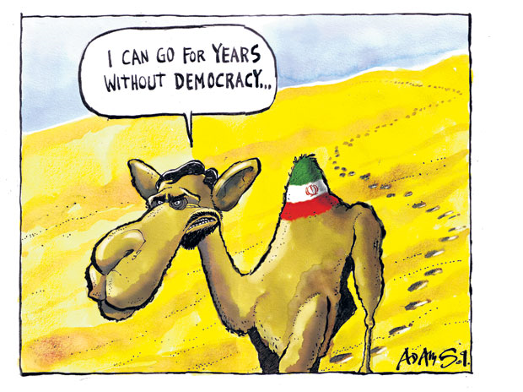
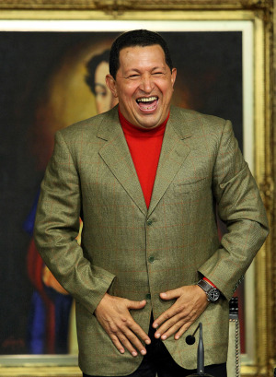
GOVERNANCE ISSUES IMPACT DEVELOPMENT WORK
THE TIE IN
Failure of the State System

Slide 14
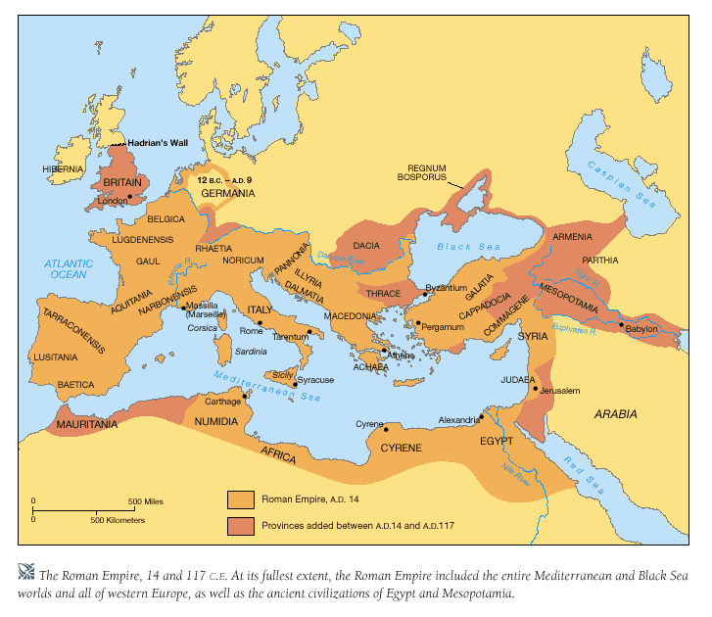
It starts with The Roman Empire: THE FAILURE TO DECENTRALIZE

Slide 15
Governance Issues- Continued
Local Government Defined:
Primary unit of government that has both political leadership and bureaucratic structures

Slide 16
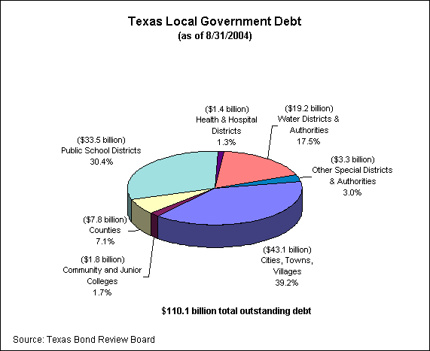
What Local Government Does

Slide 17
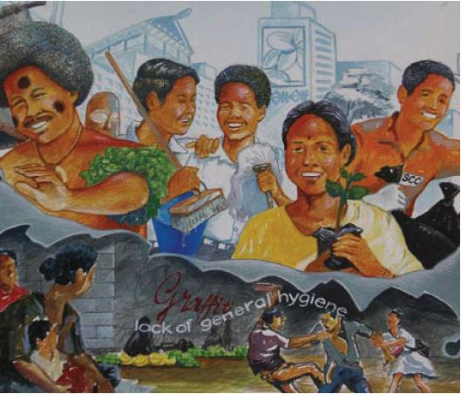
A Universal- Pacific Local Government Capacity Building Project

Slide 18
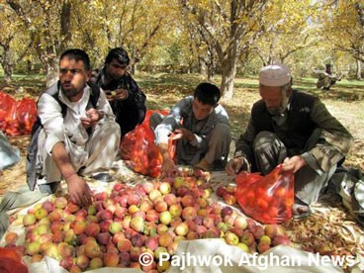
Potential Development Themes
Potential areas of development include infrastructure improvement, agricultural productivity, pasture improvement, value adding (product processing), postharvest technology and irrigation system improvement.
At the Grassroots:
LOCAL GOVERNMENT
LEVEL

Slide 19
What Local Government Does?
Services: local roads, sanitation, water, basic health, primary education
Depend Upon: Skilled Personnel
Fiscal/budget allocation
Taxes and transfers
Planning
Strategic priorities
Managing
Implementing

Slide 20
Local Government and Development: The Goal
Bottom Up Participation Planning vs. politics: myths of participation

Slide 21
Decentralized Governance
Subsidiarity- higher units of Government should not do what can be done by lower units
Not always about democracy

Slide 22
Reinventing Government?

Slide 23
Decentralization and Local Government: Models
Devolution- Political
Deconcentration- administrative
Delegation- autonomous control
Privatization- private or non-profit sector

Slide 24
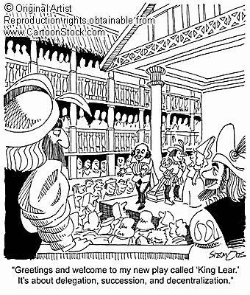
It all comes from Shakespeare?

Slide 25
Local Government and the Local State
Local State (Local level national authority) vs. Local Government
Functional vs. Territorial Control
Devolution (Spatial Planning)
Urban vs. Rural
Urban linked with Rural

Slide 27
The Primary Unit of Government
Municipality: Lowest level with Bureaucrats
English/American
Town vs. county (Rural vs. Urban)
Continental European
Commune (KEY: no distinction between rural and urban)

Slide 28
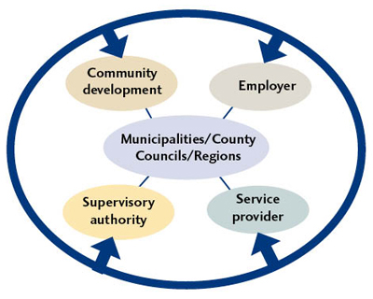
Swedish Local Government Organizations

Slide 29
Deconcentration
Functional vs. Prefectoral
Prefectoral integrated
Prefectoral unintegrated

Slide 30
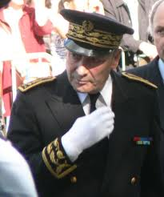
French Prefect

Slide 31
Control Systems
Prefectoral - Integrated
Interior
Local Govt.
Public Works
Agriculture
Education
Labor
District
Office
Council/Chief
Public Works
Office
District Ag.
Office
District Ed.
Office
District
Labor
Office

Slide 32
Control Systems
Prefectoral - Unintegrated
Interior
Local Govt.
Public Works
Agriculture
Education
Labor
Police
District
Office
Police
Council/
Chief
Public Works
Office
District Ag.
Office
District Ed.
Office
District
Labor
Office

Slide 33
Control Systems
Functional
Home Affairs
Local Govt.
Public Works
Agriculture
Education
Labor
Council
Public Works
Office
District Ag.
Office
District Ed.
Office
District
Labor
Office

Slide 34
Governance and Civil Society
Civil Society Organizations: Tie into Decentralized Governance

Slide 35
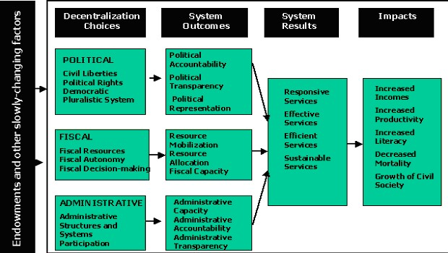
Civil Society as a Dependent Variable

Slide 36
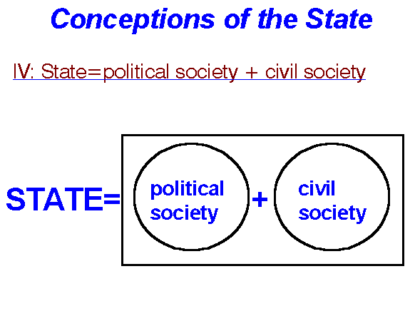
TIE IN

Slide 37
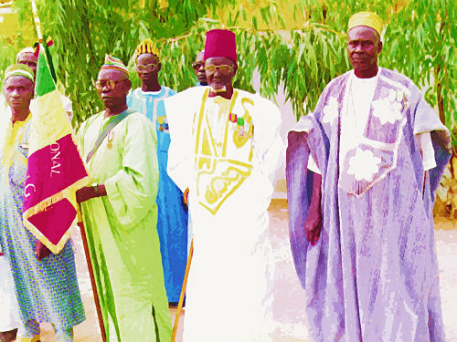
GOVERNANCE, TRADITIONAL LEADERSHIP AND THE LOSS OF TRADITIONAL LEADERS (ETHNIC OR CIVIL?)

Slide 38
Civil Society and Human Rights Issues Review
Civil Society and Human Rights
"Human Rights, Basic Needs and the Stuff of Citizenship" (Anonymous)
Issue: First vs. Second and Third generation Human Rights and Civil Society

Slide 39
Origins- Natural Disaster: Humanitarian Assistance and Human-Made Disaster
War, Drought, Agricultural Failure
Focus on Rural Development
Human Rights
Focus on Governance

Slide 41
State Societal Linkages
Central State - Macro
Weak
Strong
SOFT STATE…………………………….PREDATORY STATE
State-mezzo Weak
Strong
Mono-State…...INTERGOVERNMENTAL Systems in place.…..Local State
Civil Society - Micro
Weak
Strong
Local - SOFT STATE….………………LOCAL GOVERNMENT

Slide 42
Civil Society and Governance
Civil Society: Definition
Associations and organizations that are beyond the clan and the family and short of the state (does not include state organs)

Slide 43
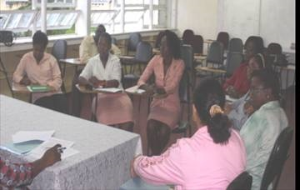

Slide 44
The Goal
Learning Process Model--“incrementalism“- theoretical alternatie
Bottom up and interactive
Village development committees vs. local planning officers
Paternalism of the district officer vs. patronage of local level minor networks
Street level bureaucrats vs. agents from center

Slide 45
Civil Society
Definition:
Networks of organizations, groups and individuals pursuing socio-economic interests
"Beyond the family but short of the state”
- Hegal
"Human Rights, Basic Needs and the Stuff of Citizenship”
- First vs. Second and Third generation

Slide 46
The Grass Roots Principle

Slide 47
Postscript- World Bank Mission
Local Governance and Civil Society in Guinea Conakry (Stakeholder Analysis- March, 2006)
A Collapsed State: (1960-2015)
Creation of a Poverty Alleviation Fund- includes Micro-Credit
Design Capacity for Service Delivery
Need for Predictable Governance and stable Civil Society

Slide 48
CENTRAL TO THE DEBATE: More than Local Governance?

Slide 49
Politicians and the Grassroots
More from Yes Minister

Slide 50
DISCUSSIONS, QUESTIONS DEBATES
GOVERNANCE AND LOCAL GOVERNANCE

