Slide 1
PIA 2574-African Development Seminar: Conflict, Governance and Development
The Ethnicity and Violence in Post-colonial Africa

Slide 2
Tribes and Myths
The Click

Slide 3
Regional Patterns

Slide 4
Theories of Ethnicity: Primordial Sentiments
Primordialism- Allegiance based on givens, culture, language and religion
Contrasts Primorial vs. civil sentiments (Civil Society)
Primordial- Permanent and unchanging

Slide 5
Primordialism
Corporate sentiments of oneness
Personality flaw that must be corrected
Undermines the Nation
Ethnicity is destructive
Embedded in ancient myths and history

Slide 6
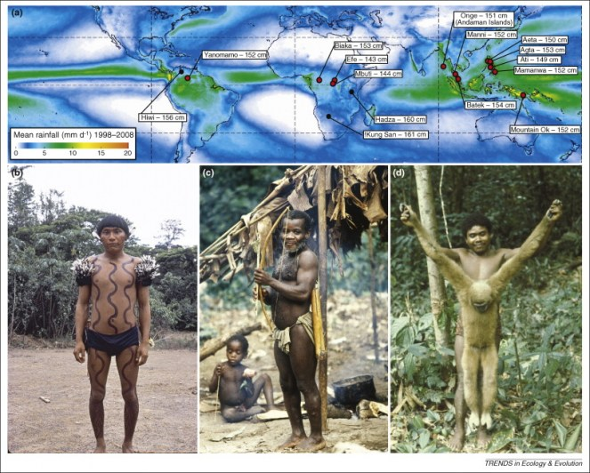
Indigenous Peoples?

Slide 7
Ethnicity
Clifford Geetrz and his Critics
Clifford Geertz, “The Integrative Revolution: Primordial Sentiments and Civil Politics in the New States”
In Clifford Geertz, ed. OLD SOCIETIES AND NEW STATES (New York: Free Press, 1968).

Slide 8
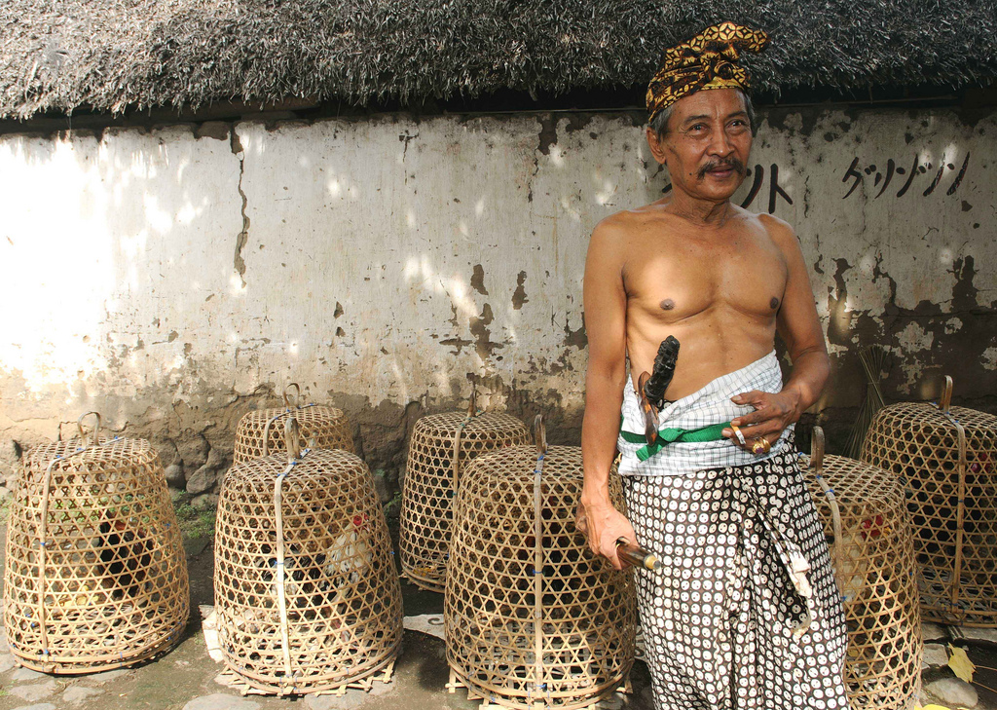
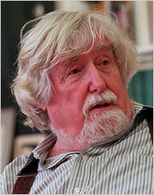
Balinese Status Titles taken from Clifford Geertz’s (1926-2006)writing entitled “Person, Time, and Conduct in Bali : The Social Nature of Thought”, that will give you an interesting insight on Balinese social-cultural life.

Slide 9
Implications of Primordialism
Corporate sentiments of oneness
Personality flaw that must be corrected
Undermines the Nation
Ethnicity is destructive
Embedded in ancient myths and history

Slide 10
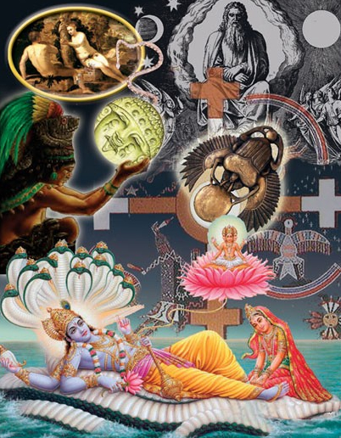
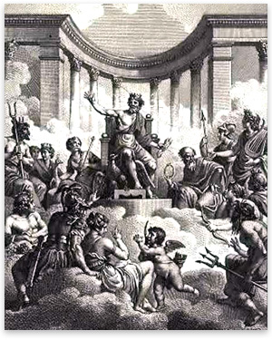
Myths of Origins

Slide 11
Critique of Primordialism- Ethnicity as a Process
Contextual and Changing
Towns: urban contact and the “other”
“retribalization”
European origins of ethnic identity
Tradition actually changes

Slide 12
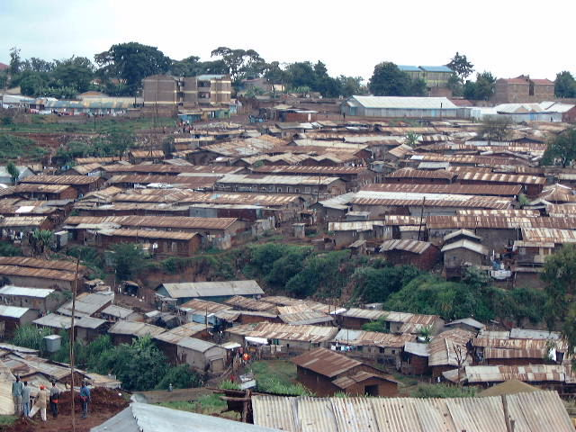

Slide 13
Cleavages and Conflict
Cumulative (overlapping) vs. Crosscutting- What is Northern Ireland?
Eg. NORTHERN IRELAND:
Catholic
Poor
Urban
Working Class
Cross cutting: One category does not define another

Slide 14
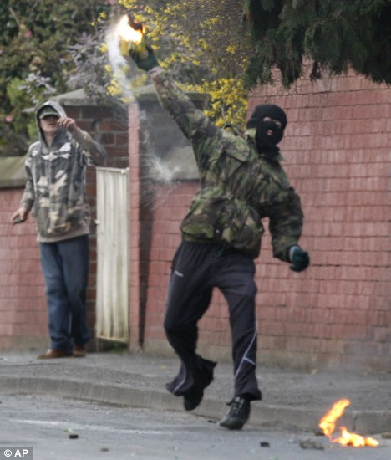
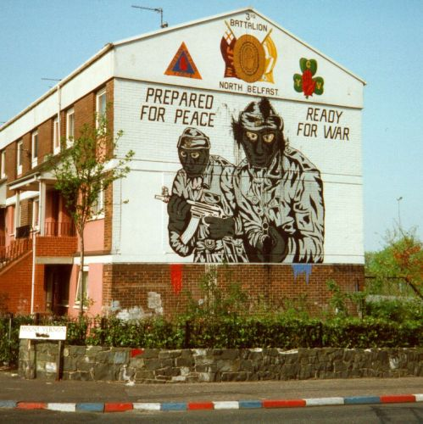
Northern Ireland

Slide 15
Related Terms Finding a meaning for Social divisions
Cultural Pluralism
Cultural Sub-nationalism
Religious Fundamentalism and Nationalism

Slide 16
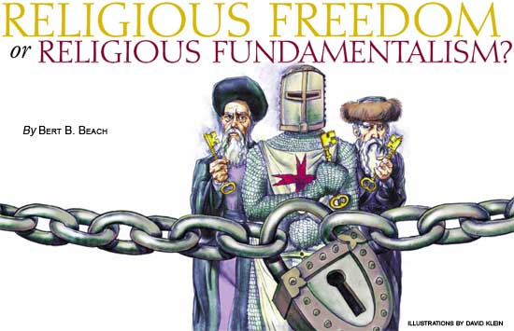
Identity and Religion- Fundamentalism?

Slide 17
Explanations of Ethnicity
cultural sub-nationalism- language, culture, religion and race
Awkward, what is “sub” about it?
Contextual- intensification of ethnic identity- and the reverse
Ethnicity as Nationalism

Slide 18
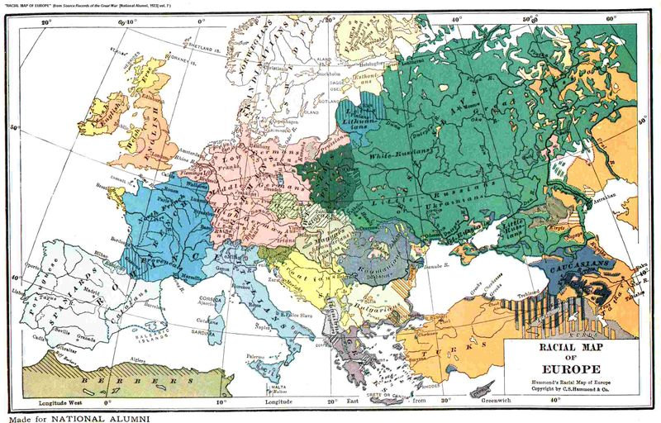

Slide 19
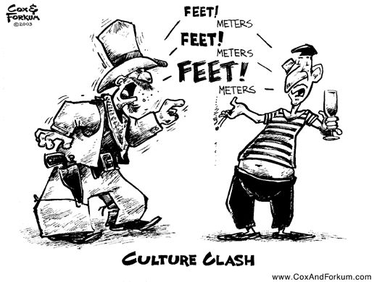
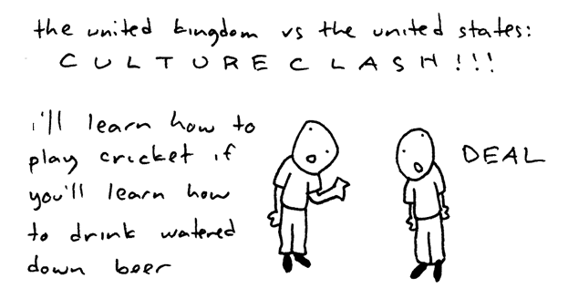
Culture Clashes

Slide 20
Examples of Ethnic Conflict: Which is not?
Cambodia
Bosnia/Kosovo
Somalia
Central Africa: Rwanda/Zaire
East Timor and Indonesia

Slide 21
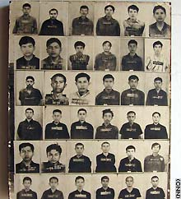
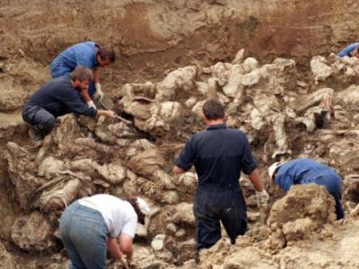
What is the Ethnic Issue?
Prosecutors said the gravest atrocities were the 1995 Srebrenica massacre of 8,000 Muslims.
More than 1.7 million Cambodians are thought to have died at the hands of the Khmer Rouge.

Slide 22
Ethnicity
The Story of Lingala:
Language spoken along Congo River by many groups
No real Ngala Group
Missionaries and Colonial officers “heard the language”
By 1960, a group definition

Slide 23
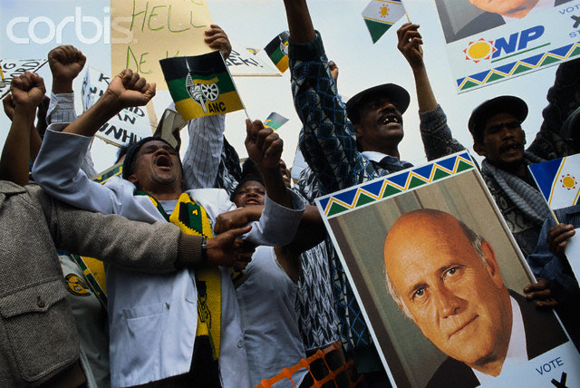
Race, Nationalism and Ethnicity
DISCUSSION POINT: IS AFRICAN ETHNICITY DIFFERENT?

Slide 24
Defining Ethnicity: Africa- Ethnic and racial Mosaic
Core Separatism based on Language
Language Group Identity
Impacted by Colonialism-Divide and ally
Geographic Ethnic Separation
Multi-Ethnic Groups live together
Sub-Nationalism- Perception of Group as nation

Slide 25
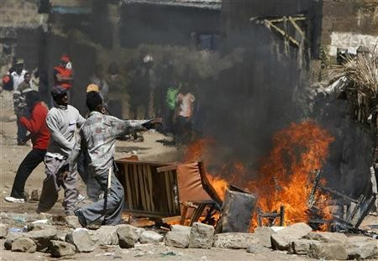
Luo vs. Kikuyu in Kenya

Slide 26
Nigeria
152,217,341 people (2010)
10 Major languages and clusters (350,000 people +)
248 minor Languages and dialects

Slide 27
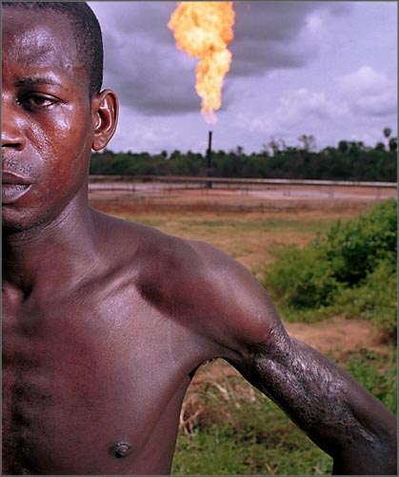
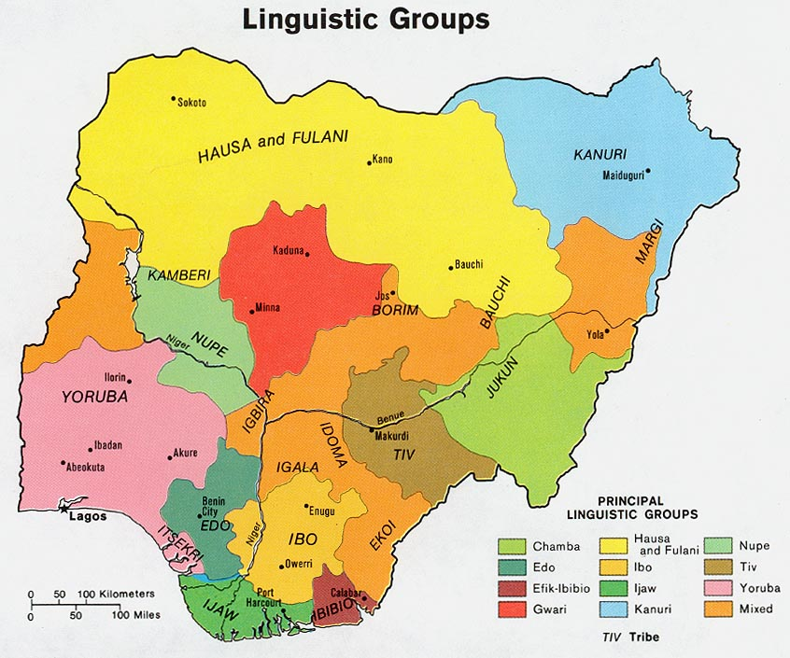

Slide 28
Nigeria: Three Places in One?
Northern Nigeria: Dry, Grazing County Moslem, Hausa and Fulani
Middle Belt: Temperate, Hilly, Underutilized potential for Grain Crops- small heterogeneous groups, Tiv and Nupe
South: Tropical forest, humid, palm oil, cocoa, oil. Yoruba, Wes, Ibo East

Slide 29
The Scandinavia Problem
Norway- A Nation State of 4.9 million people
Iceland- An Island Nation of 313,376
“Ibo” (Igbo)- a “tribe” of 17-30 million people
Theme: a State without a Nation

Slide 30
Defining Nationalism without states: The Norway Problem
“Tribalism” Defined as parochialism-Identification and value system
Set within Autonomous Local Communities
Problems with "tribalism“
European Term, Conventional Use
Tribes vs. “Detribalization”- What does it mean?

Slide 31
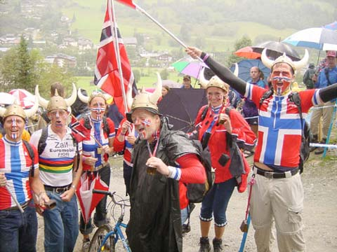
Norwegians

Slide 32
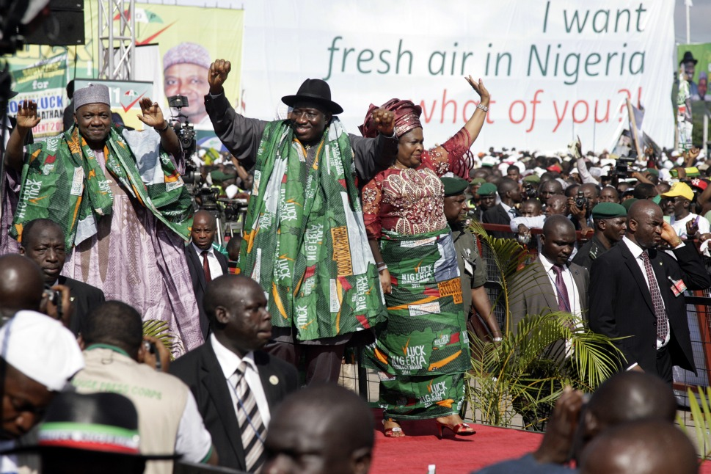
Middle Belt Politics

Slide 33
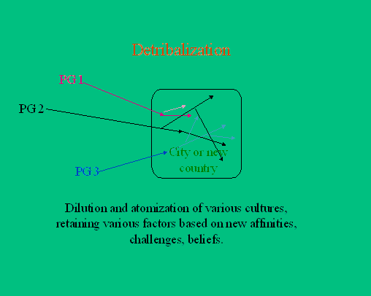
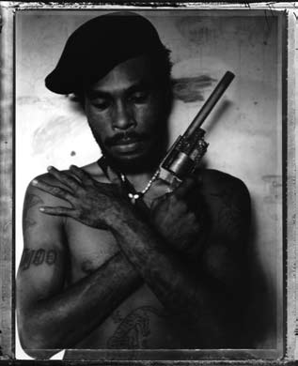
“Guns and Arrows: The Detribalization of Papua New Guinea” Australian photographer, Stephen Dupont

Slide 34
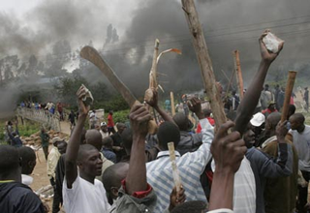
Ethnic Consciousness
Sometimes New
Often accidental
External in origin
Formed by urban contact
Changing
Related to Differences in Economic Advantages

Slide 35
Asian Ethnicity
A Core Nationality and Outlying “tribes”
Indonesia and Java
India and Hindi (Crosscutting caste, religion and language)
Kurds: Minorities in Four Countries- Turkey, Iraq, Syria, Iran
Iran: Persia

Slide 36
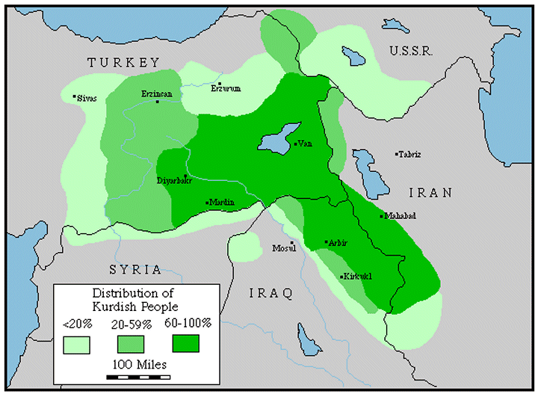

Slide 37
Ethnicity, Race and Culture
Focus of Explanations for Failure in Africa
The nature of conflict
The legitimacy of colonial borders
Are Settlers a different “tribe?”

Slide 38
Ethnicity and Class
Class is Traditional
Class was reinforced by Colonial Rule
New Organizational and Economic Elites have ties to Pre-colonial elites
Strikes and Spoils- Tend to be Ethnic in Nature
Some Ethnic Groups had better access to wealth

Slide 39
Ethnicity vs. Language-Issues
Ethnicity as a concept (Language and False Ethniity)
Colonial vs. Indigenous Languages
The role of Settler lingua francas: English, French, Portuguese and Trade Languages: Hausa, Swahili, Lingala

Slide 40
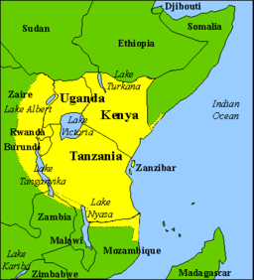
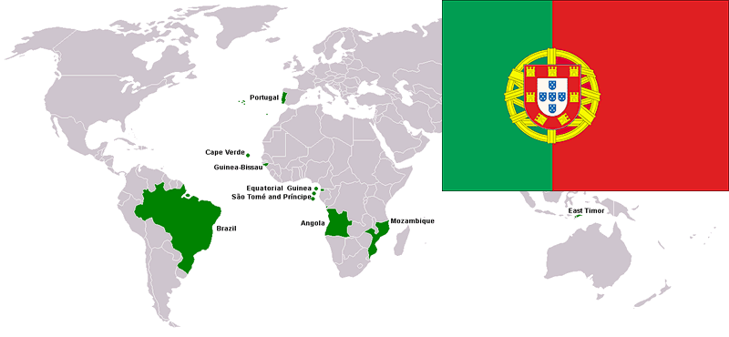
Swahili and Portuguese Cultural Areas

Slide 41
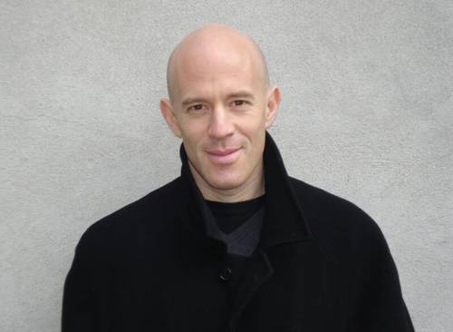
Daniel Bergner, (Born in 1960) In the Land of Magic Soldiers, Journalist, New York Times
Book Discussion Next Week
Images of War
Critical Analysis of the book?
Important or inflammatory?

Slide 42
Race and Culture
Biology vs. Attitudes (“Race”)
Race vs. Ethnicity
The Colonial Lingua Franca and Indigenous Languages
Pre-indigenous vs. Mixed Race Peoples: Who is an African?

Slide 43
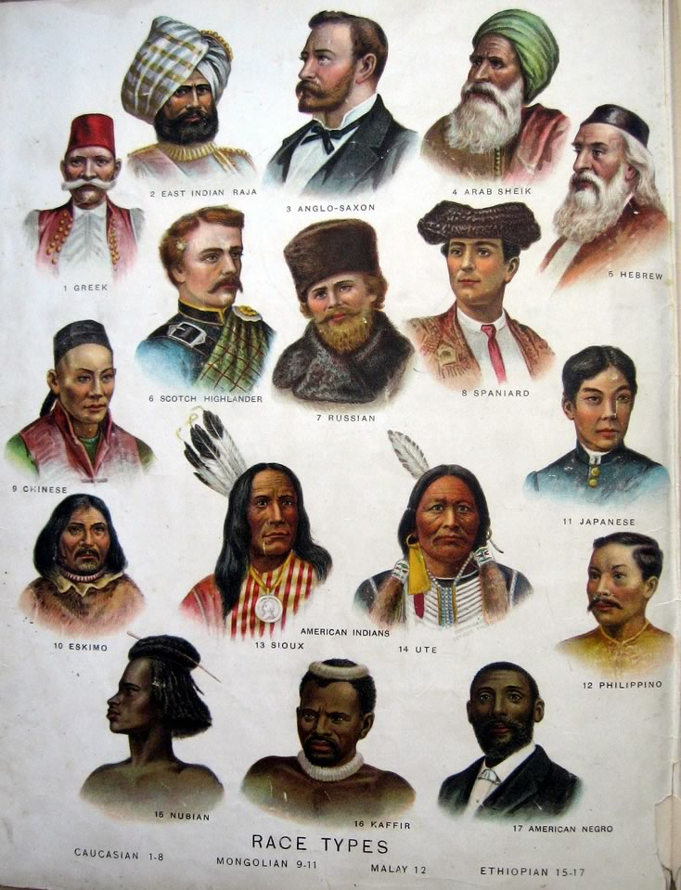
Historical Racial Stereotypes

Slide 44
Settlers: Not Just British
Impact on the Whole Continent
Question: Was Europe’s Relationship with Africa Different than with the Middle East, Asia and Latin America
The New Settlers: Foreign Aid Workers, Contractors and Missionaries?

Slide 45
Settlers: Statistical Profile 1955-1970
Algeria: 1,000,000 (1955)
Morocco and Tunisia: 750,000
West Africa and Madagascar, 170,00)
Angola: 700,000 (1970)
Mozambique: 250,000 (1970)
Other 75,000:
Italian East Africa: 162,000 (Italians, 1940)
Libya- 115,000

Slide 46
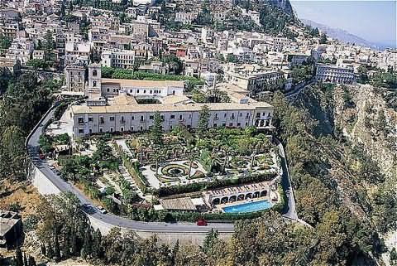
Asmara, Eritrea- Colonial Art Deco

Slide 47
Settlers: The Issue and the Problem- Start with the Demographics
Francophone Africa:
North Africa, Algeria and permanent association
The Importance of “Francophonie” on Culture and Values

Slide 48
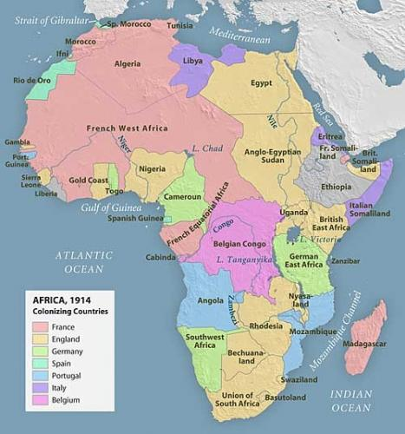
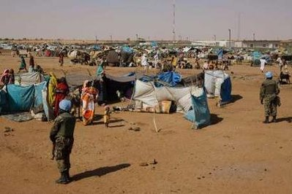
Colonial Borders

Slide 49
Defining Nationalism
North Africa: "Arab majorities" and "minorities"-
Sudan, Chad, Mauritania and Morocco
The Horn- Clans, religion and colonial borders

Slide 50
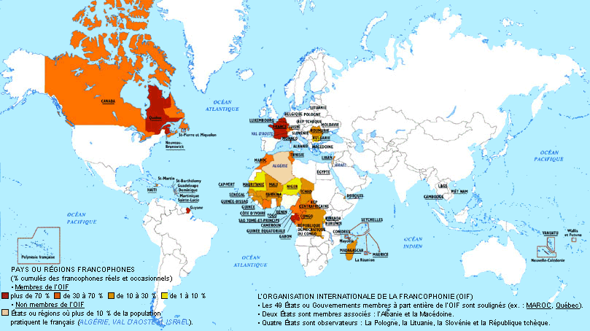
The Francophonie

Slide 51
Francophone Africa (c. 1958)
Congo (Belgium): 110,000 (1958)
Burundi: 5,000
Francophone: 30,000 (“colon”- estimated)
Indians and Arabs (60,000)

Slide 52
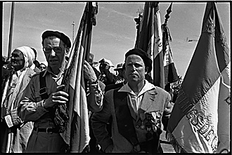
French Colons in Algeria

Slide 53
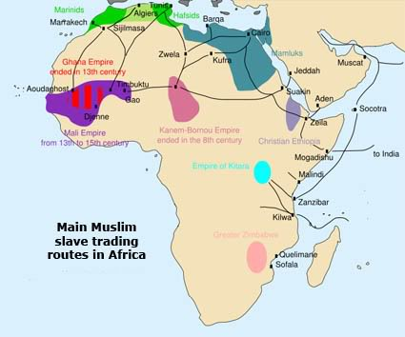
Origins of Arab Community in East and West Africa

Slide 54
West Africa
Role of the "Syrians" and "Lebanese“ (c. 120,000)
Arabs as "settlers?“
People of mixed race?
Who are indigenous peoples?

Slide 55
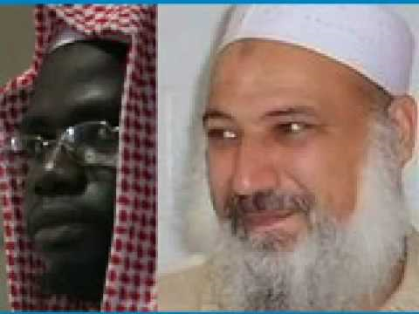
Ghana

Slide 56
East Africa: 1965
Tanganyika
Whites: 23,000
Indians 100,000
Kenya
Whites: 78,000
Indians: 110,000
Uganda
Whites: 3,000
Indians: 78,000

Slide 57
Eastern and Southern Africa: South Asian Community
Asians- The forgotten settlers
Indians in Eastern and Southern Africa (1.7 million)
Amin, Mugabe and the indigenous people argument

Slide 58
Mixed Race: Afro-Europeans- “So Called Coloureds
Eastern and Central Africa
80,000 people
Issue- Loyalty to the State and conflict with Indigenous Peoples

Slide 59
Kenya
"White Mischief"- Settlers in Kenya
Above the law
Land and Compromise
e. Post-colonial "whites"

Slide 60
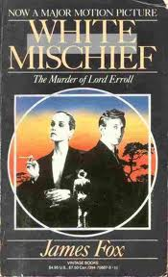
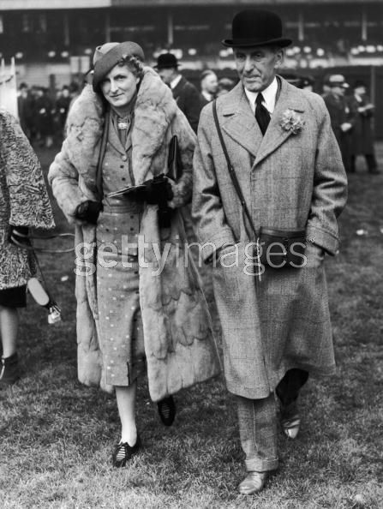
The infamous story of Sir Jock Delves, Lady Diana Delamere and the Murder of Lord Errol in the Happy Valley of Kenya in 1941.

Slide 61
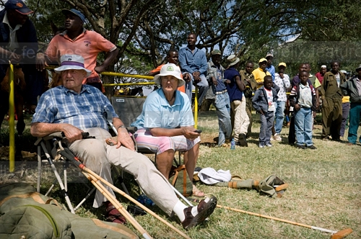
A white couple, settlers and horse owners, together with their staff, standing directly behind them, watch a polo game at Nairobi Polo Club, a remnant of Kenya's colonial history, July 1, 2007

Slide 62
Missionaries, Traders and Settlers, and now foreign aid
British Settlers
Missionaries and Settlers
East Africa, the Federation (Zambia, Malawi and Zimbabwe)
Southern Africa
The special issue of Namibia

Slide 63
Federation of Rhodesia and Nyasaland, 1953-1963
Federation:
Indians: 30,000
Whites:310,000
Northern Rhodesia: whites: 76,000
Southern Rhodesia: whites: 223,000 (1975-270,000)
Nyasaland: 9,300 Whites

Slide 64
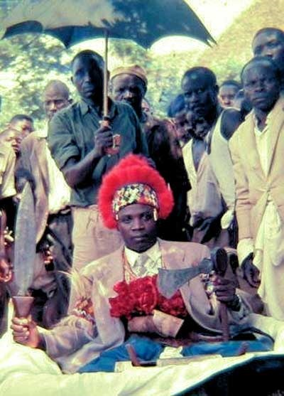
Traditional Leader in Northern Rhodesia- 1950s

Slide 65
Southern Africa: The Other Settlers
Portugal and Portuguese
mass settlement and "provincial" status
Over one million overseas Settlers
(eg. Teresa Heinz)
Belgians, Greeks, Germans, Italians, Dutch, Americans-
Indians (Asians), Arabs, Chinese

Slide 66
Maria Teresa Thierstein Simões-Ferreira Heinz (born October 5, 1938 in Lourenço Marques, Mozambique

Slide 67
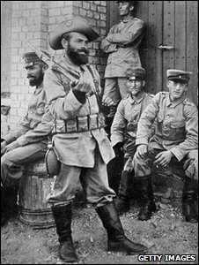
Namibia Germans

Slide 68
Southern Africa- 1985
Botswana-
Whites 5,000
Mixed Race 2,000
Swaziland
Whites 8,000
Mixed Race 4,000 (Euro-african)
Namibia-
Whites100,000 (23,000 German speakers)
Mixed Race: 22,000

Slide 69
King Mswati III of Swaziland

Slide 70
Bishop Abel Muzorewa, 1925-2010. Compromised with White Rulers (1978)

Slide 71
Zimbabwe
Military demobilization and Rhodesia
"Home Rule"- UDI
Zimbabwe and Non-racialism
Indigenous Peoples and Land

Slide 72
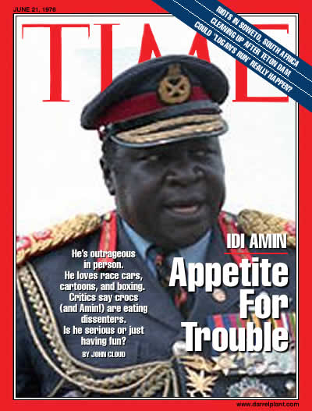
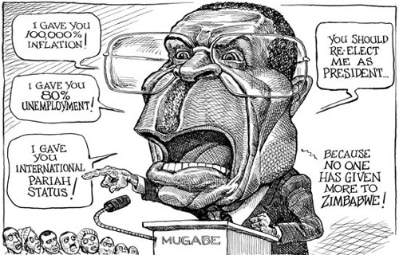
African Leadership: To be Continued

Slide 73
The Problem: Who are Indigenous Peoples?

Slide 74
South Africa Profile, 1990
Indians 1,000,000 (3%)
Africans: 25,000,000 (73%)
Mixed Race “Coloureds- 3,000,000 (9%)
Whites- 4, 800,000 (14%)
Indigenous: San-Khoisian: 31,000 (less than .5%)
Others: Chinese, Japanese, Arabic (30,000- less than .5%)

Slide 75
South Africa: The Special Case?
1653 Dutch- settlement and movement
“So Called Coloureds“ [ and Indians]
1815: End of Napoleonic War
1820s settlers: British
British vs. Dutch-

Slide 76
South Africa Profile, 1985
White: 4,800,000 (14.8%)
(60% Afrikaans, 40% English and others)
(Jewish South Africans approximately 100,000 people)
“Coloured:” 2,900,000 (8.7%)
(Mixed Race- 80% Afrikaans speaking, 20% English Speaking)

Slide 77
South Africa
The People in the Middle

Slide 78
South Africa
Role of working class and poor whites
Mining and labor reserve- "peasant based proletariat
Multi-racialism, non-racialism vs. “Africanization”
Carnegie Commission- 1922 “Problem of Poor Whites”

Slide 79
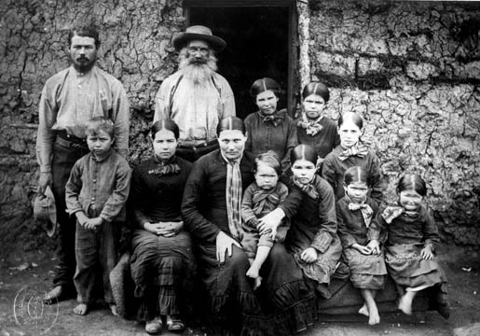
Boer Family- c. 1900

Slide 80
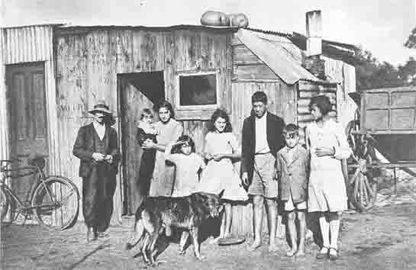
Carnegie Commission, 1922- The Debate Continues
h
https://cdn-images-1.medium.com/max/1200/1*QGrVDSYzLMPyW4-HRUdL4Q.jpeg

Slide 81
South Africa and the World
Prior to WW II. White Dominion
Investment and Mines
World Wide Similarity of Values
Part of “British Empire”
Independent, legal, legitimate

Slide 82
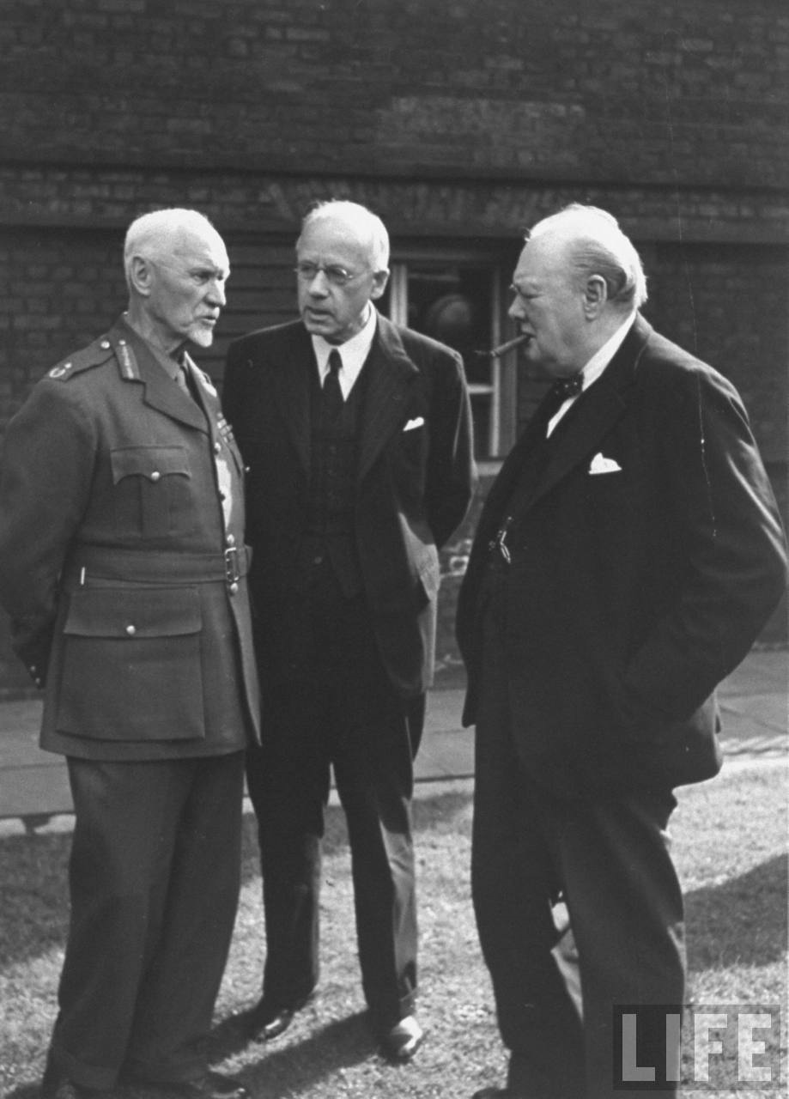
Prime Minister Winston Churchill (R) talking with Field Marshall Jan Christian Smuts (L) and Peter Fraser (C) at a Dominion Conference April, 1945

Slide 83
South Africa
Trusteeship vs. Assimilation
Segregation vs. Apartheid- "Homelands" as nations
Afrikaans vs. African Nationalism
Majority rule vs. minorities
Multi-Racialism vs. Non-Racialism vs. ”Africanism”

Slide 84
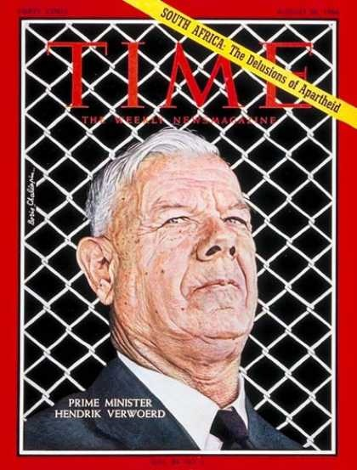
“Grand” Apartheid August 26, 1966

Slide 85
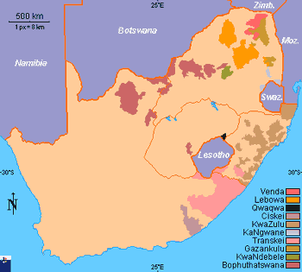
South Africa’s Homelands, Prior to 1994

Slide 86
Homeland Presidents: 9th October 1971: Three Chiefs of South African 'Bantustan', (from left - right), Chief Buthelezi of Kwa Zulu, Chief Kaiser Matanzima of Transkei, and Chief Lucas Mangope of Bophuthatswana

Slide 87
South Africa and the World
Decolonization (1910)
1948 and Apartheid
Homelands and Nationalism
Anti-Communism
White Nationalism like Black Nationalism
“Polecat of the World”

Slide 88
South Africa and the World
“Tar Baby”- Nixon, Kissinger: The Cold War and Apartheid and beyond
Benign Neglect
Tilt to the Whites, Rhodesia, Portugal and South Africa, 1975-1986
Comprehensive Anti-Apartheid Sanctions
Non-Racial Rule- 1994

Slide 89
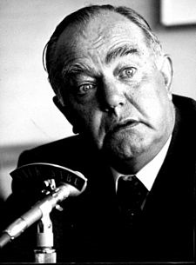
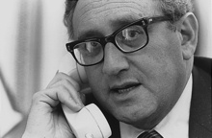
Henry Kissinger, Ian Smith and John Vorster

Slide 90
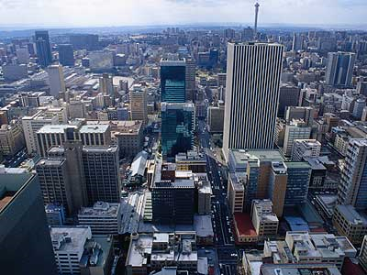
Johannesburg

Slide 91
After February 2, 1990

Slide 92
Visit to Pittsburgh, Heinz Lecture December 6, 1991

Slide 93
Inauguration, May 10, 1994

Slide 94
Interview, Cyril Ramaphosa, Then Secretary General, African National Congress June 21, 1996

Slide 95
Thabo Mbeki and Jacob Zuma

Slide 96
Cyril Ramaphosa, New President of South Africa

Slide 97
Authors and Culture
Sylvain Bemba (Congo-DRC) Journalist, dramatist and novelist (1934-1995)
Barbara Kimenye Uganda Journalist and children’s author (1929-2012)

Slide 98
Meet the Authors
James Mathews, South African poet and journalist (Born in 1929)
Alex La Guma, South African Novelist (1925-1965)

Slide 99
Bemba and Kimenye
“The Dark Room”
Images of Paris
Gender and Immigrants
Race and Behavior (An Excuse?)
Significance of the story?
“The Winner”
The problem of
Accumulation
The Role of Family
The Economy of Affection

Slide 100
Short Story Themes (Mathews and Bemba)
“The Park”
District Six and Cape Town: “So-Called Coloured” People?”
What was the problem with the Park?
Petty Apartheid?
Significance of the story?
“A Matter of Taste”
Taste or Money?
Tension
Race and Class?
Culture in South Africa

