Slide 1
PIA 2501
Development Policy
And Management
Week Three

Slide 2
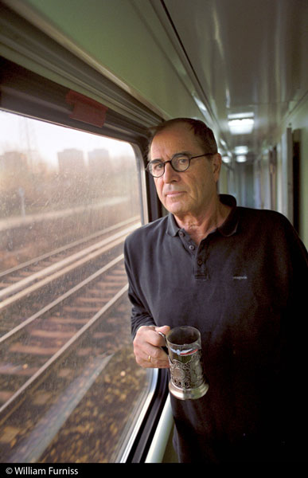
Influence: Transition Authors
Paul Theroux- “Tarzan as an Expatriate”
Peace Corps, 1963-1965
Born | 10 April 1941 (age 75) Medford, Massachusetts
Occupation | Peace Corps Volunteer, Malawi Novelist, Travel writer, short story writer, literary critic
Nationality | American
Started Writing | 1967

Slide 3
This week’s Themes

Slide 4
Overview of Course Themes: Looking for these in Your Readings
From Nationalism to Decolonization
Links with (and Legacy of) Colonialism
Theories of Modernization
The End of the Cold War
Debates About Donors
The Focus on Governance
Critiques of Modernization
Underdevelopment and Dependency

Slide 5
Neo-Nationalism in Europe and Latin America (1930s)
António de Oliveira Salazar (1932)- Portuguese Overseas Territories
Franco and the Spanish Civil War
Peronism (Juan Peron: Argentina 1944)
Impact of the functions of government
  Territorial Governors appointed by the President (Prefects)
  The importance of Military control in regions -Spanish Military Governors called Presidencies

Slide 6
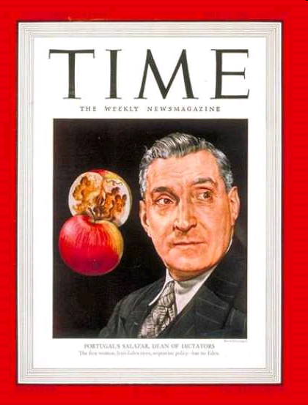
António de Oliveira Salazar, “ Supreme Leader” of Portugal, 1932-1970

Slide 7
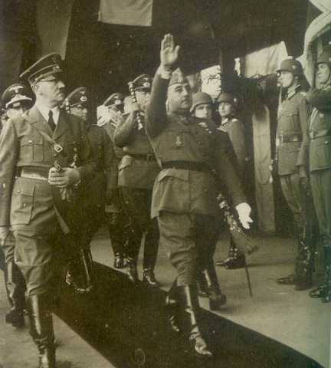
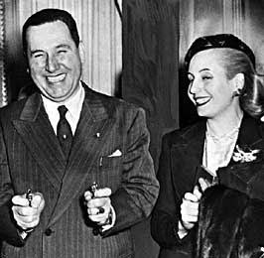
“The Leaders” Argentina and Spain
Juan and Eva Peron and Francisco Franco and Friend

Slide 8
Neo-Nationalism in Latin America (1940’s) - The Spanish Legacy?
Patronage (The Universal Problem)
  Legalistic basis of governance in principal
  Clientalist, class or mass based appeal, charisma
  Community level political culture: “localismo” inward looking villages and communities

Slide 9
Socialism and Fascism: Legacy WWII
Some have used the term “Totalitarianism”
Provided models for Corporatist “Development”
Legacy of Imperial and Socialist Land Based Empires (Germany, Russia, Austria and Turkey)
Corporatist and Commandist Variations

Slide 10

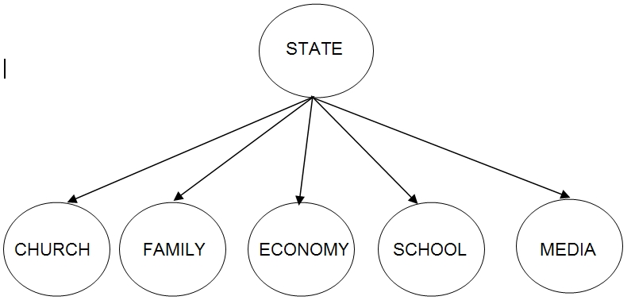

Slide 11
PIA 2501: Development Policy and Management
1. The Legacy of Colonialism: The Anthropologists?

Slide 12
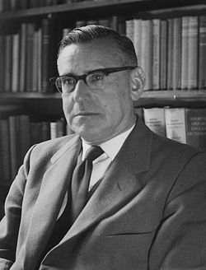
Development Theory
Review
In 1950, There existed…
Colonial Anthropological Theories
Rhetoric of Nationalism throughout world
Political change and independence
The Rhetoric contrasts with public sector continuity and debate about its role in economic development
Beginnings of Cold War
        Picture Above: Isaac Schapera (23 June 1905 born in Garies, South Africa – 26 June 2003 London, England), was a social anthropologist at the London School of Economics

Slide 13
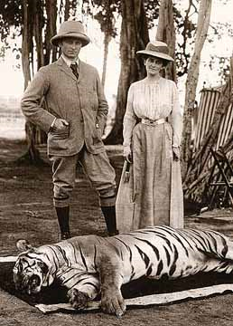
The Impact of Colonialism and Imperialism on Development Theories
Note: Colonial Origins-
Anthropology- “Primitivism”
Colonial Mission
was Modernization,
Nationalism
and Development
Anthropology Traced
Patterns of Change
Dychotomy: Traditional vs. Modern

Slide 14
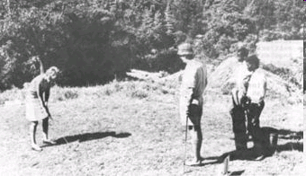
"The good life" for Rhodesian whites, taken from Rhodesian government booklet promoting white immigration, 1970

Slide 15
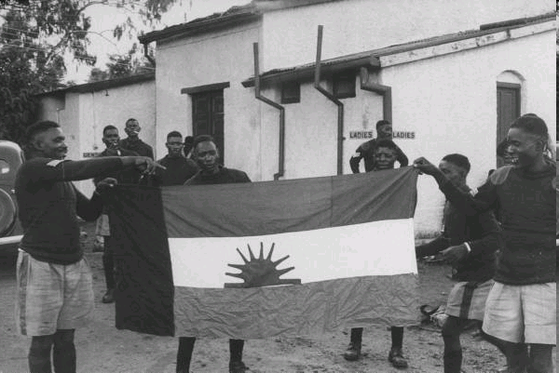
Nyasaland- March 1959

Slide 16
2. Theories of Modernization
MODERNIZATION, Nationalism and Independence: Major Theme

Slide 17
!V. Asia and Africa: From Middle Class Nationalism to Mass Movements
World War II led to the collapse of over
seas empires
Begins Japanese imperialism and Asian
nationalism
The Atlantic Treaty and self-determinism
Two patterns:
  Gandhi and non-violence and
  Sukarno, Ho Chi Minh and violent resistance or
  revolution

Slide 18
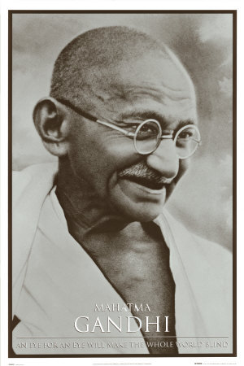
The Beginning of the Development
Era
The End of Colonialism- Decolonization after World War Two

Slide 19
The “Development Era” 1948-1989
In the 1940s and 1950s there was a rhetoric of Nationalism through out the World
Political Change (Nationalism in the Middle East, and Latin America) and Independence (Caribbean, Africa, and Asia (1960s-1970s)
Transformation in Eastern Europe and the CIS (1980s)

Slide 20
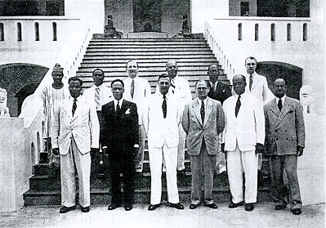
The New Colonials and End of Sea Based Colonialism (Sir Charles Arden-Clarke of Gold Coast in the Center)
Egypt- 1922
Dutch East Indies- 1944 (Indonesia)
Philippines (1946)
India- 1947
Israel-1948
Sudan-1965
Ghana-1957
The Deluge-1960

Slide 21

Independence
  Between 1945 and 1985 more than one hundred new states came into existence (Another 20 or so by the end of the century)
  Kwame Nkrumah “Seek ye first the Political Kingdom”
  Implication was that economic
  development would follow

Slide 22
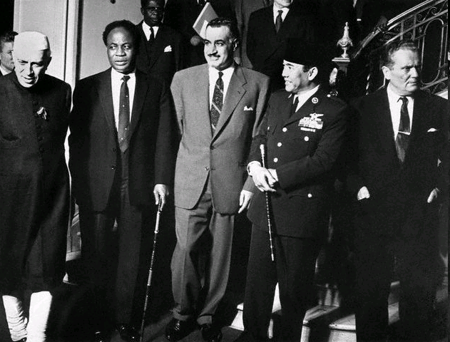
(L to R) PM Pandit Jawaharlal Nehru of India, Pres. Kwame Nkrumah of Ghana, Pres. Gamal Abdel Nasser of United Arab Rep., Pres. Sukarno of Indonesia, & Pres. Tito of Yugoslavia.

Slide 23
Mixed vs. Command Economies
9. Nationalism, Independence and Theories of Development
Socialism as a “Model?”
Part of European Social Democracy Movement?

Slide 24
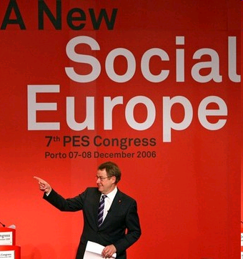

Social Democracy

Slide 25
Vs. Communist Theory and Development
State Control
Social Engineering
Command Economy
Industrialization vs. Rural Transformation
State Managed Development

Slide 26
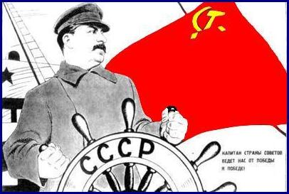
The Great Helmsman

Slide 27
Keynesianism and the “Western” Development Model

Slide 28
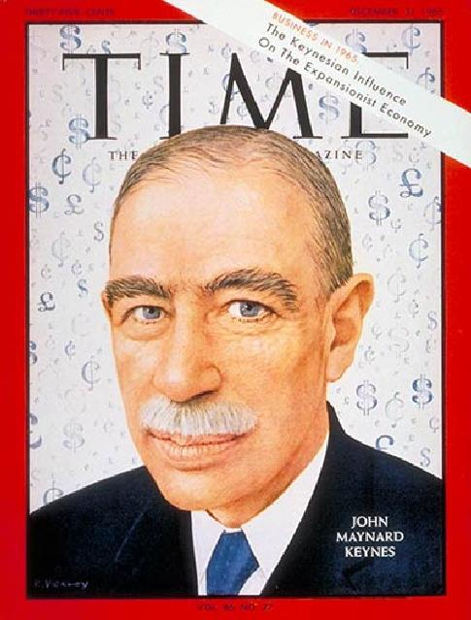
Historical Character
John Maynard Keynes

Slide 29
John Maynard Keynes, 1883-1946
British Economist who worked several years in the British India Office
John Rapley:“Keynes had no problem with the market economy. He liked the machine but judged it to be in need of improvement if it was to operate well.”

Slide 30
John Maynard Keynes
  His goal was to influence the market and not replace it
  Influenced the U.S. New Deal and the thinking of the Labour Party in England
  He had an important influence on the social democratic parties in Western Europe
  His ideas suggested that European mixed economies could be replicated in LDCs

Slide 31
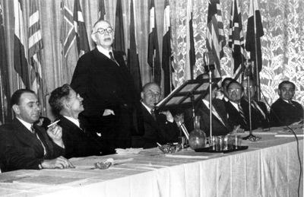
British economist Lord John Maynard Keynes (3rd l.) addresses the Bretton Woods Conference in July 1944

Slide 32
Keynesianism as Economic Principle
Government had a role in the management of the economy
KEY: Faith in the State

Slide 33
Keynesianism- Keynes on the End of the Gold Standard VIDEO
  Physical development (roads and dams) and Economic Growth
  Physical and Mental Change or Social Development
  Human Resource Development vs. Social and Economic Change
  Proposed a Mixed Economy—public and private

Slide 34
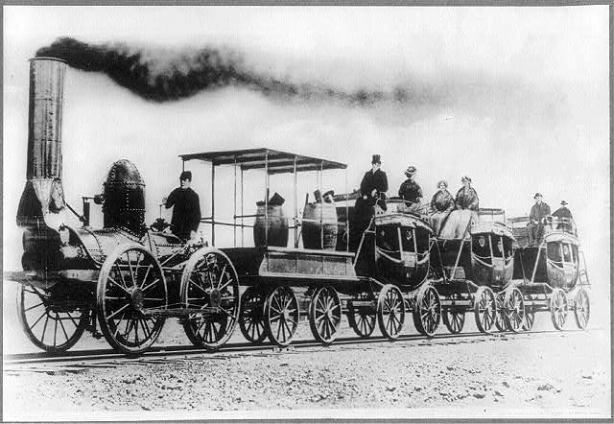

Modernization

Slide 35
Modernization, Development Theory, and its Critics
A. Agraria vs. Industria

Slide 36
Development: The Modernization Definition
      Agraria
Attitudes: parochial – fixed rules
Customs: particularistic / inherited
Status: ascriptive
Functionally: diffuse
Holistic Change
Lack of Specialized Roles
Result
Agricultural, rural, poor
Oral / illiterate
Authoritarian instability
Subsistence – non-monetary
Revolution and violence
Occupation fixed
  Industria
Universalistic
Legal / Rational
Achievement Oriented
Roles Functionally Specific
High Degree of Technology
Manufacturing and Production
Oriented
Result
Commercial
Democratic / Peaceful
Occupational mobility
Literate
Urban, Rich
Incrementalism, Stability and Gradual Change

Slide 37
Beginnings of Development Theory- 1950s
There existed…Many terms
Division of the world in the 1950s and after
    Non-Western Colonial Dichotomy
    Third World—West, East and "Non-West"
    Developing States and Modernization
    North vs. South states
    More Developed vs. Lesser Developed Countries—LDCs
    Keynesianism

Slide 38
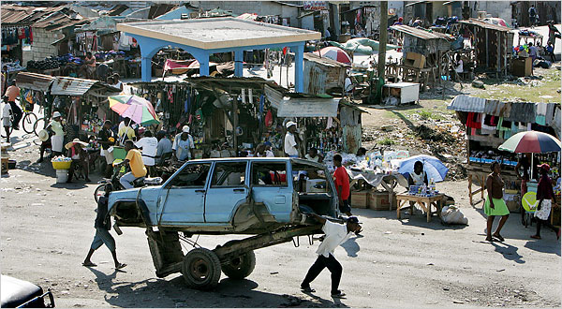
C. Concept of Modernization, Continued
  Haiti: City Image
  Dual Society / Dual Economy: Characteristics:
    Tradition is source of poverty and underdevelopment
    Modernization assumes dual economy with an enclave modern sector

Slide 39
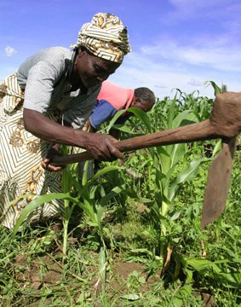
Concept of Modernization, Continued
Characteristics:
  Concept of Empathy
    putting oneself in the position of others, according to Daniel Lerner in The Passing of Traditional Society
    Mobile personality or acceptance of new ideas
    Series of individual changes affect society, including secularism, literacy, and urbanization
    Society changed by mass based communications

Slide 40
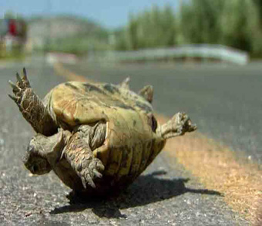
Empathy?

Slide 41
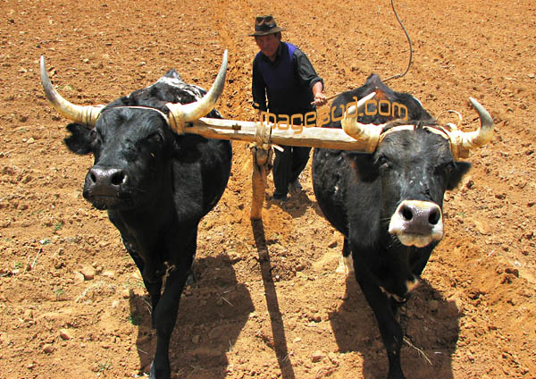
Modernization, Continued
    Movement from traditional to modern (and rural to urban) in all societies
    The “West” has distinguishing characteristics which distinguish it from Third World
    Result is an assumption of Dichotomy
    (references include writing by Talcott Parsons, Marian Levy, Frank Sutton and in modified form Fred Riggs)

Slide 42
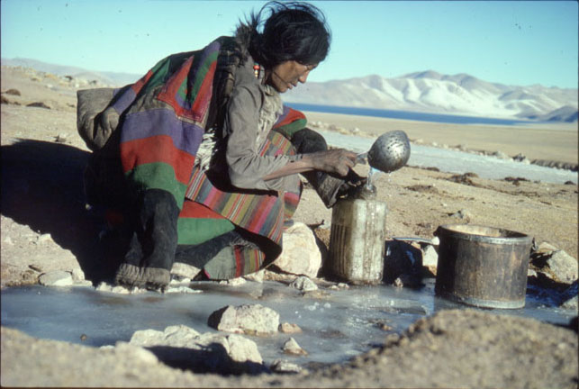
Concept of Modernization
Characteristics:
  Social Mobilization (focus on value change)
    Defined the process in which old social, economic and psychological commitments are “shaken off”
    Social mobilization, and for some, forced value change was the key to modernization
    Social Engineering

Slide 43
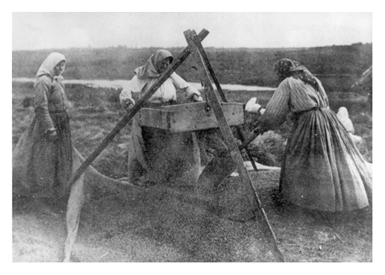
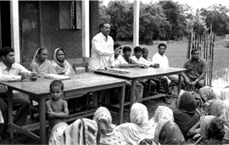
Social Mobilization- Continued
    Advocates call for use of the mobilizing party for social engineering purposes (Sometimes Forced)
    Goal became the use of the state to break down personal (organic) values and integrate modern values into a common political and socio-economic change system

Slide 44

AUTHOR OF THE DAY
Kathleen Staudt: Author, Professor of Political Science, University of Texas at El Paso
  Peace Corps Volunteer in the Philippines (1966-1968) Researcher in Kenya- 1970s. Current focus, Mexico and U.S. Border issues
  Raised Questions- Is there a grass-roots perspective? Role of Gender?
  Why or Why not?

Slide 45

Staudt in Botswana, 1975

Slide 46
Gender and Development: Modernization vs. Traditionalism
Sue Ellen M. Charlton
  Is gender discrimination a product of colonialism or traditionalism?
  Is Gender different in developing societies?
  How are women under counted?
  Is it a gender issue or a women’s issue?

Slide 47
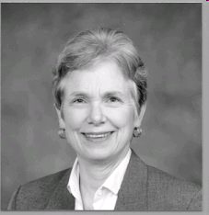
Sue Ellen M. Charlton

Slide 48
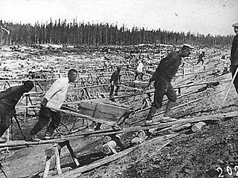
The Impact and End of the the Cold War
Dates: 1948-1991
Impact of Soviet Union on the Development Debate
Heavy Industrialization

Slide 49
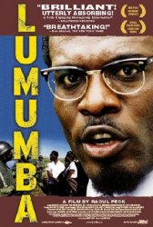
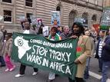
The Cold War
Proxy Wars
New and Old

Slide 50
There Existed…The World Between 1950 and 1989
North America, Antipodes, Western Europe and Japan (First World)
The self-described socialist states—Eastern Europe, Soviet Union, China, most of South East Asia and Cuba (Second World)
Africa, most of Asia, Latin America, Middle East and Caribbean (Third World)

Slide 51
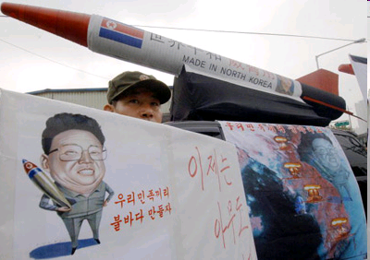
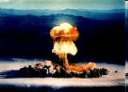
The Arms Race

Slide 52
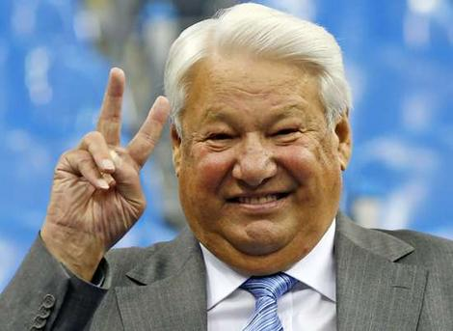
The Development Period
  Begins with Arms Race of 1950s and ends with civil society and the collapse of the Soviet Union (1991)
  Out of this comes the Transitional states as part of the developing world.
  Ten Year Interregnum
  to September 11.
  Three “Ds”

Slide 53
The End of the Cold War: 1991-2001
An expansion of the “concept” of developing and transitional states
  Were also called “Newly Industrializing” or “Newly Emerging” or Transitional States
Impact of End of Socialism
  Eastern Europe, Balkans, Turkic and Asian States, Russia, Ukraine and Belarus
  Impact on “third world socialism” in Latin America, Africa and Asia

Slide 54
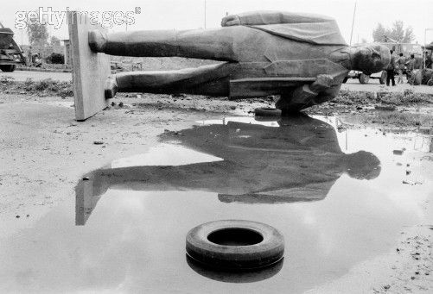
Ethiopia, 1991

Slide 55
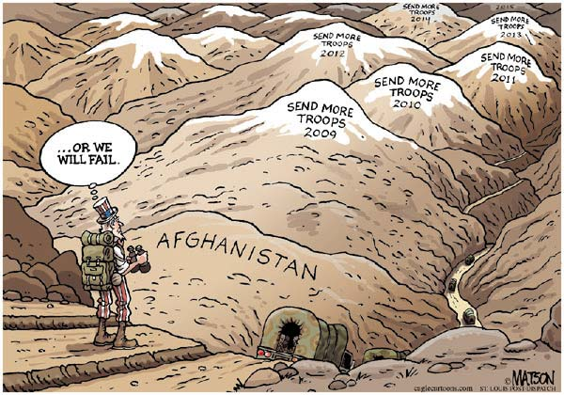
War in Afghanistan?

Slide 56
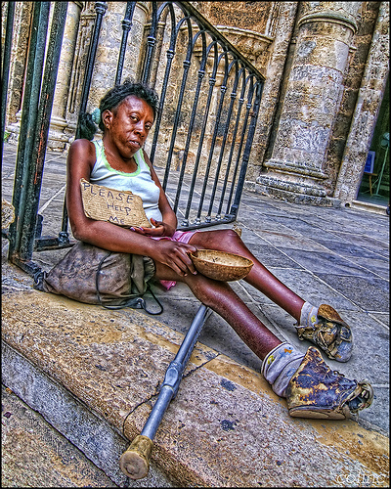
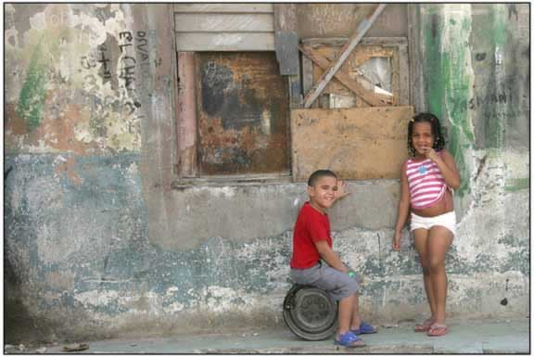
Poverty in Cuba
A Future in Tourism?

Slide 57
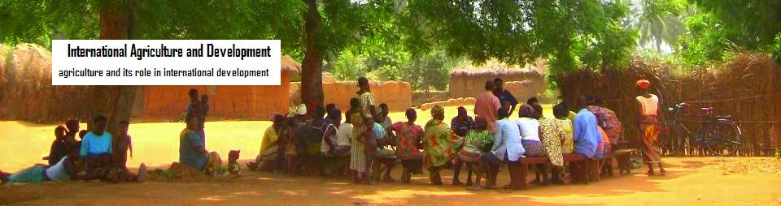
Development
Debates About Donors

Slide 58
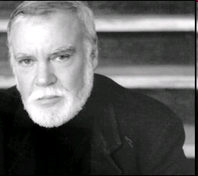
Author and Donor Critic
Norman Rush:
Whites
“Alone in Africa”
“Near Pala”
Rush is the Author of two other books on Botswana
Mating
Mortals

Slide 59
The U.S. Peace Corps
Are Peace Corps volunteers “Modernizers?”
Are they lick ants? Pests? Neo-colonialists?
Are Peace Corps volunteers and other development workers like colonial agents?
Empathy and the foreign worker?
Norman and Elsa Rush—Co-Directors of the U.S. Peace Corps in Botswana from 1978 to 1983

Slide 60
The Dead Aid Debate
So Called “Neo-Colonialism”

Slide 61
Foreign Aid as a Reality?

Slide 62
Foreign Aid Peaked in the Bush Years

Slide 63
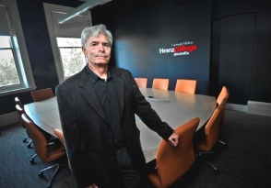
Picard and Buss
Terry Buss, Professor of International Development at Carnegie Mellon University, Adelade, Australia
Foreign Aid As Neo-C0lonialism?

Slide 64
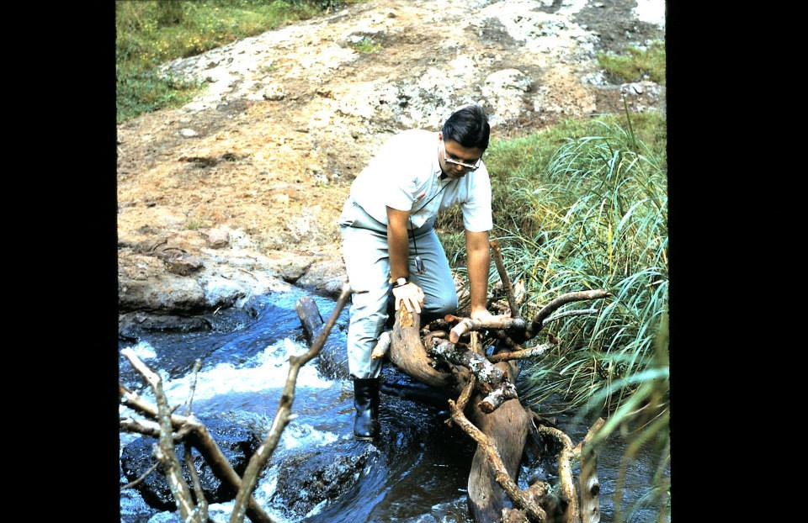
Picard and Buss
The Other Author in Uganda 1966
Not a Wise Move

Slide 65
Questions and Discussion?
On a Hopeful Note: Nicholas Kristof and Sheryl WuDunn

Slide 66
Political Development: The Importance of Satire? Video
5. The Focus on Governance

Slide 67
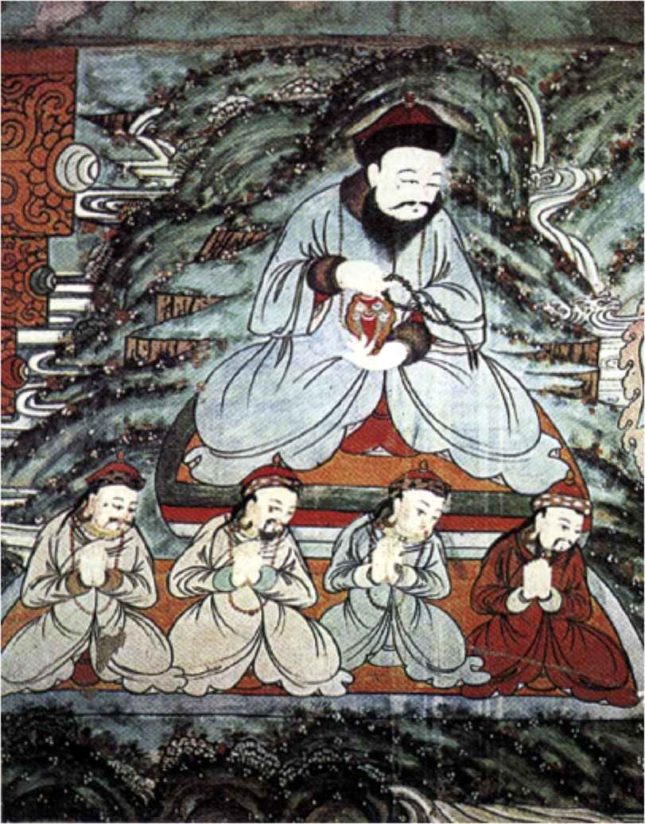
Patronage in Mongolia

Slide 68
Democracy and Governance
    Model became western parliamentary (representative), the rule of law and political systems based on democracy and Governance Principles
    At issue: Which comes first, political or economic development?
    Role of Civil Society- Pluralism

Slide 69
Part of Concept of Modernization
Political Development
Two Themes- Monte Palmer
The Governance Perspective
  Political Development is a prerequisite to social and economic development
  Traditional society and modern society is a dichotomy

Slide 70
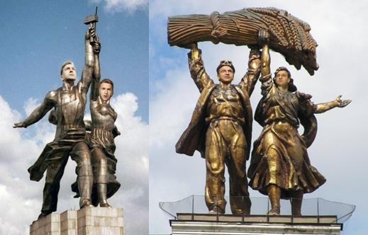
Concept of Modernization- Political Development
Governance Argument (political development as key)
Characteristics: Democracy and Governance vs. Bureaucracy
    Bureaucratic Class (according to Manfred Halpern) are “modernizers” since only bureaucracy can penetrate rural areas
    What is needed is a coalition between government leaders, the bureaucracy and industry (John Kautsky)
Russian State Heroes- 2007

Slide 71
The Problems of Development Management
Quote of the Week:
"...political systems in the developing areas must bear increasing responsibility for mobilizing the state's human and material resources in support of the objectives of economic and social mobilization."
  Monte Palmer

Slide 72
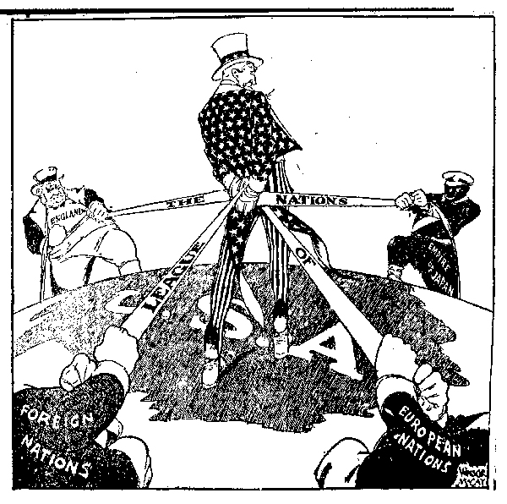
Debates: An Isolationist Cartoon, 1930s
6. Critiques of Modernization

Slide 73
Critiques of Modernization Theory- 1
Interpretations of Pre-Colonial Society
  The heart of the matter: Pre-colonial and pre-modern society is characterized by violence, poverty and "Primitivism”
    Modernization theory is based on this assumption (Joseph Conrad, Heart of Darkness Image)
  The ecological approach and dependency theorists reject this
    At issue is the idea of “balance”
    Individuals and social groups were in balance with their physical environment

Slide 74
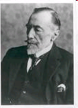
Joseph Conrad

Slide 75
Critiques of Modernization- 2
Ecological View: Characteristics
  People lived in "Primitive" communism and were hunter/gatherers
  Subsistence farmers, grew grains and forged metals- They were in balance with environment
  “Praxis” allowed individuals to control their interaction with nature

Slide 76
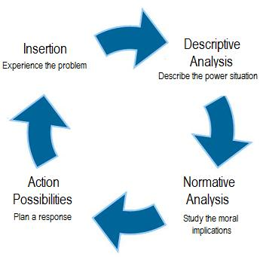
System in Balance

Slide 77
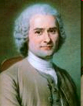
Ecological View
  Direct creative activity was used to procure food and shelter, through the use of own tools. Natural Life
  This was the Rousseauian Natural “Man.”
  Jean-Jacques Rousseau
  (28 June 1712 – 2 July 1778)

Slide 78
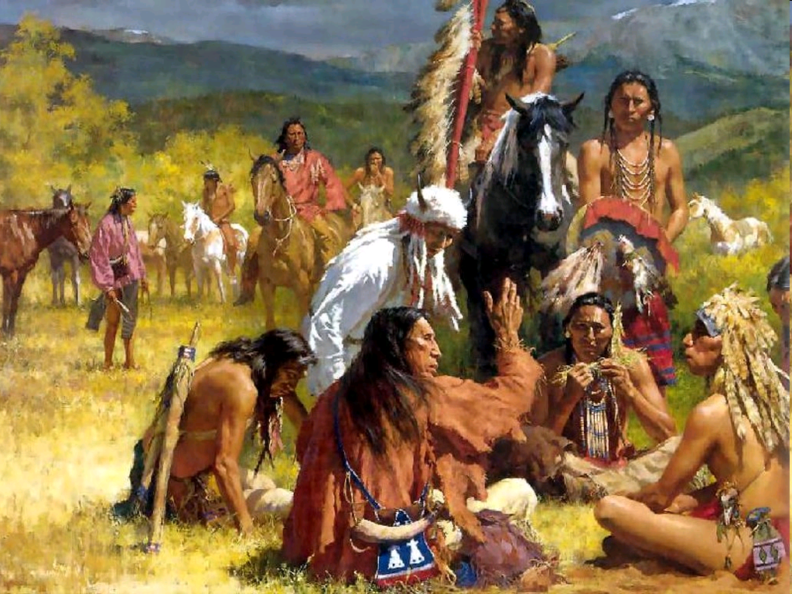
The Ideal?

Slide 79
Ecological View
  Change came with the development of excessive surplus, imbalanced trade, the creation of elites, domestic rule and then international empires.
      Rome, China, and the land based Empires in Europe ending with Sea-Based Empires

Slide 80

A Natural Balance?

Slide 81
Critiques of Modernization Theory-3
Colonial Underdevelopment Argument: The Psychological Dimension
    Focus of the debate—resistance vs. collaboration and its impact upon post-colonial society
    Colonizer has an inferiority complex (Minnoni)
    Colonial vs. colonized: (Memmi) colonized peoples have a dependency relationship with the West. It is based on the colonizer’s search for economic gain
    Revolution as a cleansing process (Franz Fanon)

Slide 82
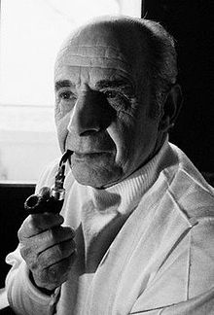
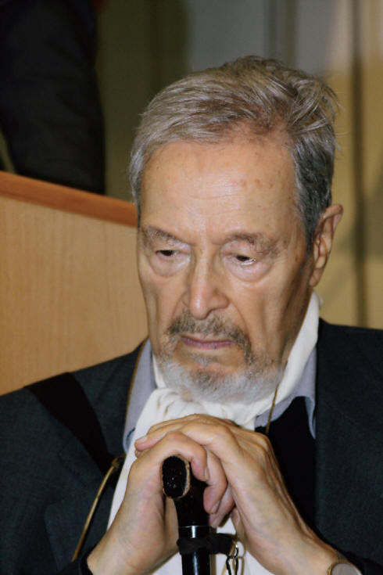
Octave Mannoni and Albert Memmi

Slide 83
Prospero vs. Caliban
Prospero—In exile, isolated and inferior
Caliban—Dependence and the Fear of Abandonment
Further Reading:
    Franz Fanon, Wretched of the Earth (New York: Grove Press, 1963).
    O. Mannoni, Prospero and Caliban: The Psychology of Colonization (New York: Praeger, 1964)
    Albert Memmi, The Colonizer and the Colonized (New York: Orion Press, 1965)

Slide 84
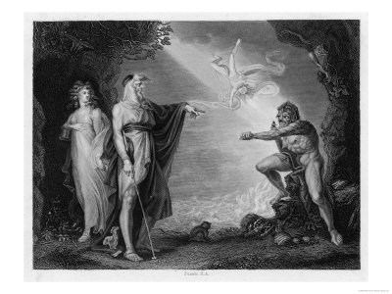
CALIBAN
The Half Human Offspring of the Devil and a Witch who is a Servant of Prospero
in “The Tempest”

Slide 85

Critiques of Modernization Theory
Colonial Underdevelopment Argument
  Seeds of Violence and
  Cognitive Dissonance
Role conflict (Robert Merton)
    Indirect rule vs. assimilation
    Role set (conflict between
    colonial officials and Religious
    or traditional leaders)

Slide 86

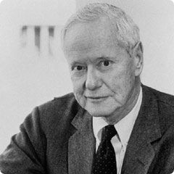
Robert Merton and Cognitive Dissonance

Slide 87

Critiques of Modernization Theory
Colonial Underdevelopment Argument
  Traditionalism: Dichotomy or misplaced polarity (Gusfield)
    Co-existence in Saudi Arabia and Japan
    Modernization of Tradition in Swaziland
    Secularization of tradition in Mexico

Slide 88
Critiques of Modernization Theory
Interpretations of Underdevelopment and “Third Worldism”
  Underdevelopment theorists critiqued Modernization Theory:
  Modernization theory had its origins in Colonial ideology and the anthropological ideas that supported it.

Slide 89

Interview Robert Chambers Research Associate at the Institute of Development Studies, University of Sussex, United Kingdom
He was born in 1932 and is an academic and development practitioner
Equity not Growth
Advocate of the
“participatory“
approach to
development

Slide 90
7. Underdevelopment and Dependency
Structuralism
Biology in the Tropics
Inelasticity of Tropical Products
Rigidity of Extractive goods

Slide 91
“Underdevelopment in History”
  Rejects Dualism and “stage theories” of development (Keith Griffin)
  Africa, Asia, Latin America not historically under-developed
  European nations took slaves, metals and raw materials to build industrialization and grow their economies between 1500 and 1900
  Empty Bucket- Full Bucket

Slide 92
Dependency Theory
and the beginnings of Dependency theory
Structuralism and
Interpretations of Underdevelopment and “Third Worldism”
  In the beginning (1500) LDCs were self-sufficient at low level
  Argument: Europe used its empire to market surplus goods and pay sub-economic costs for raw materials, agricultural products and minerals
  Issue: Inelasticity (tropicalism vs. “underdevelopment”)

Slide 93

FINAL CRITIQUE: Development Tourism?

Slide 94
Dependency Theory
  During 500 Years of colonialism Northern Tier states used colonialism to extract from LDCs
      Result often was the destruction of local production, agriculture and food production
  The colonial government supported export import trade and where possible, SETTLERS
  Europe became dependent on extraction from the “third world”

Slide 95

Dependency Theory VIDEO
Debates
About Chile
Dependency
Theory and Neo-
Orthodoxy
“The Chicago
Boys”

Slide 96

NEXT WEEK
THE LIMITS OF DEVELOPMENT MANAGEMENT: The Bureaucracy and the Post-Colonial State
Structural Adjustment
and “The Chicago Boys”

