Slide 1
PIA 2574 Resource Guide and Syllabus AFRICAN DEVELOPMENT SEMINAR: Conflict, Governance and Development
Overview

Slide 2
The Bottom Line
Introduction of the Group- background, interests- Future?
Discussion of syllabus.

Slide 3
Reading: The Bottom Line- Syllabus and Resource Guide are the Keys
1. Read Weekly Assignments
2. Prepare short third person biography and participate in discussion. Prepare one question or discussion point each week.
3. Write a Regional Policy Research Paper
4. There will be a final take home exam.

Slide 4
Research Assignment
Written Assignment
Research Paper Oral Presentation and Papers: Each member of the class will make a formal group presentation to the class and prepare a well written research paper (20-25 page limit) which will be turned in at the end of the semester. The assignment will be established according to your region of interest (30%).

Slide 5
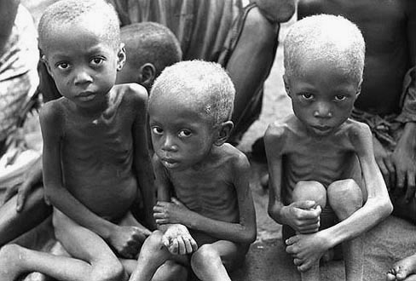
The Key to Debate?

Slide 6
The Bottom Line
Poverty, Human Security and Conflict are part of the Issue
Art, Social Cohesion and Creativity are also important.
Most People in Africa’s 54 states work, love, play and communicate (the continent of the ubiquitous cell phone).
The Important role of “Hybridity.”

Slide 7
The Goal? An African Middle Class Family in Lusaka, Zambia

Slide 8
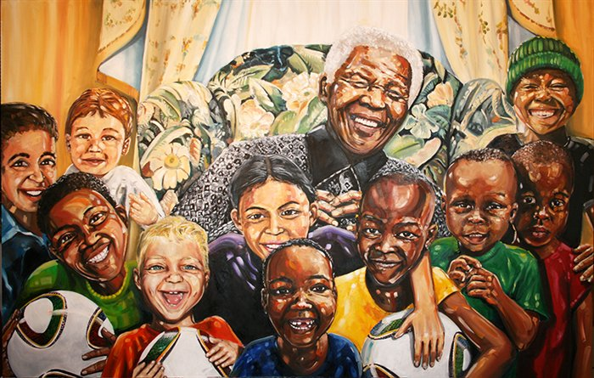
People, History and Culture
The Rainbow Nation Myth

Slide 9
Questions?

Slide 10
Introduction and Overview of Discussion: Theories and Themes
An Overview of the Problem
Regional Failures
Geography
Natural Resources
People, History and Culture
Political Systems and Institutional Collapse
Donor Fatigue and Dependence

Slide 11
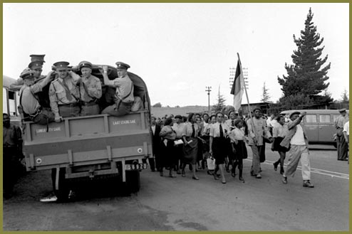
South Africa and Congo, 1940s

Slide 12
African Underdevelopment: Overview- “We Are the World”
In early 1983, observers began to pick up rumors that a tragedy of mass proportion was about to occur in the horn of Africa. One projection was that up to thirteen million people in the horn of Africa could starve to death.
Six months latter, drought and civil war led to mass starvation in which millions of people in Ethiopia, Eritrea, Sudan and Somalia died. A new era began in post-colonial Africa that continues until today.
Instead of social and economic development, journalists and academics focused on, war, collapsed states, humanitarian assistance, donor fatigue and structural adjustment.
That focus, for better or worse, continues today.

Slide 14
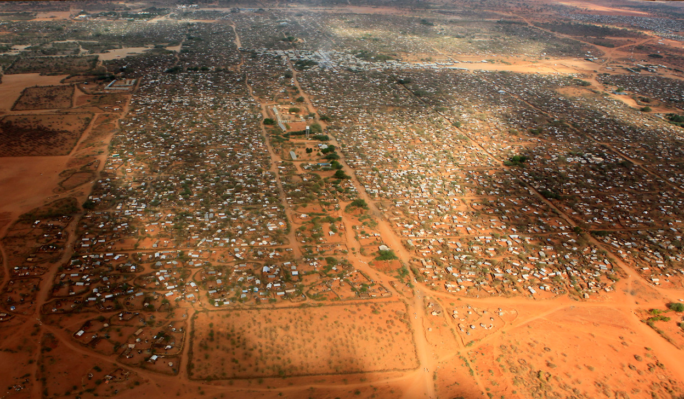
World’s Largest Refugee Camp, Dadaab, Kenya (500,000 people). Northern Uganda (1million) may now exceed it.

Slide 15
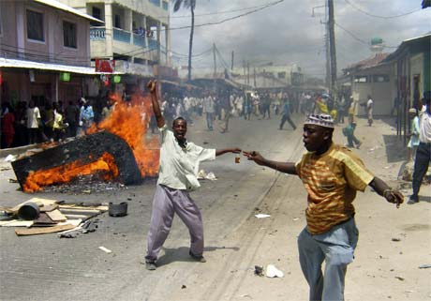
The Image

Slide 16
Africa and Poverty
The Question is Why?

Slide 17
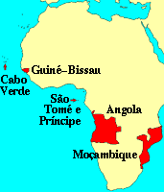
African Regions: The Language Issue
Francophone
Lusophone*
Horn of Africa
North Africa
Anglophone Africa
Southern Africa
South Africa

Slide 18
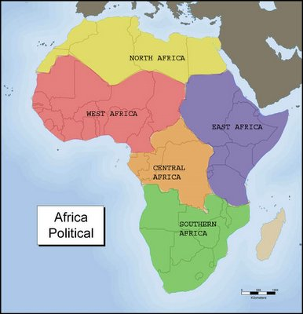
Fifty Four Countries?

Slide 19
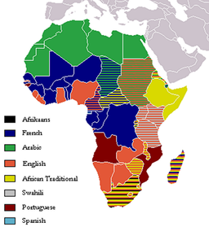
European and Trade Languages

Slide 20
DISCUSSION POINT:
The Failure of Regional
Integration in Africa
IS REGIONALISM THE
ALTERNATIVE TO GLOBALISM?

Slide 21
Regions and Integration: A brief Overview
An alternative future-Interlocking Regions-Combines Languages and Culture/History
Culture and Politics: Role of Language
1. North Africa- Arabic (Plus French and English)
2. Horn- Somali, Amharic, Tigrinya (Italian Legacy, inc. Libya)
3. Francophone and ECOWAS (The Problem of Anglophone West)

Slide 22
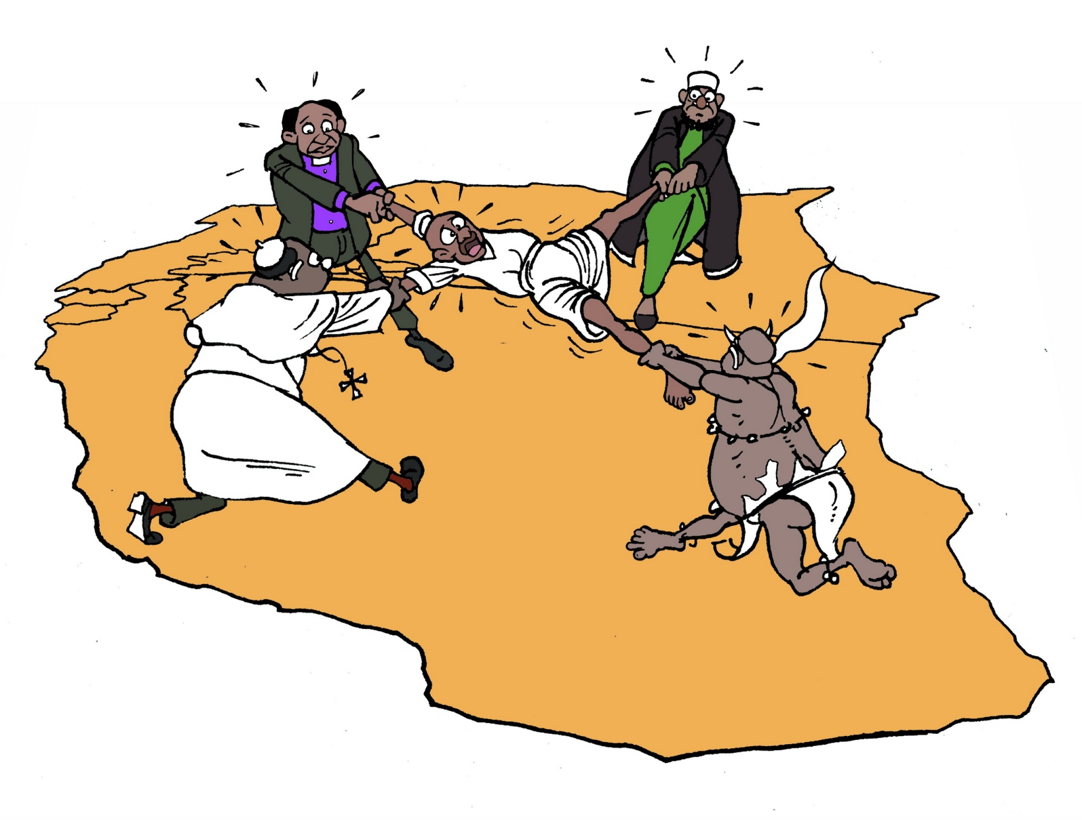
East African Regional Scenarios from Society for International Development (SID)

Slide 23
Regions and Integration:
4. SADC and Southern Africa: 15 countries. Alternative Free Trade Association of Eastern and Southern Africa. Lusophone vs. Anglophone (Special role: South Africa and Settlers)
5. The Great Lakes: Eastern and Central Africa as a style of governance: Uganda, Kenya, Tanzania, the Horn (Swahili)
6. Central Africa: Anarchy Zone? Former Zaire, Rwanda and Burundi

Slide 24
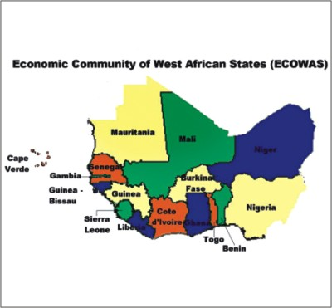
A Military Scenario sans Economics

Slide 25
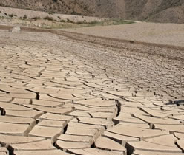
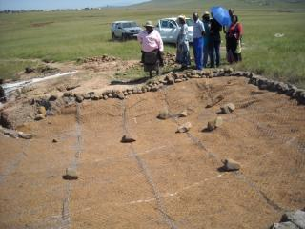
Geography
Tropical Soils
Desertification
Deforestation
Water Loss
Land Uses
Savannah vs. Rain Forrest

Slide 26
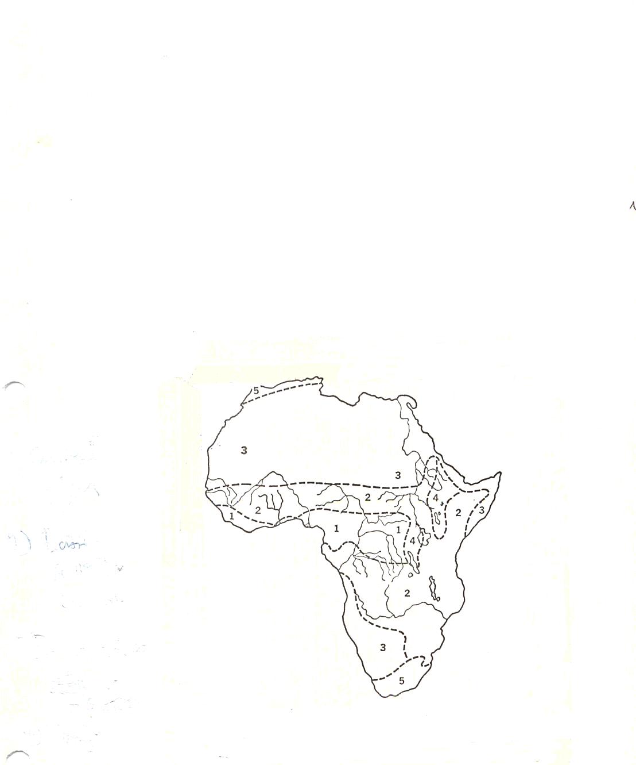
The African Continent

Slide 27
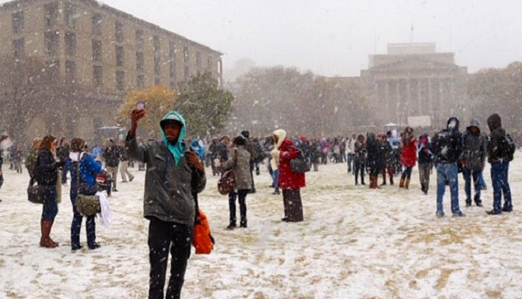
Johannesburg, August 7, 2012

Slide 28
San in Southern Africa

Slide 29
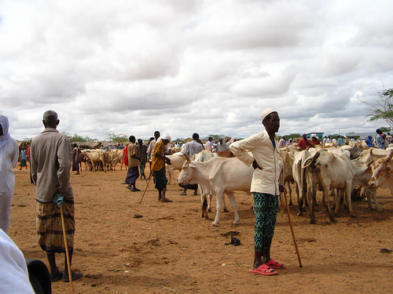
Somali Pastoralists in Northern Kenya

Slide 30
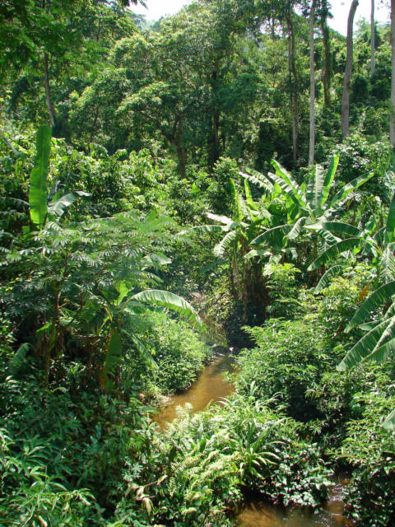
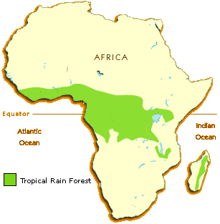
Most of Africa is not rainforest

Slide 31
Regional Features
Rift Valley and Lake Systems
Deserts: Sahara and Kalahari/Namib
River Systems:
Nile
Niger
Congo
Zambezi
Volta

Slide 32
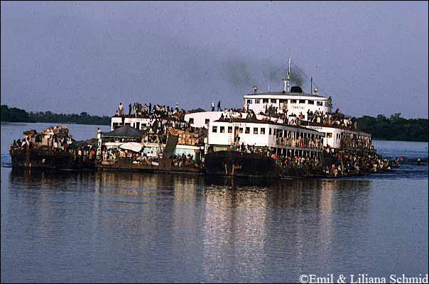
Congo River

Slide 33
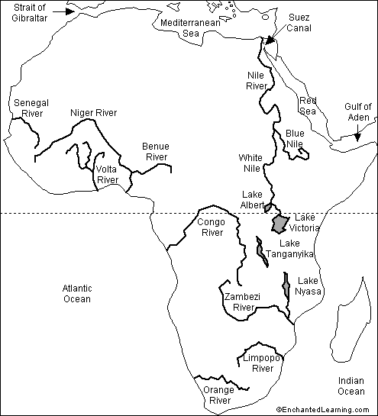
Big Rivers

Slide 34
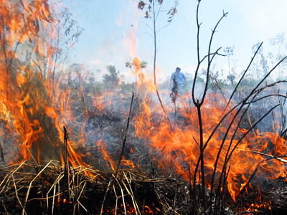
Patterns of Rain and Agriculture
Monsoon Tropical Rain
Alternating Wet and Dry
Deserts- Sahara, Namib, Kalahari
Shifting Agriculture
Slash and Burn
No Humus/regeneration of soil
Leaching: Nutrients and Minerals

Slide 35
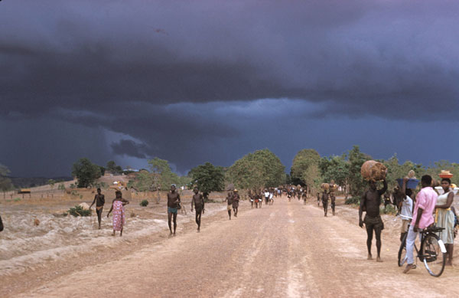

Slide 36
Natural Resources: The PROBLEM: Desertification
Overgrazing
The destruction of forests
Loss of Top Soil
Patterns of Cyclical Drought
Major Declines in Food Production

Slide 37
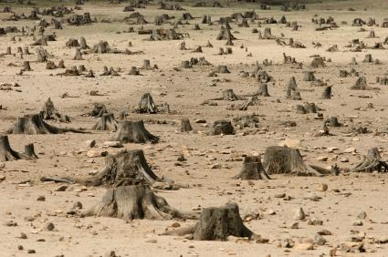
Deforestation

Slide 38
Africa: Climatic Regions
Tropical Rain Forest
Tropical Savanna and Summer Rain
Low Latitude Dry Climates
Undifferentiated Highlands
Mediterranean

Slide 39
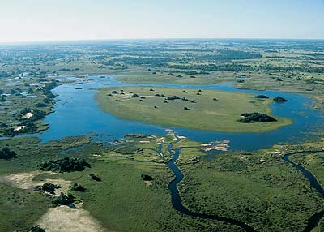
Okavango Delta

Slide 40
ISSUE: THE NATURE OF TROPICAL AGRICULTURE
Hunters and Gatherers (none or few)
Pastoralists
Subsistence Farming- roots, grain, Bananas
Cattle and Small Stock
Commercialization of Animal Husbandry and Agriculture
Land Use and Property Rights Issues

Slide 41
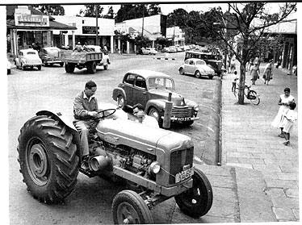
European Settlers: Eldoret Kenya, 1960- The Issue of Land

Slide 42
Natural Resource Curse: Elite Extraction and Corruption
Oil- Extraction and Short Term Benefits
Diamonds- Conflict and Blood Diamonds
Gold- Basis of Settler Wealth
Specialized metals: technology, phone and computers
Forests and natural resources
Wildlife

Slide 43
Reminder: Overview of Discussion: Theories and Themes
An Overview of the Problem
Regional Failures
Geography
Natural Resources
People, History and Culture
Institutional Collapse
Donor Fatigue and Dependence

Slide 44
HISTORY: Fragmentation, Dependence and Conflict
HISTORY AND POLITICAL DEVELOPMENT
THE NATURE OF THE PAST
THE IMPACT OF COLONIALISM AND NATIONALISM

Slide 45
Ten Minute Break

Slide 46
Brought to you by the “Baby Boomers” in 1985---
We Are The World
NAÏVE, DUMB OR?

Slide 47
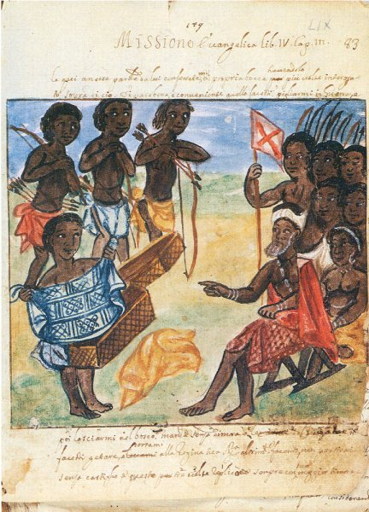
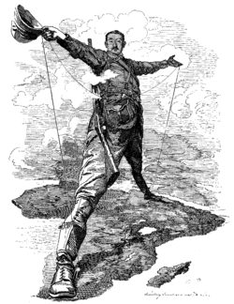
African History

Slide 48
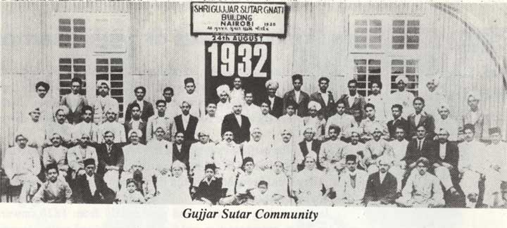
From the East

Slide 49
DISCUSSION POINTS: History
Did Things Fall Apart?
Did Europe Under-develop Africa?
Should the Settlers Go Home?
Was Colonialism in Africa Different?

Slide 51
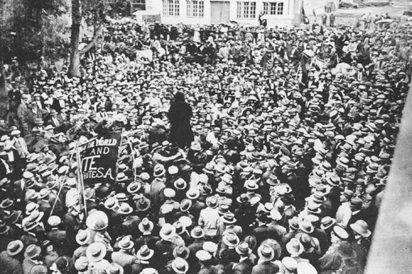
South African Strike, 1922
“ Workers of the world, unite and fight for a white South Africa!"

Slide 52
History and Political Development The Nature of The Past
Role of oral history
Isolation from North Africa/Europe
African Historical Migration
Nature of Political Organization- "state vs. Stateless" systems
Impact of Slavery
Oral tradition vs. Written Language
Lack of Political Organization?

Slide 53
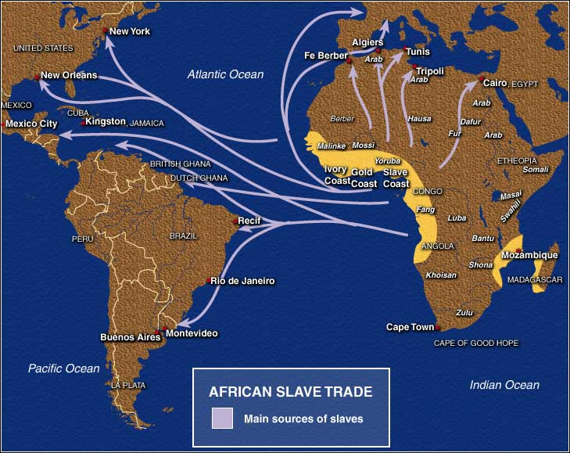
Pre-Colonial History: Atlantic and Sahara Slave Trade

Slide 54
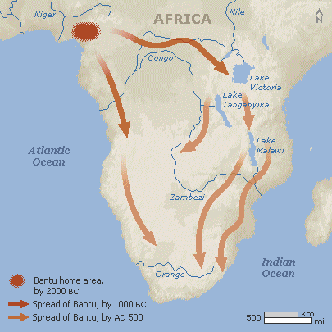
African Migration

Slide 55
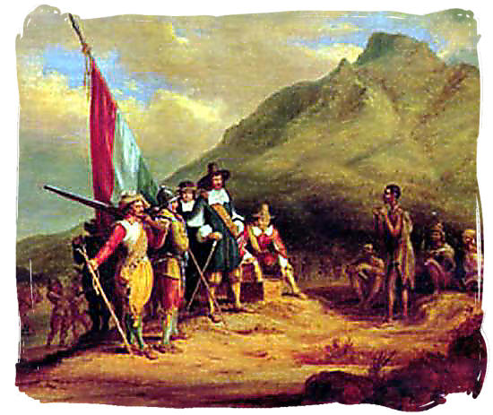
Jan van Riebeeck and Bantu Arrival Debate

Slide 56
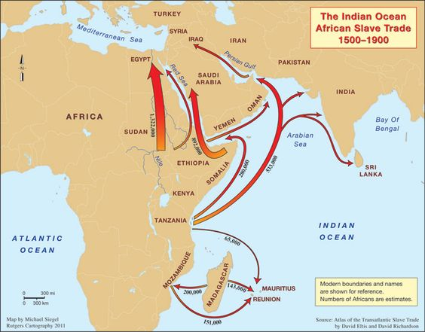
Indian Ocean and Red Sea Slave Trade

Slide 57
Pre-Colonial Polities- Principles
State vs. Stateless Systems
Not a dichotomy but a Continuum
Age Grade
Kinship
Lineage
Hierarchy/Bureaucratic (Weberian)
Hybrid Legacy

Slide 58
African Political Systems: The Problem of Institutional Collapse
Extended Family and Clan Systems: Hunter-Gatherers in Southern Africa and Somalia
Age Grade Systems- Ibo in Nigeria, Luo in East Africa and Kikuyu in Kenya
Kingdoms (State Systems)- Ethiopia, Yoruba, Buganda, Zululand and Swaziland

Slide 59
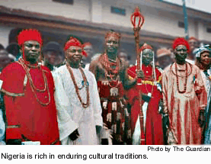
Age Grade Systems: circa seven years apart (A Generic Example)
Children
Youths
Circumcised Young Men
Warriors
Governors
Elders
Governing Age Grade

Slide 60
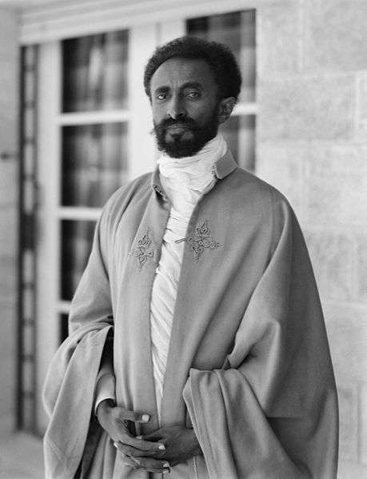
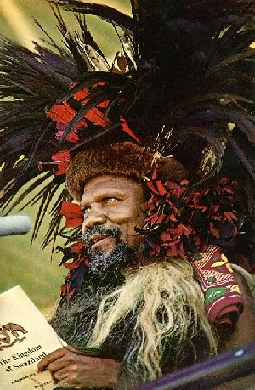
Haile Selassie of Ethiopia and Sobuza II of Swaziland

Slide 61
Pre-Colonial History: The Issue of Iron
Iron Age Sites
Meroe: 550 BC
Egypt: 600 BC
Carthage: 840 BC
Nok Culture (Nigeria): 200 B.C.
Axum and Ethiopia: 25 AD
Zimbabwe: 200 AD
Tzaneen (South Africa): 500 AD

Slide 62
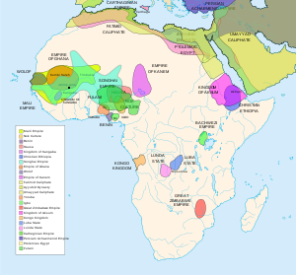
Iron Age Kingdoms

Slide 63
African Migration-Theories
Movement From Northeast to South West
The Bantu Heartland idea
Indigenous Occupants: Pygmy, San, Khoisian, Nama
The Issue of so called “Mixed Race People”
Issue of Arrival in West and South Africa -1600 and 1653
Myth of Arrival: 1653
The importance of Carbon Dating

Slide 64
Western Africa Pre-Colonial Systems: Images and Myths?
Ghana- 300-1100 AD:
Trans-Saharan Trade (Gold For Salt)
Feudal Structures
Slave Trade to Middle East
Mali- 1200-1400 (Timbuktu)
Islamic Invasion
Hierarchical
Part of Middle East and Islamic Cultural Patterns

Slide 65
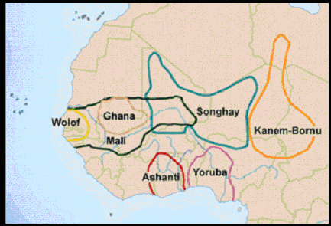
West African Kingdoms

Slide 66
Western Africa: Historical Kingdoms
Songrai/Songhay- 1400-1700
Money: Gold and Cowries
Laws and Hierarchical Administration
Islamic Education
Shift to Coastal Trade and Slavery 1600

Slide 67
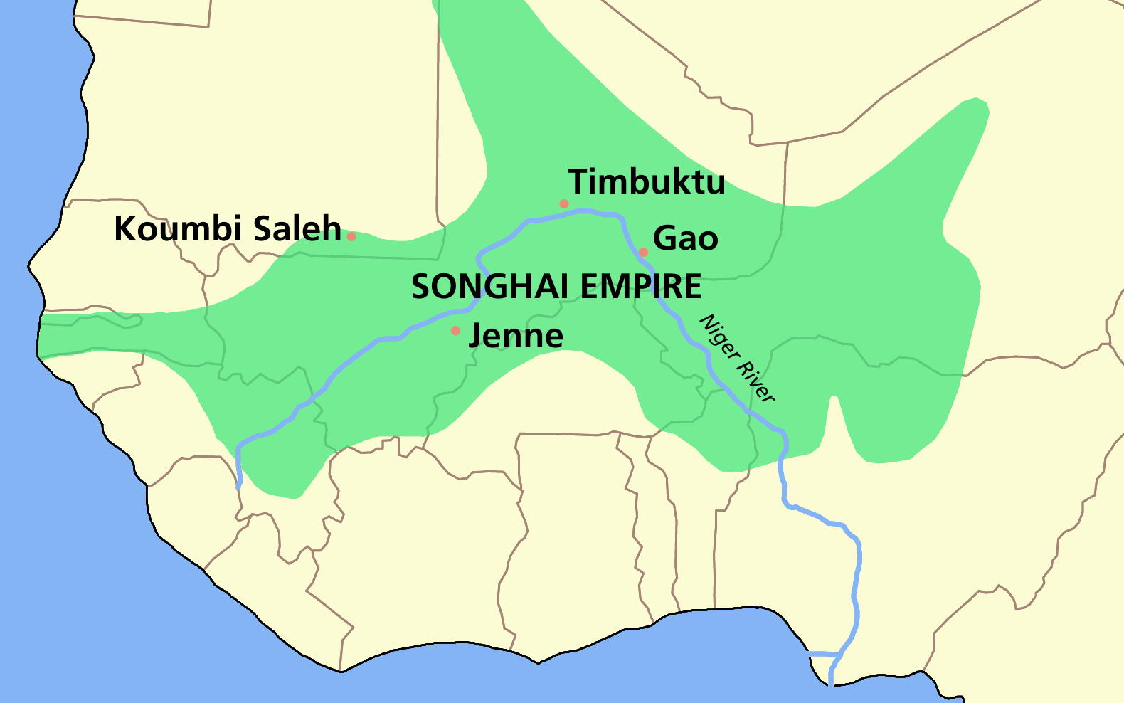

Slide 68
Western Africa
Hausa, Mossi, Borno
Islamic Empires: Invasion, Establishment and Puritanism
Futa Jalon and Usman dan Fodio, 1804
Identity of Arab, Berber and African

Slide 69
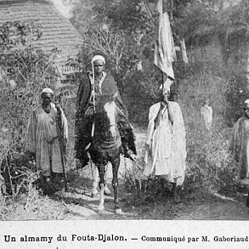
Futa Jalon

Slide 70
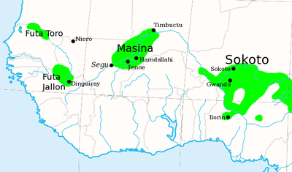
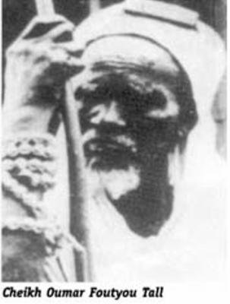
Kingdom of Fouta Djallon , 1776-1896, Islamic Empire
Cheikh Oumar Foutou Tall,1796-1864

Slide 71
Eastern and Southern Africa
Khoisian 200 BC-1600
Bunyoro from 1300
Buganda from 1500-1800
Mwonomotopa1500-1800
Luba/Lunda 1500-1800
Zulu Empire and Dissolusion 1700-1850
Portugal 1600-1975
Afrikaners 1652-1994

Slide 72
State Survival: Moshoeshoe I, King of the Basotho, 1796-1870

Slide 73
1907- Winston Churchill with King Daudi Chwa II of Buganda in Kampala

Slide 74
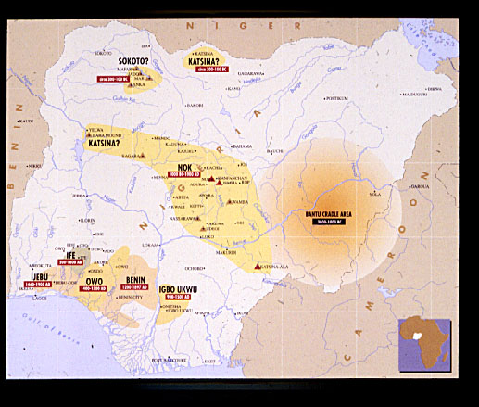
Nigerian Kingdoms

Slide 75
The Institution of Slavery
Roman, Middle Eastern and African Slavery
African Kingdoms, trade and slavery
Chattel Slavery and the Overseas Trade

Slide 76
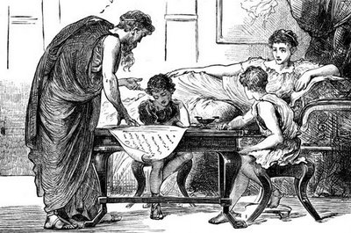
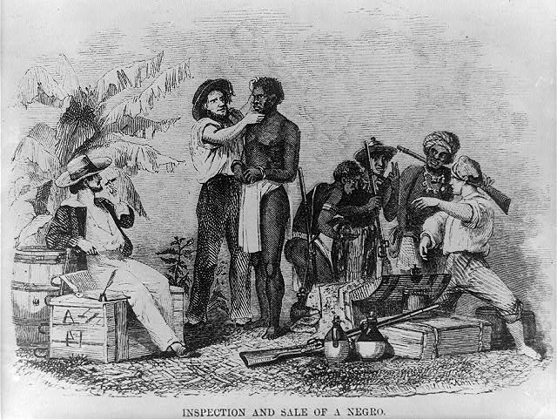
Slavery: Teacher vs. Chattel

Slide 77
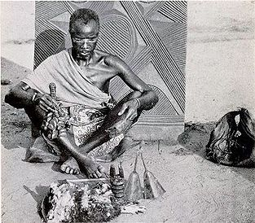
The Issue of religion
Indigenous
Christianity
Syncretistic
Islam

Slide 78
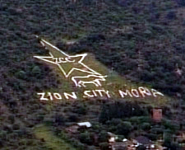
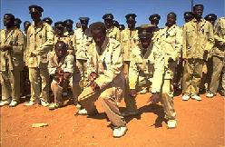
Syncretistic Religion
Zion Christian Church

Slide 79
The Influence of Islam
Middle Eastern and Asian influences:
Indians and Syrians
Land based trade- Still little understood
Puritanism and Revival in the nineteenth century
Extremism: Boko Haram and Al-Qaeida (AKIM) 20th century
Competition with Christianity: (Catholic, Protestant and Pentecostalism

Slide 80
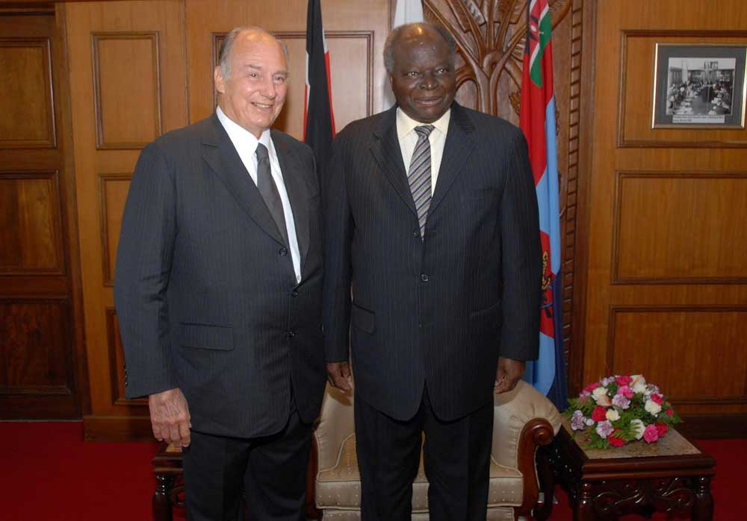
Aga Khan Visits Kenya (with President Mwai Kibaki)

Slide 81
Africa in the Nineteenth Century Major Events
The Moslem Invasions of the Western Sudan and the East African Coast- 1800-1840
The Replacement of the Slave Trade with trade in cash crops (palm oil, cocoa, peanuts, and cocoa and minerals (gold, diamonds, coal, copper, etc.)- 1820-1900
The Replacement of informal Spheres of Influence with formal partition of the continent and the establishment of Imperial Rule, 1870-1890
Boer vs. Britain vs. Bantu in Southern Africa
Foretelling of Islamic Fundamentalism in 20th Century?

Slide 82
Battle of Blood River, 1868

Slide 83
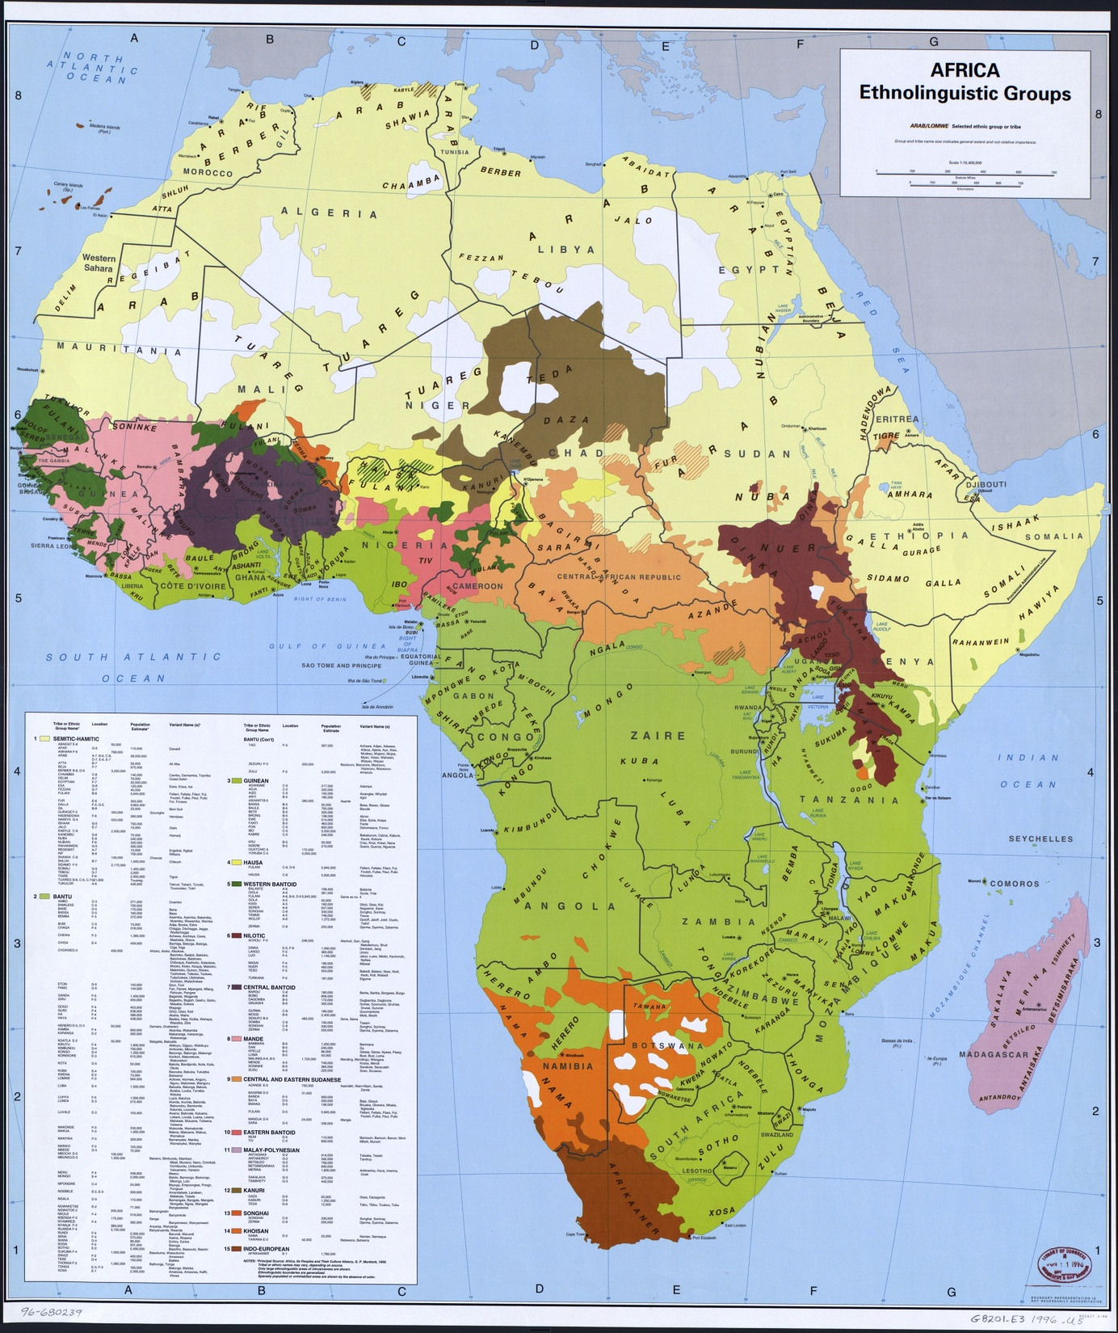

Slide 84
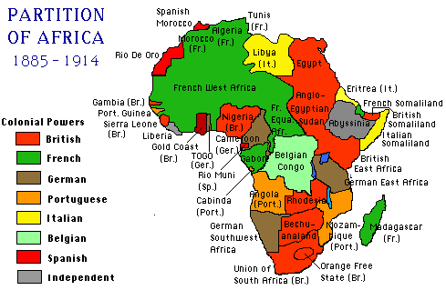

Slide 85
Anglo-Boer War: Siege of Mafeking

Slide 86
Preview: Institutional Collapse: Donors, Theories of State Failure and the rise of Sub-national Violent Political Groups
Ethnic Identity, Culture/religious Clash and Violent conflict
Authoritarianism: One Party Systems and Military Regimes
Over-expansion of state’s economic management function
Violation of social contract with middle class
Elite Predation- corruption and diversion of public resources
Aid dependence and externalization of public sector management
Debate over Islamic Fundamentalist Groups
Donors and Donor Fatigue

Slide 87
Kenya, 2007-2008

Slide 88
Discussion
“Do Things Fall Apart in Africa After 1870?” Why or Why Not?

Slide 89
NEXT WEEK
“Bula Matari came to represent [the] alien authority…”
Crawford Young
With Henry
Morton Stanley
On the Nile,
1874-77

Slide 90
Come Back Africa (1956)
VIDEO
http://www.youtube.com/watch?v=Buod66bq0cg

