Slide 1
Supplementary Slides
Pia 2501
Week Five

Slide 2
NIEO and the Brandt Report
Chair: Willy Brandt, former Chancellor of the Federal Republic of Germany
Common Crisis, North South: Cooperation for World Recovery
1980, 1983
Accepted (in theory) basic premises of Dependency Theory

Slide 3
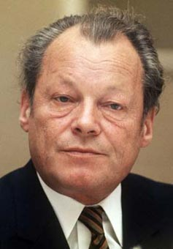
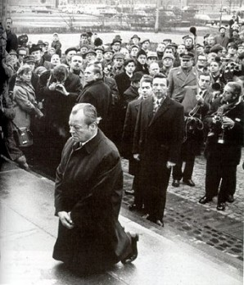
Willy Brandt (1972 and 1992)

Slide 4
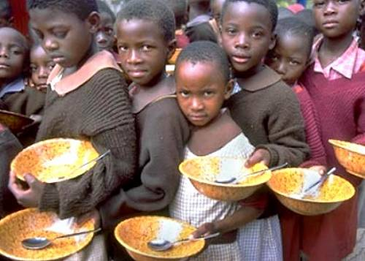
“A New International Economic Order is Deemed Necessary”

Slide 5
Basic Needs Assumptions: 1975-1983
Institutionalize Project capacity in development program structures (The works of
Dennis Rondinelli)
All civil service to explore new technologies and leadership styles
Promote Sustainability and Institutional Capacity
Shift Priorities to Rural Development
Small is Beautiful- appropriate technologies
A bit of Romanticism?

Slide 6
Assumptions of the NIEO States (Brandt Report)
Need for structural change in world economy
Thesis: Industrial Development in Europe caused underdevelopment in LDCs
Northern Tier States extract resources from LDCs
No low level equilibrium trap—regression to underdevelopment
Sources: Thomas B. Birnberg and Stephen A. Resnik, Colonial Development : an Econometric Study (New Haven : Yale
University Press, 1975)
See also the works of Susan George

Slide 7
Assumptions of the NIEO States (Brandt Report)
European involvement in LDCs was extractive and "created" underdevelopment
underdevelopment is a historical problem
16th century—Europe and World
Europe, 1600—technologically advanced but resource poor
Asia, Africa, Central and South America—resource "rich" and self-sufficient but technologically poor

Slide 8
Brandt Report
Imperialism from 1600 to 1900 led to resource transfer from LDCs to West
“FROZEN INEQUITY”

Slide 9
Assumptions of the NIEO States (Brandt Report)
Result in LDCs was decline in agricultural self-sufficiency and indigenous commercial and industrial activity
Was no dual economy—a world economy was created which the peasant economy deeply penetrated
Metropole
Sub-Metropole
Periphery
Sub-periphery

Slide 10
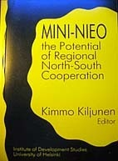
Assumptions of the NIEO States (Brandt Report)
LDC acts as a market for more Developed Countries (MDCs)—eg. Agriculture depends on Agri-business
Cooptation of Local Elites as consumers of LDC resources
Continues to Influence Thinking

Slide 11
Assumptions of the NIEO States: Redeux
The Goal: Need to moderate or eliminate dependency relationship through counter-dependency
Self-sufficiency—China in the 1950s
Dependency avoidance—Canada, Scandinavia and Japan in nineteenth century
Dependency reversal—India, Brazil (1970s)
Dependent Development—(Newly Industrializing Countries, NICs, Emerging States The BRICS)
Regional Cooperation—ASEAN, CIS, SADC, ECOWAS, MERCESOR

Slide 12
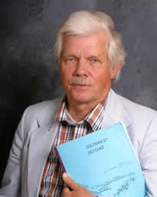
Donor Response Basic Needs Assumptions:
Jon R. Moris, Managing Induced Rural Development (Bloomington, Ind: International Development Institute, Indiana University, 1981).
Jon R. Moris and James Copestake, Qualitative Enquiry for Rural Development : a Review (London : Intermediate Technology Publications on behalf of the Overseas
Development Institute, 1993).
Professor of Agriculture at Utah State University,
Logan Utah

Slide 13
Internal Capacity Issues (Bryant & White)
Basic Needs Assumptions: Problem
Need for increased capacity of public, parastatal and private sectors
State should remain central to development planning and management
Need for administrative reform to develop more creative development structures

Slide 15
Internal Capacity Issues (Bryant & White)
Basic Needs Assumptions: Problem
Need for increased capacity of public, parastatal and private sectors
State should remain central to development planning and management
Need for administrative reform to develop more creative development structures

Slide 16
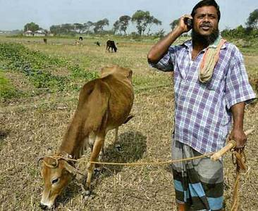
The Future of Development Management?

Slide 17
Internal Capacity Issues (Bryant & White)
Debates: the “Attitudes Problem”
How to get people to think developmentally?
Changes in programmatic values have an impact on LDC elites
Is working for the State different than working in the non-profit or private sector?

Slide 18
Internal Capacity Issues (Bryant & White)
Debates: the “Attitudes Problem”
Problem of the Organizational Bourgeoisie: Bureaucratic values unchanged from colonial period as domestic elites manipulate public policy (Picard)
Myth of civil service neutrality: Bureaucratic elites have interests
At best what results is benign neglect, at worst resource extraction

Slide 19
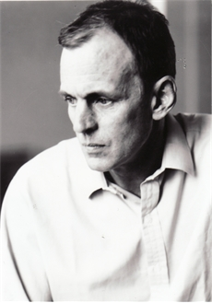
James Fox, White Mischief: The Murder of Lord Erroll, New York: Vintage Books, 1998. 1987 Film.
The Story of Happy Valley, Kenya.
Good Picture of Colonial Africa
James Fox

Slide 20
Book 1: White Mischief September 29
James Fox: British Journalist, Sunday Times (London)
Description: Amorality of Colonial Kenya
Issue: What does the book tell us about Colonialism

Slide 21
White Mischief in the 21st Century?
AN OUT TAKE

