Slide 1
Week 4: Political Development & Governance
ID Seminar 2016

Slide 2
Golden Oldies Summaries
Cesar Cedero & Jessi Hanson

Slide 3
Berger, Samuel. 'Pyramids of Sacrifice' pp 1-113, 1974
Myth of Growth (Capitalist Ideology)- The Western tradition- production increases with industry, so does individual freedom;
To modernize means to take control of the world and control of one's self through rationality (Weber), and through gaining control we can define our own destiny; today it is the United States and Western nations pushing the ideal of capitalism and democracy as a myth of change; industry should be privatized more than publicized
Policy makers "have rational interests to develop their countries", but the question is who is the policy makers
Yet this comes at a great human cost, as demonstrated by the vision of Cortez conquering Cholula which was done in the name of modernization and succession
All human can be cruel so we should not romanticize the oppressed as they may once have been the oppressor, but must understand the power dynamic of the myth and the cost of development, and enforcing change at the sacrifice of others
Question of who benefits from modernization- neocolonialist views demonstrate such as through Frank and Dependency Theory that the 3rd world in colonial times was plundered of its resources, and today, the 3rd world is still being drained of its exports to pay for industrialization of which produces profits that mostly further the interests of national elite and foreign rich
Democracy models assume that all participate in the political system yet concerns only the metropoles really benefit while the periphery does not as much

Slide 4
Berger, Samuel. 'Pyramids of Sacrifice' Cont'd
Myth of Revolution(Socialist Ideology)- Through revolution, the emotional promise, that the rising up the common man, and redistribution of power and prosperity will be shared
Often requires unofficial violence which is not a formal political program and often differs per context; through this force of the masses a great change will occur
Win 'heart of the people' through the myth of progress and revolution, yet there are the cost of human lives often through purges- revolutionary warfare and the new regime that takes hold in attaining power (77)
Soviet power myth also promotes industrial development but through profit and income distribution influenced by the publicized models controlled by the state, and this myth is embellished as Soviet Union has not likely advanced its industry that much as they are equal economically and in modernization as Italy in 1967
This myth does promote improved social systems, with more equitable distribution but at what cost?
Paulo Freire (Brasil)- education for promoting education for political action to expand political consciousness for actions to help the individual and the society is important; it is important to promote 'conscious raising' to help citizens see each other as 'we' and not 'they'
Berger- American sociologist; Dialectical Modernization Theorist?
Man's inhumanity to men

Slide 5
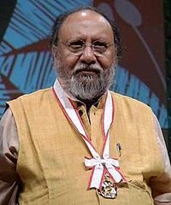
Nandy, Ashis. "Colonization of the Mind." 1994
Colonialism and neo-colonialism's ability to create secular hierarchies are incompatible with traditional order
The ancient form of human greed and violence will always affect political systems and attempts to modernize
The current trend of development is to create a homogenized technically controlled, absolute hierarchical world that pits modern verses primitive existence
Taking in consideration the culture of a people is important in defining their capacity in political and economic systems
Indian political psychologist, social theorist, and critic

Slide 6
Nandy, Ashis. "Colonization of the Mind." 1994 Continued
Using traditions that have existed for long periods of time (for example before colonialism) is a good resource to utilize and not to be pushed out when developing systems, which is what colonialists tried to do long ago
One technique that a dominant power may do in enforcing its control or assert its legitimacy is to push out the older 'traditional' order to replace it with their own
Colonialism was maybe an instrument for progress but new understandings of it have identified the importance of renovating and vitalizing political development through use of culture and tradition
(Example: Ghandi- let the country determine its own path while looking to good examples)

Slide 7
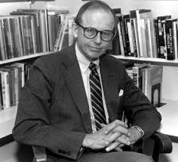
Samuel Huntington
Political scientist.
Harvard Ph.D. and he taught for half a century.
White House national security council policy coordinator.
In 68 he advocated for harsh conventional approaches to the Vietcong challenge in Vietnam.
He was denied twice admission into NAS

Slide 8
Political Order in Changing Societies
What causes disorder and stability in changing polities?
Rapid social change and the rapid mobilization of new groups into politics coupled with the slow development of political institutions.
Political stability is the result of the institutionalization of political systems and their level of political participation.
There are three patterns of political modernization: continental, British, and American.
These three patterns created different results in terms of rationalization of authority, functional specialization, structure differentiation.
He also argues that monarchies, the oldest of traditional political systems, are called to modernize to thwart revolutionary threats.

Slide 9
The Clash of Civilizations
At the micro level the most violent fault lines are between Islam and its Orthodox, Hindu, African, and Western Christian neighbors.
At the macro level, the dominant division is between the “the West and the Rest”.
Increasing interest in nuclear weapons by the rest of the world has made the West interested in non-proliferation.
In terms of democracy and human rights, the West's agenda for here has clashed rejection of rest of the world.
Immigration has seen the most ambiguous position in the West while the immigration wave increases from the rest of the world.
In a world with constant Muslim demographic growth and ascendant Asian power, conflicts between the west and challenging civilizations will be more central to global politics than other lines of cleavage

Slide 10
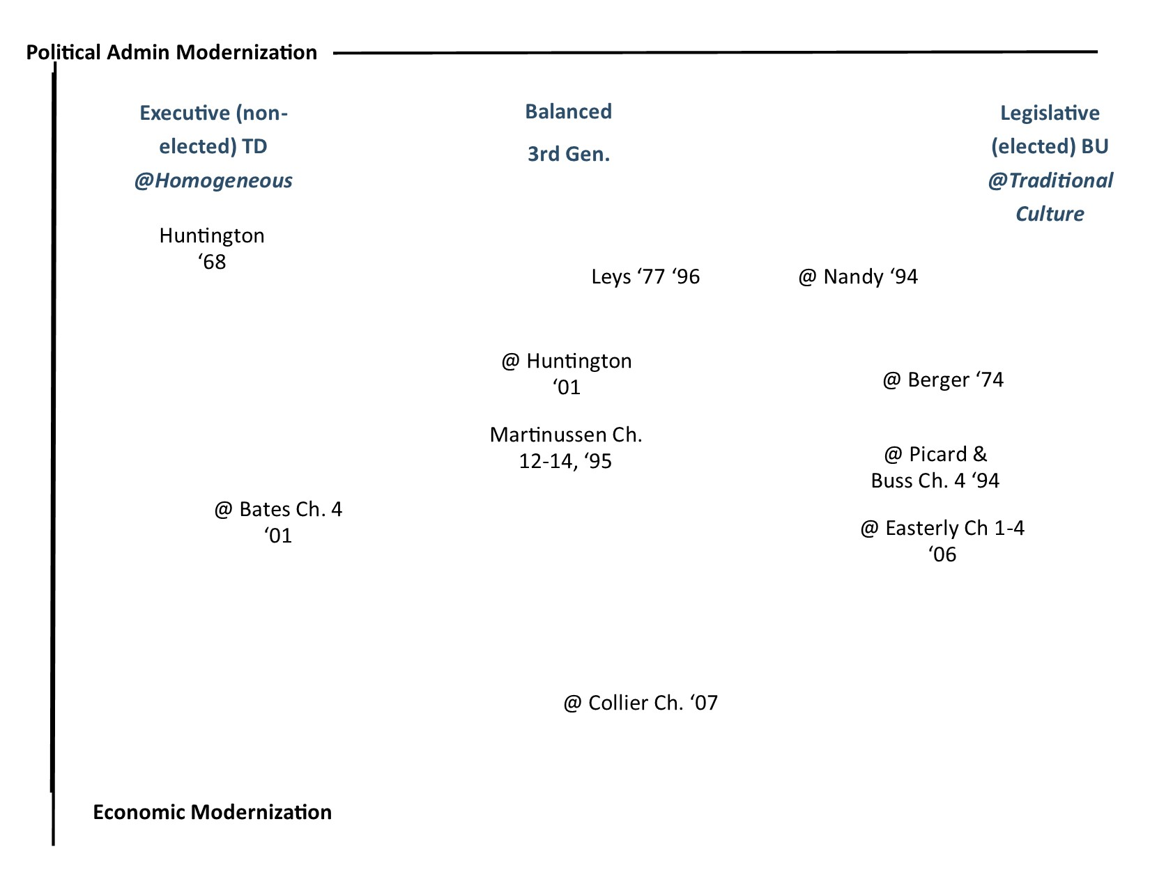

Slide 11
Major Themes
Political Modernization: can you achieve it through traditional system or you have to go through westernization?
Balance of power: between executive structure and legislative structure; it is equal important for different political regimes
Debunking development: what is development based on different perspectives?
The impact of foreign aid: governments need to please donors or bargain with their citizens

