Slide 1
PIA 2567: Technical Assistance and Program Design
Grants and Contracts

Slide 2
The Private Sector and Non-Profits
Possibilities and Limitations

Slide 4
Privatization: In the U.S. and the World
Definition:
The process of divesting direct civil service responsibility for the provision of public services or the collection of revenues
Focus here on the World View in the 1980s as defined by the U.S.

Slide 5
Privatization: Grants and Contracts
The Key to Understanding Contracting Out
Prior to 1979: Focus of Contracts was Purchases and construction (Physical)
Before 1979- Social Services: “Block Grants
Now Social Services: Contracted Out or Categorical Grants (Tied Grants)

Slide 6
The Nature of Grants: Philanthropy
1. Charity- Give Food, “The twelve loaves”
2. Philanthropy- Teach people to fish
3. Social Entrepreneurialism- Teach people to make money
KEY: All are based on a system of Grants

Slide 7
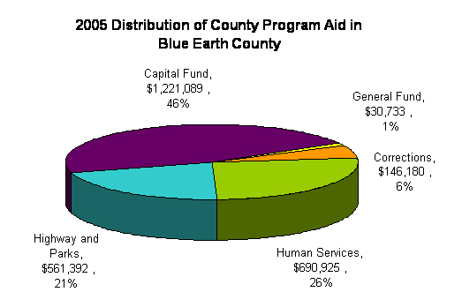
Block Grants vs. Categorial Grants
Community Development Block Grants
Categorial Grants

Slide 8
Problem:
Foreign Aid based on Grants to Governments
By the 1970s- Many governments had failed or gone deeply into debt.
Rejected “charity”. Turned to “Philanthropy”
“The Non-Profit and the “Thousand Points of Light.
PRIVATIZATION

Slide 9
Context of Privatization: The Reagan-Thatcher Revolutions
Economic Reform and Structural Adjustment:
a. IMF Stabilization and trade liberalization
b. Currency reform, auctions-end
of subsidies (end urban privileges) to end radical inflation

Slide 10
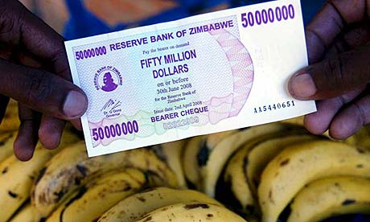
Target for Currency Auction

Slide 11
The Reagan-Thatcher Revolutions
Market prices for agriculture and industrial goods
Deregulate the economy
Most Importantly: Free Trade
Domestic Changes followed International Reforms (Contracts and Tendering)

Slide 12
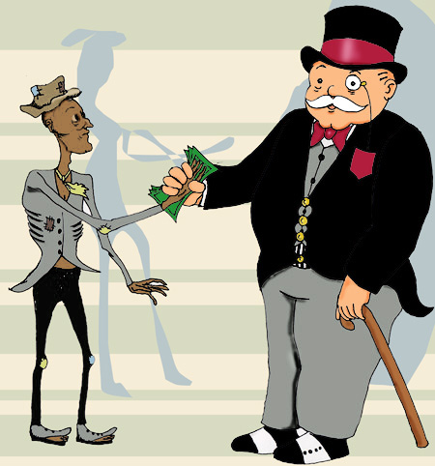
One View of Free Trade

Slide 13
Conditionality and Privatization
Conditionality- World Bank and UNDP and the "Management“
SAPs- /Structural Adjustment Programs
Focus on Policy and Administrative Reforms
Conditionality- World Bank and UNDP and the "Management“ of Structural Adjustment Countries

Slide 14
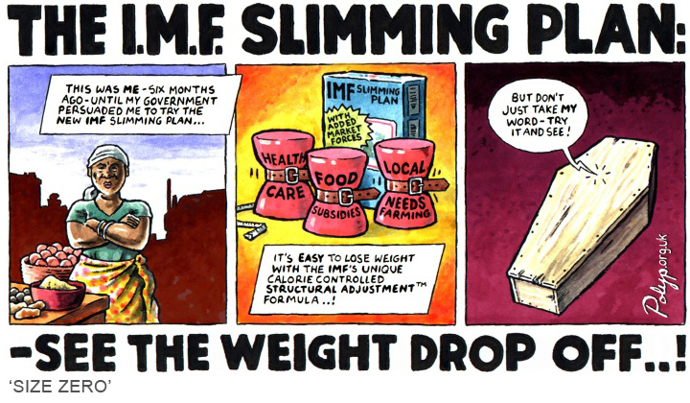
One View of SAPs

Slide 15
Conditionalities
Reform the Bureaucracy andDecrease Size of Public Service
Individual Consultants, Grantees and Contractors work with investments and the service/commercial sector
Bridging and sectoral loans and grants (Social Funds) major source of international involvement
Reliance on the Private and non-profit sector

Slide 16
Privatization Reforms
1. Strategic Planning and Management
2. Deregulation
3. Performance Management
5. Merit Recruitment
5. Contracting Out

Slide 17
Administrative Reforms and Privatization
End of Corruption
“Reinventing Government”- end to hierarchy and intra-governmental competition
Rewards based on Performance
Monitoring and contracts management

Slide 18
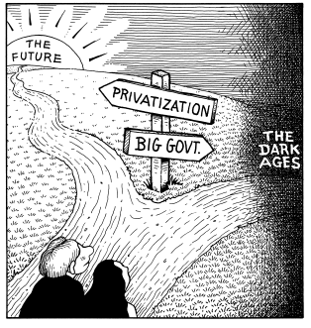
The View from the 1080s

Slide 19
Social Entrepreneurialism
Thousand Points of Light Assumption
Support start up costs through fundraisers
Micro-credit for crafts
Provide income through services
Generate income for human security support through tourism or Bed and Breakfasts (BKU)
Develop skills for survivors of gender violence
Sell items on the internet for humanitarian support

Slide 20
Newman’s Own

Slide 21
Development and Charity
Fundraising for Human Security

