Slide 1
Week 3
International Development Seminar

Slide 2
Almond and Powell: Comparative Politics
Background
1970s
Influenced by sociological, anthropological and communications theories
Theoretical framework: structural functionalism
Apply system theory to politics (interdependence and boundary)
Actual performance and underlying propensities (culture)
A political system has the major functions/activities: conversion, capability to interact with other social systems in the environment, and maintenance and adaptation.
In order to compare different political systems, it’s important to understand their institutions (structures), as well as their respective functions.
These institutions should be analyzed in a meaningful and dynamic historical context.

Slide 3
Lerner: The passing of traditional society
Background
1950s
Historic shift of modes of communicating ideas and attitudes: mass media
Based on a survey study in 6 Middle East Arab countries
Theoretical framework
Major hypothesis: empathetic capacity is the predominant personal style only in modern society.
Exposure to media messages would facilitate the transition of Muslim societies from tradition to modernity.
Retrospect: Islam is capable of effectively protecting its own institutions and values.

Slide 4
Definition of Modern:
cosmopolitan
urban
literate
highly specialized in their vocation
more financially stable
capable of understanding various world situations
interdependent
more secular than devout.

Slide 5
James Ferguson: Development and Bureaucratic Power in Lesotho
Lesotho Reality
70 % of average rural household income comes from wage labor in South Africa, 6 % from agricultures
The World Bank mission to Lesotho, portrayed as a nation of “farmers”, is not focused on wage labourers.
Taking Politics out of Development
The Bank doesn’t consider the political character of the state; the uses of official positions and state power by the bureaucratic elite, bureaucratic inefficiency and corruption
Bureaucracy is seen as a problem of poor organization or lack of training

Slide 6
James Ferguson: Development and Bureaucratic Power in Lesotho - cont’d
Failure
“Development” officials assumed that the projects were givens and they are only in charge of implementation.
Failure of livestock development; “Development” planner wants to convince farmers to sell their grazing animals
However, there is a reluctance to convert grazing animals to cash through sale because investment in livestock constitutes a consequences of a sort of retirement fund and migrant labour
The Side Effects of Failure
Canadian government’s interest in rural development to find export markets for farm machinery
Development projects are a machine for reinforcing and expanding bureaucratic power

Slide 7
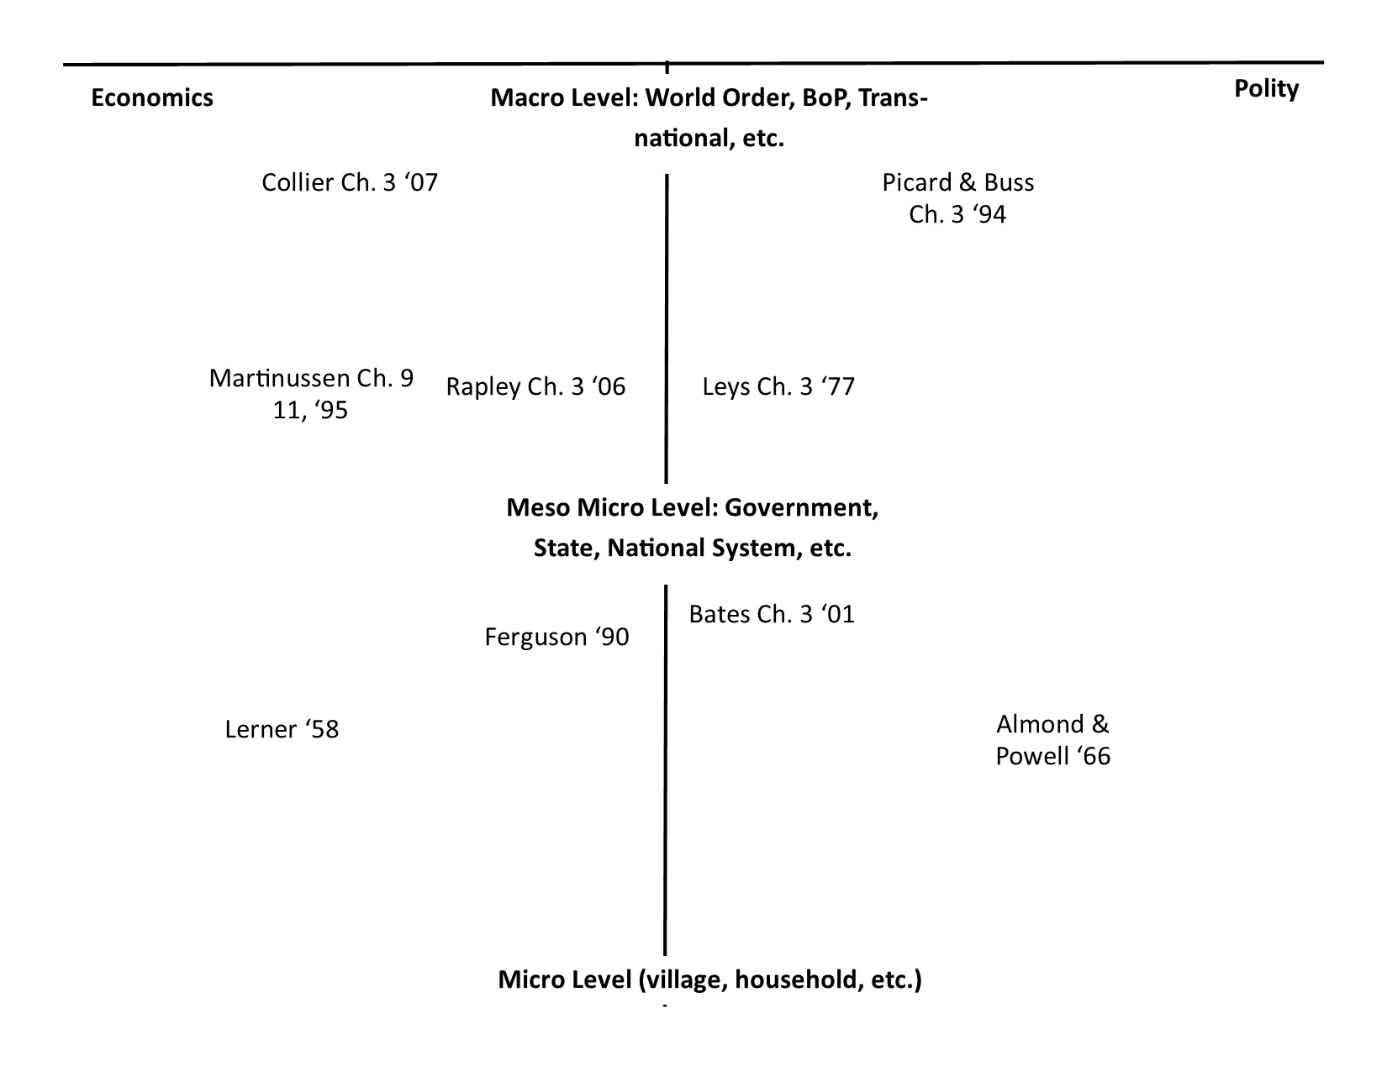
Literary Map or 'Grid'

Slide 8
Major themes
The role the monopoly of coercion in economic and political development through endogenous and exogenous arrangements.
Historical of the evolution of colonialism into western, globalize, or modernized systems.
Different roles, payoffs, and definitions of modernization.
Was modernization imposed or accepted?
Traditional and /or local cultural resilience in modernization.
Success and failure cases in modernization

