Slide 1
South Africa: From the Iron Age to Apartheid and to a Post-Apartheid Government
Louis A. Picard
Director
Ford Institute for Human Security
University of Pittsburgh

Slide 2
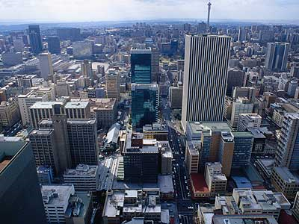
Johannesburg

Slide 3
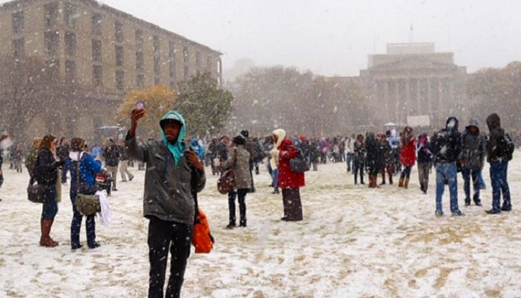
Johannesburg, August 7, 2012 and a Prompt: Remember, in South Africa, not everything is what it seems

Slide 4
South Africa Profile, 1985: Is South Africa Different?
Indians 900,000 (2.7%)
Africans: 24,000,000 (72%)
Indigenous: San-Khoisian: 31,000 (less than .5%)
Others: Chinese, Japanese, Arabic (30,000- less than .5%)

Slide 5
South Africa Profile, 1985
White: 4,800,000 (15%)
(60% Afrikaans, 40% English and others)
(Jewish South Africans approximately 100,000 people)
“Coloured:” 3,900,000 (9%)
(Mixed Race- 80% Afrikaans speaking, 20% English Speaking)

Slide 6
Historical Themes
Origins and Indigenuity
Settlers or Citizens
Imperialism: From Assimilation to Segregation
Afrikaner Nationalism and Apartheid
Nationalism and Liberation

Slide 7
Eastern and Southern Africa: A Time Line
Khoisian 200 BC-1600
Iron Age Pre-Bantu c.200AD
Bunyoro from 1300
Buganda from 1500-1800
Mwonomotopa1500-1800
Portugal 1600-1975
Khosa Kingdoms: c. 1750
Luba/Lunda 1500-1800
Zulu Empire and Breakup 1700-1850
Afrikaners 1652
British 1820

Slide 8
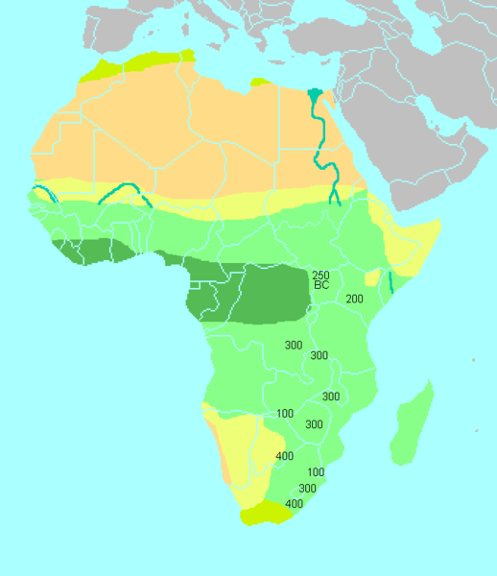
Iron Age Sites in Eastern and Southern Africa

Slide 9
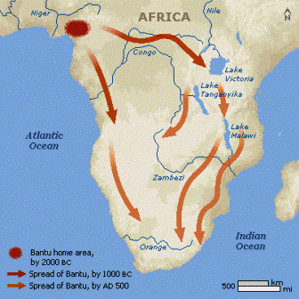

Slide 10
San in Southern Africa: The Indigenous Peoples Debate

Slide 11
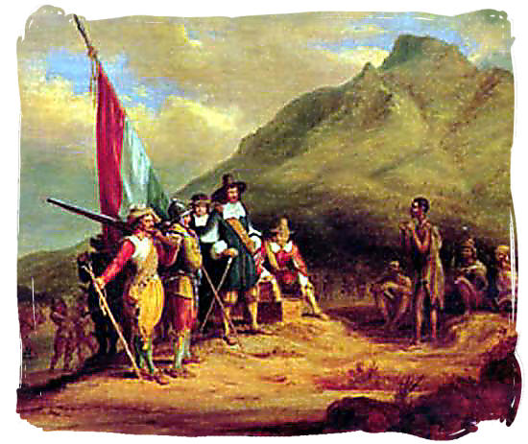
Jan van Riebeeck, San and Bantu Speaking Peoples Arrival Myths

Slide 12
The first 1820 British settlers arrived in Table Bay on 17 March 1820

Slide 13
Origins of Colonialism in Southern Africa- A Timeline
Jan van Riebeck and the Cape- 1652
Britain- Cape Colony: 1815
Cecil John Rhodes: British South Africa Company (Bechuanaland, The Rhodesias and Nyasaland- Company Rule c. 1890 to 1923)
Union of South Africa, 1910
National Party Victory, and Apartheid as Law, 1948
Declaration of Republic, 1960

Slide 14
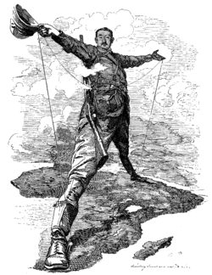
Cecil Rhodes and the Imperial Dream

Slide 15
Pseudo-Scientific Racism

Slide 17
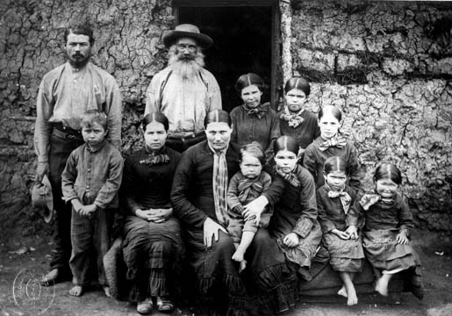
Boer Family- c. 1900. Another Tribe?

Slide 18
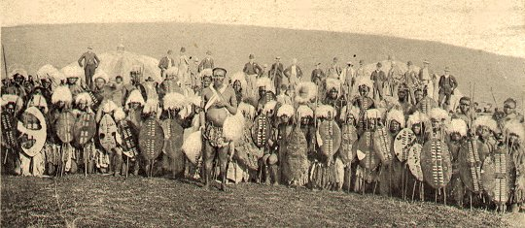
Zulu Clan- Early 20th Century

Slide 19
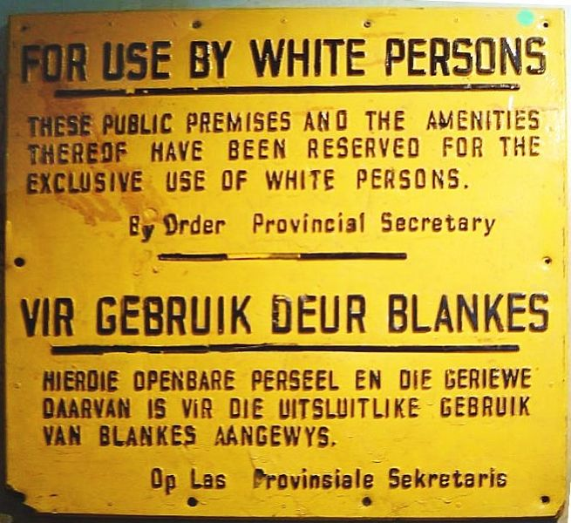
Colonialism in South Africa: Sub-Colonial system and Commericalism

Slide 20
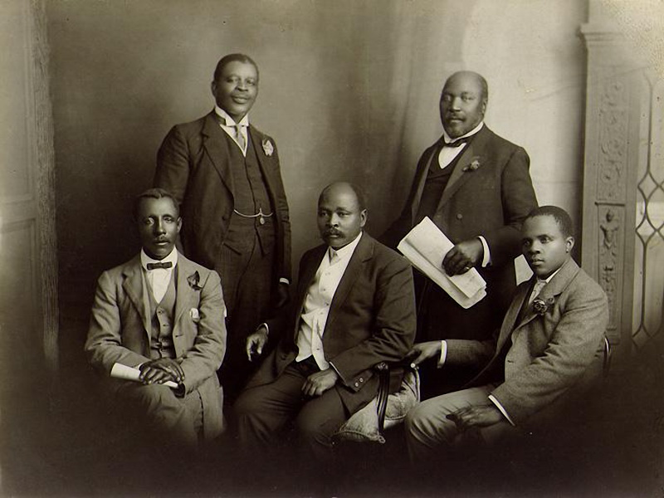
South African Native National Congress Leadership 1914

Slide 21
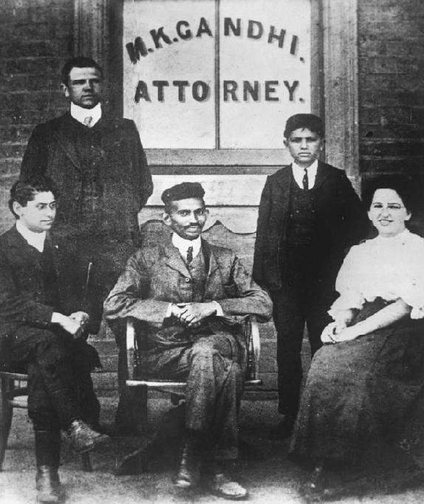
The Role of Non-Violence: Gandhi, and the Indian Community in South Africa

Slide 22
South Africa and the World
Prior to WW II. White Dominion
Investment and Mines
World Wide Similarity of Values
Part of “British Empire”
Independent, legal, legitimate

Slide 23
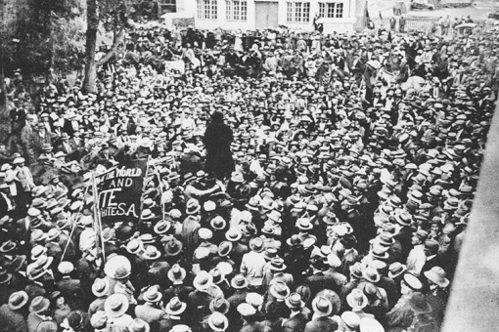
South African Strike, 1922
“ Workers of the world, unite and fight for a white South Africa!"

Slide 24
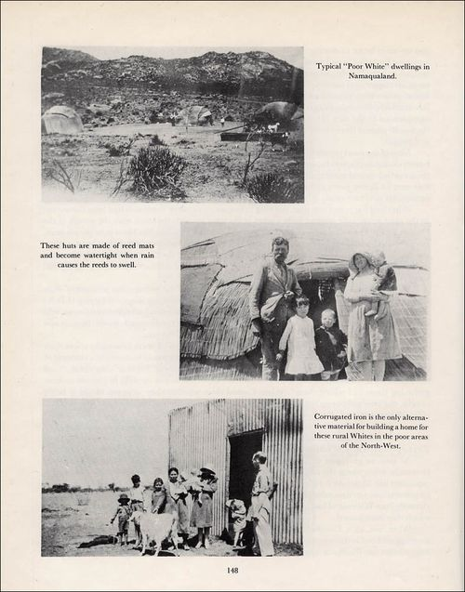
Poor Whites and the Carnegie Commission, 1932

Slide 25
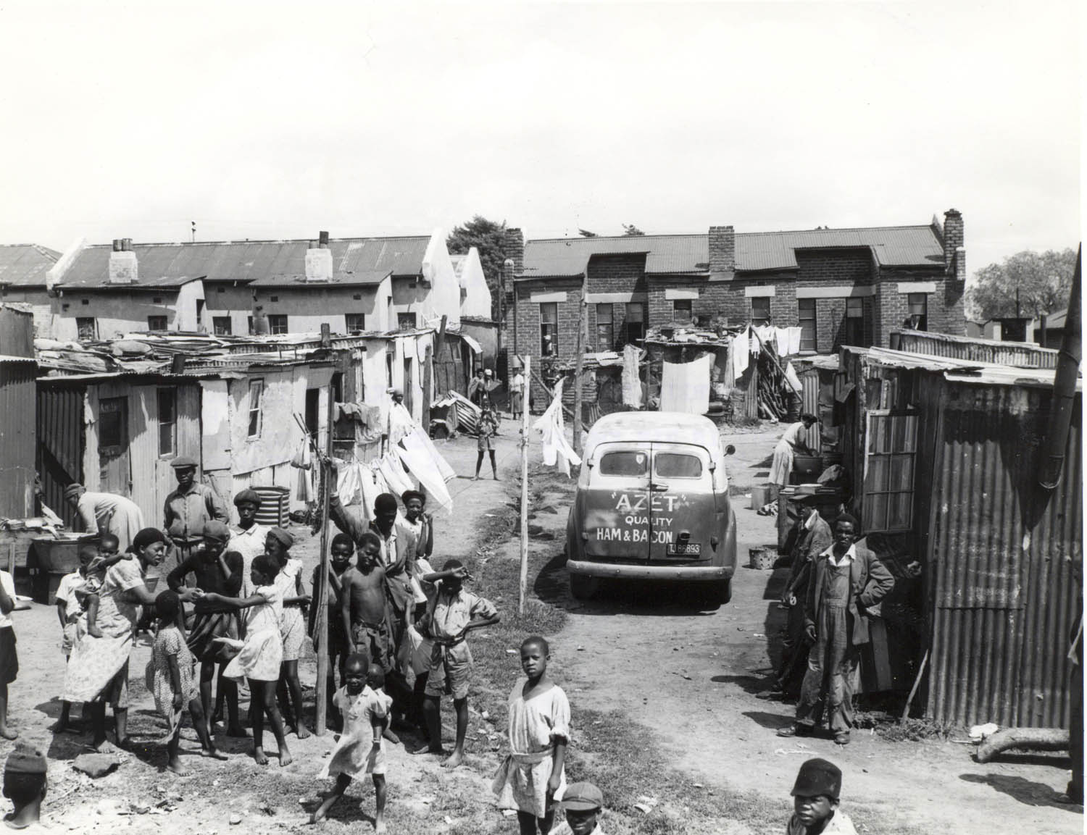
Sophiatown, Johannesburg, Transvaal

Slide 26
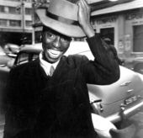
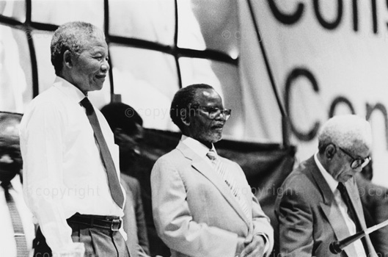
African National Congress Youth League, 1943-44
Peter Mda, Nelson Mandela, Walter Sisulu and Oliver Tambo
Peter Mda

Slide 27
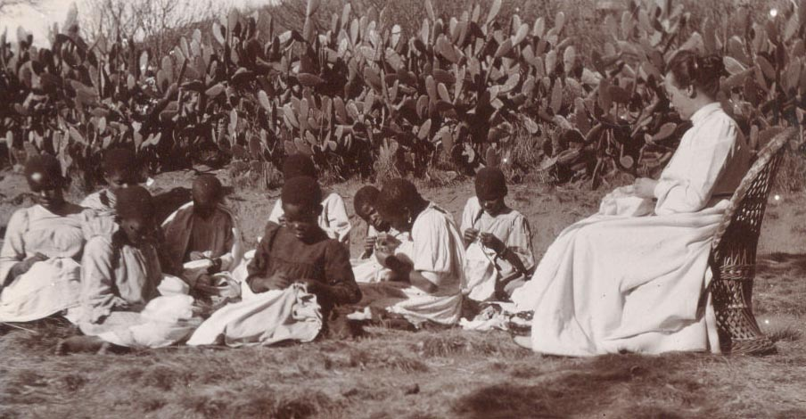
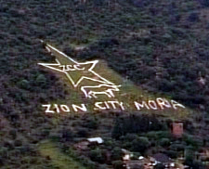
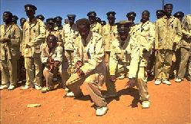
Missionaries and Syncretistic Religion
Zion Christian Church: Origins late 19th Century

Slide 28
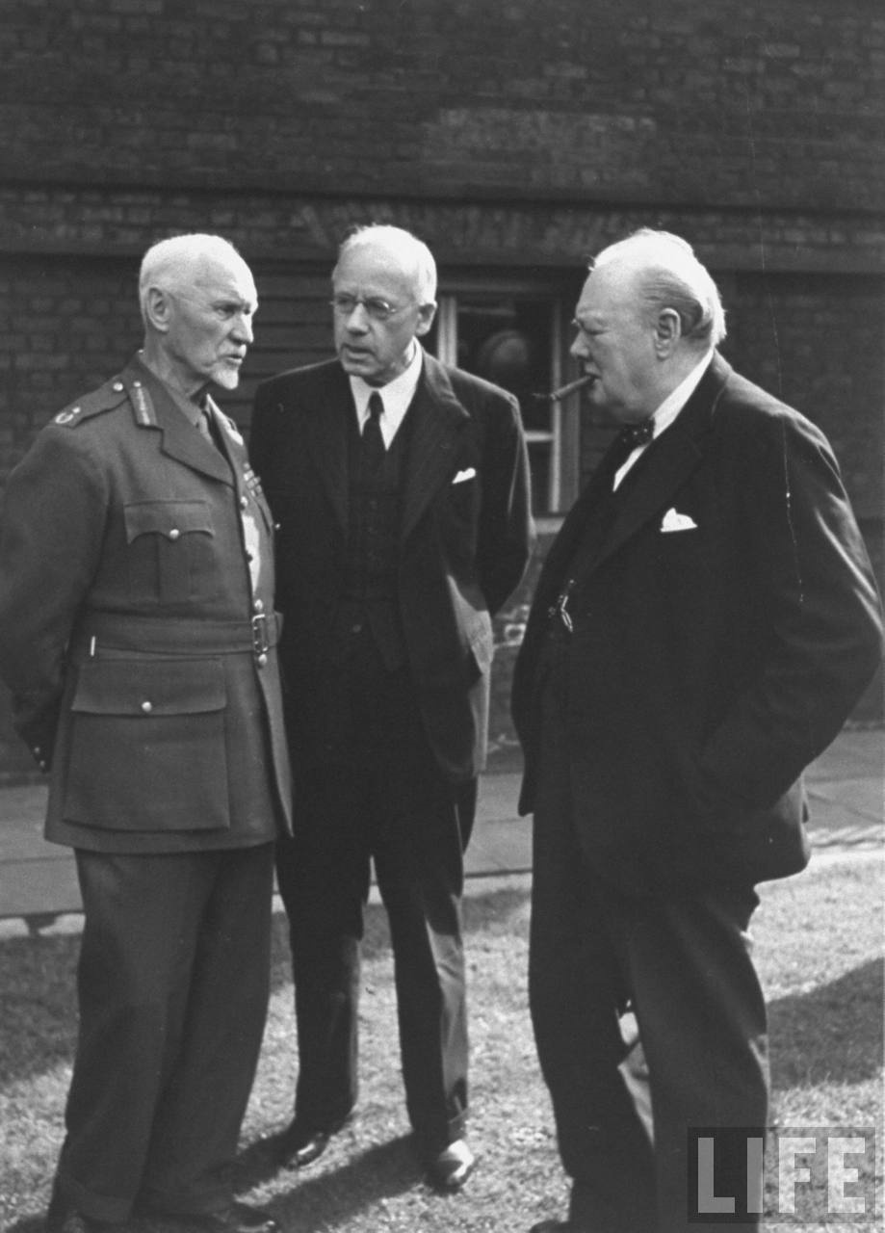
Prime Minister Winston Churchill (R) talking with Field Marshall Jan Christian Smuts (L) and Peter Fraser (C) at a Dominion Conference April, 1945

Slide 29
South Africa: The Rhetoric
Trusteeship vs. Assimilation: 19th Century
Segregation vs. Apartheid- "Homelands" as nations (1900-1948
Afrikaans vs. African Nationalism vs. Non-Racialism
Majority rule vs. minorities (?)

Slide 30
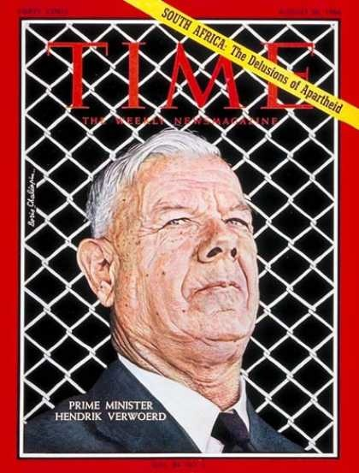
August 26, 1966

Slide 31
The South African Version
http://www.youtube.com/watch?v=xHgU1Jw6oyw&feature=relmfu

Slide 32
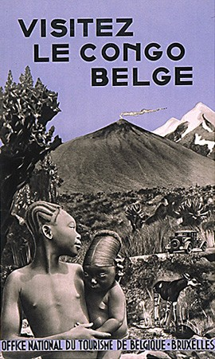
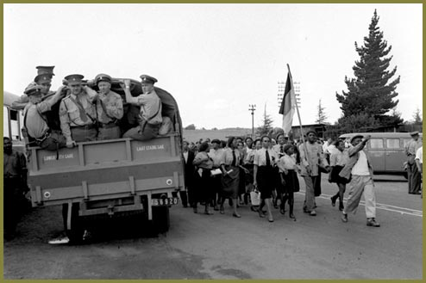
South Africa and the Congo, 1940s

Slide 33
South African History
Trusteeship vs. Assimilation
Segregation vs. Apartheid- "Homelands" as nations
Afrikaans vs. African Nationalism
Majority rule vs. minorities

Slide 34
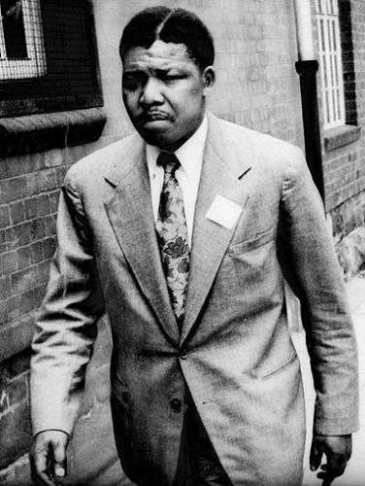
Nelson Mandela, Attorney at Law

Slide 35
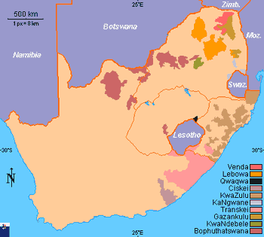
South Africa’s Homelands, Prior to 1994

Slide 36
Homeland Presidents: 9th October 1971: Three Chiefs of South African 'Bantustan', (from left - right), Chief Buthelezi of Kwa Zulu, Chief Kaiser Matanzima of Transkei, and Chief Lucas Mangope of Bophuthatswana

Slide 37
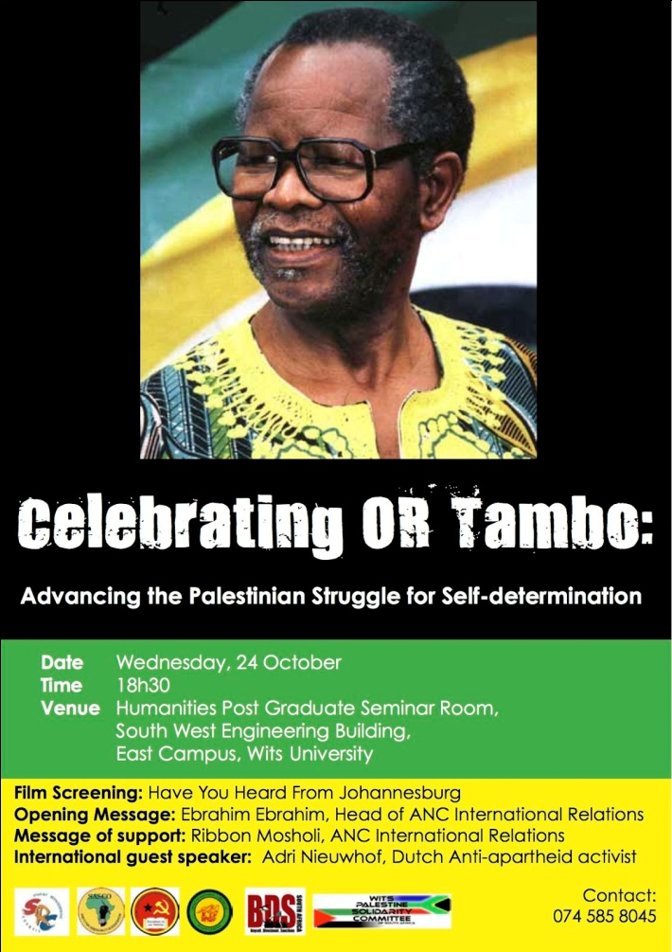
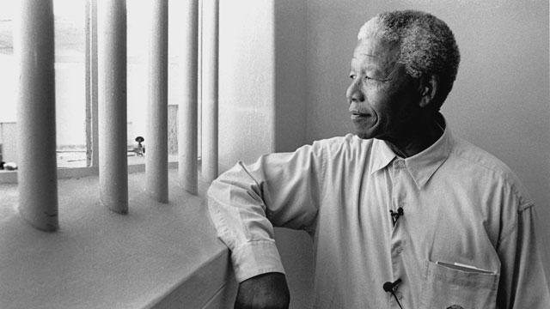
South African Politics: Prison or Exile

Slide 38
South Africa and the World
Decolonization?
1948 and Apartheid
Homelands and Nationalism
Anti-Communism
White Nationalism like Black Nationalism?
“Polecat of the World”
“Rainbow Nation”
BRICS

Slide 39
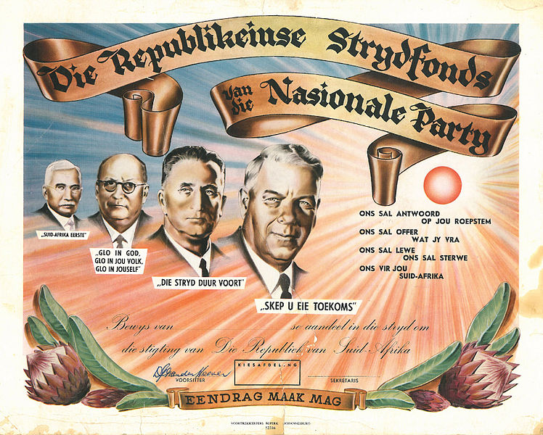
Apartheid

Slide 40
The Collapse of Apartheid
From Violence to Revolution: Unnatural rebels
ANC, Russia and SACP (End of Cold War)
Urbanization, Ungovernable Townships and the United Democratic Front
Sanctions, Banks and International Pressures

Slide 41
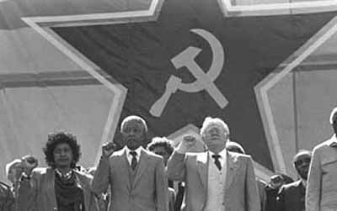
The South African Communist Party

Slide 42
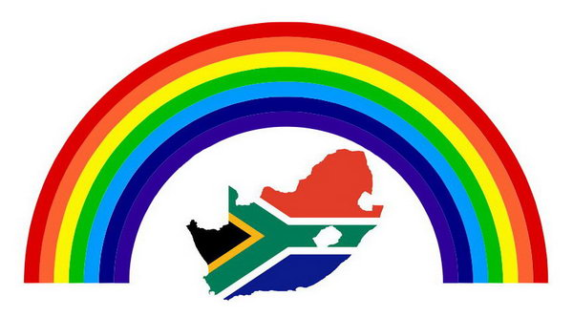
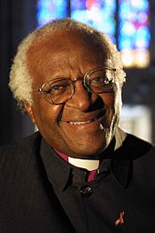
A Rainbow Nation?
Arch-Bishop Desmond Tutu

Slide 43
FIFTEEN MINUTE BREAK

Slide 44
Post-Apartheid Themes
Rainbow Nation
Political Institutions and Constitutional Governance
Dominant Party
Black Empowerment and Affirmative Action
Urban Poverty and the Rural Labor Reserves
Political Crisis, Corruption and Satirical Responses

Slide 45
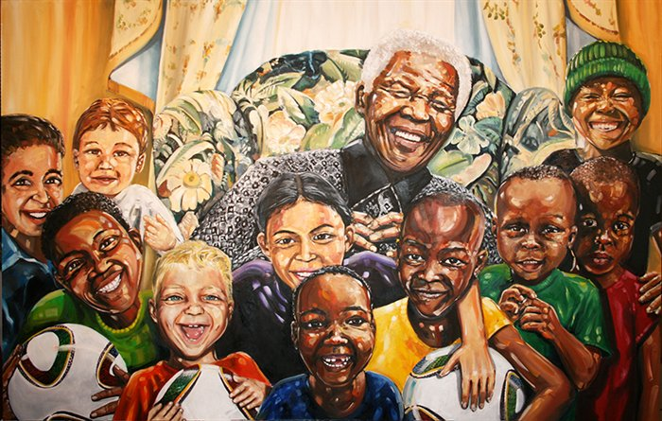
People, History and Culture
The Rainbow Nation Myth

Slide 46
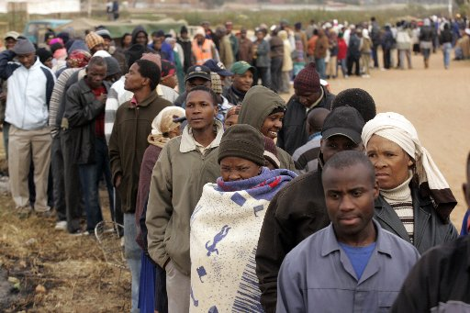
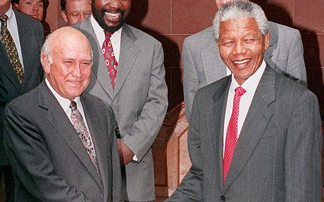
Democracy? 26–29 April 1994

Slide 47
Inauguration, May 10, 1994

Slide 48
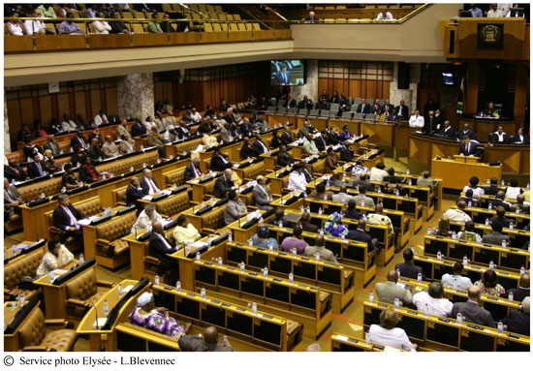
South Africa’s Parliament

Slide 49
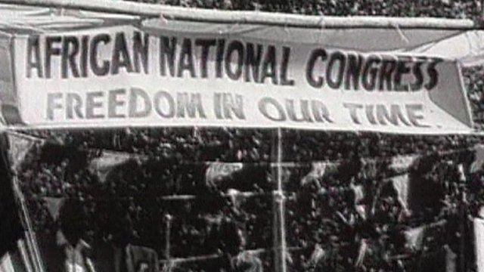
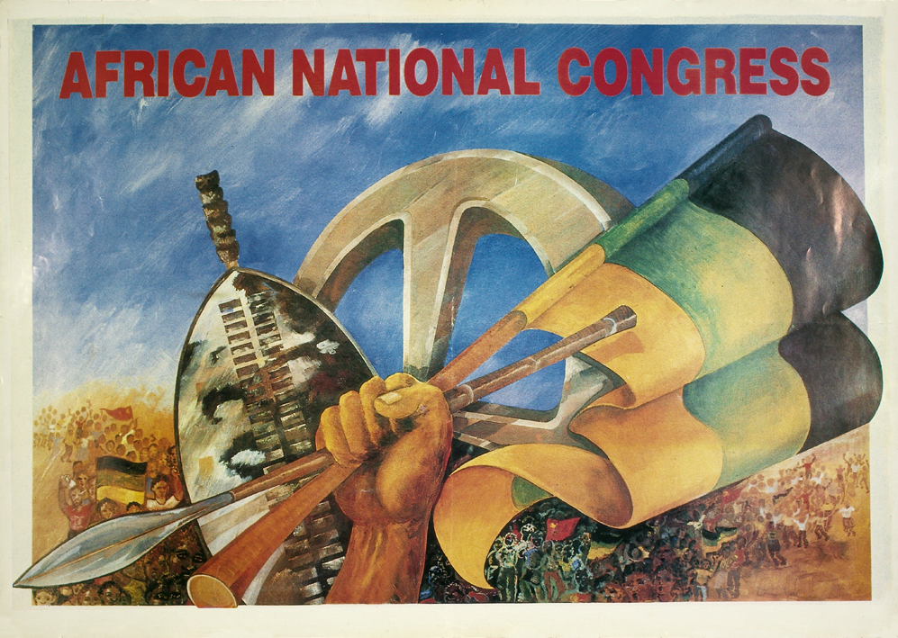
A One Party Dominant System: The African National Congress
Founded in 1912
Freedom Charter

Slide 50
Post-Apartheid South Africa
Multi-racialism, non-racialism vs. “Africanization”
Role of working class and poor whites and BEE
Debate about the State and Consumption/corruption

Slide 51
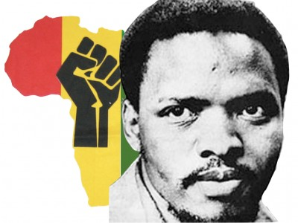
Legacy of African Nationalism: Steve Biko

Slide 52
“African Capitalism” in South Africa
BEE
The Stereotype?

Slide 53
South Africa: The Dependency Issues
Role of working class and poor whites
Mining and labor reserve- "peasant based proletariat
Multi-racialism, non-racialism vs. “Africanization”

Slide 54
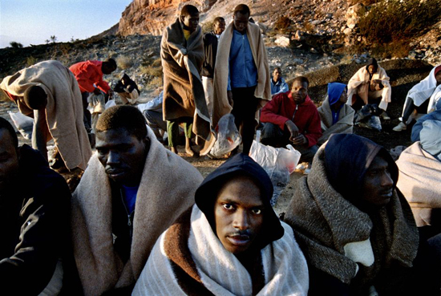
“Peasantariat” Families, the Labor Reserve and Mining- South African Mines and City Lights

Slide 55
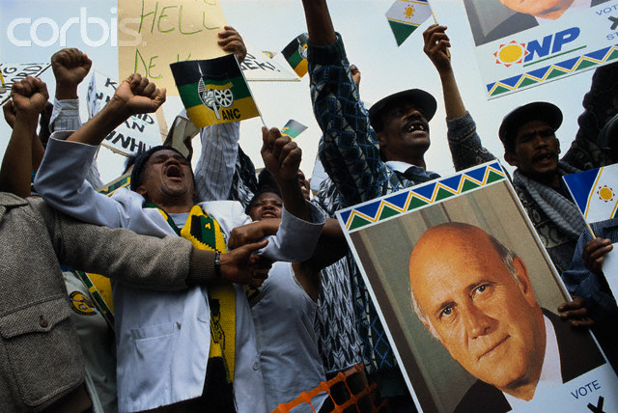
Race, Nationalism and Ethnicity
So called “Cape Coloureds” and the National Party in 1994

Slide 56
“So-Called Coloured” South Africans

Slide 57
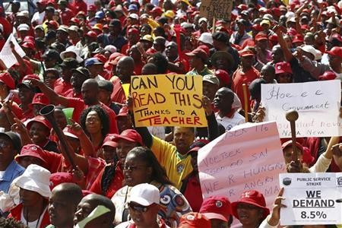
The Labor Debate: South African Public Service on Strike

Slide 58
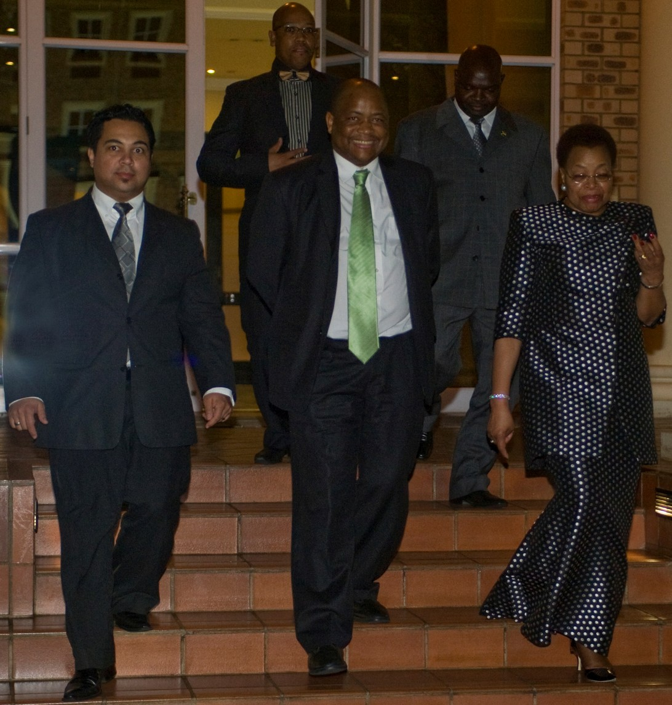
Renowned international social activist Graça Machel Mandela , with Kuseni Dlamini, CEO of Old Mutual South Africa and Emerging Markets, attended the Old Mutual Staff volunteerism awards dinner. Accompanying them is Anthony Petersen (left), Amos Hadebe (back left) and Dr Pandelani Mathoma, Managing Director Old Mutual. (GSPIA PhD 2001).

Slide 59
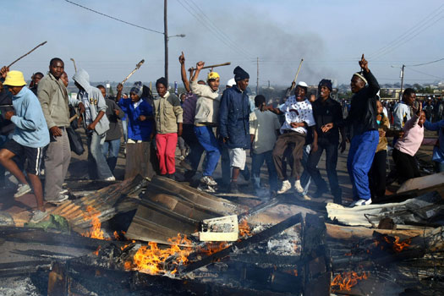
South Africa 2008 Xenophobia

Slide 60
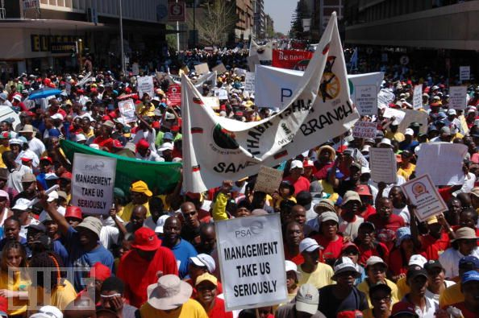

Slide 61
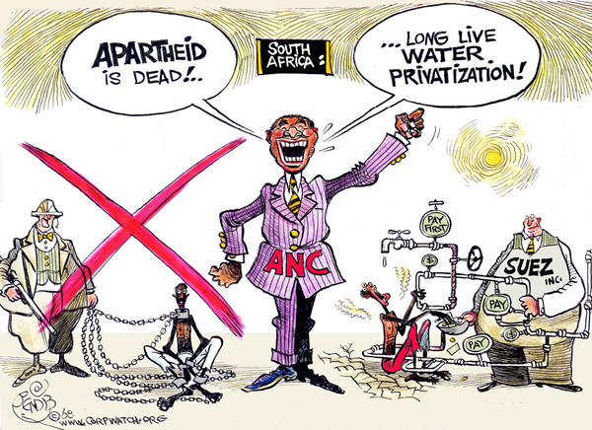
South African Cartoon Attacking Privatization

Slide 62
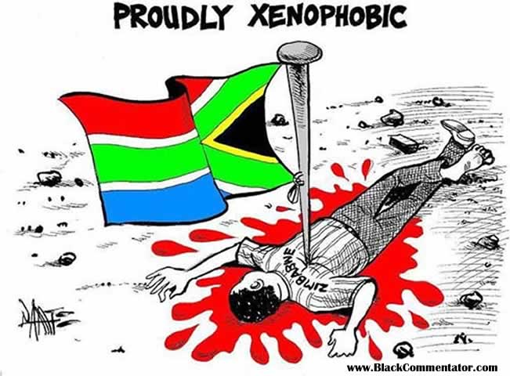

Slide 63
Debates about Corruption and Socialism: 2012
Julius Malema
And the Marikana Massacre (2012)

Slide 64
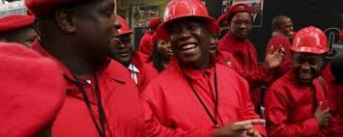
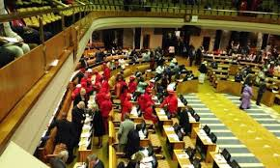
Economic Freedom Fighters
Julius Malema and the Red Overalls

Slide 65
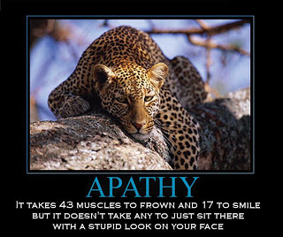
South African Political Poster: Still some spark?

Slide 66
Jacob Zuma, President of South Africa, 2009-Present (Now a Zulu Ethnic Group?)

Slide 67
Goodwill Zwelethini – King of Zulu South Africa. Born: 14 July 1948.

Slide 68
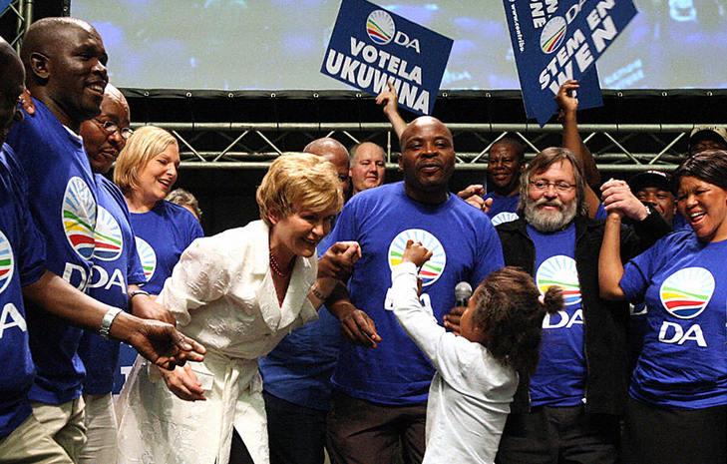
Democratic Alliance South Africa
Helen Zille, Cape Leader

Slide 69
Democratic Alliance: Now Under African Leadership: Mmusi Maimane

Slide 70
The Cartoon Debates

Slide 71
Corruption in South Africa

Slide 72
The Most Offensive

Slide 73
Village Meetings in Rural Southern Africa
Kgotla

Slide 74
The Importance of Satire: A Prompt: Is Political Democracy Important?
Helen Zille
Still the Premier of Cape Province
Cast of Characters:
Tim Modise TV Personality
Jacob Zuma, President of SA
Julius Malema, Nationalist Leader

Slide 75
Prompt: Not Everything is what it seems

Slide 76
Prompt: Is Political Democracy Important?

