Slide 1
PIA 2501 Development Policy and Management
The New Orthodoxy
In Foreign Aid

Slide 2
Foreign aid as Foreign Policy:
Preview of Capstone Course on Foreign Aid, Fall 2012

Slide 3
Historical Values:
Exchange: credits and grants for commercial exchange;
Balance of Power: Carrot vs. Stick
Humanitarian Values
Security Needs

Slide 4
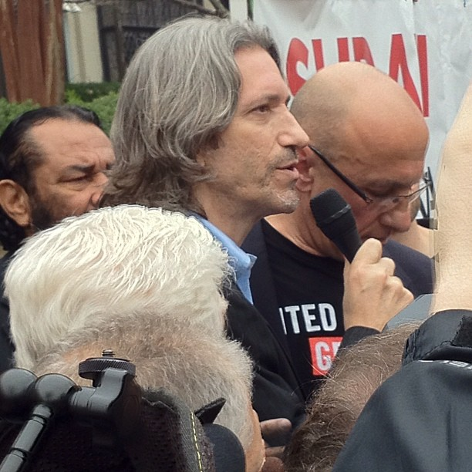
5. Role of Publicity, Debate and Controversy
Breaking News:
George Clooney and John Prendergast Arrested at Sudan Protest
George Clooney and John Prendergast were arrested outside the Sudanese embassy in Washington, D.C. while protesting the Government of Sudan's war crimes against its own people.

Slide 5
Niccolò di Bernardo dei Machiavelli (May 3, 1469 – June 21, 1527)
Machiavelli emphasized the need for the exercise of brute power where necessary and rewards, patron-clientelism, where possible to preserve the status quo.

Slide 6
In the Beginning: Dutch East India Company- Commercial Interests

Slide 7
Events-1
European Expansion and Colonial Origins of Assistance (after 1500)
U.S. expansion across the West and Pacific- “Manifest Destiny”
Nineteenth Century Experiments and U.S. Colonies (eg. Cuba, Central America, Liberia, Philippines)

Slide 8
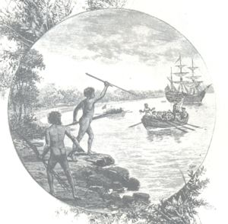
Notes:
8

Slide 9
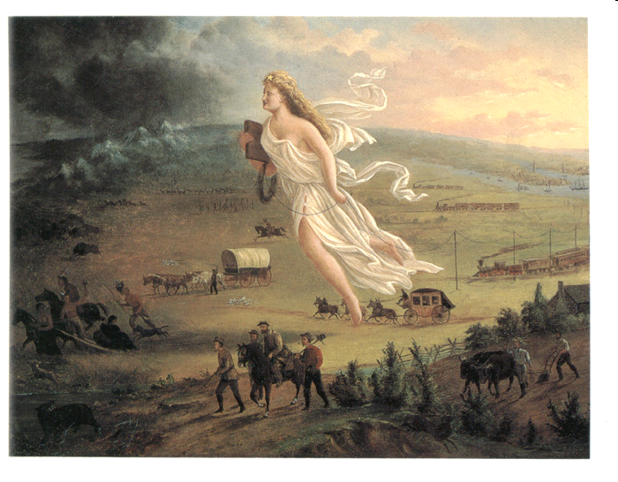

Slide 10
Events-2
Post-World War One: Refugees and Food Crisis
Roosevelt and Good Neighbor Policy
World War II and Defense Assistance Pacts

Slide 11
“American Red Cross Worker with French Refugee Family”

Slide 12
Good Neighbors?

Slide 13
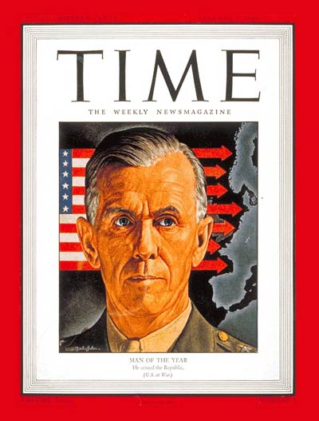
The Marshall Plan
George C. Marshall
Origins of Modern Foreign Aid
VIDEO
“America was wealthy and confident”

Slide 14
The Problem- 1950
Lend Lease- 1941
Marshall Plan- 1948
Point Four-1951
Creation of USAID 1961
Redefinition of Foreign Aid, 2001
The goal of foreign aid was the reduction of material poverty through economic growth and the delivery of social services, the promotion of good governance and support for social institutions (Education and Health)

Slide 15
The Assumption- 1950
It was assumed that this would be done through democratically selected, accountable institutions, and reversing negative environmental trends through strategies of sustainable development.
But there was also the cold war.

Slide 17
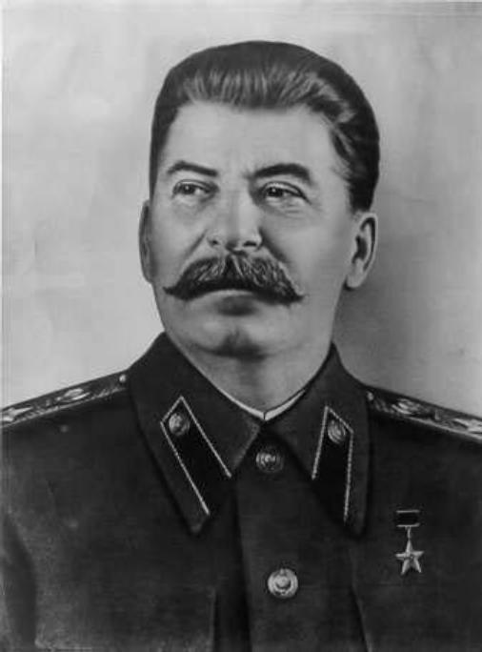
Harry Truman and Joseph Stalin
The Cold War and the Search for Allies

Slide 18
The Problem- 2012
Ostensibly, the goals of foreign aid in 2003 remain what they were more than half a century ago.
BUT-

Slide 19
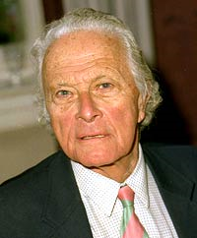
The Problem-2
In addition to (or because of) the Cold War
Ultimately, as a number of economists have noted, “universal models of growth [did] not work well.”
Note: (Lord) Peter Thomas Bauer, London School of Economics, 1915-2002
Quote: David Sogge, Give and Take: What’s the Matter with Foreign Aid? (London: Zed Books, 2002), p. 8.

Slide 20
Periods of Foreign Aid
New Nations- 1950s
Vietnam and Peace Corps-1960s
Basic Needs- 1970s
Structural Adjustment- 1980s
End of Cold War- 1990s
Post-September 11, 2001

Slide 21
Images

Slide 22
Vietnam vs. the Peace Corps
1965-1968

Slide 23
The Current Issues
Governance
Basic Social Needs: MDG
Diplomacy, Security and Foreign Aid
Human Security (Above All)

Slide 24
Evelyn Akullu
Evelyn Akullu came to the orphanage in march 2004 after being picked from her hospital in Lira, Uganda. She had been burnt by the Lord’s Resistance Army rebels at Barlonyo in Feb. 2004. By the time she was picked up, she was rotting in the hospital due to lack of drugs.

Slide 25
This little girl is a killer.
Esther was kidnapped to be a fighter in the Lord's Resistance Army in Northern Uganda. She fought for three years.

Slide 26
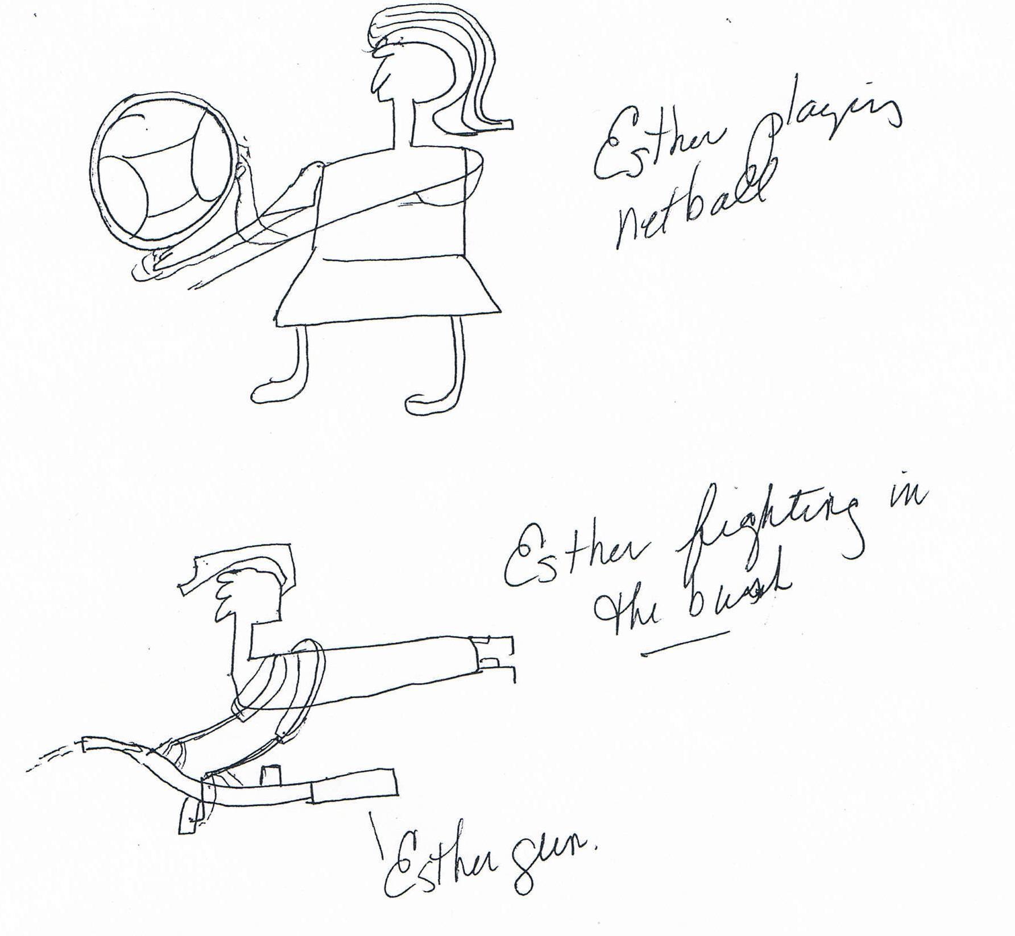
Esther’s Drawing of Herself

Slide 27
Foreign Aid
USAID Priorities

Slide 29
Motives and Ethics
It is said that part of the motivation for foreign aid has been ethical and humanitarian in nature.
However, there has been one constant defining foreign aid over the last fifty years.
The humanitarian and development goals of foreign aid have been distorted by the use of aid for donor country commercial and political purposes.
Notes:
29

Slide 30
Motives and Ethics-2
Policy makers in more developed countries, and especially in the United States, have tended to see their action in terms of their generosity and to justify the use of force in order to meet ideological and developmental goals.
Rewards were used as carrots to tempt conflicting sides into accepting mediation.
The question: Do the current USAID priorities have an ethical base?
Notes:
30

Slide 31
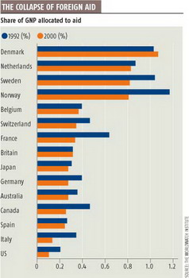

Slide 32
The Issue
The issue of sustainable development should be examined from both a policy and an ethical dimension.
What is the role of ethics in group and individual behavior
This suggests that ultimately there have both been policy problems and moral ambiguities that have plagued technical assistance and foreign aid.

Slide 33
Policy Assumptions
Policy makers in more developed countries, and especially in the United States, have tended to see their action in terms of the their generosity
And to justify the use of force and unilateral action in order to meet ideological and developmental goals.
Rewards were used as carrots to tempt conflicting sides into accepting mediation or policies
Notes:
33

Slide 34
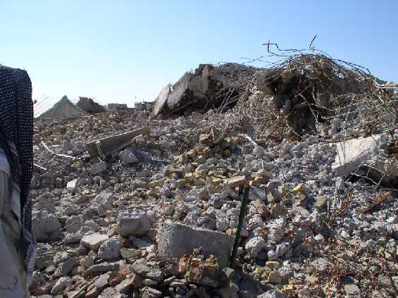
“We had to destroy the village in order to save it”

Slide 35
Policy Concerns
There has often been very little public recognition to the commercial needs met by foreign aid
Or the bridge between security and foreign aid,
There was a disproportion of power between LDC states and Western, and especially American Power
Notes:
35

Slide 36
Policy Concerns-2
Ultimately foreign aid organizations, like their counterparts in other areas of contracting, are in a struggle to capture and retain resources
Donor values and misperceptions are part and partial of the picture of foreign aid.
Notes:
36

Slide 37
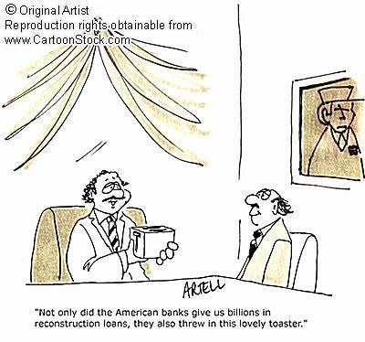

Slide 38
The Issue-2
Foreign aid problems are rooted both in the evolution of foreign aid policy over the last half century---
but also in the ethical and cultural assumptions that were the antecedents of state to state foreign aid as it developed in the wake of the Second World War.
The debate about foreign aid and development revolves around two issues: cultural transformation and what used to be called modernization.

Slide 39
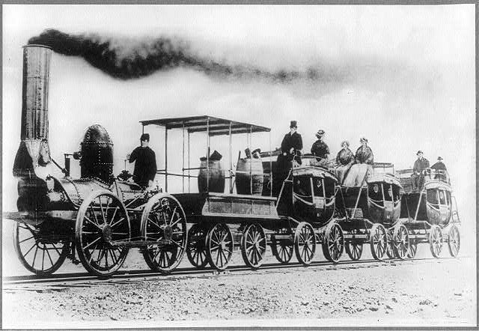
Modernization:
The Only Game in Town?
Back to the Beginning of the Semester

Slide 40
Cultural Transformation
The issue occurs at two levels.
First, there is the concept of identity and how one identifies oneself in relationship to family, language and culture.
Second, there is the issue of morality that ultimately is defined, at least in part by national policy.

Slide 41
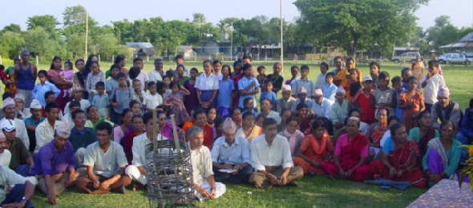
Social Mobilization Training Still Around

Slide 42
Modernization: The Only Game In Town?
Thus an understanding ofdevelopment should occur at two levels, the relationship between the individual, a socialization process and the extent to which national ethical and moral values impact upon the individual.
The result of Modernization is said to be an urban, modern secular person. (Western)
Discussion: YES or NO?

Slide 43
The Dilemma of Modernization
“Americans had been brought up in a pluralistic world, where even the affairs of the family are managed by com-promises between its members. In the traditional Vietnamese family (and in other traditional families throughout the Third World)- a family whose customs survived even into the twentieth century- the father held absolute authority over his wife (or wives) and children.”
The argument is that the western concept of decision-making is based on compromise. Compromise, however, is not a universal concept.
Quote from Frances FitzGerald, Fire in the Lake: The Vietnamese and the Americans in Vietnam (New York: Vintage, 1972), p. 19.

Slide 44
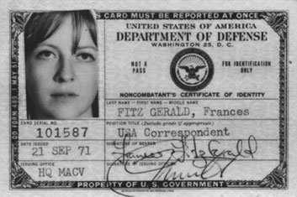
Frances FitzGerald, Born in 1940

Slide 45
Last Argument
Picard Editorial
Truth in Advertising

Slide 46
2012 SYMPOSIUM THE TRUMAN LEGACY SYMPOSIUM ON FOREIGN AID
May 18-19, 2012 Harry S. Truman Little White House Key West, Florida
1:20 p.m. to 1:50 p.m.
Address by Louis Picard, University of Pittsburgh, "Harry Truman's Foreign Aid Legacy and What Has Happened to It."

Slide 47
Foreign Aid and Foreign Policy
Foreign and Security Policy in the Twentieth Century
Groupthink and the March of Folly Problem
Groupthink (Irving Janis)- Leadership cannot be criticized.

Slide 48
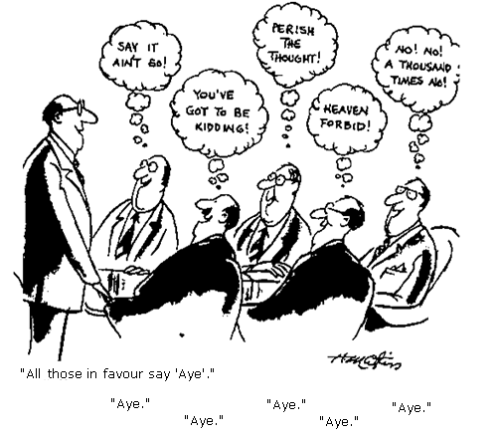

Slide 49
The March of Folly Problem
Given the nature of government in the twentieth century, for foreign aid to succeed it would have perceived as in the self-interest of a country’s leadership of both donor and recipient nations.
However, as Barbara Tuchman points out, “[a] phenomenon noticeable throughout history regardless of place or period is the pursuit by governments of policies contrary to their own interests,”
that is contrary to important constituencies or the state as a whole.
Quote from Barbara W. Tuchman, The March of Folly: From Troy to Vietnam (New York: Alfred A. Knopf, 1984), p.4.

Slide 50
Author of the Week: Barbara Tuchman (January 30, 1912- February 6, 1989)

Slide 51
March of Folly-2
Foreign aid was said to hold the promise of institutional development, that is the building of structures capable of introducing and supporting the changes implied in the term modernization.
Foreign aid, to its critics however, lacked an adequate conceptual basis. Result: Bureaucratized and Projectized Processes
Foreign aid policy like other foreign policies suffered from an absence of reality. Where problems and conflicts exist among peoples they are not always solvable by foreign forces or modernization technologies.

Slide 52
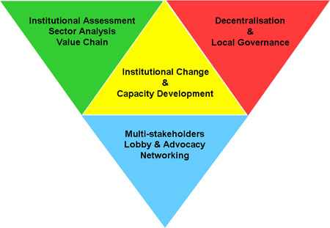

Slide 54
Millennium Development Goals: Eight Goals for 2015

Slide 55
March of Folly-3
In foreign aid, nation building has been the most presumptuous of such illusions. The importance of reason in decision-making follows from this.
Counter-productive policies can be identified if there is a real time alternative course of action available that can be subject to group discussion and eventual choice.

Slide 56
March of Folly-4
Using this definition, foreign aid policies have often been counter-productive since productive policies require thoughtful analysis.
Too often, foreign aid policies are pursued almost perversely even when “demonstrably unworkable or counter-productive.”
Unworkable policies, Tuchman points out, are “pursued at the sacrifice of the possible.”
Quotes from Tuchman, , p. 33 and p. 128.

Slide 57
March of Folly-5
There are two problems with decision-making:
First, decisions are often formed through prejudice which “hazardous to government.”
Secondly, decisions in turn are too often made with the ‘terrible encumbrance’ of dignity and honor.
Both Quotes from Tuchman.

Slide 58
March of Folly- 6
The foreign aid system as it has evolved in the U.S. and in other bilateral and multilateral organizations over the last sixty years is bureaucratic in nature. As Henry Kissinger noted in the late 1960s, there was
a sort of blindness [in terms of foreign aid] in which bureaucracies run a competition with their own programs and measure success by the degree to which they fulfill their own norms, without being in a position to judge whether the norms made any sense to begin with.
Quoted in John Franklin Campbell, The Foreign Affairs Fudge Factory (New York: Basic Books, 1971), p. 8..

Slide 59
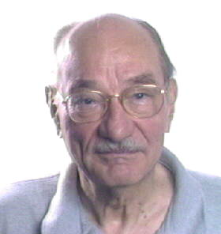
March of Folly- 7
In foreign policy, (including foreign aid policy) national honor often required that foolish policies continued to be pursued despite overwhelming evidence that the goal was unattainable.
The U.S. involvement in Vietnam (and some say Iraq and Afghanistan) is said to be part of this pattern. Folly in public policy occurs when groups and organizations are unable to make decisions and draw conclusions from the evidence available. Costs rather than benefits from a policy result if the donor tries to “avoid interference that is needless or irrelevant to major foreign policy purposes.”
Decision-makers need to focus on both problems.
Noted by John D. Montgomery, The Politics of Foreign Aid: American Experience in Southeast Asia (New York: Praeger,
1962), p. 250.

Slide 60
Focus: The Counter Narrative
What Emory Roe calls the development of the counter narrative is
to conceive of a rival hypothesis or set of hypotheses that could plausibly reverse what appears to be the case, where the reversal in question, even it proves factually not to be the case, nonetheless provides a possible policy option for future attention because of its very plausibility.
Quote from Emery Roe, Except- Africa: Remaking Development, Rethinking Power (New Brunswick, NJ: Transaction Publishers, 1999), p. 9.

Slide 61
The Counter-narrative

Slide 62
The Middle View
The Moderate Interpretation of Development Administration Failures
Goal: Realistic Decision-Making based on sufficient knowledge (strategic planning) “Mixed Scanning”
Balance Public-Private Partnerships

Slide 63
The Twenty-First Century Model Redux

Slide 64
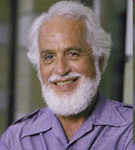
Denis A. Goulet, 75, died December 26, 2006: Appropriate Theory, Technology and Practice

Slide 65
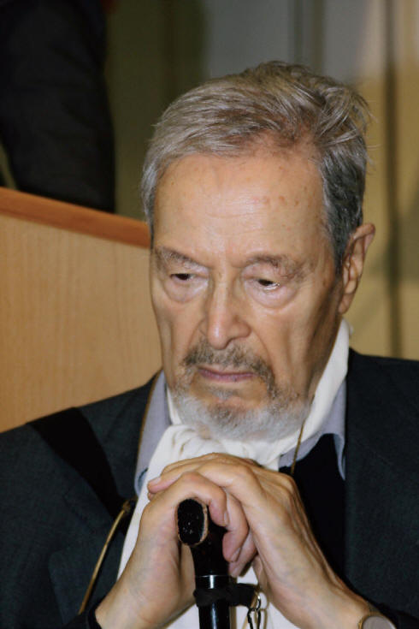
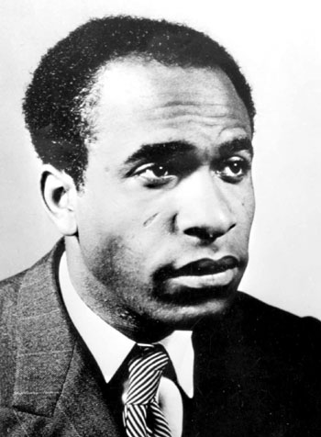
Discussion: The Two Books
Colonizer, Colonized
Wretched of the Earth
Albert Memmi, Born, December 15, 1920
Frantz Fanon (July 20, 1925 – December 6, 1961)

