Slide 1
How to Change the World Social Entrepreneurs and the Power of New Ideas
David Bornstein

Slide 2
David Bornstein
A journalist and author specializes in writing about social innovation. He has written three books on social entrepreneurship:
Social Entrepreneurship: What Everyone Needs to Know (co-authored with Susan Davis.)
How to Change the World: Social Entrepreneur and the Power of New Ideas.
The Price of a Dream: The Story of the Grameen Bank

Slide 3
This book is about people who have powerful ideas to solve social problems and improve people’s lives on a large scale—social entrepreneurs.
320 page.
21 chapter.
10 successful social entrepreneurs initiatives

Slide 4
The Concept of Entrepreneur
A French word means ‘one who takes into hand’
Was introduced by the French economist Jean-Baptiste Say.
Describes special economic actors, who ‘shifts economic resources out of an area of lower and into an area of higher productivity and greater yield.’
Restless people: people possess powerful ideas for addressing problems, and they are unable to rest until they spread their ideas society-wide.

Slide 5
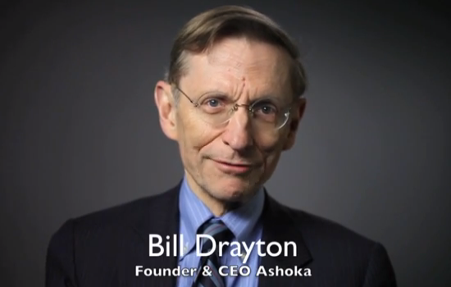
Ashoka
Founded in 1980.
The largest network of social entrepreneurs worldwide.
3,000 Ashoka Fellows in 70 countries.
Has provided start-up financing, professional support services, and connections.

Slide 6
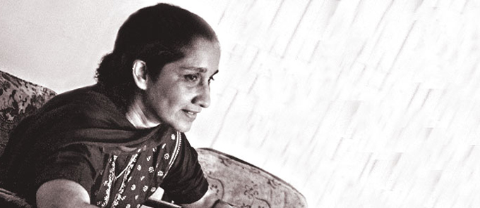
Gloria de Souza, experiential education, India

Slide 7
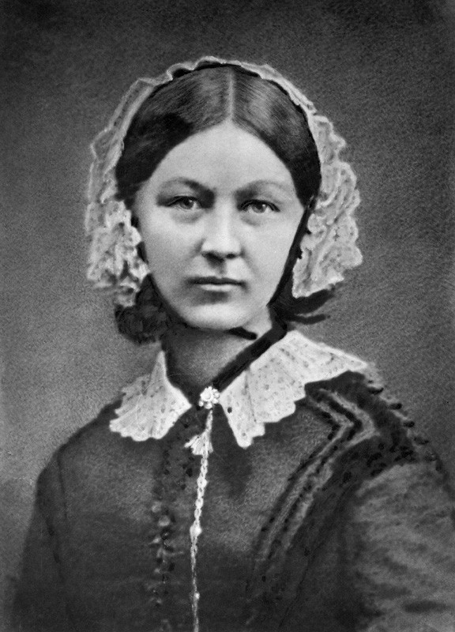
Florence Nightingale, England, Nursing (1820)

Slide 8
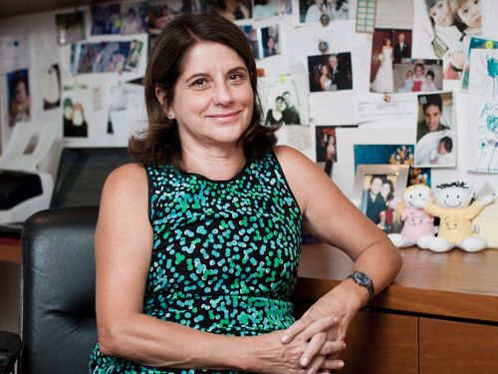
Vera Cordeiro, Brazil, reforming healthcare (1950)

Slide 9
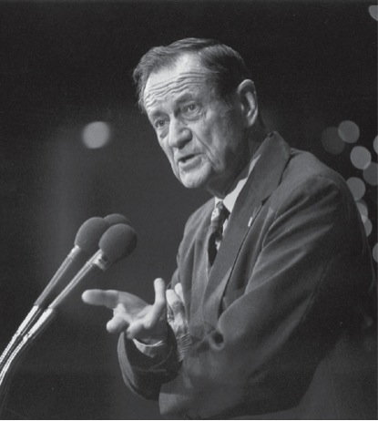
James Grant, United States, The Child Survival Revolution (1922)

Slide 10
Six Qualities of successful social entrepreneurs
1. Willingness to self-correct.
Example
Veronica Khosa has designed a prototype home-based nursing service that has influenced health care policies nationally and internationally.
She reframed her agency as a general home care service instead of AIDS service.

Slide 11
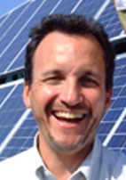
Six Qualities of successful social entrepreneurs
2. Willingness to share credit
Fabio Rosa, Brazil, succeeded in its very first attempt to raise the living standards of low-income rural families by taking cheap electricity to their homes and farms.
The idea belongs to Ennio Amaral.

Slide 12
Six Qualities of successful social entrepreneurs
3. Willingness to break free of established structures
James Grant encouraged country offices to plain their own strategies to mobilized around the new strategies

Slide 13
Six Qualities of successful social entrepreneurs
4. Willingness to cross disciplinary boundaries
‘Social entrepreneurs serve as a kind of social alchemist—pulling together people from different spheres, with different kinds of experience and expertise, who can, together, build workable soluations that are qualitatively new’

Slide 14
Six Qualities of successful social entrepreneurs
5. Willingness to work quietly
6. Strong ethical impetus
Business entrepreneurs – building greatest running-shoe company
Social entrepreneurs- vaccinating all world’s children

Slide 15
Thank you

