Slide 1
A BEND IN THE RIVER
V.S. NAIPAUL
Notes:
Nonfiction

Slide 2
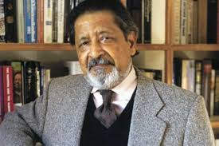
V.S. NAIPAUL
TRINIDADE
NOBEL-PRIZE WINNING AUTHOR
EDUCATED IN ENGLAND
KNOWN FOR HIS AUTOBIOGRAPHICAL WORKS AND FICTION
Notes:
Trinidadian Nobel Prize-winning British writer known for his comic early novels set in Trinidad and Tobago, his bleaker later novels of the wider world, and his autobiographical chronicles of life and travels.^{[1]} He has published more than 30 books, both of fiction and nonfiction, over some 50 years. Educated at Oxford

Slide 3
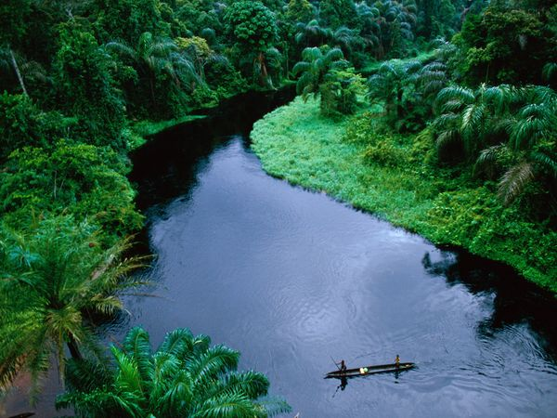
A BEND IN THE RIVER BACKGROUND
SET IN UNKNOWN AFRICAN COUNTRY
POST INDEPENDENCE, 1960, A DEVELOPING (WHAT WAS FORMERLY A BUSTLING EUROPEAN COLONIAL TOWN PRE-INDEPENDENCE AT THE BEND OF THE RIVER)
NARRARATED BY PROTAGONIST: SALIM: ETHNICALLY INDIAN MUSLIM, FORMERLY FROM IVORY COAST, A TRADER BY PROFESSION
Notes:
BIGGEST THING THAT BOTHERED ME ABOUT THE BOOK IS THAT THERE IS NO DIRECT HISTORICAL CONTEXT TO FOLLOW → After Research: Identified country as the Congo Post Independence: Following history: Post colonial Belgian Rule A PART OF THE PARIAH GROUPS IN AFRICA; ORIGINALLY FROM THE IVORY COAST

Slide 4
CHARACTERS
ZABETH: LIVES IN THE BUSH, TRAVELS TO THE TOWN TO PURCHASE GOODS FROM SALIM
METTY: FORMER SLAVE FROM SALIM’S FAMILY ON THE COAST WHO COMES TO LIVE WITH SALIM; FLEES ETHNIC PERSECUTION
FERDINANDE: ZABETH’S SON WHO STAYS WITH SALIM TO LEARN ”ACT PROPER” WHILE HE ATTENDS SCHOOL
INDAR: FORMER FRIEND OF SALIM’S ON THE COAST: GOES TO ENGLAND FOR EDUCATION; RETURNS TO AFRICA
“THE BIG MAN”
RAYMOND AND YVETTE: HISTORIAN, RESEARCHER, LIVES IN “DOMAIN”; TELLS A STORY OF MENTORING THE “BIG MAN” BEING VERY CLOSE
OTHER PARIAH COMMUNITIES
Notes:
SALIM’S INTERNAL DIALOGUE, HE COMPARES HIMSELF TO HER ETHNIC LIFE IN THE WOODS
IT IS THROUGH INDAR THAT SALIM ENTERS THE DOMAIN AND MEETS TWO CHARACTERS, RAYMOND AND YVETTE:

Slide 5
TRANSFORMATION OF LANDSCAPE:
ARRIVAL (PERIOD OF CALM): FIRST HALF OF THE STORY
FEAR (CONFLICT, WHITE MERCENARIES, INTRODUCTION OF THE “BIG MAN,”)
THE “DOMAIN” IS BUILT AND TOWN BEGINS MODERNIZING
ESCALATION (THE ”BIG MAN” BEGINS CENTRALIZING POWER AND STARTS TO ELIMINATE ALL FOREIGNERS IN THE COUNTRY TO GET BACK TO TRADITIONAL AFRICA→ NATIONALIZATION → MOBUTU’S “NATIONAL AUTHENTICITY”
COLLAPSE: STORY ENDS IN CONFLICT; ”BIG MAN” TO ARRIVE AT THE BEND IN THE RIVER TO KILL; ALL FOREIGNERS FLEE
Notes:
ARRIVAL: DAILY INTERACTIONS
BIG MAN “MOBUTU” THROUGH DESCRIPTIONS → AUTHORITARIAN → RETURN TO TRADITION
DOMAIN: ADMINISTRATORS, CIVIL SERVICE MEMBERS, FOREIGN GUESTS

Slide 6
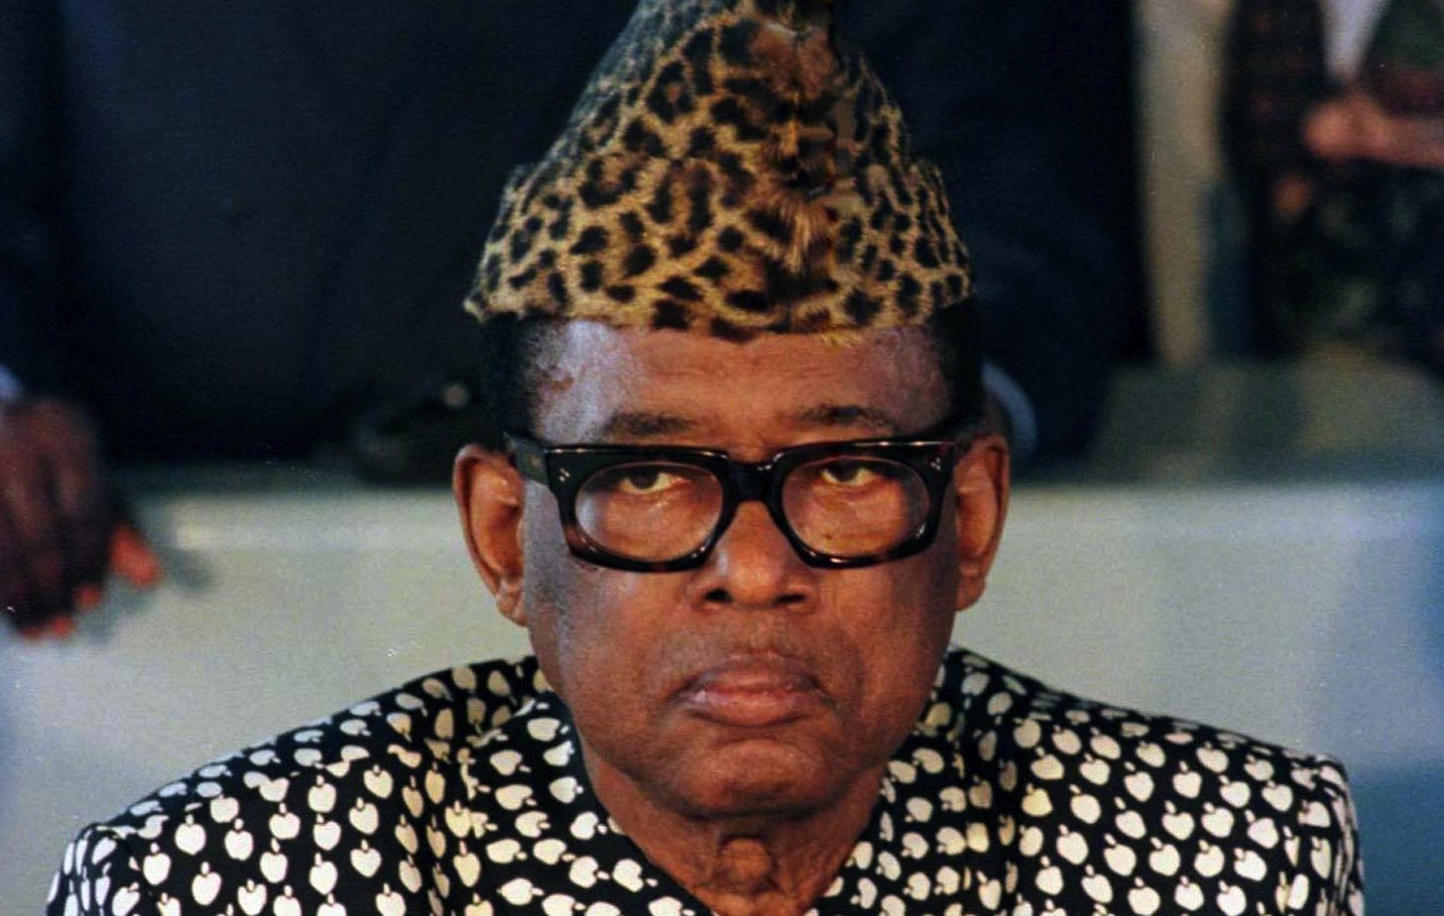
THE “BIG MAN” MOBUTU
“HE IS THE GREAT AFRICAN CHIEF, AND HE IS ALSO THE MAN OF THE PEOPLE. HE IS THE MODERNIZER AND HE IS ALSO THE AFRICAN WHO HAS REDISCOVERED HIS AFRICAN SOUL. HE’S CONSERVATIVE, REVOLUTIONARY, EVERYTHING. HE’S GOING BACK TO THE OLD WAYS, AND HE’S ALSO THE MAN WHO’S GOING AHEAD.”
“HE IS THE SOLDIER WHO DECIDED TO BECOME AN OLD-FASHIONED CHIEF, AND HE’S THE CHIEF WHOSE MOTHER WAS A HOTEL MAID.”

Slide 7
AFRICA AS SEEN THROUGH THE EYES OF A PARIAH
FOLLOWS THE INTERNAL CONFLICT OF NARRARATOR ABOUT HIS FEELINGS OF BEING ETHNICALLY INDIAN MUSLIM IN AFRICA – FEELING A PART OF THE COUNTRY BUT NOT AND FEELING A SENSE OF SUPERIORITY
A LOT OF CONTRASTS; NOT SURE OF WHO HE IS, WHERE HE BELONGS IN LIFE; THIS IS HOW THE READER COMES TO UNDERSTAND THE EVOLUTION AND ALL OF THE RELATIONSHIPS AT THE BEND IN THE RIVER
“EUROPE NO LONGER RULED. BUT IT STILL FED US IN A HUNDRED WAYS WITH ITS LANGUAGE AND SENT US ITS INCREASINGLY WONDERFUL GOODS, ADDED YEAR BY YEAR TO OUR IDEA OF WHO WE WERE, GAVE US THE IDEA OF OUR MODERNITY AND DEVELOPMENT”

Slide 8
THE GUTS – WHY READ?
VALUABLE READ: SOME THEMES
REMINANTS OF THE COLONIAL PERIOD
STRUGGLE FOR INDEPENDENCE IN THE CONGO AND THE CONFLICT THAT AROSE
DEVELOPMENT AND MODERNIZATION
VIOLENCE, CONFLICT AND CORRUPTION
TALK OF THE “OUTSIDER” RAYMOND, WHO IS AN “AFRICAN EXPERT” BUT KNOWS NOTHING OF THE “TRUE” AFRICA
FOREIGNERS AND SCHOLARS WHO COME IN AND OUT, INTERACTIONS

