Slide 1
PIA 2501
DEVELOPMENT POLICY AND MANAGEMENT
WEEK FOUR

Slide 2
Week Four
Development Policy and Management

Slide 3
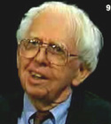
The Rising Sun- The Decline and Fall of the Japanese Empire
Empire and Beyond
John Toland, Historian and Journalist,
World War II Specialist, (1912-2004)

Slide 4
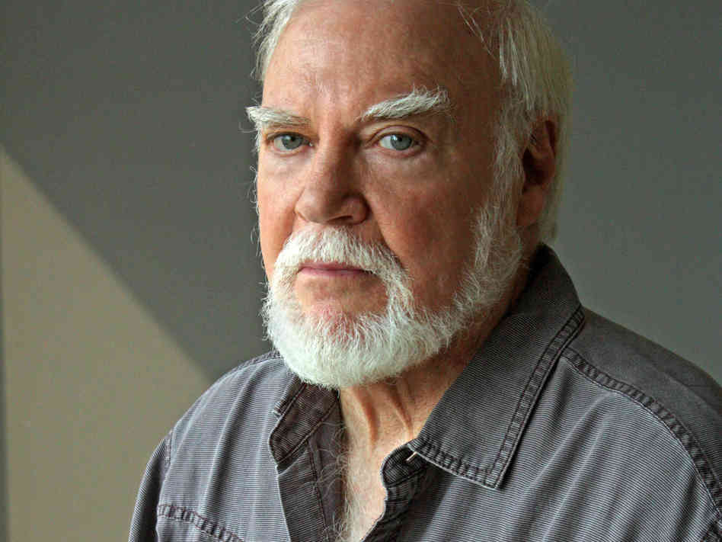
Discussion
Norman Rush, “Alone in Africa”
Norman Rush, “Near Pala”
Toland, Excerpts
from The Rising Sun

Slide 5
Overview of Themes
I. Review and the Mispolarity Problem
II. Dependency Theory
III. Development Administration Assumptions (Prior to 1970)
IV. Problems with Development Administration
V. Development Theory Revised: (1975-1983)
VI. Development Dilemmas: Donor Fatigue and Internal Capacity Limitations
VII. Structural Adjustment

Slide 6
Critiques of Modernization-Review of Arguments
Incorrect view of Subsistence Society
Ecology argument- balance vs. imbalance
Psychological Dependence

Slide 7
Prospero and Caliban- The Psychology of Depedence
Franz Fanon, Black Skin, White Mask

Slide 8
Critiques of Modernization Theory
Colonial Underdevelopment Argument
Traditionalism: Dichotomy or misplaced polarity (Gusfield)

Slide 9
The gusfield critique
Traditionalism: Dichotomy or misplaced polarity (Gusfield)
‘Mirror, mirror, on the wall’ (Gusfield Critique)
Co-existence in Saudi Arabia and Japan
Modernization of Tradition in Swaziland
Secularization of tradition in Mexico

Slide 10
The Argument Continued
I. Dependency Theory

Slide 11
Critiques of Modernization Theory
Interpretations of Underdevelopment and “Third Worldism”
Underdevelopment theorists critiqued Modernization Theory:
Modernization theory had its origins in Colonial ideology and the anthropological ideas that supported it.

Slide 12
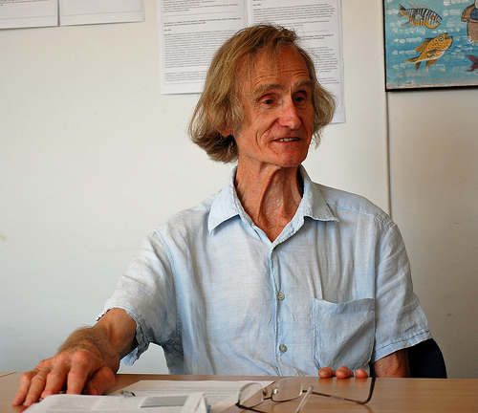
Interview Robert Chambers Research Associate at the Institute of Development Studies, University of Sussex, United Kingdom
He was born in 1932 and is an academic and development practitioner
Equity not Growth
Advocate of the
“participatory“
approach to
development

Slide 13
7. Underdevelopment and Dependency
Structuralism
Biology in the Tropics
Inelasticity of Tropical Products
Rigidity of Extractive goods

Slide 14
“Underdevelopment in History”
Rejects Dualism and “stage theories” of development (Keith Griffin)
Africa, Asia, Latin America not historically under-developed
European nations took slaves, metals and raw materials to build industrialization and grow their economies between 1500 and 1900
Empty Bucket- Full Bucket

Slide 15
Dependency Theory
and the beginnings of Dependency theory
Structuralism and
Interpretations of Underdevelopment and “Third Worldism”
In the beginning (1500) LDCs were self-sufficient at low level
Argument: Europe used its empire to market surplus goods and pay sub-economic costs for raw materials, agricultural products and minerals

Slide 16
Dependency Theory: The Empirical Argument
Interpretations of Underdevelopment and “Third Worldism”
In the beginning (1500) LDCs were self-sufficient at low level
Argument: Europe used its empire to market surplus goods and pay sub-economic costs for raw materials, agricultural products and minerals
Empirical Verification vs. Ideology (Better at the first)

Slide 17
Underdevelopment Theory- Summary
During 500 Years of colonialism Northern Tier states used colonialism to extract from LDCs
Result often was the destruction of local production, agriculture and food production
The colonial government supported export import trade and where possible, SETTLERS
Europe became dependent on extraction from the “third world”

Slide 18
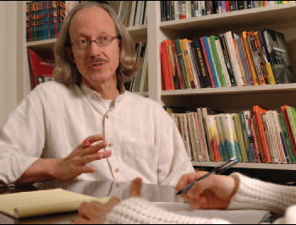
Critiques of Modernization Theory-6
Interpretations of Underdevelopment and “Third Worldism” -Discourse Analysis- “Development Language Codes” (Arturo Escobar)
Underdevelopment theorists critiqued Modernization Theory: Modernization theory had its origins in
Colonial ideology and the anthropological ideas that supported it. Modernization contains the language of imperialism

Slide 19
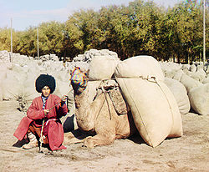
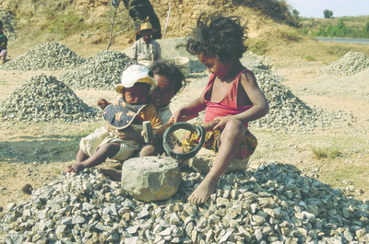
II. Development Administration Assumptions (Prior to 1970)
Agricultural Self Sufficiency?

Slide 20
The Definition of Development Administration
Quote of the Week: A Question?
"...political systems in the developing areas must bear increasing responsibility for mobilizing the state's human and material resources in support of the objectives of economic and social mobilization.“
Monte Palmer

Slide 21
Stages in Development Theory
Theory of Economic Growth (Target: Vietnam)
Key figure—Walt Rostow, The stages of economic growth: a non-Communist manifesto (Cambridge: Cambridge University Press, 1960)
There is a take off point that will lead to self-sustaining capital generation
Lesser Developed Countries (LDCs) are caught in a “low equilibrium trap”—not enough capital for growth
All nations are poor but are able to escape their poverty through their own domestic initiative (with correct policies)

Slide 22
Stages in Development Theory
Theory of Economic Growth (Rostow):
Popularized Modernization Assumptions
Traditional vs. Modern
Agraria vs. Industria
Agriculture vs. Industry
Subsistence vs. Commercialism
Advocated the “Trickle Down” effect to economic growth (Third Way)

Slide 23
Rostow and Johnson Controversy-Vietnam and Economic Development

Slide 24
III. Problems with Development Administration
Decreasing Bureaucratic Capacity over Time
Lack of Technical and Management Skills
An expanding state meant expanding debt
Gap increased between bureaucratic elites and the mass of the population

Slide 25
Bureaucratic Behavior

Slide 26
Problems, Continued
Highly centralized state structures deaden the state’s development capacity
Inherited administrative structures seen as increasingly rigid
Debate over choice between administrative reform and structural reform (Civil Service, Public Sector, Structural changes)

Slide 27
The Problems of Development Management
Quote of the Week: The Quiet American- An Alternative to expatriate non-involvement?
"The Human Condition being what it was, let them fight, let them love, let them murder, I would not be involved.“
Graham Greene

Slide 28
The Problems of Development Management
Quotes of the Week: Failure of Capitalism and Socialism (SOCIO-ECONOMIC EXIT)
"The Economy of Affection...denotes a network of support, communications and interaction among structurally defined groups connected by blood, kin, community or other affinities, for example, religion. It links together in a systematic fashion a variety of discrete economic and social units which in other regards may be autonomous.“
Goran Hydan

Slide 29
IV. Development Theory Revised: (1975-1983)
Robert McNamara -- World Bank
KEY: Necessary redistribution of resources both internationally and within an LDC
New International Economic Order vs. Basic Needs
Equity both domestically (within a country) and internationally

Slide 30
Basic Needs- The Poorest of the Poor... (Ben Heine, painter)

Slide 31
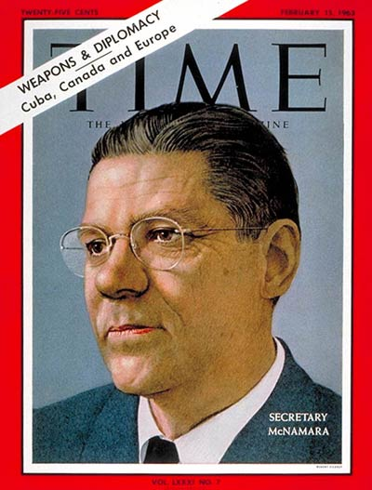
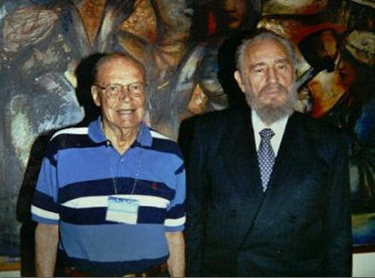
Robert McNamara

Slide 32
Development Theory Revised: 1975-1984
KEY: Necessary redistribution of resources- Fundamental Differences with Growth Theory
New International Economic Order (NIEO)
LDCs- North/South Redistribution should replace Rostowian growth assumptions
Basic Needs Assumption (World Bank)—Domestic redistribution
Strategy—growth with equity concerns

Slide 33
New International Economic Order
Detailed Discussion
Still Reflects the Counter-Narrative of Many in the Streets
Key: Redistribution of Wealth

Slide 34
Development Theory Revised: 1973-1983
KEY: Necessary- redistribution of resources : NIEO and Oil Cartel
Definition—Capacity, Equity, Empowerment and Sustainability
Reflects influence of Political Economy and Dependency Theories
NIEO: Original group of 77 countries, now 140

Slide 35
NIEO and the Brandt Report
Chair: Willy Brandt, former Chancellor of the Federal Republic of Germany
Common Crisis, North South: Cooperation for World Recovery
1980, 1983
Accepted (in theory) basic premises of Dependency Theory

Slide 36
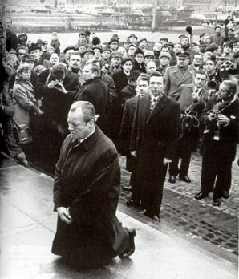
Willy Brandt (1972 and 1992)

Slide 37
Assumptions of the NIEO States (Brandt Report)
Need for structural change in world economy
Thesis: Industrial Development in Europe caused underdevelopment in LDCs
Northern Tier States extract resources from LDCs
No low level equilibrium trap—regression to underdevelopment
Sources: Thomas B. Birnberg and Stephen A. Resnik, Colonial Development : an Econometric Study (New Haven : Yale University Press, 1975)
See also the works of Susan George

Slide 38
Underdevelopment

Slide 39
Assumptions of the NIEO States (Brandt Report)
European involvement in LDCs was extractive and "created" underdevelopment
underdevelopment is a historical problem
16th century—Europe and World
Europe, 1600—technologically advanced but resource poor
Asia, Africa, Central and South America—resource "rich" and self-sufficient but technologically poor

Slide 40
Brandt Report
Imperialism from 1600 to 1900 led to resource transfer from LDCs to West
“FROZEN INEQUITY”

Slide 41
Assumptions of the NIEO States (Brandt Report)
Result in LDCs was decline in agricultural self-sufficiency and indigenous commercial and industrial activity
Was no dual economy—a world economy was created which the peasant economy deeply penetrated
Metropole
Sub-Metropole
Periphery
Sub-periphery

Slide 42
Assumptions of the NIEO States (Brandt Report)
LDC acts as a market for more Developed Countries (MDCs)—eg. Agriculture depends on Agri-business
Cooptation of Local Elites as consumers of LDC resources
Continues to Influence Thinking

Slide 43
Assumptions of the NIEO States: Redeux
The Goal: Need to moderate or eliminate dependency relationship through counter-dependency
Self-sufficiency—China in the 1950s
Dependency avoidance—Canada, Scandinavia and Japan in nineteenth century
Dependency reversal—India, Brazil (1970s)
Dependent Development—(Newly Industrializing Countries, NICs, Emerging States The BRICS)
Regional Cooperation—ASEAN, CIS, SADC, ECOWAS, MERCESOR

Slide 44
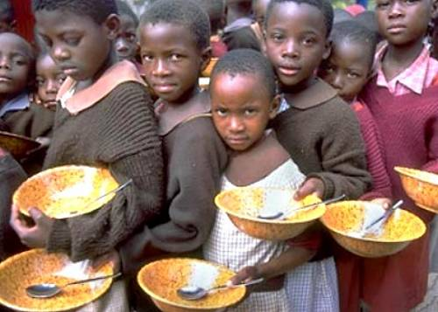
“A New International Economic Order is Deemed Necessary”

Slide 45
Basic Needs Assumptions: 1975-1983
Institutionalize Project capacity in development program structures (The works of Dennis Rondinelli)
All civil service to explore new technologies and leadership styles
Promote Sustainability and Institutional Capacity
Shift Priorities to Rural Development
Small is Beautiful- appropriate technologies
A bit of Romanticism?

Slide 46
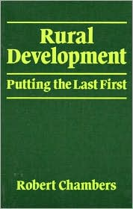
Basic Needs Assumptions
Robert Chambers, Rural Development: Putting the Last First (New York: Longman, 1983)
Move to Field Administration, Extension Work and Bottom Up Planning
Find a non-threatening way (vis-a-vis) elites to promote the redistribution of resources
Redistribution

Slide 47
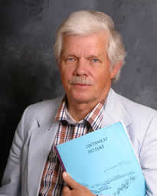
Donor Response Basic Needs Assumptions:
Jon R. Moris, Managing Induced Rural Development (Bloomington, Ind: International Development Institute, Indiana University, 1981).
Jon R. Moris and James Copestake, Qualitative Enquiry for Rural Development : a Review (London : Intermediate Technology Publications on behalf of the Overseas
Development Institute, 1993).

Slide 48
The Problem with Dependency Reversal
Debates about Free Trade VIDEO

Slide 49
Break
TEN MINUTES

Slide 50
End of Century
V. Development Dilemmas: Donor Fatigue and Internal Capacity Limitations
Note: # VI. Structural Adjustment-Next Week

Slide 52
Donor Fatigue: (1983-2000)
Donors defined as a problem as they set agendas for LDCs
Expatriates are consumers (of LDC privileges): Development Cynics
Career prospects shift from “Insensitive / AID / Embassy Types” to Grassroots, cultural sensitivity and eventually to NGOs
(Lederer and Burdick Ugly American influence)
Donors begin to advocate privatization and contracting out

Slide 53
Internal Capacity Issues(Bryant & White)
Debates: Which Comes First?
The Chicken or the Egg?
Development Administration vs. Development Management
Development Management vs. Management Development
Economic and Social Development (ESD) vs. Human Resource Development (HRD)

Slide 54
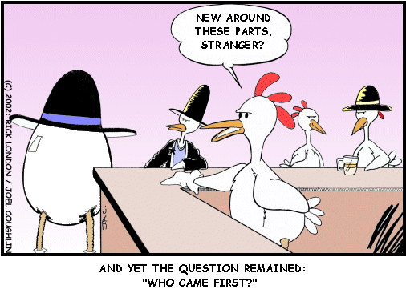
The Big Question

Slide 55
Which Comes First?
Development Management depends on administrative development and strengthening administrative structures
The deadlock—HRD vs. ESD
LDC administrators—more work with less pay
The Goal: Strengthen Administrative Capacity
Problem: Solutions to HRD increases social stratification and entrenches bureaucratic elites
Articulated in the Millennium Development Goals (UN)

Slide 56
Millennium Development Goals

Slide 57
Development Management
More Collaborative than Development Administration
Involves Public, Non-Profit and Private Sector
Development management deals with the coordination and management processes of international development programs and projects.
The dominant focus in development management is the intervention in the form of a transfer of aid by an external agency/donor and the oversight of the related project cycle,
That is project identification, planning (formulation and appraisal), implementation and monitoring, and evaluation.

Slide 58
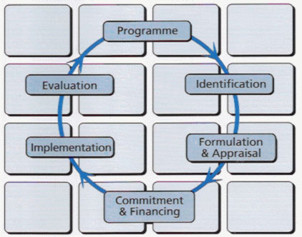
The Planning Cycle

Slide 59
Internal Capacity Issues (Bryant & White) Debates, continued: Other Chicken and Egg Problems
Balanced vs. Unbalanced Regional Development (Equity vs. Widening the Gap)
To what extent is a state planning approach, balancing regional development, possible
Unbalanced Growth and Class Formation
Balance between Public, Private (for profit and NGOs) and “Parastatal” (Public Corporation) Sectors
Political vs. Economic Development (Deadlock of Development Administration)

Slide 60
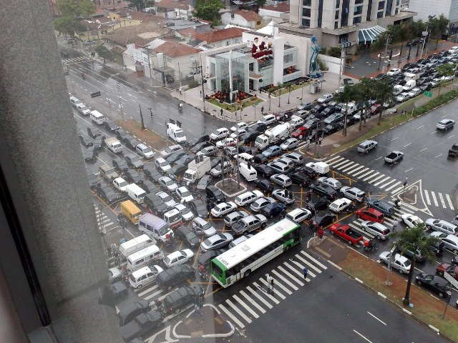

Slide 61
Internal Capacity Issues (Bryant & White)- Debates Continued
See Bernard Schaffer, The Administrative Factor; Papers in Organization, Politics and Development (London: Cass, 1973).
How much development will occur without political institutions and political will?
Bureaucratic elites are part of a process of political control and mediation and development policy may have a major political mediation (control) role.
What are the limitations of a state planning approach to development?

Slide 62
The Future of Development Management

Slide 63
Internal Capacity Issues (Bryant & White)
Debates: the “Attitudes Problem”
How to get people to think developmentally?
Changes in programmatic values have an impact on LDC elites
Problem of the Organizational Bourgeoisie: Bureaucratic values unchanged from colonial period as domestic elites manipulate public policy (Picard)

Slide 64
Internal Capacity Issues (Bryant & White)
Debates: the “Attitudes Problem”
Myth of civil service neutrality: Bureaucratic elites have interests
At best what results is benign neglect, at worst resource extraction
Problem: failure to develop and indigenous capitalism
Limited to settler, pariah groups—Jews in Eastern Europe, Chinese in much of Asia, Lebanese and East Indians in parts of Africa and Latin America (See V.S. Naipaul)

Slide 65
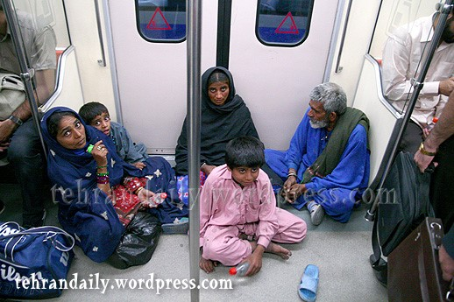
Gypsies (Roma) in Europe

Slide 66
Internal Capacity Issues (Bryant & White)
Debates: the “Attitudes Problem”
Sometimes referred to as “Comprador” classes or “dependent elites,” since they have been co-opted and are linked to Northern Tier states
Expatriate Attitudes?
Pariah Elites

Slide 67
Problem: The Expanding Civil Service
Civil Servant Component of the total Current Budget
10 to 15% in MDCs
30 to 60% in LDCs
South Africa in 2001, 46%
Benin in the 1980s, 64%
Central African Republic in the 1960s, 81%

Slide 68
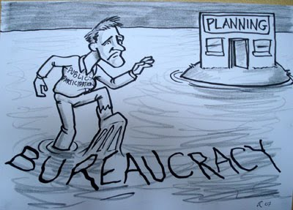

Slide 69
Internal Capacity Issues (Bryant & White)
Debates: the Bureaucratic “Attitudes Problem” continued
How developmental are bureaucrats?
Can (and Should) the state be used for SOCIAL ENGINEERING?
Is the private or non-profit sector better at development?

Slide 70
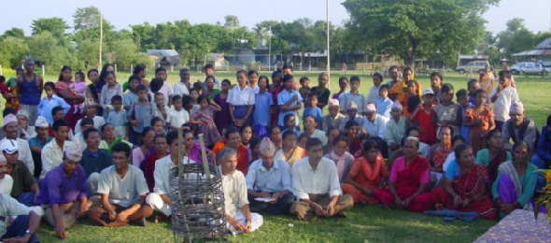
Social Mobilization Training Social Engineering VIDEO

Slide 71
Internal Capacity Issues (Bryant & White)
Basic Needs Assumptions: Problem
Need for increased capacity of public, parastatal and private sectors
State should remain central to development planning and management
Need for administrative reform to develop more creative development structures

Slide 72
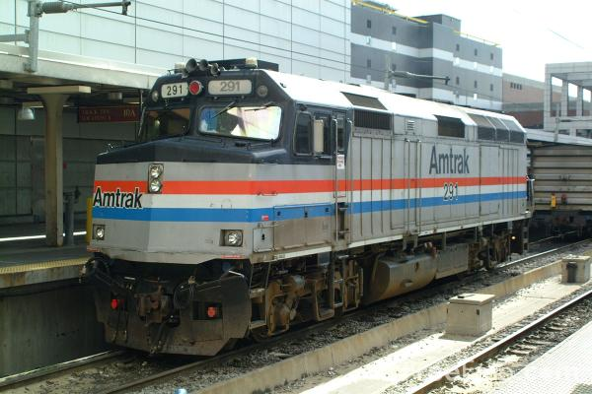
AMTRAK- Public or Private?

Slide 73
MEET THE aUTHORS
OUR “BOOKS OF THE WEEK”

Slide 74
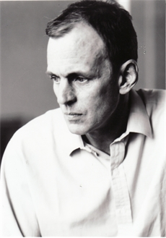
Follow Up: “White Mischief” Books
James Fox, White Mischief: The Murder of Lord Erroll, New York: Vintage Books, 1998. 1987 Film.
The Story of Happy Valley, Kenya.
Good Picture of Colonial Africa

Slide 75
Book 1: White Mischief September 29
James Fox: British Journalist, Sunday Times (London)
Description: Amorality of Colonial Kenya
Issue: What does the book tell us about Colonialism

Slide 76
White Mischief in the 21st Century
AN OUT TAKE

Slide 77
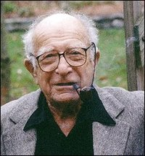
William J. Lederer and Eugene L. Burdick
(December 12, 1918–July 26, 1965)
(March 31, 1912 to
December 05, 2009)

Slide 78
Book 2: The Ugly American
Background: Origins of U.S. Foreign Aid Policy
Marshall Plan and Point Four Program
Agricultural College Bias
Ugly American and the Peace Corps (and the other “peace corps”)
Technical Assistance in Vietnam
Models of Malaya and Kenya
“Hearts and Minds” (French term, taken to Viet Nam, later used in South Africa, Iraq)

Slide 79
Vietnam

Slide 80
Authors of the Week
William Lederer and Eugene Burdick - Images
U.S. Administrators and the “official U.S.” Need to outwit the communists; find the “decent Asian”
American compound mentality: the “overseas American” sees unusual and unorthodox as “threatening”
Basic ideology of the 1950s—Image of Russian officials: cultural and linguistic sensitivity
U.S. Press—seldom writes about foreign policy and when they do, focus is on those who are “threatening” U.S. interests
Religion: able to penetrate LDCs, and recruit indigenous allies

Slide 81
What is the Answer?

Slide 82
Authors
William Lederer and Eugene Burdick- Journalists- Say Non-Fiction
Characters—their significance
Development Officials
Communist “followers”
Dairy Specialists and “Engineers”
Priests
Secretaries as Lacking in Sensitivity

Slide 83
William Lederer and Eugene Burdick, The Ugly American
Major Themes
Various meanings of the term, “ugly american”
Types of Americans overseas
The U.S. Foreign Service in 1958
Midwestern Salt of the Earth
“Hearts and Minds”

Slide 84
“The Book of the Week Club”
James Fox, White Mischief
William Lederer and Eugene Burdick, The Ugly American
What message do these give us about foreigners in Asia and Africa
What message do the books give us about “development” or the lack of it.
What criticism would you make of the books?

Slide 85
Meeting the Authors
On Writing
Paul Theroux

Slide 86
Discussion: Next Week
Chambers, Chapters 1-3
Weatherby, et. al., Chapters 1-2

