Slide 1
PIA 3090
Development Theories
Presentation Two
Overview of Issues

Slide 2
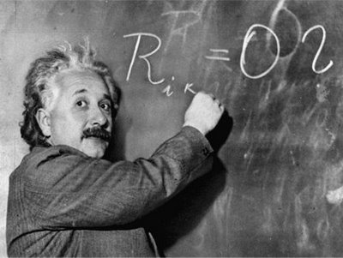
Theory?

Slide 3
How do we define it?
Pre-Discussion of Theory

Slide 4
Modernization and Dependency Theory
Overall Theme for Next Two Weeks: Modernization vs. Dependency Theory

Slide 5
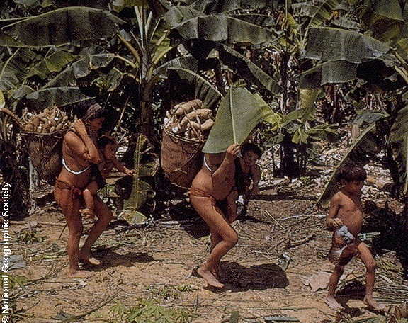
Traditional or Balanced Development? The Difference?

Slide 6
Mock Comprehensive Question
How are theories of development related to the concepts related of dependency and modernization theories? What does each say about strategies of development management? To what extent do these concepts prescribe different development policies to national level policy makers? Where does orthodox Marxism fit into the above dichotomy? Defend your views by specific reference to the literature in the field.

Slide 7
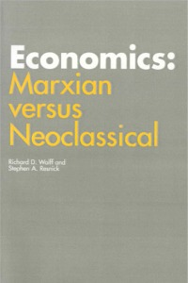
Is This About it?
Question?

Slide 8
The Nature of the Debate
Theme of the Week
"What Is to Be Done?“
Vladimir Ulyanov
Who Is He?

Slide 9
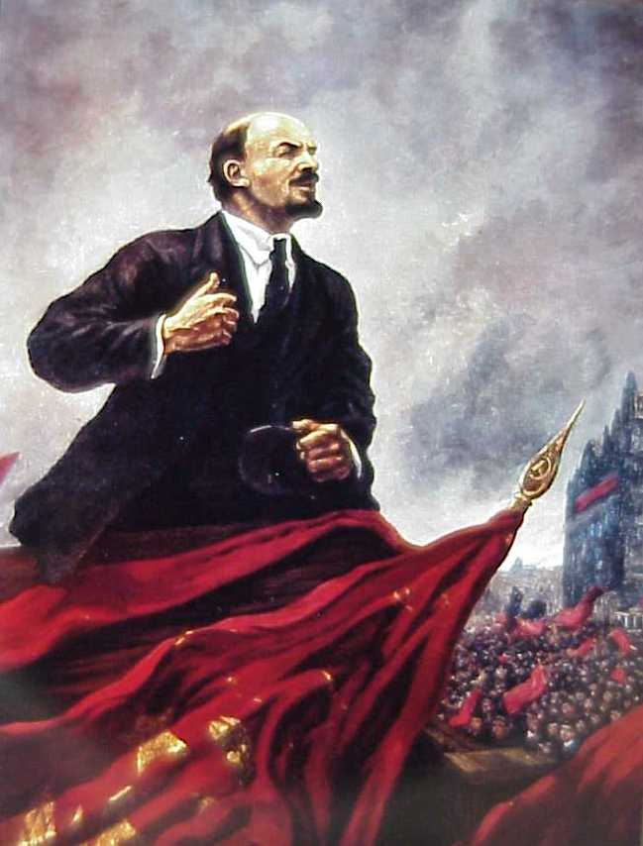
VLADIMIR ILYICH LENIN

Slide 10
Modernization
Overall Themes:
Impact of Tradition
Colonialism Overlay
Modernization Concepts
Debates

Slide 11
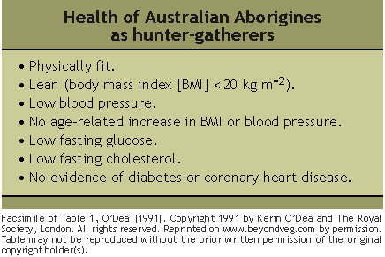
Underdeveloped?

Slide 12
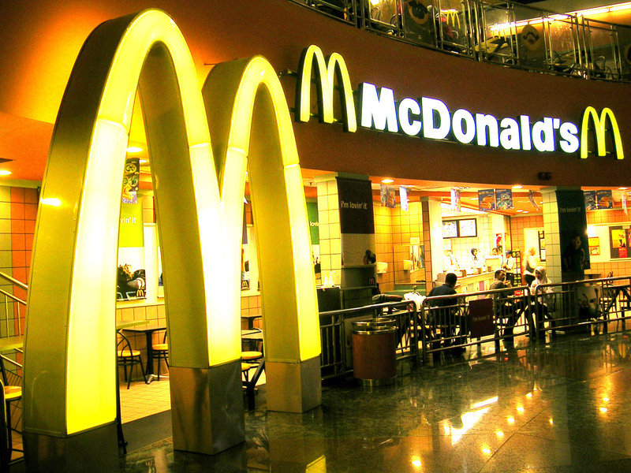
Modernization

Slide 13
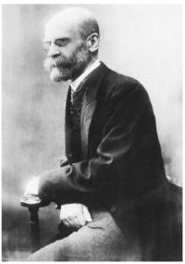
Émile Durkheim
Founder of Modern Sociology
(April 15, 1858 – November 15, 1917)
He was one of the first people to explain the existence and quality of different parts of a society by reference to what function they served in maintaining the quotidian (i.e. by how they make society "work“).
FUNCTIONALISM

Slide 14
Leadership and Tradition: The Role of Political Development
The Vexing Problem of Traditionalism and Colonialism
"The President of Mali, a descendant of the old Keita royal clans, is a president who walks like a king.“
David E. Apter
"The concept of political development is far more difficult and culture-bound than is that of economic development.
Joseph R. Gusfield

Slide 15
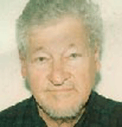
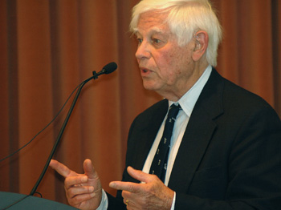
Modernizers
David Apter (December 18, 1924 – May 4, 2010)
Joseph R. Gusfield- Born in 1923

Slide 16
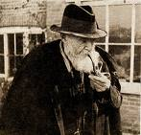
Colonialism
"Whatever happens we have got
the Maxim Gun and they have not."
Hilaire Belloc
(27 July 1870– 16 July 1953)

Slide 17
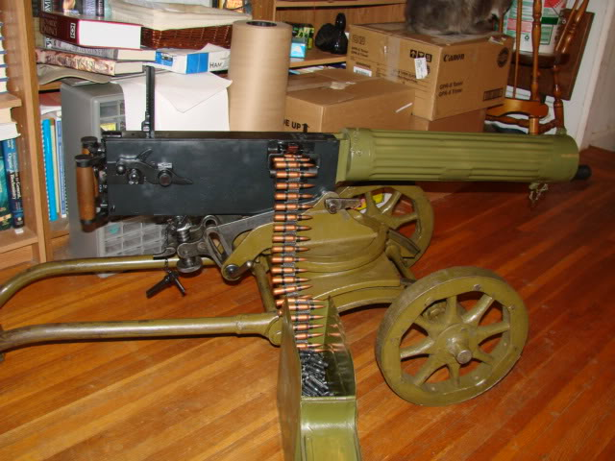
Semi auto 1910 maxim gun

Slide 18
Colonialism and the Social Development Drama:
Missionaries
Private education and health services
The Civilizing Mission
Law and Order Focus
Extraction: Minerals, Energy and Primary Products

Slide 19
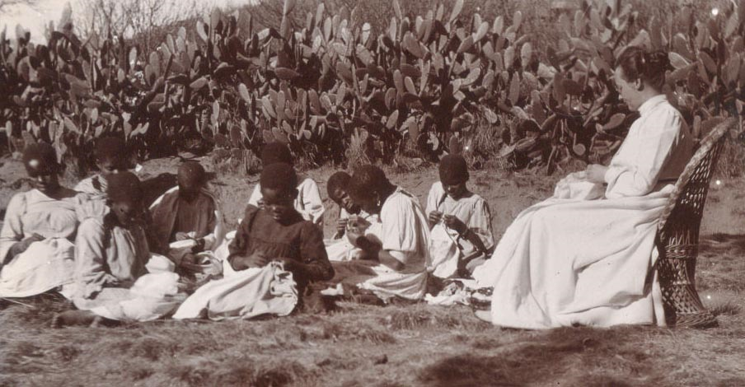
Missionary in South Africa

Slide 20
The Concept of Modernization
There are a number of characteristics usually linked to the concept of Modernization. These include:
1. Concept of Empathy
2. Characteristics of Dual Economy
3. Social Mobilization
4. Governance and Political Development
5. Social Development
6. Free Enterprise?

Slide 21
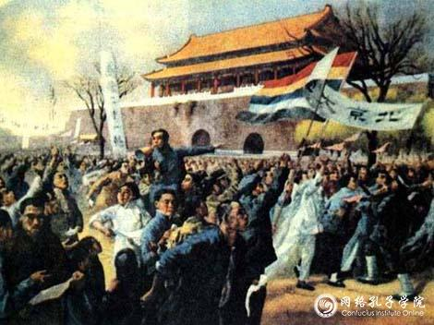
Student demonstrations in Beijing on May 4, 1919.

Slide 22
1. Concept of Empathy
Put oneself in the position of others according to Daniel Lerner in The Passing of Traditional Society. This includes:
A Mobile personality or the acceptance of new ideas
A series of individual changes affect society. These include secularism, literacy, and urbanization
A Society changed by mass based Communications. From this comes the multiplier effect of the mobile personality and empathy

Slide 23
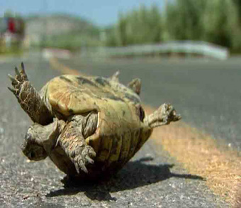
Empathy

Slide 24
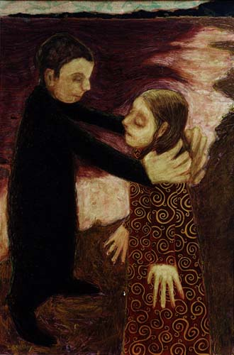
Empathy by Lora Shelley

Slide 25
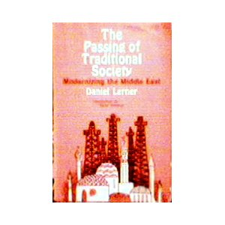
Lerner had been in the OSS During WWII

Slide 26
2. Dual Society/Dual Economy
Tradition is the source of poverty and underdevelopment
Modernization assumes a dual economy with an enclave modern sector
There is a movement from traditional to modern (and rural to urban) in all societies
The so-called West has distinguishing characteristics that distinguish it from Third World
The result is an assumption of Dichotomy (references include writing by (Talcott Parsons, Marian Levy, Frank Sutton and in modified form Fred Riggs).

Slide 27
Development: The Modernization Definition
      Agraria
Attitudes: parochial – fixed rules
Customs: particularistic / inherited
Status: ascriptive
Functionally: diffuse
Holistic Change
Lack of Specialized Roles
Result
Agricultural, rural, poor
Oral / illiterate
Authoritarian instability
Subsistence – non-monetary
Revolution and violence
Occupation fixed
  Industria
Universalistic
Legal / Rational
Achievement Oriented
Roles Functionally Specific
High Degree of Technology
Manufacturing and Production
Oriented
Result
Commercial
Democratic / Peaceful
Occupational mobility
Literate
Urban, Rich
Incrementalism, Stability and Gradual Change

Slide 28
Reference
Agraria and Industria: Two Models of the International System – JSTOR
www.jstor.org/stable/2009559
George Modelski (1961) World Politics
Volume 14 Special Issue 01 October 1961, pp 118-143.

Slide 29
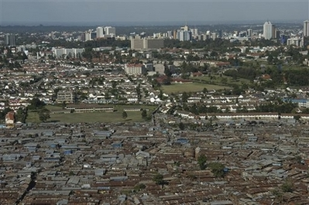
Aerial view of Kibera slum in Nairobi

Slide 30
3. Social Mobilization
Focus on is on Value change: Defines the process in which old social, economic and psychological commitments are shaken off
Social mobilization, and for some, forced value change was the key to modernization
Mobilization becomes the way that old social, economic, and psychological values are thrown off.
Advocates call for the use of the mobilizing party for social engineering purposes
The goal became the use of the state to break down personal (organic) values and integrate modern values into a common political and socio-economic change system

Slide 31
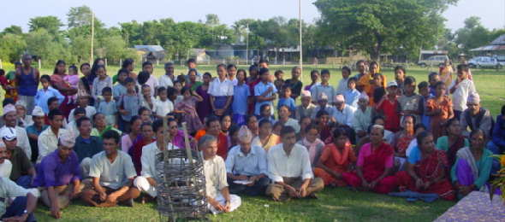
Farmers leading the way in groundwater development in Nepal

Slide 32
4. Governance and Political Development
Governance Debate: Key and Political Development is linked to Economic Development
The Bureaucratic Class (according to Manford Halpern) are Modernizers since only the bureaucracy can penetrate into the rural areas
What is needed is a coalition between government leaders, the bureaucracy and industry (John Kautsky)
The model became western parliamentary (representative), the rule of law and political systems based on democracy and pluralism
At issue: Which comes first: political or economic development or political and bureaucratic development

Slide 33
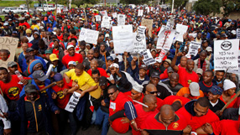
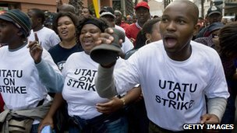
South African Public Service on Strike

Slide 34
5. Social Development and Modernization
1. Social transformation thesis: certain cultural characteristics impel or facilitate development and while others impede or undermine it (Isbister and Heady)
2. The goal becomes transformation of social structure (Isbister and Myrdal-esp. Asian Drama)- Health and Education (HRD)
3. Social systems require goal creation within social settings- there is a social need for productive activities (Dunn) Rejection of material culture?
4. The debate about whether countries can accumulate "Slack" or internal autonomy through capital accumulation
5. The debate over globalization (and rationalization) and impact on social development (“dog eat dog” problem)
6. Social integration and indigenous Languages as "Museum pieces" (World Languages: Chinese, Arabic, French, Spanish and English?)

Slide 35
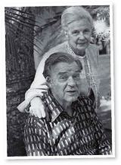
Gunar and Alva Muyrdal Swedish Sociologists
An American Dilemma: The Negro Problem and Modern Democracy. Harper & Bros, 1944
Asian Drama: An Inquiry into the Poverty of Nations
Three volumes, 1968

Slide 36

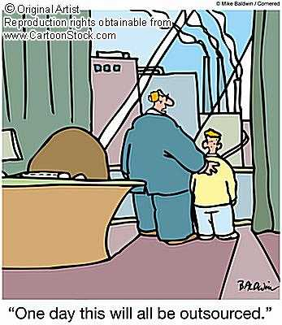
Governance and Social Services

Slide 37
6. Free Enterprise
Definition of 'Free Enterprise'
An economic system where very few restrictions are placed on business activities and ownership.
In this system, governments generally have minimal ownership of enterprises in the market place.
This system aims for limited restrictions on trade and minimal government intervention

Slide 38
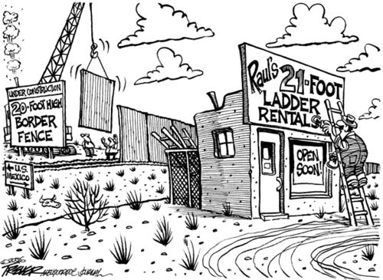
Free Enterprise?

Slide 39
Ten Minutes
Coffee Break

Slide 40
Counter-Theme
Dependency Theory

Slide 41


The Economic Commission for Latin America (ECLA) -the Spanish acronym is CEPAL- was established by Economic and Social Council resolution 106(VI) of 25 February 1948 and began to function that same year.

Slide 42
Structuralism vs. Dependency
Structuralism Stated at the Economic Commission for Latin America
A fundamental approach by structuralism has been its conceptualisation of the international system as being constituted by asymmetric center-periphery relations
Problem: Natural and Physical differences: social, water and base line prices of agricultural products and minerals
Inelasticity of Prices

Slide 43

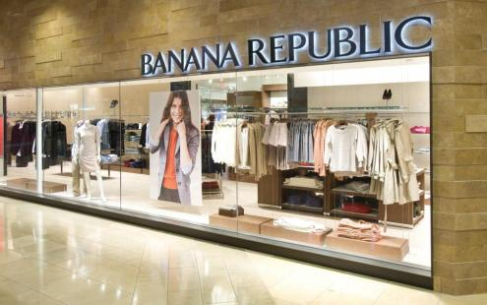
Which is it?

Slide 44
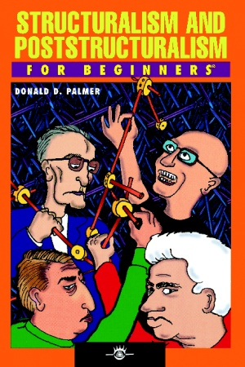
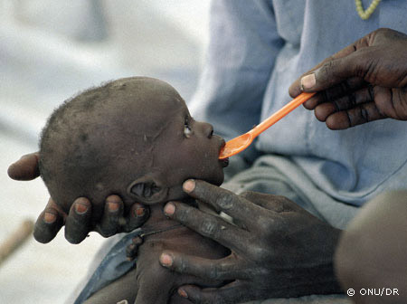
Structuralism and Underdevelopment: Define?

Slide 45
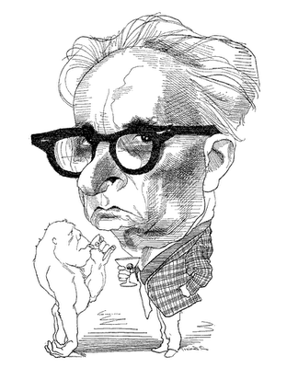
Claude Lévi-Strauss (28 November 1908 – 30 October 2009)
He argued that the "savage" mind had the same structures as the "civilized" mind. Structuralism is defined as the search for the underlying patterns of thought in all forms of human activity.
It is the physical and social environment that impacts individual and group behavior.

Slide 46
Dependency Theory
Dependency Theory follows but is different from Structuralism
1. In the beginning (1500) LDCs were self-sufficient at low level.
2. The argument: Europe used its empire to market surplus goods and pay sub-economic costs for raw materials, agricultural products and minerals.
3. During 500 Years of colonialism the Northern Tier states used colonialism to extract from LDCs creating a three part World made up of Metropols, peripheries, sub-peripheries
4. The result often was the destruction of local production, agriculture and food production

Slide 47
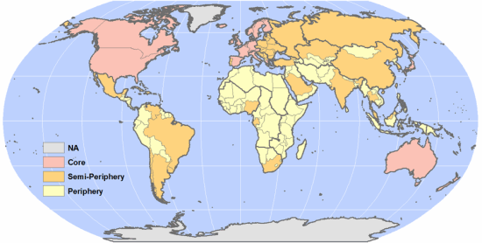
Structuralism vs. Dependency Theory- Differences? (Mini-Discussion)

Slide 48
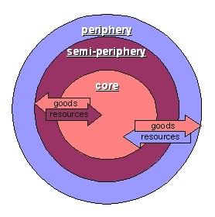
Dependency Theory

Slide 49
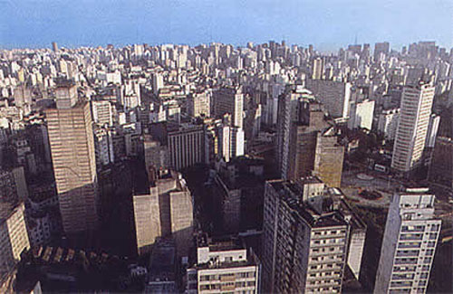
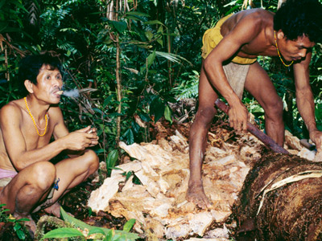
Metropole vs. Sub-Periphery

Slide 50
Dependency Theory-Continued
5. The colonial government supported export import trade and where possible, SETTLERS
6. Europe became dependent on extraction from the “third world.” The full bucket, empty bucket analogy
7. Colonies whether land based or sea based (and de jure or de facto) functioned through extractive taxation and as systems of labor reserves

Slide 51
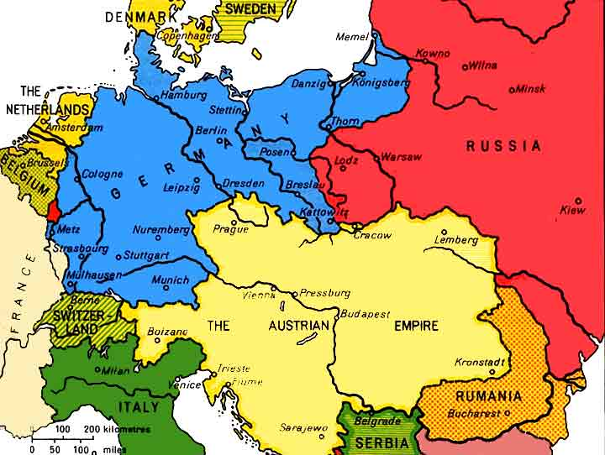
Land Based Empires: Central Europe in 1890 (DEPENDENCY?)

Slide 52
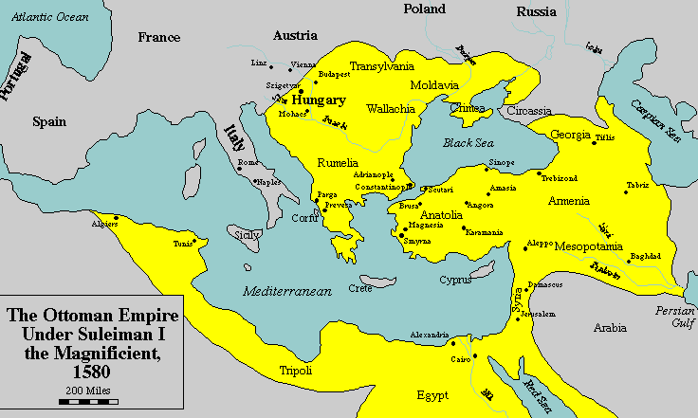
Land Based Empires: Ottoman Empire At Its Height

Slide 53
Debates about Modernization From “Dependentistas”
1. The reifying effect of unilinear theories: Underdeveloped to Developed
2. Syncretism- in religion and Culture
3. Modernizing Traditional Authorities
4. “Crony Capitalism” and Private Sector Development
5. The limits of Capitalism: Pariah groups and the Private Sector

Slide 54
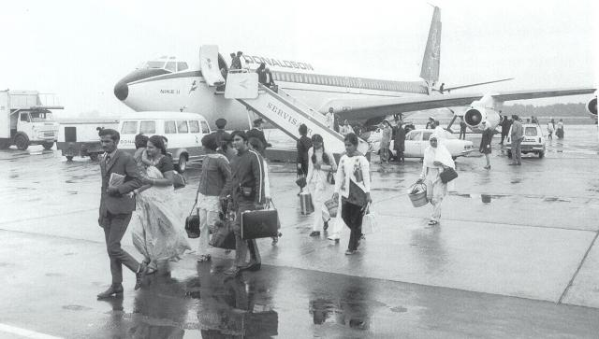
Uganda Asians. How does one view a Pariah Group?
PARIAH GROUPS
Indians, Lebanese in Africa
Roma (Gypsies in Central Europe)
Chinese in Southeast Asia
Historically Jews in Europe
Muslims in USA?

Slide 55
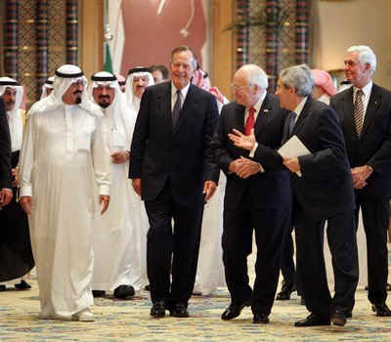
Crony Capitalism?

Slide 56
More Debates About Modernization
6. Differences within each and between each concept: Modernization and Dependency
7. The importance of the phrase "To underdevelop?" (verb)
8. Descending series of power centers- Metropole, sub-metropole, periphery and sub-periphery
9. STRUCTURALIST- Doctrine of comparative advantage (or disadvantage). Elasticity vs. inelasticity (oil vs. coffee)
10. Impact of Imperialism (and Land Empires)

Slide 57
Policy prescriptions of dependency theory: Counter-Dependency
1. Socialist World Systems Transformation (Wallerstein)
2. World Redistribution (Brandt Commission NIEO)
3. National Level Social Systems Transformation (Myrdal)
4. Regional Cooperation (producer cartels: OPEC)

Slide 58
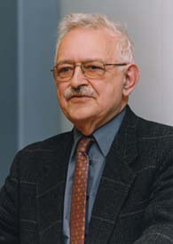
Immanuel Wallerstein
(Born in 1930)
Distinguished
Professor of Sociology
at the State University
of New York (SUNY) in Binghamton

Slide 59
Counter-Dependency Continued
5. Self-sufficiency (autarky)
6. Delinking (or partial self-sufficiency)
7. Dependency avoidance
8. Dependency reversal
9. Dependent Development (Cardozo and Evans in Munoz)

Slide 60
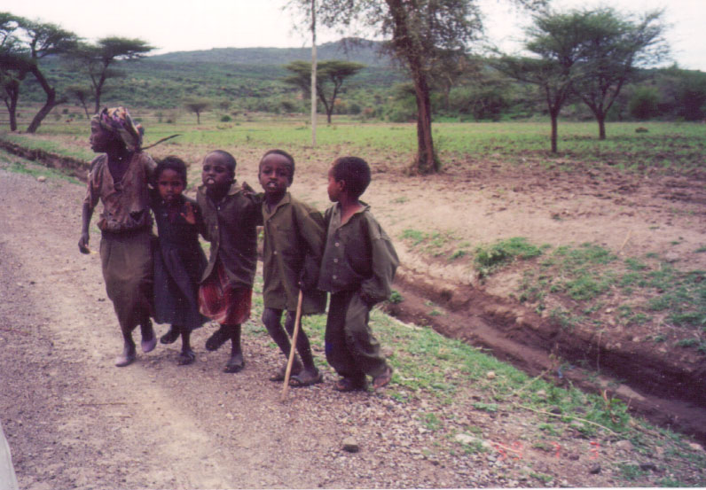
Theories of Counter-Dependency?

Slide 61
The Synthesis: Prescriptive Development Management?
Unpaid non-political announcement:
On Counter-dependency strategies see Louis A. picard, "Self-Sufficiency, Delinkage, and Food Production: Limits on Agricultural Development in Africa," in World Food policies: Toward Agricultural Interdependence , William P. Browne and Don F. Hadwiger, eds. (Boulder: Lynne Rienner Publishers, 1986), pp. 121-136 and Louis A. Picard and Michele Garrity, "Dependency Avoidance, Dependency reversal and economic development: Cases from the nineteenth-century periphery," Africanus: Journal of Development Alternatives, vol. 23, nos. 1 and 2 (1993), pp. 13-29. (After that- lost interest)

Slide 62
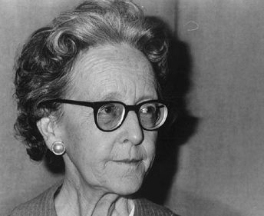
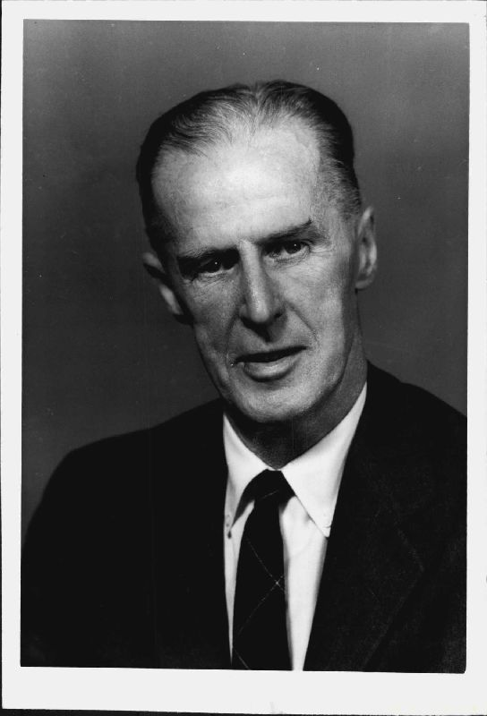
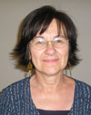
The People
Barbara Ward
(Baroness Jackson of Lodsworth)
Rupert Emerson
(Harvard)
(Kathleen Staudt)

Slide 63
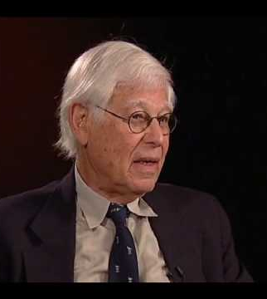
David Apter
David Ernest Apter
(December 18, 1924 – May 4, 2010)
Yale University

Slide 64
Golden Oldies
Presentation One: Alex Halman
Overview
Literary Map
Synthesis

Slide 65
Discussion of Counter-Dependency
Are We All Modernizers?

