Slide 1
Week 8 Presentation
ID Seminar
Kannu, Nauman, Jessi

Slide 2
Golden Oldies

Slide 3
Theory of Economic Growth Arthur Lewis Sir William Arthur Lewis (1915 – 1991) was an economist well known for his contributions in the field of economic development. In 1979 he won the Nobel Memorial Prize in Economics.
•The book focuses on economic growth. Though distribution of growth is a concern he doesn’t analyze it in this book.
•He is concerned with output and not consumption.
•Growth depends on resources available and human behavior. This book focuses on human behavior and considers natural resources as far as they impact human behavior.
•He identifies Three proximate cause of growth:
1.The efforts to economize: Reducing cost or increasing yield, , wealth and social status, limited horizon, experimentation, risk taking, mobility and specialization
Social and Economic Institutions: Property Rights, maintenance of law and order is the precondition for economic growth. Some states are unwilling or to weak to implement law. Economic Freedom: Individualism vs collectivism. Collective action in the form of government action might be necessary for construction of roads, conduct research etc . Vertical mobility, Religion, Extended family systems.
2. Increase knowledge of production: Societies had different approach to learning. Science is more dominant now than during the 18 century. New ideas are accepted in societies which are open to the concept of change. economic growth creates a tremendous demand for education facilities at every level. Economic development creates a demand for business and public managers.
3. Increase amount of capital or resources

Slide 4
Dr. William Maxwell McCord (1931-1992)
Sociology professor at City College of New York.
Earned a doctorate in social science at Harvard in 1955.
Began his teaching career as a Harvard instructor in social psychology.
Returned to Stanford to join the sociology department in 1958
Among his works were "The Springtime of Freedom: Evolution of Developing Societies" (Oxford University Press, 1965), "Mississippi: The Long, Hot Summer" (W. W. Norton, 1965), and, more recently, "Paths to Progress" (Norton, 1986), written with his wife, Arline McCord.
Dr. McCord joined the Freedom Riders in their drive against racial segregation.

Slide 5
McCord 'Springtime of Freedom' '65
Historical case study analysis against authoritarian or totalitarian politics that hinder growth for all
New nations can achieve development without political or economic dominance- instead through pluralism.
Redistribution of land by state for agricultural growth
Transitional villages are little transformed with forced idle workforce dependent on: direct democracy, fatalism, and isolated cohesion. Transitional man sheds his submissive self and pushes back on authoritarian systems (religion-fatalism; authoritarian rule- chiefs).
High migration from village to cities, which are not always developed enough to meet citizen's needs. Mob gives voice to needs. Revolution of expectations of transitional man to have immediate economic needs and basic needs, freedoms met and children to have better future. (Neo-Marxism?)
Japan for instance came to development of agriculture and later modernization with little disturbance to culture. Agricultural revolutions are good to stop starvation and to develop.
Focus on light, decentralized, consumer-oriented industries.
Further expenditure on education, particularly in selective secondary schools, technical institutes, and universities to produce the elite required for development. Require greater saving and productive re-investment by both the private and public sectors of economy. (Keynesian)
Argues against superiority of highly "centralized and coercive one-party regimes in achieving economic development, consensus, and national unity". Democracy can help develop a country.

Slide 6
Nigel Harris
earned his B.A. and M.A., both in Philosophy, Politics and Economics in 1959 and 1962 respectively, and his PhD, in 1963, at London School of Economics
Harris was, for a time, a leading member of the British Socialist Workers Party and edited their publication, International Socialism
1980s- Harris was one of the first people to try to analyze the global shift in production towards parts of the global south
Argued that this shift was undermining the idea of a unified and impoverished 'third world'
increasingly believed capitalism as an economic system, and left to its own devices, would necessarily be cosmopolitan and globalizing. However, in last few centuries these tendencies had been hijacked by state system, nationalism, political drives to war

Slide 7
Nigel Harris 'End of the Third World'
Analysis of 27 countries termed 'developing' producing a lot economically and are important to world economy; world economy can help developing countries to develop
Export dependency is argued to create political dependency, but all markets in the global economy are linked so this is arguably difficult as all are linked except a few. Import controls can make monopolies for national or local producers. World market has evolved so much that these theories of dependency are antiquated.
Missing element of human capital development/ human capacity, such as through education which is necessary for industry productivity.
Governments should support private industrialization and supporting a variety of work opportunities in micro-sectors to get work force growing. Competition amongst companies is healthy, as is within world economy (eg. Gang of Four)
Countries that developed well are ones with niches in technology, parts or assembly, or bundle of national specialization.
Both left and right are wrong in their view of the state and its role in economic development, as there is a newly emerging global economy superseding the old national state and its politics
De-industrialization is key with increased specialization which can better link industrial and developing economies, and redefine the role of the state in economics to expand quality public sector and state role capacity development
When industry becomes part of the power dynamic, states must compete in international market which further economic advances and helps economies grow

Slide 8
Dr. Dudley Dillard
Doctorate in economics from the University of California in 1940
Former chair of the economics department at the University of Maryland in College Park
Professor emeritus in 1984
Served as chair of the economics department from 1952 until 1975
1976 and 1977 served as provost of the Division of Behavioral and Social Sciences. Dr. Dillard received his
Expert on Keynesian economics
"The Economics of John Maynard Keynes," which was translated into 12 languages.

Slide 9
Capitalism – Dudley Dillard
1500-1750: Role of the state in capital formation through institutions, public goods and mercantilist policies – free internal trade, monetary system, legal code, workforce, literacy, security and stability.
Three centuries of capital accumulation, the Industrial Revolution and investment in technological change were primary factors for great economic success in the 16th – 18th centuries
Dillard admits that Adam Smith’s view that private profit and public welfare would reconcile through free market forces should be viewed as a system of tendencies and not in absolute terms.
Critics of capitalism (Marxist based) said it leads to formation of giant firms that need to invade foreign markets and exclude foreign products through protectionism.
While events of the 19th-20th century - WWI, Russian Revolution, Great Depression, revolts in the colonies led to decline of dominance of traditional model of W European capitalism; capitalist enterprise in UK, US, W Germany, Japan has emerged strong in the postwar period.
Concedes the limitations of unfettered capitalism, but argues for its historical role in leading economic development and raising the fortunes of European bourgeoisie.

Slide 10
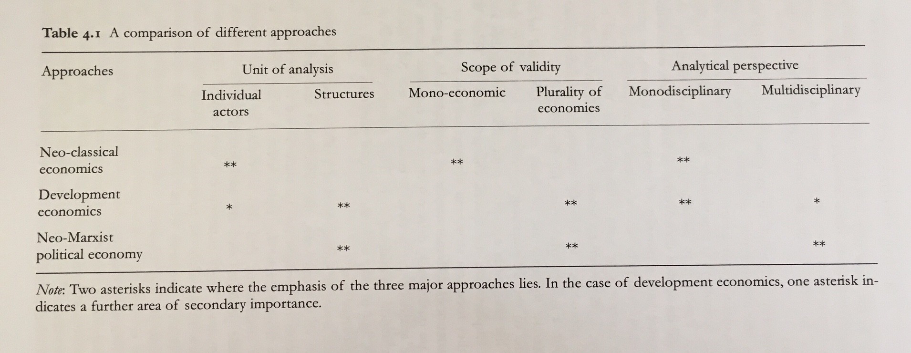
Martinussen Major Theoretical Currents in Economic Development

Slide 11
Literary Map
40s 50s 60s 70s 80s 90s
Neo-Marxist Political Economics
Marx 1880s
Singer '50,
Myrdal '68, Frank '67, Amin '76
Dillard '84 '87
Development Economics-
(Rapley calls 'Developmental State')
Prebisch 40s
Furtado 50s
Sunkel
Harris '87
McCord '65
McCord '91
Johnson '82
Wade '82 '88
Keynes 30-60s
List
JS Mills 1848
Lewis '55
Bauer & Yamey '51,
Nurkse, Rosenstein-Rodan, Rostow, Myint, Hirschman '50-'60
Neo-classical Economics

Slide 12
Major Themes
Criticisms of ISI and neo-classical economic policies
Out of disappointment of the 1980s' SAPs, there arose a pluralistic movement focused on political economics
IMF/World Bank readjusts focus on good governance and poverty reduction with a return to neo-structuralism
Rise of 'Development Economics' which bridges Neo-Marxist Political Economics with Neo-classical Economics, which eventually focuses on state development
Continue or ramp up human resource development efforts
Re-emergence of Keynesian policies

Slide 13
Mock Questions- Group 1
All primary development theory schools come from Foucault (father of discourse)
Define purpose of language by Focault, purpose of discourse literature, and its overall purpose on theory building-
Foucaut, M. (1968). The Archaeology of Knowledge.;
What are the major differences in the approach that modernization and dependency theories take:
Misconception of development between elitist view and local view:
Berger, P. (1974). Pyramids of Sacrifice: Political Ethics and Social Change. Basic Books, New York (1974) (myth of growth)
Scott. (1976). "The Moral Economy of the Peasant: Rebellion and subsistence in Southeast Asia" (Misunderstanding 'wake effect' of change)
Development studies as causation for underdevelopment - Development paradigm-
llich, I. (1994). Development as Planned Poverty. In Rahnema, M. and Bawtree, V. (Eds.). The Post-Development Reader. London: Zed Books.
Escobar, A. (1994). Making and Unmaking of Third World Development. In Rahnema, M. and Bawtree, V. (Eds.). The Post-Development Reader. London: Zed Books, 1994.
Escobar, A. (1995). Encountering Development: The Making and Unmaking of the Third World. Princeton: Princeton University Press.
Development as anti politics and self-perpetuating in terms of action and LDC status and perpetuates elites in power
Harris, N. (1987). The end of the “third world”?. Habitat International, 11(1), 119-132.
Ferguson, J. (1994). Development and Bureaucratic Power in Lesotho. In Rahnema, M. and Bawtree, V. (Eds.). The Post-Development Reader. London: Zed Books.
Ferguson, J. (1994). The Anti-Politics Machine: "Development," Depoliticization, and Bureaucratic Power in Lesotho. Minneapolis: University of Minnesota Press.
Commons vs. individuals. Inability to manage public goods without individual direct interest involvement
Ostrom, E. (1990). 'Governing the Commons: The Evolution of Institutions for Collective Action.' Cambridge: Cambridge University Press.
Sen, A. (1992). Inequality Re-examined. (realization that individual is affected by social and external pressures for rational choice)
Freire, P. (1985). The politics of education: Culture, power, and liberation. Greenwood Publishing Group
What are the implications of discourse for policy choice
Pushes understanding and paradigm, re-sets the compass for developed understanding
Martinussen Ch. 25- ID has failed to with theory construction linked carefully and precisely with good social science including ontology and espistomology
How are practitioners able to apply the policy prescriptions or approaches of discourse theory- further discourse analysis linked to improve research design

