Slide 1
PIA 3395
Development Theories
Discourse Analysis and Essentialist Arguments

Slide 2
Discourse Analysis
Some Examples and the "How long have you been beating your spouse problem."

Slide 3
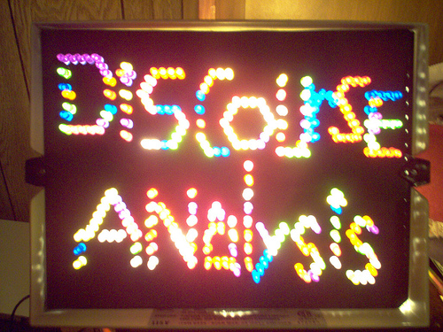

Slide 4
Discourse Analysis and Related Debate
A term for a number of approaches to analyzing written, spoken or signed language use.

Slide 5
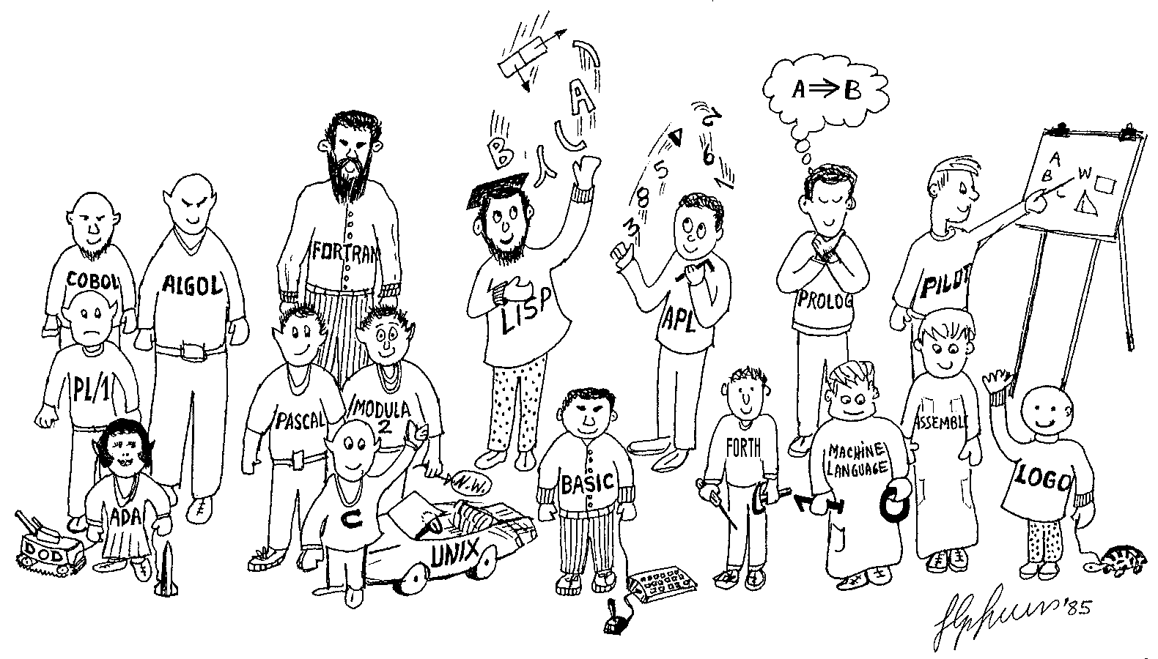
Something Like This?

Slide 6
First Example: Origins
Michel Foucault (15 October 1926 – 25 June 1984) was a French Intellectual, Historian and Sociologist.
He held a chair at the College de France in the History of Systems of Thought and also taught at the University of California at Berkeley
He studied disciplinary institutions, with a book which "narrated" the micro-power structures that developed in Western societies since the eighteenth century, with a special focus on prisons and schools both of which imprisoned the mind.

Slide 7
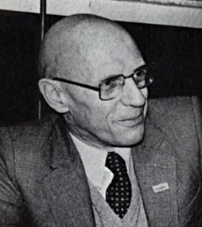

Michel Foucault

Slide 8
Definition
Theorists view language as social interaction, and are concerned with the social contexts in which discourse is embedded.
The Goal is to understand the social power and political control functions of language use

Slide 9
Underdevelopment Discourse
Left- Arturo Escobar: development studies causes underdevelopment
Attacks Globalization and Post-Fordism (post-modernism postindustrial-communications-computers and internet, etc.)
Anthropology studies “tribes” of economists in the World Bank

Slide 10
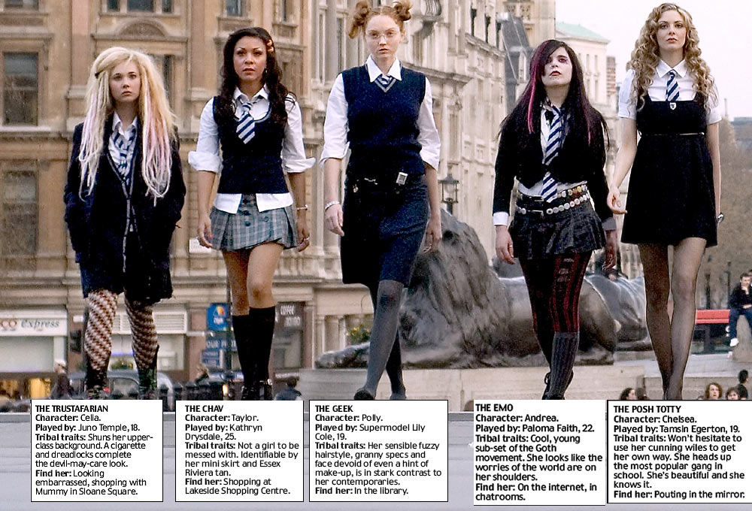
Meet the tribes of St Trinian's (Fictional Boarding School)

Slide 11
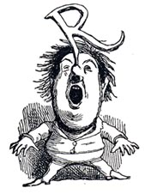
Lessons of Discourse
World Bank justifies “underdevelopment”
Promotes a mis-understanding of North-South Relationships
Underdevelopment is an active verb- that defines globalization

Slide 12
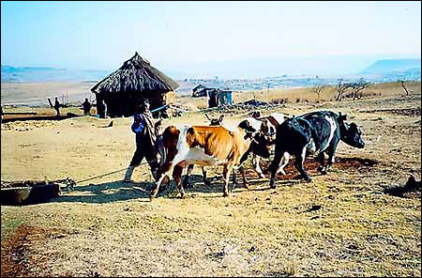
Second Example
Right- development as anti politics and self-perpetuating in terms of action and LDC status and perpetuates elites in power (Bauer and Ferguson)
Lesotho

Slide 13
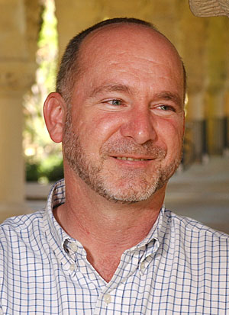
Reference: James Ferguson, Anthropologist, Stanford University
James Ferguson, The Anti-Politics Machine
"Development, Depoliticization, and Bureaucratic Power in Lesotho (Cambridge: Cambridge University Press, 1990)

Slide 14
Third Example
3. Essentialist- Elinor Ostrom: Commons vs. individuals. Inability to manage public goods without individual direct interest involvement.

Slide 15
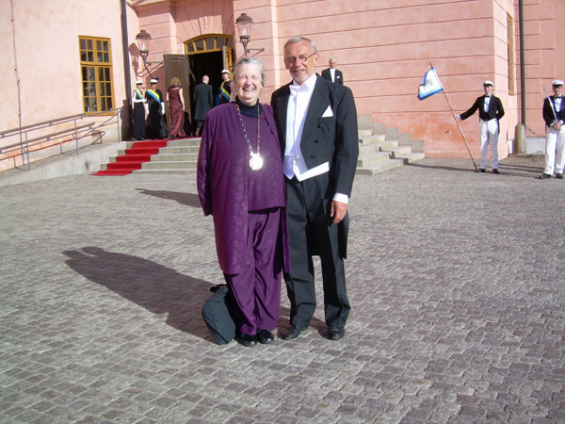
Elinor Ostom Born 1933- Nobel Prize for Economics 2009

Slide 16
Four- Public Choice and Rationalism
4. Public Choice: Peasant Organizations, Samuel Popkin and The Free Rider Problem
=The overall issue is that of Collective Action vs. individual choice
=Question: What is there between collectivization and privatization

Slide 17
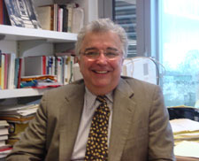
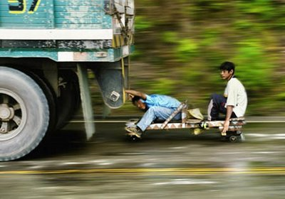
Samuel Popkin (Born 1942) and the Free Rider Problem

Slide 18
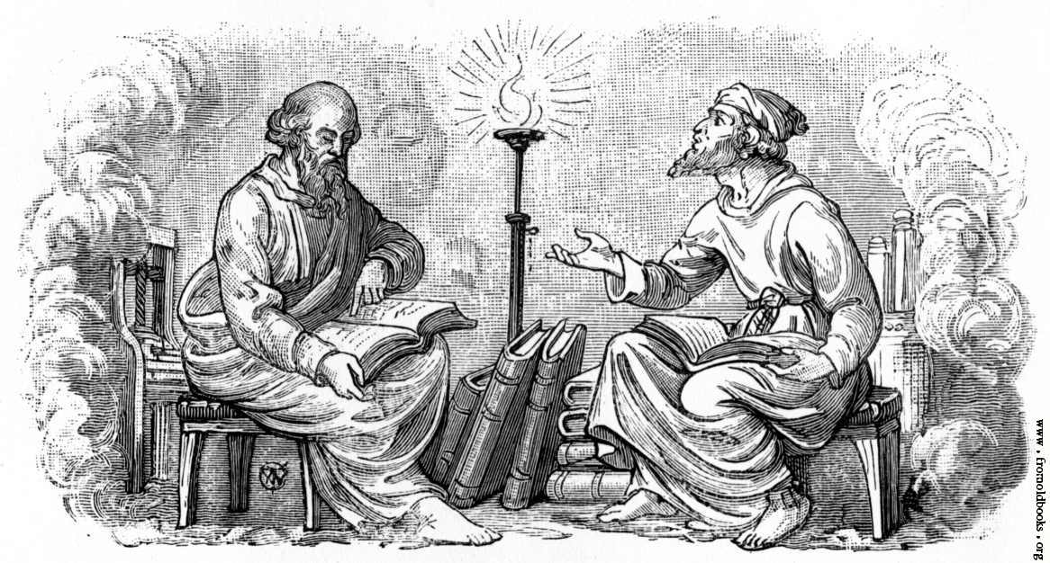
The Issue:
Is Public Choice Theory Discourse
(The Debate between Hierarchical and Empirical)

Slide 19
The Motivation of Conservative Discourse “Debates”
Tendency is to avoid collective responsibility or collective action
1. Common Pool Resources Problem
2. Prisoners dilemma- can never get to optimal
3. Change the” rules of the game” and “getting the institutions right”
4. Key: getting direct involvement (Ostrom)

Slide 20
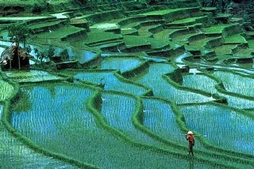
Common pool resources denote natural resources used by many individuals in common, such as fisheries, groundwater basins, and irrigation systems.

Slide 21
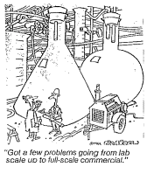
More Motivations
5. Designing their own contract with your neighbors
6. Critique: How does one ratchet up from local communities (and direct democracy) to cities, intermediate governments and nations and (lesson) avoid collective responsibility?

Slide 22
Motivations and an Issue
7. Historical Antecedents for Collective Action: Heady, Weber and complex bureaucratic systems
a. "Hydraulic Societies" and centralized bureaucratic empires
b. Classic administrative systems elitist, hierarchical and rational vs. state roles in industrialization (Late developers- Germany and Japan
c. Public Choice says public organizations require collective responsibility that is almost impossible, yet history shows bureaucracies can be collective (New Deal)

Slide 23
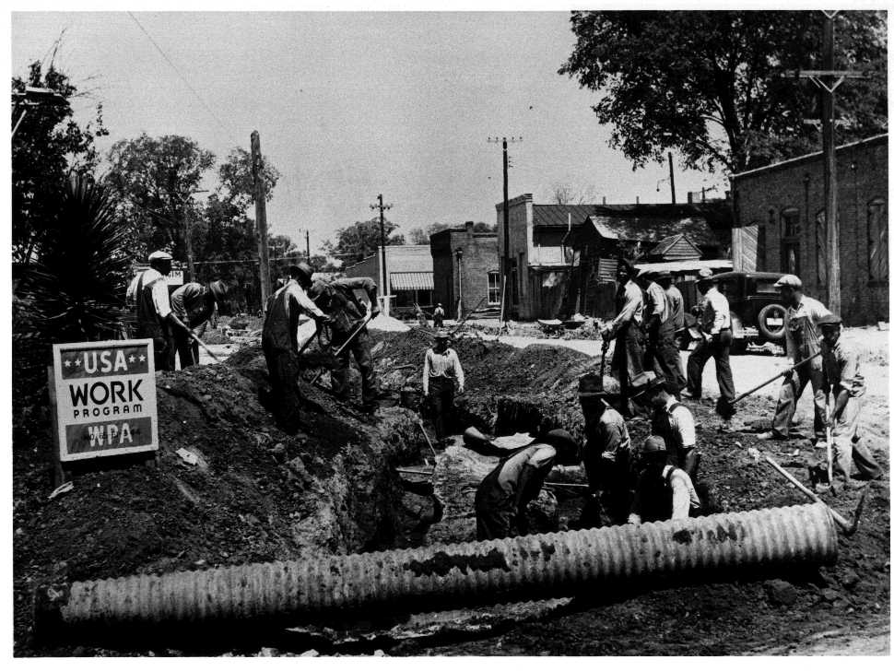
New Deal

Slide 24
Policy Debates
Policy Recommendations: What is to Be done- Reprise
1. Revolt or Hybridism? (Escobar)
2. Trade not Aid? (Bauer)
c. Individualism, indirect systems and representation? (Ostrom)
d. Culture vs. structure- (Bates vs. Sklar) debate over rational choice in peasant societies. Functional or dis-functional.
e. Post-Fordism /post-modernism- local community specificity and an interconnected world. What do we do about globalization and unskilled labor? The debate about protectionism. India, Mexico and the U.S.

Slide 25
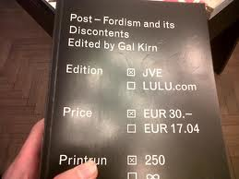
Fordism and Europe

Slide 26
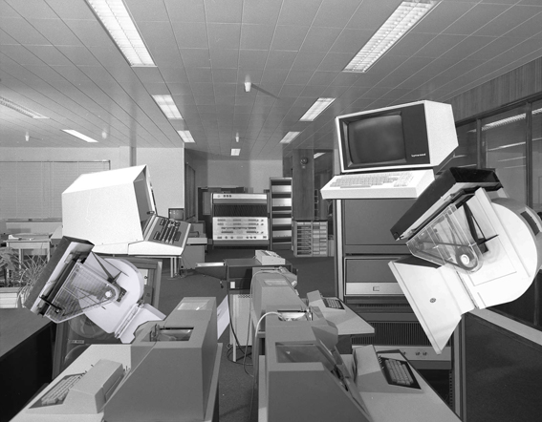
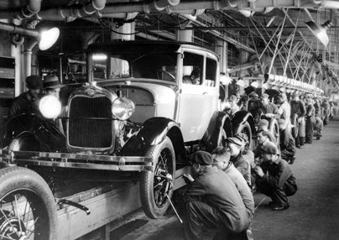
Fordism vs. Post-Fordism

Slide 27
Discourse Limitations
Critique of the discourse as method
1. Combines description with evaluation- a systematic way of presenting disputed matters that impact individuals and society. Focus is on the "disputability" of the concept.
2. Problem- discourse leads to a claim of a single mode in order to critique it. (Gasper re. Escobar). Such debates include several arguments
3.Danger oversimplification of complex debate.

Slide 28
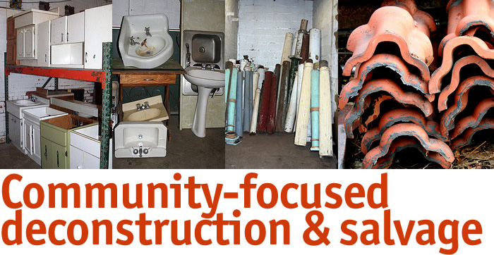
Deconstruction in Housing

Slide 29
Quotes
"Discourse is not the expression of thought, it is a practice with conditions, rules and historical transformations."
Arturo Escobar
Discourse theorists often present "somewhat lordly, yet partly inaccurate attacks by Northern fundis from both Left and Right."
Des Gasper
"...common-pool resources can be organized in a way that avoids both excessive consumption and administrative cost."
Eleanor Ostrom
"Discourse is a fancy word for talk…."
An Old Philosopher

Slide 30
Comp Question- Next Week
Mock Comprehensive Question: To what extent does the development discourse literature contribute to theory building in the development area. What are the implications of discourse for policy choices? Critique the various discourse "schools." How operational or practical (for practitioners) is discourse theory.
Deconstruct the Discourse question.

Slide 31
All Groups
Deconstruct Comp Question- Both Groups
Identify Ten References with a one sentence thesis statement (Group 1)
Write a mock comp question for each of the above quotes. (Group 2)

