Slide 1
Development Theories
PIA 3090
Week Four

Slide 2
Mock Comprehensive Question
How are theories of development related to the concepts related of dependency and modernization theories? What does each say about strategies of development management To what extent do these concepts prescribe different development policies to national level policy makers? Where does orthodox Marxism fit into the above dichotomy? Defend your views by specific reference to the literature in the field.

Slide 3
Development Policy: Discussion
Deconstruction Exercise
Comprehensive Exam
Groups:
Do deconstruction- Brief, two minute presentation

Slide 4
Development Policy: Discussion
Deconstruction Exercise
Comprehensive Exam
Groups:
Do deconstruction- Brief, two minute presentation

Slide 5
Development Theory
Group Presentations

Slide 6
Outline of Discussion
I. Overall Themes for the Week
II. The Political Development Argument
III. The Economic Model
IV. Debates about Political Institutions
V. Systems Theory and Structural Functionalism
VI. Cultural Debates and the Bureaucracy
VII. Group Representation Models
VIII. Class Analysis

Slide 7
I. Overall Theme for the Week
Political Development and Institutions are a pre-requisite for Social and Economic Development
Discussion: Political Development as a Pre-requisite?

Slide 8
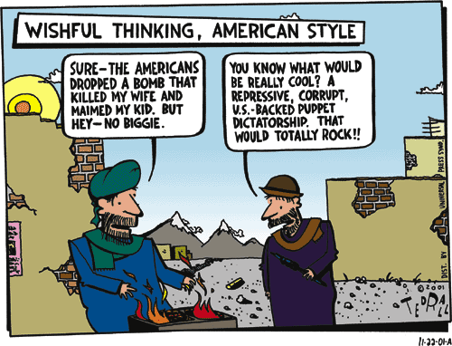

Slide 9
Sub-Themes
Institutionalization
Role of Civil Society
Economics and Politics
Systems Theory/Structural Functionalism
Corporatism

Slide 10
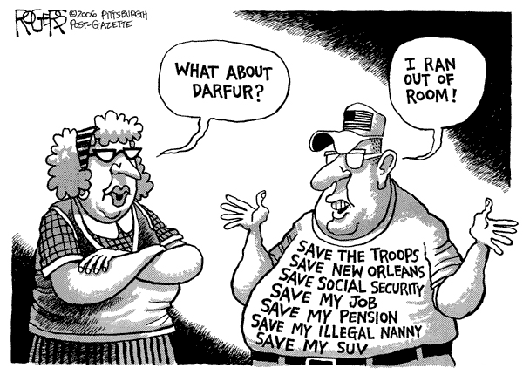

Slide 11
II. The Political Development Argument- Two Quotes Re. the Issue
"...there is a close link between respect for human rights and democracy, on the one hand, and the ability to sustain economic and social development on the other."
John Martinussen
"...states will necessarily remain central actors in development policy."
Milton Esman

Slide 12
A Conservative View

Slide 13
III. The Economic Model
Counter-argument: Asian model of Development (Authoritarian)

Slide 14
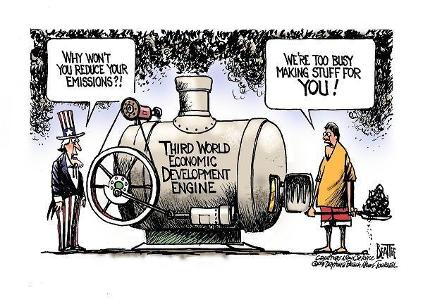
Reform and the Donor Countries

Slide 15
Antithesis: Maybe Not
NGOs and Civil Society?
"Although development studies once had a love affair with the model of a strong [democratic] state and its capacity to plan change comprehensively with technical staff, states are increasingly maligned for consuming excessive societal resources in an inefficient, bungling, even abusive manner.“
Kathleen Staudt
Obama Administration Abandons Development for War in Afghanistan (NYT- 1/28/09
Debate about Corruption in Afghanistan, September 13, 2010

Slide 16
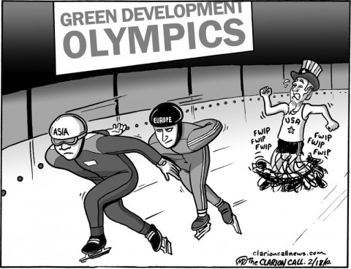

Slide 17
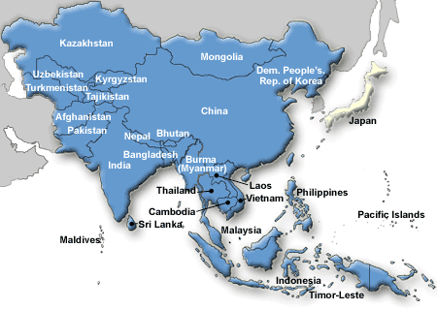
Is There an Asian Model?

Slide 18
IV. Debates about Political Institutions Samuel P. Huntington
The Huntington Model: Political Instititutionalization
Huntington’s Theory of Institutional Development Suggests stability over participation
Fear ethnic, ideological and religious based conflicts

Slide 19
The Huntington Matrix
GOAL: STABILITY OVER PARTICIPATION
Institutionalization
Participation
High Low
High INDIA ALGERIA
Low SAUDI ARABIA SWAZILAND

Slide 20
Huntington’s Formula
Order and Civilization
Institutionalization should equal Mobilization
or
Institutionalization should be greater than mobilization
but not
Institutionalization should be lower than mobilization

Slide 21
Huntington: Summary
Key: Loss of Equilibrium and Violence (David Apter with Huntington)
Political Order is Culture Bound:
Clash of Civilization Theory?
Samuel P. Huntington

Slide 22
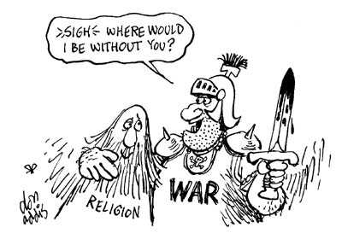
Huntington’s Fear: Political Instability as a Result of the Clash of Civilization

Slide 23
Political Development and Governance: Alternative Models
Identity
Legitimacy
Participation
Penetration
Distribution
Leonard Binder: Sequential Crises
Universal Rule?

Slide 24
Leonard Binder, UCLA
Political Crises and Sequences:
Identity
Legitimacy
Participation
Penetration
Distribution

Slide 25
Ten Minute Break.

Slide 26
V. Systems Theory and Structural Functionalism- Classic Political Science Theories
Systems Theory (David Easton) and Structural Functionalism (Almond and Verba, The Civic Culture (1957)
Origins of contemporary Civil Society Model:
“There is a ‘civic culture’ which is the most developed political form.”
Gabriel Almond and Sidney Verba

Slide 27
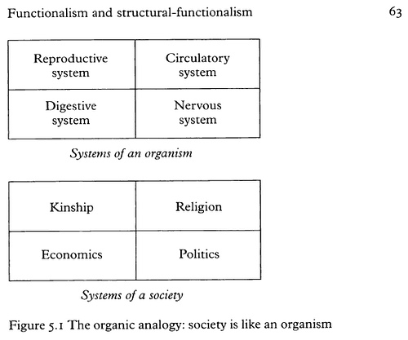
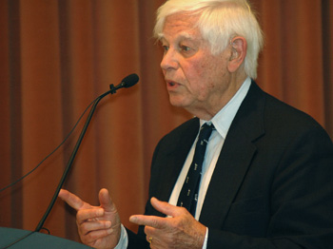
Systems Theory

Slide 28
General Systems Theory

Slide 29
Structural Functionalism: Gabriel Almond
Inputs:
interest articulation
Interest aggregation
The Black Box (With-inputs)
Outputs- Policies
Feedback

Slide 30
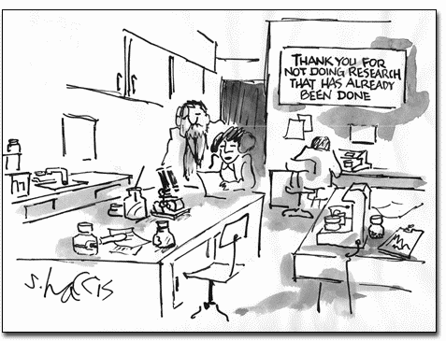

Slide 31
VI. Cultural Debates and the Bureaucracy: A Reminder
Disjointed Modernization (Gusfield and Susan Rudolph)
Misplaced Polarities Theory

Slide 32
Problems with Bureaucracy
Civil Society Collapse and the Impact of Colonialism (Crawford Young)
The Administrative State (Picard)
And the Organizational Bourgeoisie (Leonard Markovitz)
Crawford Young
Markovitz Book

Slide 33
M. Crawford Young, Born 1931- University of Wisconsin
Worked on the Colonial state and on the politics of cultural identity in the third world, and presaged the contemporary "instrumentalist" and "constructivist" approaches to political identity.

Slide 35
Debates About Bureaucracy
State centric vs. social centric Development
The importance of bureaucracies and Institutional Change (Esman and Staudt)
Strong State vs. Strong Bureaucracy: Which should dominate
Weak State but Strong Society
Weak State but strong (Praetorian) Bureaucracy

Slide 36
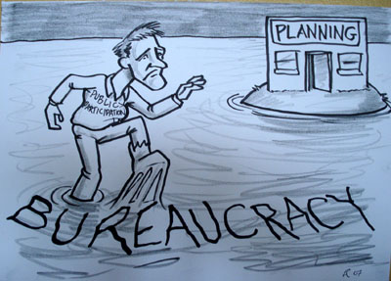

Slide 37
VII. Group Representation Models
Pluralism or Polyarchy
Corporatism and the Scandinavian Model:
Social Corporatism VS. Polyarchy (Dahl)
Fascism
Military Corporatism
Religious Corporatism

Slide 38
What is Fascism?

Slide 39
Critique of Corporatism

Slide 40
VIII. Class Analysis- Debates About Social Class
Class Analysis: (Marx and his Successors)
Rural vs. Urban
Agricultural vs. Industrial collectivization
Conservative Critique of Class War

Slide 41
Class Analysis
Marx and Class
Is Class Important?
How does it impact Development?

Slide 42
Mock Comprehensive Question for Next Week
To what extent should political issues be addressed within a developmental context? Why is political development seen to be a pre-requisite for social and economic development? What are the counter-arguments? Are there alternative models for a developed polity than the "representative democracy" model? Refer specifically to the literature on development in your response.

Slide 43
Discussion of Counter-Dependency
Are We All Modernizers?

Slide 44
Discussion Four: Governance and Political Development
I. Golden Oldies:
II. Literary Map-
III. Synthesis Themes-

Slide 45
Discussion of Comprehensives
Reasons and Strategies?

