Slide 1
PIA 3395
Development Theory
Week Three

Slide 2
Development Policy and Analysis: Terms
Terms: What are the differences between and among each and what debates run through each? (Martinussen)
a. Development Theory (Modernization?)
b. Underdevelopment Theory
Is there more to development than this?
[The internationally renowned professor John Degnbol-
Martinussen at Roskilde University, Denmark, died suddenly
on 23 September, 2002]

Slide 3
Roskilde University to open super-hero city and host machinima contest

Slide 4
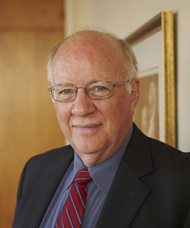
Development Policy and Analysis
c. The impact of colonialism, trade and the cold war (Turner and Hulme). “Imperial Preference”
d. Developing vs. Underdeveloped as terms (John Isbister, see below
Provost, Ryerson University Toronto, Ontario)
Question: An Old Peoples’ Theory?

Slide 5
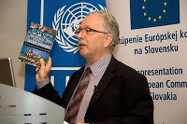
Mark Turner and David Hulme
Mark Turner is Professor of Development Policy and Management and Head of the Government Discipline at the University of Canberra, Australia (Below Left)
David Hulme, professor of Development Studies from the University of Manchester, U.K. (Above, Right)

Slide 6
Development Terms
c. Development Policy
d. Development Economics
e. Development Planning
f. Human Resource Development
g. Sustainability

Slide 7
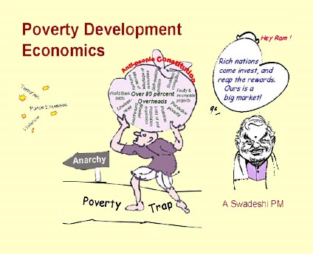
Development Economics?

Slide 8
Assess/Critique: The Development Dichotomy
Agraria
Attitudes: parochial – fixed rules
Customs: particularistic / inherited
Status: ascriptive
Functionally: diffuse
Holistic Change
Lack of Specialized Roles
Result
Agricultural, rural, poor
Oral / illiterate
Authoritarian instability
Subsistence – non-monetary
Revolution and violence
Occupation fixed
Industria
Universalistic
Legal / Rational
Achievement Oriented
Roles Functionally Specific
High Degree of Technology
Manufacturing and Production
Oriented
Result
Commercial
Democratic / Peaceful
Occupational mobility
Literate
Urban, Rich
Incrementalism, Stability
and Gradual Change

Slide 9
Rural Society?

Slide 10
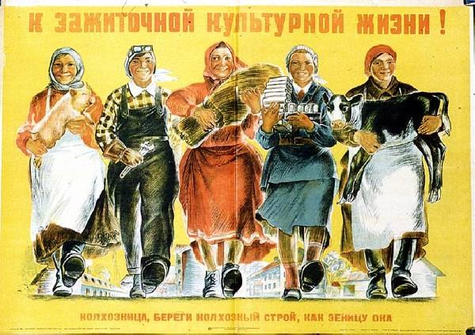

Slide 11
Development Management vs. Administration (Debate)
Thematic Issue
Development Management vs.
Development Administration
What it the difference?

Slide 12
Concept of Development Administration
Use of bureaucracies to achieve public policy goals
Original idea: state will take major role in providing leadership to improve LDC standards of living

Slide 13
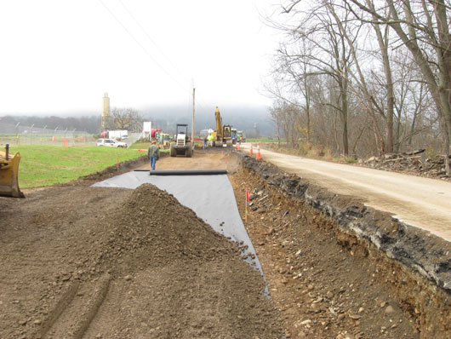
American Recovery and Reinvestment Act Funding, 2009

Slide 14
Development Administration
Administrators would provide framework for wider economic participation
Key assumption: major responsibility for development would lie with ADMINISTRATOR on national and local levels
State centric Assumptions

Slide 15
Development Administration

Slide 16
The Eternal Debate

Slide 17
Concept of Development Administration
Assumptions
Development occurs because of planned change
Political and administrative leadership have made decision to effect improvement in the social system

Slide 18
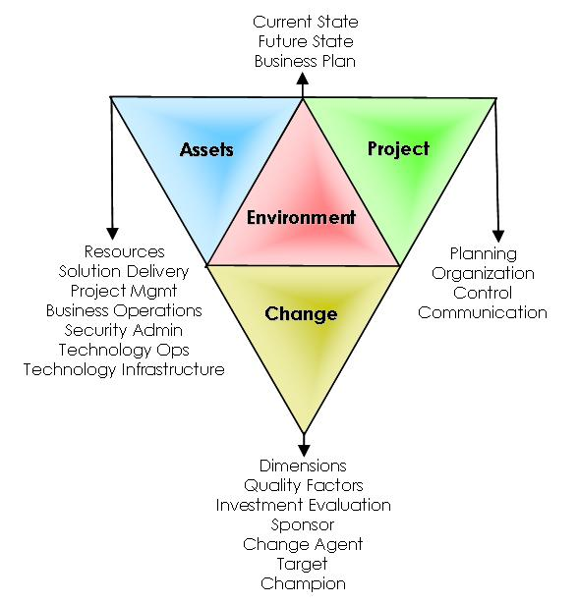
The Assumptions of Planned Change: “Rationality”

Slide 19
Concept of Development Administration
Definitions
Action and goal oriented administrator striving to promote economic and social development
Base: Concept of Planning
The setting of priorities for the use of scarce resources

Slide 20
Concept of Development Administration
Goal: Change Administrative Behavior
Original Goal – Planning
The National Plan, monitoring and managing the economy
setting targets and the achievement of goals

Slide 21
Two Views of Planning

Slide 22
Development Policy and Analysis: Mini-Discussion
Development Planning
vs.
Development Economics
-Theory vs. Practice?

Slide 23
Development Planning?

Slide 24
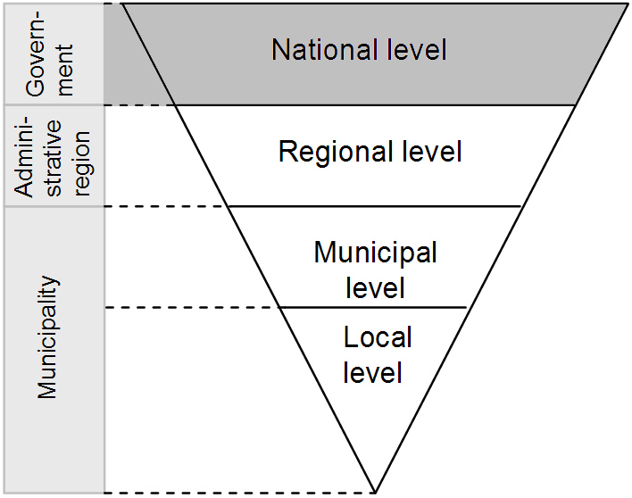

Slide 25
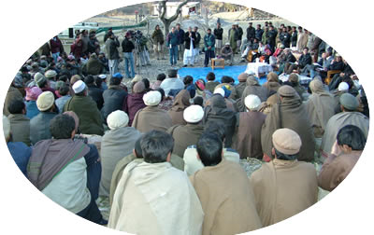
Social Mobilization

Slide 26
Bolivia National Development Plan

Slide 27
District Administration
At the District Level – Coordination
Mobilization
Socialization
Key emphasis
placed on local government authorities, extension services, district administrators

Slide 28
“On almost a daily basis, we brought villager leaders and panchayat (multi-village council) members into our conservation centre for a slideshow.”

Slide 29
Coffee Break
Ten Minutes

Slide 30
Development Management: Is it Different?
Less Hierarchical
Mobilization and
Coordination
Involves the non-profit and private sectors
The Role of Donors
Different? Probably not much!

Slide 31
Origins
Business Model. Flat Pyramid
Collective decision-making. Social Movements
Non-profit Motivations
Research and development
Academia

Slide 32
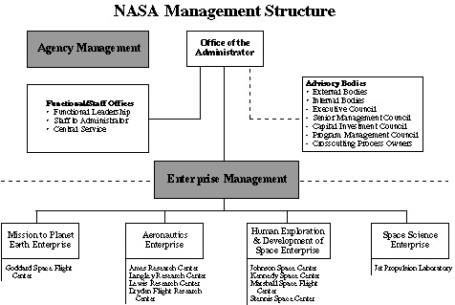
Nasa Management System

Slide 33
Underdevelopment?

Slide 34
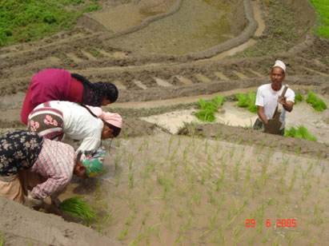
Development Policy and Analysis
Newari Society Nepal
The theory of peasant society- (Hyden) Debates:
The nature of the state:
soft, hard and praetorian (Myrdal)

Slide 35
Development Policy and Analysis
1. Bottom up or grassroots development: How realistic? Are NGOs “grassroots?” (Edwards and Hulme)
2. Has development theory fallen? Long live development studies? (Leys) The end of the third world, or the end of autonomous development?
3. Where have all the dependency theorists gone? What do we do about 500 years of history (Leys)

Slide 36
i. Role of Deconstruction Analysis: What is It?

Slide 37
Development Policy: Discussion: Next Week
Deconstruction Exercise
Comprehensive Exam
Two Groups:
Do deconstruction- Brief, two minute presentation

Slide 38
Mock Comprehensive Question
How are theories of development related to the concepts related of dependency and modernization theories? What does each say about strategies of development management To what extent do these concepts prescribe different development policies to national level policy makers? Where does orthodox Marxism fit into the above dichotomy? Defend your views by specific reference to the literature in the field.

Slide 39
Development Policy and Analysis: Presentation:
Golden Oldies
Literary Map
Synthesis

Slide 40
Discussion of Counter-Dependency
Are We All Modernizers?

