Slide 1
PIA 2567 Technical Assistance and Program Design
Field Based Research and Organizational Development- An Overview

Slide 2
Research and Public Policy: Steps
Values and Ideology
Public Policy
Laws and Executive Orders
Programs
Projects

Slide 3
Issues and Concerns
Ethnography and Culture
The Purpose of the research
Observation vs. Interaction
Qualitative vs. Quantitative
Empirical vs. Normative Research

Slide 4
The Project: Types of Research
Design: Organization and Process
Analysis and Observation
Monitoring
Evaluation: Process, Qualitative and Impact

Slide 5
Types of Research in East Africa
Development of a Business Plan- Design
Training development for Micro-Business- Capacity Building
Education Programs- Skills Development
Build a School or Home- Organizational Development
Assessment of Micro-lending Program- Evaluation
Special needs support- Program Development
Hidden Peoples Project- Analysis

Slide 6
Design Identifying Nature of the Problem and possible solutions—specific needs and desired changes
Appraisal: (Mandatory) data needed to prepare the project plan
Analysis: Collection of…
Social Analysis targeted groups: women, minorities, indigenous peoples
Economic Analysis- Cost Benefit
Institutional Analysis

Slide 7
Sustainability
Organizational Requirements
Recurrent Cost Implications
Human Skills Needed
Social Acceptance
Prediction
Selection of preferred alternatives

Slide 8
The Project Cyle

Slide 9
Management Plan

Slide 10
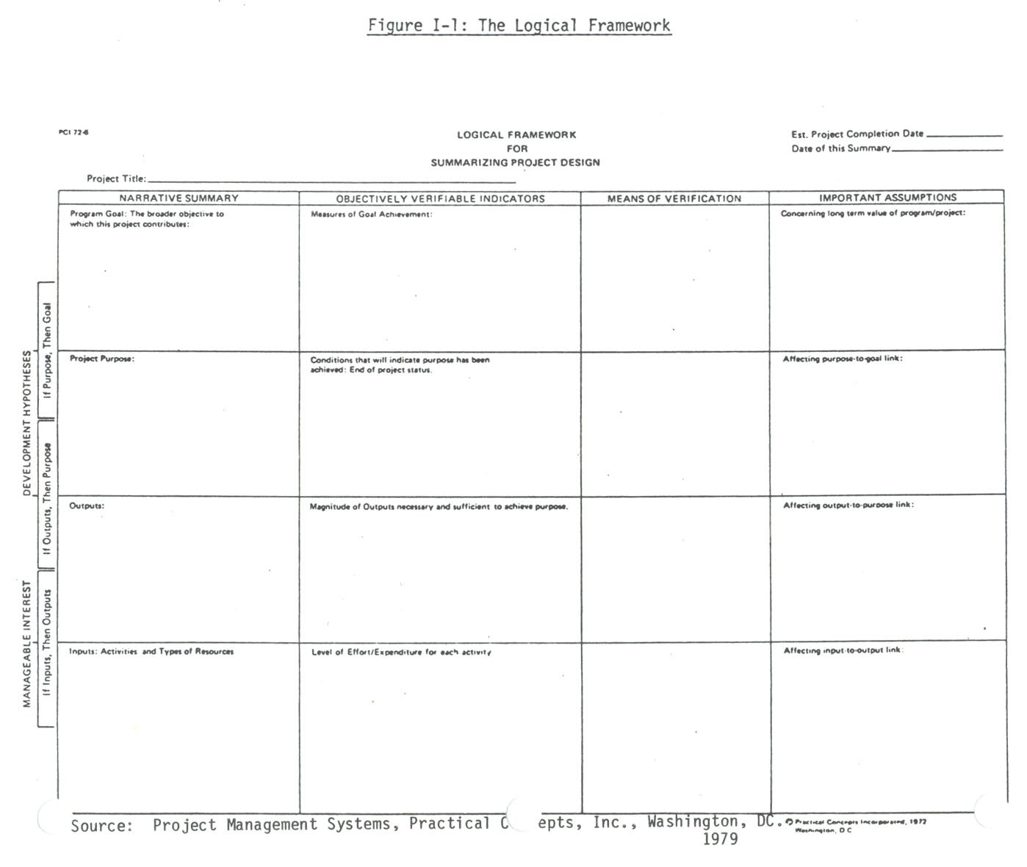
The Log Frame

Slide 11
Project Design and the Logical Framework
The Log Frame is a tool for organizing the information and activities necessary to plan the project.
The arrangement of information at different levels serves to communicate clearly the results for which management is held responsible and the elements outside the control of management.
The levels within the Log Frame refer to:
Inputs - resources to be used
Outputs - the results obtained by management using the inputs
Purpose - the reason for the outputs
Goal - the "higher" objective for the project
The assumptions affecting achievement at each level must be made explicit.
In order to measure achievement, we must determine appropriate 'indicators' and 'means of verification.'

Slide 12
To be continued…
QUESTIONS AND COMMENTS

