Slide 1
PIA 2574-African Development Seminar: Conflict, Governance and Development
The Ethnic Question in Africa

Slide 2
Tribes and Myths
The Click

Slide 3
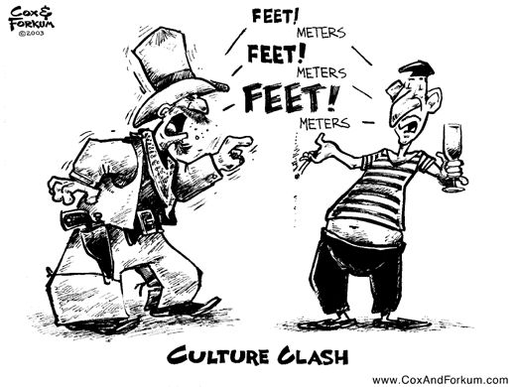
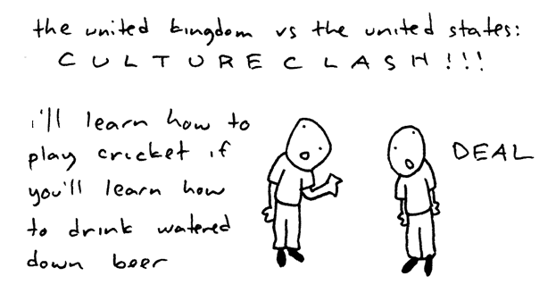
Culture Clashes

Slide 4
Examples of Ethnic Conflict: Which is not?
Cambodia
Bosnia/Kosovo
Somalia
Central Africa: Rwanda/Zaire
East Timor and Indonesia

Slide 5
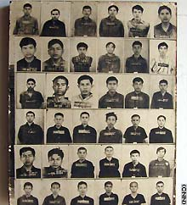
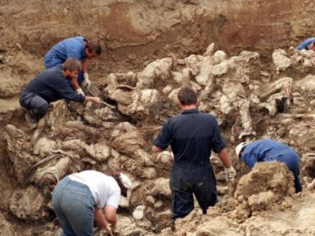
What is the Ethnic Issue?
Prosecutors said the gravest atrocities were the 1995 Srebrenica massacre of 8,000 Muslims.
More than 1.7 million Cambodians are thought to have died at the hands of the Khmer Rouge.

Slide 6
Ethnicity
The Story of Lingala:
Language spoken along Congo River by many groups
No real Ngala Group
Missionaries and Colonial officers “heard the language”
By 1960, a group definition

Slide 7
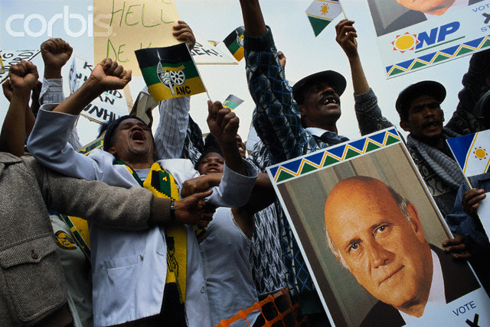
Race, Nationalism and Ethnicity
DISCUSSION POINT: IS AFRICAN ETHNICITY DIFFERENT?

Slide 8
Defining Ethnicity: Africa- Ethnic and racial Mosaic
Core Separatism based on Language
Language Group Identity
Impacted by Colonialism-Divide and ally
Geographic Ethnic Separation
Multi-Ethnic Groups live together
Sub-Nationalism- Perception of Group as nation

Slide 9
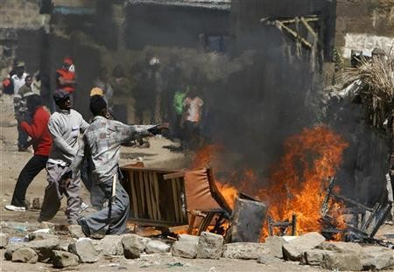
Luo vs. Kikuyu in Kenya

Slide 10
Nigeria
152,217,341 people (2010)
10 Major languages and clusters (350,000 people +)
248 minor Languages and dialects

Slide 11
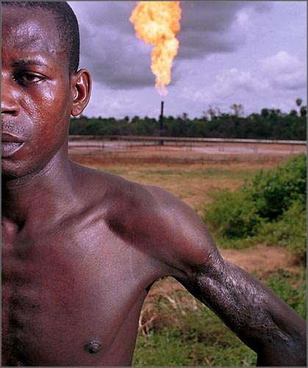
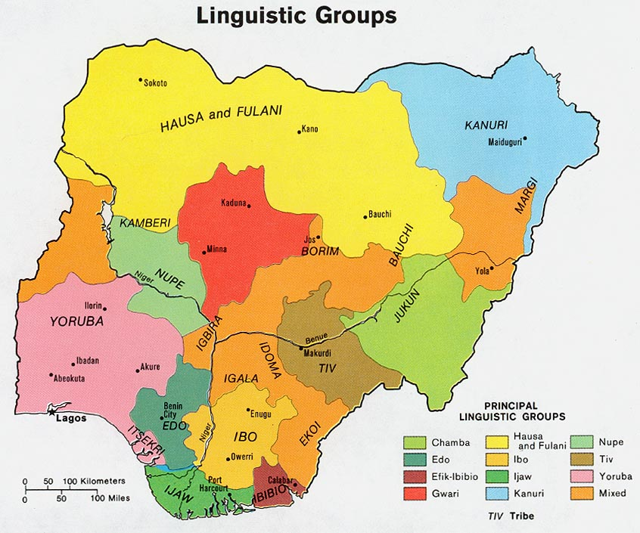

Slide 12
Nigeria: Three Places in One
Northern Nigeria: Dry, Grazing County Moslem, Hausa and Fulani
Middle Belt: Temperate, Hilly, Underutilized potential for Grain Crops- small heterogeneous groups, Tiv and Nupe
South: Tropical forest, humid, palm oil, cocoa, oil. Yoruba, Wes, Ibo East

Slide 13
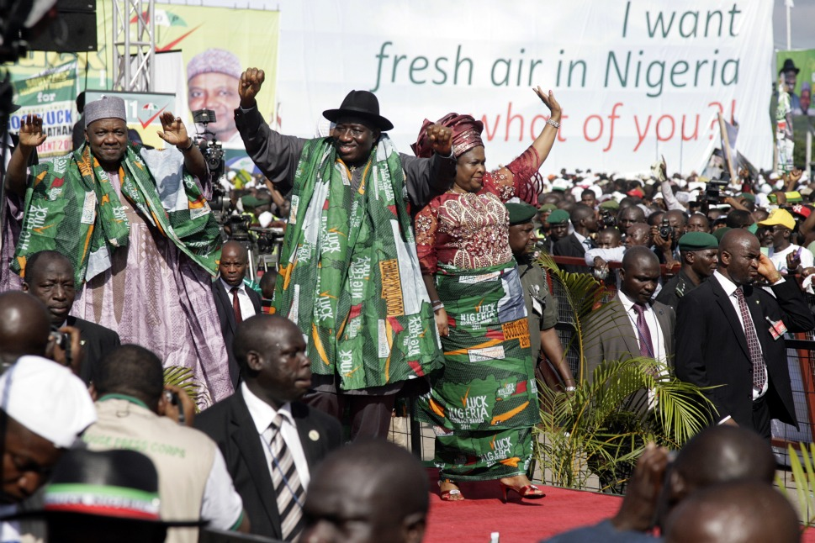
Middle Belt Politics

Slide 14
The Scandinavia Problem
Norway- A Nation State of 4.9 million people
Iceland- An Island Nation of 313,376
“Ibo” (Igbo)- a “tribe” of 17-30 million people
Theme: a State without a Nation

Slide 15
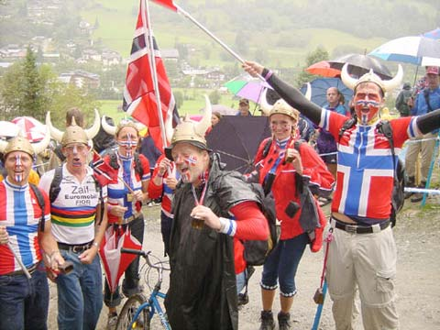
Norwegians

Slide 16
Defining Nationalism without states: The Norway Problem
Defined as parochialism-Identification and value system set within Autonomous Local Communities
Problems with "tribalism“
European Term, Conventional Use
Tribes vs. “Detribalization”- What does it mean?

Slide 17
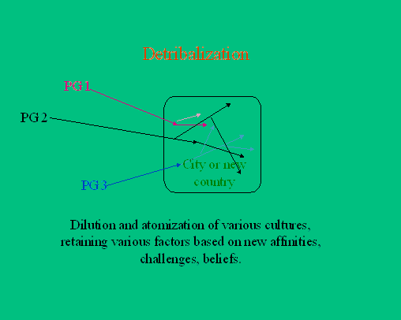
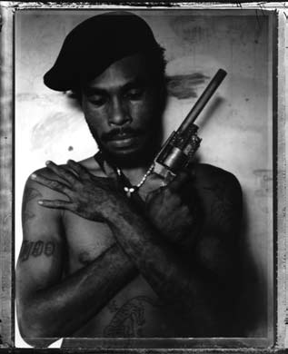
“Guns and Arrows: The Detribalization of Papua New Guinea” Australian photographer, Stephen Dupont

Slide 18
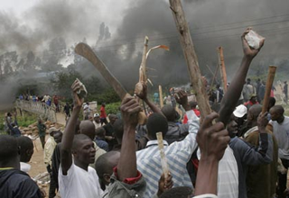
Ethnic Consciousness
Sometimes New
Often accidental
External in origin
Formed by urban contact
Changing
Related to Differences in Economic Advantages

Slide 19
Asian Ethnicity
A Core Nationality and Outlying “tribes”
Indonesia and Java
India and Hindi (Crosscutting caste, religion and language)
Kurds: Minorities in Four Countries- Turkey, Iraq, Syria, Iran
Iran: Persia

Slide 20
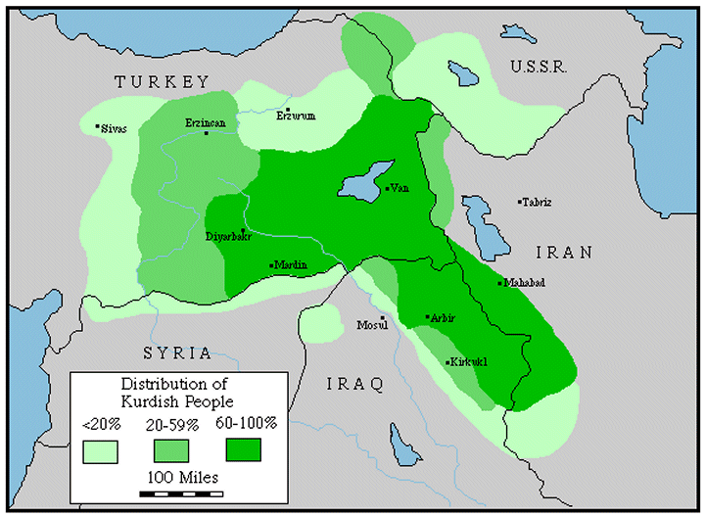

Slide 21
Defining Nationalism
North Africa: "Arab majorities" and "minorities"-
Sudan, Chad, Mauritania and Morocco
The Horn- Clans, religion and colonial borders

Slide 22
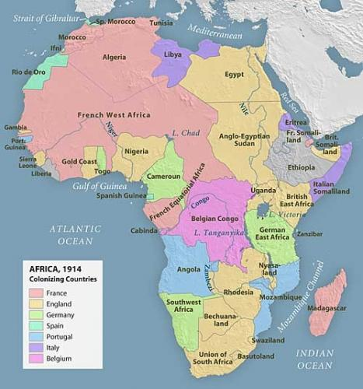
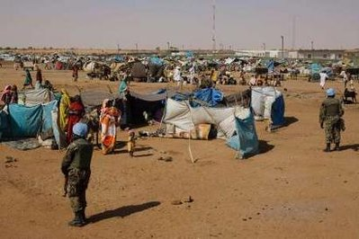
Colonial Borders

Slide 23
Ethnicity, Race and Culture
Focus of Explanations for Failure in Africa
The nature of conflict
The legitimacy of colonial borders
Are Settlers a different “tribe?”

Slide 24
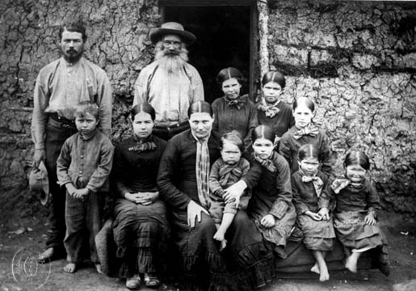
Boer Family- c. 1900

Slide 25
Ethicity
Clifford Geetrz and his Critics
Clifford Geertz, “The Integrative Revolution: Primordial Sentiments and Civil Politics in the New States”
In Clifford Geertz, ed. OLD SOCIETIES AND NEW STATES (New York: Free Press, 1968).

Slide 26
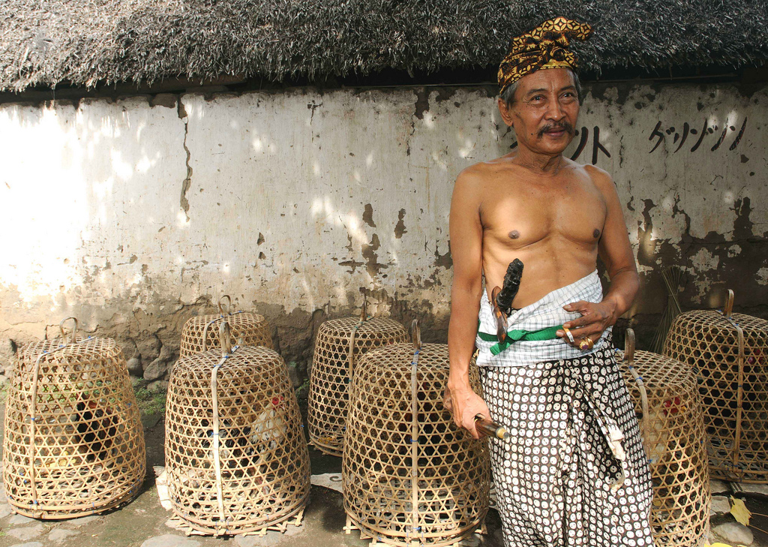
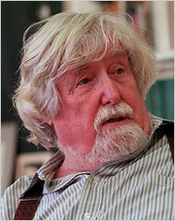
Balinese Status Titles taken from Clifford Geertz’s (1926-2006)writing entitled “Person, Time, and Conduct in Bali : The Social Nature of Thought”, that will give you an interesting insight on Balinese social-cultural life.

Slide 27
Theories of Ethnicity: Primordial Sentiments
Primordialism- Allegiance based on givens, culture, language and religion
Contrasts Primorial vs. civil sentiments (Civil Society)
Primordial- Permanent and unchanging

Slide 28
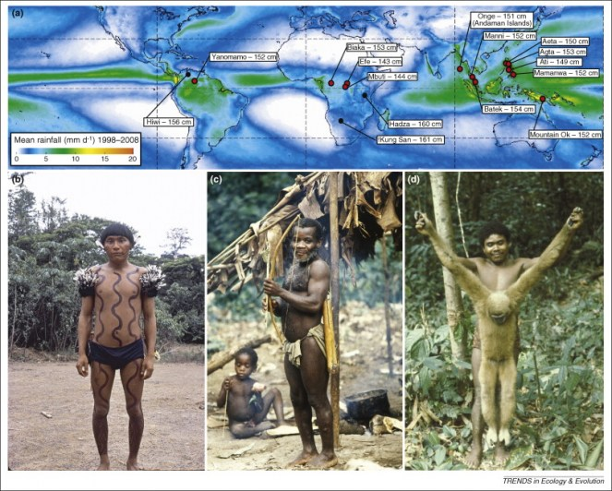
Indigenous Peoples

Slide 29
Primordialism
Corporate sentiments of oneness
Personality flaw that must be corrected
Undermines the Nation
Ethnicity is destructive
Embedded in ancient myths and history

Slide 30
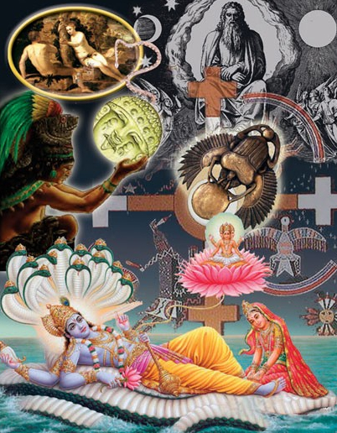
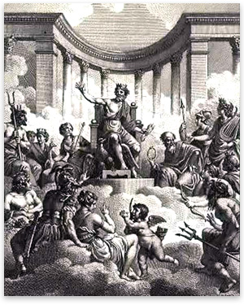
Myths

Slide 31
Critique of Primordialism Ethnicity as a Process
Contextual and Changing
Towns: urban contact and the “other”
“retribalization”
European origins of ethnic identity
Tradition actually changes

Slide 32
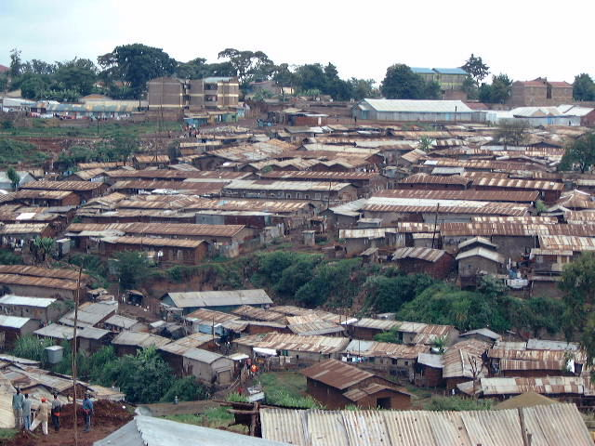

Slide 33
Cleavages and Conflict
Cumulative (overlapping) vs. Crosscutting- What is Northern Ireland
Eg. NORTHERN IRELAND:
Catholic
Poor
Urban
Working Class

Slide 34
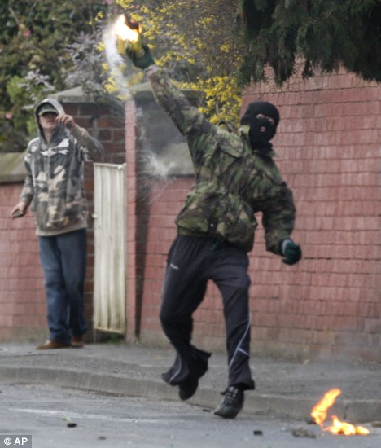
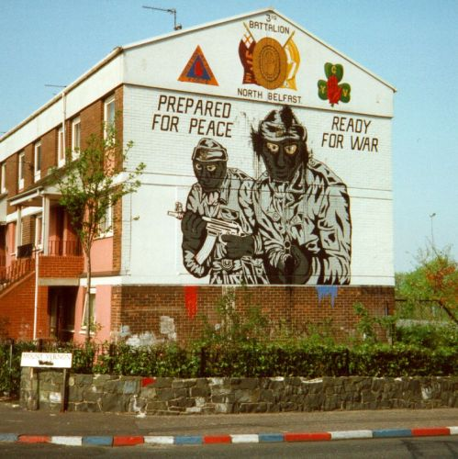
Northern Ireland

Slide 35
Related Terms Finding a meaning for Social divisions
Cultural Pluralism
Cultural Sub-nationalism
Religious Fundamentalism and Nationalism

Slide 36
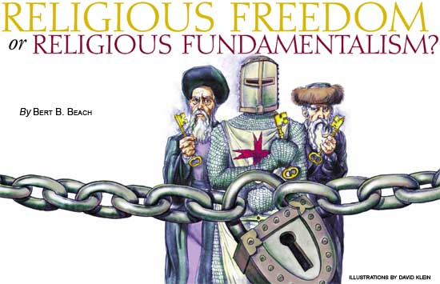
Religious Fundamentalism

Slide 37
Explanations of Ethnicity
cultural sub-nationalism- language, culture, religion and race
Awkward, what is “sub” about it?
Contextual- intensification of ethnic identity- and the reverse
Ethnicity as Nationalism

Slide 38
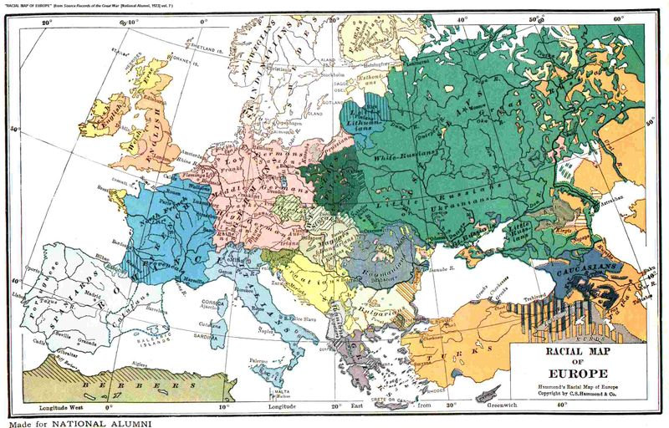

Slide 39
Ethnicity and Class
Class is Traditional
Class was reinforced by Colonial Rule
New Organizational and Economic Elites have ties to Pre-colonial elites
Strikes and Spoils- Tend to be Ethnic in Nature

Slide 40
Ethnicity vs. Language-Issues
Ethnicity as a concept (Review)
Colonial vs. Indigenous Languages
The role of Settler lingua francas: English, French, Portuguese and Trade Languages: Hausa, Swahili

Slide 41
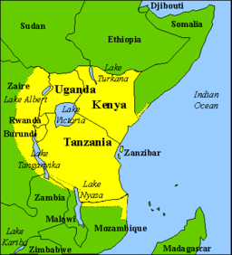
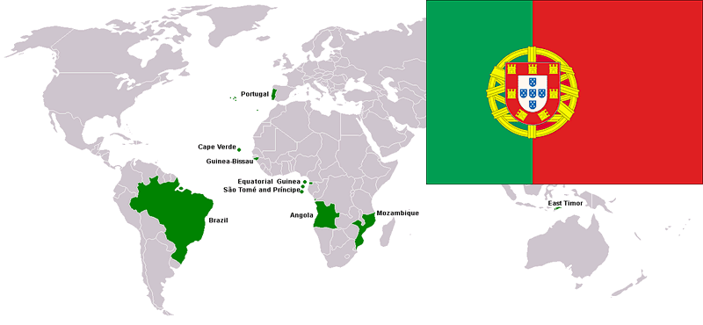
Swahili and Portuguese Cultural Areas

Slide 42
The Mau Mau Crisis
The British View

