Slide 1
PIA 2574 Resource Guide and Syllabus AFRICAN DEVELOPMENT SEMINAR: Conflict, Governance and Development
Overview

Slide 2
The Bottom Line

Slide 3
Reading: The Bottom Line- Syllabus is a Resource Guide
1. Read Three Required Texts
2. Read two historical and Policy Analysis Books (at least one marked “Recommended.”)
3. Read One Discussion Book
4. Read One Discussion and one Case Study Reading Each Week for about twelve weeks.

Slide 4
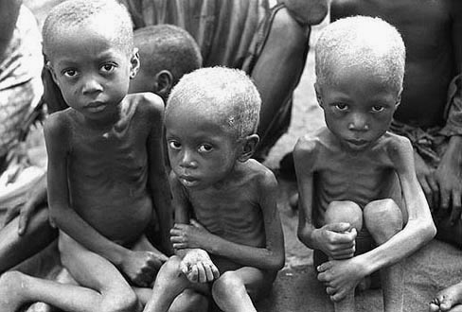
The Key to Debate?

Slide 5
The Bottom Line: Requirements
Short Bio- Picture, background, and books chosen to read;
Weekly participation in discussion focused on CASE STUDIES;
Research Presentation and Paper
Take Home Exam

Slide 6
The Goal? An African Middle Class Family in Lusaka, Zambia

Slide 7
Research Assignment
Revised Assignment
Research Paper Oral Presentation and Papers: Each member of the class will make a formal group presentation to the class and prepare a well written research paper (20-25 page limit) which will be turned in at the end of the semester. The assignment will be established according to your region of interest (30%).

Slide 8
Questions?

Slide 9
Introduction and Overview of Discussion: Theories and Themes
An Overview of the Problem
Regional Failures
Geography
Natural Resources
People, History and Culture
Political Systems and Institutional Collapse
Donor Fatigue and Dependence

Slide 10
African Underdevelopment: Overview-
In early 1983, observers began to pick up rumors that a tragedy of mass proportion was about to occur in the horn of Africa. One projection was that up to thirteen million people in the horn of Africa could starve to death.
Six months latter, drought and civil war led to mass starvation in which millions of people in Ethiopia, Eritrea, Sudan and Somalia died. A new era began in post-colonial Africa that continues until today.
Instead of social and economic development, journalists and academics focused on, war, collapsed states, humanitarian assistance, donor fatigue and structural adjustment.
That focus continues today.

Slide 12
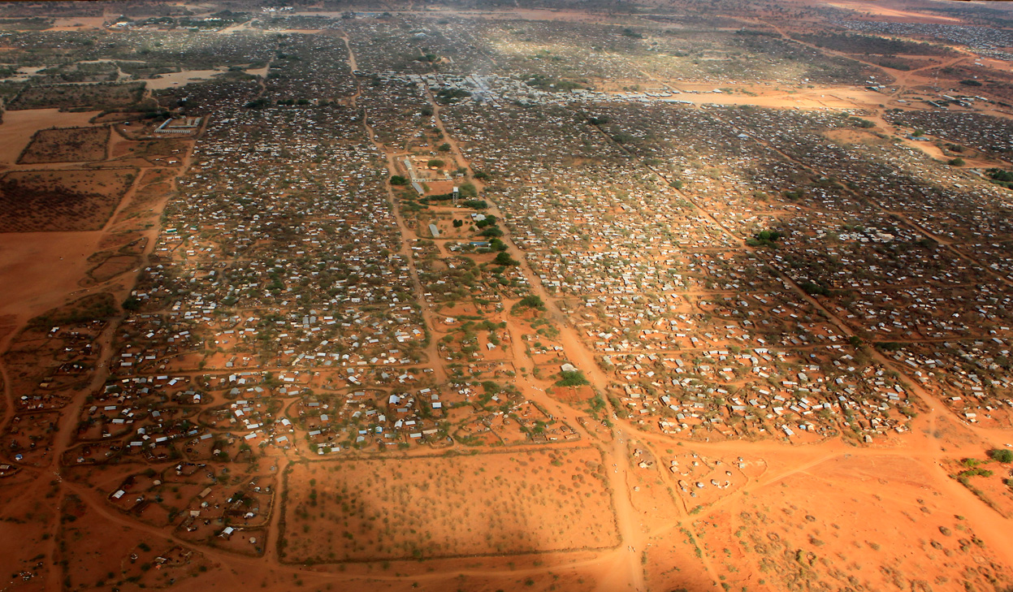
World’s Largest Refugee Camp, Dadaab, Kenya (500,000 people)

Slide 13
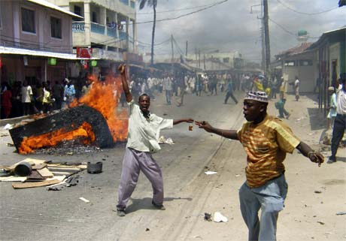
The Image

Slide 14
Africa and Poverty
The Question is Why?

Slide 15
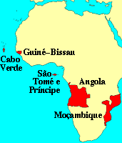
African Regions
Francophone
Lusophone
Horn of Africa
North Africa
Anglophone Africa
Southern Africa

Slide 16
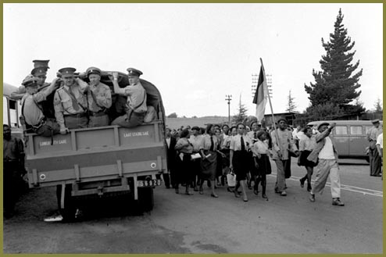
South Africa and Congo, 1940s

Slide 17
DISCUSSION POINT:
The Failure of Regional
Integration in Africa
IS REGIONALISM THE
ALTERNATIVE TO GLOBALISM?

Slide 18
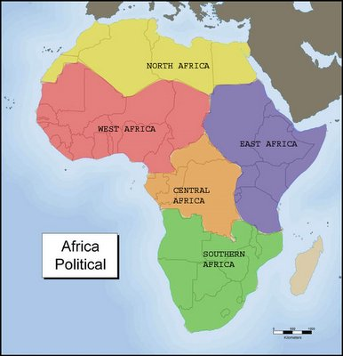
Fifty Four Countries?

Slide 19
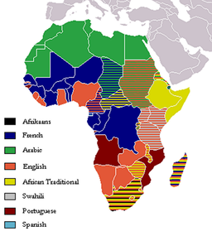
European Languages

Slide 20
Regions and Integration: A brief Overview
An alternative future-Interlocking Regions-Combines Languages and Culture/History
Culture and Politics: Role of Language
1. North Africa- Arabic (Plus French and English)
2. Horn- Somali, Amharic, Tigrinya (Italian Legacy, inc. Libya)
3. Francophone and ECOWAS (The Problem of Anglophone West)

Slide 21
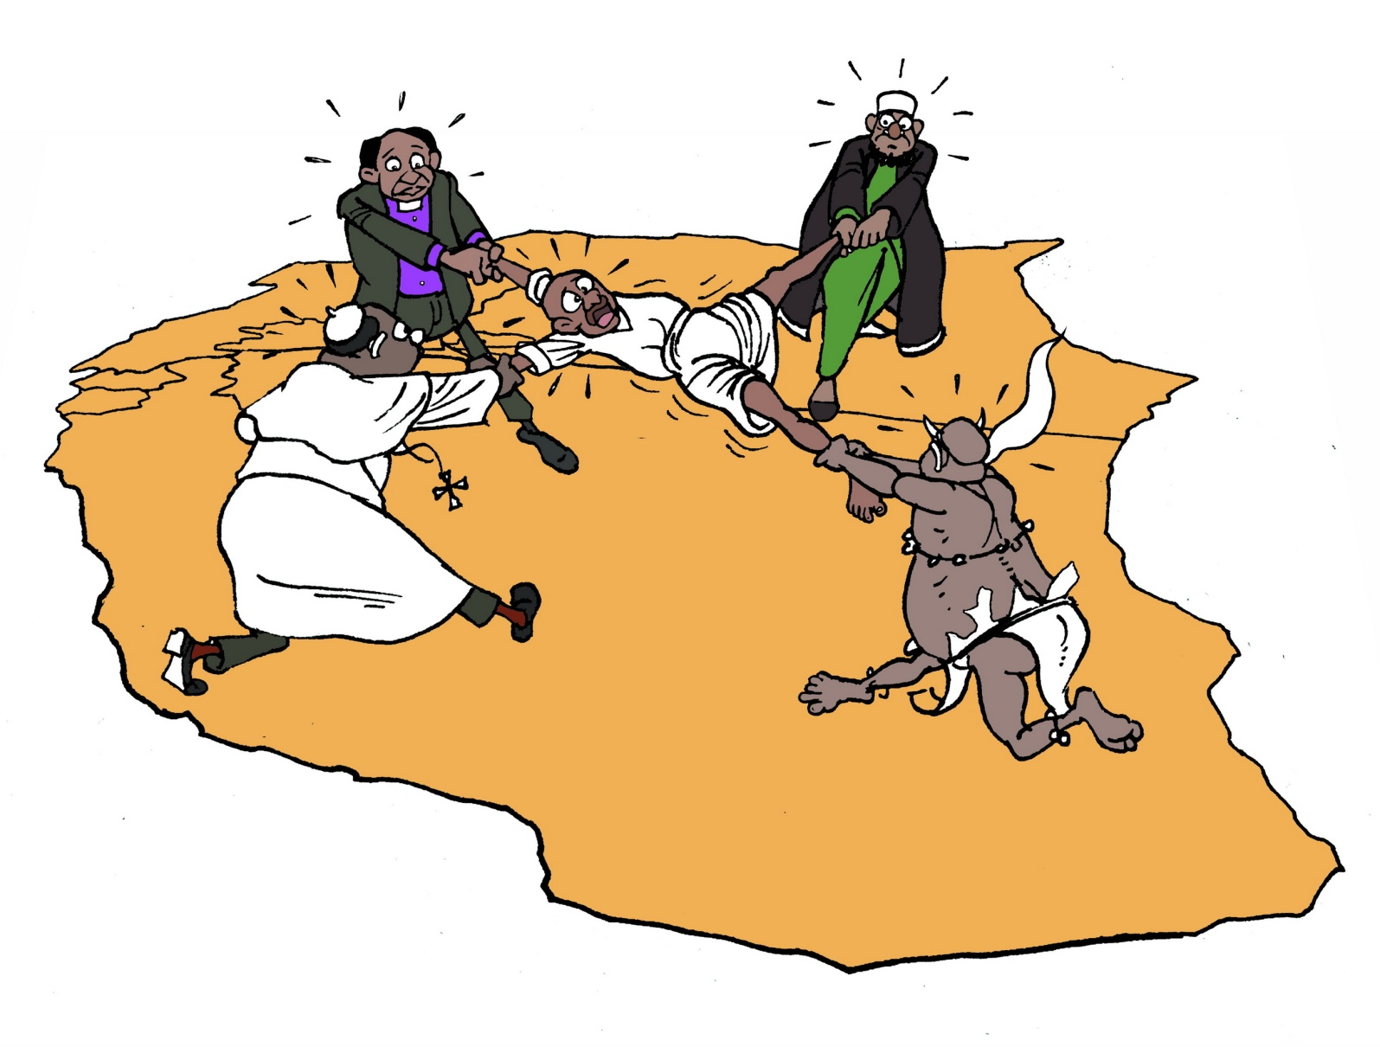
East African Regional Scenarios from Society for International Development (SID)

Slide 22
Regions and Integration:
4. SADC and Southern Africa: 15 countries. Alternative Free Trade Association of Eastern and Southern Africa. Lusophone vs. Anglophone (Special role: South Africa and Settlers)
5. The Great Lakes: Eastern and Central Africa as a style of governance: Uganda, Kenya, Tanzania, the Horn (Swahili)
6. Central Africa: Anarchy Zone? Former Zaire, Rwanda and Burundi

Slide 23
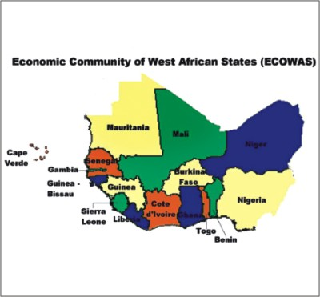
A Military Scenario sans Economics

Slide 24
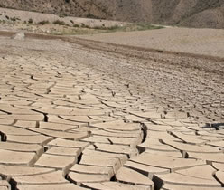
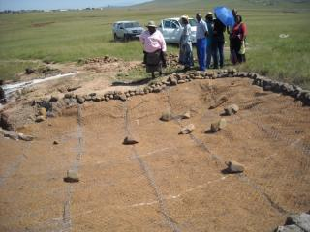
Geography
Tropical Soils
Desertification
Deforestation
Water Loss
Land Use

Slide 25
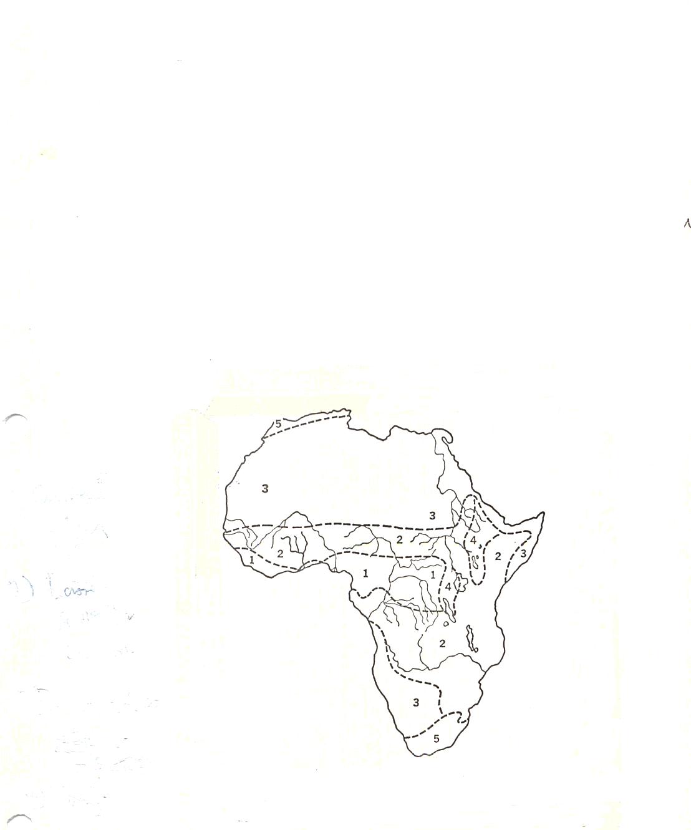
The African Continent

Slide 26
Africa: Climatic Regions
Tropical Rain Forest
Tropical Savanna and Summer Rain
Low Latitude Dry Climates
Undifferentiated Highlands
Mediterranean

Slide 27
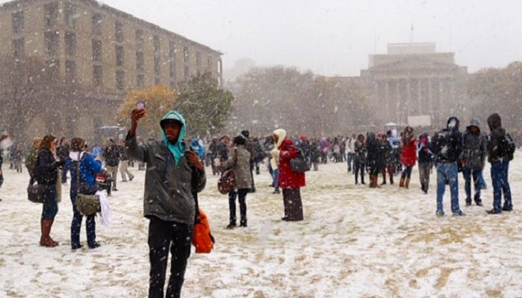
Johannesburg, August 7, 2012

Slide 28
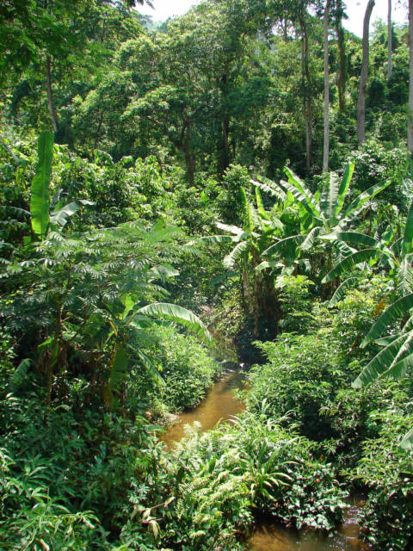
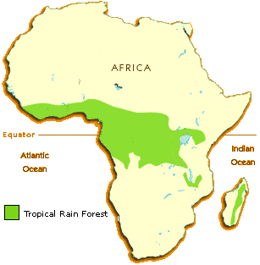
Most of Africa is not rainforest

Slide 29
Regional Features
Rift Valley and Lake Systems
Deserts: Sahara and Kalahari/Namib
River Systems:
Nile
Niger
Congo
Zambezi
Volta

Slide 30
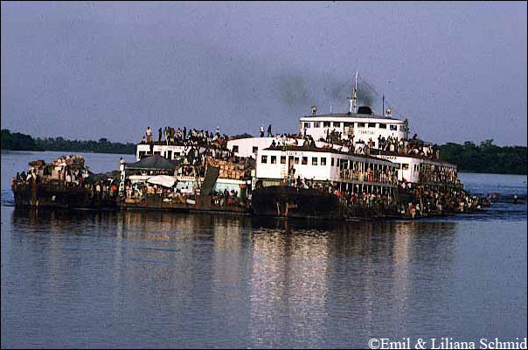
Congo River

Slide 31
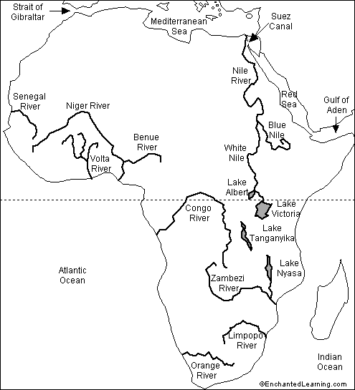
Big Rivers

Slide 32
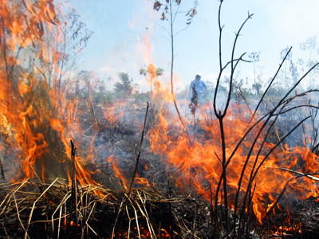
Patterns of Rain and Agriculture
Monsoon Tropical Rain
Alternating Wet and Dry
Deserts- Sahara, Namib, Kalahari
Shifting Agriculture
Slash and Burn
No Humus/regeneration of soil
Leaching: Nutrients and Minerals

Slide 33
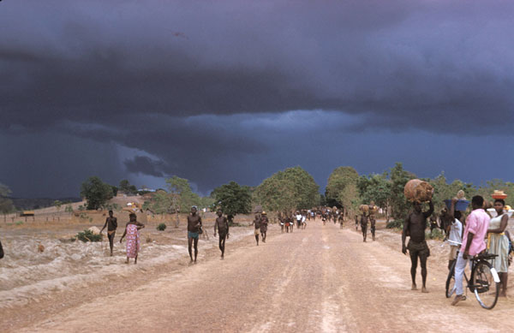

Slide 34
Natural Resources: The PROBLEM: Desertification
Overgrazing
The destruction of forests
Loss of Top Soil
Patterns of Cyclical Drought
Major Declines in Food Production

Slide 35
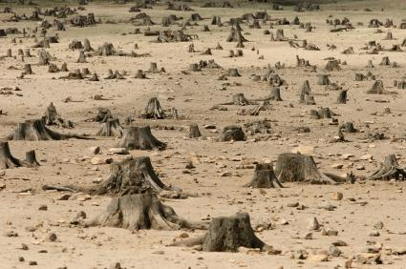
Deforestation

Slide 36
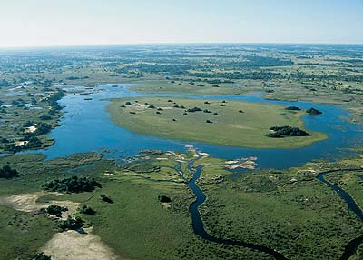
Okavango Delta

Slide 37
ISSUE: THE NATURE OF TROPICAL AGRICULTURE
Hunters and Gatherers (none or few)
Pastoralists
Subsistence Farming- roots, grain, Bananas
Cattle and Small Stock
Commercialization of Animal Husbandry and Agriculture
Land Use and Property Rights Issues

Slide 38
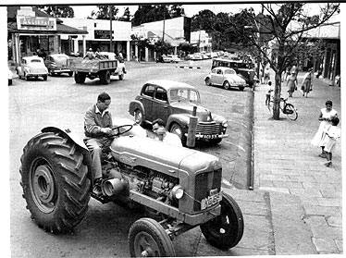
European Settlers: Eldoret Kenya, 1960- The Issue of Land

Slide 39
Natural Resource Curse: Elite Extraction and Corruption
Oil- Extraction and Short Term Benefits
Diamonds- Conflict and Blood Diamonds
Gold- Basis of Settler Wealth
Specialized metals: technology, phone and computers
Forests and natural resources
Wildlife

Slide 40
Ten Minute Break

Slide 41
Reminder: verview of Discussion: Theories and Themes
An Overview of the Problem
Regional Failures
Geography
Natural Resources
People, History and Culture
Institutional Collapse
Donor Fatigue and Dependence

Slide 42
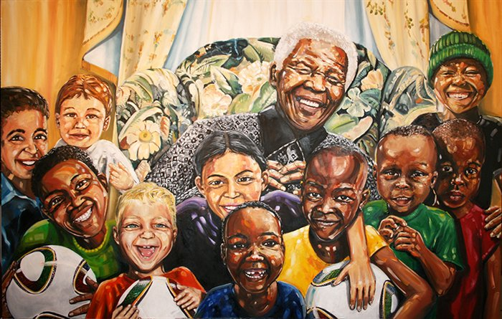
People, History and Culture
The Rainbow Nation Myth

Slide 43
San in Southern Africa

Slide 44
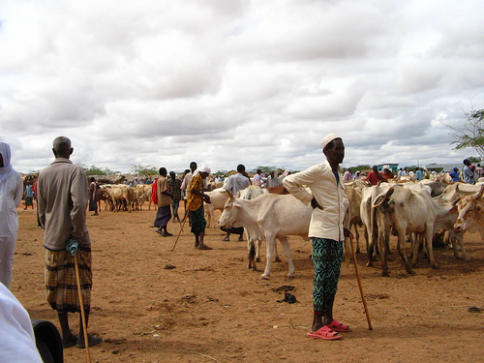
Somali Pastoralists in Northern Kenya

Slide 45
HISTORY: Fragmentation, Dependence and Conflict
HISTORY AND POLITICAL DEVELOPMENT
THE NATURE OF THE PAST
THE IMPACT OF COLONIALISM AND NATIONALISM

Slide 46
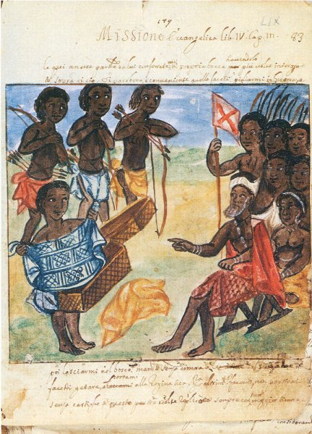
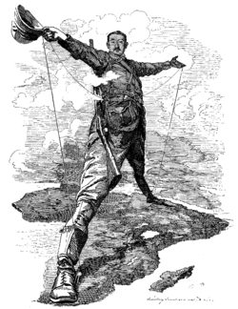
African History

Slide 47
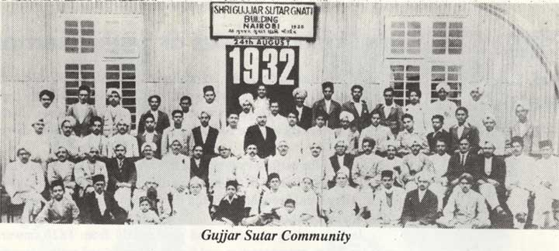
From the East

Slide 48
DISCUSSION POINTS: History
Did Things Fall Apart?
Did Europe Under-develop Africa?
Should the Settlers Go Home?
Was Colonialism in Africa Different?

Slide 50
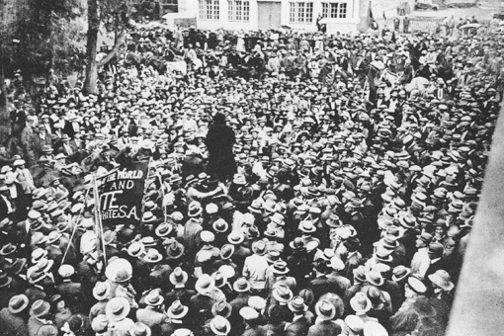
South African Strike, 1922
“ Workers of the world, unite and fight for a white South Africa!"

Slide 51
History and Political Development The Nature of The Past
Oral tradition vs. Written Language
Role of oral history
Isolation from North Africa/Europe
African Historical Migration
Nature of Political Organization- "state vs. Stateless" systems
Impact of Slavery
Oral tradition vs. Written Language
Nature of Political Organization- "state vs. Stateless" systems- Lack of Political Organization?

Slide 52
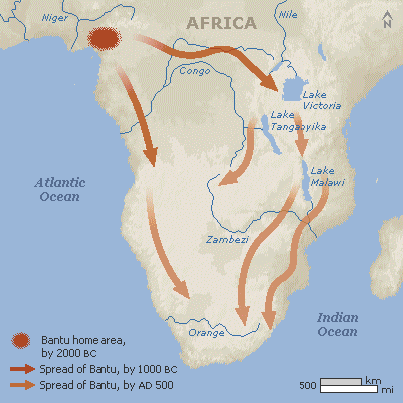
African Migration

Slide 53
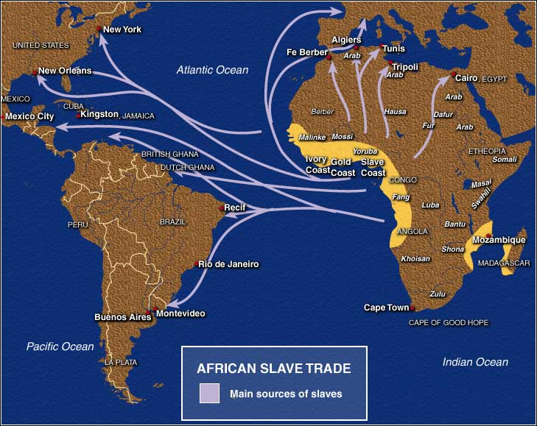
Pre-Colonial History: Slave Trade

Slide 54
Pre-Colonial Polities- Principles
State vs. Stateless Systems
Not a dichotomy but a Continuum
Age Grade
Kinship
Lineage
Hierarchy/Bureaucratic (Weberian)

Slide 55
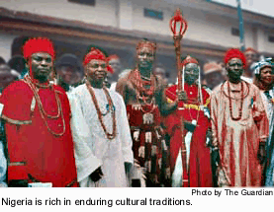
Age Grade Systems: circa seven years apart (A Generic Example)
Children
Youths
Circumcised Young Men
Warriors
Governors
Elders
Governing Age Grade

Slide 56
African Political Systems: The Problem of Institutional Collapse
Extended Family and Clan Systems: Hunter-Gatherers in Southern Africa and Somalia
Age Grade Systems- Ibo in Nigeria, Luo in East Africa and Kikuyu in Kenya
Kingdoms (State Systems)- Ethiopia, Yoruba, Buganda, Zululand and Swaziland

Slide 57
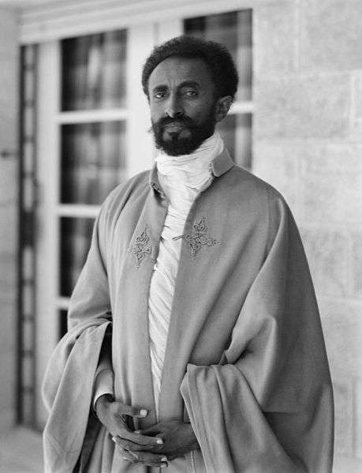
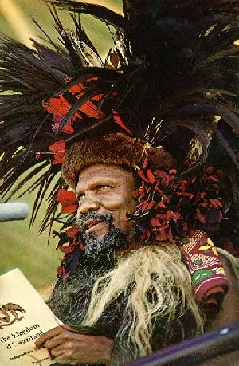
Haile Selassie of Ethiopia and Sobuza II of Swaziland

Slide 58
Pre-Colonial History: The Issue of Iron
Iron Age Sites
Meroe: 550 BC
Egypt: 600 BC
Carthage: 840 BC
Nok Culture (Nigeria): 200 B.C.
Axum and Ethiopia: 25 AD
Zimbabwe: 200 AD
Tzaneen (South Africa): 500 AD

Slide 59
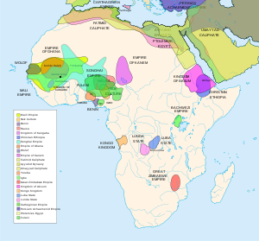
Iron Age Kingdoms

Slide 60
African Migration-Theories
Movement From Northeast to South West
The Bantu Heartland idea
Indigenous Occupants: Pygmy, San, Khoisian
Issue of Arrival in West and South Africa -1600 and 1653
Myth of Arrival: 1653
The importance of Carbon Dating

Slide 61
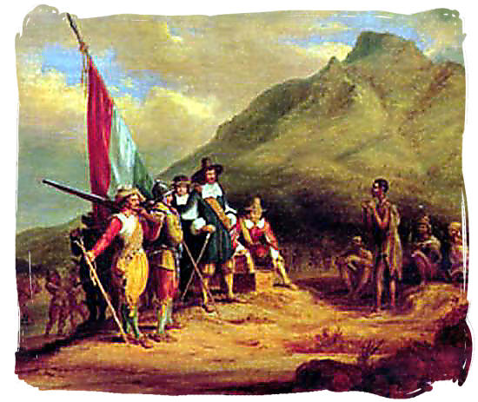
Jan van Riebeeck and Bantu Arrival

Slide 62
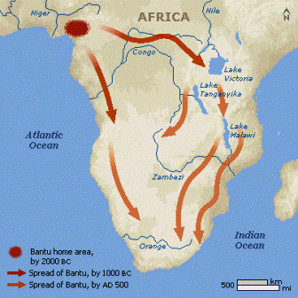

Slide 63
Western Africa Pre-Colonial Systems: Images and Myths?
Ghana- 300-1100 AD:
Trans-Saharan Trade (Gold For Salt)
Feudal Structures
Slave Trade to Middle East
Mali- 1200-1400 (Timbuktu)
Islamic Invasion
Hierarchical
Part of Middle East and Islamic Cultural Patterns

Slide 64
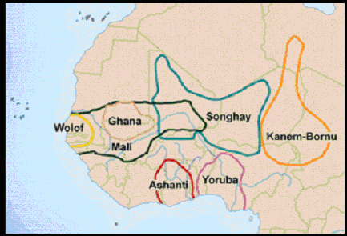
West African Kingdoms

Slide 65
Western Africa: Historical Kingdoms
Songrai/Songhay- 1400-1700
Money: Gold and Cowries
Laws and Hierarchical Administration
Islamic Education
Shift to Coastal Trade and Slavery 1600

Slide 66
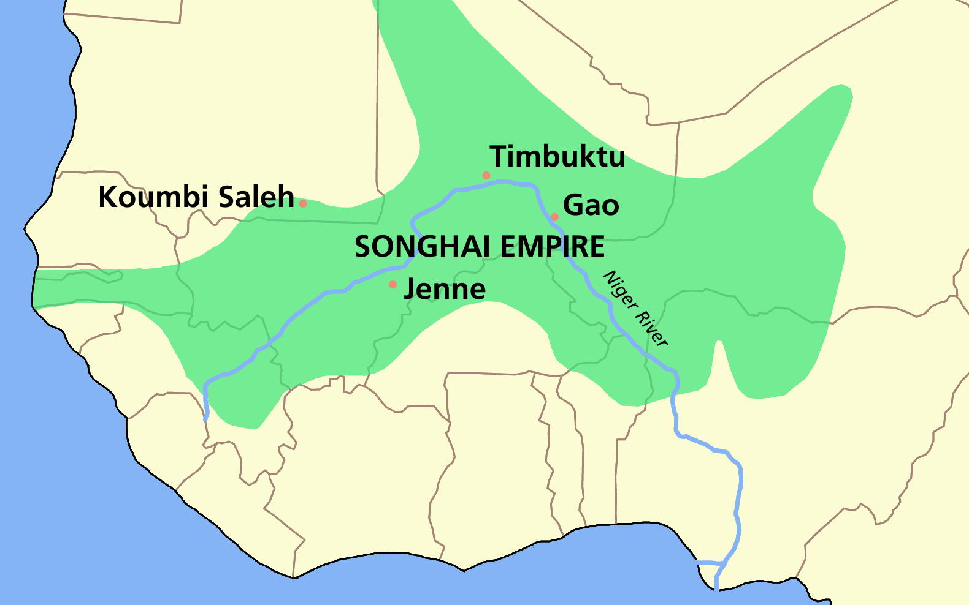

Slide 67
Western Africa
Hausa, Mossi, Borno
Islamic Empires: Invasion, Establishment and Puritanism
Futa Jalon and Usman dan Fodio, 1804
Identity of Arab, Berber and African

Slide 68
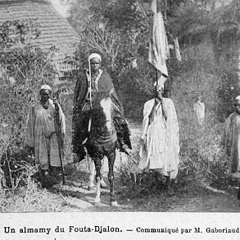
Futa Jalon

Slide 69
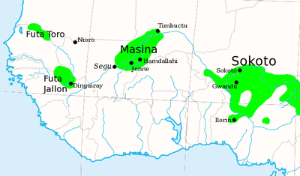
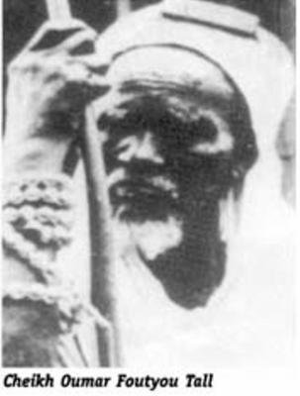
Kingdom of Fouta Djallon , 1776-1896, Islamic Empire
Cheikh Oumar Foutou Tall,1796-1864

Slide 70
Eastern and Southern Africa
Khoisian 200 BC-1600
Bunyoro from 1300
Buganda from 1500-1800
Mwonomotopa1500-1800
Luba/Lunda 1500-1800
Zulu Empire and Dissolusion 1700-1850
Portugal 1600-1975
Afrikaners 1652-1994

Slide 71
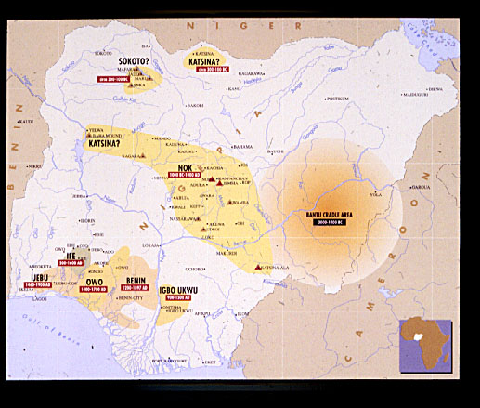
Nigerian Kingdoms

Slide 72
The Institution of Slavery
Roman, Middle Eastern and African Slavery
African Kingdoms, trade and slavery
Chattel Slavery and the Overseas Trade

Slide 73
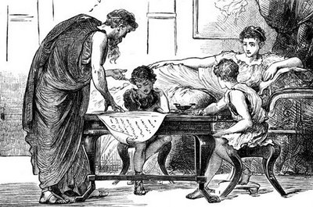
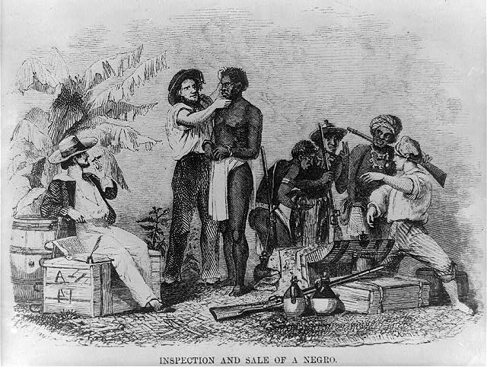
Slavery: Teacher vs. Chattel

Slide 74
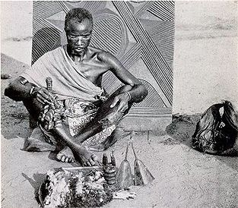
The Issue of religion
Indigenous
Christianity
Syncretistic
Islam

Slide 75
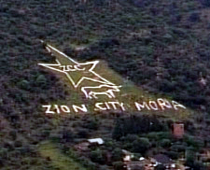
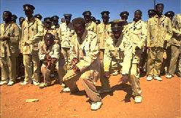
Syncretistic Religion
Zion Christian Church

Slide 76
The Influence of Islam
Middle Eastern and Asian influences:
Indians and Syrians
Land based trade- Still little understood
Puritanism and Revival in the nineteenth century
Extremism: Boko Haram and Al-Qaeida 20th century
Competition with Christianity

Slide 77
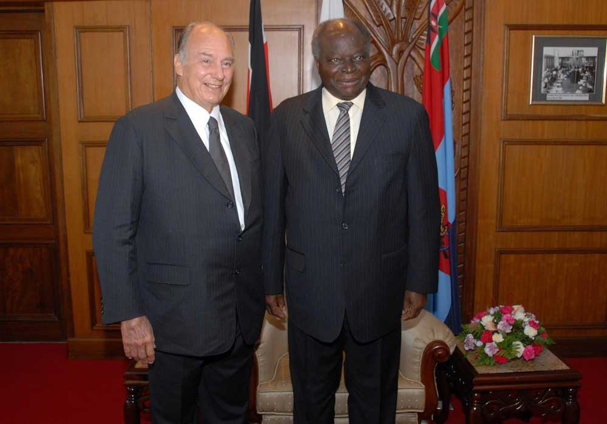
Aga Khan Visits Kenya (with President Mwai Kibaki)

Slide 78
Africa in the Nineteenth Century Major Events
The Moslem Invasions of the Western Sudan and the East African Coast- 1800-1840
The Replacement of the Slave Trade with trade in cash crops (palm oil, cocoa, peanuts, and cocoa and minerals (gold, diamonds, coal, copper, etc.)- 1820-1900
The Replacement of informal Spheres of Influence with formal partition of the continent and the establishment of Imperial Rule, 1870-1890
Foretelling of Islamic Fundamentalism in 20th Century?

Slide 79
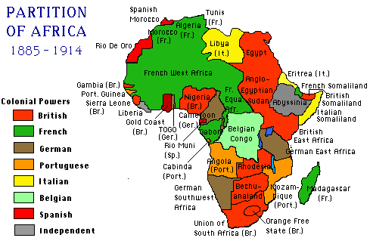

Slide 80
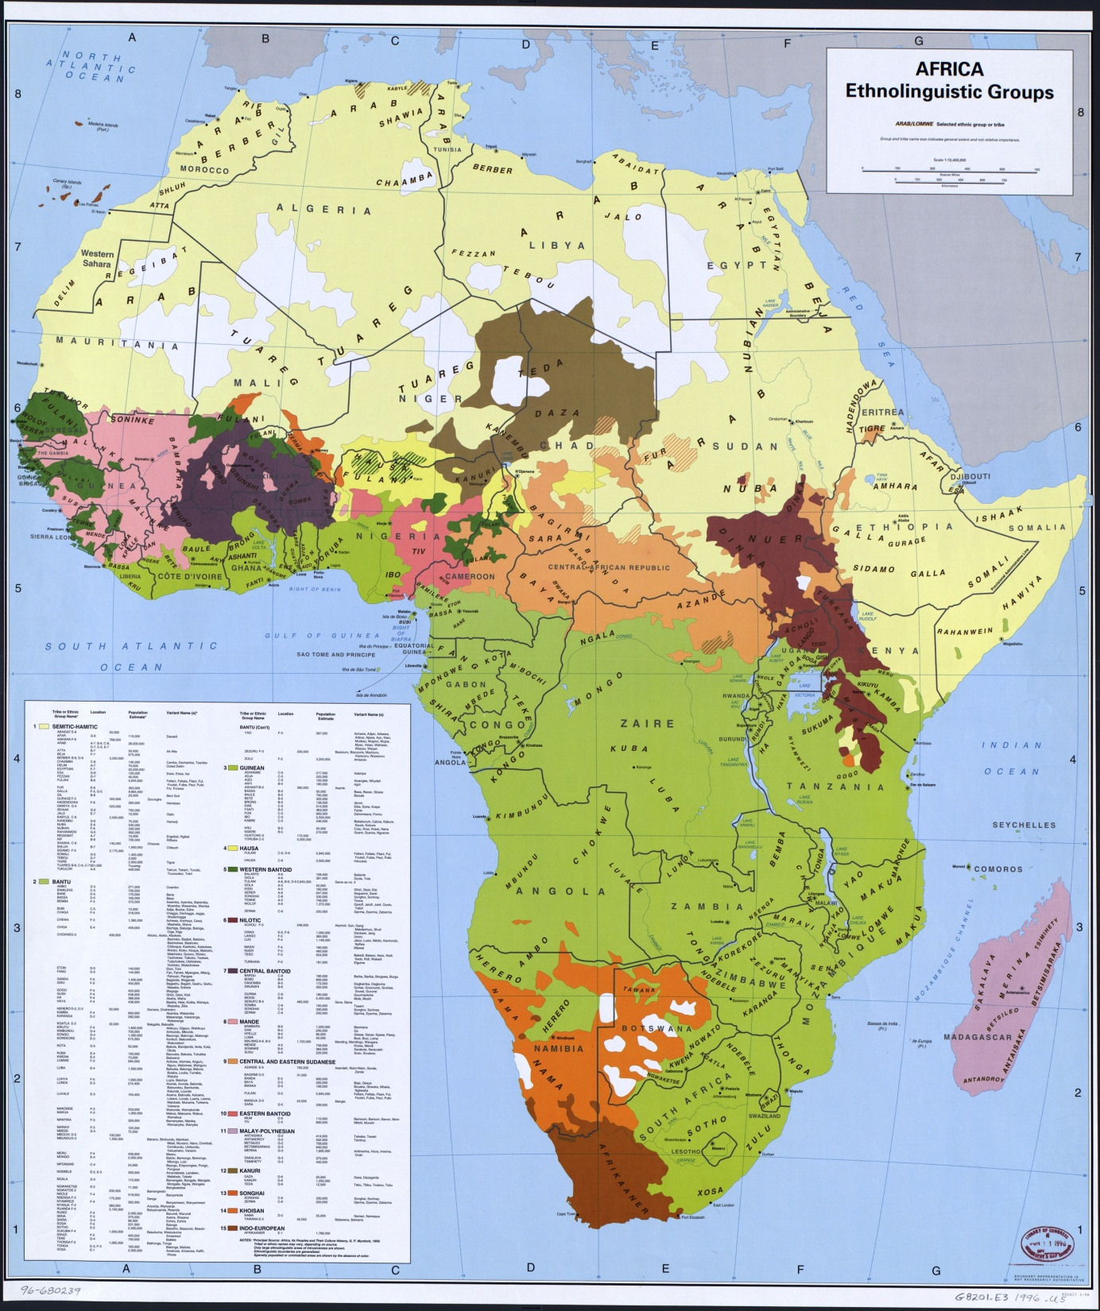

Slide 81
Preview: Institutional Collapse: Donors, Theories of State Failure and the rise of Sub-national Violent Political Groups
Ethnic Identity, Culture/religious Clash and Violent conflict
Authoritarianism: One Party Systems and Military Regimes
Over-expansion of state’s economic management function
Violation of social contract with middle class
Elite Predation- corruption and diversion of public resources
Aid dependence and externalization of public sector management
Debate over Islamic Fundamentalist Groups
Donors and Donor Fatigue

Slide 82
Kenya, 2007-2008

Slide 83
Discussion
“Do Things Fall Apart in Africa After 1870?” Why or Why Not?

Slide 84
NEXT WEEK
“Bula Matari came to represent [the] alien authority…”
Crawford Young
With Henry
Morton Stanley
On the Nile,
1874-77

Slide 85
Come Back Africa (1956)
VIDEO
http://www.youtube.com/watch?v=Buod66bq0cg

