Slide 1
PIA 2501
Development Policy
And Management:
The Bureaucracy, Civil Society and the Post-Colonial State- A Legacy of Colonialism?
Week Four

Slide 2
Influence: Transition Authors
Paul Theroux- “Tarzan as an Expatriate”
Peace Corps, 1963-1965
Born | 10 April 1941 (age 75) Medford, Massachusetts
Occupation | Peace Corps Volunteer, Malawi Novelist, Travel writer, short story writer, literary critic
Nationality | American
Started Writing | 1967

Slide 3
This week’s Themes

Slide 4
Overview of Course Themes: Looking for these in Your Readings
Links with (and Legacy of) Colonialism
Theories of Modernization
The End of the Cold War
Debates About Donors
The Focus on Governance
Critiques of Modernization
Underdevelopment and Dependency

Slide 5
PIA 2501: Development Policy and Management
1. The Legacy of Colonialism: The Anthropologists?

Slide 6
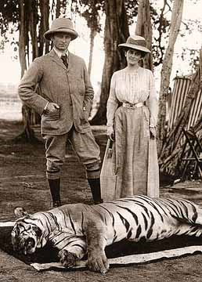
The Impact of Colonialism and Imperialism on Development Theories
Note: Colonial Origins-
Anthropology- “Primitivism”
Colonial Mission
was Modernization,
Nationalism
and Development
Anthropology Traced
Patterns of Change
Dychotomy: Traditional vs. Modern

Slide 7
Debates about “primitivism”
Sustainability and Hunting Gathering
Racist or Prescient?

Slide 8
Colonialism "The good life" for Rhodesian whites, taken from Rhodesian government booklet promoting white immigration, 1970”

Slide 9
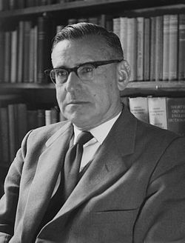
Development Theory Review
In 1950, There existed…
Colonial Anthropological Theories
Rhetoric of Nationalism throughout world
Political change and independence
The Rhetoric contrasts with public sector continuity and debate about its role in economic development
Beginnings of Cold War
Picture Above: Isaac Schapera (23 June 1905 born in Garies, South Africa – 26 June 2003 London, England), was a social anthropologist at the London School of Economics

Slide 10
Independence Nyasaland- March 1959

Slide 11
2. Theories of Modernization
MODERNIZATION, Nationalism and Independence: Major Theme

Slide 12
The “Development Era” 1948-1989
In the 1940s and 1950s there was a rhetoric of Nationalism through out the World
Political Change (Nationalism in the Middle East, and Latin America) and Independence (Caribbean, Africa, and Asia (1960s-1970s)
Transformation in Eastern Europe and the CIS (1980s)

Slide 13
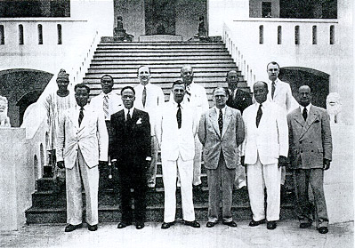
The New Colonials and End of Sea Based Colonialism (Sir Charles Arden-Clarke of Gold Coast in the Center)
Egypt- 1922
Dutch East Indies- 1944 (Indonesia)
Philippines (1946)
India- 1947
Israel-1948
Sudan-1965
Ghana-1957
The Deluge-1960

Slide 14
Independence
Between 1945 and 1985 more than one hundred new states came into existence (Another 20 or so by the end of the century)
Kwame Nkrumah “Seek ye first the Political Kingdom”
Implication was that economic
development would follow

Slide 15
(L to R) PM Pandit Jawaharlal Nehru of India, Pres. Kwame Nkrumah of Ghana, Pres. Gamal Abdel Nasser of United Arab Rep., Pres. Sukarno of Indonesia, & Pres. Tito of Yugoslavia.

Slide 16
Mixed vs. Command Economies
9. Nationalism, Independence and Theories of Development
Socialism as a “Model?”
Part of European Social Democracy Movement?

Slide 17
Social Democracy

Slide 18
Vs. Communist Theory and Development
State Control
Social Engineering
Command Economy
Industrialization vs. Rural Transformation
State Managed Development

Slide 19
The Great Helmsman

Slide 20
Keynesianism and the “Western” Development Model

Slide 21
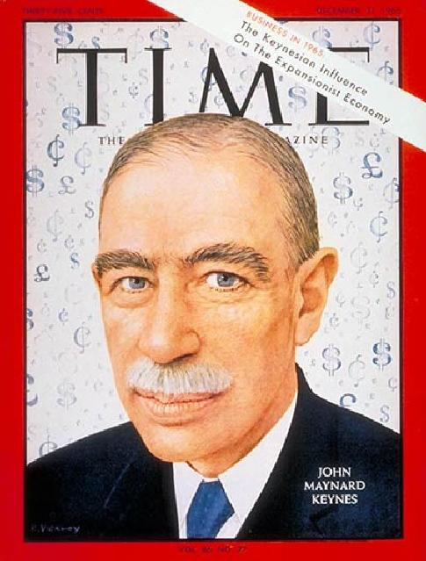
Historical Character
John Maynard Keynes

Slide 22
John Maynard Keynes, 1883-1946
British Economist who worked several years in the British India Office
John Rapley:“Keynes had no problem with the market economy. He liked the machine but judged it to be in need of improvement if it was to operate well.”

Slide 23
John Maynard Keynes
His goal was to influence the market and not replace it
Influenced the U.S. New Deal and the thinking of the Labour Party in England
He had an important influence on the social democratic parties in Western Europe
His ideas suggested that European mixed economies could be replicated in LDCs

Slide 24
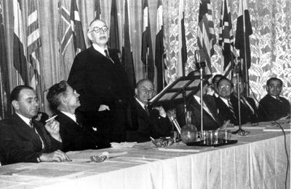
British economist Lord John Maynard Keynes (3rd l.) addresses the Bretton Woods Conference in July 1944

Slide 25
Keynesianism as Economic Principle
Government had a role in the management of the economy
KEY: Faith in the State

Slide 26
Keynesianism- Keynes on the End of the Gold Standard VIDEO
Physical development (roads and dams) and Economic Growth
Physical and Mental Change or Social Development
Human Resource Development vs. Social and Economic Change
Proposed a Mixed Economy—public and private

Slide 27
Modernization

Slide 28
Modernization, Development Theory, and its Critics
A. Agraria vs. Industria

Slide 29
Development: The Modernization Definition
Agraria
Attitudes: parochial – fixed rules
Customs: particularistic / inherited
Status: ascriptive
Functionally: diffuse
Holistic Change
Lack of Specialized Roles
Result
Agricultural, rural, poor
Oral / illiterate
Authoritarian instability
Subsistence – non-monetary
Revolution and violence
Occupation fixed
Industria
Universalistic
Legal / Rational
Achievement Oriented
Roles Functionally Specific
High Degree of Technology
Manufacturing and Production
Oriented
Result
Commercial
Democratic / Peaceful
Occupational mobility
Literate
Urban, Rich
Incrementalism, Stability and Gradual Change

Slide 30
Beginnings of Development Theory- 1950s
There existed…Many terms
Division of the world in the 1950s and after
Non-Western Colonial Dichotomy
Third World—West, East and "Non-West"
Developing States and Modernization
North vs. South states
More Developed vs. Lesser Developed Countries—LDCs
Keynesianism

Slide 31
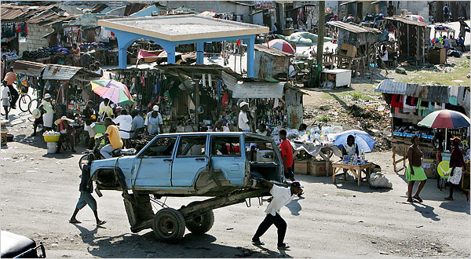
C. Concept of Modernization, Continued
Haiti: City Image
Dual Society / Dual Economy: Characteristics:
Tradition is source of poverty and underdevelopment
Modernization assumes dual economy with an enclave modern sector

Slide 32
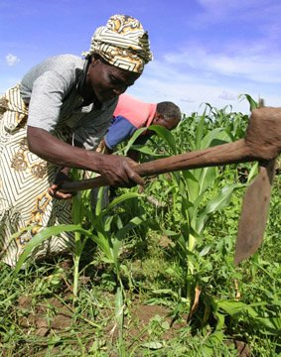
Concept of Modernization, Continued
Characteristics:
Concept of Empathy
putting oneself in the position of others, according to Daniel Lerner in The Passing of Traditional Society
Mobile personality or acceptance of new ideas
Series of individual changes affect society, including secularism, literacy, and urbanization
Society changed by mass based communications

Slide 33
Empathy?

Slide 34
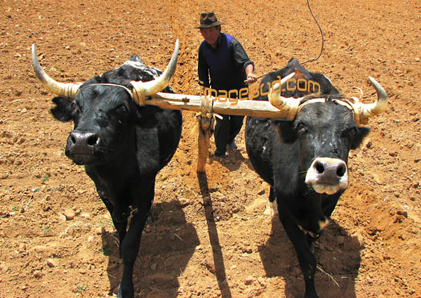
Modernization, Continued
Movement from traditional to modern (and rural to urban) in all societies
The “West” has distinguishing characteristics which distinguish it from Third World
Result is an assumption of Dichotomy
(references include writing by Talcott Parsons, Marian Levy, Frank Sutton and in modified form Fred Riggs)

Slide 35
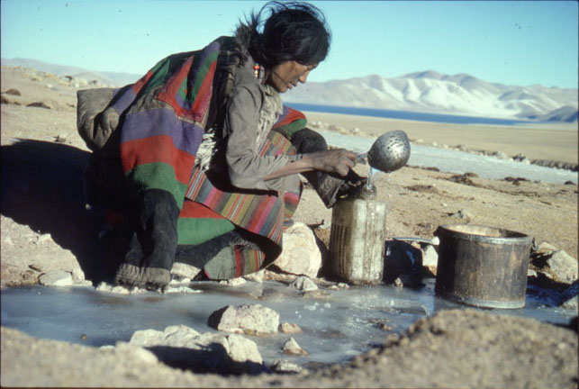
Concept of Modernization
Characteristics:
Social Mobilization (focus on value change)
Defined the process in which old social, economic and psychological commitments are “shaken off”
Social mobilization, and for some, forced value change was the key to modernization
Social Engineering

Slide 36
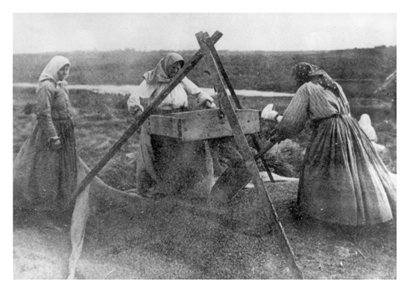
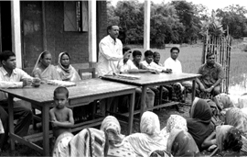
Social Mobilization- Continued
Advocates call for use of the mobilizing party for social engineering purposes (Sometimes Forced)
Goal became the use of the state to break down personal (organic) values and integrate modern values into a common political and socio-economic change system

Slide 37
AUTHOR OF THE DAY
Kathleen Staudt: Author, Professor of Political Science, University of Texas at El Paso
Peace Corps Volunteer in the Philippines (1966-1968) Researcher in Kenya- 1970s. Current focus, Mexico and U.S. Border issues
Raised Questions- Is there a grass-roots perspective? Role of Gender?
Why or Why not?

Slide 38
Staudt in Botswana, 1975

Slide 39
Gender and Development: Modernization vs. Traditionalism
Sue Ellen M. Charlton
Is gender discrimination a product of colonialism or traditionalism?
Is Gender different in developing societies?
How are women under counted?
Is it a gender issue or a women’s issue?

Slide 40
Sue Ellen M. Charlton

Slide 41
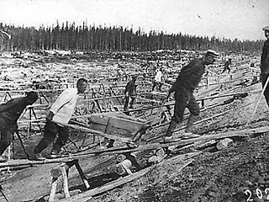
The Impact and End of the the Cold War
Dates: 1948-1991
Impact of Soviet Union on the Development Debate
Heavy Industrialization

Slide 42
The Cold War
Proxy Wars
New and Old

Slide 43
There Existed…The World Between 1950 and 1989
North America, Antipodes, Western Europe and Japan (First World)
The self-described socialist states—Eastern Europe, Soviet Union, China, most of South East Asia and Cuba (Second World)
Africa, most of Asia, Latin America, Middle East and Caribbean (Third World)

Slide 44
The Arms Race

Slide 45
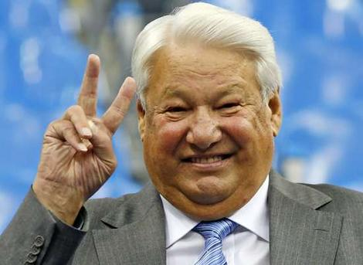
The Development Period
Begins with Arms Race of 1950s and ends with civil society and the collapse of the Soviet Union (1991)
Out of this comes the Transitional states as part of the developing world.
Ten Year Interregnum
to September 11.
Three “Ds”

Slide 46
The End of the Cold War: 1991-2001
An expansion of the “concept” of developing and transitional states
Were also called “Newly Industrializing” or “Newly Emerging” or Transitional States
Impact of End of Socialism
Eastern Europe, Balkans, Turkic and Asian States, Russia, Ukraine and Belarus
Impact on “third world socialism” in Latin America, Africa and Asia

Slide 47
Ethiopia, 1991

Slide 48
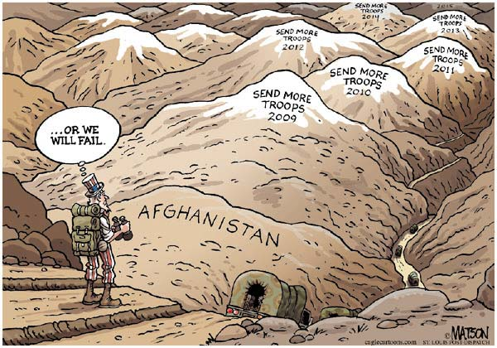
War in Afghanistan?

Slide 49
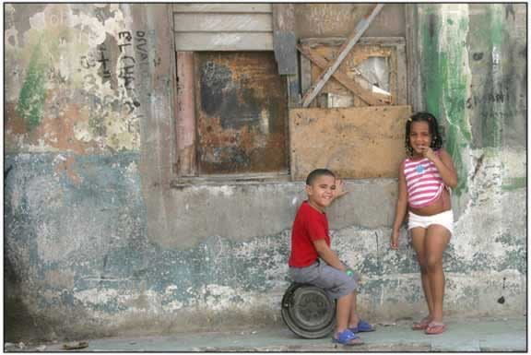
Poverty in Cuba A Future in Tourism?

