Slide 1
PIA 2501
Development Policy and Management
Week Nine

Slide 2
Theme Three
Governance,
Local Government and Civil Society

Slide 3
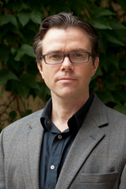
Who are our Primary authors?
Paul A. Haslam, University of Ottawa
Paul A. Haslam, Jessica Schafer and Pierre Beaudet
Introduction to International Development: Approaches Actors and Issues (Oxford, UK: Oxford University Press, 2009).

Slide 4
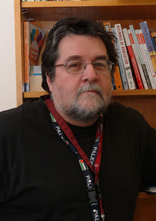
Both from the University of Ottawa
Pierre Beaudet
Jessica Schafer

Slide 5
Reminder: Five Development Themes
Development Theory
Development Planning and Management
Governance, Local Government and Civil Society
Human Resource Development (Millennium/Sustainable Development Goals)
Donors and Development

Slide 6
Sustainable Development Goals (2016)

Slide 7
Political Development: The Importance of Satire? Video
The Focus on Governance

Slide 8
Part of Concept of Modernization
Political Development
Two Themes- Monte Palmer
The Governance Perspective
Political Development is a prerequisite to social and economic development
Traditional society and modern society is a dichotomy

Slide 9
Democracy and Governance
Model became western parliamentary (representative), the rule of law and political systems based on democracy and Governance Principles
At issue: Which comes first, political or economic development?
Or Social Development (HRD) -Role of Civil Society- Pluralism

Slide 10
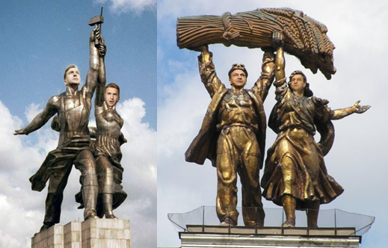
Concept of Modernization- Political Development
***Governance Argument (political development as key to Modernization)
Characteristics: Democracy and Governance vs. Bureaucracy
Bureaucratic Class (according to Manfred Halpern) are “modernizers” since only bureaucracy can penetrate rural areas
What is needed is a coalition between government leaders, the bureaucracy and industry (John Kautsky)
Russian State Heroes- 2007

Slide 11
The Problems of Development Management
Quote of the Week:
"...political systems in the developing areas must bear increasing responsibility for mobilizing the state's human and material resources in support of the objectives of economic and social mobilization."
Monte Palmer

Slide 12
BUT THE PROBLEM: Patronage in Mongolia

Slide 13
Reminder: Neo-Orthodoxy: Neutral or Negative on Governance
Development management- development programs are “bad”
Can’t make planning better
Neo-Orthodoxy and privatization
Market Currencies, Free Trade and Small Government

Slide 14
The Middle View: 2016
The Moderate Interpretation of Development Management Failures
Goal: Realistic Decision-Making based on sufficient knowledge (strategic planning) “Mixed Scanning”
Balance Public-Private Partnerships
Focus on Human Resource Development (HRD)

Slide 15
Structural Adjustment Policies 1985-2001 plus….
The Structural Adjustment Argument- Need to
stabilize currency and markets (getting the prices right)
Promote Free Trade
Need to refocus role of state from development to law and order and deregulation
Address the problem of Debt and Structural Adjustment reforms (IMF and World Bank)
Strengthen Skills levels in LDCs

Slide 16
New Emphasis After 1983: Human Security and Human Rights
Failure of the Central State
NGOs, Private Sector and Civil Society
Democracy, Governance and Local Government

Slide 17
Three Issues Now
I. Governance
II. Local Government
III. Civil Society

Slide 18
Governance

Slide 19
And Satire is Still Important
Capital Steps- They put the Mock in Democracy

Slide 20
Governance and the State
Sovereignty
Authority to Govern (Ostrom)
Presumption of “Independence”
A National Government status given by International Community and by use of International Law
"States will necessarily remain central actors in development policy and development management."
Milton Esman

Slide 21
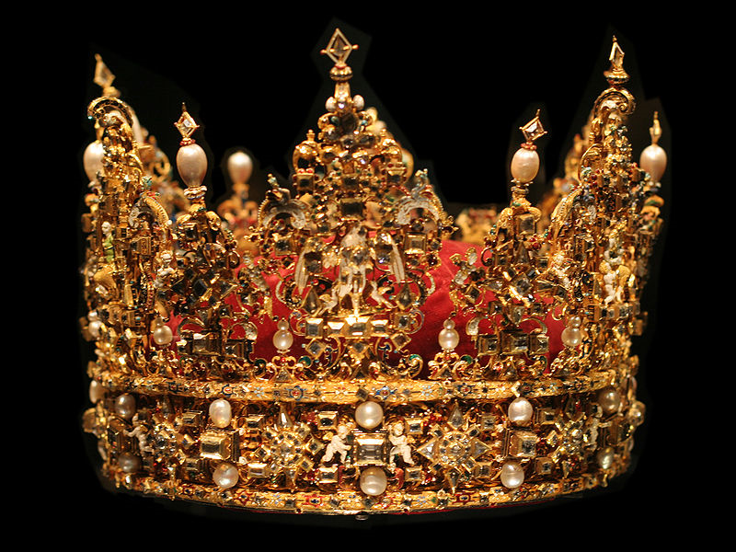
Sovereignty: What Does it Mean?

Slide 22
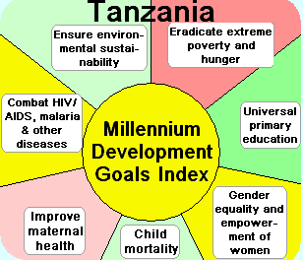
But Where is Governance?

Slide 23
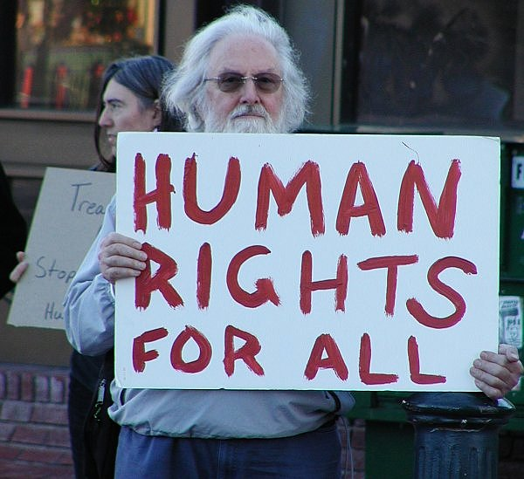

Slide 24
Governance: an Overview of Issues
Focus of International Development: Post-2001: “Democracy and Governance”
Human Rights (First Generation-Political)
But not second (social) or third (economic)

Slide 25
Terms
Basic Terms:
1. The Environment of Development
2. Governance-Manner in which the state is created, modified or overthrown
3. Rule of Law

Slide 26
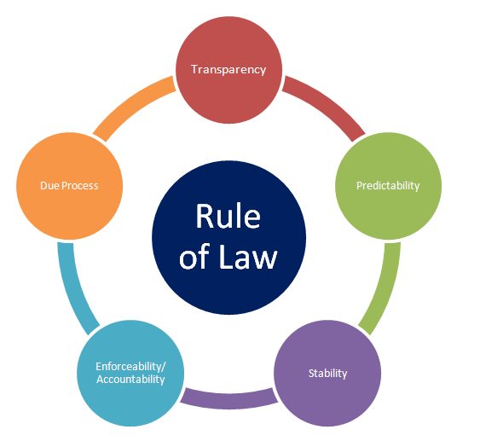

Slide 27
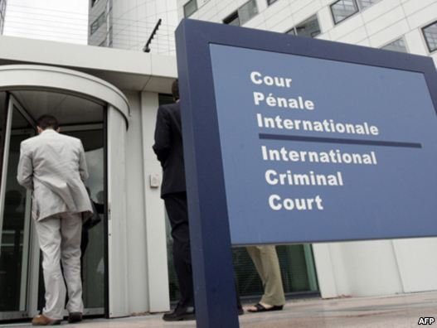
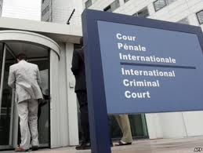
International Criminal Court

Slide 28
Governance and Sovereignty
Is Sovereignty a Development issue? Swaziland vs. China
"[T]ransformation (and globalization) has led to a reinvention of government and what it does“
- Anonymous

Slide 29
Governance and Sovereignty
Rules of the Game politics:
Zero/sum vs. sum/sum politics
"Splintering”
Break up of states--centrifugal forces
Interest Group Liberalism: The goal?
Civil Society as organizational
Not the individual or the mass

Slide 30
Sovereignty: A Historical Concept
1. Autonomous Governance
2. Territorial Integrity
3. International Recognition
4. Membership in UN and other International Bodies
Treaty of Westphalia (1648)

Slide 31
At Issue: The Nature of Conflict

Slide 32
Governance and Sovereignty
The need for apathy?
Constitutional vs. Social stability
Institutional structures:
Checks and balances
The Institutional State
What is the "Institutional State?” Why is it important?

Slide 33
Governance and Democracy
Three Views

Slide 34
Types of Democracy: Terms
Direct Democracy
Actual direct participation of a population in decision-making about laws and regulations
Town hall or village model

Slide 35
New England Town Hall

Slide 36
Types of Democracy, Continued
Indirect Democracy
Some form of representative democracy
Pluralism
Existence of various diverse interest associations, individuals and groups within society (Focus on Tolerance)

Slide 37
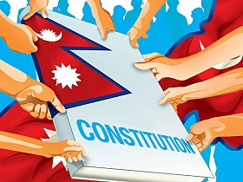
Nepal Poster

Slide 38
Direct Democracy vs. Representative Democracy
Problem with Populism
Mob Justice?
Minority rights
Shifting majorities
Problem with Plebiscites
Size and the Need for Indirect Representation

Slide 40
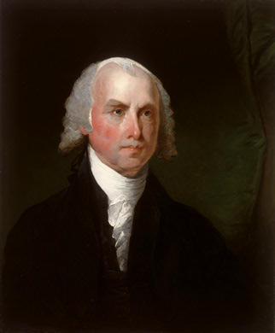
James Madison and Democracy: The Warning
The problem with majorities
Tyranny
Factions

Slide 41
Democracy: What is it?
LIMITED!
"It is only when men learn what it means to be free, and struggle to maintain proper limits upon the exercise of authority so that no one is allowed to become master of the others that human beings have the possibility of creating mutual relationships which they may freely enter and leave as they seek mutually productive patterns of human development."
- Vincent Ostrom

Slide 42
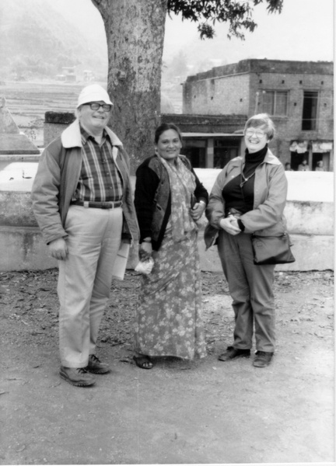
Vincent Ostrom, Tej Kumari Mahat and Elinor Ostrom

Slide 43
Types of Democracy, cont.
Polyarchy
Diverse interest associations of society compete with each other over policy issues (Structured Pluralism)
Cooperative Movements (or Corporatism)
Diverse interest associations cooperate with each other and with organs of the state to make policy (Scandinavia)

Slide 44
Robert Dahl (Yale University (1915-2015) and Polyarchy

Slide 45
Democracy: What is it?
“The policy makers have rational interests--to develop their countries, to improve the condition of their people, to acquire or stay in power, or to steal as much as possible.”
Peter Berger, Pyramids of Sacrifice

Slide 46
Peter L. Berger (Born Peter Berger: Born March 17, 1929- Boston University)
Central to Peter Berger's work is the relationship between society and the individual

Slide 47
Review: Governance and the Rule of Law
VIDEO
Albie Sachs

Slide 48
DISCUSSION, QUESTIONS, DEBATES.

