Slide 1
PIA 2501
DEVELOPMENT POLICY AND MANAGEMENT
WEEK FOUR

Slide 2
Week Four
Development Policy and Management

Slide 3
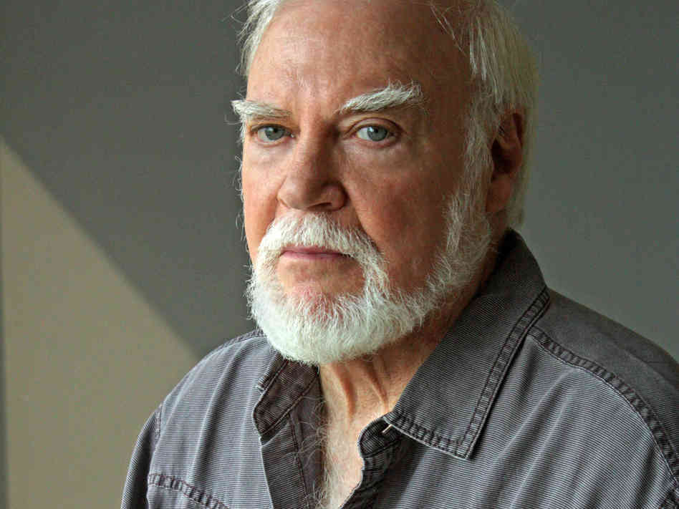
Next Week’s Discussion
Norman Rush, “Alone in Africa”
Norman Rush, “Near Pala”
Toland, Excerpts
from The Rising Sun

Slide 4
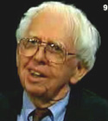
The Rising Sun- The Decline and Fall of the Japanese Empire
Empire and Beyond
John Toland, Historian and Journalist,
World War II Specialist, (1912-2004)

Slide 5
The Japanese Co-Prosperity Sphere
The Dependency Reversal View

Slide 6
Critiques of Modernization Theory- 1
Interpretations of Pre-Colonial Society
The heart of the matter: Pre-colonial and pre-modern society is characterized by violence, poverty and "Primitivism”
Modernization theory is based on this assumption (Joseph Conrad, Heart of Darkness Image)
The ecological approach and dependency theorists reject this
At issue is the idea of “balance”
Individuals and social groups were in balance with their physical environment

Slide 7
Joseph Conrad

Slide 8
Critiques of Modernization- 2
Ecological View: Characteristics
People lived in "Primitive" communism and were hunter/gatherers
Subsistence farmers, grew grains and forged metals- They were in balance with environment
“Praxis” allowed individuals to control their interaction with nature

Slide 9
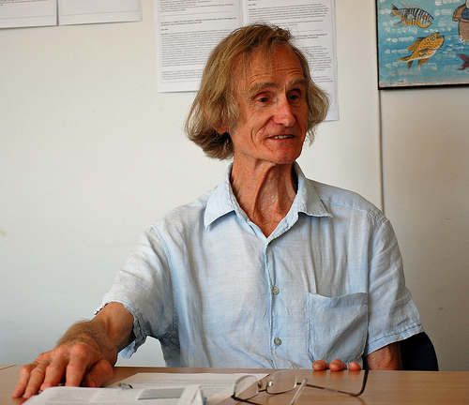
Research Associate at the Institute of Development Studies, University of Sussex, United Kingdom
Dr. Robert Chambers Interview Video
He was born in 1932 and is an academic and development practitioner
Equity not Growth
Advocate of the
“participatory“
approach to
development

Slide 10
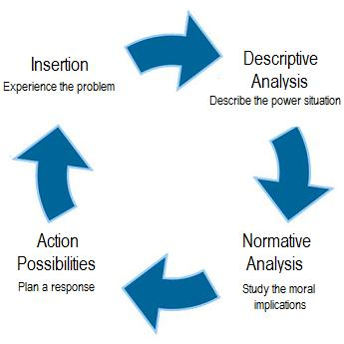
System in Balance

Slide 11
Ecological View
Direct creative activity was used to procure food and shelter, through the use of own tools. Natural Life
This was the Rousseauian Natural “Man.”
Jean-Jacques Rousseau
(28 June 1712 – 2 July 1778)

Slide 12
The Ideal?

Slide 13
Ecological View
Change came with the development of excessive surplus, imbalanced trade, the creation of elites, domestic rule and then international empires.
Rome, China, and the land based Empires in Europe ending with Sea-Based Empires

Slide 14
A Natural Balance?

Slide 15
Critiques of Modernization Theory-3
Colonial Underdevelopment Argument: The Psychological Dimension
Focus of the debate—resistance vs. collaboration and its impact upon post-colonial society
Colonizer has an inferiority complex (Minnoni)
Colonial vs. colonized: (Memmi) colonized peoples have a dependency relationship with the West. It is based on the colonizer’s search for economic gain
Revolution as a cleansing process (Franz Fanon)

Slide 16
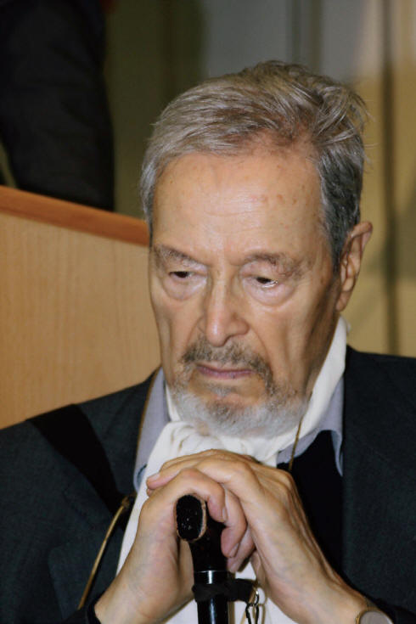
Octave Mannoni and Albert Memmi

Slide 17
Prospero vs. Caliban
Prospero—In exile, isolated and inferior
Caliban—Dependence and the Fear of Abandonment
Further Reading:
Franz Fanon, Wretched of the Earth (New York: Grove Press, 1963).
O. Mannoni, Prospero and Caliban: The Psychology of Colonization (New York: Praeger, 1964)
Albert Memmi, The Colonizer and the Colonized (New York: Orion Press, 1965)

Slide 18
CALIBAN
The Half Human Offspring of the Devil and a Witch who is a Servant of Prospero
in “The Tempest”

Slide 19
Critiques of Modernization Theory: 4
Colonial Underdevelopment Argument
Seeds of Violence and
Cognitive Dissonance
Role conflict (Robert Merton)
Indirect rule vs. assimilation
Role set (conflict between
colonial officials and Religious
or traditional leaders)

Slide 20
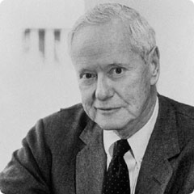
Robert Merton and Cognitive Dissonance

Slide 21
Critiques of Modernization Theory: 5
Interpretations of Underdevelopment and “Third Worldism”
Underdevelopment theorists critiqued Modernization Theory:
Modernization theory had its origins in Colonial ideology and the anthropological ideas that supported it.

Slide 22
The gusfield critique
Traditionalism: Dichotomy or misplaced polarity (Gusfield)
‘Mirror, mirror, on the wall’ (Gusfield Critique)
Co-existence in Saudi Arabia and Japan
Modernization of Tradition in Swaziland
Secularization of tradition in Mexico

Slide 23
Criticism of Modernization 6. Under-development, Structuralism and Dependency
Structuralism
Biology in the Tropics
Inelasticity of Tropical Products
Rigidity of Extractive goods

Slide 24
Dependency Theory
and the beginnings of Dependency theory
Structuralism and
Interpretations of Underdevelopment and “Third Worldism”
In the beginning (1500) LDCs were self-sufficient at low level
Argument: Europe used its empire to market surplus goods and pay sub-economic costs for raw materials, agricultural products and minerals
Issue: Inelasticity (tropicalism vs. “underdevelopment”)

Slide 25
“Underdevelopment in History”
Rejects Dualism and “stage theories” of development (Keith Griffin)
Africa, Asia, Latin America not historically under-developed
European nations took slaves, metals and raw materials to build industrialization and grow their economies between 1500 and 1900
Empty Bucket- Full Bucket

Slide 26
Dependency Theory
During 500 Years of colonialism Northern Tier states used colonialism to extract from LDCs
Result often was the destruction of local production, agriculture and food production
The colonial government supported export import trade and where possible, SETTLERS
Europe became dependent on extraction from the “third world”

Slide 27
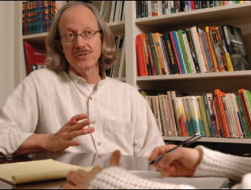
Critiques of Modernization Theory-7
Interpretations of Underdevelopment and “Third Worldism” -Discourse Analysis- “Development Language Codes” (Arturo Escobar)
Underdevelopment theorists critiqued Modernization Theory: Modernization theory had its origins in Colonialism
Colonial ideology and the anthropological ideas that supported it. Modernization contains the language of imperialism
GOAL: Dependency Avoidance
Or Reversal

Slide 28
The Problem with Dependency Reversal
Debates about Free Trade VIDEO

Slide 29
Break
TEN MINUTES

Slide 30
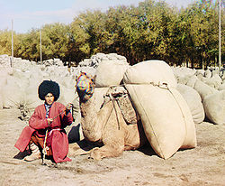
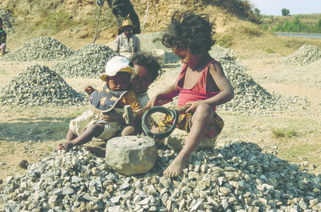
Development Administration Assumptions (Prior to 1970)
Agricultural Self Sufficiency?

Slide 31
The Definition of Development Administration
Quote of the Week: Keynsianism?
"...political systems in the developing areas must bear increasing responsibility for mobilizing the state's human and material resources in support of the objectives of economic and social mobilization.“
Monte Palmer

Slide 32
Stages in Development Theory
Theory of Economic Growth (Target: Vietnam)
Key figure—Walt Rostow, The stages of economic growth: a non-Communist manifesto (Cambridge: Cambridge University Press, 1960)
There is a take off point that will lead to self-sustaining capital generation
Lesser Developed Countries (LDCs) are caught in a “low equilibrium trap”—not enough capital for growth
All nations are poor but are able to escape their poverty through their own domestic initiative (with correct policies)

Slide 33
Stages in Development Theory
Theory of Economic Growth (Rostow):
Popularized Modernization Assumptions
Traditional vs. Modern
Agraria vs. Industria
Agriculture vs. Industry
Subsistence vs. Commercialism
Advocated the “Trickle Down” effect to economic growth (Third Way)

Slide 34
Rostow and Johnson Controversy-Vietnam and Economic Development

Slide 35
Problems with Development Administration
Decreasing Bureaucratic Capacity over Time
Lack of Technical and Management Skills
An expanding state meant expanding debt
Gap increased between bureaucratic elites and the mass of the population

Slide 36
Internal Capacity Issues(Bryant & White)
Debates: Which Comes First?
The Chicken or the Egg?
Development Administration vs. Development Management
Development Management vs. Management Development
Economic and Social Development (ESD) vs. Human Resource Development (HRD)

Slide 37
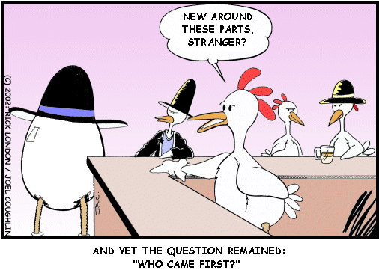
The Big Question

Slide 38
Which Comes First?
Development Management depends on administrative development and strengthening administrative structures
The deadlock—HRD vs. ESD
LDC administrators—more work with less pay
The Goal: Strengthen Administrative Capacity
Problem: Solutions to HRD increases social stratification and entrenches bureaucratic elites
Articulated in the Millennium Development Goals (UN)

Slide 39
Internal Capacity Issues (Bryant & White)
Debates: the “Attitudes Problem”
How to get people to think developmentally?
Changes in programmatic values have an impact on LDC elites
Problem of the Organizational Bourgeoisie: Bureaucratic values unchanged from colonial period as domestic elites manipulate public policy (Picard)

Slide 40
Bureaucratic Behavior

Slide 41
Internal Capacity Issues (Bryant & White) Debates, Other Chicken and Egg Problems
Balanced vs. Unbalanced Regional Development (Equity vs. Widening the Gap)
To what extent is a state planning approach, balancing regional development, possible
Unbalanced Growth and Class Formation
Balance between Public, Private (for profit and NGOs) and “Parastatal” (Public Corporation) Sectors
Political vs. Economic Development (Deadlock of Development Administration)

Slide 42
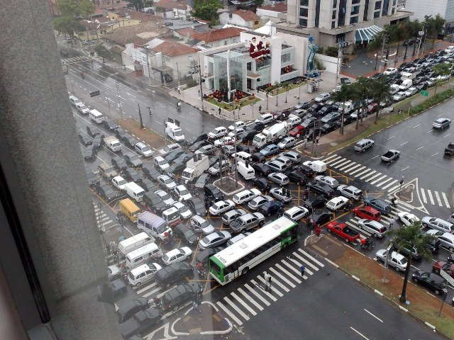

Slide 43
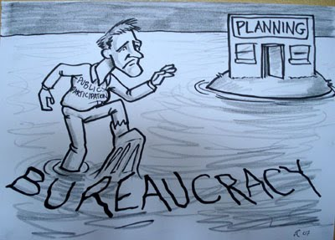

Slide 44
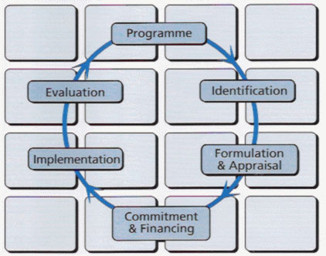
The Planning Cycle

Slide 45
Internal Capacity Issues (Bryant & White)
Debates: the “Attitudes Problem”
Sometimes referred to as “Comprador” classes or “dependent elites,” since they have been co-opted and are linked to Northern Tier states
Expatriate Attitudes?
Pariah Elites

Slide 46
Internal Capacity Issues (Bryant & White)- Debates Continued
See Bernard Schaffer, The Administrative Factor; Papers in Organization, Politics and Development (London: Cass, 1973).
How much development will occur without political institutions and political will?
Bureaucratic elites are part of a process of political control and mediation and development policy may have a major political mediation (control) role.
What are the limitations of a state planning approach to development?

Slide 47
Problem: The Expanding Civil Service
Civil Servant Component of the total Current Budget
10 to 15% in MDCs
30 to 60% in LDCs
South Africa in 2001, 46%
Benin in the 1980s, 64%
Central African Republic in the 1960s, 81%

Slide 48
Internal Capacity Issues (Bryant & White)
Debates: the Bureaucratic “Attitudes Problem” continued
How developmental are bureaucrats?
Can (and Should) the state be used for SOCIAL ENGINEERING?
Is the private or non-profit sector better at development?

Slide 49
Development Management
More Collaborative than Development Administration
Involves Public, Non-Profit and Private Sector
Development management deals with the coordination and management processes of international development programs and projects.
The dominant focus in development management is the intervention in the form of a transfer of aid by an external agency/donor and the oversight of the related project cycle,
That is project identification, planning (formulation and appraisal), implementation and monitoring, and evaluation.

Slide 50
Problems, Continued
Highly centralized state structures deaden the state’s development capacity
Inherited administrative structures seen as increasingly rigid
Debate over choice between administrative reform and structural reform (Civil Service, Public Sector, Structural changes)

Slide 51
The Problems of Development Management
Quote of the Week: The Quiet American- An Alternative to expatriate non-involvement?
"The Human Condition being what it was, let them fight, let them love, let them murder, I would not be involved.“
Graham Greene

Slide 52
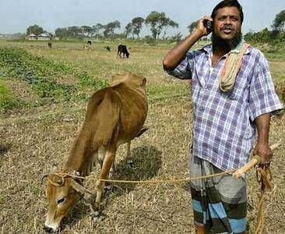
The Future of Development Management?

Slide 53
The Problems of Development Management
Quotes of the Week: Failure of Capitalism and Socialism (SOCIO-ECONOMIC EXIT)
"The Economy of Affection...denotes a network of support, communications and interaction among structurally defined groups connected by blood, kin, community or other affinities, for example, religion. It links together in a systematic fashion a variety of discrete economic and social units which in other regards may be autonomous.“
Goran Hydan

Slide 54
IV. Development Theory Revised: (1975-1983)
Robert McNamara -- World Bank
KEY: Necessary redistribution of resources both internationally and within an LDC
New International Economic Order vs. Basic Needs
Equity both domestically (within a country) and internationally

Slide 55
Basic Needs- The Poorest of the Poor... (Ben Heine, painter)

Slide 56
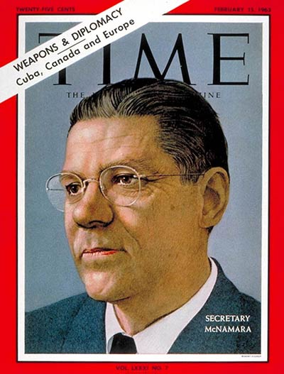
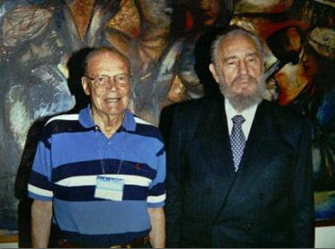
Robert McNamara

Slide 57
Development Theory Revised: 1975-1984
KEY: Necessary redistribution of resources- Fundamental Differences with Growth Theory
New International Economic Order (NIEO)
LDCs- North/South Redistribution should replace Rostowian growth assumptions
Basic Needs Assumption (World Bank)—Domestic redistribution
Strategy—growth with equity concerns

Slide 58
New International Economic Order
Detailed Discussion
Still Reflects the Counter-Narrative of Many in the Streets
Key: Redistribution of Wealth

Slide 59
Development Theory Revised: 1973-1983
KEY: Necessary- redistribution of resources : NIEO and Oil Cartel
Definition—Capacity, Equity, Empowerment and Sustainability
Reflects influence of Political Economy and Dependency Theories
NIEO: Original group of 77 countries, now 140

Slide 60
Underdevelopment

Slide 61
NIEO and the Brandt Report
Chair: Willy Brandt, former Chancellor of the Federal Republic of Germany
Common Crisis, North South: Cooperation for World Recovery
1980, 1983
Accepted (in theory) basic premises of Dependency Theory

Slide 62
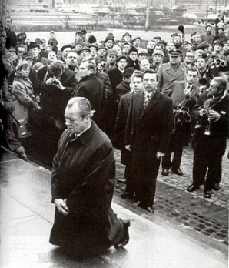
Willy Brandt (1972 and 1992)

Slide 63
Assumptions of the NIEO States (Brandt Report)
Need for structural change in world economy
Thesis: Industrial Development in Europe caused underdevelopment in LDCs
Northern Tier States extract resources from LDCs
No low level equilibrium trap—regression to underdevelopment
Sources: Thomas B. Birnberg and Stephen A. Resnik, Colonial Development : an Econometric Study (New Haven : Yale University Press, 1975)
See also the works of Susan George

Slide 64
Assumptions of the NIEO States (Brandt Report)
European involvement in LDCs was extractive and "created" underdevelopment
underdevelopment is a historical problem
16th century—Europe and World
Europe, 1600—technologically advanced but resource poor
Asia, Africa, Central and South America—resource "rich" and self-sufficient but technologically poor

Slide 65
Brandt Report
Imperialism from 1600 to 1900 led to resource transfer from LDCs to West
“FROZEN INEQUITY”

Slide 66
Assumptions of the NIEO States (Brandt Report)
Result in LDCs was decline in agricultural self-sufficiency and indigenous commercial and industrial activity
Was no dual economy—a world economy was created which the peasant economy deeply penetrated
Metropole
Sub-Metropole
Periphery
Sub-periphery

Slide 67
Assumptions of the NIEO States (Brandt Report)
LDC acts as a market for more Developed Countries (MDCs)—eg. Agriculture depends on Agri-business
Cooptation of Local Elites as consumers of LDC resources
Continues to Influence Thinking

Slide 68
Assumptions of the NIEO States: Redeux
The Goal: Need to moderate or eliminate dependency relationship through counter-dependency
Self-sufficiency—China in the 1950s
Dependency avoidance—Canada, Scandinavia and Japan in nineteenth century
Dependency reversal—India, Brazil (1970s)
Dependent Development—(Newly Industrializing Countries, NICs, Emerging States The BRICS)
Regional Cooperation—ASEAN, CIS, SADC, ECOWAS, MERCESOR

Slide 69
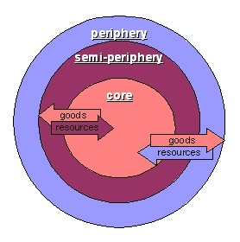
Counter-Dependency Theory VIDEO
Debates
About Chile
Dependency
Theory and Neo-
Orthodoxy
“The Chicago
Boys”

Slide 70
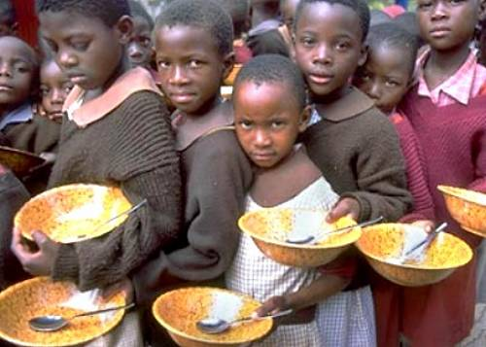
“A New International Economic Order is Deemed Necessary”

Slide 71
Basic Needs Assumptions: 1975-1983
Institutionalize Project capacity in development program structures (The works of Dennis Rondinelli)
All civil service to explore new technologies and leadership styles
Promote Sustainability and Institutional Capacity
Shift Priorities to Rural Development
Small is Beautiful- appropriate technologies
A bit of Romanticism?

Slide 72
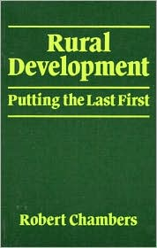
Basic Needs Assumptions
Robert Chambers, Rural Development: Putting the Last First (New York: Longman, 1983)
Move to Field Administration, Extension Work and Bottom Up Planning
Find a non-threatening way (vis-a-vis) elites to promote the redistribution of resources
Redistribution

Slide 73
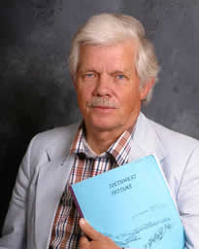
Donor Response Basic Needs Assumptions:
Jon R. Moris, Managing Induced Rural Development (Bloomington, Ind: International Development Institute, Indiana University, 1981).
Jon R. Moris and James Copestake, Qualitative Enquiry for Rural Development : a Review (London : Intermediate Technology Publications on behalf of the Overseas
Development Institute, 1993).
Professor of Agriculture at Utah State University,
Logan Utah

Slide 74
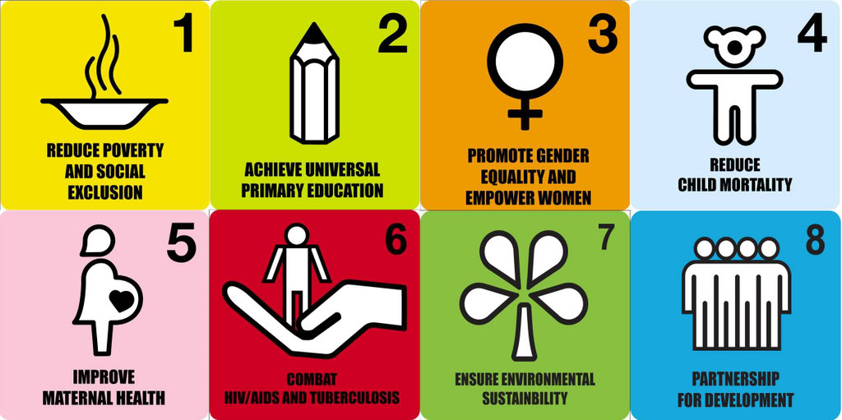
Millennium Development Goals

Slide 75
Internal Capacity Issues (Bryant & White)
Basic Needs Assumptions: Problem
Need for increased capacity of public, parastatal and private sectors
State should remain central to development planning and management
Need for administrative reform to develop more creative development structures

Slide 76
End of Century
Development Dilemmas: Donor Fatigue and Internal Capacity Limitations
1983-2001- Structural Adjustment

Slide 77
Donor Fatigue: (1983-2000)
Donors defined as a problem as they set agendas for LDCs
Expatriates are consumers (of LDC privileges): Development Cynics
Career prospects shift from “Insensitive / AID / Embassy Types” to Grassroots, cultural sensitivity and eventually to NGOs
(Lederer and Burdick Ugly American influence)
Donors begin to advocate privatization and contracting out

Slide 79
FINAL CRITIQUE: Development Tourism?

Slide 80
NEXT WEEK
THE LIMITS OF DEVELOPMENT MANAGEMENT: The Bureaucracy and the Post-Colonial State
Structural Adjustment
and “The Chicago Boys”

