Slide 1
PIA 2501
Development policy and Management
The foreign Aid Debate

Slide 2
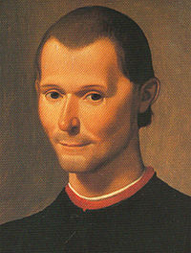
Niccolò di Bernardo dei Machiavelli (May 3, 1469 – June 21, 1527)
Machiavelli emphasized the need for the exercise of brute power where necessary and rewards, patron- clientelism to preserve the status quo.
THE CARROT AND THE STICK

Slide 3
FDR’s Good Neighbor Policy
Roosevelt created the Office of the Coordinator of Inter-American Affairs (OCIAA) in August 1940 and appointed Nelson Rockefeller to head the organization.
Largest Project- Pan-American Highway
Set the model for foreign aid in post-WWII world

Slide 4
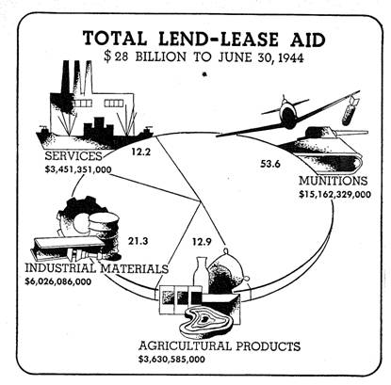
Review: Foreign Aid During World War II- Lend Lease

Slide 5
The Problem- 1950
    The goal of foreign aid was the reduction of material poverty through economic growth and the delivery of social services, the promotion of good governance and support for social institutions (Education and Health)

Slide 6
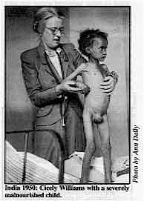
India 1950

Slide 7
The Assumption- 1950
    It was assumed that this would be done through democratically selected, accountable institutions, and reversing negative environmental trends through strategies of sustainable development.
    But there was also the cold war.

Slide 8
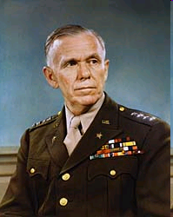
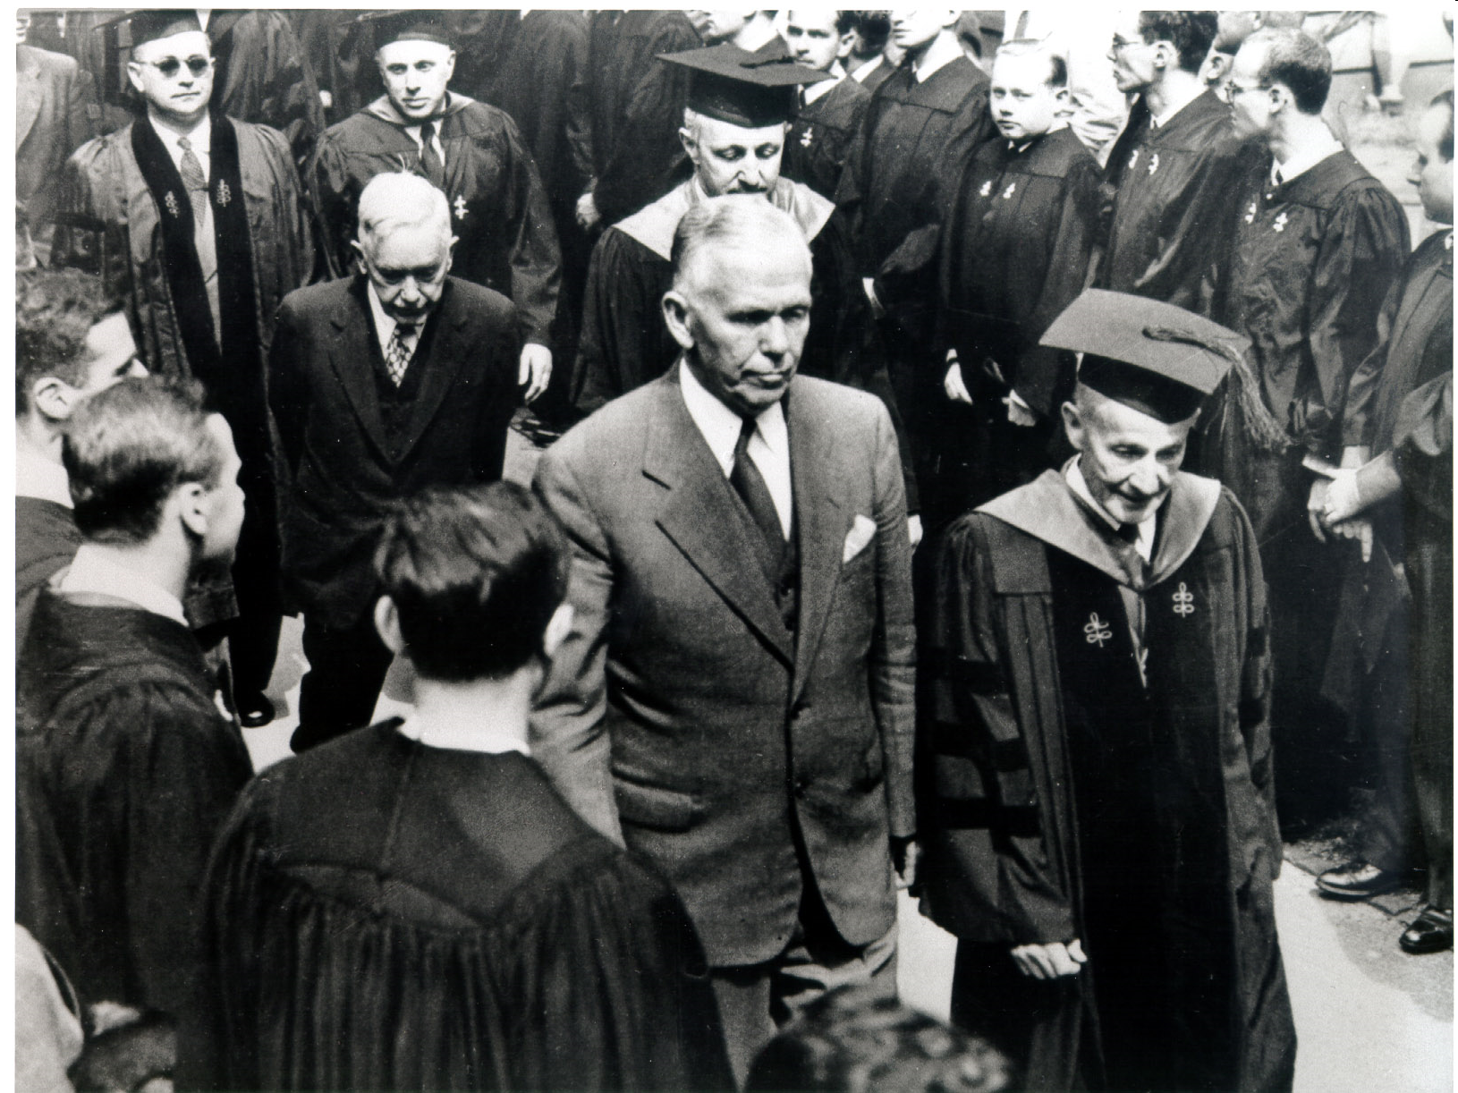
George C. Marshall and the Marshall Plan

Slide 9
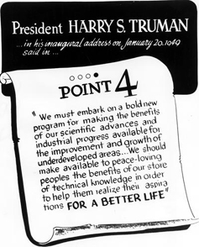
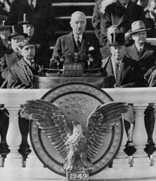
The Point Four Program: 1949 Inaugural Address

Slide 10
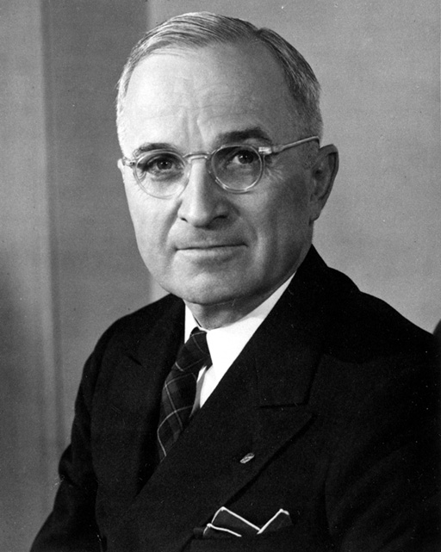
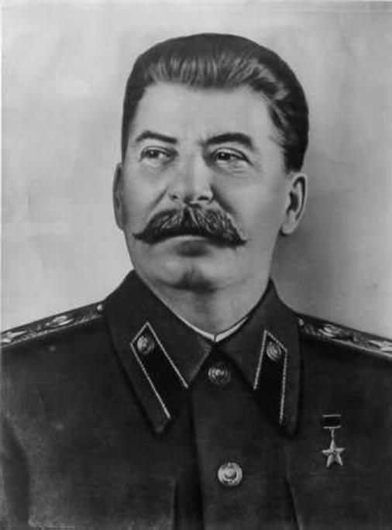
Harry Truman and Joseph Stalin
The Cold War and the Search for Allies

Slide 11

Three Views of Foreign Aid
1. Part of Balance of Power- Carrot and Stick Approach (based on exchange Theory)
2. Commercial Promotion: Focus on International Trade
3. Humanitarian Theory: Moral Imperative

Slide 12
Reminder: The Issue and the Goal Here
The issue of sustainable International development should be examined from both a policy and an ethical dimension.
The thesis is that ultimately there have both been policy problems and moral ambiguities that have plagued technical assistance and foreign aid.

Slide 13
The Problem in 2011
Ostensibly the Goals are the same-
However…

Slide 14
The Problem
In addition to (or because of) the Cold War
Ultimately, as a number of economists have noted, “universal models of growth [did] not work well.”
Quote David Sogge, Give and Take: What’s the Matter with Foreign Aid? (London: Zed Books, 2002), p. 8.

Slide 15
Foreign Aid Structures
1. Technical Cooperation Agency (Truman) -1950
2. Mutual Defense Administration (Eisenhower) -1953
3. U.S. Agency for International Development (Kennedy to Obama) -1961

Slide 16
Domestic Management Systems and International Influences
Historical periods of budgetary and fiscal management:
1951-1970- Industriial Growth (Take Off Theory)
1975-1981: Basic Needs
1981-1990: Structural Adjustment
After 1991:
    Collapse of the Soviet Union and the “End of History”
    “Clash of civilizations”
September 11, 2001: Three D’s- Defense, Development and Diplomacy

Slide 17
Peacekeeping, and international organizations- Issues of DDD
  Northern State mechanisms: NATO and EU
  Mediators
  Unilateral vs. Multilateral (U.S., France and U.K.)- Why Iraq is important

Slide 18
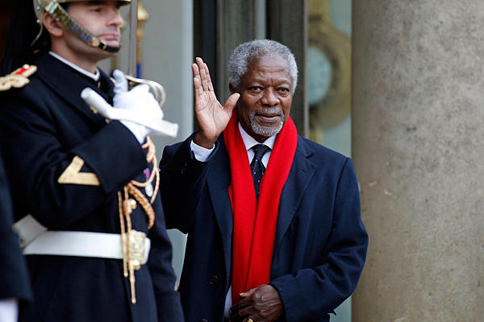
Former UN Secretary General Kofi Annan

Slide 19
National or Transnational Groups?
Al Qaeda in the Arabian Peninsula
Al Qaeda in Iraq
Al Qaeda in the Islamic Maghreb
Boko Haram
Al Shabaab

Slide 20
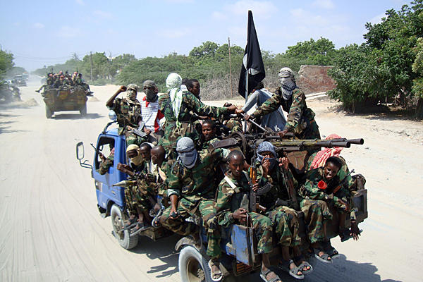

Slide 21
Peacekeeping and international organizations- Issues
  Multi-lateral and bi-lateral- Continental vs. International
  Regional Groups: ECOWAS, Africa Union, SADC
  What is NATO?
  United Nations Peacekeeping vs. Monitoring vs. Conflict control (Rules of Engagement)

Slide 22
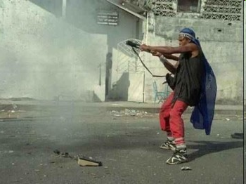
Liberian Civil War

Slide 23
Peacekeeping and international organizations- Issues from the Cold War
  Role of “proxy” states/armies (Ethiopia)
  Impact of Foreign and Military assistance Programs (Horn, Sahel and War on Terror)
  Special Role: Mediation Centers (Institute of Peace, Leadership and Governance at Africa University, Zimbabwe)

Slide 24
Terrorism and Counter Terrorism. Is it an Issue?
Terrorism and Counter-terrorism (Includes regional, sub-regional, national and sub-national levels of activity) – U.S. and Europe
Global vs. non-global
How Relevant to LDCs?

Slide 25
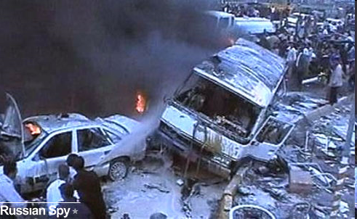
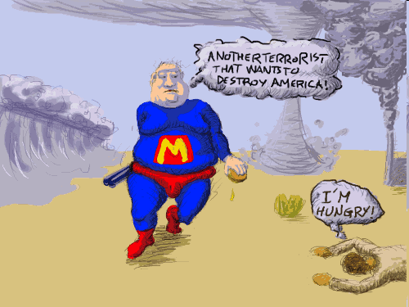
North vs. South?

Slide 26
Counter-Terrorism Strategies
Legislation, Finance, Border Security (including passports and travel documents Control)
Police, military and security, combating ideological Support for Terrorism
Strengthening Traditional Leadership
Information and Intelligence and International Cooperation
Offensive Combat

Slide 27
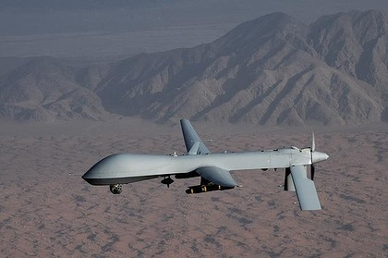

Slide 28
Sector Reforms and Counter-Terrorism
Evolution of U.S. CT Policy in Africa Since September 11
Impact of ethnic and religious identification on Terrorist threats
Challenges of parallel governance and the Arab Spring (Egypt, Tunisia, and Libya)
AFRICOM

Slide 29
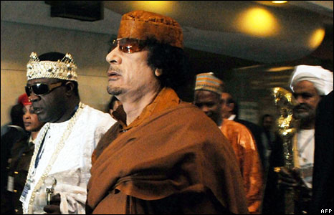
Popular Appeals

Slide 30
Regional Threats
The threat of Collapsed States and crime- Diamonds, Drugs, guns (Columbia, Guinea Conakry)
Paramilitary Violence (Philippines, Great Lakes)
Organized Crime, and Piracy (Air, Land and Sea)- Indian Ocean and gulf of Guina
Religious Fundamentalism and CVE
(Countering Extreme Violence)

Slide 31
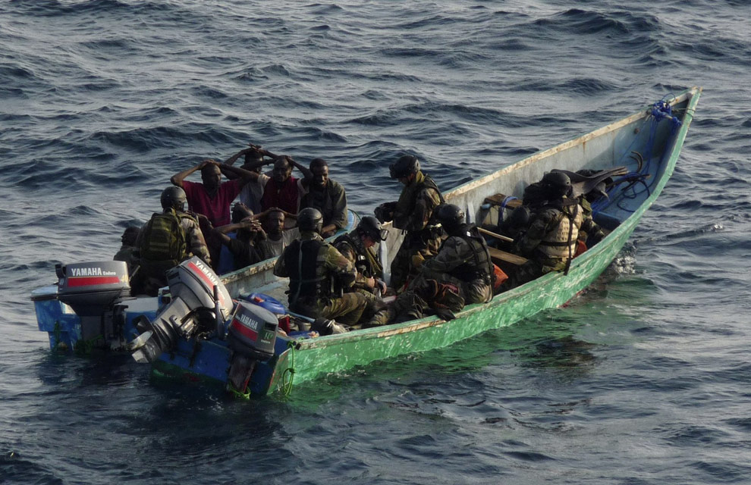

Slide 32
V. Post-Conflict Governance
      The Role of Negotiated Pacts
      Truth and Reconciliation vs. Justice
      International Courts Issues

Slide 33

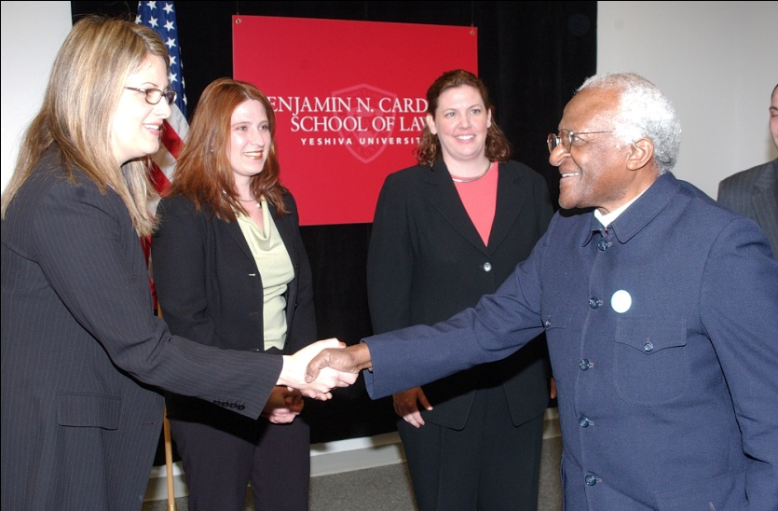
Liberian Truth and Reconciliation Commission
Conflict Resolution
vs.
Justice
Bishop Desmond Tutu

Slide 34
Post-Conflict Governance
      Demilitarizing societies
      State Rebuilding and Institutional Development
      Shift from Development to Democracy and Governance

Slide 35
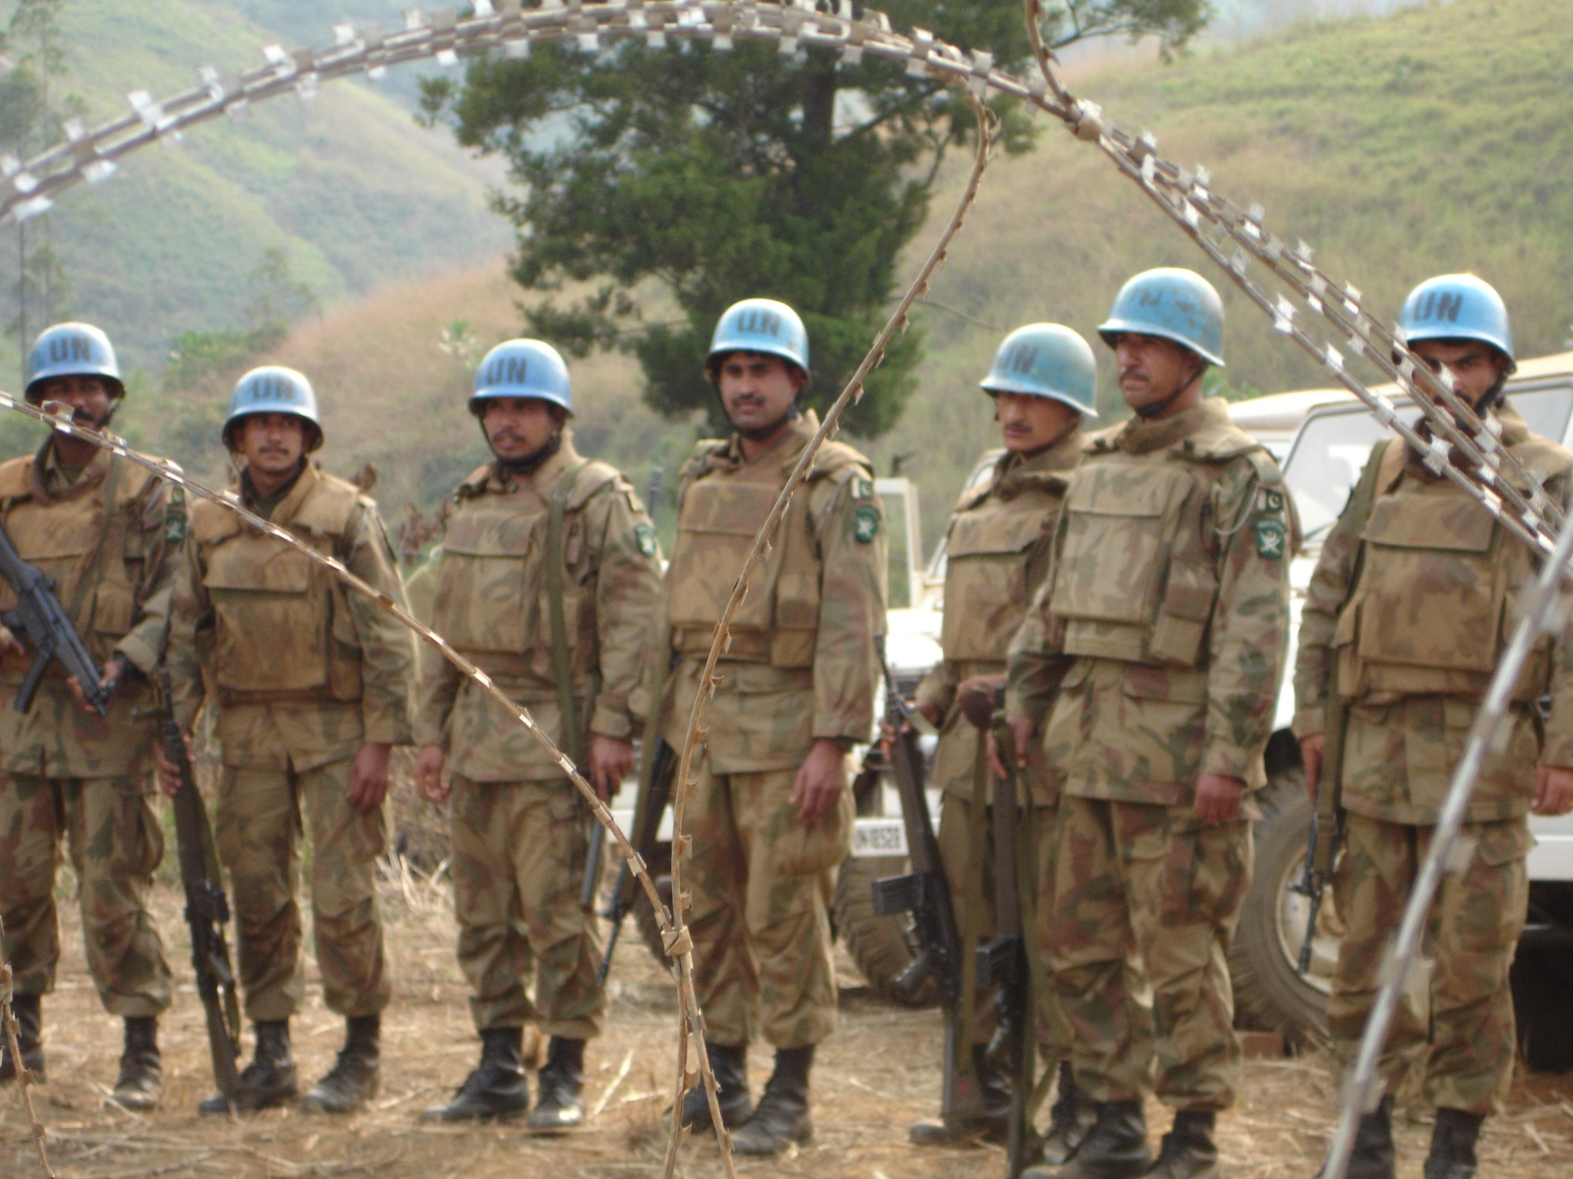
Nation-Building, United Nations Style

Slide 36
Foreign Aid and Foreign and Security Policy-
Two Historical Views
So Called “Whole of Government” Approach-
The Method
Historical Debate about “Hearts and Minds”- The Problem

Slide 37
“Whole of Government” in Foreign Policy
        Definition:
        Integrated Approach to Conflict and Post-Conflict Situations in Fragile States

Slide 38
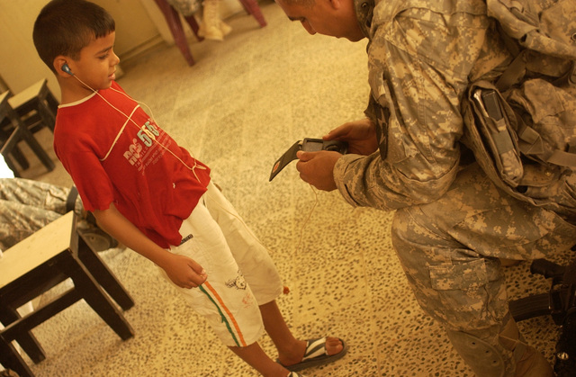

Slide 39
“Whole of Government” (DDD)
      Focus: Diplomacy, Development and Defense
      Usually Add Information/ Intelligence, Trade and Finance, Environmental, etc.

Slide 40


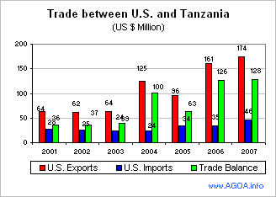
The Trade Issue and DDD

Slide 41
Whole of Government Countries: Extent of Integration
Scandinavia
Canada
U.K.
Australia
France
U.S.

Slide 42
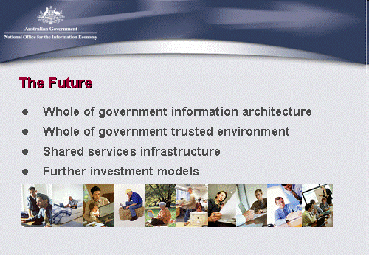
Australia

Slide 43
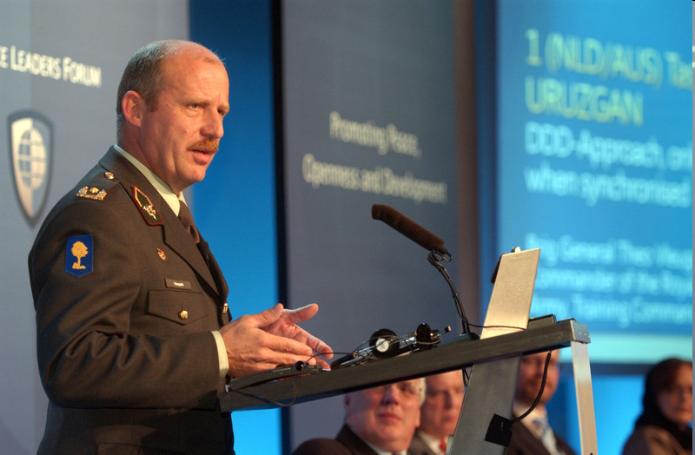
Netherlands
“Development, Defense and Diplomacy should be the three legs of any stabilization operation, says the recently returned commander of the first Netherlands-Australian Task Force in southern Afghanistan.”
Brigadier General Theo Vleugels, of the Royal Netherlands Army

Slide 44
“Hearts and Minds Debate”
“Hearts and Minds”
Phrase Widely Used re. AFRICOM-
Development Linked to Ideological Change- Rural Development, Collective Villages, Militias
Five “Classic” Variations

Slide 45
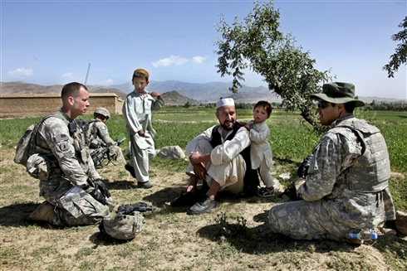
Counter-Insurgency (COIN) in Afghanistan

Slide 46
“Hearts and Minds” Five Examples
a. Origins- Malayan Emergency- (But Not Kenya)- Malaya Only clearly agreed upon Success re. “Hearts and Minds.” Next three failed to meet “goals”
b. French Military Theory- Best Represented in debates about Indo-China not Algeria
c. U.S. Goal: Vietnam- “Third Force” (Quiet vs. “Ugly” American literary image)

Slide 47
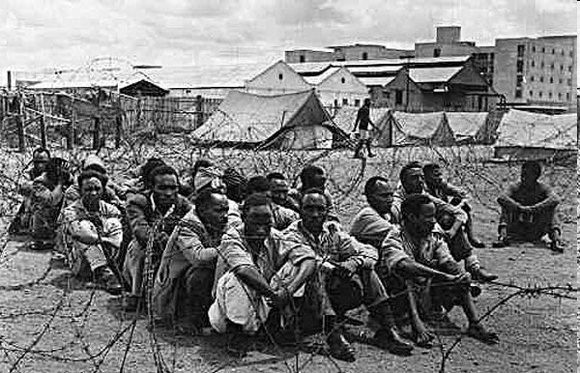
Kenya: Not so friendly

Slide 48
“Hearts and Minds” Examples
Cold War- Successfully ended (1948-1989).
WHAM- “Winning Hearts and Minds” P.W. Botha- So-Called “Total Strategy”

Slide 49
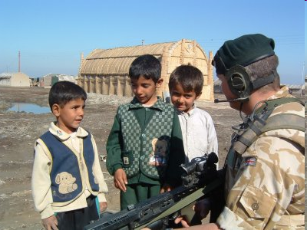
Iraq, Afghanistan and North and West Africa

Slide 50
Whole Government vs. Hearts and Minds in AFRICOM
Issues:
a. Cold War- Focus re. Hearts and Minds was on States. Key- Political Leadership was Coordinating
b. Now since 2001, there is a perception “World Wide” re. U.S. that there is military and security which is driving AFRICOM- Focus: Non-State Actors (Terrorist Groups) and Community Loyalty

Slide 51
Is that all there is in Foreign Aid?
Hearts and Minds and Whole of Government?

