Slide 1
PIA 2501
Development Policy and Management

Slide 2
Discussion
Sue Ellen Charlton, Ch 7
“Women in the Third World Development”
Robert Chambers, Ch 4-7
“Rural Development”
Picard & Moudoud “The 2008 Guinea Conakry Coup”

Slide 3
The International Dimension
The End of the Cold War
The World Bank and the Reagan/Thatcher changes
End of Cold War and Post-September 11.
Review of Context

Slide 4
End of assumption- Progress is inevitable: Rejection of Social Change Models
1983- Robert McNamara resigns from World Bank- New and Different Demands
Institutions, social change and basic needs abandoned
Export Economies--Minerals, agricultural commodities and livestock: Orthodoxy
Back to the Future- The key to growth is Structural Adjustment, privatization and market growth
Refocus on Governance, Conflict Mitigation and HRD/Socialization (2001-2013)
Notes:
4

Slide 5
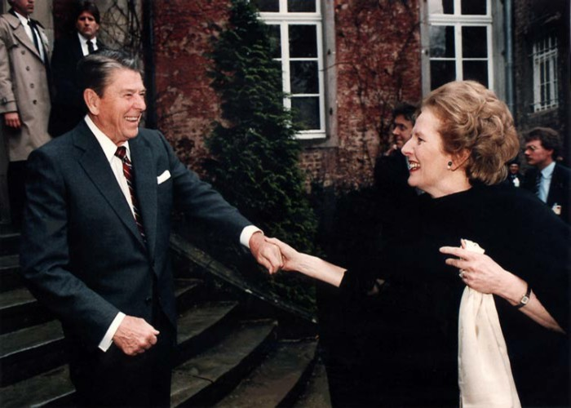

Slide 6
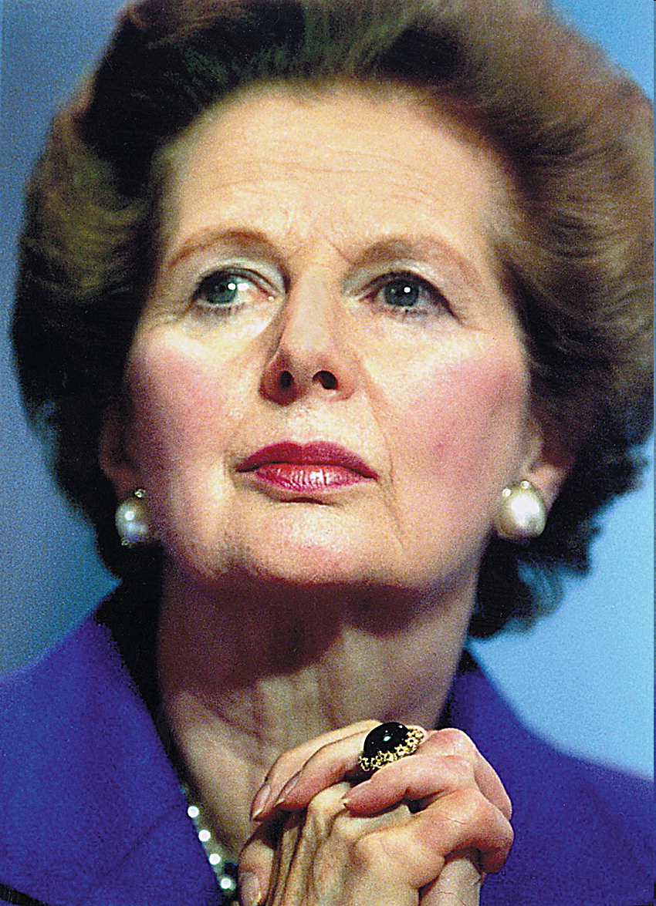
Whither the “then” New Regime: 1983-2012

Slide 7
1985: Bad Planning Discovered
Illness and death of Brezhnev in Soviet Union
The Change: Russia and Structural Adjustment
Planning- The “Ivory Tower” problem
Ronald Reagan and Margaret Thatcher at height of their power
Problems of Second World Applied to “Third World”
Notes:
7

Slide 8
A Forgotten Question: Who were Brezhnev and Andropov

Slide 9
Perception of Development Problems- Planning Bad- 1991 to Financial Crisis, 2009 (Summary)
The Change: End of Cold War
Structural Adjustment- 1989-2001
International conflict shifts from East-West rivalry and cold war to ethnic, regional and internal conflicts culminating in September 11, 2001
Now is Economic and Social Planning and State Building Back with Millennium Development Goals?
Notes:
9

Slide 10
Bad Planning Discovered
Ethiopia- Mengistu Haile Mariam declares a Leninist state in 1983
13 million face starvation in Horn of Africa
"We are the World" leads to Donor Fatigue
and the conclusion that development is private
From Program to Project Planning: Failure in Africa
Notes:
10

Slide 11
The Reagan/Thatcher Mantra: Development Planning: Failure and Future of Command Economies?
Transitional conflicts in Angola, Mozambique- Cold War Proxies
CIS and Central Europe become part of development portfolio
Cambodia, Nicaragua (Central America), Cuba?
Bosnia, Somalia, Rwanda, Kosovo, Congo (Rise of Internal/Civil Wars)
Notes:
11

Slide 12
Failure of Command Economies, the End of a Century and new focus on HRD
Afghanistan and Iraq in the 1990s
Sudan: A Thirty Years War and Two failed states
Terrorism and the Failure of Development
Venezuela and Nicaragua , the fall and rise of the Sandinistas
Notes:
12

Slide 13
Return of “Populist” Command Economy- The Once and Future Presidents

Slide 14
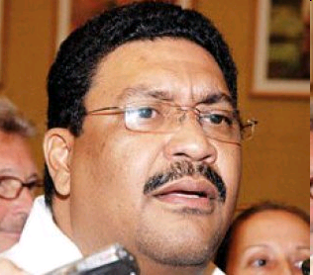
Valdrack Jaentschke
Development Minister in Nicaragua (GSPIA, 1991)
1990s Worked as Consultant for International NGOs Promoting “Democracy”
2009- Declared Government would expel NGOs promoting Opposition To Current Government

Slide 15
Now Vice Minister of Foreign Affairs
MID Graduate School of Public and International Affairs, University of Pittsburgh

Slide 16
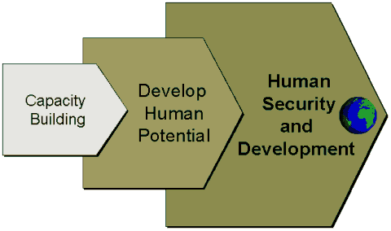
FROM PLANNING TO HUMAN RESOURCE DEVELOPMENT Part II: Building Capacity
Notes:
16

Slide 17
The Problem: Public Corruption and Loss of Faith in State social action

Slide 18
DEVELOPMENT PLANNING and Social Development
Problems and Issues,
2001-2012
The Problem: Quiet Corruption and the Public Sector VIDE0
Notes:
18

Slide 19
Corruption and Human Resource Development
Behavior Modification vs. Socialization

Slide 20
Behavior Modification through HRD
Focus of Discussion Last Week

Slide 21
Development Planning as Socialization: Today’s Focus
Primary—Family; before school
Secondary--Primary and Secondary Education
Tertiary--Adult (including Higher education and On the Job)
Problem: Social Engineering
Notes:
21

Slide 22
Primary Socialization in Lithuania?

Slide 23
Development Planning and Social Change: Overall Assumption
Classical Assumption
Role of the government agent is:
ACT AS A CHANGE AGENT
and Provide necessary stimulation to society to ensure social change
Key: Focus is on Human Behavior
Notes:
23

Slide 24
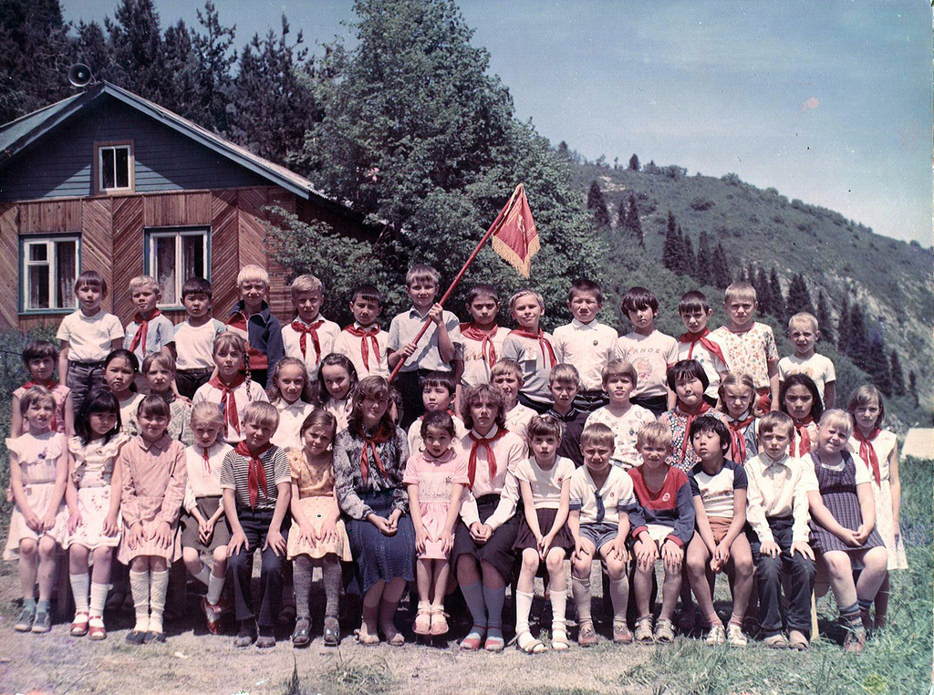
Young Pioneers Kazakh S.S.R.

Slide 25
Development Planning and Human Capacity: Assumptions
Development Planning as a Concept
State will serve as engine of development
Goal will be to change society, economy and political structures
Controversy not over physical planning but social change and economic behavior
Notes:
25

Slide 26
Social Development Assumptions
Assumes that there can be state managed social mobilization
Basic premise: planning is setting of priorities for use of scarce resources through use of rational rather than political processes for family support, education and health
Notes:
26

Slide 27
The Assumption: Development Planning as Socialization
Planned socialization includes secondary and tertiary socialization, but not primary socialization
Eg. Social Engineering
Why is Primary Socialization so powerful?: Discussion?
Notes:
27

Slide 28
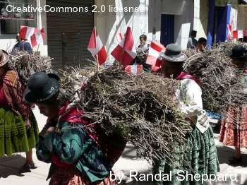
Traditional Gender Roles in Peru

Slide 29
Development Planning Assumptions- Continued
Development Planning historically has accepted premises of Development Administration:
State bureaucracy should take major role in social mobilization, economic transformation and increases in productivity; define policy goals for society
Rejected by some advocates of Development Management
Notes:
29

Slide 30
Development Planning Assumptions
7. Assumes that development occurs because of planned change
8. Originally, Keynesian planners saw state taking a major role in providing leadership to improve standards of living in LDCs
Key: Change Socialization Patterns (Agraria vs. Industria)
Notes:
30

Slide 31
Heavy Industry Focus

Slide 32
Political Assumptions with Development Planning
Assumes political and administrative leadership have made the decision to effect changes in the system
This is a meeting point of both counter-dependency strategy and modernization (Keynesianism)
Need to strengthen administrative capacity for social change in development economics and planning area
Notes:
32

Slide 33
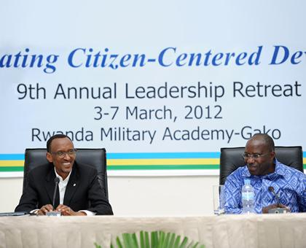
Strong Leadership to Change Social Patterns?
President Paul Kagame of Rwanda: Visionary or Tyrant

Slide 34
Development and Social Planning
“The Devil is in the Details” Not in ideology
An Old Philosopher
Notes:
34

Slide 35
Problem: The Lack of Administrative Skills
Human Development depends upon “administrative capacity”
Institutional arrangements for planning, planning agencies, management systems and processes that are innovative
Human behavior is complex. It involves:
Networks,
Organizations and
Institutions
Technology
Notes:
35

Slide 36
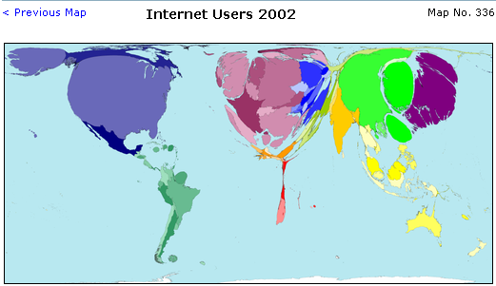

Slide 37
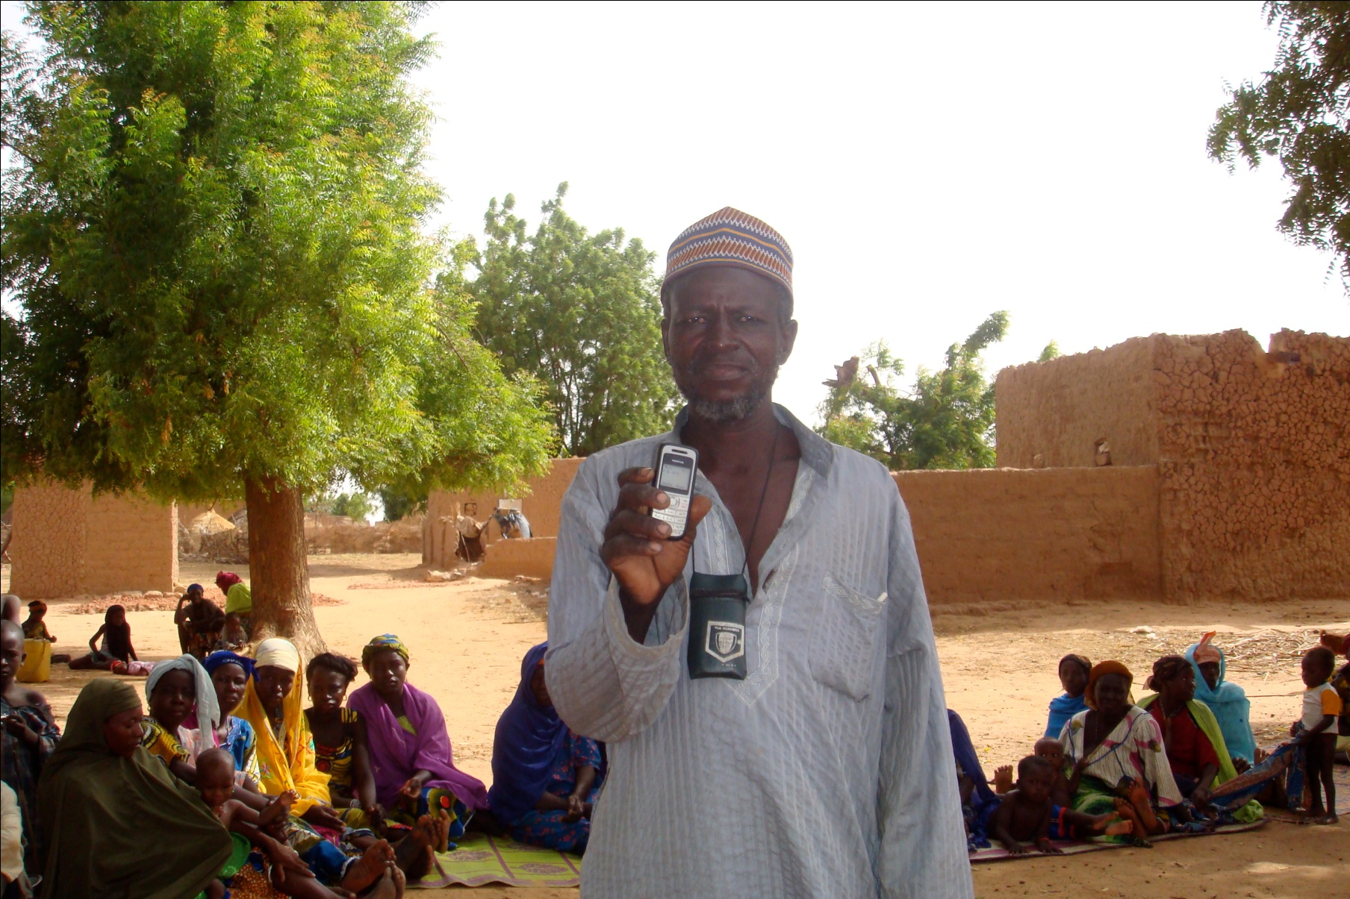
Technology Plays a Role

Slide 38
The Implementation Problem
Major responsibility for implementation lies with Planning official at the local level
Development change occurs because of planned action
Assumes political and administrative leadership have made decision to effect improvement in the social system
Local level capacity often non-existent
Notes:
38

Slide 39
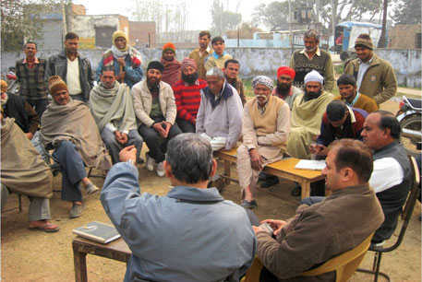
Farmers at a crop planning meeting at an extension service stations in Haryana, India.

Slide 40
Discussion
Assess the idea of forced social engineering
Notes:
40

Slide 41
SATIRE VIDEO
One Response to the Authoritarian Regime

Slide 42
Meet the Authors

Slide 43
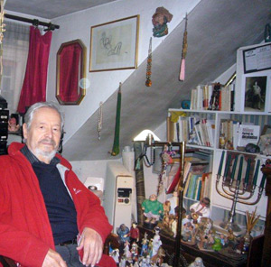
Our Authors
Alber Memmi was born December 15, 1920) and is a French writer and essayist of Tunisian-Jewish origin.

Slide 44
Our Authors
Daniel Bergner is a writer for the New York Times Magazine

Slide 45
Today’s Books
Colonizer, Colonized- Memmi
In the Land of Magic Soldiers: Bergner

Slide 46
Discussion

