Slide 1
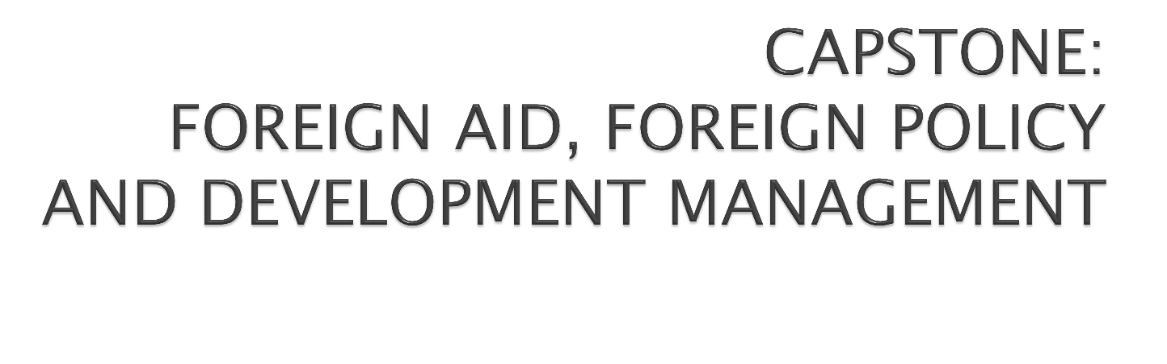

PIA 2096

Slide 2

Introduction and Overview

Slide 3

Please ask questions and contribute to
discussion

Slide 4





Foreign aid as Foreign Policy

Slide 5
 In the Beginning

Slide 6

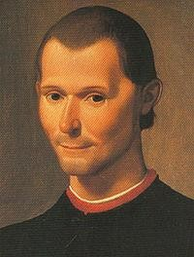


Niccolò di Bernardo dei Machiavelli (May 3, 1469 – June 21, 1527)
Machiavelli emphasized the need for the exercise of brute power where necessary and rewards, patron- clientelism to preserve the status quo.

Slide 7

The goal of foreign aid was said to be the reduction of material poverty through economic growth and the delivery of social services, the promotion of good governance and support for social institutions (Education and Health)
Or was it “Machiavellian?” DISCUSS

Slide 8

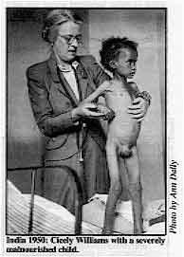

Slide 9

It was assumed that this would be done through democratically selected, accountable institutions, and reversing negative environmental trends through strategies of sustainable development.
But there was also the cold war.

Slide 10

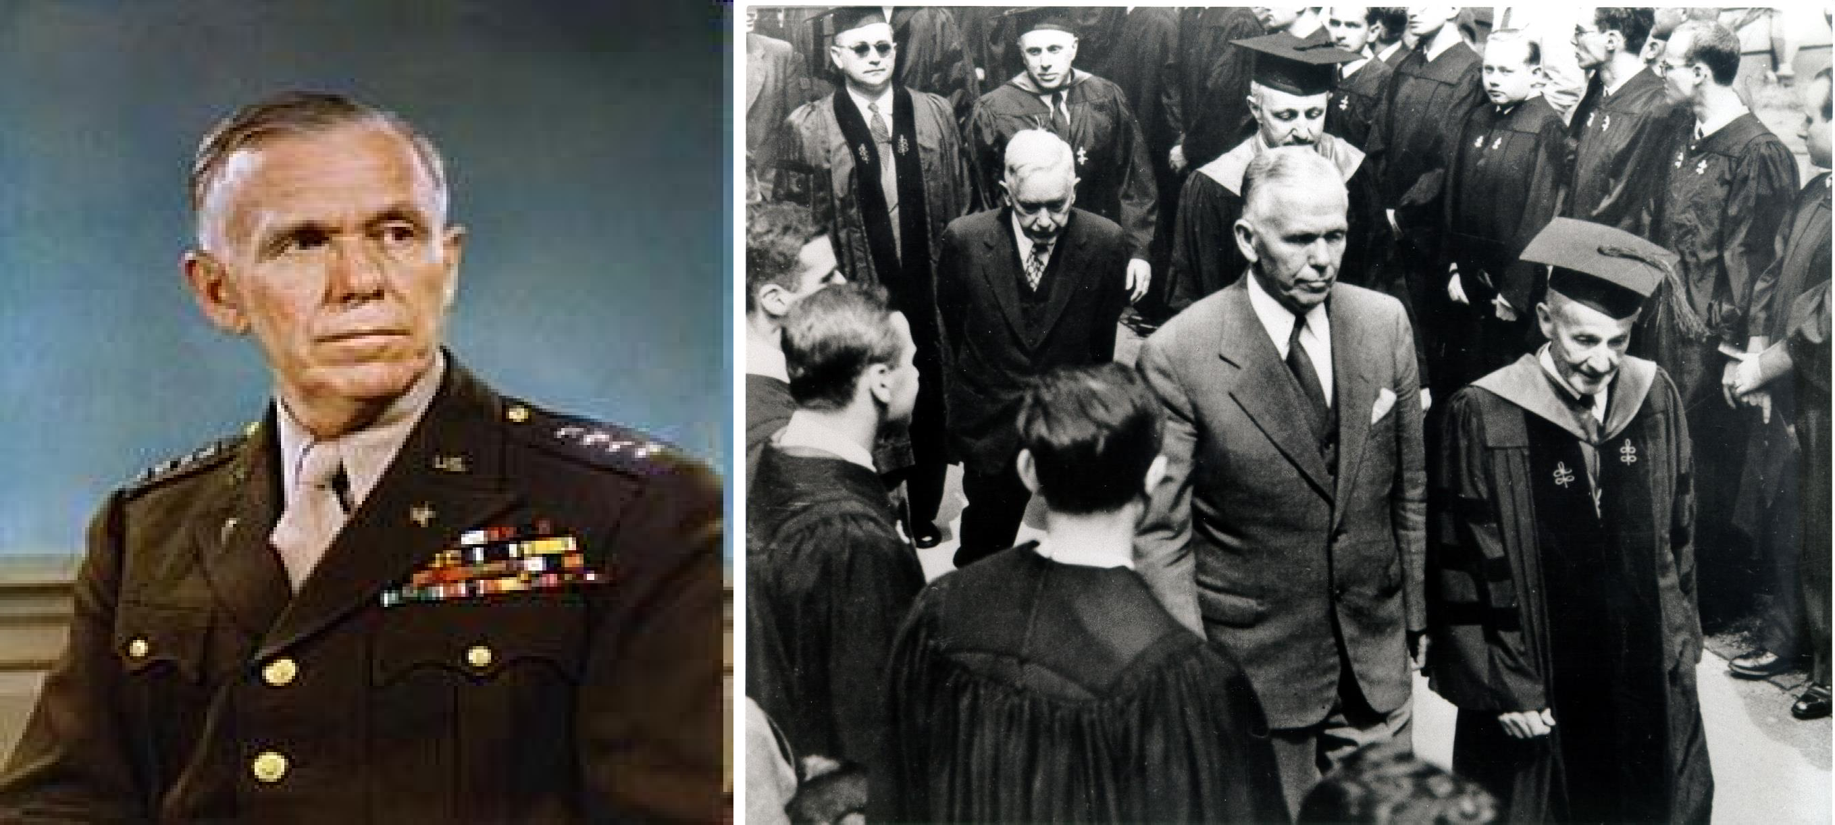

Slide 11
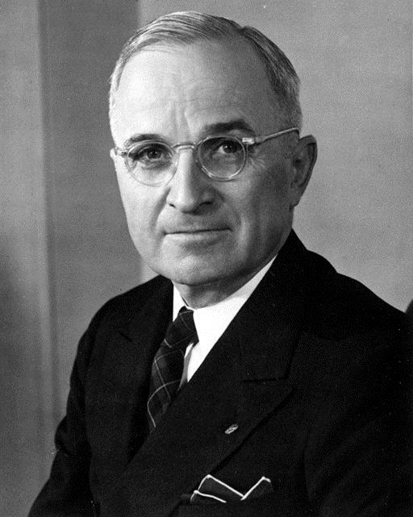
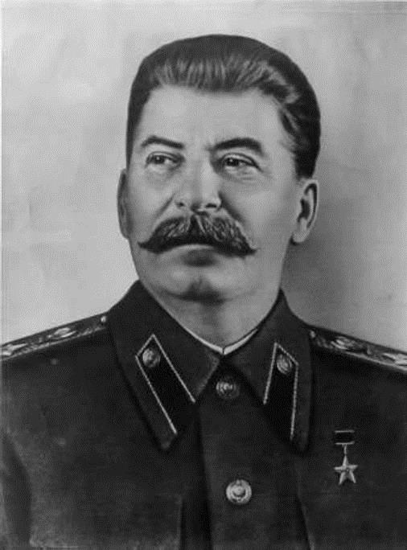




Harry Truman and Joseph Stalin
The Cold War and the Search for Allies

Slide 12
 Ostensibly the Goals are the same-
 However…

Slide 13

 In addition to (or because of) the Cold War (AND NOW) the War against “Violent Extremism”
 Ultimately, as a number of economists have noted, “universal models of growth [did] not work well.”
 Quote David Sogge, Give and Take: What’s the Matter with Foreign Aid? (London: Zed Books, 2002), p. 8.

Slide 14
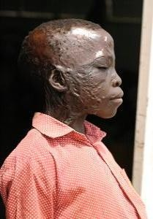

Evelyn Akullu
Evelyn Akullu came to the orphanage in march 2004 after being picked from her hospital in Lira, Uganda. She had been burnt by the Lord’s Resistance Army rebels at Barlonyo in Feb. 2004. By the time she was picked up, she was rotting in the hospital due to lack of drugs.

Slide 15

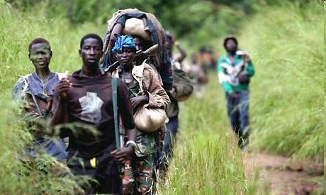

Slide 16

This little girl is a killer.
Esther was kidnapped to be a fighter in the Lord's Resistance Army in Northern Uganda. She fought for three years in Northern Uganda and Southern Sudan.

Slide 17

Course Themes

Slide 18

First, we will examine the origins of foreign aid in the nineteenth and early twentieth century.
Following this, we look at the expansion of foreign aid policy in the post-World War II period. Particular attention is given to the legacy of Vietnam as it impacted foreign aid and the impact of September 11.

Slide 19
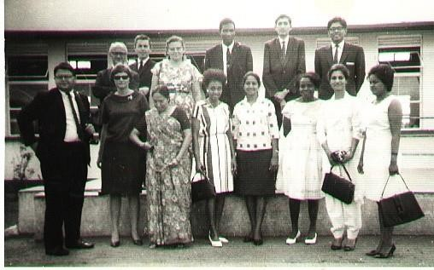
Vietnam vs. the Peace Corps
1965-1968

Slide 20

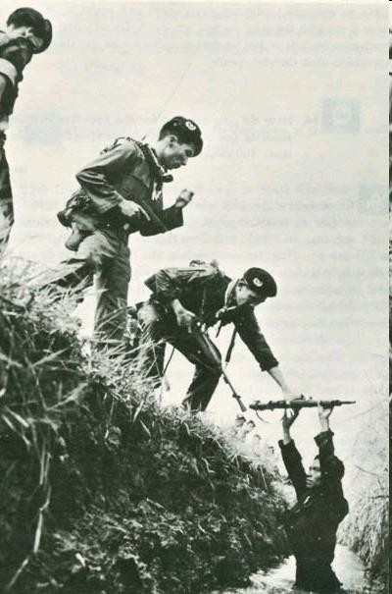

Slide 21

The discussion goes on to examine bilateral aid, multilateral organizations and the role of NGOs.
Finally, we will examine the counter-role relationships between donors and LDC program managers and conclude with a discussion of the moral ambiguities of foreign aid.

Slide 22

 Better Understand the Debate between Unilateralism and Multilateralism
 Discuss the assumptions of the so-called “Three Ds”- Defense, Diplomacy and Development
 Understand the organizational limitations of the
“Whole of Government” approach:
 Understand the bureaucratic concepts of “Staying in your Lane,” and “Stove-piping”- Defending Turf through Departmentalism

Slide 23

 The issue of sustainable development should be examined from both a policy and an ethical dimension.
 What is the role of ethics in group and individual behavior
 This suggests that ultimately there have both been policy problems and moral ambiguities that have plagued technical assistance and foreign aid.

Slide 24

 Foreign aid problems are rooted both in the evolution of foreign aid policy over the last half century---
 but also in the ethical and cultural assumptions that were the antecedents of state to state foreign aid as it developed in the wake of the Second World War.
 The debate about foreign aid and development revolves around two issues: cultural transformation and what used to be called modernization.

Slide 25

 The issue occurs at two levels.
 First, there is the concept of identity and how one identifies oneself in relationship to family, language and culture.
 Second, there is the issue of morality that ultimately is defined, at least in part by national policy.

Slide 26

Origins

Slide 27
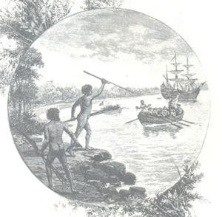

Slide 28

 Thus an understanding of development should occur at two levels, the relationship between the individual, a socialization process and the extent to which national ethical and moral values impact upon the individual.
 The result of Modernization is said to be an urban, modern secular person. (Western)

Slide 29

“Americans had been brought up in a pluralistic
world, where even the affairs of the family are
managed by compromises between its members. In the traditional Vietnamese family (and in other traditional families throughout the Third World)- a family whose customs survived even into the
twentieth century- the father held absolute
authority over his wife (or wives) and children.”
 The argument is that the western concept of decision-making is based on compromise.
Compromise, however, is not a universal concept.
Quote from Frances FitzGerald, Fire in the Lake: The Vietnamese and the Americans in Vietnam (New York: Vintage, 1972), p. 19.

Slide 30



Slide 31

 Groupthink and the March of Folly Problem
 Groupthink (Irving Janis)- Leadership cannot be criticized.

Slide 32
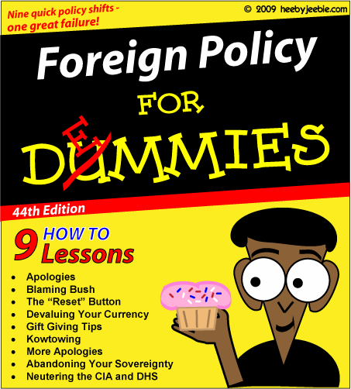

Slide 33

 Given the nature of government in the twentieth century, for
foreign aid to succeed it would have perceived as in the self- interest of a country’s leadership of both donor and recipient nations.
 However, as Barbara Tuchman points out, “[a] phenomenon noticeable throughout history regardless of place or period is the pursuit by governments of policies contrary to their own interests,”
 that is contrary to important constituencies or the state as a
whole.
 One Problem: GROUPTHINK
 Quote from Barbara W. Tuchman, The March of Folly: From Troy to Vietnam (New York: Alfred A. Knopf, 1984), p.4.

Slide 34
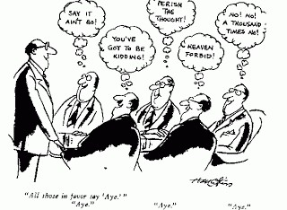

Slide 35

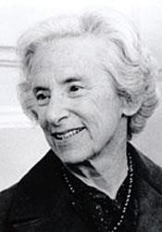

Slide 36

 Foreign aid, to its critics however, lacked an adequate
 Foreign aid was said to hold the promise of institutional development, that is the building of structures capable of introducing and supporting the changes implied in the term modernization.
conceptual basis. Result: Bureaucratized and Projectized Processes
 Foreign aid policy like other foreign policies suffered from an absence of reality. Where problems and conflicts exist among peoples they are not always solvable by foreign forces or modernization technologies.

Slide 37
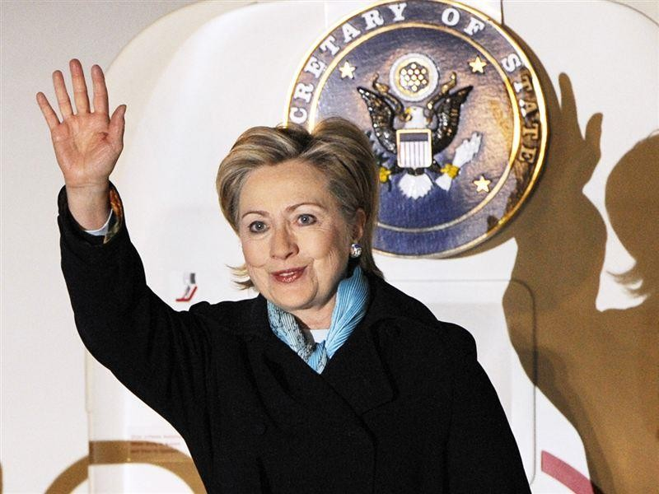

Slide 38

 In foreign aid, nation building has been the most presumptuous of such illusions. The importance of reason in decision-making follows from this.
 Counter-productive policies can be identified if there is a real time alternative course of action available that can be subject to group discussion and eventual choice.

Slide 39
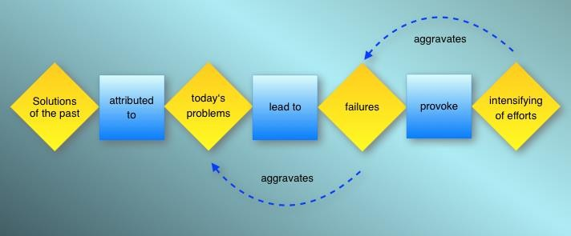

Slide 40

Using this definition, foreign aid policies have often been
counter-productive since productive policies require
thoughtful analysis.
Too often, foreign aid policies are pursued almost perversely even when “demonstrably unworkable or counter- productive.”
Unworkable policies, Tuchman points out, are “pursued at the sacrifice of the possible.”
Quotes from Tuchman, , p. 33 and p. 128.

Slide 41


Slide 42

There are two problems with decision-making:
 First, decisions are often formed through prejudice which are “hazardous to government.”
 Secondly, decisions in turn are too often made with
the ‘terrible encumbrance’ of dignity and honor.
Both Quotes from Tuchman.

Slide 43


Slide 44

The foreign aid system as it has evolved in the U.S. and in
other bilateral and multilateral organizations over the last sixty years is bureaucratic in nature. As Henry Kissinger noted in the late 1960s, there was
a sort of blindness [in terms of foreign aid] in which bureaucracies run a competition with their own programs and measure success by the degree to which they fulfill their own norms, without being in a position to judge
whether the
norms made any sense to begin with.
Quoted in John Franklin Cambell, The Foreign Affairs Fudge Factory (New York: Basic Books, 1971), p. 8..

Slide 45
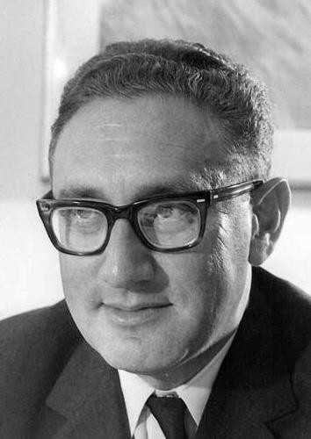

Slide 46

 In foreign policy, (including foreign aid policy) national honor
often required that foolish policies continued to be pursued despite overwhelming evidence that the goal was unattainable.
 The U.S. involvement in Vietnam (and some say Iraq) is said to be part of this pattern. Folly in public policy occurs when groups and organizations are unable to make decisions and draw conclusions from the evidence available. Costs rather
than benefits from a policy result if the donor tries to “avoid interference that is needless or irrelevant to major foreign policy purposes.”
 Decision-makers need to focus on both.
Noted by John D. Montgomery, The Politics of Foreign Aid: American Experience in Southeast Asia (New York: Praeger, 1962), p. 250.

Slide 47
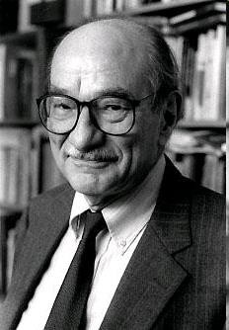

Slide 48

What Emory Roe calls the development of the counter narrative is
to conceive of a rival hypothesis or set of hypotheses that
could plausibly reverse what appears to be the case, where the reversal in question, even it proves factually not to be the case, nonetheless provides a possible policy option for future attention because of its very plausibility.
Quote from Emery Roe, Except- Africa: Remaking
Development, Rethinking Power (New Brunswick, NJ: Transaction Publishers, 1999), p. 9.

Slide 49


Slide 50

 There is often very little public recognition to the commercial needs met by foreign aid
 Or the bridge between security and foreign aid,
 There was a disproportion of power between LDC states and Western, and especially American Power

Slide 51
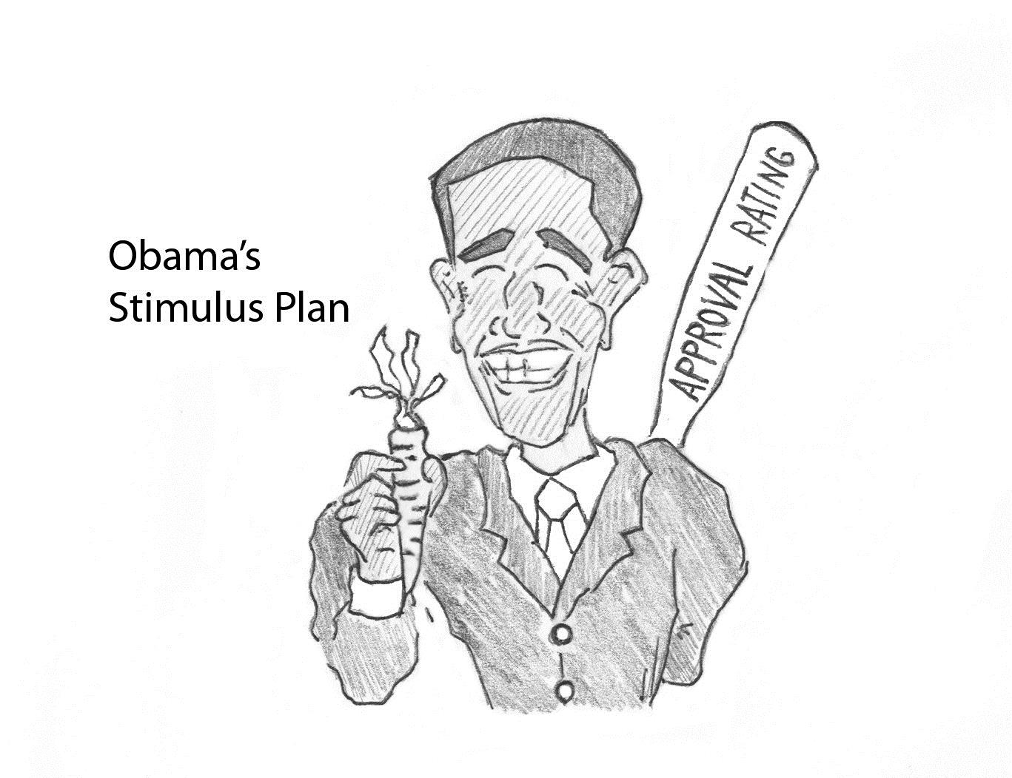

Slide 52

 Ultimately foreign aid organizations, like their counterparts in other areas of contracting, are in a struggle to capture and retain resources
 Donor values and misperceptions are part and partial of the picture of foreign aid.

Slide 53
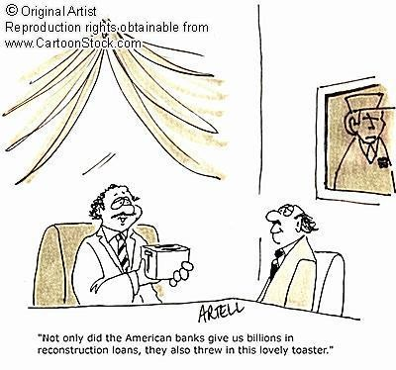

Slide 54

USAID Priorities

Slide 55
Where does USAID's Money Go?
Top 20 FY 2007 Benefiting Countries (Program Funds)
 | Country | Obligated FY 2007 | Obligated FY 2008 to date
1 | Worldwide | 2,703,619,188 | 101,893,138
2 | Afghanistan | 1,445,651,383 | 511,400
3 | Iraq | 1,243,080,343 | 48,000
4 | Egypt | 605,704,157 | 4,274,678
5 | Pakistan | 457,985,585 | 15,891,546
6 | Sudan | 382,486,655 | 1,615,033
7 | Kenya | 289,410,439 | 0
8 | Jordan | 280,371,000 | 0
9 | South Africa Republic | 250,096,145 | 67,879
10 | Ethiopia | 213,845,722 | 22,204,543
11 | Uganda | 204,219,281 | 2,773,870
12 | Indonesia | 191,936,684 | 3,457
13 | Nigeria | 189,219,518 | 164,714
14 | Lebanon | 167,416,776 | 218,432
15 | Botswana | 159,990,581 | 100,000
16 | Liberia | 134,580,726 | 1,859,155
17 | Haiti | 130,911,398 | 100,000
18 | Tanzania | 130,252,425 | 0
19 | Zambia | 127,021,388 | 0
20 | Mozambique | 125,918,155 | 7,251,600
Obligation Activity Prossessed via NMS vs. GLAAS vs. Phoenix
NMS (Assistance and Acquistion) | Oblig. FY 2007 $3.2 billion | Oblig. FY 2008 to date $0.1 billion
GLAAS (Acquisition) | $1.1 billion | $0.1 billion
Phoenix (Assistance, Acquistion, Other Instruments) | $7.0 billion | $1.7 billion
Top 20 FY 2007 Program Areas
 | Program Area | Oblig. FY 2007 | Oblig. FY 2008 to date
1 | Health (3.1) | 4,327,988,718 | 18,605,472
2 | Protection, Assistance and Solutions (5.1) | 1,637,521,098 | 143,383,000
3 | Good Governance (2.2) | 1,011,895,268 | 22,222,112
4 | Infrastructure (4.4) | 705,244,696 | 10,397,460
5 | Education (3.2) | 627,225,539 | 4,161,549
6 | Financial Sector Capacity (4.3) | 496,694,057 | 12,154,011
7 | Agriculture (4.5) | 434,996,618 | 117,509
8 | Stabilization Operations & Security Sector Reform (1.3) | 397,236,293
9 | Civil Society (2.4) | 364,790,353 | 12,529,274
10 | Counter-Narcotics (1.4) | 357,682,852
11 | Conflict Mitigation and Reconciliation (1.6) | 350,757,009 | 1,348,217
12 | Macroeconomic Foundation for Growth (4.1) | 290,232,614 | 19,251
13 | Trade and Investment (4.2) | 276,137,567 | 3,270,771
14 | Private Sector Competitiveness (4.6) | 274,417,161 | 1,076,055
15 | Environment (4.8) | 255,161,181 | 4,550,524
16 | Rule of Law and Human Rights (2.1) | 162,172,494 | 2,053,232
17 | Political Competition and Consensus-Building (2.3) | 154,755,803 | 1,862,445
18 | Economic Opportunity (4.7) | 114,710,215 | 71,742
19 | Program Support (6.1) | 107,036,698 | 27,669,317
20 | Soc. & Econ. Svs. & Protection for Vul. Pop. (3.3) | 87,397,631 | 5,885,017
Top 20 FY 2007 Vendors
 | Vendor | Obligated FY 2007 | Obligated FY 2008 to date
1 | World Food Program | 687,217,890 | 58,215,842
2 | Global Fund | 642,252,952 | 0
3 | International Relief and Development | 396,182,002 | 143,436,800
4 | Development Alternatives, Inc. | 378,219,716 | 125,521,582
5 | Research Triangle Institute | 368,641,028 | 19,048,446
6 | Louis Berger International, Inc. | 288,588,913 | 172,412,719
7 | Chemonics Internaltional Inc. | 258,354,260 | 177,687,650
8 | Partnership for Supply Chain Management | 208,115,383 | 300,000
9 | Management Systems Intl, Inc. | 192,747,292 | 4,231,213
10 | Academy for Educational Development, Inc. | 186,196,455 | 38,909,449
11 | Family Health International | 179,656,691 | 23,108,494
12 | CHF International | 145,491,508 | 0
13 | National Planning Commission | 131,328,730 | 0
14 | PACT, Inc. | 129,693,156 | 0
15 | Bearing Point, Inc. | 123,600,758 | 53,830,767
16 | Associates in Rurual Development | 122,583,006 | 25,649,322
17 | World Health Organization | 117,261,563 | 9,294,367
18 | John Snow, Inc. | 109,670,604 | 0
19 | CARE, Inc. | 108,449,858 | 19,527,958
20 | Ssangyong-Hutama Joint Association | 108,247,253 | 0
Top 10 FY 2007 Bureaus that Obligated the Most Program Funds
 | Bureau | Obligated FY 2007 | Obligated FY 2008 to date
1 | ANE | 4,955,369,126 | 24,218,877
2 | AFR | 2,488,699,626 | 24,037,273
3 | GH | 1,741,273,466 | 1,339,854
4 | DCHA | 1,704,667,236 | 168,549,835
5 | LAC | 699,736,905 | 3,572,355
6 | E+E | 685,541,361 | 9,945,937
7 | EGAT | 296,865,107 | 14,508,283
8 | M | 46,141,970 | 25,638,959
9 | ODP | 8,008,825 | 312,821
10 | RECOVERY | 5,562,983 | 47
Source: M/CFO/FS as of December 25, 2007

Slide 56

 It is said that part of the motivation for foreign aid has been ethical and humanitarian in nature.
 However, there has been one constant defining foreign aid over the last fifty years.
 The humanitarian and development goals of foreign aid have been distorted by the use of aid for donor country commercial and political purposes.

Slide 57
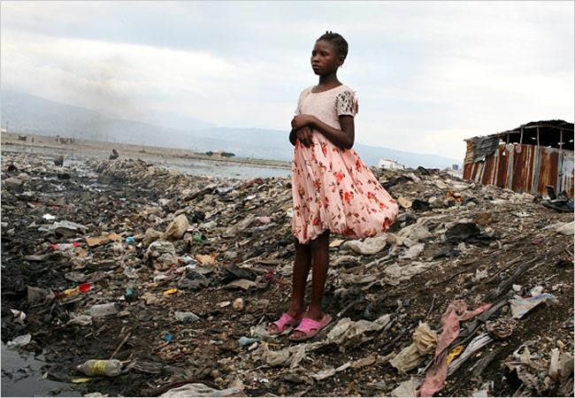

Slide 58

 Policy makers in more developed countries, and especially in the United States, have tended to see their action in terms of their generosity and to justify the use of force in order to meet ideological and developmental goals.
 Rewards were used as carrots to tempt conflicting
sides into accepting mediation.
 The question: Do the current USAID priorities have
an ethical base?


Slide 59

Policy makers in more developed countries, and especially in the United States, have tended to see their action in terms of the their generosity


And to justify the use of force and unilateral action in order to meet ideological and developmental goals.
Rewards were used as carrots to tempt conflicting sides into accepting mediation


Slide 60
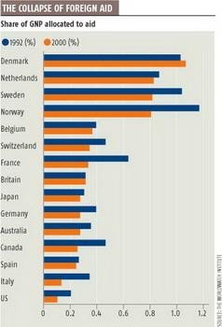

Slide 61

This course examines several related themes:
First, we will examine the origins of foreign aid in the nineteenth and early twentieth century.
Following this, we look at the origins of foreign aid policy in the post-World War II period. Particular attention is given to the legacy of Vietnam as it impacted foreign aid and the impact of September 11.

Slide 62
The discussion goes on to examine bilateral aid, multilateral organizations and the role of NGOs.
Finally, we will examines the counter-role relationships between donors and LDC program managers and concludes with a discussion of the moral ambiguities of foreign aid.
Focus will be on the twin issues of Unilateralism and the “Three Ds” of contemporary foreign aid.

Slide 63

Discussion of the Readings:
And Questions?

