Slide 1
PIA 2020 Introduction to Public Affairs
Week THREE- Debates about democracy and public Policy
Governance, Political institutions and Society

Slide 2
A Note: Degree Specific Readings
Be Able to Discuss and share your Views on the Book:
What will this book be about?
Why do you think it is assigned to you to read in this class? Aka. What might you gain in learning in reading it?
How did the assigned reading for today relate to the Core and/or Classic readings? What were common or overlapping themes?

Slide 3
THEMES OF THE WEEK
Sovereignty
Democracy
Political Institutions
Authoritarianism
Grassroots (Local Governance)

Slide 4
I. Sovereignty
The Basics: Governance, and the Nation State System
Sovereignty
Authority to Govern (Ostrom)
Presumption of Independence
A National Government status given by International Community and by use of International Law
Reflected in Embassies and UN Membership

Slide 5
Terms to Define (or Confuse?)
Nation vs. State vs. Tribe
Norway (5 million) vs. Igbo or Ibo (27 million) (tribe?)
State- sovereign, with history
Government vs. Governance
Process: elections, selections decisions
Vs. Organizational Components (Legislative, Executive and Judicial)

Slide 6
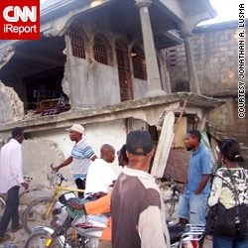
But? How Sovereign: The Haiti Earthquake, January 12, 2010

Slide 7
Sovereignty vs. Globalization
Transnational Governance Systems
Haiti: 2,000 civilian and 9,000 military forces (International Forces)- To Deal with an Earthquake
Transnational Governance or the New Imperial Model

Slide 8
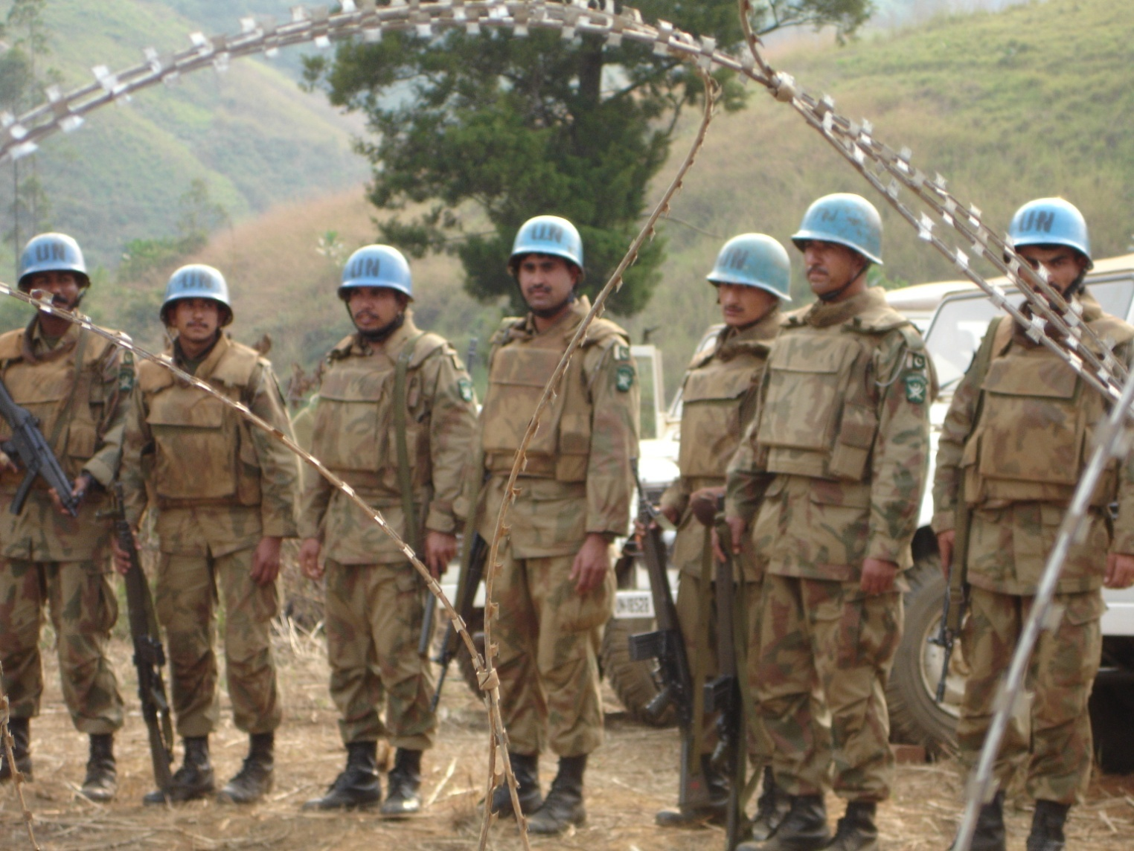
UN Blue Hats: Around the World

Slide 9
Summary Overview
The Governance Concept: Issues
1. Sovereignty- Legal Autonomy (International Law- Defined by Diplomacy)
2. Democracy vs. Governance (Institutions)
3. Penetrated by International Institutions

Slide 10
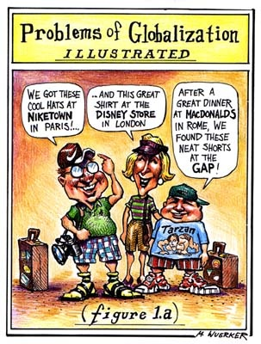
Governance and Sovereignty
A Renewed Interest-Transitions and international systems
"[T]ransformation (and globalization) has led to a reinvention of government and what it does“*
*Bruce Parrott in in Karen Dawisha and Bruce Parrott, eds., The Consolidation of Democracy in East-Central Europe (Cambridge: Cambridge University Press, 1997)

Slide 11
Transitional vs. Developing Society
Governance- Transitional vs. Developing states- Different from Developed Countries?
There was (1991) a discovery of “new” problems in Eastern Europe, Caucasus and Central Asia with the END OF THE COLD WAR
Janine Wedel Collision and Collusion: The Strange Case of Western Aid to Eastern Europe 1989-1998. (New York, N.Y.: St. Martin's, 1998)
Issue: Fragile vs. Collapsed States

Slide 12
Fragile and Collapsed States
Cambodia
Haiti
DRC (Congo)
Somalia
Chad
South Sudan
Libya
Mini-Discussion: What is the Difference?

Slide 13
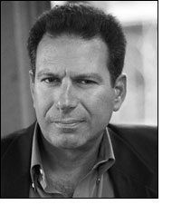
Sovereignty and Governance: The Cultural Dimension
The Issue: Is there a “Clash of Cultures?”
Roman Catholic
Orthodox
Islam
Issue of the Week: Samuel P. Huntingon’s idea- See debates Robert Kaplan, Balkan Ghosts

Slide 14
Samuel P. Huntington (April 18, 1927–December 24, 2008) Book: Clash of Civilizations

Slide 15
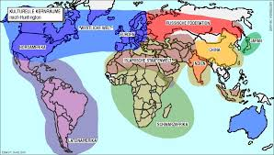
Samuel P. Huntington, The Clash of Civilizations and the Remaking of World Order (New York: Touchstone Books, 1996).
)

Slide 16
Governance: an Overview of Issues
Basic Terms: The Environment of Development
Governance Revisited: Processes
Manner in which the state is created, modified or overthrown
Regime Change

Slide 17
II. Democracy
The Nature of the Debate

Slide 18
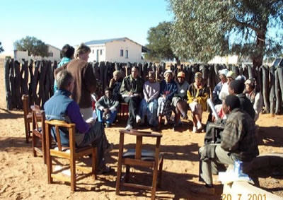
Types of Democracy
Botswana Kgotla
“Panchayat in India”
Town hall or village model
Direct Democracy-
The Tswana Kgotla
Actual direct participation of a population in decision-making about laws and regulations

Slide 19
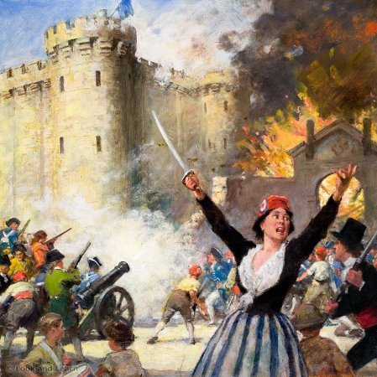
Direct Democracy: The Mob
Mass Involvement or People’s Democracy

Slide 20
Types of Democracy: Terms
Indirect Democracy-Representation
Some form of representative democracy
Existence of various diverse interest associations and groups within society

Slide 21
Indirect? Democratic?

Slide 22
Robert A. Dahl 1915-2014
Dahl argues that democratic societies are pluralistic and competitive and that there are many different elites involved, who have to work both in contention and in compromise with one another.

Slide 23
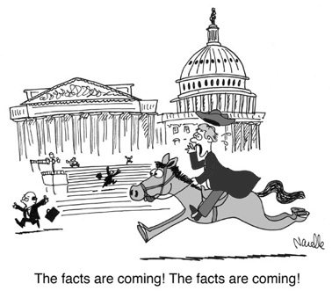
Oligarchy
Diverse interest associations of society compete with each other over policy issues
Competitive
Pluralism
Civil Society

Slide 24
Types of Democracy, cont.
Cooperative Movements (or Social Corporatism)
Diverse interest associations cooperate with each other and with organs of the state to make policy
Authoritarian (Mussolini’s Italy)
Military (Peron’s Argentina)
Social (Scandinavia)
WE RETURN TO THIS IN DISCUSSION OF AUTHORITARIANISM

Slide 25
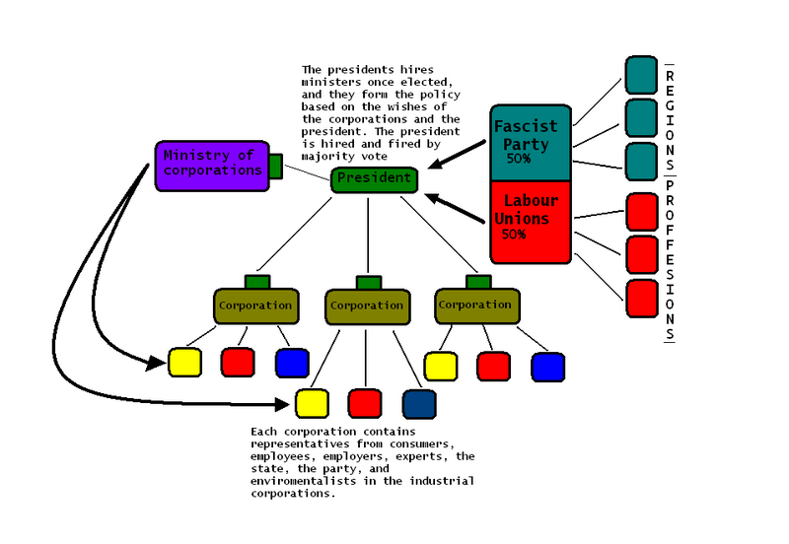
Corporatism

Slide 26
Democracy: What is it?
“It is only when men learn what it means to be free, and struggle to maintain proper limits upon the exercise of authority so that no one is allowed to become master of the others that human beings have the possibility of creating mutual relationships which they may freely enter and leave as they seek mutually productive patterns of human development.”
- Vincent Ostrom

Slide 27
Elinor and Vincent Ostrom

Slide 28
Democracy
Limited
Institutionalized
Non-Zero Sum (Win Win)

Slide 29
The Zero Sum Game

Slide 30
Democracy: What is it?
The Cynic Revised
“The policy makers have rational interests--to develop their countries, to improve the condition of their people, to acquire or stay in power, or to steal as much as possible.“-
Peter Berger, Pyramids of Sacrifice

Slide 31
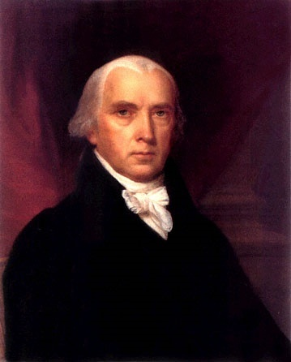
James Madison and Democracy
The Eighteenth Century Cynic
The problem with
majorities
2. Tyranny
3. Factions

Slide 32
Direct Democracy vs. Representative Democracy
Problem with Populism
Mob Justice (Fear of French Revolution)
Lack of Minority rights
Shifting majorities and tolerance
Problem with Plebiscites
Size and the Need for Indirect Representation

Slide 33
III. Political Institutions: Models of Governance
Who Gets:

Slide 34
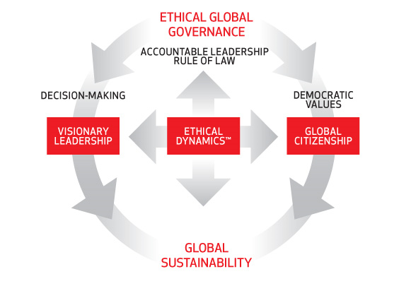
Models of Governance: An Ideal

Slide 35
Governance Failure and Sovereignty
Rules of the Game politics:
Zero/sum vs. sum/sum politics
"Splintering”
Break up of states--centrifugal forces
Goal: Interest Group Liberalism (Tolerance of Groups)
Civil Society as organizational
Not the individual or the mass

Slide 36
Political Models
Separation of Powers
Parliamentary System
Mixed Systems of Government
One Party or No Party Systems
Military and Authoritarian Systems

Slide 37
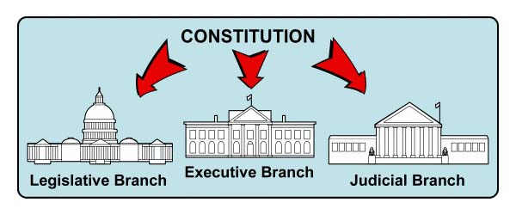
Separation of Powers
“Presidential System”
U.S.
Mexico
Philippines
Many Latin
American
Countries

Slide 39
Parliamentary System: Cabinet or Fused Government
United Kingdom
Scandinavia
Central Europe
India
Former British Colonies

Slide 40
The French Hybrid- The Mixed Presidential Model
France
French Colonies
Weak Hybrids with a Ceremonial President

Slide 41
Hierarchy of Authority

Slide 42
IV. Authoritarianism Leninism and the Mob

Slide 43
The “ISMs”
Fascism
Socialism
Capitalism
Communism

Slide 44
One Party States: “Democratic Centralism”
Communist or
Leninist States
Afro-Marxist
Fascist
“No Party Regimes”
Weak One Party Systems

Slide 45
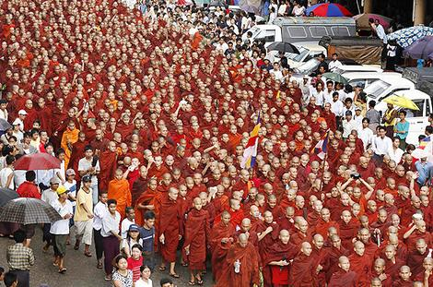
The Power of the Group

Slide 46
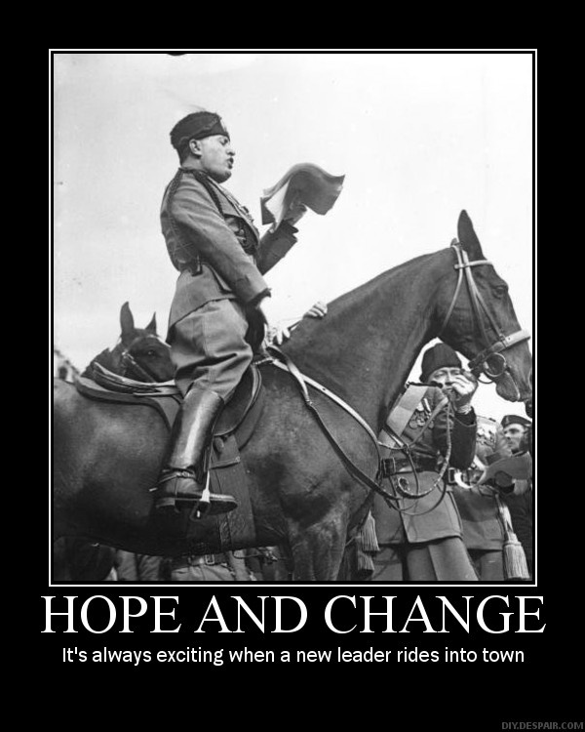
Regime Change

Slide 47
“Absolutism,” Institutions (or Not)

Slide 48
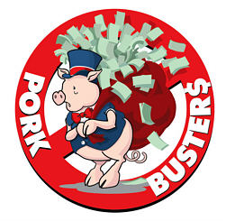
Authoritarianism
Authoritarian systems- Structures absent to protect citizens from fused state and bureaucracy
Non-Constitutional Systems: Military Regimes and One Party States- Politicized bureaucracy
Rent Seeking, Nepotism and Corruption

Slide 49
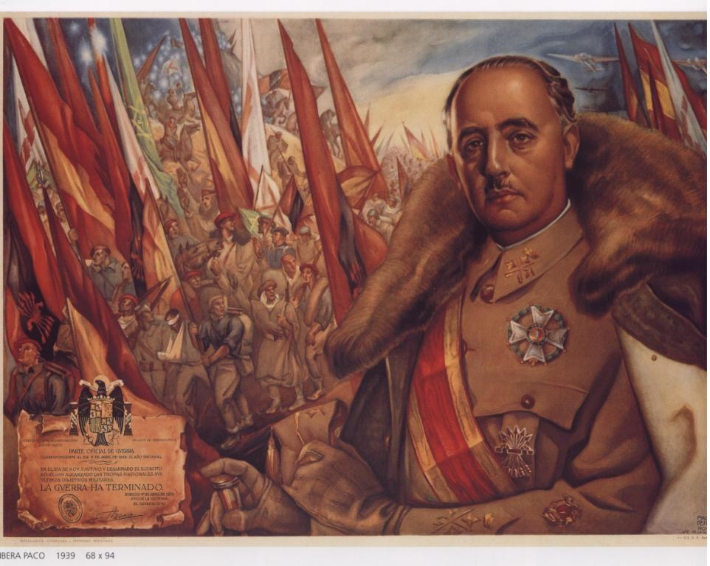
Corporatism as the Alternative Concept- Groups and Leadership Francisco Franco Caudillo of Spain (1939-1975)

Slide 50
Political Structures and Society
Statist view of Society- Collectivist (Frances FitzGerald- Fire in the Lake on Vietnam)- Four Views
a. Idea of an active, creative state, development oriented (Keynes)
b. Marxist-Leninist model- communitarian
c. Corporatist idea of society as groups- civil service as a group (Western Europe?) (Can Lead to Fascism)
d. Focus- Group Mobilization

Slide 51
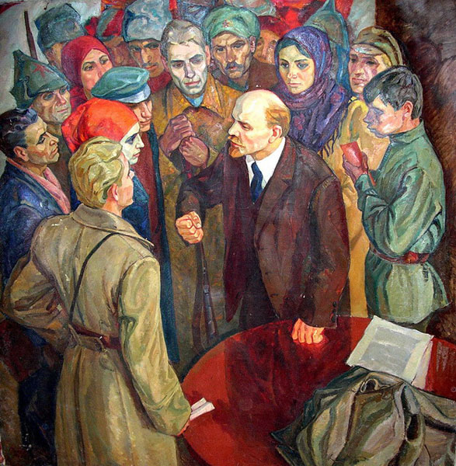
Lenin- Mobilization of Working Class

Slide 52
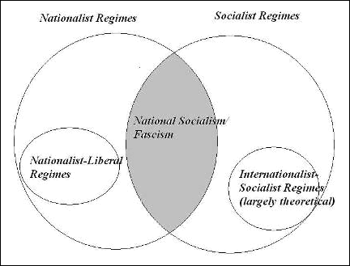
Does This Help?

Slide 53
V. Governance Issues: Grass Roots or Micro-Level
Need to Focus on Local Government (not Local State)
Primary unit of government that has both political leadership and bureaucratic structures

Slide 54
Local Government Financial Allocation (A Preview)

Slide 55
Governance Issues
Civil Society
Associations and organizations that are beyond the clan and the family and short of the state (does not include state organs)
Relationship to Democracy (Anglo-Saxon vs. Continental)
Individual (Rule of Law) vs. Collective (Corporatist) view

Slide 56
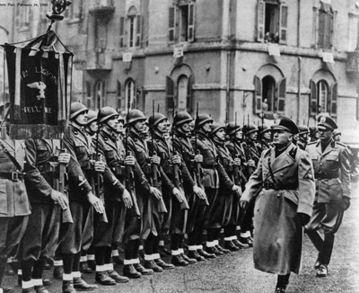
Fascism and Italy
VIDEO
The Banality of Authoritarianism

Slide 57
Discussion- How to Define political values Lemann
What does Chicago represent? Is it a different social culture or more of the same U.S. racial environment?
Describe what the North represents politically and economically? How does it fit into social and economic analysis?
In the Northern U.S. are issues racial, class based or cultural? Which are most important?

Slide 58
Picard and Buss
How do missionary values influence foreign aid and foreign policy decisions? Are they still important in the 21st century?
Is foreign aid a legacy of colonialism and Imperialism? What is the difference between the latter two terms?
What are the economic issues related to foreign policy and foreign aid?

Slide 59
Schiavo-Campo
What are the “moral dimensions of political culture? Are their universal moral values?
Are elites morally justifiable? What limits should there be on them?
Is the decision on “the size of government” (How big) a moral question, an economic question or a political question?

