Slide 1
The Structure and Process of Bureaucracies, Regulations and Political Institutions
PIA 2020 Introduction to Public Affairs

Slide 2
Overview: Public Sector Reform
U.S. Case Study- Reform of the U.S. in the 19th
Century
Comparative Focus
Models for Change
Problems of Bureaucrati Dysfunction

Slide 3
Lincoln and the Accusation of Patronage

Slide 4
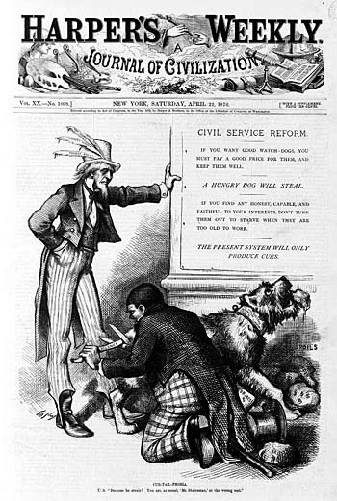
The U.S. Case Study

Slide 5
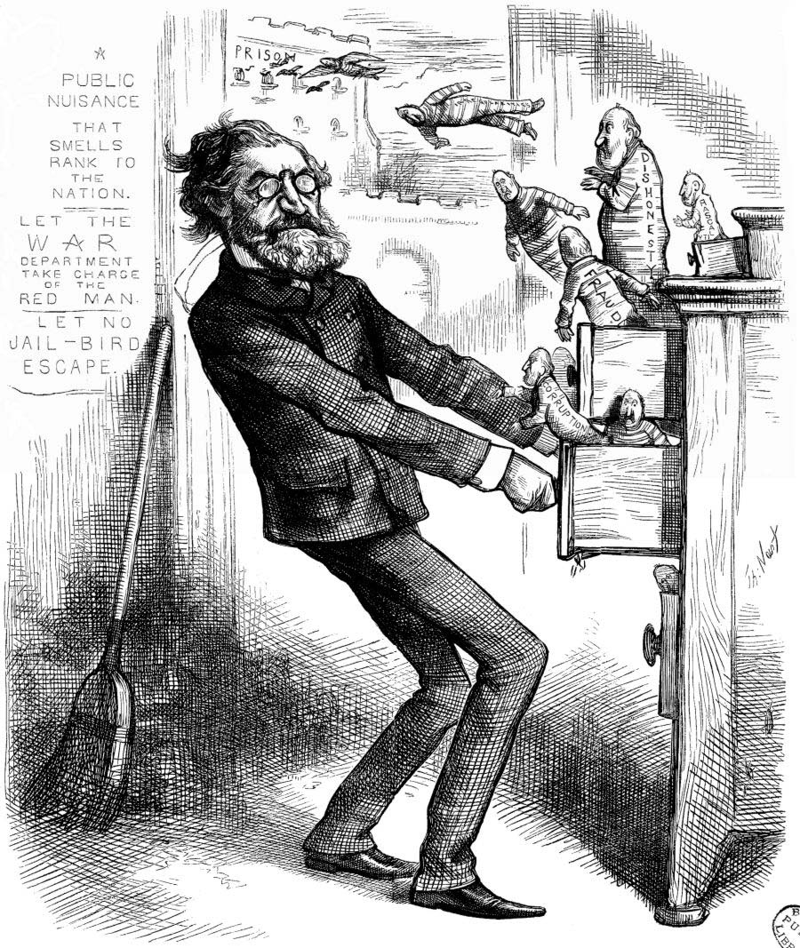
Rutherford B. Hays, 1877-1881 (Indian Affairs)

Slide 6
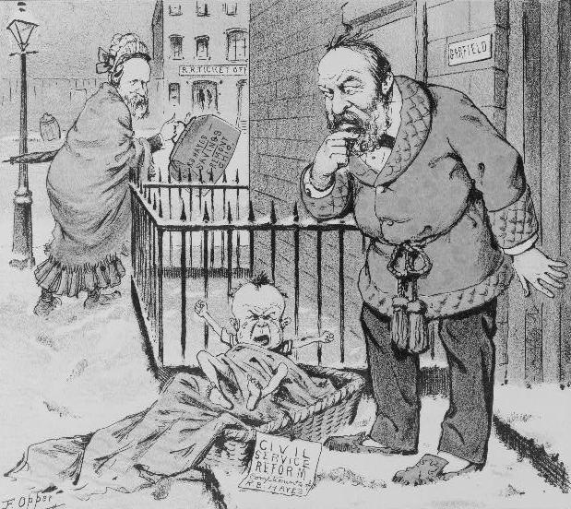
Civil Service Reform: Puck Political Cartoon

Slide 7
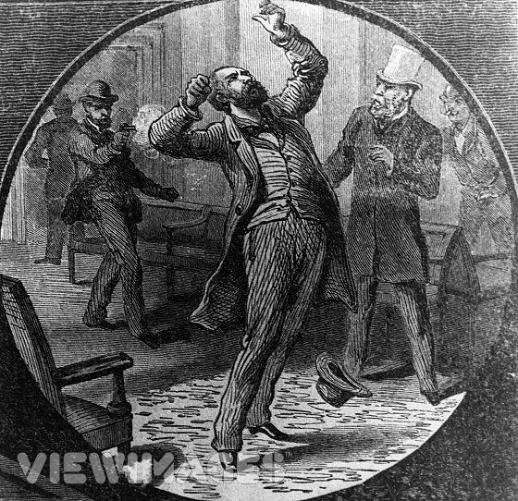
James A. Garfield Assassination July 2, 1881

Slide 8
U.S.A. Post-1883 Political Reforms- The Pendleton Civil Service Reform Act
Spoils, patronage and 1883 reforms.
Selling jobs
Administrators Cannot be involved in Politics
Start a Period of Strong Legislative Reform

Slide 9
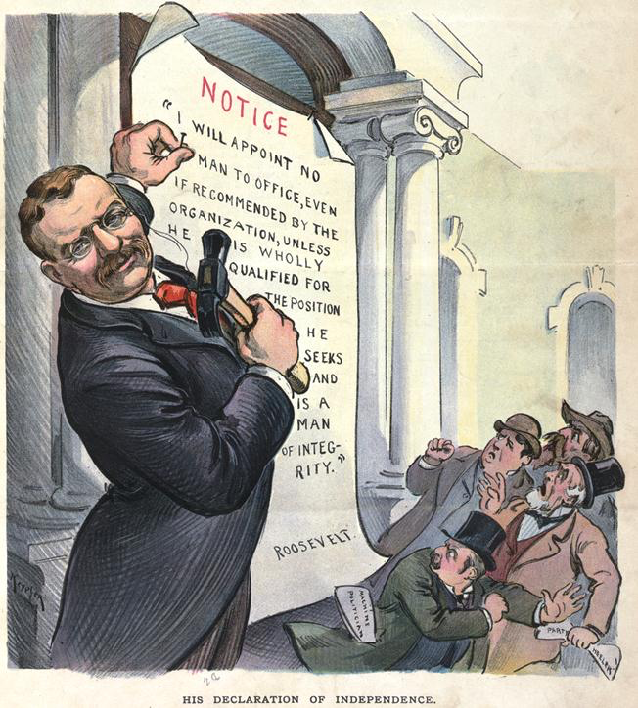
Theodore Roosevelt and Legislative Reforms

Slide 10
Woodrow Wilson: Academic and Politician
Origins of Progressivism
Woodrow Wilson and Progressivism: Babies and Bathwater?
Dichotomy- politics and administration-
Popularized by Woodrow Wilson

Slide 11
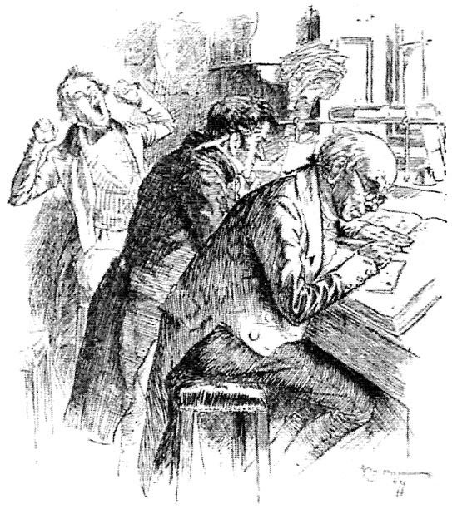
The Clerical Administrator- 1875: Rule of Law or Rule of lawyers and clerks

Slide 12
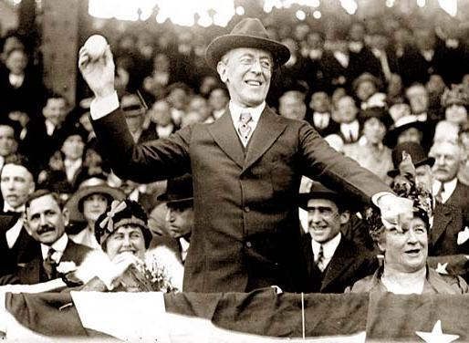
American Institutions- Woodrow Wilson, Political Scientist and the Separation of Politics and Administration (Successor to Weber) Routinizati of Charisma

Slide 13
U.S. Civil Service Reforms
5. Wilson Popularized Max Weber's ideas
6. Keynesianism and Good Government
7. Privatization, Free Trade and Small Government
8. Debate about Contracting Out

Slide 14
The Myth: Classical Non-Partisanism in the 1930s
The Politics/Administration Dichotomy:
The Role of Non-Partisan Movements and
Generic Management
POSDECORB (Luther Gulick)
(Planning, Organizing, Staffing, Directing,
Coordinating, Reporting, and Budgeting)
Non-Political but How Neutral?

Slide 15
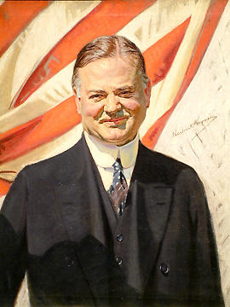
Modern Reforms: U.S. Model? (Herbert Hoover: U.S. President, 1929-1933)
U.S. Civil Service Reform: 1883: End of Spoils
Hoover Commissions: 1940s and 1950s (Admin. Reform)
New Public Administration: Advocacy Reform and Affirmative Action
Structural Adjustment: Debt Management and Privatization- Internationalized Reform
New Public Management: Customers and Clients and Privatization

Slide 16
Comparative Public Affairs Issues of the Day
These include ways in which administrators interact with their political environment and influence the policy making process.
We also examine several specific administrative problems that have themselves become contentious policy issues
What Does it Mean to Compare?

Slide 17
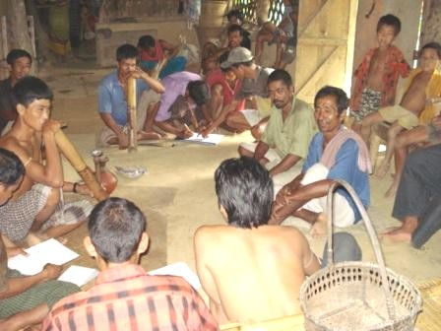
Governance in Bangladesh Are the Issues Different from Ohio?

Slide 18
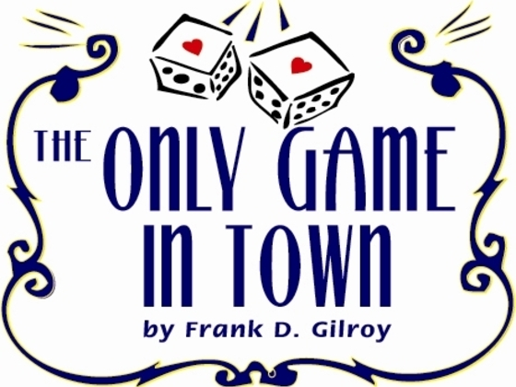
Bureaucracy and Power: Key Question
Recruitment?
The control of bureaucratic power, upon which comparisons of diverse bureaucracies can be valid.
The Use of History: Historical Kingdoms in Asia, Africa and Europe all precursors to modern state system

Slide 19
REVERT TO HISTORICAL REVIEW Max Weber’s Models of Management
Traditional- Monarchy
Charismatic- Revolution
Legal Rational Model

Slide 20
Traditional King George III

Slide 21
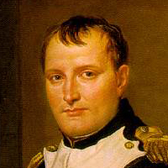
Charismatic? WHAT DOES THAT MEAN?

Slide 22
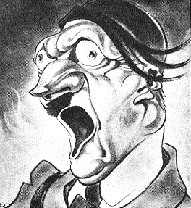
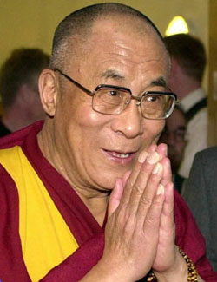
Institutions vs. Charisma?

Slide 23
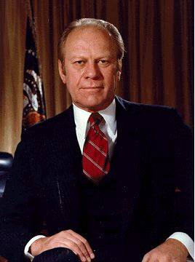
Gerald R. Ford? Institutions or Charisma?

Slide 24
Public Affairs from a Comparative Perspective: Issues to date
Legal Rational Model and Democracy and Governance
Political Institutions
Public Sector Reform: Legal, Behavioral, Fiscal
Keynesianism and Good Governance
Intersection of Public Sector and Civil Society
Contracts and Privatization

Slide 25
Major themes in a U.S. Focused Comparative Public Administration-
Administrative Structures and Society-
An Individualist view of state-society relationships
a. Common law view of society;
b. Anglo-Saxon model: law and order as basic function of government;
c. Society made up of individuals- liberalism

Slide 26
Political Structures and Public Management: Patterns of Change
1. Issues of Governance, Interests and Political Development
2. The Administrative State Problem: Patronage
3. Weak Political controls and a strong bureaucratic elite
4. The Problem of Nepotism and Corruption

Slide 27
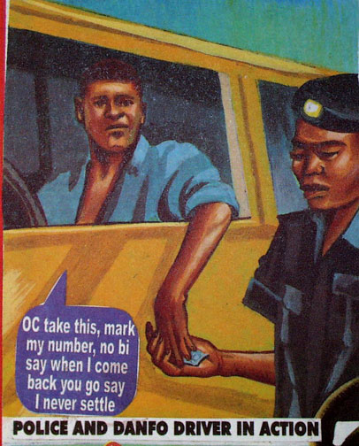
Anti-Corruption Poster: A Reminder?

Slide 28
Legal-Rational Model-Characteristics: BASED ON “DEMOCRATIC “PRINCIPLES- AN ENVIRONMENTAL PERSPECTIVE
Legal-Rational Model- Modern-specialized/technical:
a. Merit Selection
b. Hierarchy- Chain of Command
c. Routinisation of Charisma
d. Institutions and the Rule of Law

Slide 29
Legal-Rational- Continued
e. Division of Labor and functional specialization
f. Administrative work: full time, no sinecures
g. Contractual agreement, Contracts and Privatization
h. Professional or technical training
i. Address The Problem of Corruption

Slide 30
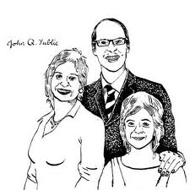
Clients and Democracy, c. 1950
John Q. Public
Is there such a person?

Slide 31
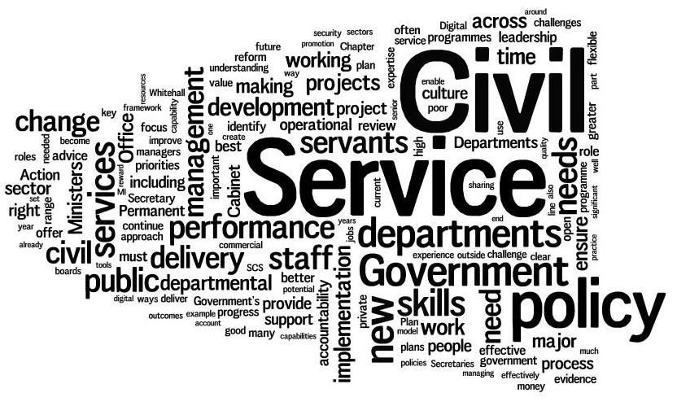
Public Service Reform: Can It End Private Privilege in Government?
Is This the key to Governance?

Slide 32
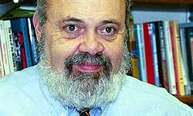
Issue for the Day: Bureaucracy and its Dysfunction- Author of the Day: PITT’s B. Guy Peters (THE OR NOT PROBLEM)

Slide 33
Definitions from Peters
1. Public Administration- Rule Application
2. Bureaucracy- Hierarchical organizations designed to utilize the enforcement of universal and impersonal rules to maintain authority
3. Public Policy- Key: Rule making as well as rule application

Slide 34
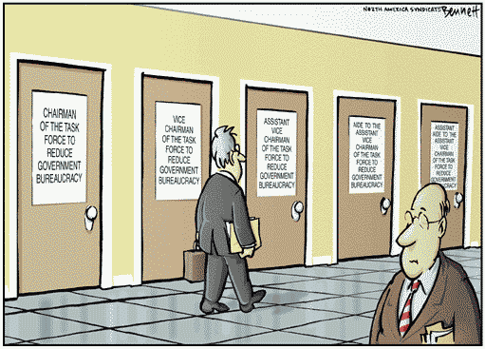
A More Cynical View

Slide 35
The Public Sector Problem:
Inefficiency
Corruption
Interest Influence
Authoritarianism
Patronage

Slide 36
The perennial tensions between official and personal norms in organizations
The issue of the "bureaucratic experience," (Hummel), that differs from the social (human) experience
Hummel says "dehumanizing“
Standards and policies defined by the past and standardized for all
e. g. people, as cases
Source of Corruption But not all Government is Corrupt.

Slide 37
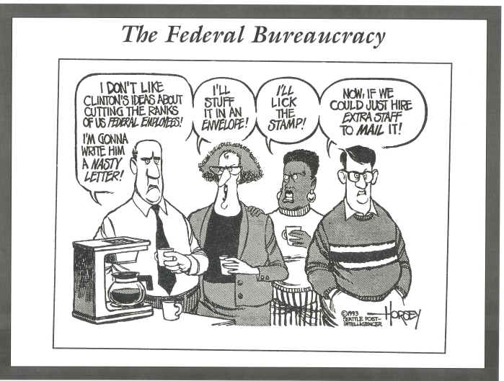
Civil Service/Public Sector Reform

Slide 38
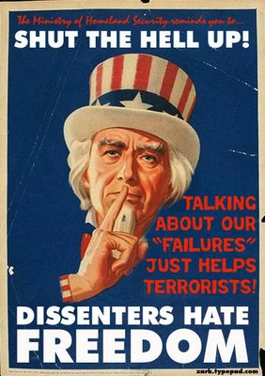
Control: How to vs. Should one?

Slide 39
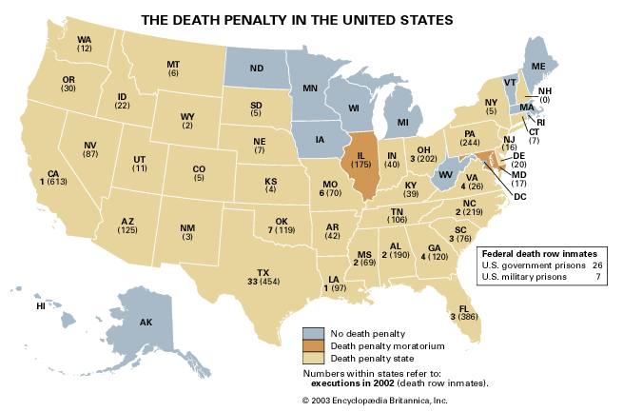
The Bottom Line
GOVERNMENT HAS THE MONOLOPY OF POWER (Ultimately Life and Death)

Slide 40
Government: Differences from the private sector-
Difference in Product
4. Private- emphasis is on profit, economy and efficiency
5. Public- need to account for the political and social- not what is always efficient
6. Issue- motivation or its absence in the public sector

Slide 41
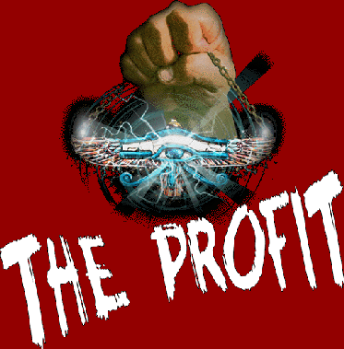

Slide 42
REFORMS: CREATING THE LEGAL-RATIONAL MODEL- Review
Legal Rational Model and Democracy and Governance
Institutions vs. Charisma
Public Sector Reform: Legal, Behavioral, Fiscal
Keynesianism and Good Governance
International Development and the Intersection of Public Sector and Civil Society

Slide 43
The Role of Groups
Reform Perspective
Extent of access to public sector
Iron Triangle
Problem of Illicit Access

Slide 44
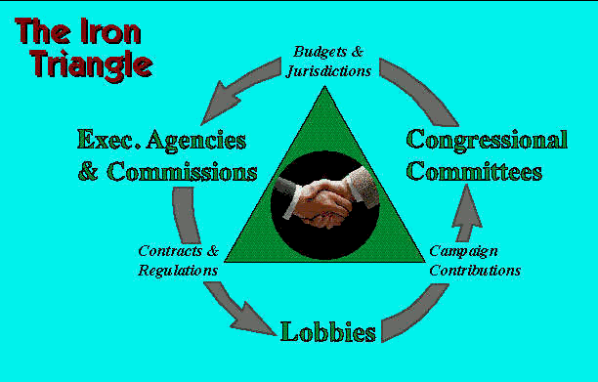
The Iron Triangle and the Revolving Door

Slide 45
Contemporary Democracy and Public Policy Concepts: A Summary
Democracy and Public Policy- Representation
Historical vs. Contemporary Models: Law and Order vs. Economic and Social Policy
Governance and Political Economy: Who gets what when and how?
Recruitment- affirmative action and representative bureaucracy
Regulation and Deregulation- Privatization and Contracting Out
More Developed States vs. Less Developed States

Slide 46
Contemporary Democracy and Public Policy Issues
Democracy and Public Policy- Representation
Historical vs. Contemporary Models: Law and Order vs. Economic and Social Policy
Governance and Political Economy: Who gets what when
and how?
Recruitment- affirmative action and representative bureaucracy
Regulation and Deregulation- Privatization and Contracting Out
More Developed States vs. Less Developed States

Slide 47
Bureaucrats: Powerful or Silly
Video: The Ministry of Silly Walks

Slide 48
QUESTIONS Schiavo-Campo
1. Is there such a thing as public interest? Who criticizes this idea?
2. Define and critique Reinventing Government.
3. What is the New Public Management. Assess its strengths and weaknesses.
4. Is Libertarianism and extreme form of deregulation? Discuss.

Slide 49
Picard and Buss
1. What were the origins of Modern foreign aid?
2. What was the difference between the Marshall Plan and Point Four?
3. How did Foreign Aid Change after 1960?
4. Is foreign aid focused on humanitarian needs?

Slide 50
Zakaria
1. How does Zakaria explain Fascism? Is this similar to the "Altright?"
2. How is economics linked to democratic politics? Is Democracy inevitable?
3. Explain "Illiberal" democracy. Give examples.
4. What are tyrannies of the majority? Assess Zakaria's concept of "liberal democracy."

Slide 51
Lemann
1. Do you think the United States was a liberal or illiberal democracy in 1955?
2. How has the U.S. changes since the 1960s?
3. What did African-American leaders seek in Chicago? Washington? Clarksville?
4. Was the "Great Black Migration" a positive thing or a negative thing? Assess.
General question: Identify four or five themes that come out of the core readings thus far.

