Slide 1
PIA 2020 Introduction to Public Affairs
Week Four: Historical Models, “Contemporary Models,” and Socio-Economic Changes

Slide 2
Three Broad Concerns:
Social and Economic Debates
Political Institutions
Public Policy Processes

Slide 3
Introduction to Public Affairs
Themes of the Week
Five Concepts of Economics and Government
Mercantilism
Classical Liberalism
Keynesianism
Command Economics
Neo-Orthodoxy

Slide 4
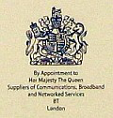
1. Mercentilism
Theory that trade generates wealth and that the state should manage and authorize economic and trade activities through concessions to private organizations

Slide 5
The Debate about Mercantilism
Mercantilism is an economic theory and practice, dominant in Europe from the 16th to the 18th century (1600-1800), that promotes governmental regulation of a nation’s economy for the purpose of augmenting state power at the expense of rival national powers.

Slide 6
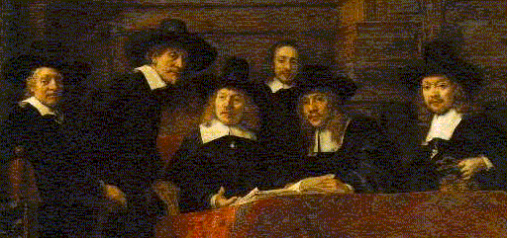
Rembrandt's painting “The Mercantilists”

Slide 7
Mercantilism and “Neo-Mercantilism”
Themes:
Building overseas colonies;
Forbidding colonies to trade with other nations;
Monopolizing markets through State Supported Companies and Concessions;
Forbidding trade to be carried in foreign ships;
Export subsidies;
Promoting manufacturing with research or direct subsidies;
Maximizing the use of domestic resources;

Slide 8
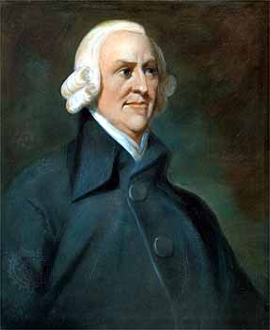
II. Classical Liberalism (Free Trade): (1848-1932)
Rejection of Big Government It Starts with Adam Smith
June 5, 1723 – July 17, 1790

Slide 9
Classical Liberalism?

Slide 10
Classical Liberalism?

Slide 11
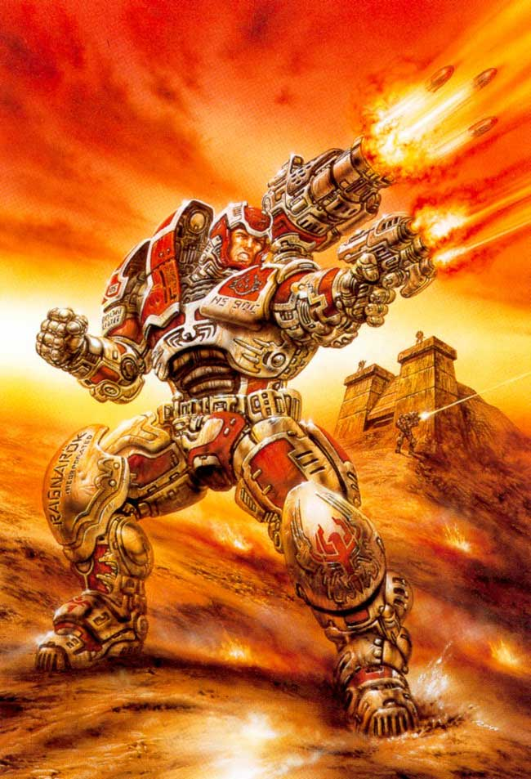
Liberalism or Not Liberalism

Slide 12
No- Classical Liberalism means the Free Market
A free market is an economic system where the prices for goods and services are determined by the open market and sellers and consumers are motivated by the processes of supply and demand.
There should be no government interference with this process.

Slide 13
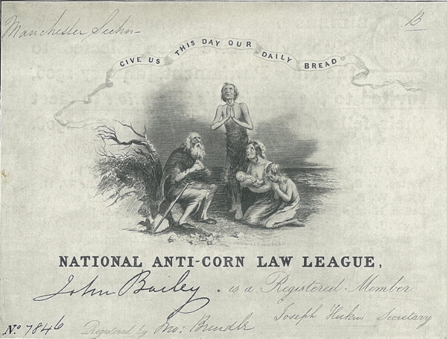
Repeal of the British Corn Laws 1846. Beginning of Classical Liberal Period.
Corn Laws: Imposed restrictions and tariffs on imported grain. They were designed to keep grain prices high to favour domestic producers.

Slide 14
Orthodox Economics
Adam Smith is often touted as the world's first free-market capitalist. He is the father of modern economics and a major proponent of laissez-faire economic policies is quite secure.
Laissez-faire philosophies, such as minimizing the role of government intervention and taxation in the free markets, and the idea that an "invisible hand" guides supply and demand.
.Smith argued that the market should guide all economic activities.

Slide 15
Free Enterprise?

Slide 16
III. Command Economics Ideology as Social Science

Slide 17
The Public Sector and the Economy
Reminder:
Karl Marx- The Other German-
Source of ideas about the developmental state. Marx as a Social Scientist not an Ideologue. The contemporary of Max Weber

Slide 18
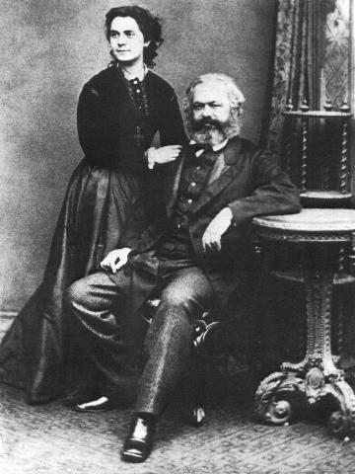
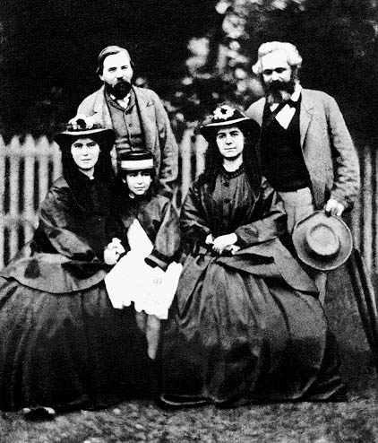
Marx with his Wife Jenny (1869) and with Friedrich Engels and Family (1864)

Slide 19
Karl Marx: Another Five Minutes
a.. Original Marxian views- State as the instrument of the ruling classes
b. The dialectic and Historical Materialism
c. Model: (John Armstrong- The Conservative Marxist)
-Thesis
-Antithesis
-Synthesis

Slide 20
Dialectic
Thesis Antithesis
Synthesis

Slide 21
Class Conflict: Four Epochs
Slavery
Feudalism
Capitalism
Socialism (National Socialism?)
e. Functionaries as the petty bourgeoisie
Communism- state and the bureaucracy whither away
Fascism- Society will Whither Away

Slide 22
Vladimir Ilyich Ulyanov (Lenin) (April 22 1870 – January 21, 1924)

Slide 23
IV. Keynesianism and the Great Depression: 1929-1941

Slide 24
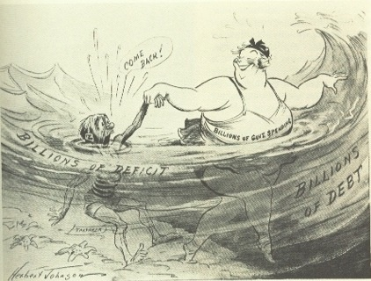
A New Debate? A 1930s Cartoon

Slide 25
Command Economy- Revised by Keynes and Franklin D. Roosevelt
Under socialism, government, the bureaucracy should manage the economy. Keynes: Partial Management
The development of an elaborate national planning system
Keynes- Failure of market
European Social Democracy

Slide 26
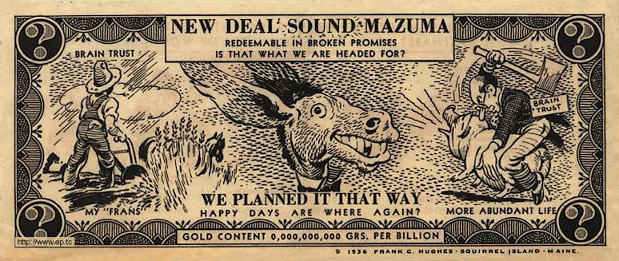
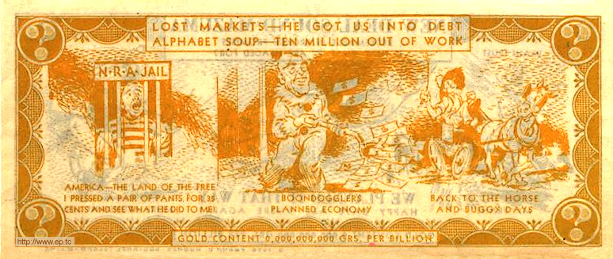

Slide 27
The Public Sector and the Economy
Mixed or Social Democratic
Socialist Industrialization
Autarky with Rural Mobilization
Corporate/ Fascist

Slide 28
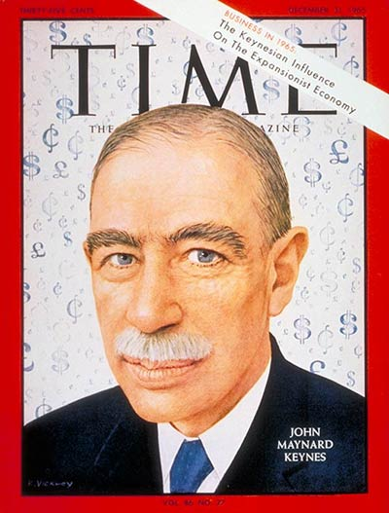
“Were All Keynesians Now” Friday, Dec. 31, 1965

Slide 29
The Functions of Government under Keynesian Control
1. Traditional- police and law and order
2. National Defense
3. Social Services- Education and Health and Welfare
4. Resource Mobilization
5. Priming the Pump: Economic Stimulus and Control

Slide 30
The Functions of Government under Keynesian Control- Continued
6. Economic Growth generation: From Roosevelt and the New Deal to Kennedy and Johnson, The Great Society
6. LDCs and Modernization Theory: Agraria vs. Industria (Turner and Holm)
7.The challenge of Public Choice, rationalism and the University of Chicago School: Neo-Orthodoxy- less influence outside of the Anglo-Saxon world: Counter-views from c. 1960

Slide 31
Unification of the North Atlantic- 1930s-1970s- The Primacy of Keynesianism
1. Monetary Policy
2. Fiscal Policy
3. Wage and Price controls

Slide 34
The European Model, North Atlantic Unity and Japan
Focus on the State Economic System
Collectivist vs. Individualist Approach
Europe vs. Anglo-Saxon
Debates about Groups: Competitive vs. Cooperative (Corporatist)

Slide 35
Social Democracy: Debate
The Rose as a Symbol
Socialism and the Rise of Labor in Europe
The Second International
All European Countries have a Social Democratic Party (The Second International)

Slide 36
American Activism vs. European Socialism (U.S. Social Democratic Party)

Slide 37
Command Economy
The debate: Keynesianism and European Socialism (the Rose)- How much is this part of Command Economy Framework? (Guy Peters)
Development Administration: Command Economics in the Third World? (Heady, Riggs vs. Vincent and Eleanor Ostrom)
Development Management: An Oxymoron?

Slide 38
5. Neo-Orthodoxy. Rejection of Keynes

Slide 39
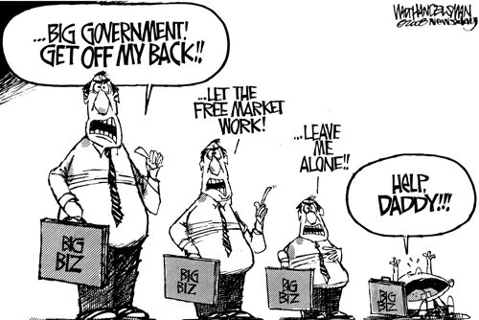

Slide 40
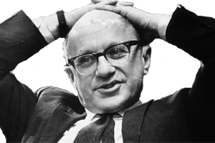
Milton Friedman (July 31, 1912 – November 16, 2006) Neo-Orthodoxy

Slide 41
Neo-Orthodoxy or the University of Chicago School
People have rational preferences between outcomes that can be identified and associated with values.
Individuals maximize utility and firms maximize profits.
People act independently on the basis of full and relevant information.
Government should not interfere with individual behavior
The Invisible Hand of the Market is the key to Economic Growth
International Reform is called Structural Adjustment

Slide 42
Summary: Debate over the Economy
1. The International Contemporary State: Continental Europe vs. the U.S. or the U.K.
2. Adam Smith, "the hidden hand" and Classical Economics- An Anglo-Saxon View esp. USA (The Neo-Classical Rebound)
3. Eastern Europe and Former Soviet Union: Command Economy (whole or part):

Slide 43
Summary
The Public Sector and the Economy: “Contemporary Models” of Governance and Socio-Economic Change
Keynes and he European Model, North Atlantic Unity and Japan
Neo-Orthodoxy: The Debates Over Development: Africa, Asia and Latin America
Models of Governance Institutions
Comparative Methodology Issues

Slide 45
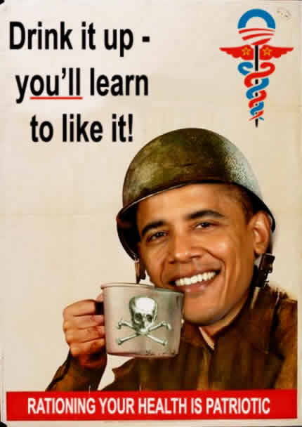
2011- Debates About Obamacare?”

Slide 46
What is Next? From 1989-2016
End of Cold War
Application of Structural Adjustment to Socialist Countries
September 11
Democracy and Governance
Public Private Partnerships
Evaluation and Contracting Out
Three D’s: Diplomacy, Defense and Development
Whole of Government Approach

Slide 47
The Public Sector and Development- Weber vs. Marx
John Maynard Keynes
1883-1946
One of the major goals of this course will be to examine this issue (Law and Order vs. Social and Economic Change) and
Examine the role that the bureaucracy has played in the development process in Europe, the states of the former Soviet Union, the United States and the newly industrializing states of East Asia, Africa and Latin America.
OR NOT!!!

Slide 48
Theories of Social Class
Just a Little Bit of Theory

Slide 49
Discussion Questions
Schiavo-Campo
1. What is the difference between structure and process? Which does public policy relate to? Why?
2. What is the separation of powers according to S-C? Is this a good thing or a bad thing?
3. How unique or similar is the U.S. to other countries?

Slide 50
Discussion Questions
Lemann
1. How does policy made in Washington effect the great migration?
2. What are the different views of people in the Clarksdale, Chicago and Washington?
3. Evaluate the public policy decisions made in the 1960s.

Slide 51
Discussion Questions
Picard and Buss
1. What is "manifest destiny?
2. Describe patterns of U.S. foreign aid that developed before World War II.
3. Describe the patterns of foreign assistance that came out of unofficial or private organizations prior to World War II.

Slide 52
Questions and Discussion
Reading and the lectures

